Slide 1
Emergence in Cognitive Science:
Semantic Cognition
Jay McClelland
Stanford University

Slide 2
Approaches to Understanding Intelligence
Symbolic approaches
  explicit symbolic structures
  structure-sensitive rules
  discrete computations
Emergence-based approaches
  Symbolic structures and processes are seen as approximate characterizations of the emergent consequences of continuous and distributed processing and representation

Slide 3
Some Constructs in Cognitive Science:
Can They All Be Viewed as Emergents?
Putative Represented Entities
  Concepts, categories
  Rules of language and inference
  Entries in the mental lexicon
  Syntactic and semantic representations of linguistic inputs
Architectural Constructs
  Working memory
  Attention
  The central executive
Cognitive Processes and Their Outcomes
  Choices
  Decisions
  Inferences
  Beliefs
Developmental Constructs
  Stages
  Sensitive periods
  Developmental anomalies
Cognitive Neuroscience
  Modules for
    Face recognition
    Episodic memory
    …

Slide 4
Two Views of Semantic Knowledge Structure and Learning
Structured Probabilistic Models
  Knowledge is assigned to a mental structure of one or another specific type.
  Learning is the process of selecting the best structure type, then selecting a specific instance of the type.
Learning-Based PDP Models
  Semantic knowledge arises as a consequence of a gradual learning process.
  The structure that emerges is naturally shaped by the structure present in experience.
  It may correspond (approximately) to a specific structure type, but it need not.

Slide 5
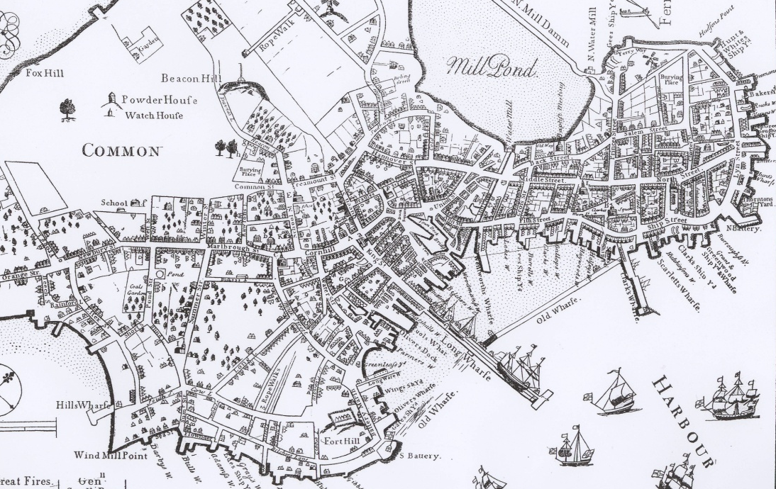

Emergent vs. Stipulated Structure
Old Boston
Midtown Manhattan

Slide 6
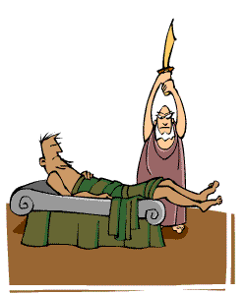
What Happens to Natural Structure in a Structured Statistical Model?

Slide 7
Plan for the Rest of the Talk
A PDP model of semantic cognition capturing
  Emergence of semantic knowledge from experience
  Disintegration of semantic knowledge in neurodegenerative illness
  Comparison to a structured statistical model
The theory of the model
  What is it learning, and why?
Initial steps in a new direction
  Capturing shared structure across domains

Slide 8



The Rumelhart Model
The Quillian
Model

Slide 9
Rumelhart’s Goals for the Model
Show how learning could capture the emergence of hierarchical structure
Show how the model could make inferences as in a symbolic model

Slide 10


Early
Later
Later
Still
E
x
p
e
r
i
e
n
c
e

Slide 11
Start with a neutral representation on the representation units. Use backprop to adjust the representation to minimize the error.

Slide 12
The result is a representation similar to that of the average bird…

Slide 13
Use the representation to
infer what this new thing can do.

Slide 14





Phenomena in Development
Progressive differentiation
Overgeneralization of
  Typical properties
  Frequent names
Emergent domain-specificity of representation
Basic level advantage
Expertise and frequency effects
Conceptual reorganization

Slide 15
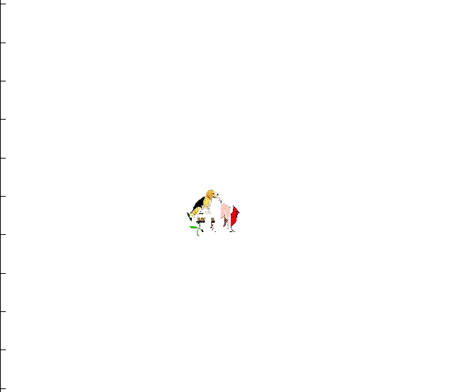

Slide 16


Disintegration in Semantic Dementia
Loss of differentiation
Overgeneralization

Slide 17
Architecture for the Organization of Semantic Memory
action
name
Temporal
pole
motion
color
valance
form
Medial Temporal Lobe

Slide 18
Disintegration in Semantic Dementia
Loss of differentiation
Overgeneralization

Slide 19
Neural Networks and
Probabilistic Models
The model learns to match the conditional probability structure of the training data:
  P(Attribute_{i} = 1|Item_{j} & Context_{k}) for all i,j,k
It does so subject to strong constraints imposed by the initial connection weights and the architecture.
  These constraints produce progressive differentiation, overgeneralization, etc.
Depending on the structure in the training data, it can behave as though it is learning a specific type of structured representation:
  Hierarchy
  Linear Ordering
  Two-dimensional similarity space…

Slide 20
The Hierarchical Naïve Bayes Classifier Model (with R. Grosse and J. Glick)
Items are organized in categories
Categories may contain sub-categories
Features are probabilistic and conditionally independent, given the category.
We start with a one-category model, and learn p(f|C) for each feature.
We differentiate as evidence builds up violating conditional independence.
Sub-categories inherit feature probabilities of the parents, then learn feature probabilities from there.
Living Things
Animals Plants
Birds Fish
Flowers Trees
…

Slide 21
A One-Class and a Two-Class Naïve Bayes Classifier Model
Property | One-Class Model | Plant class in two-class model | Animal class in two-class model
Can Grow | 1.0 | 1.0 | 1.0
Is Living | 1.0 | 1.0 | 1.0
Has Roots | 0.5 | 1.0 | 0
Has Leaves | 0.4375 | 0.875 | 0
Has Branches | 0.25 | 0.5 | 0
Has Bark | 0.25 | 0.5 | 0
Has Petals | 0.25 | 0.5 | 0
Has Gills | 0.25 | 0 | 0.5
Has Scales | 0.25 | 0 | 0.5
Can Swim | 0.25 | 0 | 0.5
Can Fly | 0.25 | 0 | 0.5
Has Feathers | 0.25 | 0 | 0.5
Has Legs | 0.25 | 0 | 0.5
Has Skin | 0.5 | 0 | 1.0
Can See | 0.5 | 0 | 1.0

Slide 22

Accounting for the network’s feature attributions with mixtures of classes at different levels of granularity
Regression Beta Weight
Epochs of Training
Property attribution model:
P(f_{i}|item) = α_{k}p(f_{i}|c_{k}) + (1-α_{k})[(α_{j}p(f_{i}|c_{j}) + (1-α_{j})[…])

Slide 23
Should we replace the PDP model with the Naïve Bayes Classifier?
It explains a lot of the data, and offers a succinct abstract characterization
But
  It only characterizes what’s learned when the data actually has hierarchical structure
So it may be a useful approximate characterization in some cases, but can’t really replace the real thing.

Slide 24

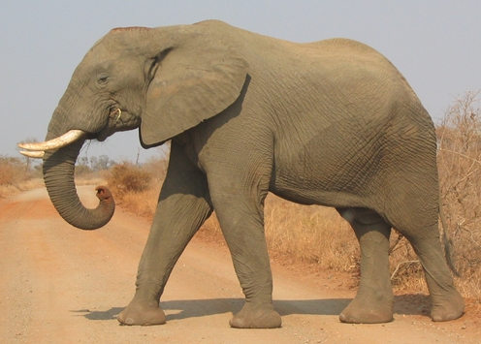
An exploration of these ideas in the domain of mammals
What is the best representation of domain content?
How do people make inferences about different kinds of object properties?

Slide 25
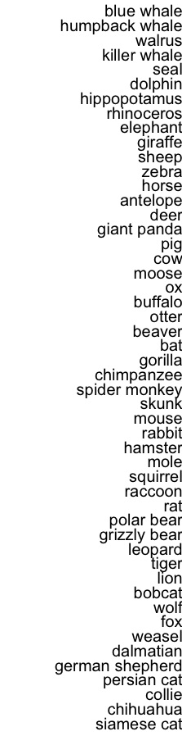
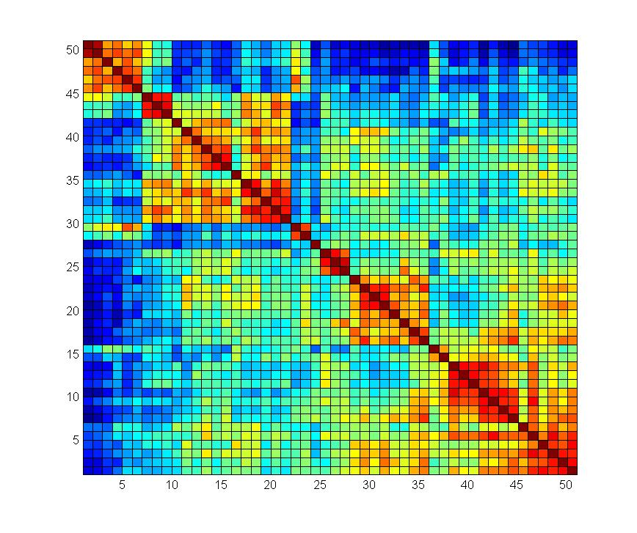

Slide 26

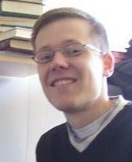
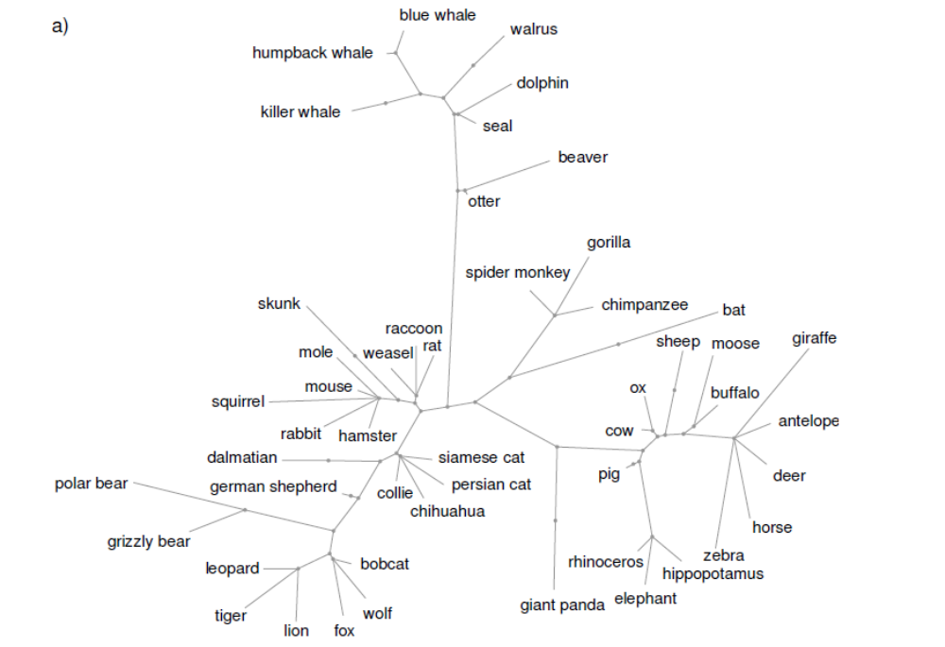
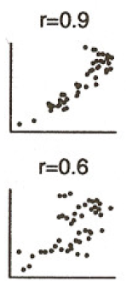
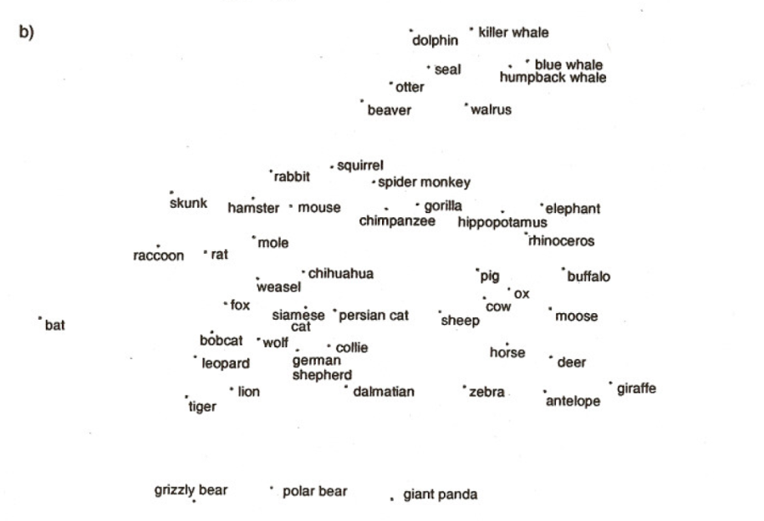
Structure Extracted by a Structured Statistical Model

Slide 28
Predictions
Both similarity ratings and patterns of inference will violate the hierarchical structure
Experiments by Jeremy Glick confirm these predictions

Slide 31
Applying the Rumelhart model to the mammals dataset
Behaviors
Body Parts
Foods
Locations
Movement
Visual Properties
Items
Contexts

Slide 32
Simulation Results
The model progressively extracts more and more detailed aspects of the structure as training progresses

Slide 33
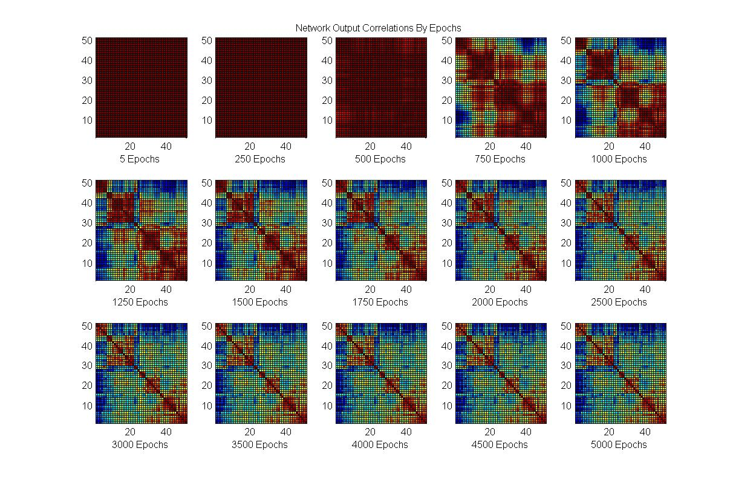
Network Output

Slide 34
Simulation Results
The model progressively extracts more and more detailed aspects of the structure as training progresses
Can we characterize mathematically what the model has learned?

Slide 35
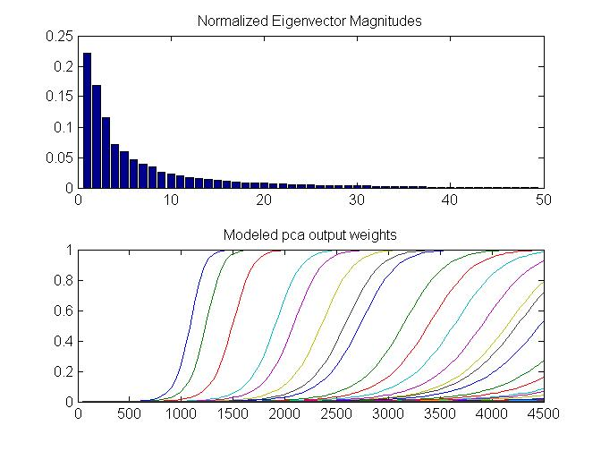

Slide 36
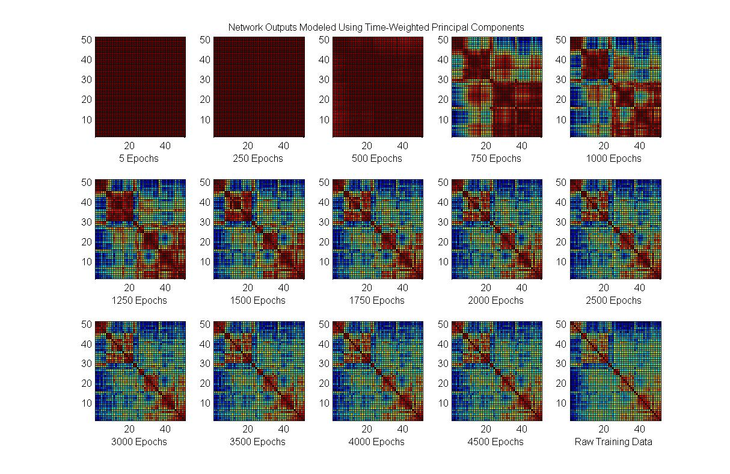
Progressive PCs

Slide 37
Network Output

Slide 38
Learning the Structure in the
Training Data
Progressive sensitization to successive principal components captures learning of the mammals dataset.
This subsumes the naïve Bayes classifier as a special case.
So are PDP networks – and our brain’s neural networks – simply performing PCA?
  No!

Slide 39
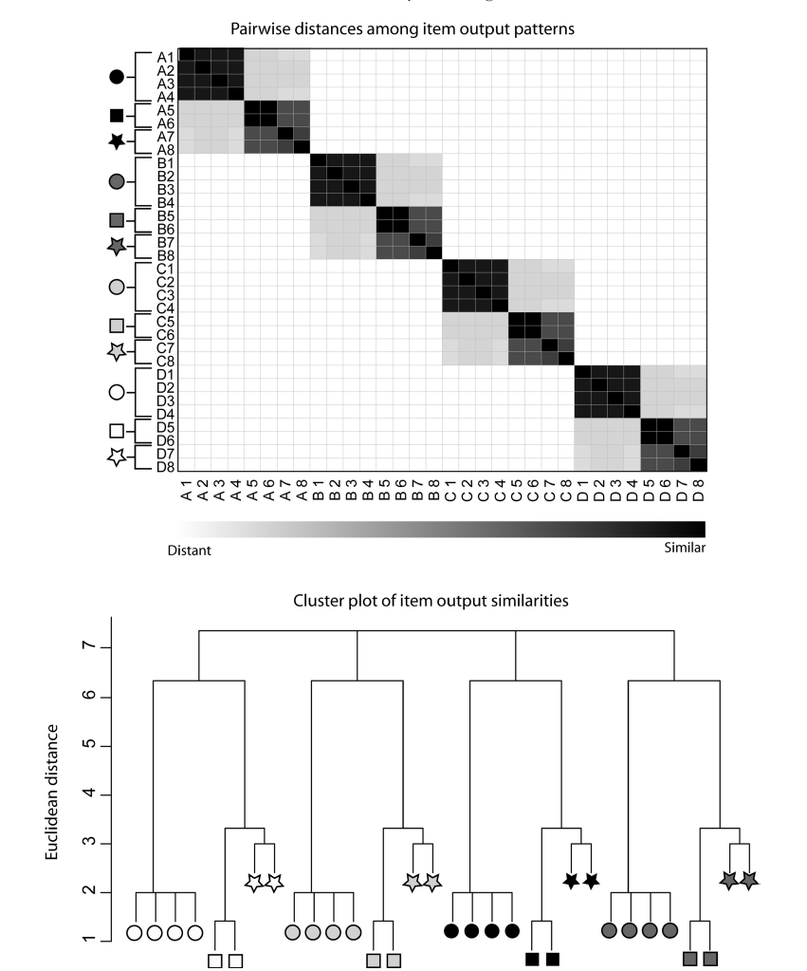
Extracting Cross-Domain Structure

Slide 40
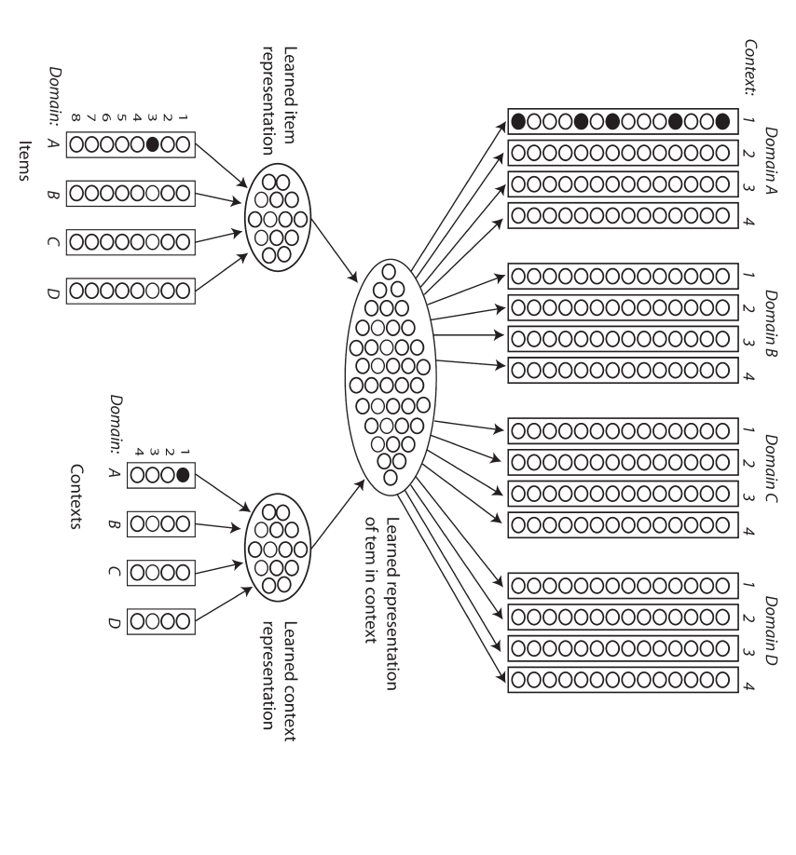
v

Slide 41
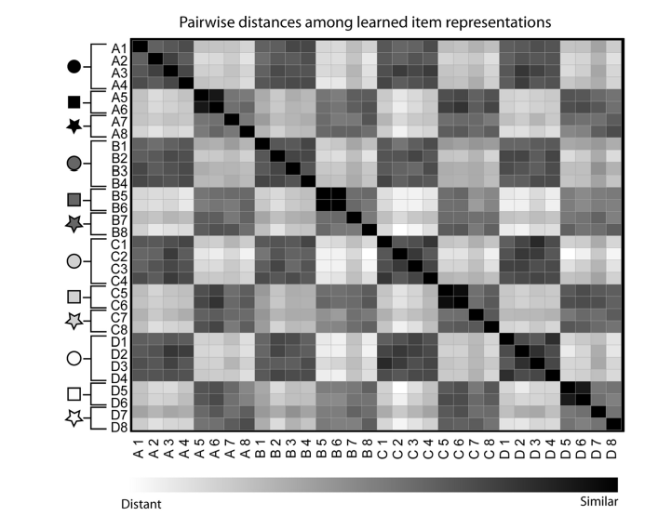
Input Similarity
Learned Similarity

Slide 42

A Newer Direction
Exploiting knowledge sharing across domains
  Lakoff:
    Abstract cognition is grounded in concrete reality
  Boroditsky:
    Cognition about time is grounded in our conceptions of space
  My Take:
    In general cognition in any domain borrows on knowledge in other domains.
    This happens automatically in a neural network that processes both domains with the same connections.
    Initial modeling work by Paul Thibodeau supports this view.

Slide 43
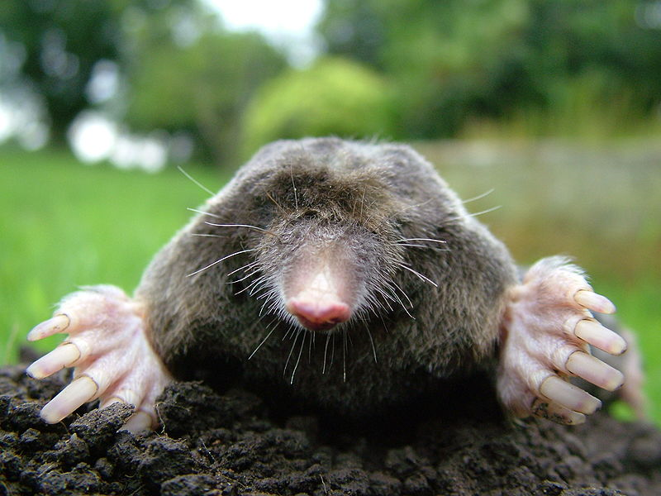
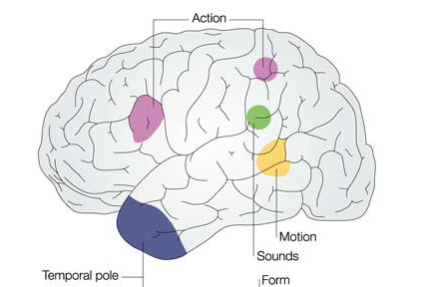
Thanks!

Slide 44
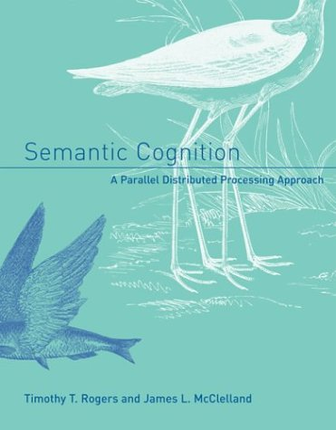
In Rogers and McClelland (2004) we also address:
  Conceptual differentiation in prelinguistic infants.
  Many of the phenomena addressed by classic work on semantic knowledge from the 1970’s:
    Basic level
    Typicality
    Frequency
    Expertise
  Disintegration of conceptual knowledge in semantic dementia
  How the model can be extended to capture causal properties of objects and explanations.
  What properties a network must have to be sensitive to coherent covariation.

