Slide 1
Emergence of Semantic Structure from Experience
Jay McClelland
Stanford University

Slide 2
The Nature of Cognition, and the Place of PDP in Cognitive Theory
Many view human cognition as inherently
  Structured
  Systematic
  Rule-governed
In this framework, PDP models are seen as
  Mere implementations of higher-level, rational, or ‘computational level’ models
  … that don’t work as well as models that stipulate explicit rules or structures

Slide 3
The Alternative
We argue instead that cognition (and the domains to which cognition is applied) is inherently
  Quasi-regular
  Semi-systematic
  Context sensitive
On this view, highly structured models
  Are Procrustian beds into which natural cognition fits uncomfortably
  Won’t capture human cognitive abilities as well as models that allow a more graded and context sensitive conception of structure

Slide 4
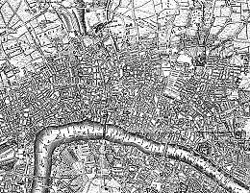

Emergent vs. Stipulated Structure
Old London
Midtown Manhattan

Slide 5
Where does structure come from?
It’s built in
It’s learned from experience
There are constraints built in that shape what’s learned

Slide 6
What is the nature of the constraints?
Do they specify types of structural forms?
  Kemp & Tenenbaum
Or are they more generic?
  Lake & Tenenbaum
  Most work in the PDP framework
Are they constraints on the process and mechanism? Or on the space of possible outcomes?
  PDP models and the K&T / L&T models rely on different sorts of constraints.
  It’s far from clear that those in K&T or L&T are better.

Slide 7
Outline
The Rumelhart model of semantic cognition, and how it relates to probabilistic models of semantic cognition.
Some claims it instantiates about the nature of semantic cognition that distinguish it from K&T
  Data supporting these claims, and challenging K&T
Toward a fuller characterization of what the Rumelhart model learns (and one of the things it can do that sustains our interest in it).
Some remarks about the so-called ‘common-sense core’.

Slide 8



The Rumelhart Model
The Quillian
Model

Slide 9
DER’s Goals for the Model
Show how learning could capture the emergence of hierarchical structure
Show how the model could make inferences as in the Quillian model

Slide 10


Early
Later
Later
Still
E
x
p
e
r
i
e
n
c
e

Slide 11
Start with a neutral representation on the representation units. Use backprop to adjust the representation to minimize the error.

Slide 12
The result is a representation similar to that of the average bird…

Slide 13
Use the representation to
infer what this new thing can do.

Slide 14
Questions About the Rumelhart Model
Does the model offer any advantages over other approaches?
Can the mechanisms of learning and representation in the model tell us anything about
    Development?
    Effects of neuro-degeneration?

Slide 15





Phenomena in Development
Progressive differentiation
Overgeneralization of
  Typical properties
  Frequent names
Emergent domain-specificity of representation
Basic level advantage
Expertise and frequency effects
Conceptual reorganization

Slide 16


Disintegration in Semantic Dementia
Loss of differentiation
Overgeneralization

Slide 17
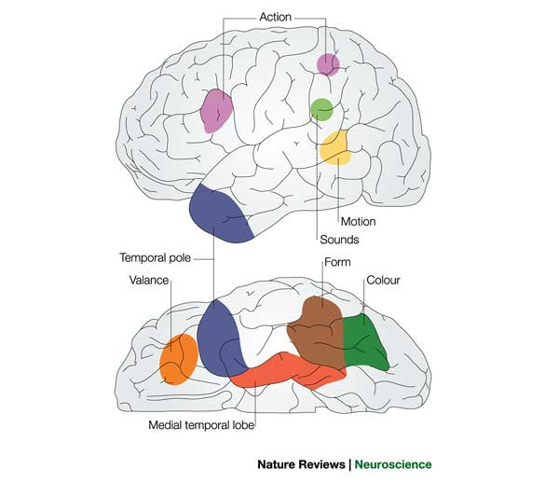
The Parallel Distributed Processing
Approach to Semantic Cognition
Distributed representations reflect different kinds of content in different areas
Semantic dementia kills neurons in the temporal pole, and affects all kinds of knowledge
Removal of the medial temporal lobes affects the ability to learn new semantic information, and produces a graded loss of information acquired within the last 1-30 years
language

Slide 18
Architecture for the Organization of Semantic Memory
action
name
Temporal
pole
motion
color
valance
form
Medial Temporal Lobe

Slide 19
Neural Networks and
Probabilistic Models
The Rumelhart model is learning to match the conditional probability structure of the training data:
  P(Attribute_{i} = 1|Item_{j} & Context_{k}) for all i,j,k
The adjustments to the connection weights move them toward values than minimize a measure of the divergence between the network’s estimates of these probabilities and their values as reflected in the training data.
It does so subject to strong constraints imposed by the initial connection weights and the architecture.
  These constraints produce progressive differentiation, overgeneralization, etc.
Depending on the structure in the training data, it can behave as though it is learning something much like one of K&T’s structure types, as well as many structures that cannot be captured exactly by any of the structures in K&T’s framework.

Slide 20
The Hierarchical Naïve Bayes Classifier Model (with R. Grosse and J. Glick)
The world consists of things that belong to categories.
Each category in turn may consist of things in several sub-categories.
The features of members of each category are treated as independent
  P({f_{i}}|C_{j}) = Π_{i} p(f_{i}|C_{j})
Knowledge of the features is acquired for the most inclusive category first.
Successive layers of sub-categories emerge as evidence accumulates supporting the presence of co-occurrences violating the independence assumption.
Living Things
Animals Plants
Birds Fish
Flowers Trees
…

Slide 21
A One-Class and a Two-Class Naïve Bayes Classifier Model
Property | One-Class Model | 1st class in two-class model | 2nd class in two-class model
Can Grow | 1.0 | 1.0 | 0
Is Living | 1.0 | 1.0 | 0
Has Roots | 0.5 | 1.0 | 0
Has Leaves | 0.4375 | 0.875 | 0
Has Branches | 0.25 | 0.5 | 0
Has Bark | 0.25 | 0.5 | 0
Has Petals | 0.25 | 0.5 | 0
Has Gills | 0.25 | 0 | 0.5
Has Scales | 0.25 | 0 | 0.5
Can Swim | 0.25 | 0 | 0.5
Can Fly | 0.25 | 0 | 0.5
Has Feathers | 0.25 | 0 | 0.5
Has Legs | 0.25 | 0 | 0.5
Has Skin | 0.5 | 0 | 1.0
Can See | 0.5 | 0 | 1.0

Slide 22

Accounting for the network’s feature attributions with mixtures of classes at different levels of granularity
Regression Beta Weight
Epochs of Training
Property attribution model:
P(f_{i}|item) = α_{k}p(f_{i}|c_{k}) + (1-α_{k})[(α_{j}p(f_{i}|c_{j}) + (1-α_{j})[…])

Slide 23
Should we replace the PDP model with the Naïve Bayes Classifier?
It explains a lot of the data, and offers a succinct abstract characterization
But
  It only characterizes what’s learned when the data actually has hierarchical structure
So it may be a useful approximate characterization in some cases, but can’t really replace the real thing.

Slide 24

An exploration of these ideas in the domain of mammals
What is the best representation of domain content?
How do people make inferences about different kinds of object properties?

Slide 25
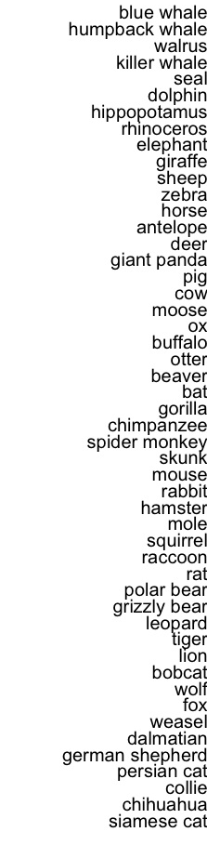
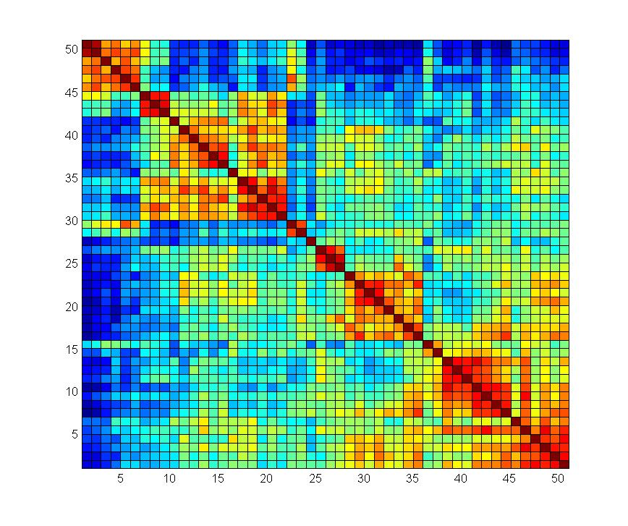

Slide 26

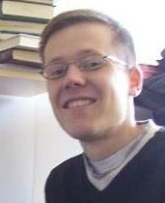
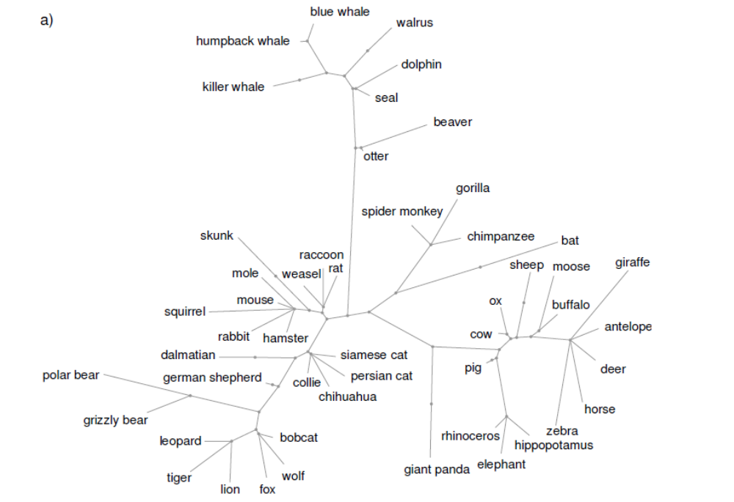
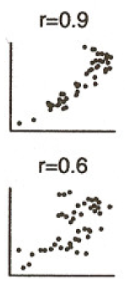
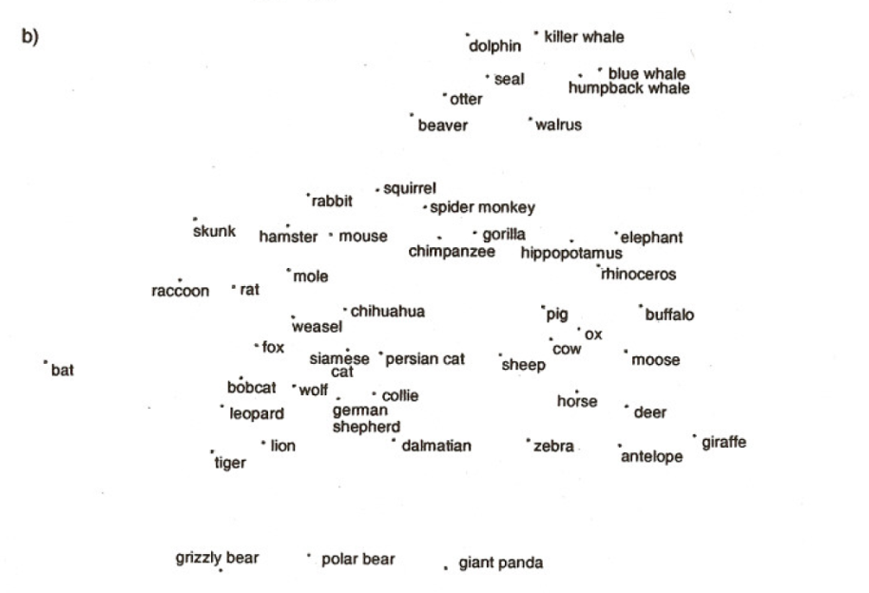
Structure Extracted by a Structured Statistical Model

Slide 29
Predictions
Similarity ratings and patterns of inference will violate the hierarchical structure
Patterns of inference will vary by context

Slide 30
Experiments
Size, predator/prey, and other properties affect similarity across birds, fish, and mammals
Property inferences show clear context specificity
Property inferences for blank biological properties violate predictions of K&T’s tree model for weasels, hippos, and other animals

Slide 33
Applying the Rumelhart model to the mammals dataset
Behaviors
Body Parts
Foods
Locations
Movement
Visual Properties
Items
Contexts

Slide 34
Simulation Results
We look at the model’s outputs and compare these to the structure in the training data.
The model captures the overall and context specific structure of the training data
The model progressively extracts more and more detailed aspects of the structure as training progresses

Slide 35
Simulation Output

Slide 36
Training Data

Slide 37
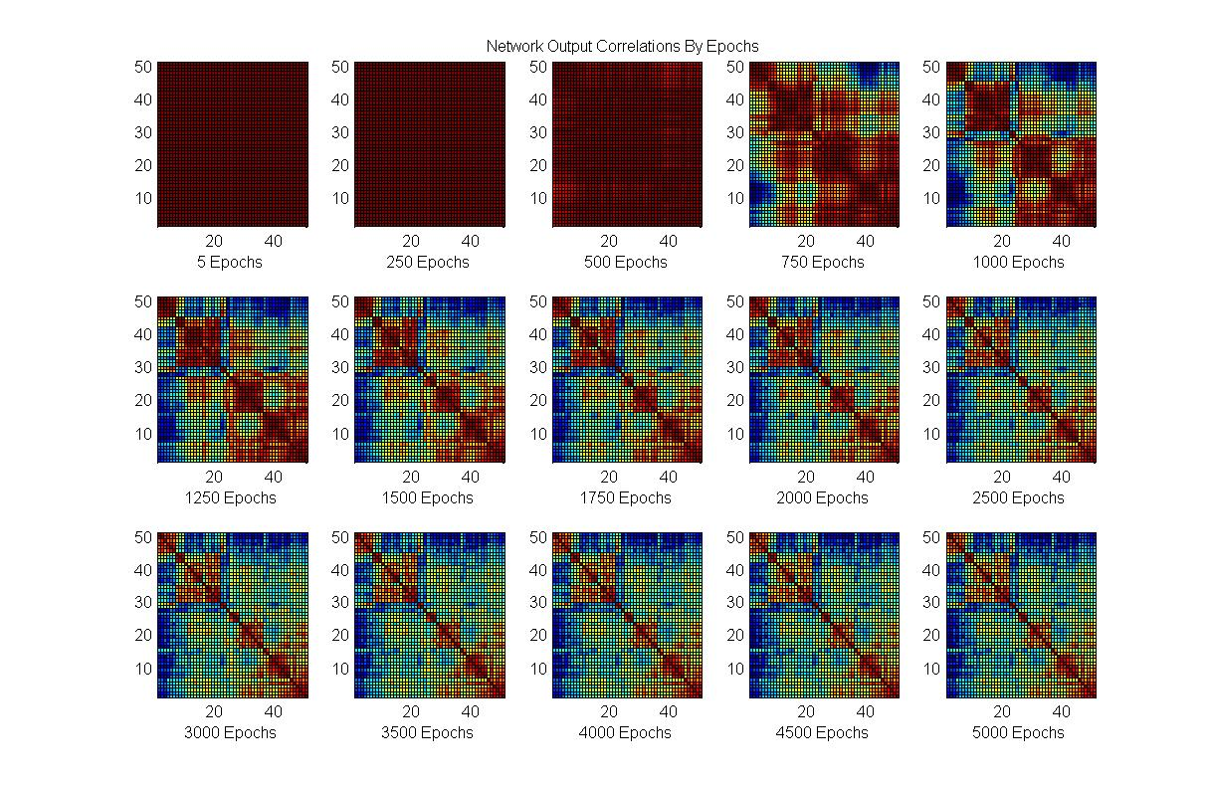
Network Output

Slide 38
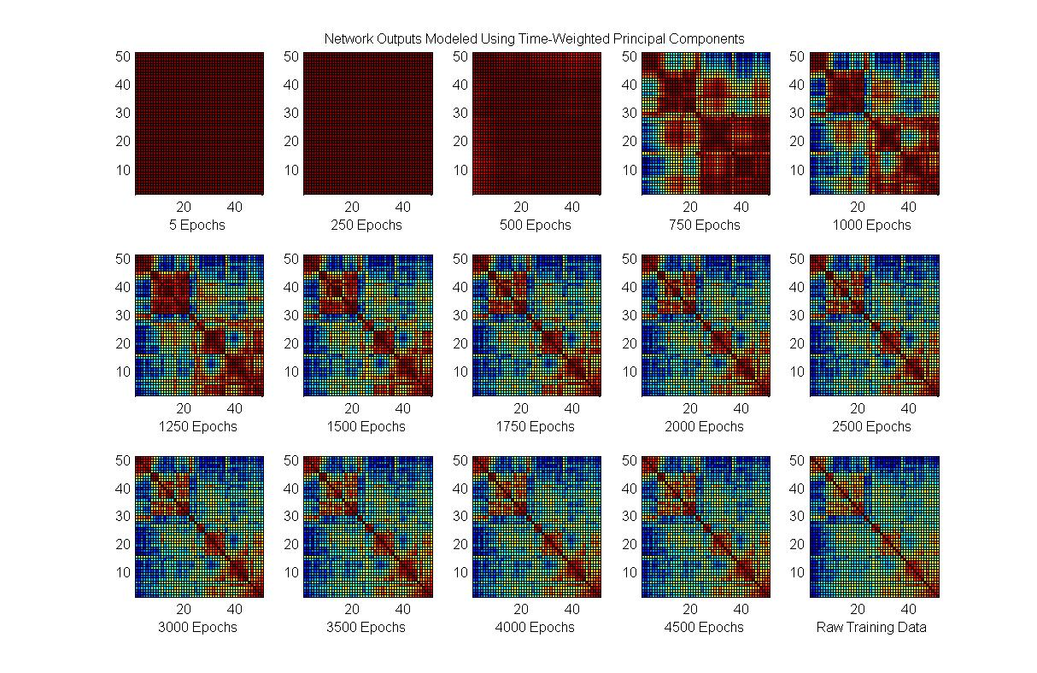
Progressive PCs

Slide 39
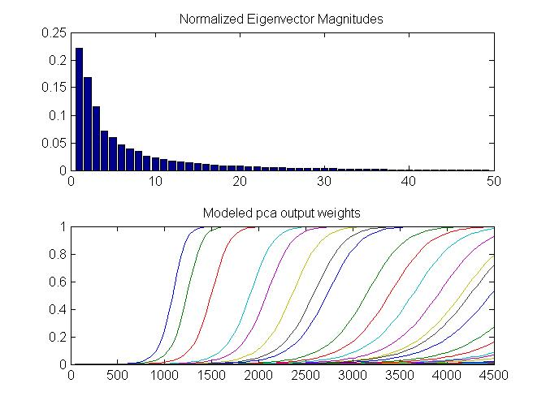

Slide 40
Learning the Structure in the
Training Data
Progressive sensitization to successive principal components captures learning of the mammals dataset.
This subsumes the naïve Bayes classifier as a special case when there is no real cross-domain structure (as in the Quillian training corpus).
So are PDP networks – and our brain’s neural networks – simply performing familiar statistical analyses?
  No!

Slide 41
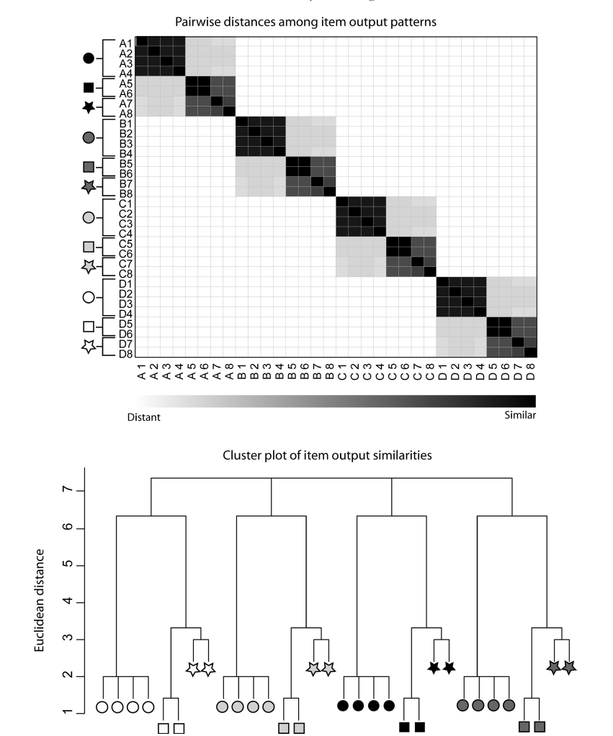
Extracting Cross-Domain Structure

Slide 42
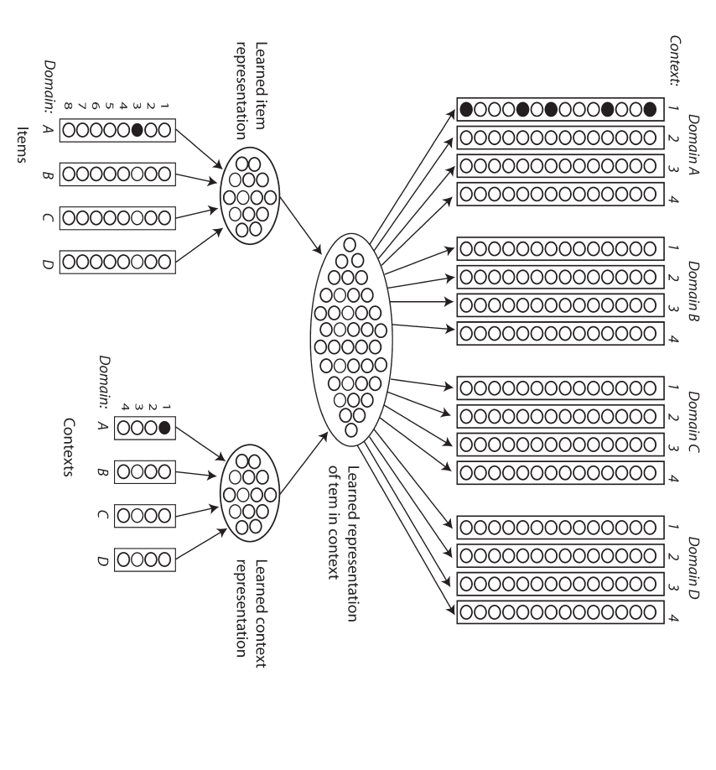
v

Slide 43
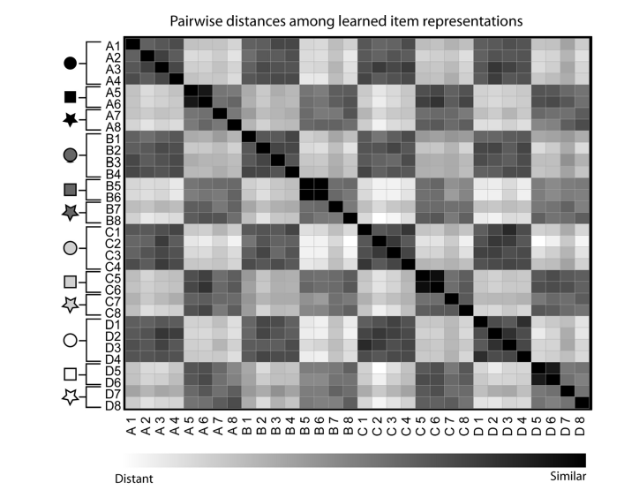
Input Similarity
Learned Similarity

Slide 44

A Newer Direction
Exploiting knowledge sharing across domains
  Lakoff:
    Abstract cognition is grounded in concrete reality
  Boroditsky:
    Cognition about time is grounded in our conceptions of space
Can we capture these kinds of influences through knowledge sharing across contexts?
    Work by Thibodeau, Glick, Sternberg & Flusberg shows that the answer is yes

Slide 45
Summary
Distributed representations provide the substrate for learned semantic representations in the brain that develop gradually with experience and degrade gracefully with damage
Succinctly stated probabilistic models can sometimes nicely approximate the structure learned, if the training data is consistent with them, but what is really learned is not likely to exactly match any such structure.
The structure should be seen as a useful approximation rather than a procrustean bed into which actual knowledge must be thought of as conforming.

Slide 46
Comments on Tenenbaum’s Common Sense Core Project
Children who supposedly have the common sense core fail simple tests they should easily pass
  E.g., the A not B task
Connectionist models have addressed emergence of performance in A not B and other object knowledge tasks.
These models capture age-related changes as consequences of learning to maintain representations of objects that at no longer in sight.
Preliminary work has been done addressing infancy studies supporting a distinction between agents and other kinds of moving objects
  Information about differences between animate and inanimate objects is available in experience, and is learnable in SRN-style models that learn about objects from event structure.
Initial indifference to object details would be expected in a PDP model (it’s not clear why this occurs on other approaches).
Thus, as with object semantics, it is likely connectionist models will turn out to work quite well in addressing the graded development of ‘common sense knowledge’.

Slide 47
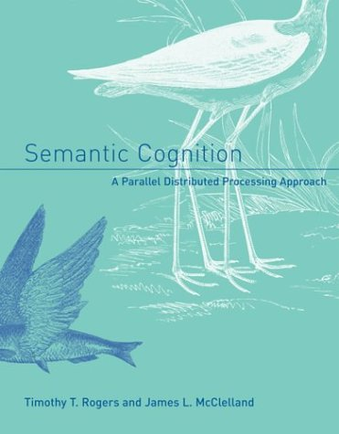
In Rogers and McClelland (2004) we also address:
  Conceptual differentiation in prelinguistic infants.
  Many of the phenomena addressed by classic work on semantic knowledge from the 1970’s:
    Basic level
    Typicality
    Frequency
    Expertise
  Disintegration of conceptual knowledge in semantic dementia
  How the model can be extended to capture causal properties of objects and explanations.
  What properties a network must have to be sensitive to coherent covariation.

