Slide 1
Emergence of Mathematical Abilities from Experience in Distributed Neural Networks
Jay McClelland
and the PDP lab at Stanford

Slide 2
Why is Math so Hard to Learn?
Late grade-school-aged kids misunderstand equations
  What goes in the blank: 7 + 3 + 4 = __ + 4
Many middle-school-aged kids misunderstand fractions
  Is 19/20 closer to 1 or 21?
Most Stanford undergraduates don’t understand the rudiments of trigonometry
  Which expression below has the same value as
  cos(-30°)?
    sin(30°) -sin(30°) cos(30°) -cos(30°)

Slide 3
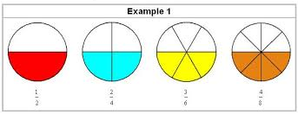
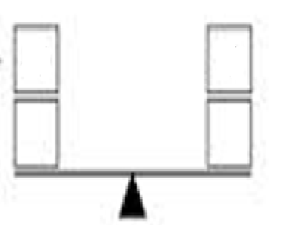
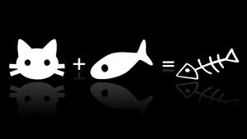
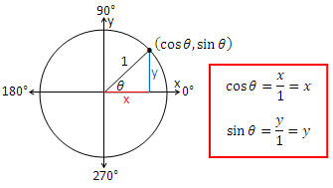
Failure to attach the appropriate meaning to mathematical expressions
A fraction N/D represents a certain number N of pieces of a unit whole divided into D equal parts
An equation represents an equivalence relation between two quantities, one to the left and one to the right of the equals sign
The sine / cosine of an angle θ in degrees represents
  the projection of a point on the unit circle specified by θ onto the vertical / horizontal axis through the center of the circle,
  or equivalently, the coordinates of the point on the circle
XXX
4
7
5
?

Slide 4
cos(70)

Slide 5
cos(–70+0)

Slide 6
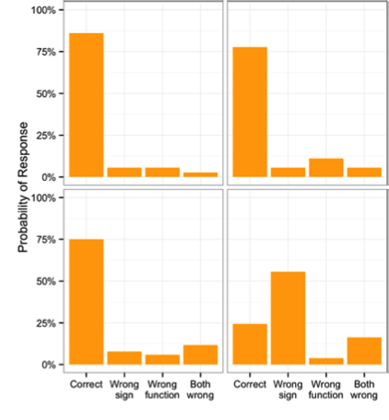
sin(-θ) cos(-θ)
Reported Circle Use:
“A Lot”
“A Little” or
“Not at all”

Slide 7
Who is to blame for these failures?
The teacher / the textbook:
  Too much emphasis on abstract concepts, rote procedures, and algebraic manipulation
  Not enough emphasis on maintaining contact with the meaning of the concepts in question
The students / their parents / our implicit theories about our abilities
Yes all this is true… but still – the concepts seem very simple once you understand them – and they are being presented.
So, Again, Why are they so hard to learn??

Slide 8
Habits of Mind¹
Learning to encode expressions automatically so that their meaning is readily apparent in the mind depends on a gradual strengthening process that occurs incrementally over repeated opportunities to learn
  This is no different in principle from learning to read words aloud, or many other things we learn
We quickly loose awareness that we are engaging in these processes – once they have been well practiced, the meaning of an expression comes to mind without explicit thought and appears to be intuitive and obvious.
Margolis, H. (1987). Patterns, thinking and Cognition. U. of Chicago Press.

Slide 9
Can studies of learning in neural networks help dig more deeply into these issues?
Example 1:
  Learning to read
Example 2:
  Learning to represent numerosity
Example 3:
  Learning to solve equation problems
Discussion and future directions

Slide 10
Neural Network Models of Representation and Learning
Connections are real-valued, so representation and learning are real-valued also
Connection-based knowledge can approximate discrete rule-like behavior, and can capture influence of continuous variables too
Connection adjustment occurs via small increments, making change occur gradually
Performance generally changes gradually, but can exhibit accelerations and decelerations.
/h/ /i/ /n/ /t/
H I N T

Slide 11
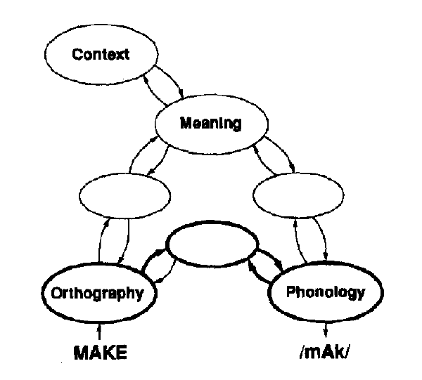
Warning: Simulation vs Theory
The models I will describe deliberately simplifies a complex system by considering only some of its parts and by trying to extract key properties of learning systems in the brain rather than mimicking all of their details

Slide 12
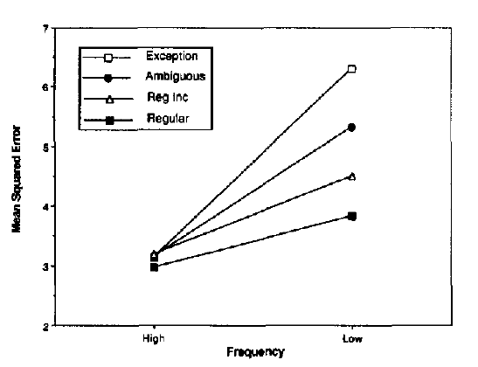
RIND
SOWN
HIVE,
HINT
HAKE
NETWORK ERROR
REACTION TIME
FIND
OWN
FIVE
TAKE
HIGH LOW
FREQUENCY

Slide 13
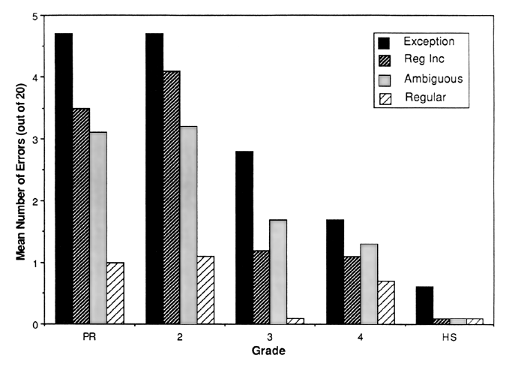
MEAN ERRORS (out of 20)
3 4 HS
GRADE

Slide 14
Memorization, Rules or ??
Networks like this can generalize – they are not strictly memorizing their inputs
Some earlier versions did not generalize as well as human subjects do, but other versions generalize quite well.
For example, in Plaut et al 1996, the reading model read nonwords as well as human subjects do, and made a similar pattern of responses.
  GAKE almost always pronunced to rhyme with TAKE
  MAVE sometimes rhymes the SAVE, sometime with HAVE

Slide 15
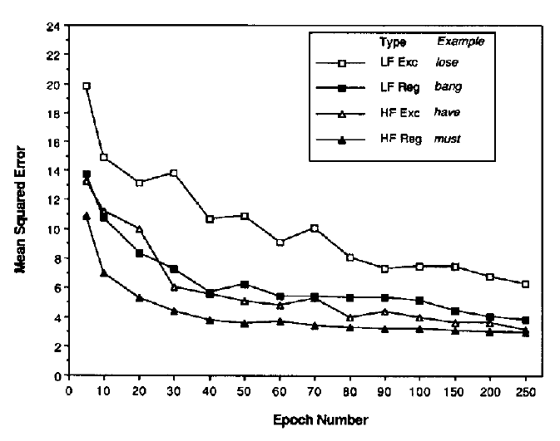
Model’s Improvement With Experience
RIND
HAKE
HAVE
TAKE

Slide 16
Summary
Connections strengthen gradually with experience; speed and accuracy of processing gradually increases
The knowledge acquired generalizes: The network can read pronounceable nonwords as human subjects do
Frequent and typical items are learned most quickly
Less frequent items and less typical items are harder to learn, but are eventually mastered by the network
The knowledge is implicit and becomes more and more robust and sensitive to complexities with experience

Slide 17
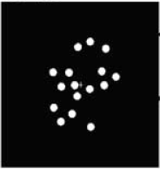
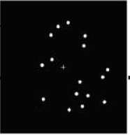
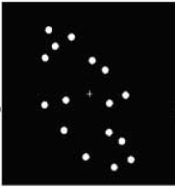
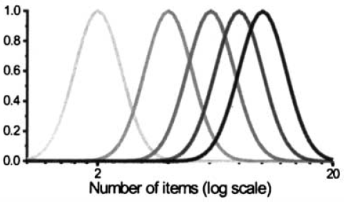
The Approximate Number System (ANS)
Piazza et al. 2004
Notes:
The approximate number system (ANS) is a cognitive system that supports the estimation of themagnitude of a group of objects without relying on language or symbols. The ANS is credited with the non-symbolic representation of all numbers greater than four, with lesser values being carried out by the parallel individuation system, or object tracking system.[1] Beginning in early infancy, the ANS allows an individual to detect differences in magnitude between groups. The precision of the ANS improves throughout childhood development and reaches a final adult level of approximately 15% accuracy, meaning an adult could distinguish 100 items versus 115 items without counting.

Slide 18
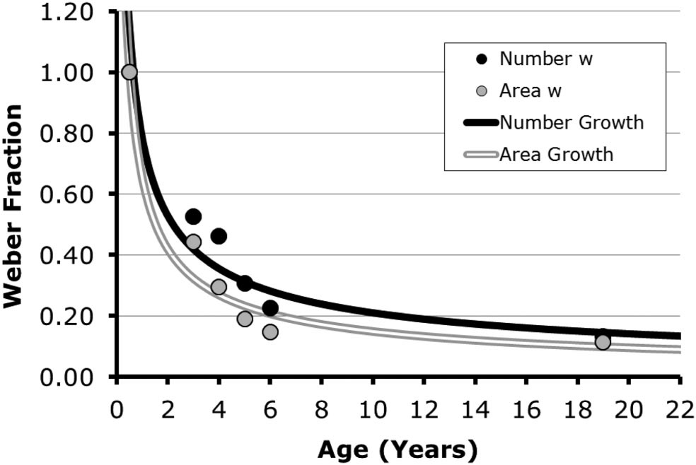
Progressive Improvement in Judging Numerosity and Area (Odic et al, 2013)

Slide 19
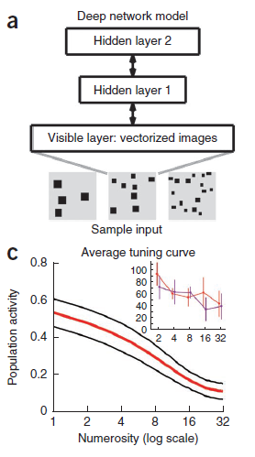
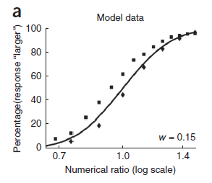
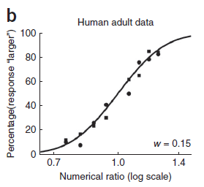
Stoianov & Zorzi (2013)

Slide 20
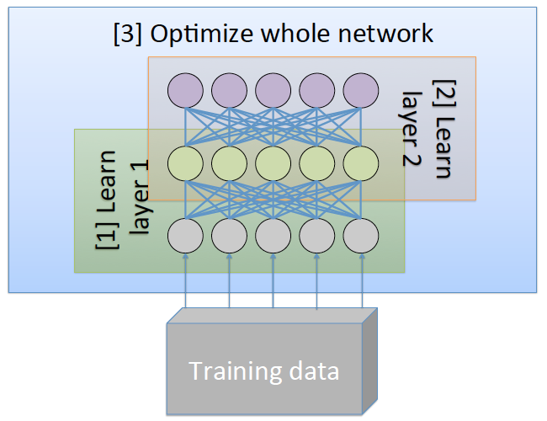
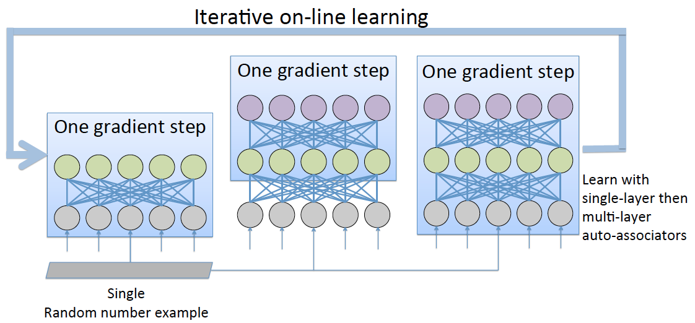

Progressive development of a representation that supports numerosity judgments
At several points in training, the network is tested for it’s ability to use the representation
At the top layer to judge whether the number of items in the input is greater
or less than a standard

Slide 21
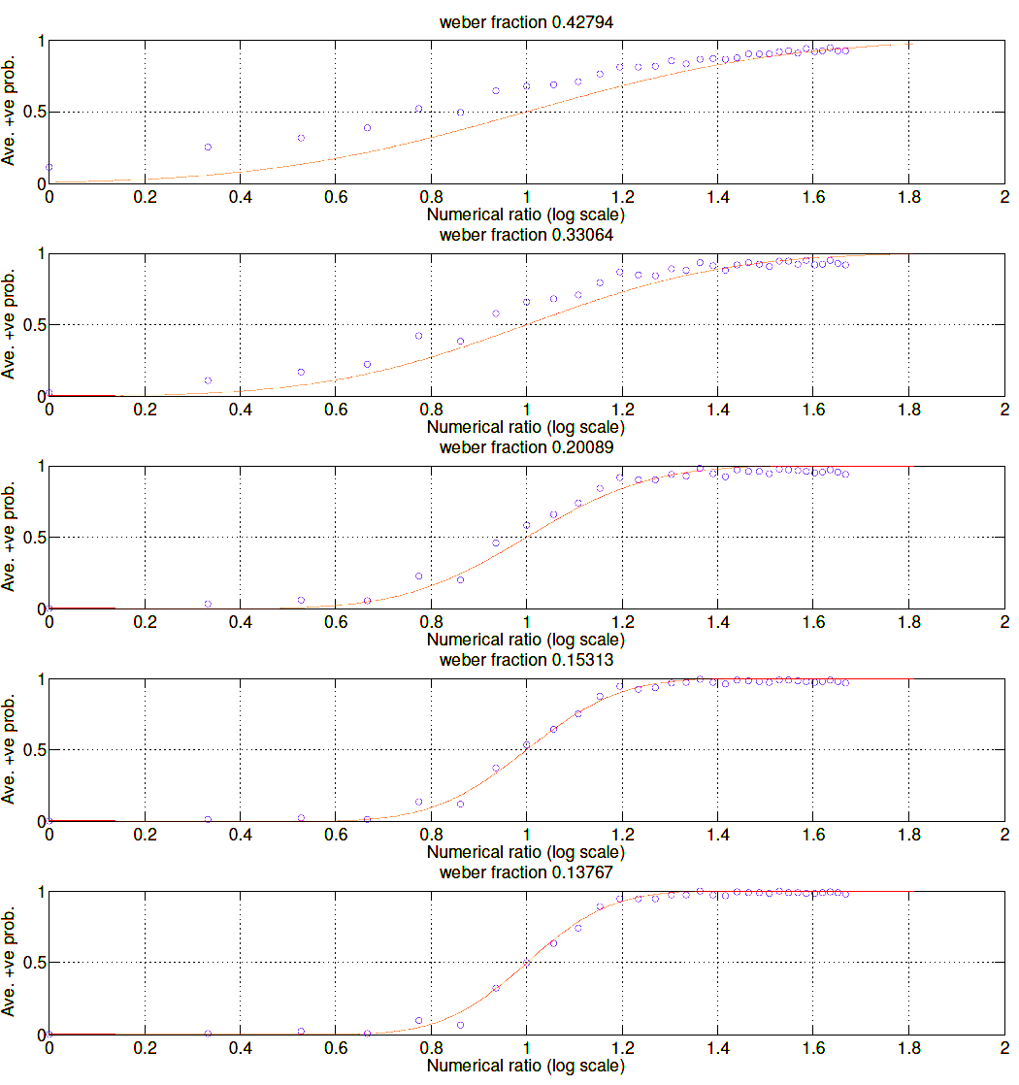
Results at Different
Time Points

Slide 22
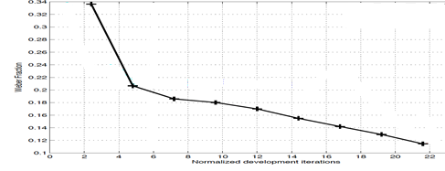
Children vs. Network
0.3
0.2
0.1
Scaled Network ‘Age’

Slide 23
Summary
Learning to do a non-numeric task can create a representation sensitive to numerosity in a very generic neural network
Characteristics of biological numerosity can arise without the task of representing number per se
The structure of the training set may matter for this
  What factors are characteristic of natural experience?
  What factors affect the network’s numerosity representations?
Take-home point is that human-like sensistivity to number can arise and can be progressively refined from a very general architecture and learning mechanism

Slide 24
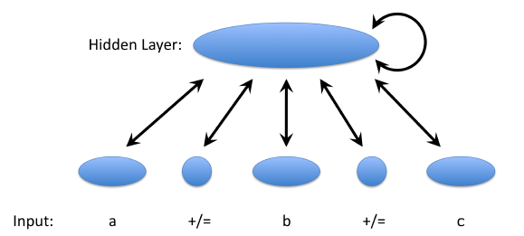
A neural network model that learns “the concept of equivalence”
Or at least, it learns to pass behavioral tests whose success has led others to attribute implicit knowledge of the concept of equivalence
A project by one of my PhD students, Kevin Mickey

Slide 25
Phenomena to be addressed
Children answer incorrectly in problems of the form:
  a = b + __
They tend to put the sum of a and b in the blank, rather than the correct answer, which is b – a.
When given such equations in a brief presentation, and asked to reproduce them, they tend to reproduce them as
  a + b = __
While the expressions used in studies are often more complex, these simple examples capture the essence of the phenomenon.

Slide 26
Analysis of Input
Researchers have studied textbooks used in different school systems, and they find:
  Operands are predominantly on the left of the equal sign in early-grade texts and examples
    ~90% of cases have operands only on the left
  When a blank occurs it is by itself about 60% of the time
  Thus, there are cases like
    __ + b = c or a + __ = c
  But few very few cases like
    a = __ + c or a = b + __
Our training set mirrored these statistics

Slide 27
Important Point
The statistics are stationary throughout the simulation
  So the changing pattern in the network is a function of how the network responds to these statistics, not changes in the training statistics

Slide 28
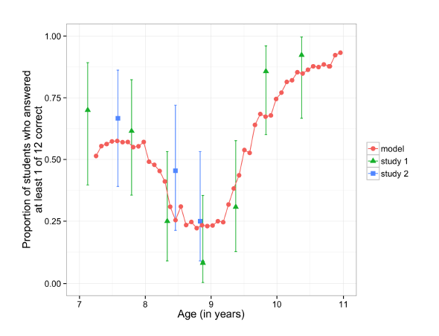

Simulation Results Compared to
Experimental Data

Slide 29
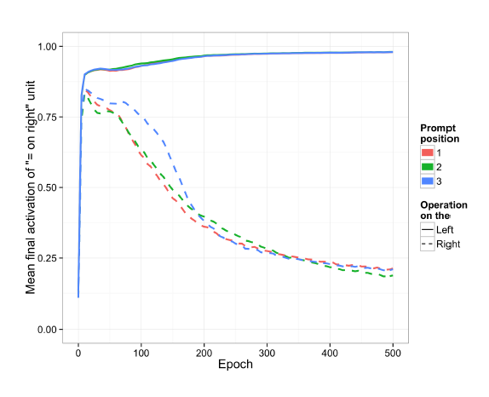
Illusions of Equal Signs
When equal sign is on the right
Illusory equal
signs
When equal sign is on the left

Slide 30
Discussion of equivalence simulation
At first:
  the model exhibits an ‘add all’ strategy, filling in the blank with the sum of the other numbers presented
  and it exhibits illusory perception of the = sign in reproducing a = b + __ equations
With additional training, even though problems in which the equal sign is on the right predominate, the model gradually comes to overcome both tendencies, as children do as they gain more and more practice with arithmetic

Slide 31
Limitations and Future Directions
The models we’ve used so far:
  Use a single parallel settling process, whereas mathematical problem solving clearly can involve a sequence of operations
  Use representations of number that don’t fully capture what we know about number intuitions
  Lack an interface to explicit propositional statements
  Lack an interface to visuospatial representations
All of these are important gaps
  We have our work cut out for us to incorporate these elements into a more complete model of how we acquire mathematical abilities.

Slide 32
Implications for Education
Learning robust automatic encoding skills that translate inputs to their meanings takes time and progresses slowly
Thus, we cannot expect to achieve expertise overnight
Perhaps most importantly, we cannot blame ourselves or the teacher if we do not understand!
  Understanding emerges slowly and requires immersion and engagement
Teaching should emphasize
  Objects and relations in the world that the expressions map onto
  Mapping into this world rather than blindly manipulating symbols
  Establishing solid ground before building more on top of it
  Realizing that things will not seem clear at first but meaning will emerge with practice
4
7
5
?

Slide 33
Muchas Gracias!

