Slide 1
Dynamics of learning:
A case study
Jay McClelland
Stanford University

Slide 2
Piaget’s theory of stages and development
Our knowledge takes qualitatively different forms at different stages
This occurs because our knowledge schemas adapt with experience
  ‘Equilibration: Assimilation & Accommodation’
Questions about the theory:
  What do these words mean?
  How does it work?
  How can incremental adjustments lead to qualitative change?

Slide 3
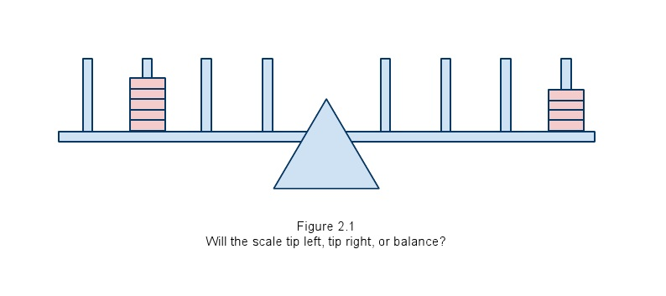
An example domain:
The balance scale
Will the scale tip left, tip right, or balance?

Slide 4
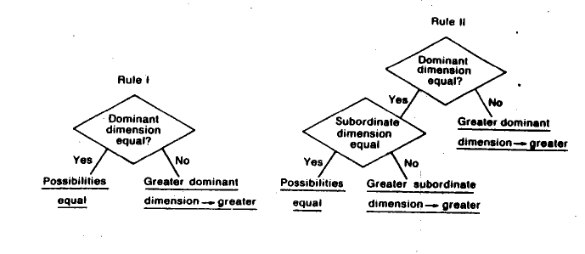
Siegler’s First Two Rules
Rule assessment procedure:
24 problems of 6 types
Children are characterized as ‘using a rule’
if 20/24 responses are consistent with it

Slide 5
Findings
Children 5-7 generally behave in accordance with Rule 1
Then, most children’s behavior is briefly consistent with Rule 2, before they progress to more complex patterns of responding
Around the time of these transitions, children exhibit increasing, graded sensitivity to the distance cue
  Rule 1 kids will take distance into account if the distance difference is large enough

Slide 6
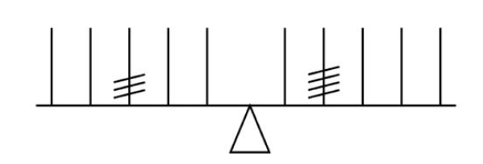
Siegler’s Intervention Experiment
Two groups of ‘Rule 1’ children
  Young (about 5 yrs old)
  Older (7-8 yrs old)
All children see 16 ‘conflict’
problems
After the experience:
  Older children progress to Rule 2
  Younger children show no change or start choosing randomly

Slide 7
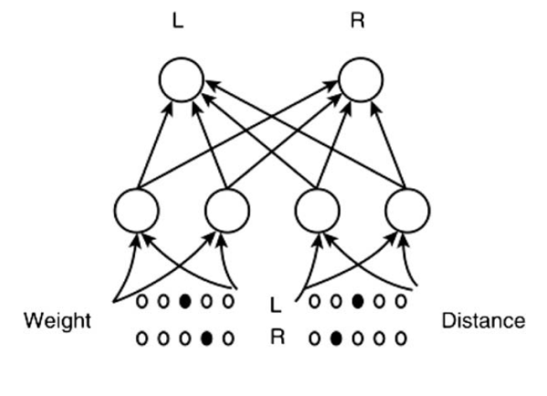
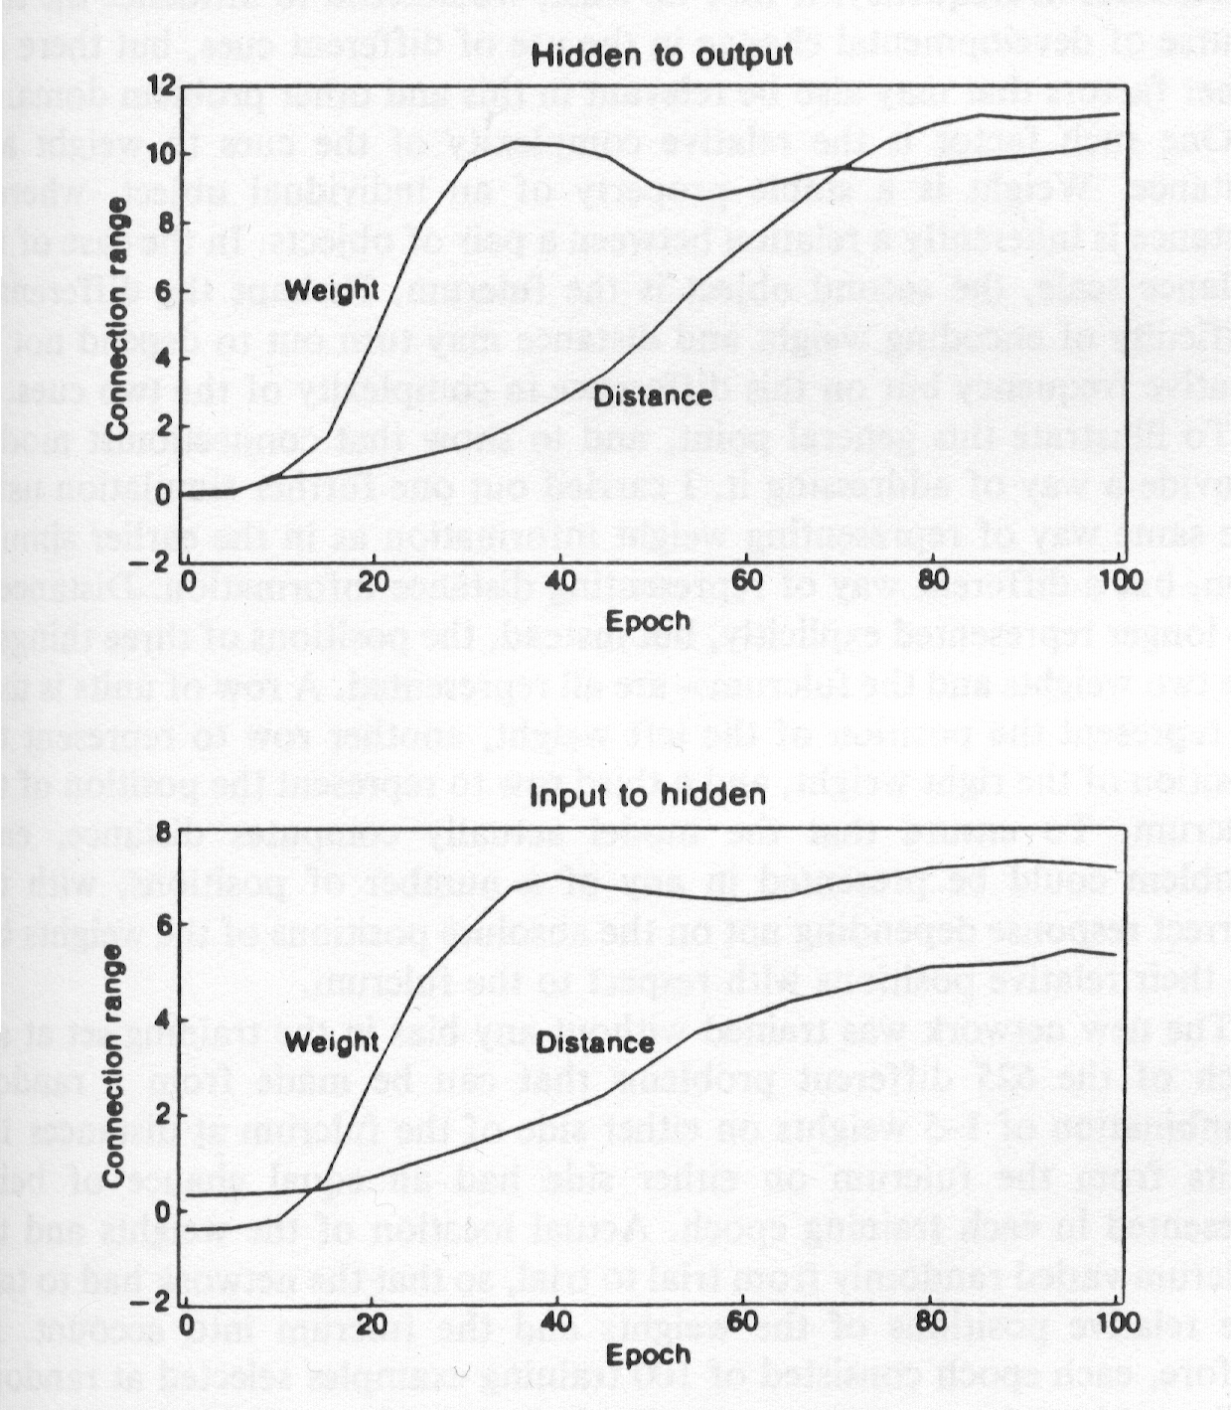
An Alternative to Rules
Knowledge is implicit
  In the connections in a neural network
Experience with problems shapes the connections
The network learns to become sensitive to weight and distance gradually through the accumulation of small changes
Like children, it shows graded sensitivity to distance

Slide 8
Graded Differences in Connections Lead to Different Outcomes of Learning at Different Points in Development
Training with conflict problems at epoch 20 leads to degradation of performance.
Training at 40 epochs leads to progress.

Slide 9
Is the Model too Continuous?
‘Rules’ might be seen as similar to phases of matter (solid, liquid, gas)
This view predicts that children’s performance should exhibit ‘catastrophe flags’ that signify such transitions

Slide 10
Another Interesting Question
Can the model teach itself?

Slide 11
Van der Maas et al Experiment
Pre-test
A series of distance problems
Post-test
Over 300 children tested!

Slide 21
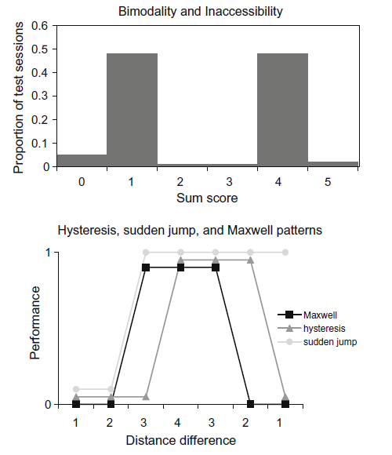
Van der Maas et al Catastrophe Flags
Pre and post-test
  ‘Inaccessible region’
  Jump across gap
Distance series
  ‘Maxwell’
  ‘Hysteresis’
  ‘Sudden jump’

Slide 22
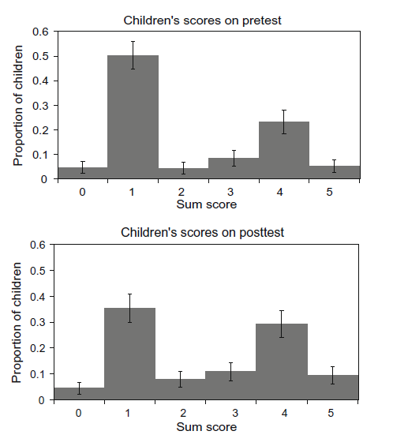
Findings
Pretest Scores
Posttest Scores

Slide 23
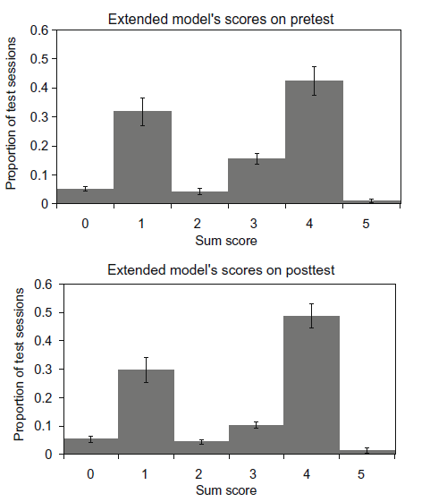
Simulation with Model that Teaches Itself
Model Pretest Scores
Distance Series:
Children vs. Model
Model Posttest Scores

Slide 24
Conclusion
We are far from a perfect understanding of transitions in learning
But we have come a long way
Simple rule-based models miss a lot
Models with learning dynamics capture quite a lot more:
  They show gradual knowledge accumulation and yet capture patterns of change similar to what we see in children

