Slide 1
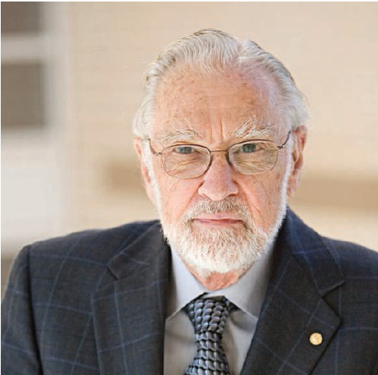
Duncan Luce
Foundations of Mathematical Social Science and Mentorship of Outstanding Scientists

Slide 2
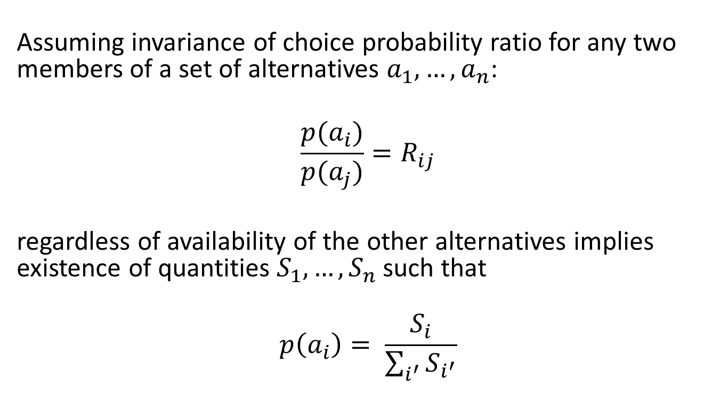
Luce’s Choice Theory
Assuming invariance of choice probability ratio for any two members of a set of alternatives $a_{1},…,a_{n}$:
$$\frac{p(a_{i})}{p(a_{j})}=R_{ij}$$
regardless of availability of the other alternatives implies existence of quantities $S_{1},…,S_{n}$such that
$$p\left(a_{i}\right)= \frac{S_{i}}{\sum_{i^{′}}{S_{i^{′}}}}$$

Slide 3
Influence
Maybe a measure of what it means to be an experimental psychologist is whether we've published a paper with Luce's choice ratio in it. … We see it now in neuroscience, where "divisive normalization" is a hot topic -- neural activity seems to be normalized by dividing the firing rate for a neuron by the total firing rate in the population. They don't always cite Luce, but they should.
Gordon Logan
The choice axiom is substantially deeper and more consequential than a ratio of strengths quantity by itself. As “Individual Choice Behavior” demonstrates, it implies a profound type of independence (“invariance” might be a preferable term) among choice objects, even as the set of such objects expands or contracts. The redoubtable constraints imposed on choice and preference behavior by this axiom have, I believe, been responsible for a wide terrain of […] research in economics, psychology (especially decision making) and a number of other fields.
James Townsend

Slide 4

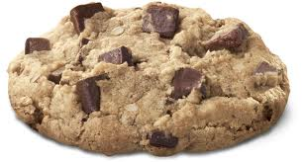
Foundations of Measurement
(with Tukey, Narens, and Others)
vs

Slide 5
Foundations of Measurement
(with Tukey, Narens, and Others)
vs

Slide 6

Duncan as Mentor
As a graduate student, I found him thoroughly intimidating, but over the years came to know him as a colleague generous with his time and ideas, with very broad interests and a warm sense of humor. Tom Wallston
Duncan was a wonderful model and mentor from the first day I met him. We mostly communicated about science via memos. His habit of forcing me to write was very beneficial. In the fullness of time, he became a friend while remaining a mentor. When I think of him, the words integrity and honesty inevitably come to mind. Brian Wandell
I was privileged to work in the Harvard psychophysics lab headed by Dave Green and Duncan. Although my research interests eventually moved […] to high-level cognition, Duncan remained a constant source of inspiration and guidance to me. I recall once giving a talk at the Math Psych Meetings when I was a young assistant professor. Duncan met me in the hallway and kidded me “not bad for a cognitive psychologist” – one of my proudest moments. Rob Nosofsky
I want to second what Rob said about Duncan being a wonderful mentor. I was an “orphan” grad student after my advisor left, so Duncan became my advisor for two years. He was generous with his time and even willing to talk about totally equation-free research! He taught me a lot and I feel very lucky to have known him. Martha Farah

