Slide 1
David E. Rumelhart:
1942-2011

Slide 2


Early Life In
Wessington Springs
South Dakota
One of three famous
cognitive scientists from
South Dakota
A family of game-players
A passion to know and to teach

Slide 3

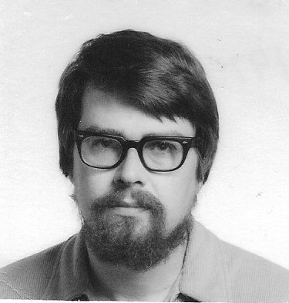
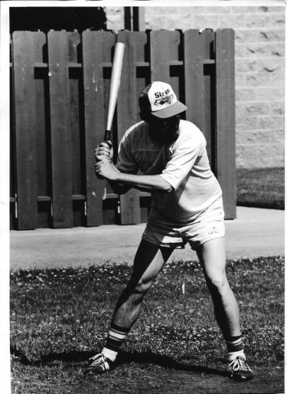
College and
Graduate School
Math and Psychology Major, USD
PhD in Mathematical Psychology at Stanford
Fast friendship and private language
Inveterate competitor and sportsman

Slide 4
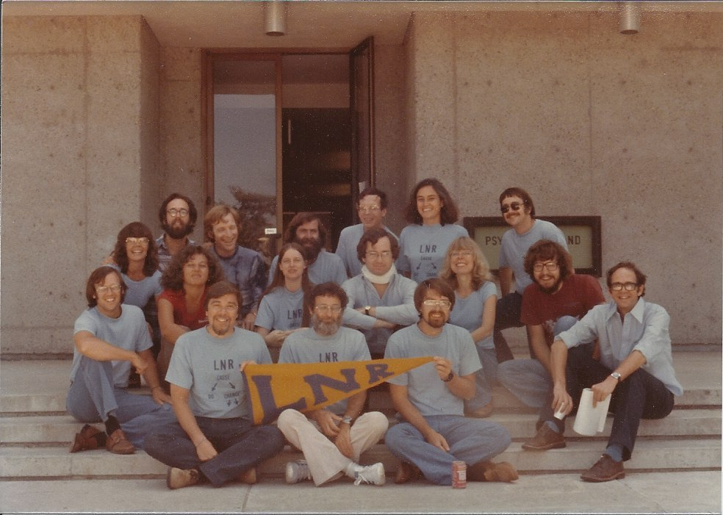
Early Years at UCSD

Slide 5
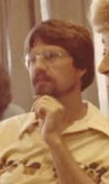
My Early Memories of David
Team teaching honors psychology
Taking David’s mathematical psychology course
Getting some good advice
Tennis and volleyball
Oh, you are working on that too??

Slide 6
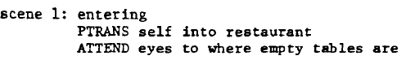
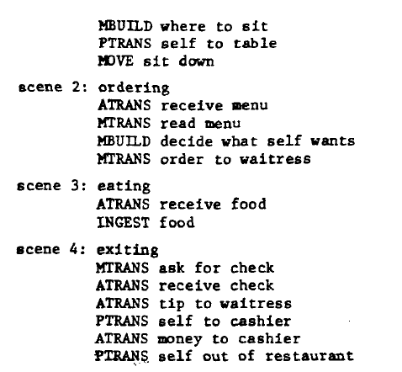
Dave’s Ideas from the Mid 70’s
Roger Shank’s Restaurant Script
Problems with Classical AI
  Limitations of theories of knowledge structure (‘schema theories’)
  Frustration over efforts to integrate constraints
Toward an Interactive
Model of Reading

Slide 7
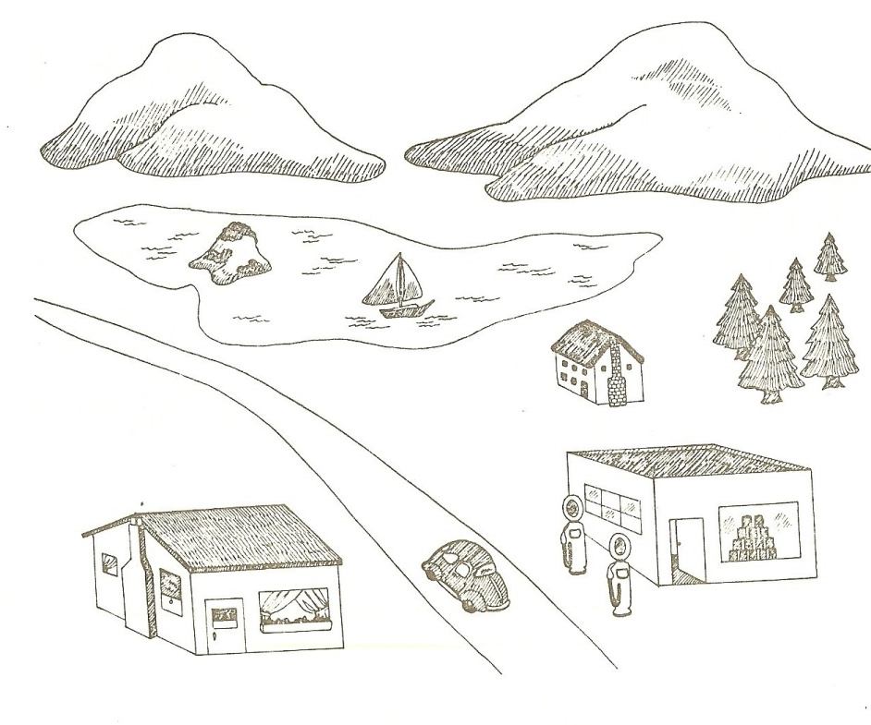

Slide 8
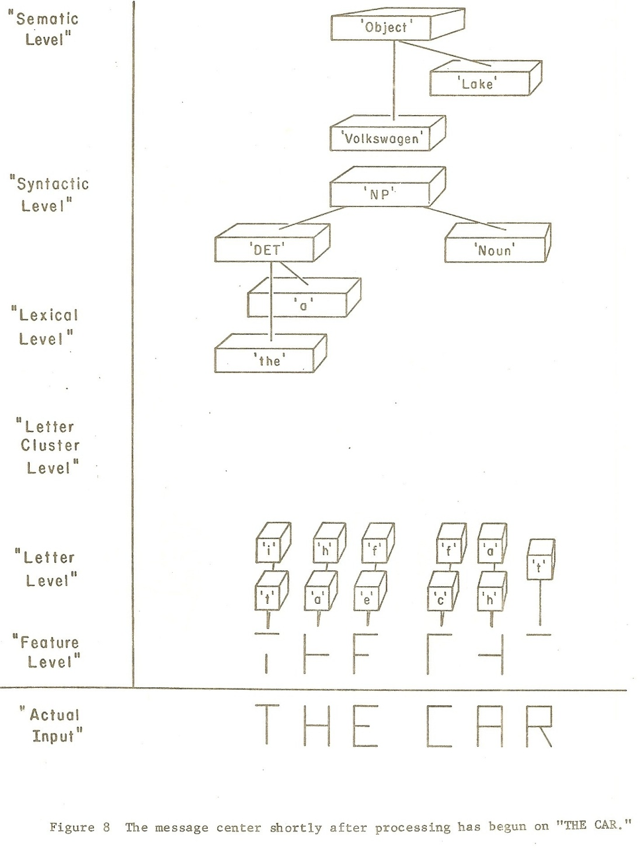

Slide 9

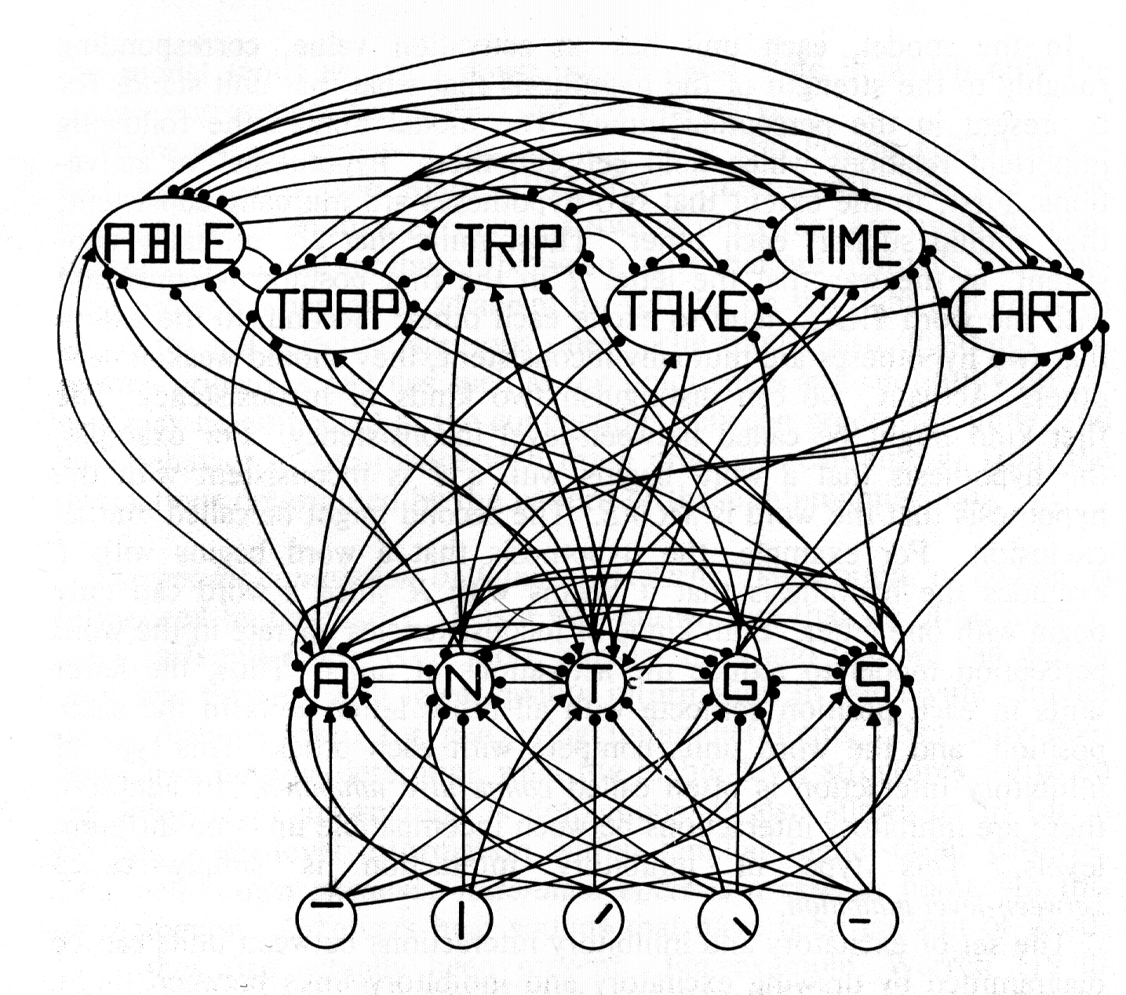
The Interactive Activation Model

Slide 10
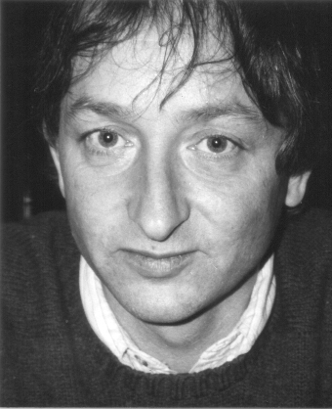
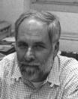
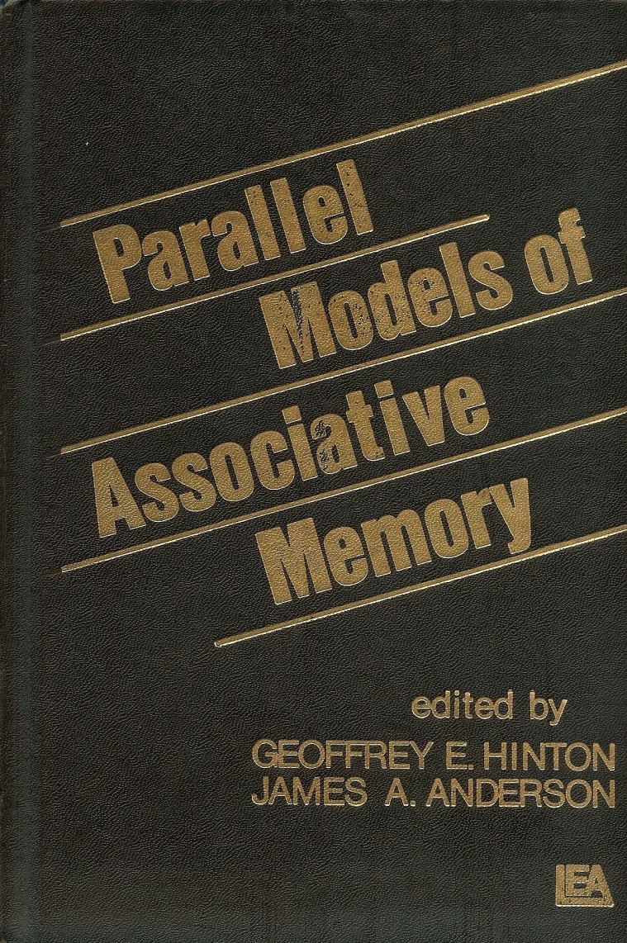
Precursors to PDP:
Neural Network Models of Mind
Rosenblatt’s Perceptron
Minsky and Pappert’s Perceptrons
Resurgence in the late 70’s

Slide 11
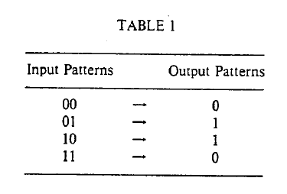
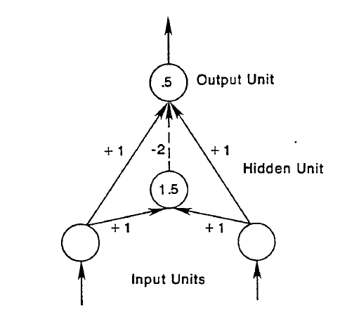

The Crux of the
Problem
A Perceptron Can’t Do Negation!

Slide 12
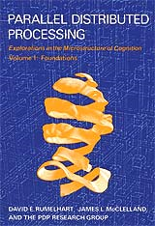
Key Contributions to
Parallel Distributed Processing
Interactive Activation
Emergent Schemata
Language without Rules
Backpropagation Learning
Algorithm

Slide 13
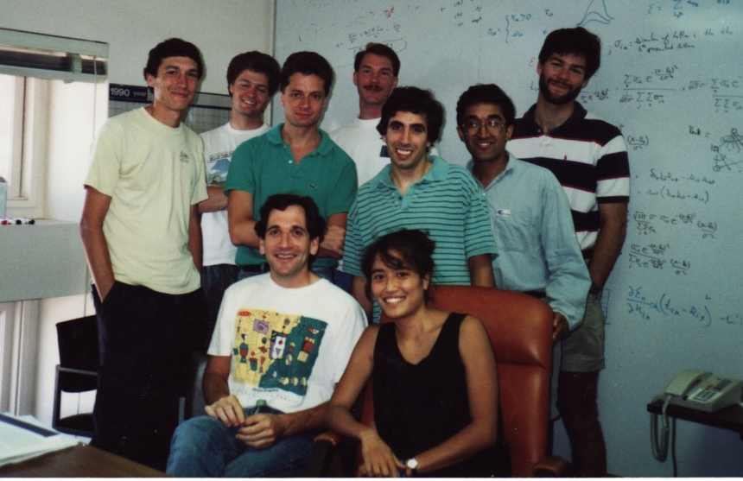
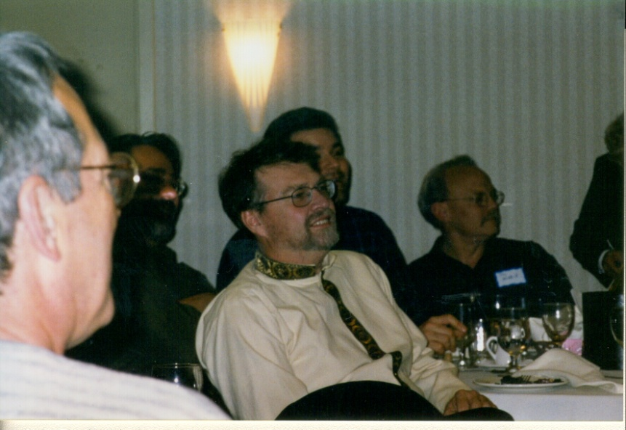
Stanford in the 90’s and After
A booming lab in the early post-PDP days
Neurological Illness
Post-retirement life with Don Rumelhart in Michigan

Slide 14
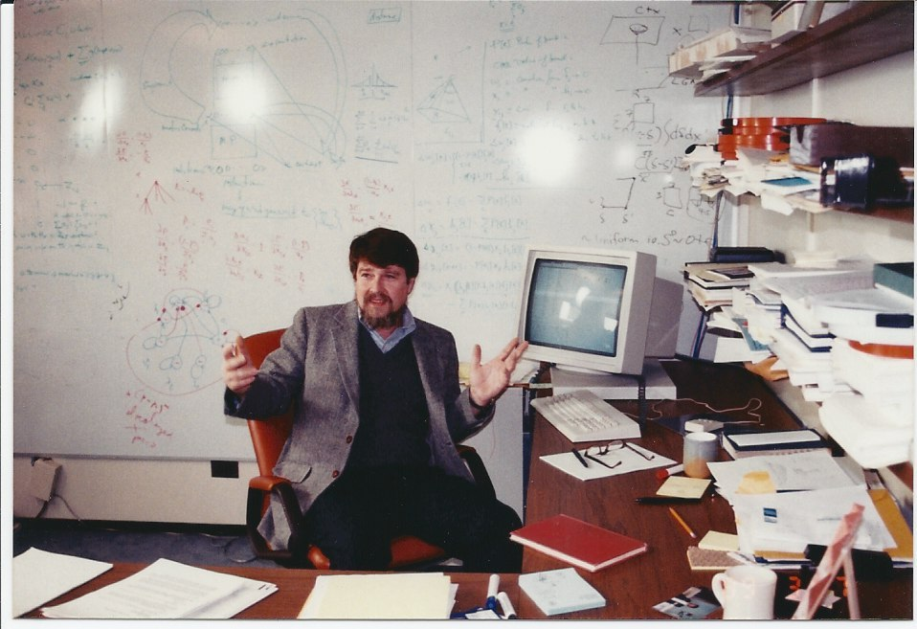
Rumelhart Back at Stanford

Slide 15
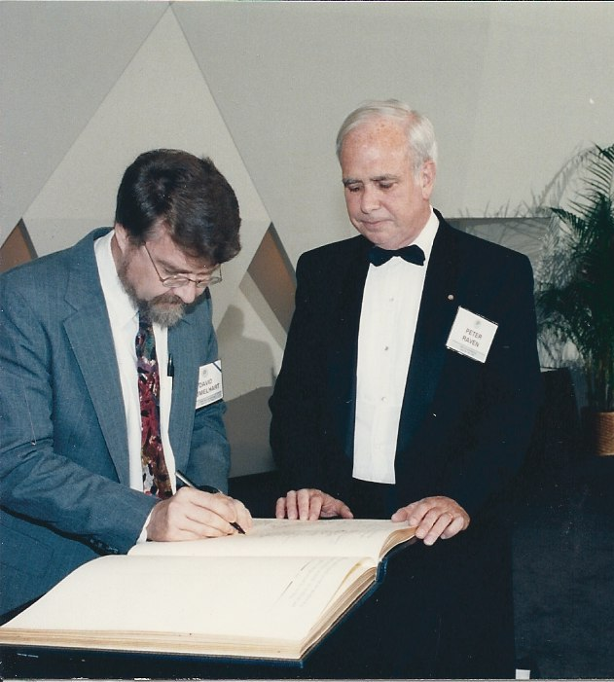
Honors and Awards
MacArthur ‘Genius Award’, 1987
National Academy of Sciences, 1991
Warren Medal, Society of Experimental Psychologists
APA Distinguished Scientific Contribution Award
Grawemeyer Prize in Psychology
Namesake and exemplar par excellence of the
David E. Rumelhart Prize for Contributions to the Theoretical Foundations of Cognitive Science

Slide 16
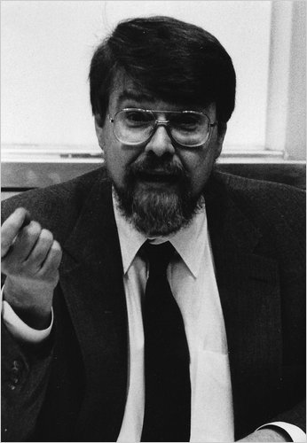
Characteristics of a
Penetrating Mind
Ignore mundane distractions
Focus on the crux of the problem
Reduce it to the minimal case
Develop a formal system
Write your own code

