Slide 1
Context Model, Bayesian Exemplar Models, Neural Networks

Slide 2
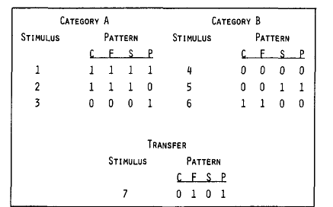
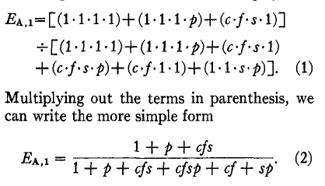

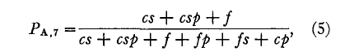
Medin and Shaffer’s
‘Context Model’
No category information -- only specific
items or exemplars.
Evidence for category A given probe p:
E_{A,p} = Σ_{i in a}S(p,i)/(Σ_{i in a}S(p,i) + Σ_{i in b}S(p,i))
Where
S(p,i) = Π_{j} (P_{j} = I_{ij} ? 1:α_{j}) ; α_{j} = c,f,s,p
Prob. of choosing category A given probe p:
P_{A,p} = E_{A,p}

Slide 3
Medin and Shaffer’s
‘Context Model’
No category information -- only specific
items or exemplars.
Evidence for category A given probe p:
E_{A,p} = Σ_{i in a}S(p,i)/(Σ_{i in a}S(p,i) + Σ_{i in b}S(p,i))
Where
S(p,i) = Π_{j} (P_{j} = I_{ij} ? 1:α_{j}) ; α_{j} = c,f,s,p
Probability of choosing category A given probe p:
P_{A,p} = E_{A,p}

Slide 4
Some things about the model
Good matches count more than weak matches
An exact match counts a lot
But many weak matches can work together to make a (non-presented) prototype come out better than any exemplar
Dimension weights like ‘effective distance’ (or maybe ‘log of effective distance?’
If weight = 0, we get a categorical effect
Dimension weights are important – how are they determined?
  Best fit to data?
  Best choice to categorize examples correctly?

Slide 5
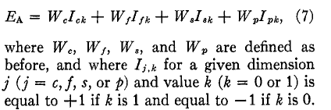


Independent cue models
For items 1, 2, 3 and 7:

Slide 6
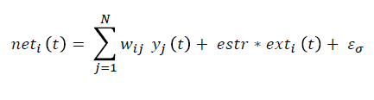
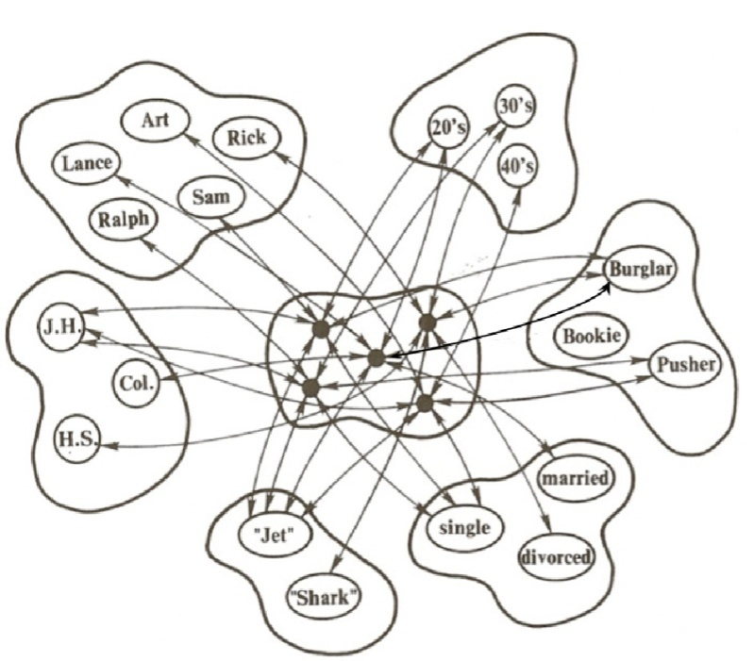



Neural Network Model Similar to Context Model
Within each pool, units inhibit each other;
between pools, they are mutually exictatory
if net_{i}(t) > 0
else
Choice rule:

Slide 7
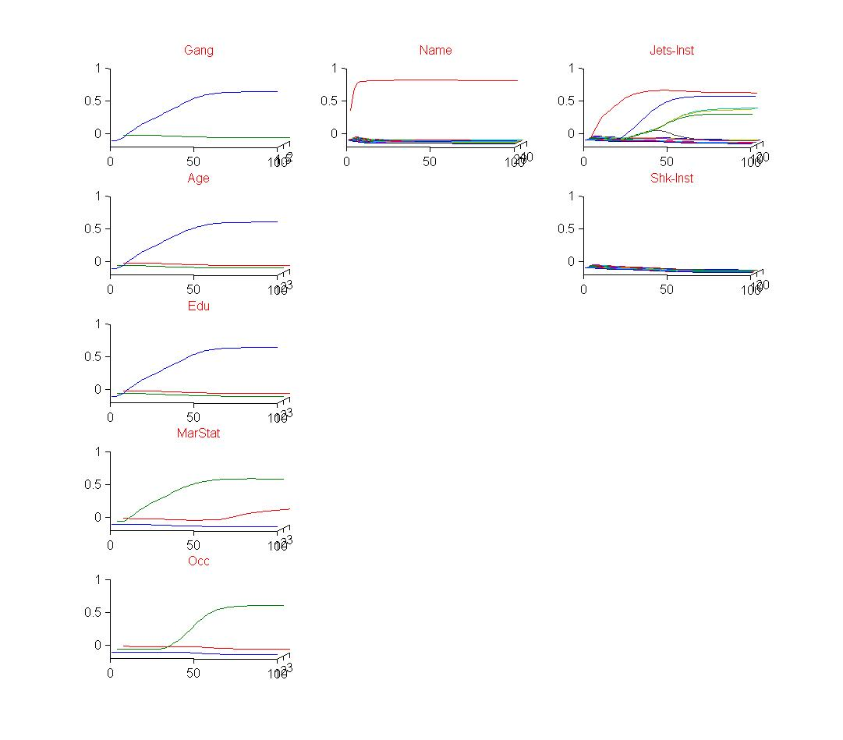
What REMERGE Adds to Exemplar Models
Recurrence allows similarity between stored items to influence performance, independent of direct activation by the probe.
X

Slide 8

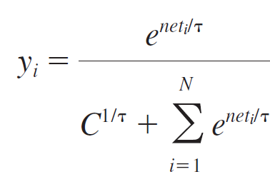
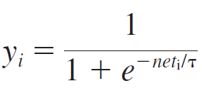
Bayes/Exemplar-like Version of the Remerge Model
inp_{i}
inp_{i}
Hedged softmax function:
Logistic function:
Choice rule:

Slide 9
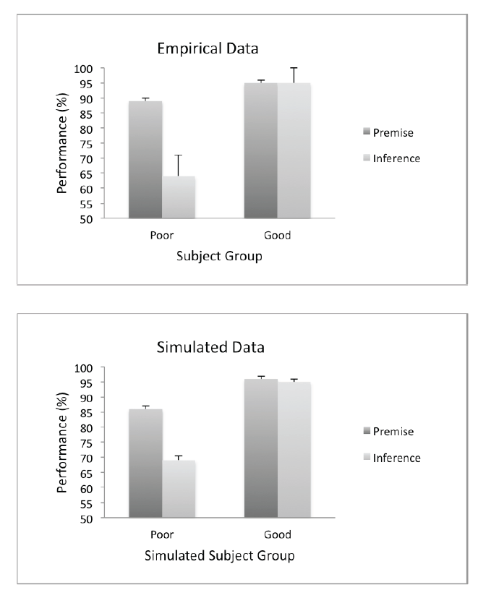
Acquired Equivalence
(Shohamy & Wagner, 2008)
Study:
  F1-S1;
  F3-S3;
  F2-S1;
  F2-S2;
  F4-S3;
  F4-S4
Test:
  Premise: F1: S1 or S3?
  Inference: F1: S2 or S4?

Slide 10
Acquired Equivalence
(Shohamy & Wagner, 2008)
Study:
  F1-S1;
  F3-S3;
  F2-S1;
  F2-S2;
  F4-S3;
  F4-S4
Test:
  Premise: F1: S1 or S3?
  Inference: F1: S2 or S4?
F1 S1 F2 S2 F3 S3 F4 S4

Slide 11
Acquired Equivalence
(Shohamy & Wagner, 2008)
S1 S2 S3 S4
Study:
  F1-S1;
  F3-S3;
  F2-S1;
  F2-S2;
  F4-S3;
  F4-S4
Test:
  Premise: F1: S1 or S3?
  Inference: F1: S2 or S4?
F1 S1 F2 S2 F3 S3 F4 S4

Slide 12
Acquired Equivalence
(Shohamy & Wagner, 2008)
S1 S2 S3 S4
Study:
  F1-S1;
  F3-S3;
  F2-S1;
  F2-S2;
  F4-S3;
  F4-S4
Test:
  Premise: F1: S1 or S3?
  Inference: F1: S2 or S4?
F1 S1 F2 S2 F3 S3 F4 S4

Slide 13
Acquired Equivalence
(Shohamy & Wagner, 2008)
Study:
  F1-S1;
  F3-S3;
  F2-S1;
  F2-S2;
  F4-S3;
  F4-S4
Test:
  Premise: F1: S1 or S3?
  Inference: F1: S2 or S4?

