Slide 1
PDP Models of Reading
Psych 205
May 20, 2013

Slide 2
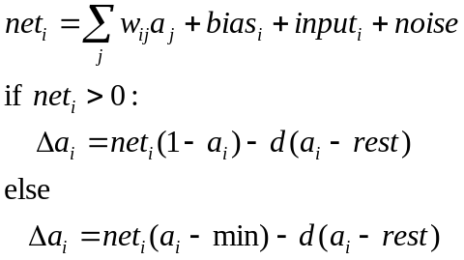
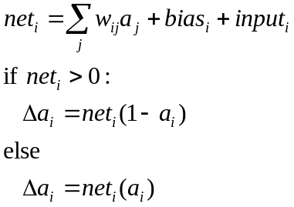
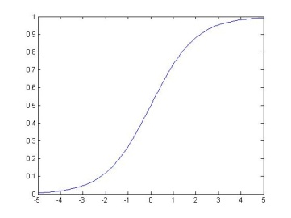


Input and activation of units in PDP models
General form of unit update:
Simple version used in cube
simulation:
An activation function that links PDP models to Bayesian ideas:
Or set activation to 1 probabilistically:
max=1
Input from
unit j
a
w_{ij}
0
rest
min=-.2
unit i
a_{i} or p_{i}
net_{i}

Slide 3
Cognitive Neuropsychology (1970’s)
Deep and surface dyslexia (1970’s):
  Deep dyslexics can’t read non-words (e.g. VINT), make semantic errors in reading words (PEACH -> ‘apricot’)
  Surface dyslexics can read non-words, and regular words (e.g. MINT) but often regularize exceptions (PINT).
Work leads to ‘box-and-arrow’ models, reminiscent of flow-charts

Slide 4
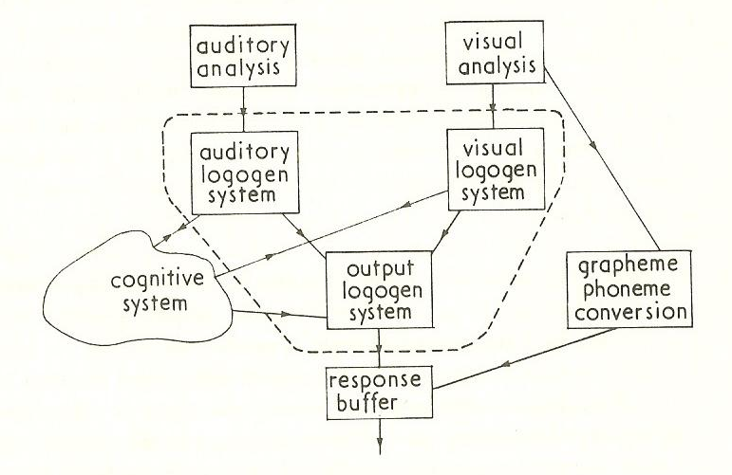

Slide 5
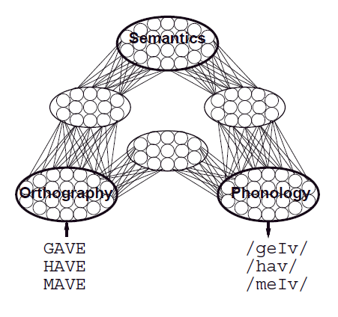
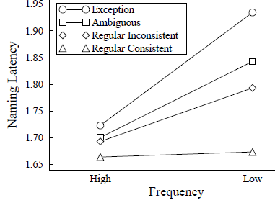
Graceful Degradation in Neuropsychology
Patient deficits graded in severity
Error patterns have systematic characteristics:
  Deep dyslexic produce both visual and semantic errors:
    symphony -> sympathy
    symphony -> orchestra
  Errors in fluent surface dyslexia (as well as errors and RTs in normal reading) depend on a word’s frequency, and on a word’s neighbors
PINT
TREAD
MINT
LAKE
Effects of lesions to units and connections in distributed PDP models capture both of these features of patient deficits.

Slide 6
Core Principles of Parallel Distributed Processing
/h/ /i/ /n/ /t/
Processing occurs via interactions among neuron-like processing units via weighted connections.
A representation is a pattern of activation.
The knowledge is in the connections.
Learning occurs through gradual connection adjustment, driven by experience.
Learning affects both representation and processing.
H I N T

Slide 7
Learning in a Feedforward PDP Network
Propagate activation ‘forward’ producing a_{i} (a_{j}) for all units using the logistic activation function.
Calculate error at the output layer:
δ_{i} = f(t_{i} – a_{i})
Propagate error backward to calculate error information at the ‘hidden’ layer:
δ_{j} = f(Σ_{i}w_{ij}f(t_{i} – a_{i}))
Change weights:
Δw_{ij}=δ_{i}a_{j}
/h/ /i/ /n/ /t/
H I N T

Slide 8
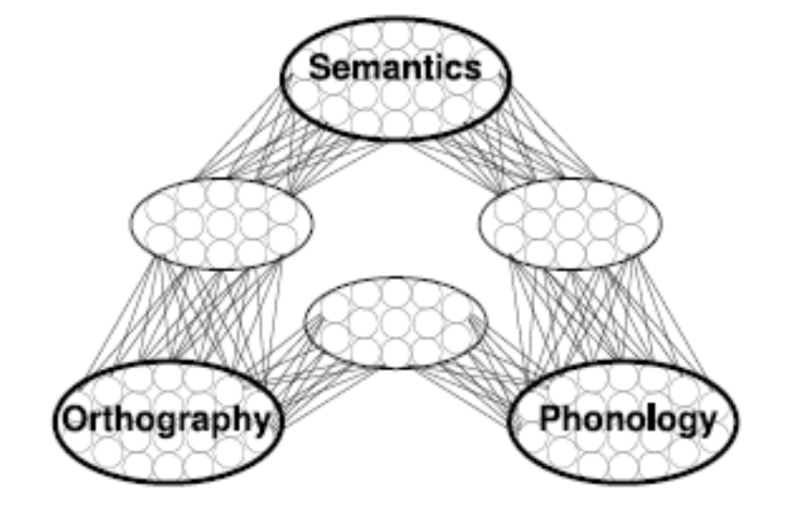
Additional Features of the PDP Framework
Processing is in general thought to be continuous, bidirectional, and distributed within and across components of the cognitive system:
  Each part contributes to the processing that takes place in other parts.
  The outcome of processing anywhere can depend on processing everywhere.
Processing can be very robust for highly typical and frequent items in well-practiced tasks such that considerable degradation can be tolerated before there is an apparent deficit.
CONTEXT

