Slide 1
Integrating New Findings into the Complementary Learning Systems Theory of Memory
Jay McClelland, Stanford University

Slide 2
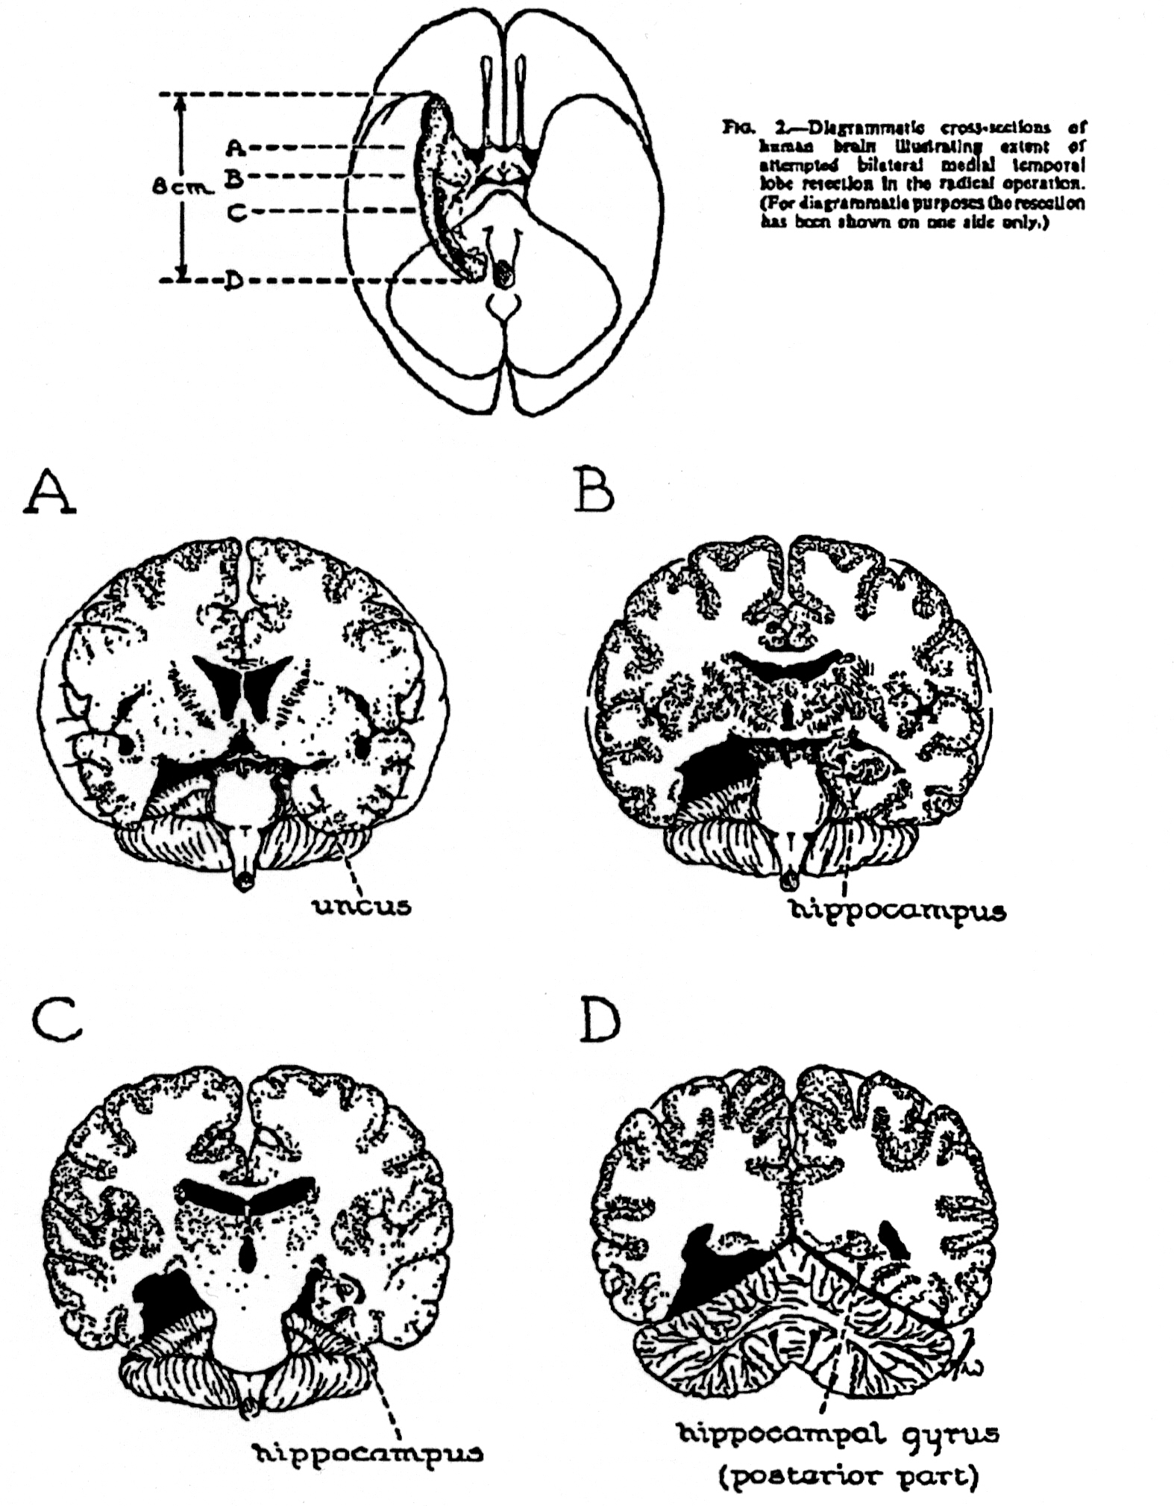
Effects of Hippocampal
Lesions in Humans
l
Intact performance on tests of general intelligence, world knowledge, language, digit span, …
Dramatic deficits in formation of some types of new memories
Spared implicit learning
Temporally graded retrograde amnesia

Slide 3
Why Are There Complementary Learning Systems?
Hippocampus uses sparse distributed representations to minimize interference among memories and allow rapid new learning.
Neocortex uses dense distributed representations that promote generalization along meaningful lines, but learning proceeds very gradually.
Working together, these systems allow us to learn
  Shared structure underlying experiences in a domain
  Details of specific experiences
  Without interference of new learning with knowledge of shared structure

Slide 4
A model of neocortical learning
(Rumelhart, 1990; McC et al. 1995)
Relies on distributed representations capturing aspects of meaning that emerge through a very gradual learning process
The progression of learning and the representations formed capture many aspects of cognitive development
  Differentiation of concept representations
  Generalization of learning to new concepts
  llusory correlations and overgeneralization
  Domain-specific variation in importance of feature dimensions
  Reorganization of conceptual knowledge

Slide 5
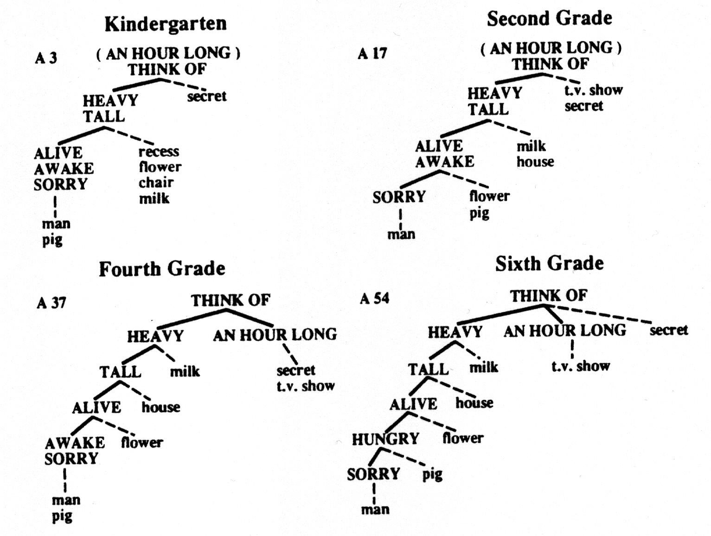

Slide 6

The Rumelhart Model

Slide 7

The Training Data:
All propositions true of
items at the bottom level
of the tree, e.g.:
Robin can {grow, move, fly}

Slide 8
Target output for ‘robin can’ input

Slide 9
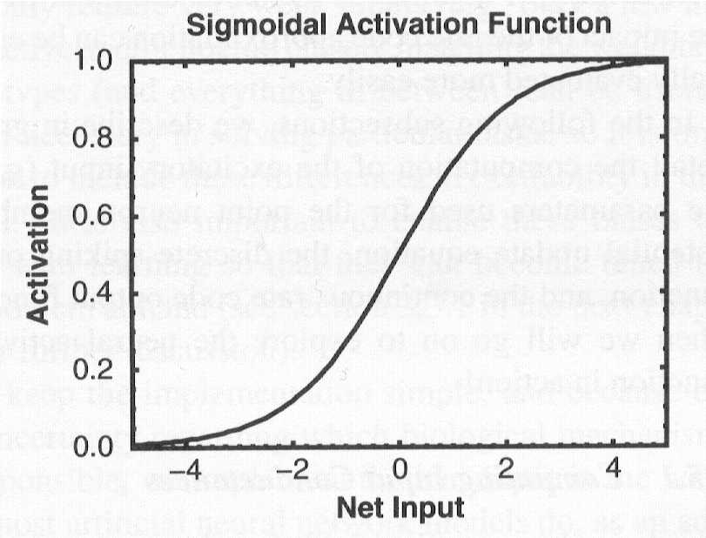
Forward Propagation of Activation
a_{j}
w_{ij}
net_{i}=Σa_{j}w_{ij}
a_{i}
w_{ki}

Slide 10
Back Propagation of Error (δ)
a_{j}
w_{ij}
δ_{i} ~ Σδ_{k}w_{ki}
a_{i}
w_{ki}
δ_{k} ~ (t_{k}-a_{k})
Error-correcting learning:
At the output layer: Δw_{ki} = εδ_{k}a_{i}
At the prior layer: Δw_{ij} = εδ_{j}a_{j}
…

Slide 12


Slide 13

Early
Later
Later
Still
E
x
p
e
r
i
e
n
c
e

Slide 14
sparrow
Train network with sparrow-isa-bird

Slide 15
sparrow
It learns a representation similar
to other birds…

Slide 16
sparrow
Use the representation to
infer what this new thing can do.

Slide 17
Complementary Learning Systems
(McClelland et al 1995; Marr 1971)
action
name
Temporal
pole
motion
color
valance
form
Medial Temporal Lobe

Slide 18
Disintegration of Conceptual Knowledge in Semantic Dementia
Progressive loss of specific knowledge of concepts, including their names, with preservation of general information
Overgeneralization of frequent names
Illusory correlations: Overgeneralization of domain typical properties

Slide 19


Picture naming
and drawing in
Sem. Demantia

Slide 20


Slide 21
Rogers et al (2005) model of semantic dementia
Gradually learns through exposure to input patterns derived from norming studies.
Representations in the integrative layer are acquired through the course of learning.
After learning, the network can activate each other type of information from name or visual input.
Representations undergo progressive differentiation as learning progresses.
Damage to units within the integrative layer leads to the pattern of deficits seen in semantic dementia.
integrative
layer
name
function
assoc
vision

Slide 22
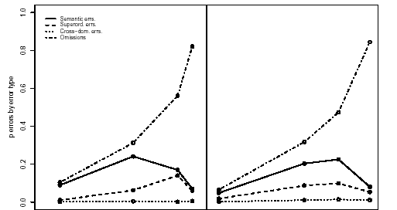
Errors in Naming As a Function of Severity
Patient Data
Simulation Results
omissions
within categ.
superord.
Severity of Dementia
Fraction of Neurons Destroyed

Slide 23
Simulation of Delayed Copying
Visual input is presented, then removed.
After several time steps, pattern is compared to the pattern that was presented initially.
Omissions and intrusions are scored for typicality
temporal
pole
name
function
assoc
vision

Slide 24
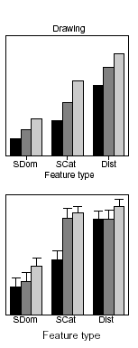
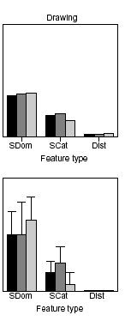
IF’s ‘camel’
DC’s ‘swan’
Simulation results
Omissions by feature type
Intrusions by feature type

Slide 26
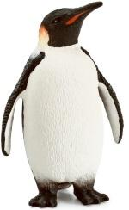
Adding New Inconsistent Information to the Neocortical Representation
Penguin is a bird
Penguin can swim, but cannot fly

Slide 27
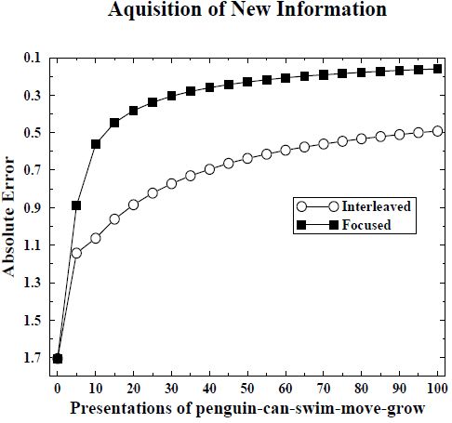
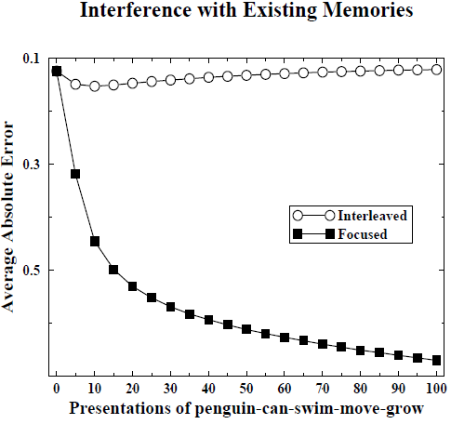
Catastrophic Interference and Avoiding it with Interleaved Learning

Slide 28
Complementary Learning Systems Theory
(McClelland et al 1995; Marr 1971)
action
name
Temporal
pole
motion
color
valance
form
Medial Temporal Lobe

Slide 29
Challenges for CLS
If extraction of generalizations depends on gradual learning, how do we form generalizations and inferences shortly after initial learning?
Why do some studies find evidence consistent with the view that an intact MTL facilitates certain types of generalization in memory?
How can we explain new findings showing that new information can sometimes be consolidated into neocortical representations quickly?

Slide 30
Challenges for CLS
If extraction of generalizations depends on gradual learning, how do we form generalizations and inferences shortly after initial learning?
Why do some studies find evidence consistent with the view that an intact MTL facilitates certain types of generalization in memory?
How can we explain new findings showing that new information can sometimes be consolidated into neocortical representations quickly?

Slide 31
REMERGE: Recurrence and Episodic Memory Result in Generalization
(Kumaran & McClelland, 2012)
Holds that several MTL based item representations may work together through recurrent activation to produce generalization and inference
Draws on classic exemplar models (Medin & Shaffer, 1978; Nosofsky, 1984)
Extends these models by allowing similarity between stored items to influence performance, independent of direct activation by the probe (McClelland, 1981)
Demonstrates the strong dependence of some forms of generalization and inference on the strength of learning for trained items

Slide 32
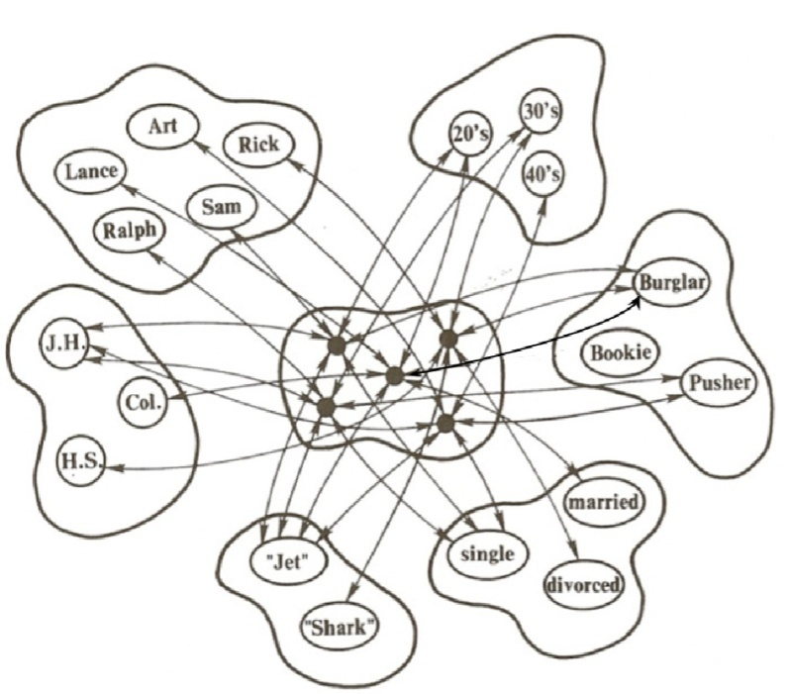
What REMERGE Adds to Exemplar Models
X

Slide 33
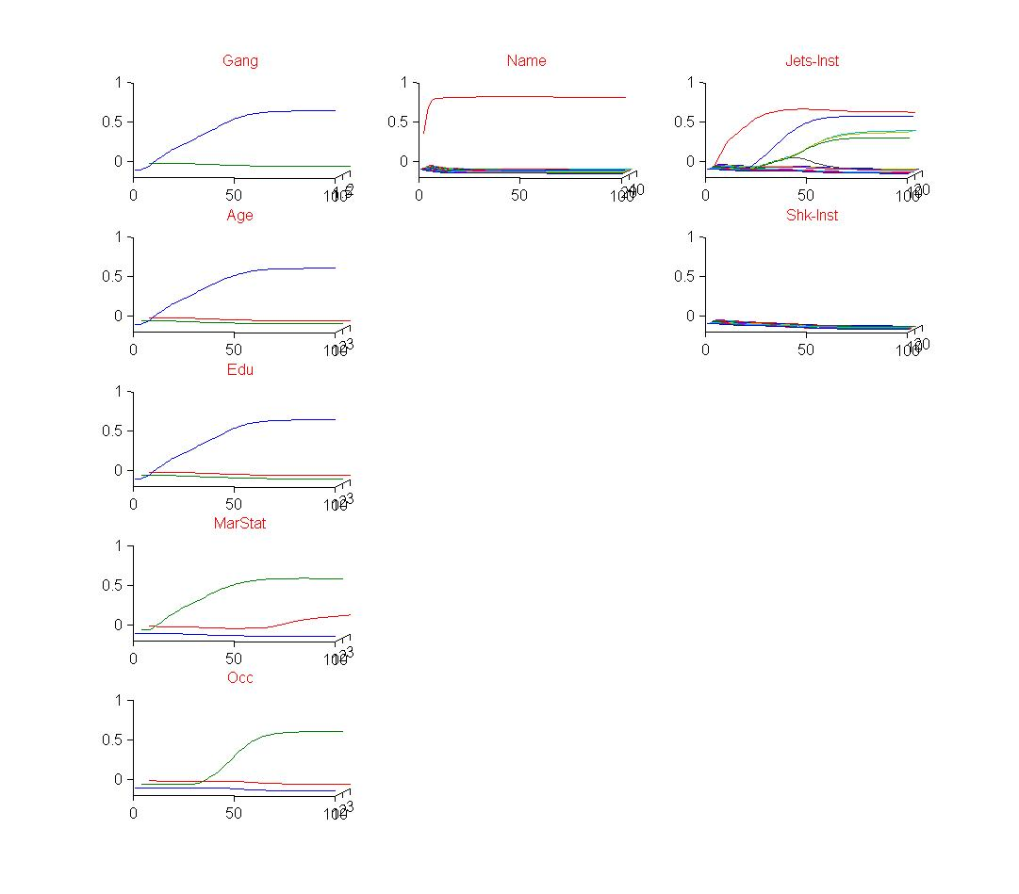
What REMERGE Adds to Exemplar Models
Recurrence allows similarity between stored items to influence memory, independent of direct activation by the probe.
c
X

Slide 34
Neural Network Model, Exemplar Model, or Probabilistic Model?
REMERGE was initially built on the IAC model, a neural network/connectionist model
But the same principles can be captured in an exemplar model formulation, which in turn is closely related to an explicitly Bayesian formulation
In fact there are now two versions of the model (IAC, GCM) and a probabilistic version is on its way

Slide 35

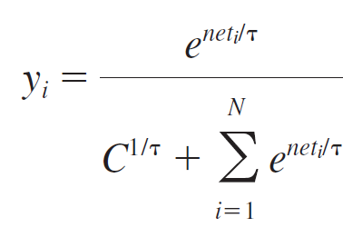
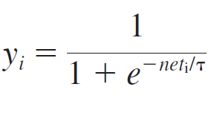
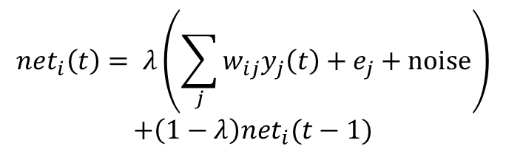
GCM-like Version of REMERGE
Input from other units:
Choice rule:
$${net}_{i}\left(t\right)= λ\left(\sum_{j}{w_{ij}y_{j}\left(t\right)+e_{j}}+noise\right)$$
$$+\left(1−λ\right){net}_{i}(t−1)$$
Hedged softmax activation function:
Logistic activation function:

Slide 36
“Learning” in REMERGE
Connection weights in REMERGE are specified by the modeler, not learned by a connection adjustment rule.
Stronger weights lead to better performance
Weight strength can vary as a function of amount of exposure, individual differences, and brain injury

Slide 37
Phenomena Considered
Benchmark Simulations
  Categorization
  Recognition memory
Acquired Equivalence
Associative Chaining
  In paired associate learning
  In hippocampal reactivation after spatial learning
Transitive Inference
  Effects of increasing study
  Effects of sleep
Spared Category Learning in Amnesia

Slide 38
Phenomena Considered
Benchmark Simulations
  Categorization
  Recognition memory
Acquired Equivalence
Associative Chaining
  In paired associate learning
  In hippocampal reactivation after spatial learning
Transitive Inference
  Effects of increasing study
  Effects of sleep
Spared Category Learning in Amnesia

Slide 39
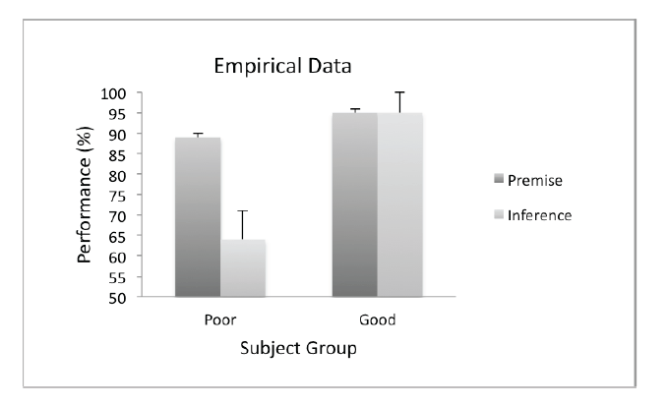
Acquired Equivalence
(Shohamy & Wagner, 2008)
Study:
  F1-S1;
  F3-S3;
  F2-S1;
  F2-S2;
  F4-S3;
  F4-S4
Test:
  Premise: F1: S1 or S3?
  Inference: F1: S2 or S4?

Slide 40
Acquired Equivalence
(Shohamy & Wagner, 2008)
Study:
  F1-S1;
  F3-S3;
  F2-S1;
  F2-S2;
  F4-S3;
  F4-S4
Test:
  Premise: F1: S1 or S3?
  Inference: F1: S2 or S4?
F1 S1 F2 S2 F3 S3 F4 S4

Slide 41
Acquired Equivalence
(Shohamy & Wagner, 2008)
S1 S2 S3 S4
Study:
  F1-S1;
  F3-S3;
  F2-S1;
  F2-S2;
  F4-S3;
  F4-S4
Test:
  Premise: F1: S1 or S3?
  Inference: F1: S2 or S4?
F1 S1 F2 S2 F3 S3 F4 S4

Slide 42
Acquired Equivalence
(Shohamy & Wagner, 2008)
S1 S2 S3 S4
Study:
  F1-S1;
  F3-S3;
  F2-S1;
  F2-S2;
  F4-S3;
  F4-S4
Test:
  Premise: F1: S1 or S3?
  Inference: F1: S2 or S4?
F1 S1 F2 S2 F3 S3 F4 S4

Slide 43
Roles of Neocortical Learning
Gradually learns the ‘features’ (dimensions of the neocortical distributed representations) that serve as the basis for exemplar learning in the MTL
Provides efficient, structured distributed representations that capture structure in experience
But what about those findings showing that new ‘schema consistent’ knowledge can be integrated into neocortical networks quickly?

Slide 44
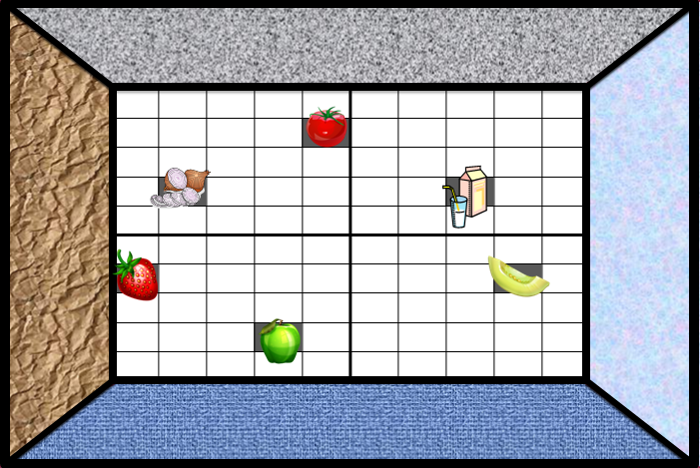
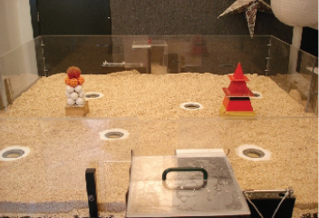
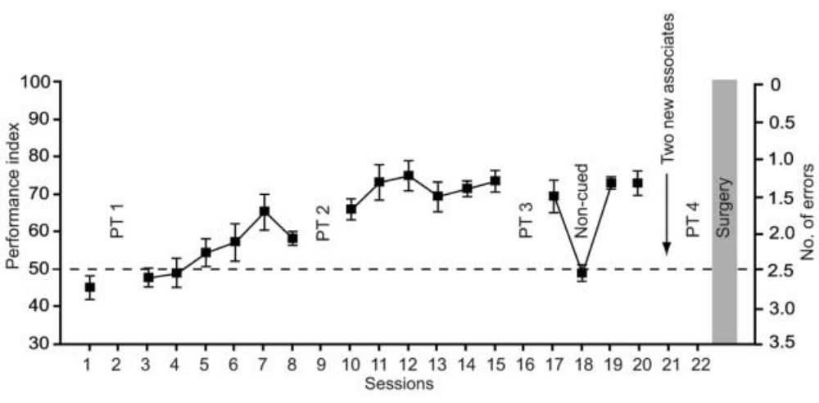
Tse et al (Science, 2007, 2011)
During training, 2 wells
uncovered on each trial
Additional tests after
surgery for old and new
associations.
Then train and test a
second pair of new
associations.

Slide 45
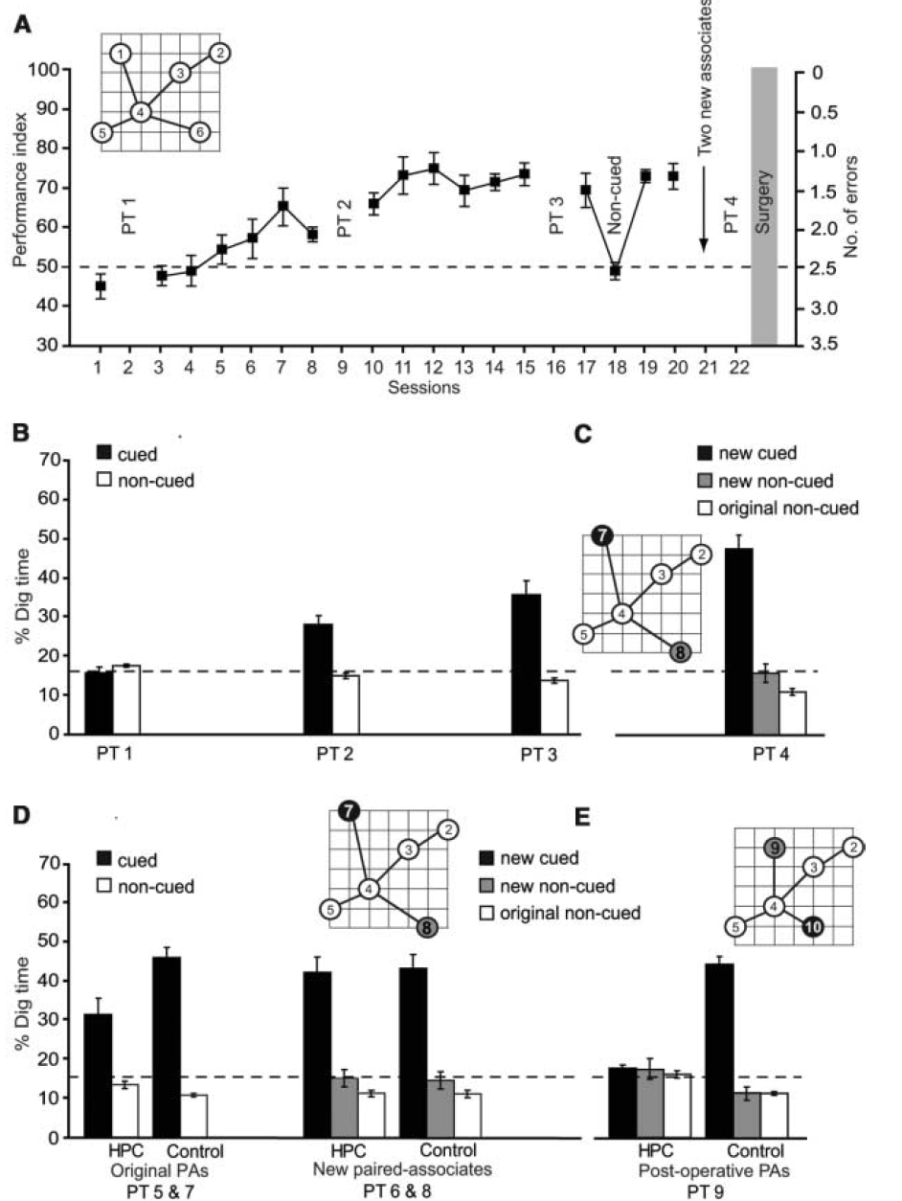

Slide 46


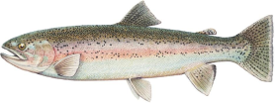

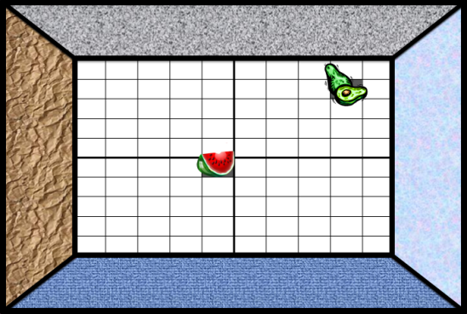
Schemata and
Schema Consistent Information
What is a ‘schema’?
  An organized knowledge structure into which new items could be added.
What is schema consistent information?
  Information consistent with the existing schema.
Possible examples:
  Trout
  Cardinal
What about a penguin?
  Partially consistent
  Partially inconsistent
What about previously unfamiliar odors paired with previously unvisited locations in a familiar environment?

Slide 47

New Simulations
Initial training with eight items and their properties as indicated at left.
Added one new input unit fully connected to representation layer to train network on one of:
  penguin-isa & penguin-can
  trout-isa & trout-can
  cardinal-isa & cardinal-can
Used either focused or interleaved learning
Network was not required to generate item-specific name outputs.

Slide 48
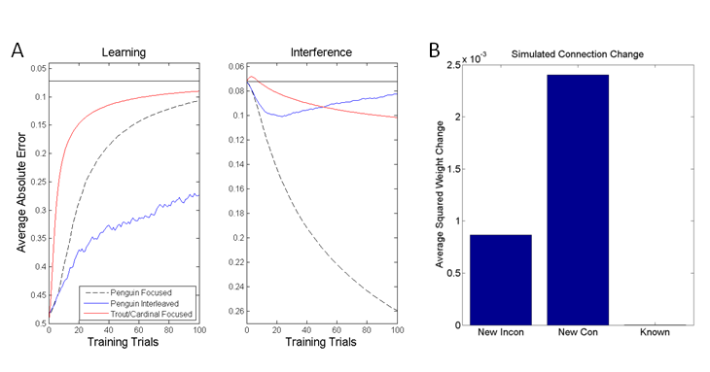

New Learning of Consistent and Partially Inconsistent Information

Slide 49
Overall Discussion
The work described here (with a new hippocampal model, and an old neocortical model) addresses both types of challenge to the CLS theory
But many questions remain
  What is an item and how is it represented in the hippocampus and the neocortex?
  What new information is sufficiently ‘schema consistent’ to be learned rapidly in amnesia?
  Even if the models capture important features of hippocampal and neocortical learning, how are these processes actually implemented in real nervous systems?

