Slide 1
Theory of Decision Time Dynamics, with Applications to Memory

Slide 2
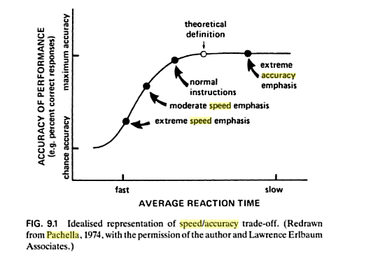
Pachella’s Speed Accuracy
Tradeoff Figure

Slide 3
Key Issues
If accuracy builds up continuously with time as Pachella suggests, how do we ensure that the results we observe in different conditions don’t reflect changes in the speed-accuracy tradeoff?
How can we use reaction times to make inferences in the face of the problem of speed-accuracy tradeoff?
  Relying on high levels of accuracy is highly problematic – we can’t tell if participants are operating at different points on the SAT function in different conditions or not!
In general, it appears that we need a theory of how accuracy builds up over time, and we need tasks that produce both reaction times and error rates to make inferences.

Slide 4
A Starting Place: Noisy Evidence Accumulation Theory
Consider a stimulus perturbed by noise.
  Maybe a cloud of dots with mean position μ = +2 or -2 pixel from the center of a screen
  Imagine that the cloud is updated once every 20 msec, of 50 times a second, but each time its mean position shifts randomly with a standard deviation σ of 10 pixels.
What is theoretically possible maximum value of d’ based on just one update?
Suppose we sample n updates and add up the samples.
Expected value of the sum = μ*n
Expected value of the standard deviation of the sum = σ√n
What then is the theoretically possible maximum value of d’ after n updates?

Slide 5
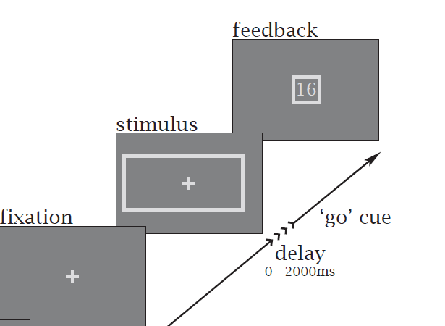
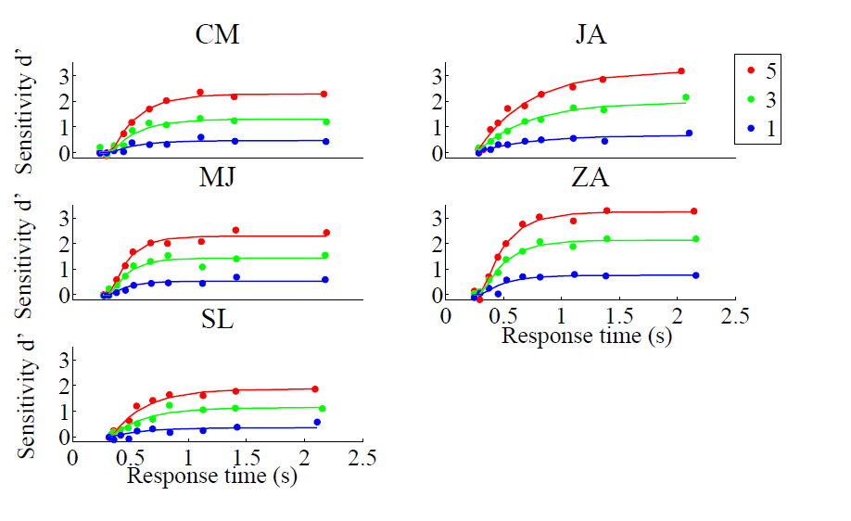
Some facts and some questions
With very difficult stimuli, accuracy always levels off at long processing times.
  Why?
    Participant stops integrating before the end of trial?
    Trial-to-trial variability in direction of drift?
      Noise is between as well as or in addition to within trials
    Imperfect integration (leakage or mutual inhibition, to be discussed later).
If the subject controls the integration time, how does he decide when to stop?
What is the optimal policy for deciding when to stop integrating evidence?
  Maximize earnings per unit time?
  Maximize earning per unit ‘effort’?

Slide 6
A simple optimal model for a sequential random sampling process
Imagine we have two ‘urns’
  One with 2/3 black, 1/3 white balls
  One with 1/3 black, 2/3 white balls
Suppose we sample ‘with replacement’, one ball at a time
  What can we conclude after drawing one black ball? One white ball?
  Two black balls? Two white balls? One white and one black?
Sequential Probability Ratio test.
Difference as log of the probability ratio.
Starting place, bounds; priors
Optimality: Minimizes the # of samples needed on average to achieve a given success rate.
DDM is the continuous analog of this

Slide 7
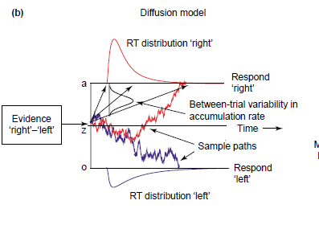
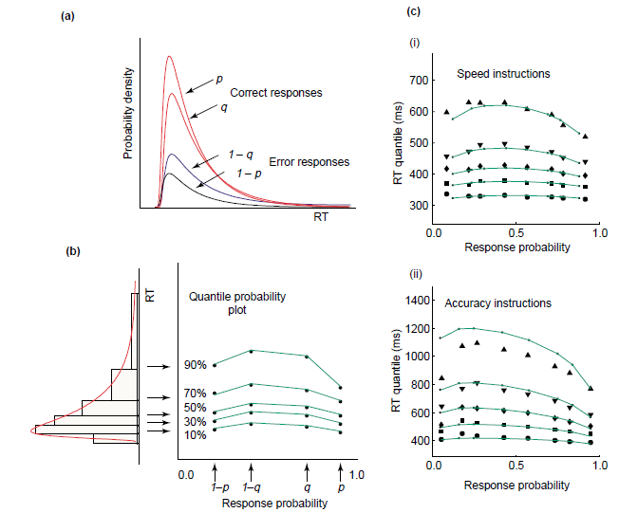
Ratcliff’s Drift Diffusion Model Applied to a Perceptual Discrimination Task
There is a single noisy evidence variable that adds up samples of noisy evidence over time.
There is both between trial and within trial variability.
Assumes participants stop integrating when a bound condition is reached.
Speed emphasis: bounds closer to starting point
Accuracy emphasis: bounds farther from starting point
Different difficulty levels lead to different frequencies of errors and correct responses and different distributions of error and correct responses
Graph at right from Smith and Ratcliff shows accuracy and distribution information within the same Quantile probability plot

Slide 8
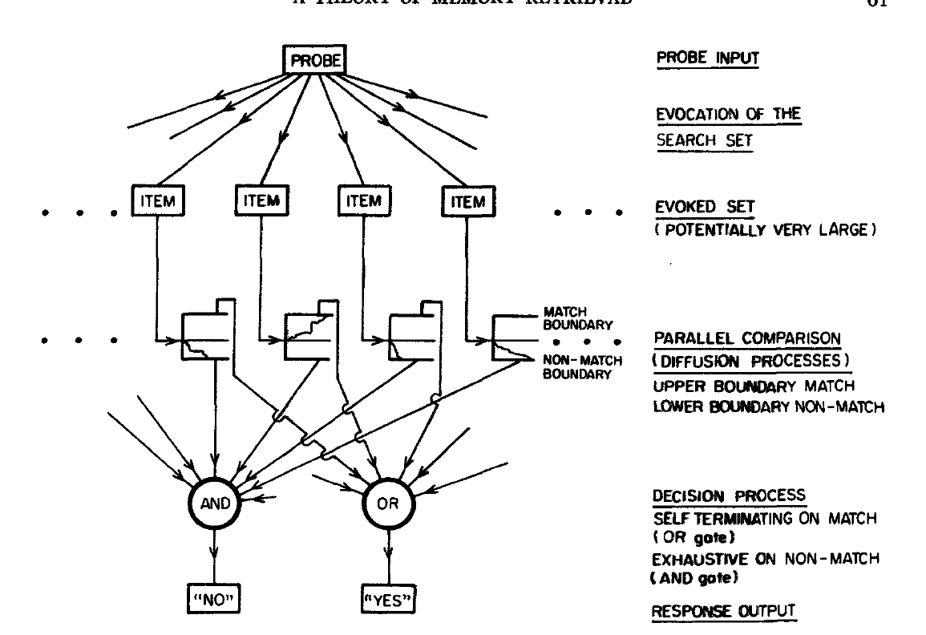
Application of the DDM to Memory

Slide 9
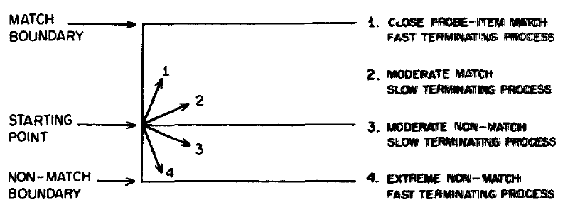
Matching is a matter of degree
What are the factors influencing ‘relatedness’?

Slide 10
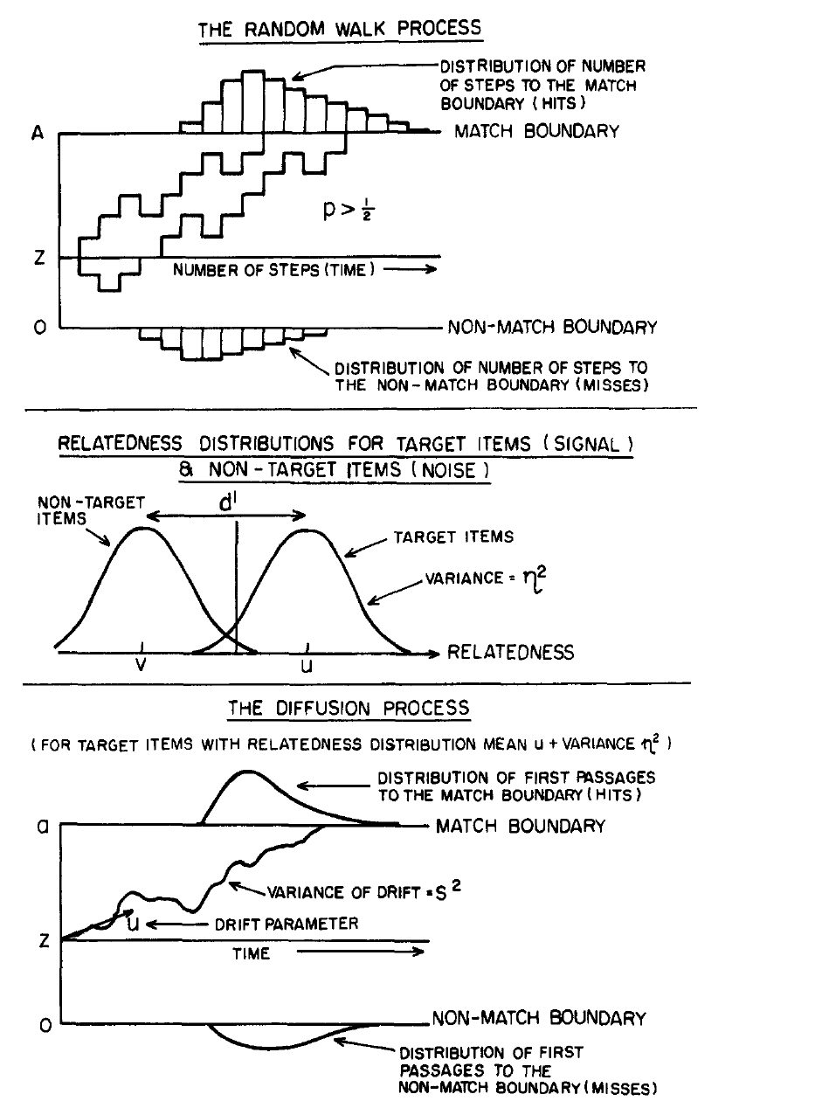
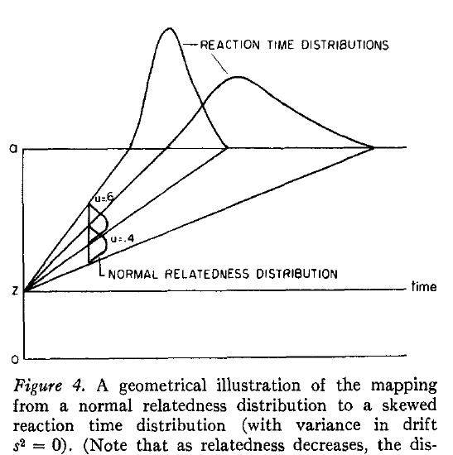
Some features of the model

Slide 11
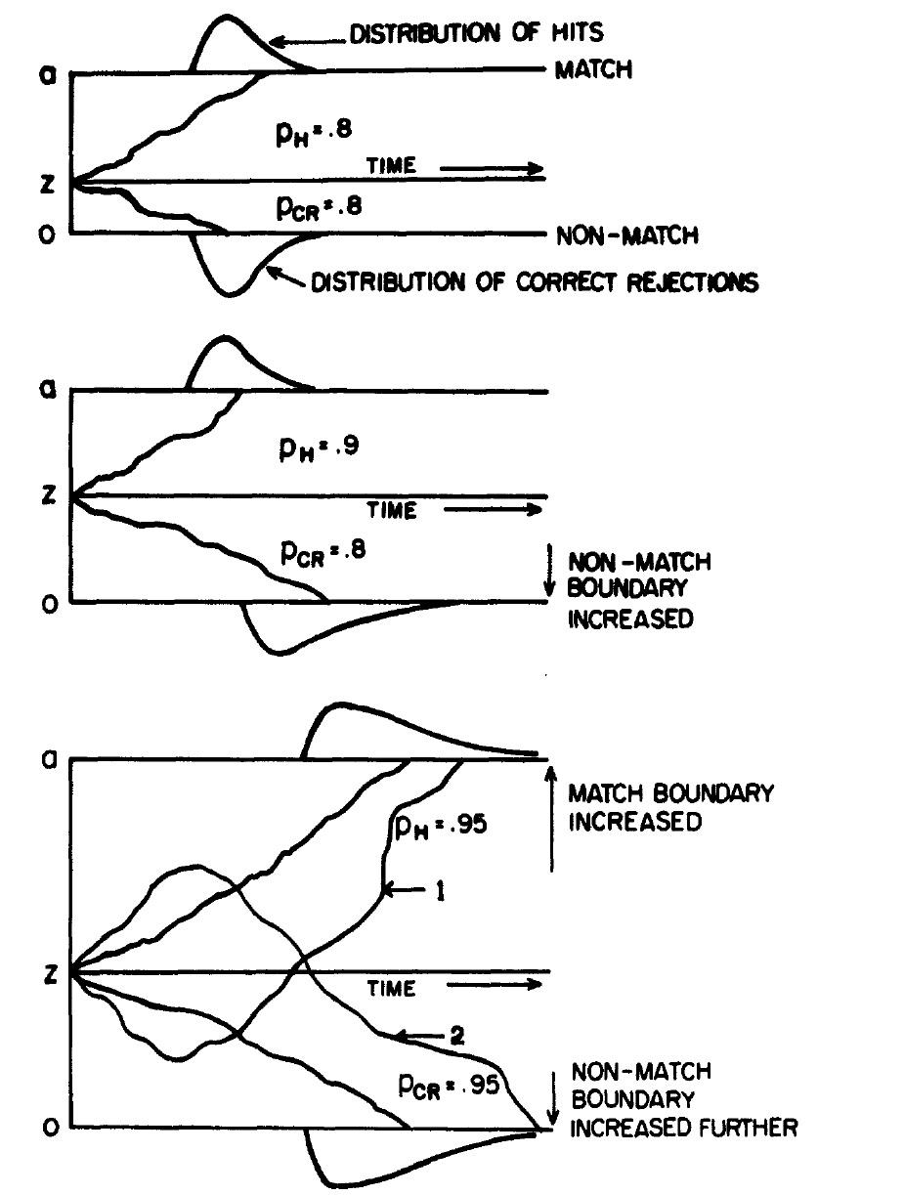
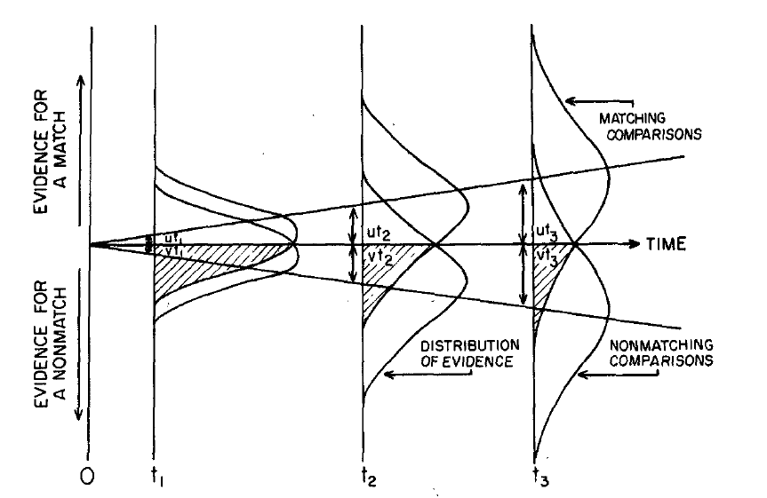
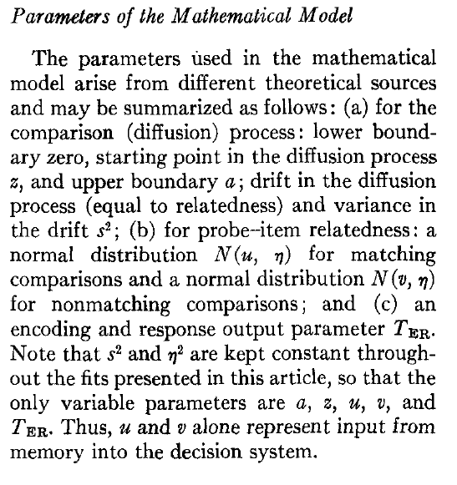

Slide 12
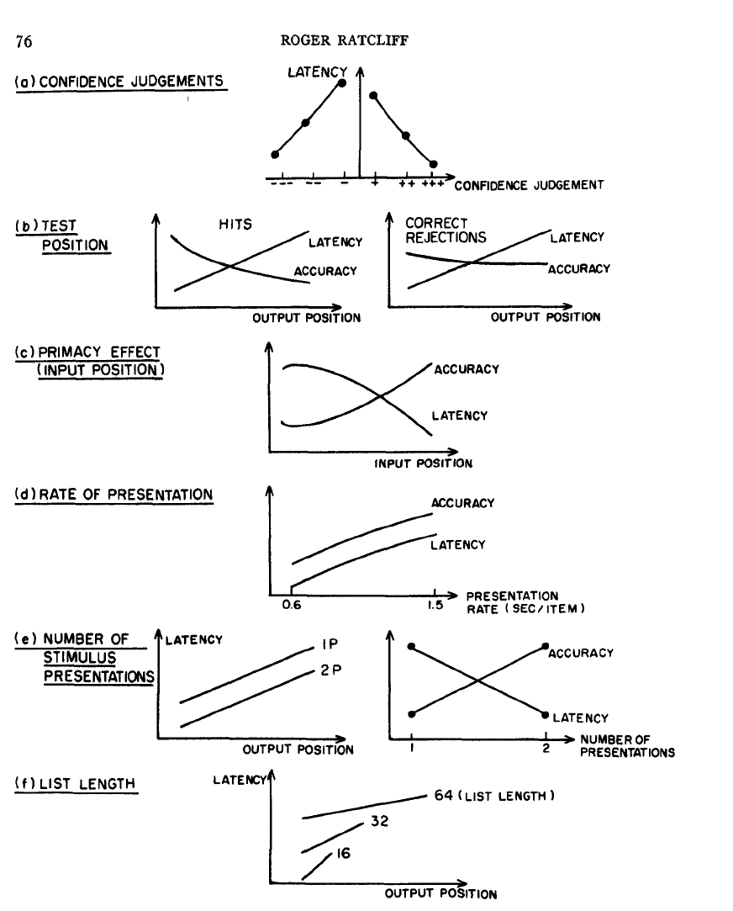
Ratcliff & Murdock (1976)
Study-Test Paradigm
Study 16 words, test 16 ‘old’ and 16 ‘new’
Responses on a six-point scale
  ‘Accuracy and latency are recorded’

Slide 13
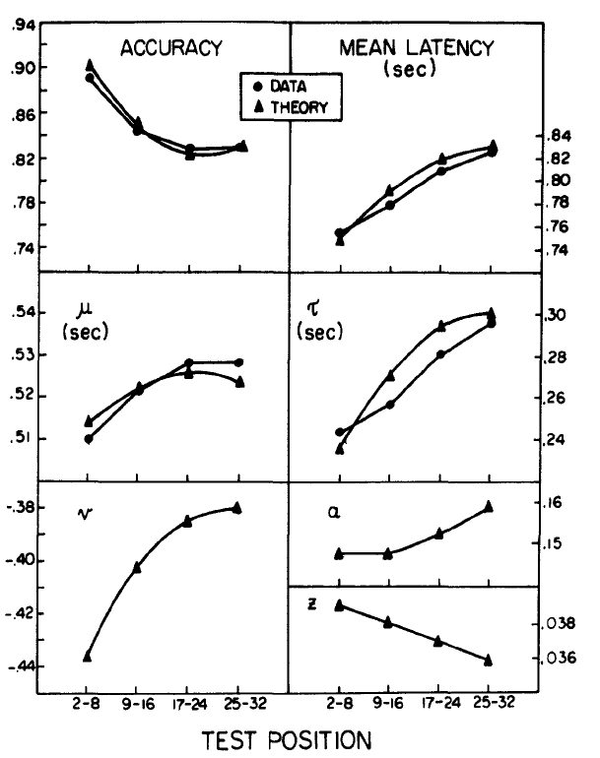
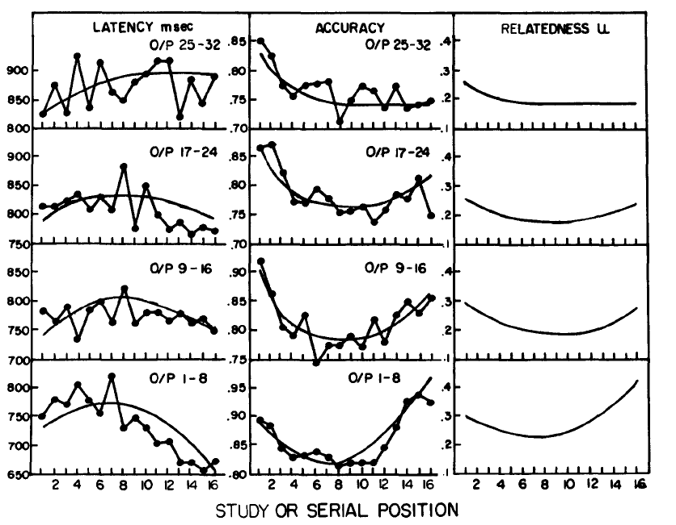
Fits and Parameter Values

Slide 14
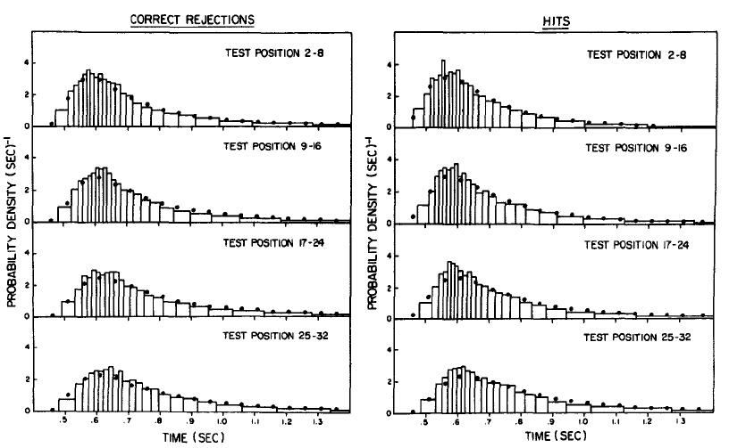
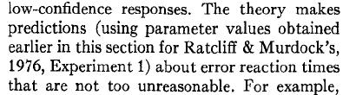
RTs for Hits and Correct Rejections

Slide 15
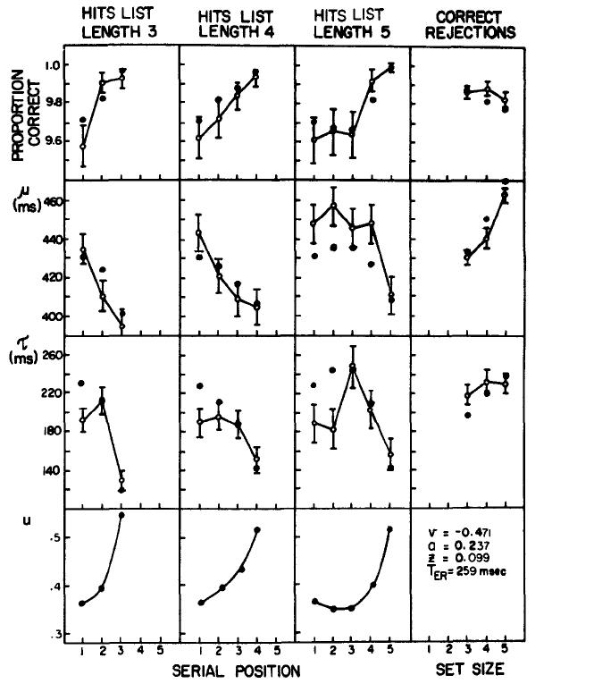
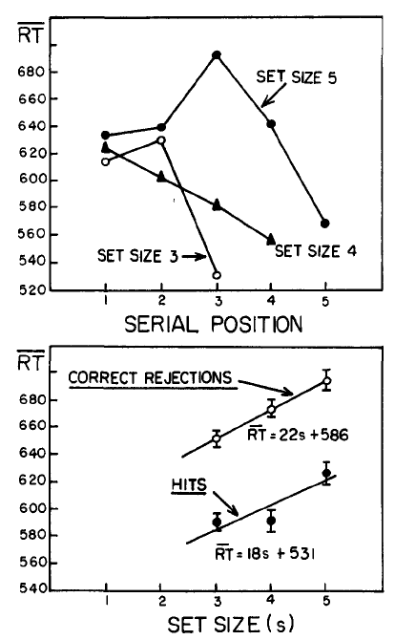
Sternberg Paridigm
Set sizes 3, 4, 5
Two participants data averaged

Slide 16
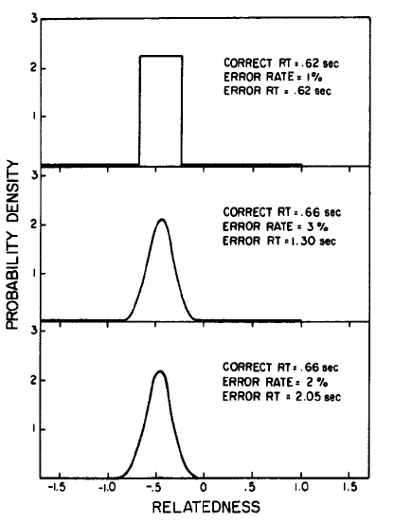
Error Latencies
Predicted error latencies too large
Error latencies show extreme dependency on tails of the relatedness distribution

Slide 17
Some Remaining Issues
For Memory Search:
  Who is right, Ratcliff or Sternberg?
  Resonance, relatedness, u and v parameters
  John Anderson and the fan effect
Relation to semantic network and ‘propositional’ models of memory search
  Spreading activation vs. similarity-based models
  The fan effect
What is the basis of differences in confidence in the DDM?
  Time to reach a bound
  Continuing integration after the bound is reached
  In models with separate accumulators for evidence for both decisions, activation of the looser can be used

Slide 18
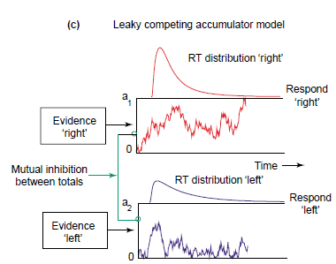
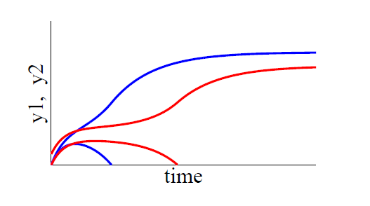
The Leaky Competing Accumulator Model as an Alternative to the DDM
Separate evidence variables for each alternative
  Generalizes easily to n>2 alternatives
Evidence variables subject to leakage and mutual inhibition
Both can limit accuracy
LCA offers a different way to think about what it means to ‘make a decision’
LCA has elements of discreteness and continuity
Continuity in decision states is one possible basis of variations in confidence
Research is ongoing testing differential predictions of these models!

