Slide 1
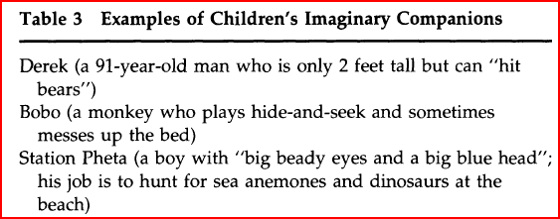
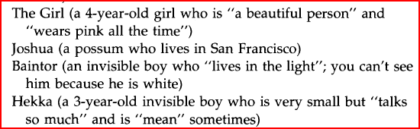
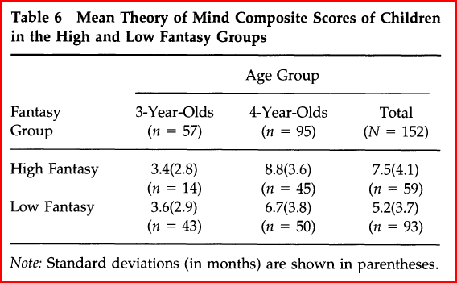
M. Taylor and S. Carlson. (1997). The Relation between Individual Differences in Fantasy and Theory of Mind
Theory Children's behaviors on fantasy / pretense measures are related to their performance on theory of mind tasks independent of verbal intelligence, due to similar mental mechanisms. Particular interest in imaginary characters.
Method --152 preschool children (M age = 4,0; range = 3,4 to 4,8).--verbal intelligence assessed using PPVT.
--Pretense measures (20 total): 1. child & parent interviews. 2. observed during free play 3. laboratory tasks designed to assess toy preferences and developmental level of pretense.
--Assigned to High Fantasy group if had IC or impersonated a character every day for a month.
--1 week later, 4 kinds of tasks used to assess theory of mind: 1. Appearance and reality, 2. False belief, 3. Representational change, 4. Interpretive diversity. Collapsed during analysis; interpreted only the aggregate score.
--Age & verbal intelligence controlled for during analysis.
Findings:--Theory of mind correlated with age, but not sex.
-- ANOVA on the theory of mind scores found significant main effects for High Fantasy and age.
-- no significant findings for 3-year-olds.
--ANCOVA: relation between High Fantasy and theory of mind remained a main effect controlling for verbal intelligence.
--Multiple regression with other fantasy measures also found sig effects for symbolic actions & free play w/ blocks.
-- possible that fantasy experience promotes an understanding of mind, but also possible that it works the other way, or that some third factor underlies development in both areas. (findings are largely correlational, no causation can be inferred.)
Strengths- large sample of preschool children, and multiple measures of both pretense and theory of mind.
Weaknesses –demographically homogeneous sample.
--ambiguous coding of childrens’ self-report vs. parent reports of fantasy play. No mention of inter-rater reliability for these measurements.
--small sample for High Fantasy group (17).
--despite attempts to control for it with ANCOVA , verbal intelligence may lead to other confounding factors (4 yr olds in the High Fantasy group had higher scores).
--methods for assessing fantasy may not have been appropriate for3-yr-olds.

