Slide 1
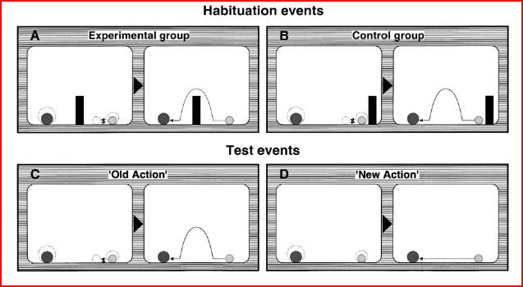
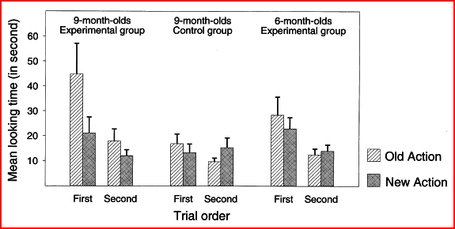
Csibra, Gergeky, Biro, Koos, Brockbank (1998). Goal attribution without agency cues: the
perception of `pure reason' in infancy.
Theory As early as 9 months of age infants can engage in naive psychological reasoning about behavior relying on the principle of rationality of action.
Method --48 9-month-old and 24 6-month-oldinfants participated.
--The stimuli were computer-animated visual events.
--Habituation event: ball jumps over wall to get to the other side. Wall is taken away. “Old Action” event: ball still jumps to get to the other side, even though there is no wall. “New Action” event: ball goes straight to the other side.)
--Differential looking times are used to assess incongruity.
Strengths--Age-differential result fits well into the developmental sequence suggested by other sources, but study proves the psychological interpretation of an other agent's behavior in terms of goals and the principle of rationality is present already at 9 months (earlier than believed before).
--follow-up experiments suggest that agency cues such as self-propulsion are not sufficient or necessary for the teleological interpretation of behavior.
Weaknesses –No good explanation for why affect is attenuated in second test.
--Still unclear in follow-up experiments how infants determine agency.
--May be alternative explanations for null result with 6 mos old infants.
Findings:
—9-mos old infants showed longer looking times for the old action test (jumping circle) event than for the new action test event (no jumping).
--The 9-mos old infants expected that (i) the end-state (goal) of the object's behavior would remain unchanged (ii) the goal-directed action of the object would adjust to the new reality (lack of obstacle).
--The 6-month-old infants showed no signs of a teleological framework.
--Findings indicate that “teleological interpretational strategy” is not restricted to humans or to social interactive contexts.

