Slide 1
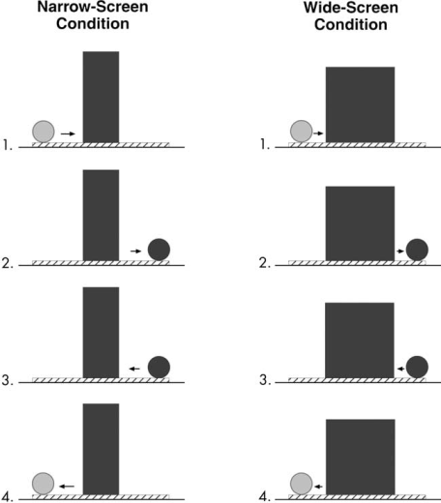
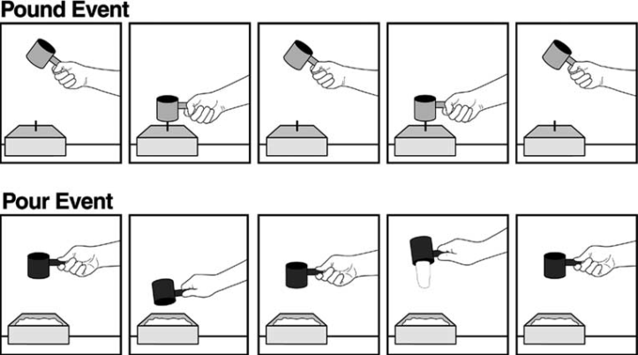
Wilcox & Chapa (rev. 2002). Priming infants to attend to color
and pattern information in an individuation task.
Theory Infants who have not yet identified surface
features (incl. color, pattern) as relevant and do not
typically include them in their event representations
could be primed to do so in individuation tasks if
shown the functional value of attending to this
information (as distinct from priming with actions
that have no functional value).
Method --Five experiments were conducted with infants 4.5 to 9.5 months of age.
--infants were first shown events in which the color (1–3) or the pattern (4,5) of an object predicted its function, then presented with the different-color or different-pattern test events, e.g. narrow-screen test.
–Example: 9.5 mos-old infants watch a red can [or can & cup] used for pounding, while a green can [or can & cup] are used for pouring, followed by red & green balls used in the “narrow screen test.” Question: can infant now differentiate based on color alone?
Key Insight
Findings: --Main finding of 5 experiments: 9.5- and 7.5-mos-olds can be primed to use color information, and 5.5- and 4.5-mos-olds for pattern information, after viewing function events, but not after viewing non-functioning action events. Younger infants needed to see more color–function pairings, and the youngest infants need to see simultaneous function events rather than successive.
--Example: 9.5-mos-olds in can + cup (two-exemplars condition) looked reliably longer at the narrow- than at the wide-screen test event, as if they (a) perceived green ball and the red ball as distinct objects, (b) recognized the screen was too narrow to hide both balls simultaneously, and, hence, (c) found the narrow-screen event unexpected. (babies in can-only condition failed to individuate balls: one color–function pairing was not
sufficient to facilitate use of color information 7.5-mos olds needed 3 exemplars.)
--What are the long-term consequences?
Strengths Provides insight into the kinds of experiences that alter types of information to which infants attend.
Weaknesses Small N (32 for each experiment).
--Possible confounding factors when distinguishing between function and non-functioning action (e.g. sound, visual complexity). How specific does the priming of surface features need to be? (i.e. specific colors/patterns?)

