Slide 1
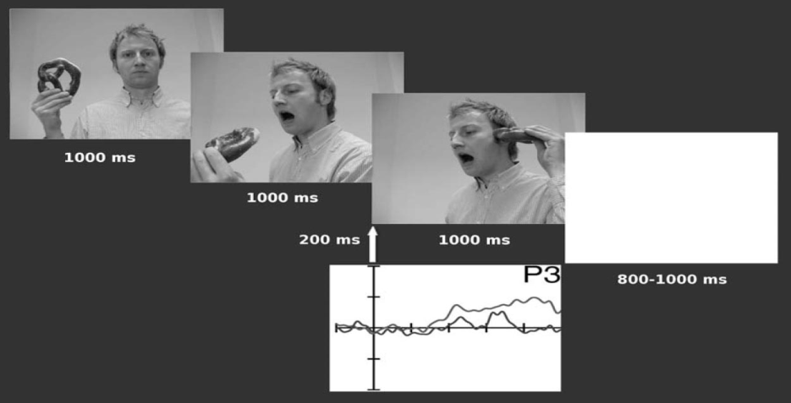
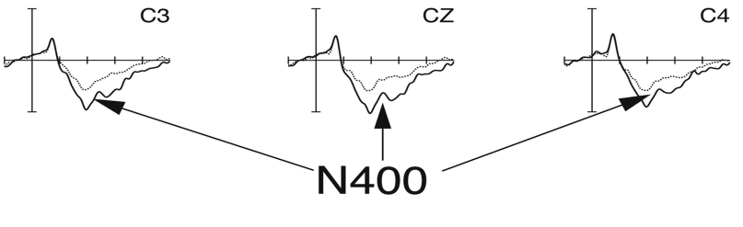
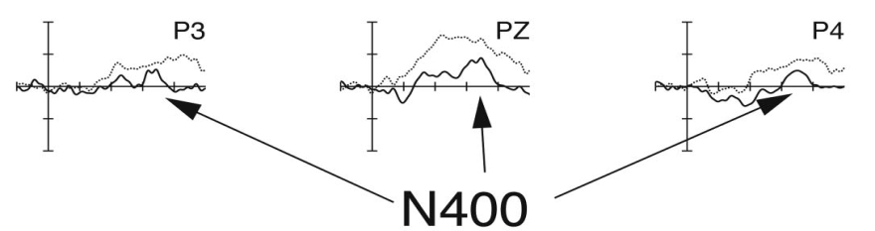
The Neural Correlates of Infant and Adult Goal Prediction: Evidence for Semantic Processing Systems
Reid, V.M., Hoehl, S, Grigutsch, M., Groehndahl, A., Parise, E., Striano, T.
Heightened N400 ERP response indicates a reversal of expectations in adults, using a verbal or semantic task
Infants are capable of recognizing incomplete fulfillment of a goal
Infants(7 and 9 months) and adults are expected to show similar N400 patterns when an anticipated action is not completed, for three dimensional actions
Participants were shown a sequence of three actions, holding something to be eaten, preparing to eat it and either eating it or putting it in an unexpected position
Expected N400 patterns were found for both adults and 9 month old infants
Similar patterns were not found for 7 month old infants
N400 patterns were distributed differently for infants than for adults, with infants showing a delay of ~700ms and with ERP differences most apparent in the parietal rather than the central region
Strengths
Measures a phenomena which could not be measured without EEG
Presents evidence for continuity over development
Weaknesses
Use of photographs rather than video may be problematic
Some different stimuli for children and adults

