Slide 1
Presentation Slides for
Chapter 9 of
Fundamentals of Atmospheric Modeling 2nd Edition
Mark Z. Jacobson
Department of Civil & Environmental Engineering
Stanford University
Stanford, CA 94305-4020
jacobson@stanford.edu
March 21, 2005

Slide 2
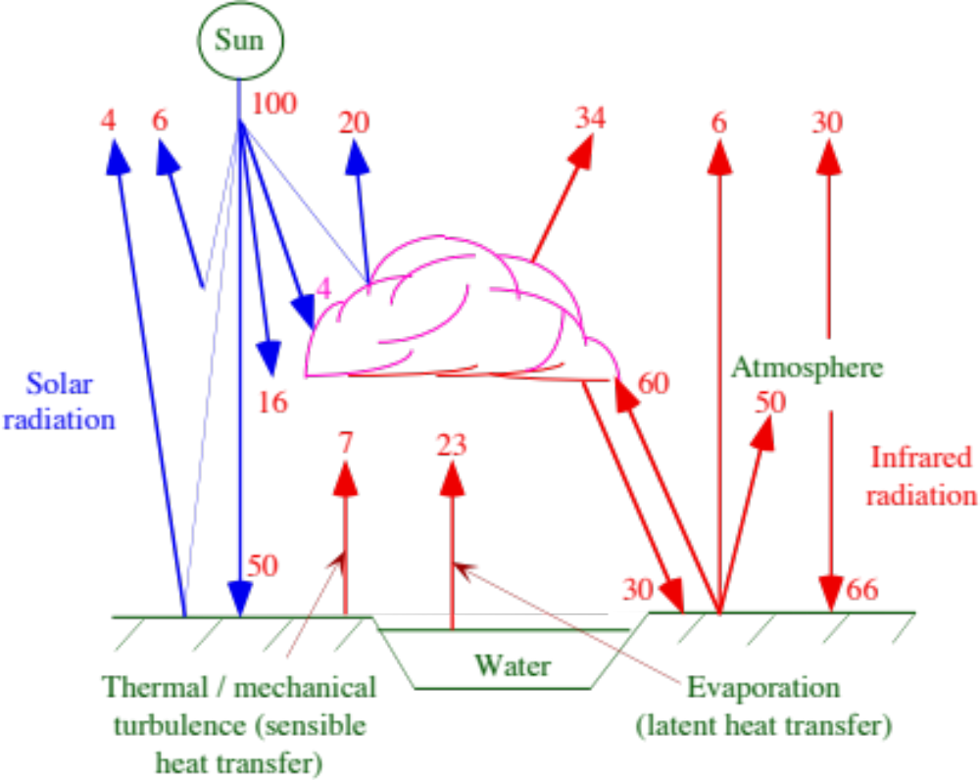
Earth-Atmosphere Energy Balance
Fig. 9.1

Slide 3
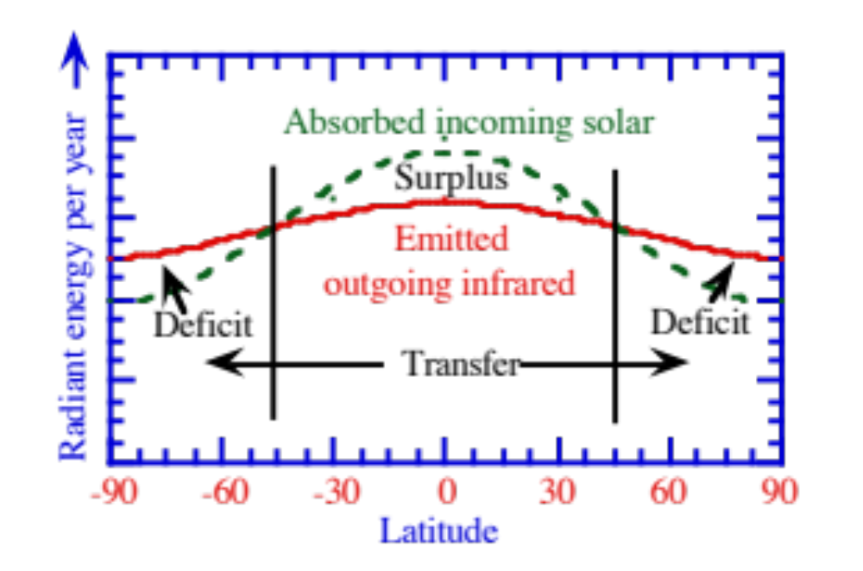
Energy Transfer From Equator to Poles
Radiant energy per year --->
Fig. 9.2

Slide 4
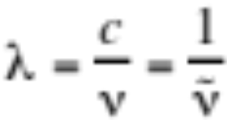
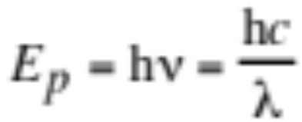
Electromagnetic Spectrum
Radiation in the form of an electromagnetic wave
Wavelength (9.1)
Radiation in the form of a photon of energy
Energy per unit photon (J photon⁻¹) (9.3)

Slide 5

Electromagnetic Spectrum
Example 9.1:
λ = 0.5 μm
--> E_{p} = 3.97 x 10⁻¹⁹ J photon⁻¹
--> ν = 5.996 x 10¹⁴ s⁻¹
--> = 2 μm⁻¹
λ = 10 μm
--> E_{p} = 1.98 x 10⁻²⁰ J photon⁻¹
--> ν = 2.998 x 10¹³ s⁻¹
--> = 0.1 μm⁻¹

Slide 6
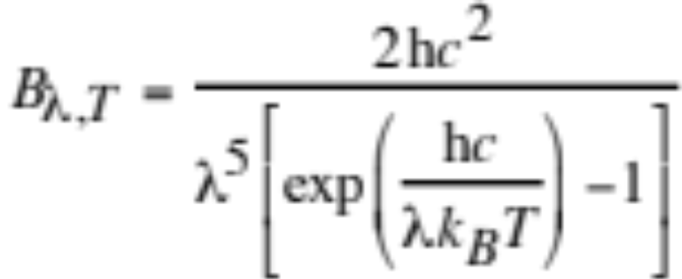

Planck’s Law
Radiance
Intensity of emission per incremental solid angle
Planck radiance (W m⁻² μm⁻¹ sr⁻¹) (9.4)
Radiance actually emitted by a substance (9.5)
Kirchoff’s law
In thermodynamic equilibrium, absorptivity (a_{λ}) = emissivity (ε_{λ}) --> the efficiency at which a substance absorbs equals that at which it emits. --> a perfect emitter is a perfect absorber

Slide 7
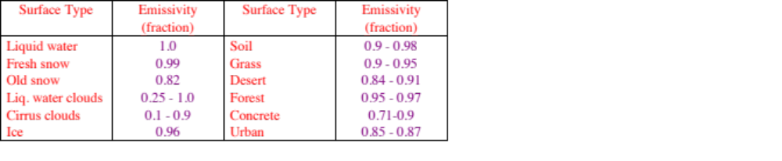
Emissivities
Infrared emissivities of different surfaces
Table 9.1

Slide 8
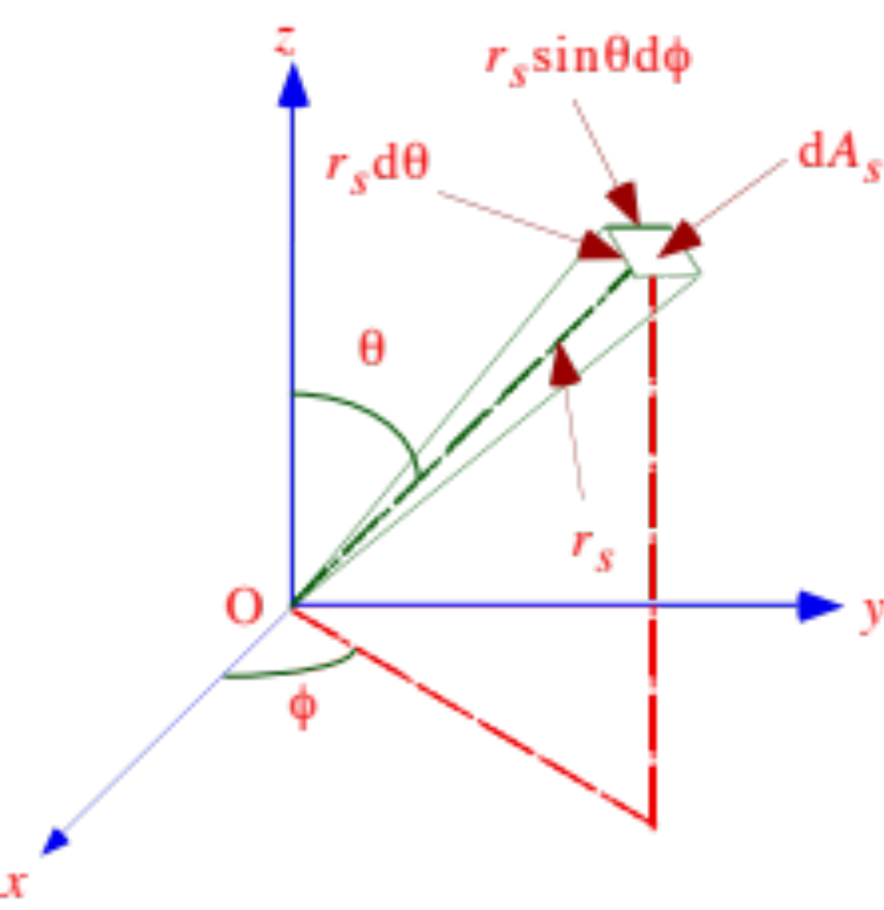
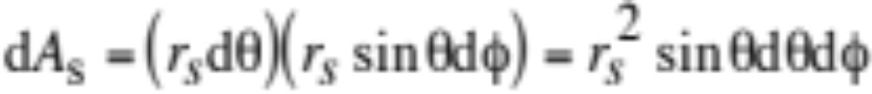
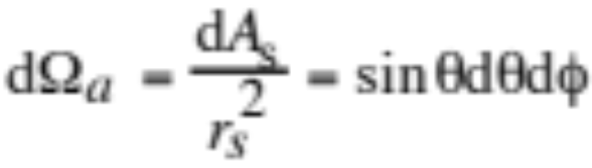
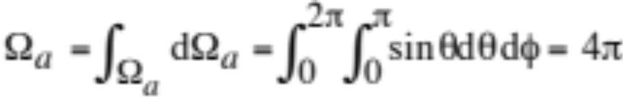
Solid Angle
Radiance emitted from point (O) passes through incremental area dA_{s} at distance r_{s} from the point.
Incremental surface area (9.7)
Incremental solid angle (sr) (9.6)
Steradians analogous to radians
Solid angle around a sphere (9.9)
Fig. 9.3

Slide 9

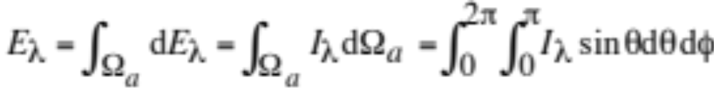
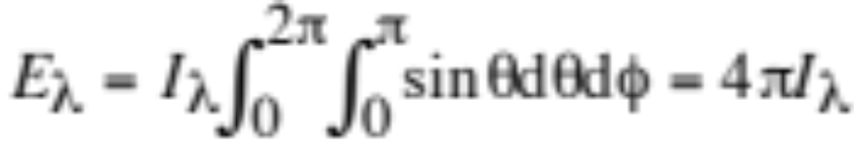
Spectral Actinic Flux
Integral of spectral radiance over all solid angles of a sphere
Used to calculate photolysis rate coefficients
Incremental spectral actinic flux (9.10)
Spectral actinic flux (9.11)
Isotropic spectral actinic flux (9.12)

Slide 10

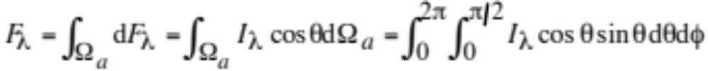
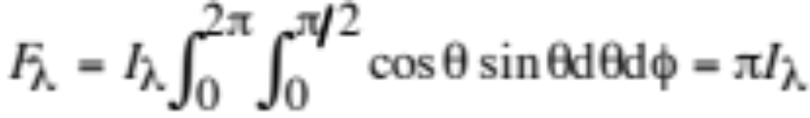

Spectral Irradiance
Flux of radiant energy propagating across a flat surface
Used to calculate heating rates
Incremental spectral irradiance (9.13)
Integral of dF_{λ} over the hemisphere above the x-y plane (9.14)
Isotropic spectral irradiance (9.15)
Spectral irradiance at the surface of a blackbody (9.16)

Slide 11
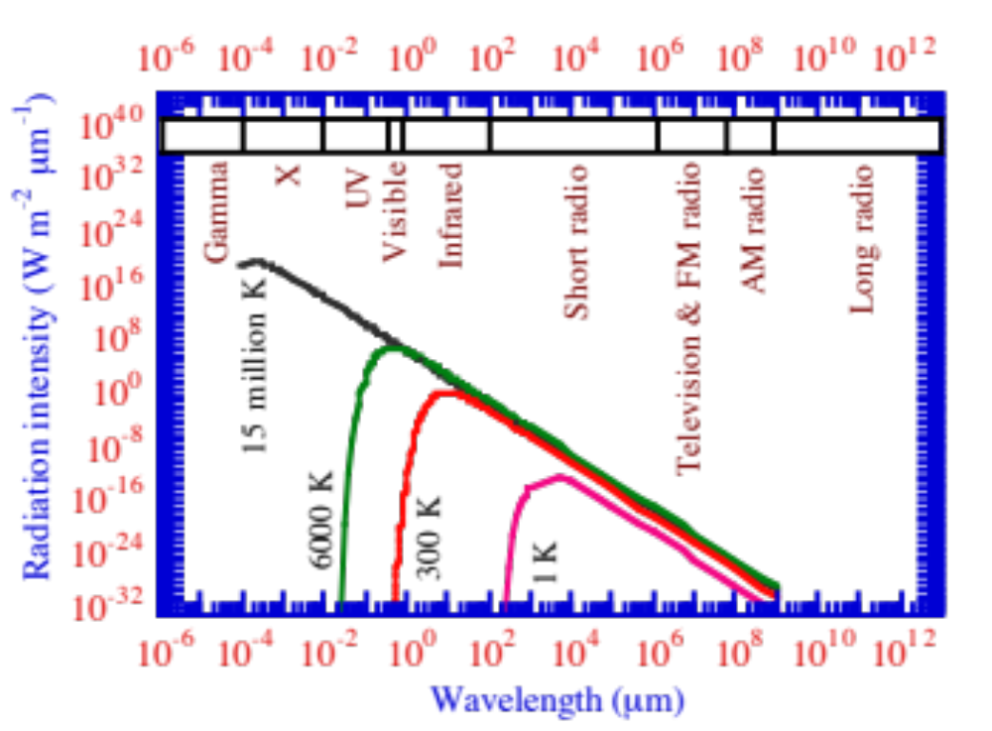
Spectral Irradiance v. Temperature
Irradiance (W m⁻² μm⁻¹)
Fig. 9.4

Slide 12
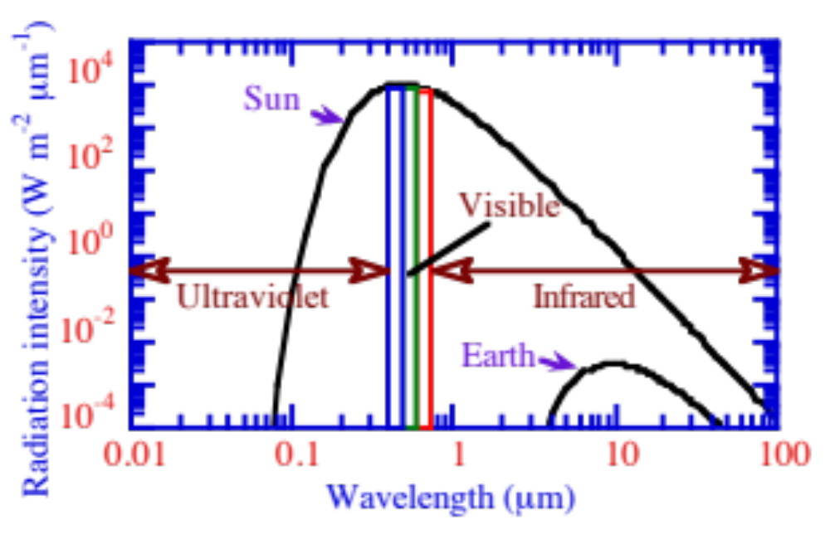
Emission Spectra of the Sun and Earth
Irradiance emission versus wavelength for the Sun and Earth when both are considered blackbodies
Irradiance (W m⁻² μm⁻¹)
Fig. 9.5

Slide 13
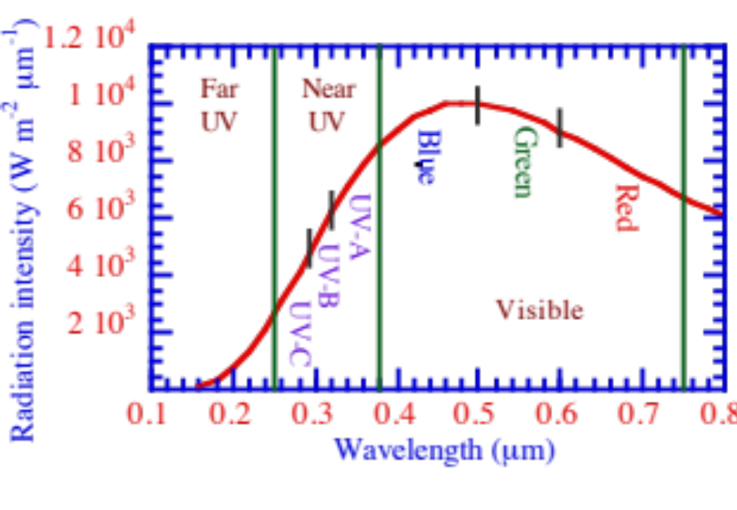
Ultraviolet and Visible Solar Spectrum
Ultraviolet and visible portions of the solar spectrum.
Irradiance (W m⁻² μm⁻¹)
Fig. 9.6

Slide 14
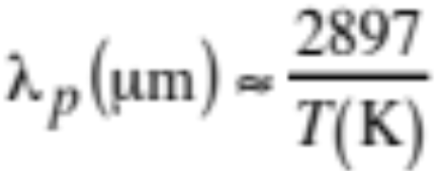
Wien’s Displacement Law
Differentiate Planck's law with respect to wavelength at constant temperature and set result to zero
Peak wavelength of emissions from blackbody (9.17)
Example 9.2:
Sun’s photosphere λ_{p} = 2897/5800 K = 0.5 μm
Earth’s surface λ_{p} = 2897/288 K = 10.1 μm

Slide 15
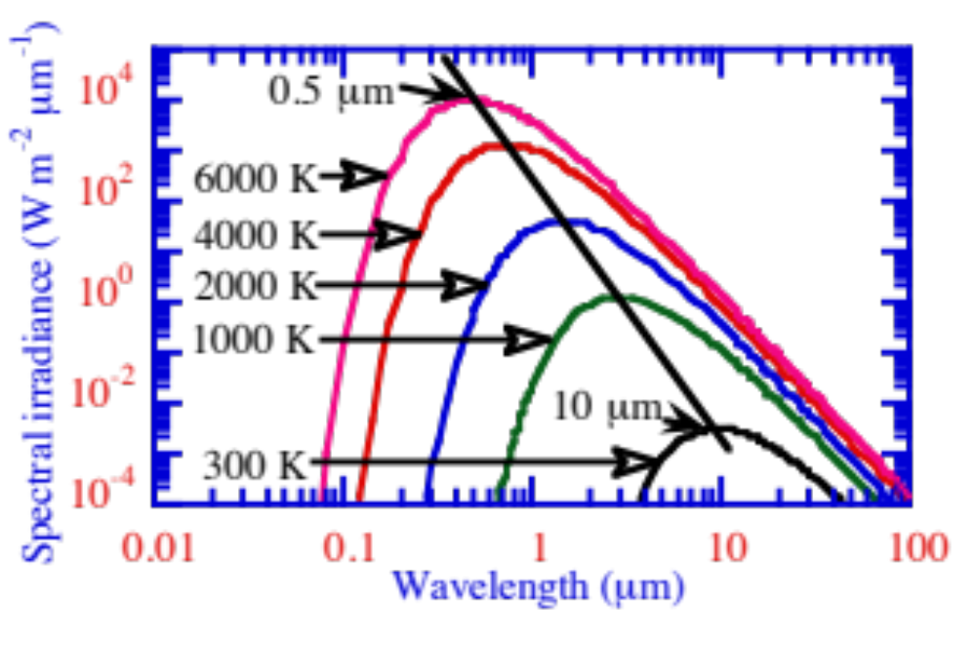
Wien’s Displacement Law
Gives line through peak irradiances at different temperatures.
Irradiance (W m⁻² μm⁻¹)
Fig. 9.7

Slide 16
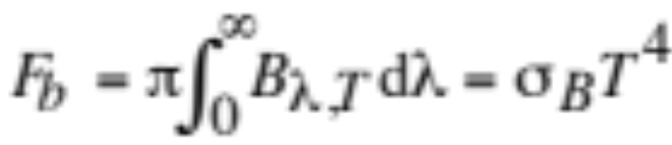
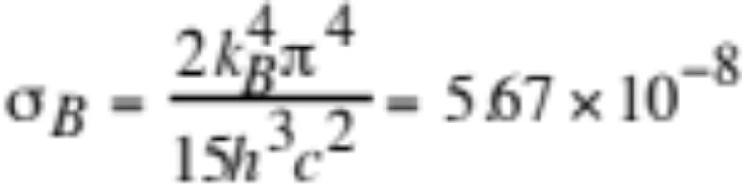
Stefan-Boltzmann Law
Integrate Planck irradiance over all wavelengths
Stefan-Boltzmann law (W m⁻²) (9.18)
Stefan-Boltzmann constant
W m⁻² K⁻⁴
Example 9.3:
T = 5800 K ---> F_{T} = 64 million W m⁻²
T = 288 K ---> F_{T} = 390 W m⁻²

Slide 17
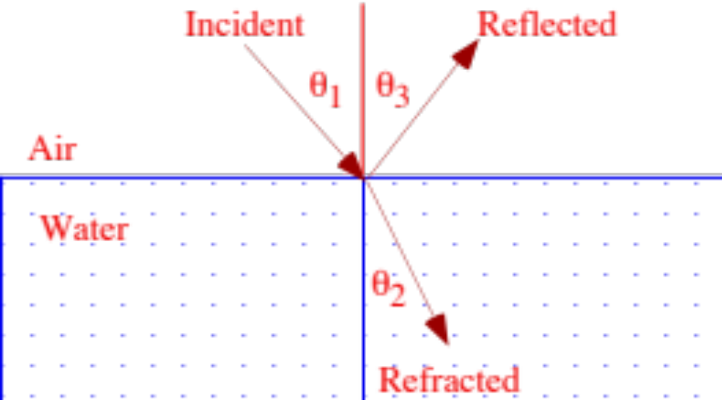
Reflection and Refraction
Reflection
Angle of reflection equals angle of incidence
Refraction
Angle of wave propagation relative to surface normal changes as the wave passes from a medium of one density to that of another
Fig. 9.8

Slide 18
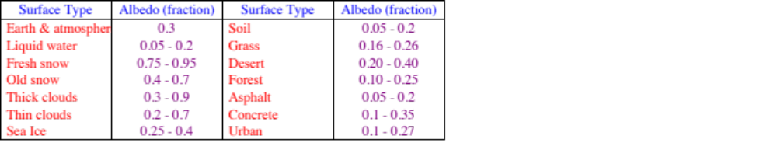
Reflection
Albedo = fraction of incident sunlight reflected
Albedos in the non-UVB solar spectrum
Table 9.2

Slide 19
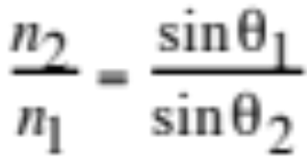
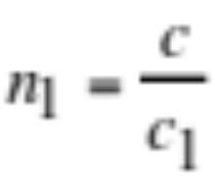
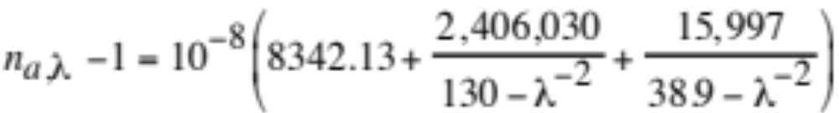
Refraction
Snell’s law (9.19)
Real part of the index of refraction (≥1) (9.20)
Ratio of speed of light in a vacuum to that in a given medium
Real part of the index of refraction of air (9.21)

Slide 20
Real Refractive Indices v Wavelength
Wavelength (μm) Air Water
0.3 1.000292 1.349
0.5 1.000279 1.335
1.0 1.000274 1.327
10.0 1.000273 1.218
Table 9.2

Slide 21
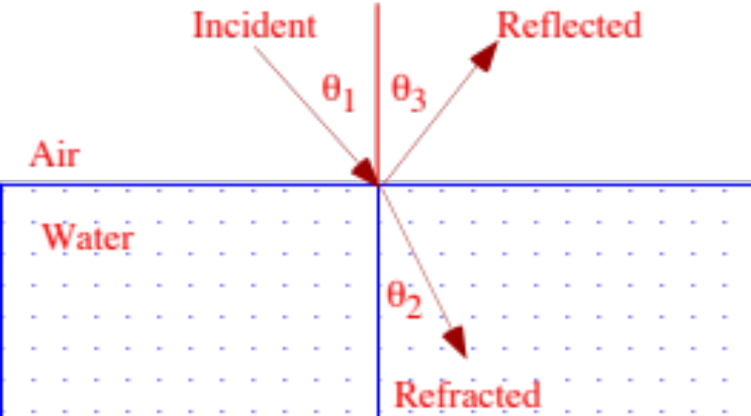
Refraction
Example 9.4:
λ = 0.5 μm
θ₁ = 45º
---> n_{air} = 1.000279
---> n_{water} = 1.335
---> θ₂ = 32º
---> c_{air} = 2.9971 x 10⁸ m s⁻¹
---> c_{water} = 2.2456 x 10⁸ m s⁻¹

Slide 22
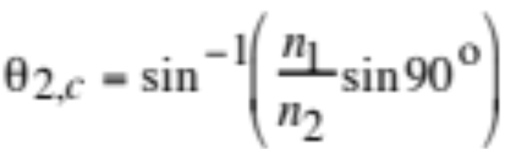
Total Internal Reflection
Critical angle (9.22)
Example 9.5:
λ = 0.5 μm
---> n_{air} = 1.000279
---> n_{water} = 1.335
---> θ_{2,c} = 48.53º

Slide 23
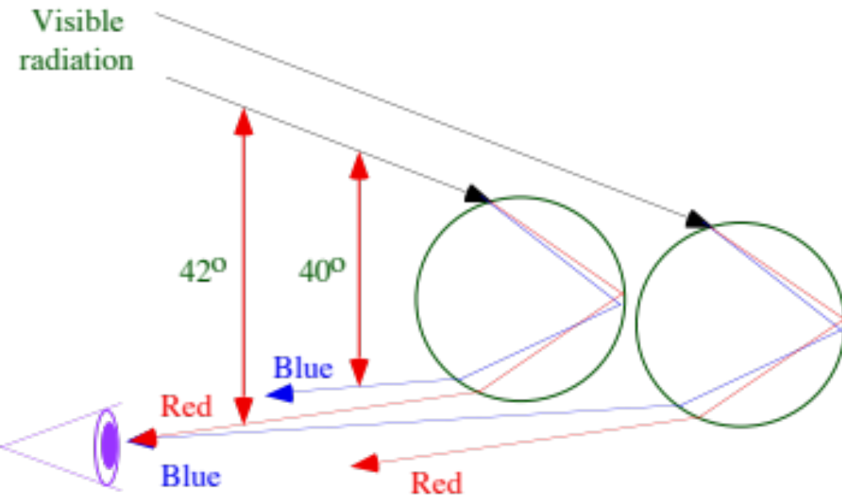
Geometry of a Primary Rainbow
Fig. 9.9

Slide 24
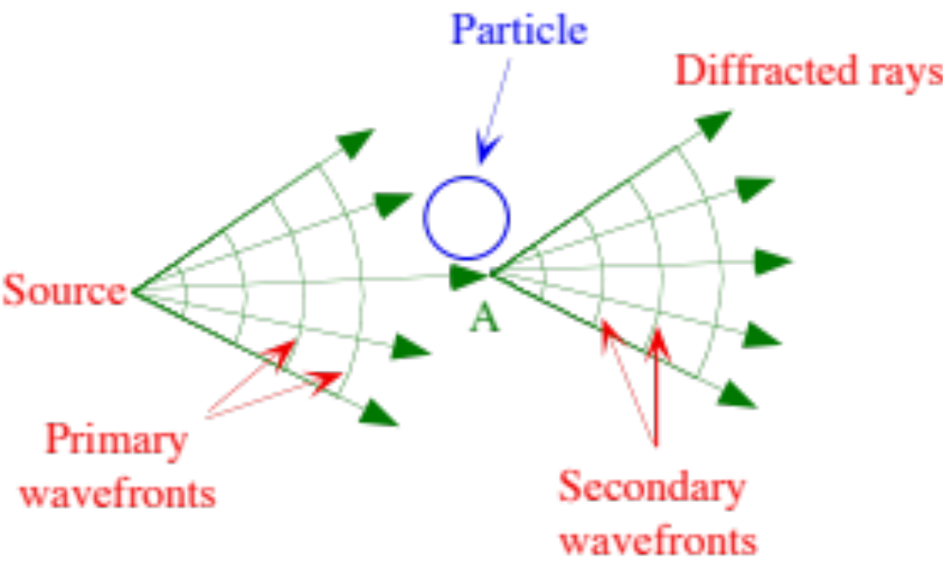
Diffraction Around A Particle
Huygens' principle
Each point of an advancing wavefront may be considered the source of a new series of secondary waves
Fig. 9.10

Slide 25
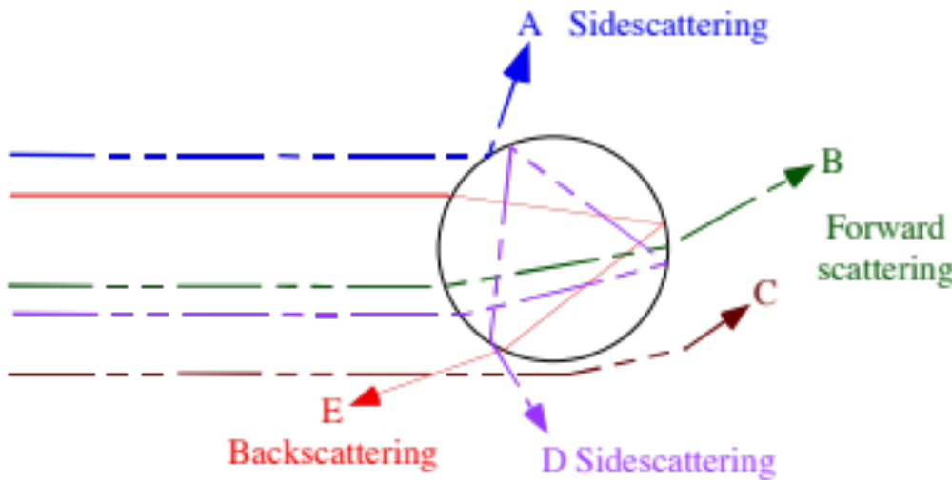
Radiation Scattering by a Sphere
Ray A is reflected
Ray B is refracted twice
Ray C is diffracted
Ray D is refracted, reflected twice, then refracted
Ray E is refracted, reflected once, and refracted
Fig. 9.11

Slide 26
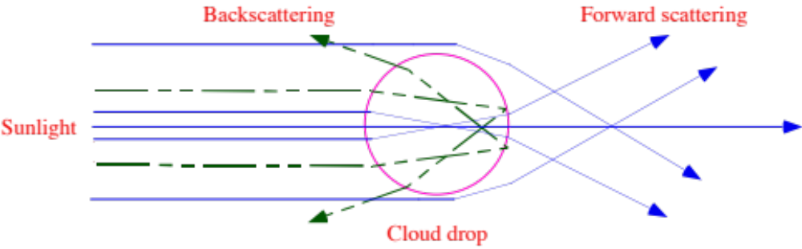
Forward and Backscattering
Cloud droplets
Scatter primarily in the forward direction
Gas molecules
Scatter evenly in the forward and backward directions.
Fig. 9.12

Slide 27
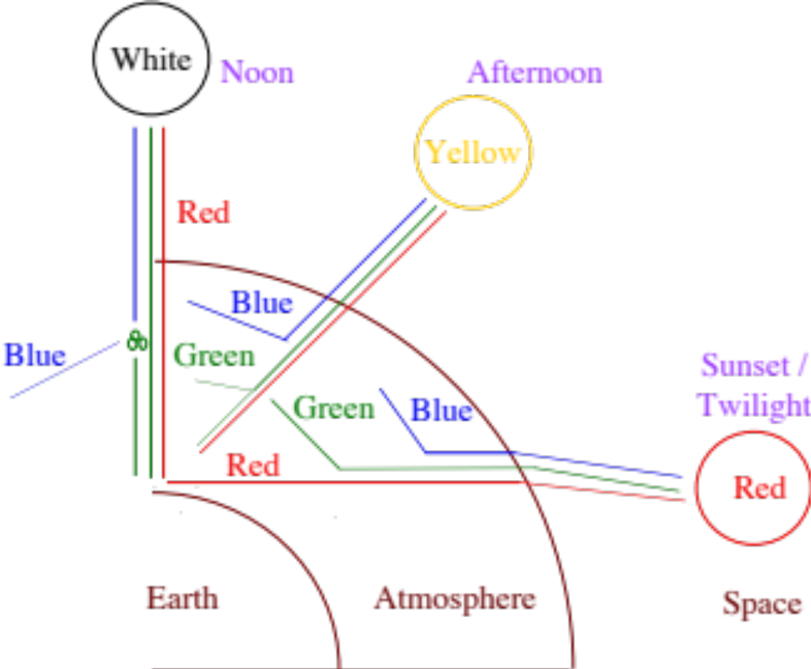
Change in Color of Sun During the Day
Fig. 9.13

Slide 28
Gas Absorption
Gas Absorption wavelengths (μm)
Visible/Near-UV/Far-UV absorbers
Ozone < 0.35, 0.45-0.75
Nitrate radical < 0.67
Nitrogen dioxide < 0.71
Near-UV/Far-UV absorbers
Formaldehyde < 0.36
Nitric acid < 0.33
Far-UV absorbers
Molecular oxygen < 0.245
Carbon dioxide < 0.21
Water vapor < 0.21
Molecular nitrogen < 0.1
Table 9.4

Slide 29
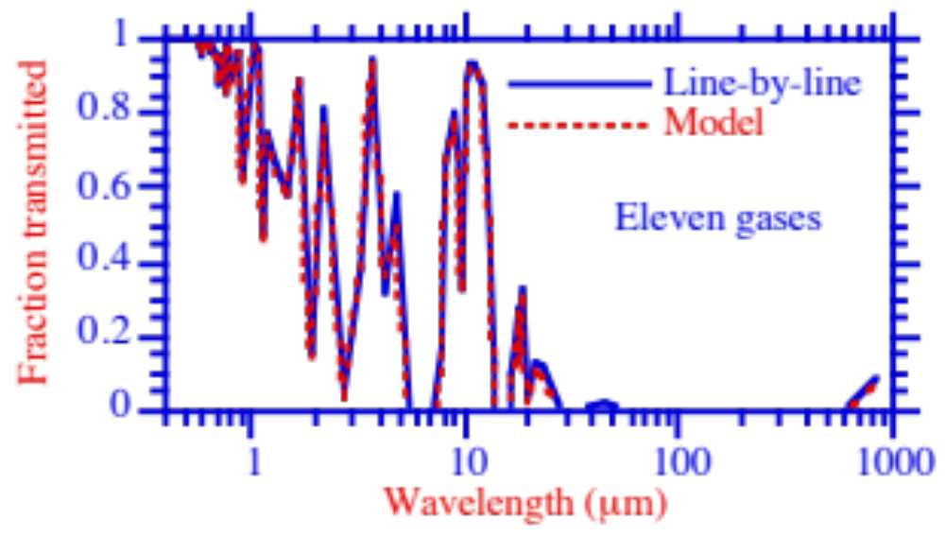
Gas Absorption
Fraction of transmitted radiation through all important gases
Fraction transmitted
Fig 9.14

Slide 30
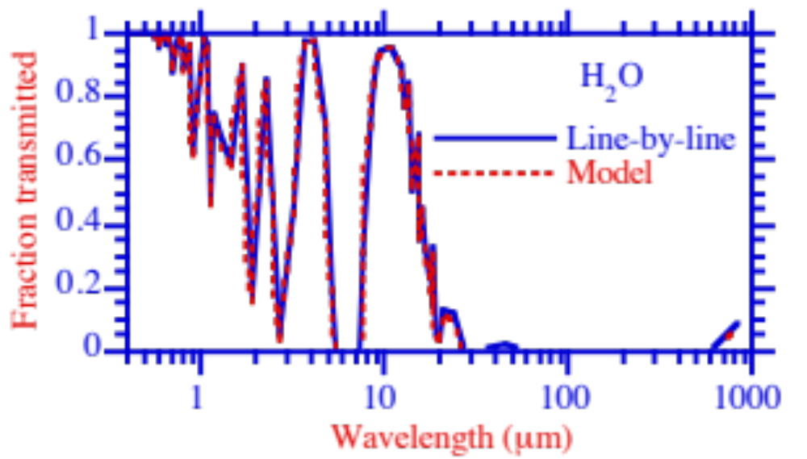
Gas Absorption
Fraction of transmitted radiation through water vapor
Fraction transmitted
Fig 9.14

Slide 31
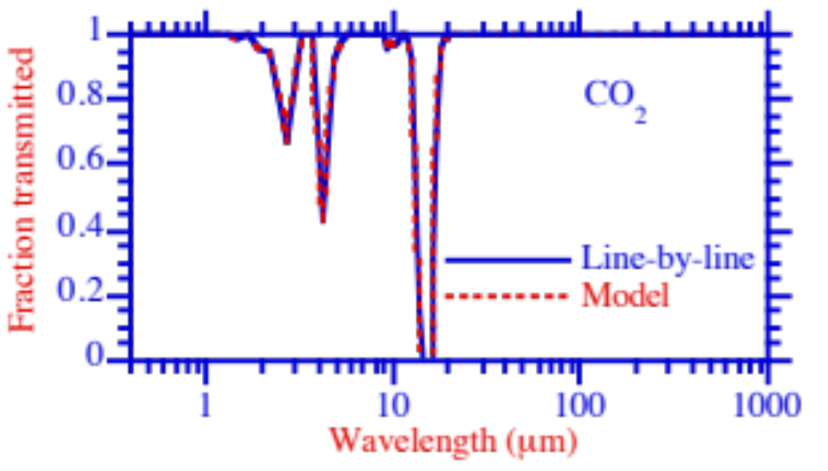
Gas Absorption
Fraction transmitted
Fig 9.14

Slide 32
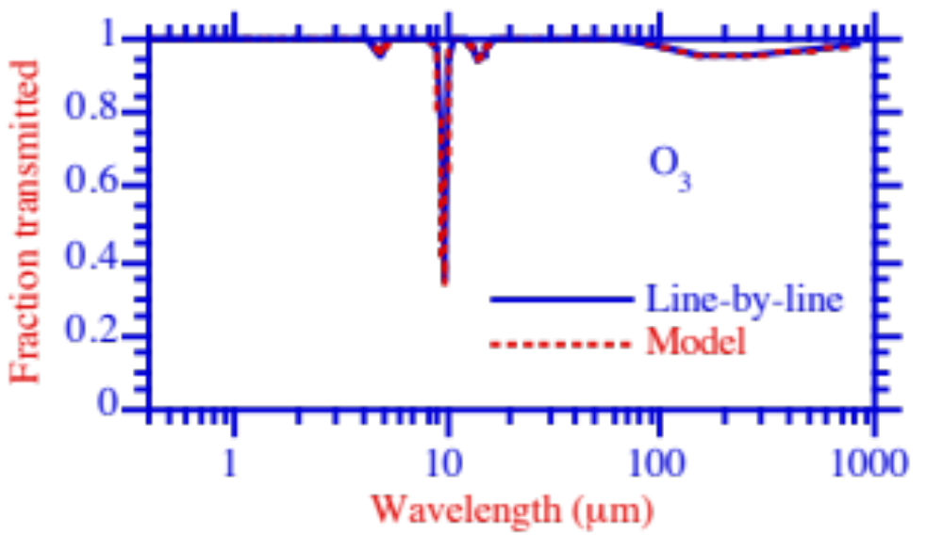
Gas Absorption
Fraction transmitted
Fig 9.14

Slide 33
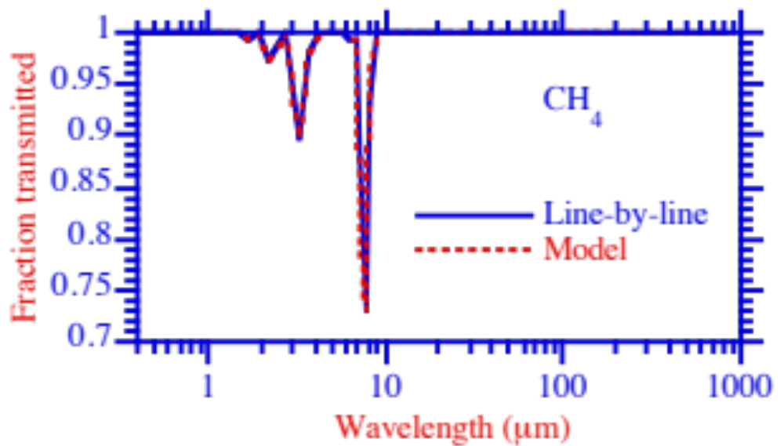
Gas Absorption
Fraction transmitted
Fig 9.14

Slide 34
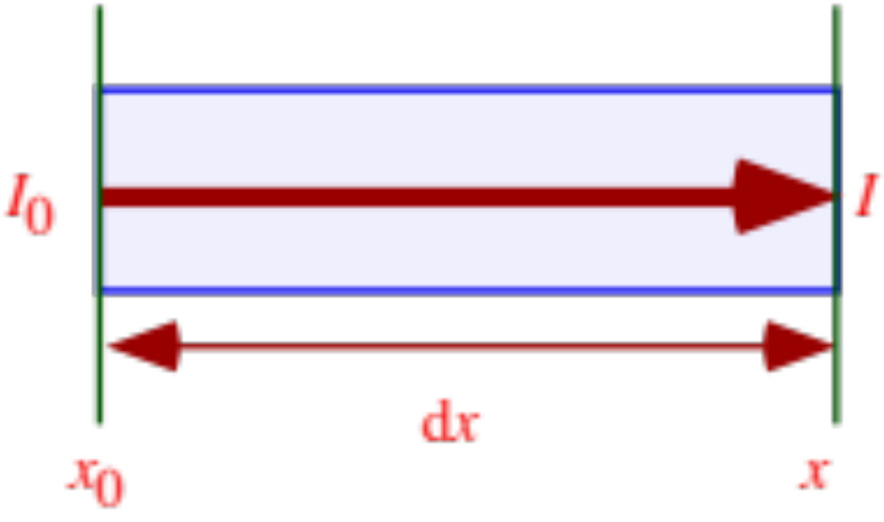
Extinction Coefficient
Attenuation of incident radiance, I_{o}, due to absorption as it travels through a column of gas.
Extinction coefficient (σ) (cm⁻¹, m⁻¹, or km⁻¹)
A measure of the loss of radiation per unit distance
Fig 9.15

Slide 35
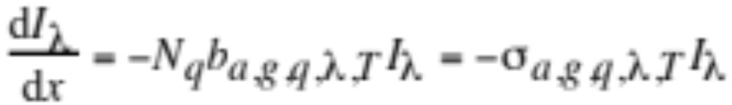
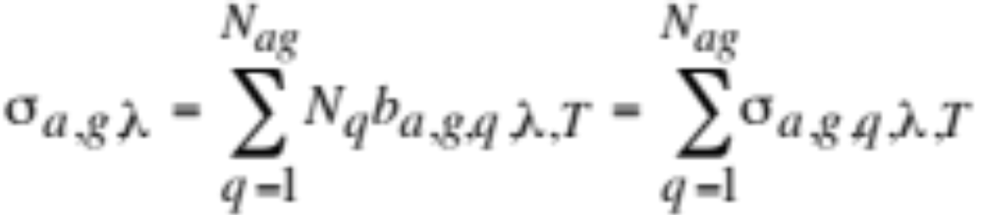
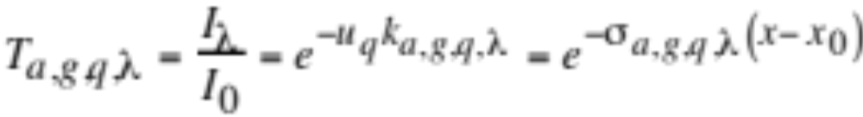
Extinction Coefficient
Reduction in radiance with distance through a gas (9.23)
Integrate (9.24)
Extinction coefficient due gas absorption (9.25)
Transmission (9.29)

Slide 36
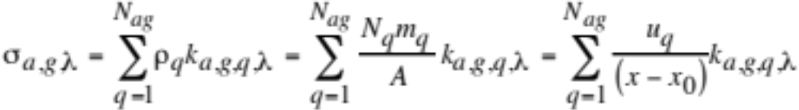
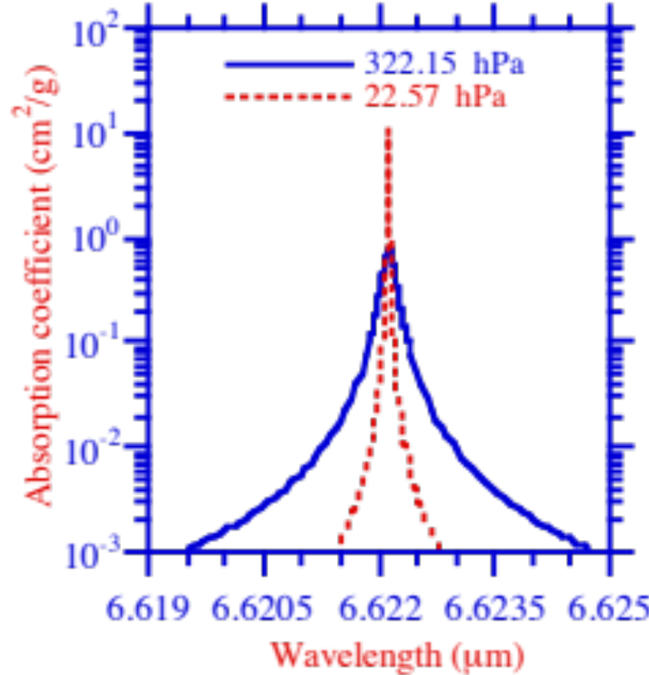
Absorption Coefficient
Extinction coefficient in terms of mass absorption (9.26)
Absorption coefficient (cm²/g)
Fig 9.16

Slide 37
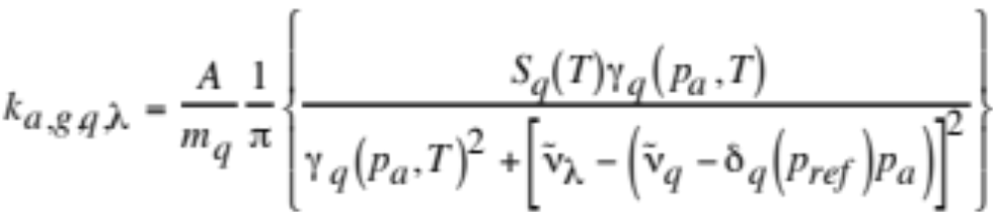
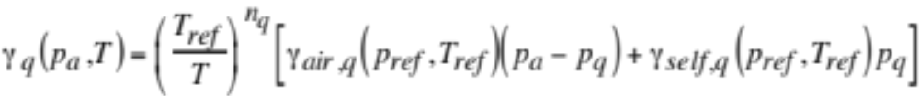
Absorption Coefficient
Absorption Coefficient (9.27)
Pressure-broadened half-width (9.28)

Slide 38
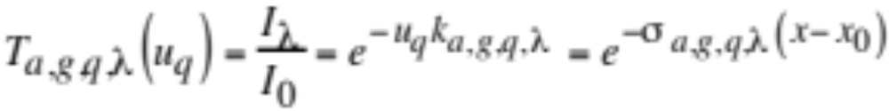
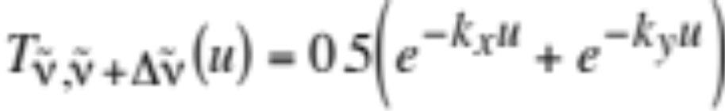
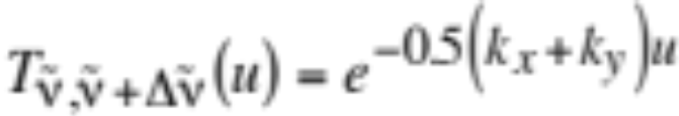
Transmission Example
Monochromatic transmission (9.29)
Exact transmission when two absorption lines (9.30)
Transmission overestimated when lines averaged (9.31)

Slide 39
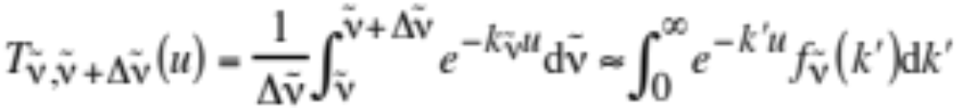


Correlated k-Distribution Method
Exact transmission in wavenumber interval (9.32)
Integration of differential probability is unity (9.33)
Reorder absorption coefs. into cumulative frequency distribution (9.34)

Slide 40

Effects on Visibility of Gas Absorption
Meteorological range (Koschmieder equation)
Meteorological ranges due to Rayleigh scattering and NO₂ absorption
<-- NO₂ absorption -->
Wavelength Rayleigh Scat. 0.01 ppmv 0.25 ppmv
(mm) (km) (km) (km)
0.42 112 296 11.8
0.50 227 641 25.6
0.55 334 1,590 63.6
0.65 664 13,000 520
Table 9.5

Slide 41

Effects on Visibility of Gas Absorption
Extinction coefficient due to NO₂ and O₃ absorption.
Extinction coefficient (km⁻¹)
Fig. 9.17

Slide 42



Gas Scattering
Rayleigh scatterer: 2πr/λ <<1
Extinction coefficient due to Rayleigh scattering (9.35)
Scattering cross section of a typical air molecule (cm²) (9.36)
Anisotropic correction factor (9.37)

Slide 43
Rayleigh Scattering Example
Example 9.6:
λ = 0.5 μm
p_{a} = 1 atm (sea level)
T = 288 K
---> σ_{s,g,λ} = 1.72 x 10⁻⁷ cm⁻¹
---> x = 227 km
λ = 0.55 μm
---> σ_{s,g,λ} = 1.17 x 10⁻⁷ cm⁻¹
---> x = 334 km

Slide 44



Imaginary Index of Refraction
Measure of extent to which a substance absorbs radiation
Attenuation of incident radiance, I₀, due to absorption
Equation for attenuation (9.38)
Integrate (9.39)
Fig 9.18

Slide 45

Complex Index of Refraction
(9.40)
Real and imaginary refractive indices at λ = 0.5 and 10 μm
<-- 0.5 μm --> <-- 10 μm -->
Substance Real Imaginary Real Imaginary
Liquid water 1.34 1x10⁻⁹ 1.22 0.05
Black carbon 1.82 0.74 2.4 1.0
Organic matter 1.45 0.001 1.77 0.12
Sulfuric acid 1.43 1x10⁻⁸ 1.89 0.46
Table 9.6

Slide 46
Transmission
Light transmission through particles at λ = 0.5 μm
<-- Transmission (I/I₀) -->
Diameter (μm) Black carbon Water
(κ=0.74) (κ=1x10⁻⁹)
0.1 0.16 0.999999997
1.0 8x10⁻⁹ 0.99999997
10 0 0.9999997
Table 9.6

Slide 47

Imaginary Refractive Index of Liquid Nitrobenzene
Imaginary index of refraction
Fig. 9.19

Slide 48

Transmission Electron Microscope (TEM) Image of Tarballs From Biomass Burning on Lacey Carbon Substrate
Adachi et al., 2011

Slide 49




Particle Extinction Coefficients
Particle absorption/scattering extinction coefficients (9.41)
Particle absorption/scattering cross sections (9.42)

Slide 50

Soot Absorption/Scattering Efficiencies
Single Particle Absorption/Scattering Efficiency at λ = 0.50 μm
Rayleigh regime
Fig. 9.20

Slide 51

Water Absorption/Scattering Efficiencies
Single Particle Absorption/Scattering Efficiency at λ = 0.50 μm.
Rayleigh regime
Fig. 9.21

Slide 52

Absorption Cross Section Enhancement
Absorption cross section enhancement due to internal mixing
Absorption cross section
Enhancement factor
Fig. 9.22

Slide 53

Aerosol Size Distributions For Simulating Global Mixing State

Slide 54



Coagulation Among 16 Aerosol Size Distributions
Initial Individual Distributions
Final Individual Distributions
dN(#/cm³)/dlog₁₀D
dN(#/cm³)/dlog₁₀D
Sum of Initial and Final Distributions
dN(#/cm³)/dlog₁₀D

Slide 55



Global Simulation Results
Globally-averaged mass percent of BC particles with a coating of different percentages over time due to coagulation and growth
Mass percent of BC in different size distributions with time due to coagulation and growth
Relative global direct radiative forcing due to BC over time due to the change in its mixing state, between that of an external mixture and that of an internal mixture.

Slide 56


Mixing Rules
Maxwell Garnett (9.55)
Bruggeman (9.56)

Slide 57

Optical Depth
Relationship between optical depth, altitude, solar zenith angle, and pathlength
Fig. 9.22

Slide 58

Modeled Extinction Coefficient Profile
Pressure (hPa)
Fig. 9.23a

Slide 59

Modeled Extinction Coefficient Profile
Pressure (hPa)
Fig. 9.23b

Slide 60

Solar Zenith Angle
Geometry for zenith angle calculations.
Fig. 10.26 b

Slide 61
Solar Zenith Angle
Cosine of solar zenith angle (9.67)
Solar declination angle (δ)
Angle between the equator and the north or south latitude of the subsolar point
Subsolar point
Point at which the sun is directly overhead
Local hour angle (H_{a})
Angle, measured westward, between longitude of subsolar point and longitude of location of interest.

Slide 62


Solar Declination Angle
Solar declination angle (9.68)
Obliquity of the ecliptic (9.69)
Angle between the plane of the Earth's equator and the plane of the ecliptic, which is the mean plane of the Earth's orbit around the Sun.

Slide 63


Solar Declination Angle
Ecliptic longitude of the sun (9.71)
Mean longitude of the sun (9.72)
Mean anomaly of the sun (9.72)

Slide 64



Solar Zenith Angle
Local hour angle (9.73)
Example:
At noon, when sun is directly overhead, H_{a} = 0 --->
When the sun is over the equator, δ = 0 --->

Slide 65
Solar Zenith Angle
Example 9.9:
1:00 p.m., PST, Feb. 27, 1994, ϕ = 35 ºN
---> D_{J} = 58
---> N_{JD} = -2134.5
---> g_{m} = -1746.23º
---> L_{m} = -1823.40º
---> λ_{ce} = -1821.87º
---> ε_{ob} = 23.4399º
---> δ = -8.52º
---> H_{a} = 15.0º
--->
---> θ_{s} = 45.8º

Slide 66


Radiative Transfer Equation
Change in radiance / irradiance along a beam of interest
Change in radiance along incremental path length (9.74)
Scattering of radiation out of the beam (9.75)
Absorption of radiation along the beam (9.76)

Slide 67

Scattering Angles
Single scattering of direct solar radiation and multiple scattering of diffuse radiation.
Fig. 9.28

Slide 68



Radiative Transfer Equation
Multiple scattering of diffuse radiation into the beam (9.77)
Single scattering of direct solar radiation into beam (9.78)
Emission of infrared Planckian radiation into beam (9.79)

Slide 69



Extinction Coefficients
Extinction due to total scattering (9.80)
Extinction due to total absorption (9.80)
Extinction due to total scattering plus absorption (9.81)

Slide 70


Scattering Phase Function
Gives angular distribution of scattered energy vs. direction
Scattering phase function for diffuse radiation
redirects diffuse radiation from μ’, φ’ to μ, φ
Scattering phase function for direct radiation
redirects direct solar radiation from -μ, φ to μ, φ

Slide 71



Scattering Phase Function
Scattering phase function defined such that (9.82)
Θ = angle between directions μ’, φ’ and μ, φ
Substitute --> (9.83)

Slide 72



Scattering Phase Function
Phase function for isotropic scattering (9.84)
Phase function for Rayleigh scattering (9.85)
Henyey-Greenstein function (9.86)

Slide 73


Scattering Phase Function
Scattering phase functions for (a) isotropic and (b) Rayleigh scattering
(a)
(b)
Fig. 9.29

Slide 74




Asymmetry Factor
First moment of phase function -- relative direction of scattering (9.88)
(9.87)
Expand with ---> (9.89)
Isotropic Scattering ---> ---> (9.90)

Slide 75



Asymmetry Factor
Rayleigh scattering ---> (9.91)
Mie scattering ---> (9.92)
Backscatter ratio (9.93)

Slide 76

Energy Emitted by Sun to Earth
Summed irradiance (W m⁻²) emitted at Sun's photosphere (9.94)
L_{p} = emissions from Sun's photosphere = 3.9 x 10²⁶ W
R_{p} = radius from Sun center to photosphere = 6.96 x 10⁸ m
T_{p} = temperature of photosphere = 5796 K
Example 9.10:
T_{p} = 5796 K
--->F_{p} ≈ 6.4 x 10⁷ W m⁻²

Slide 77


Solar Constant
Mean summed irradiance at top of Earth's atmosphere (9.95)
Calculated ≈ 1379 W m⁻²
Measured ≈ 1365 W m⁻²
Varies by +/- 1 W m⁻² over each 11 year sunspot cycle

Slide 78



Solar Constant
Daily solar flux depends on Earth-Sun distance (9.96)
Empirical formula (9.97)

Slide 79

Incident Solar Flux
Example 9.11:
December 22
---> F_{s} = 1365 x 1.034 = 1411 W m⁻²
June 22
---> F_{s} = 1365 x 0.967 = 1321 W m⁻²
--> Irradiance varies by 90 W m⁻² (6.6%) between Dec. and June
Cumulative solar irradiance as sum of spectral irradiances (9.98)

Slide 80

Seasons
Relationship between the Sun and Earth during the solstices and equinoxes
Fig. 9.30

Slide 81



Equilibrium Earth Temperature
Energy (W) absorbed by the Earth-atmosphere system (9.99)
Energy emitted by the Earth's surface (9.100)
Equate --> temperature without greenhouse effect (9.101)

Slide 82

Equilibrium Earth Temperature
Example 9.12:
= 1365 W m⁻²
A_{e,0} = 0.3
---> T_{e} = 254.8 K
Actual average surface temperature on earth ≈ 288 K --> difference due to absorption by greenhouse gases

Slide 83



Radiative Transfer Equation
(9.102)
Single scattering albedo (9.103)
Total extinction coefficient
Optical depth

Slide 84




Radiative Transfer Equation
Rewrite radiative transfer equation (9.104)
where (9.105)
(9.106)
(9.107)

Slide 85


Beer’s Law
Consider only absorption in downward direction (9.108)
Solution (9.109)

Slide 86


Schwartzchild’s Equation
Consider absorption and infrared emissions (9.111)
Solution (9.112)

Slide 87


Two-Stream Method
Divide phase function into upward (+) and downward component (9.114)
Substitute (9.114) into (9.105) (9.115)

Slide 88



Two-Stream Method
Integrated fraction of forward scattered energy (9.116)
Integrated fraction of backscattered energy (9.116)
Effective asymmetry parameter (9.117)

Slide 89


Modeled Asymmetry Parameter
Pressure (hPa)
Pressure (hPa)
Fig. 9.28

Slide 90

Two-Stream Approximation
Upward radiance equation (9.119)
Downward radiance equation (9.120)
Irradiances in terms of radiance for two-stream approximation

Slide 91



Two-Stream Approximation
Substitute irradiances and generalize for different phase function approximations
Solar irradiance (9.121)
Surface boundary condition (9.123)

Slide 92











Two-Stream Approximation
Coefficients for two stream approximations using two techniques
Approximation
Quadrature
Eddington
Infrared irradiance (9.122)
Table 9.10

Slide 93



Delta Functions
Quadrature and Eddington solutions underpredict forward scattering because expansion of phase function is too simple to obtain the strong peak in scattering efficiency.
--> adjust terms with delta functions (9.124)

Slide 94




Heating Rates
Net flux divergence equation (9.125)
Net downward minus upward radiative flux
Partial derivative term (9.126)
Temperature change (9.127)

Slide 95


Photolysis Coefficients
Photolysis rate (s⁻¹) at bottom of layer k (9.128)
Radiance at bottom of layer k (photons cm⁻² μm sr⁻¹ s⁻¹) (9.129)
Example 9.14:
I_{λ} = 12 W m⁻² in band 0.495 μm < λ < 0.505 μm
---> mean λ = 0.5 μm
---> I_{p,λ} = 3.02 x 10¹⁵ photons cm⁻² s⁻¹

