Slide 1
Presentation Slides for
Chapter 8 of
Fundamentals of Atmospheric Modeling 2nd Edition
Mark Z. Jacobson
Department of Civil & Environmental Engineering
Stanford University
Stanford, CA 94305-4020
jacobson@stanford.edu
March 10, 2005

Slide 2
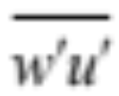
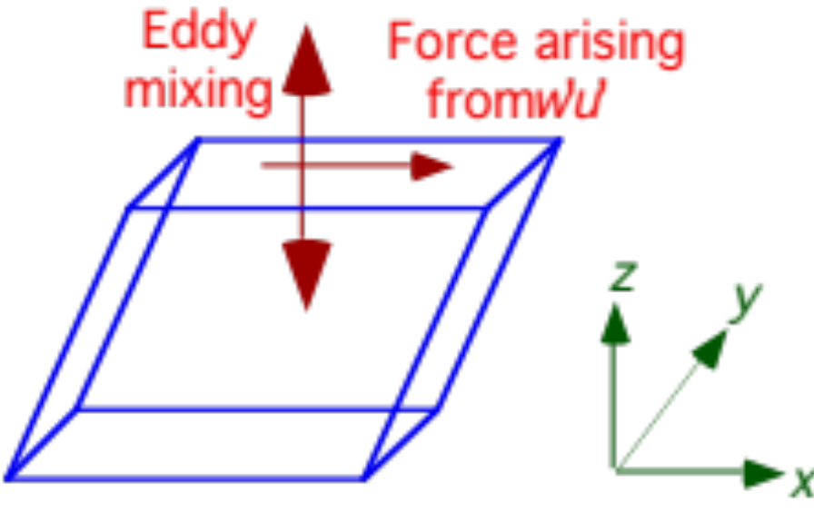
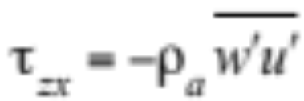
Reynolds Stress
Stress
Force per unit area (e.g. N m⁻² or kg m⁻¹ s⁻²)
Reynolds stress
Stress that causes a parcel of air to deform during turbulent motion of air
Fig. 8.1. Deformation by vertical momentum flux
Stress from vertical transfer of turbulent u-momentum (8.1)
zx = stress acting in x-direction, along a plane (x-y) normal to the z-direction

Slide 3
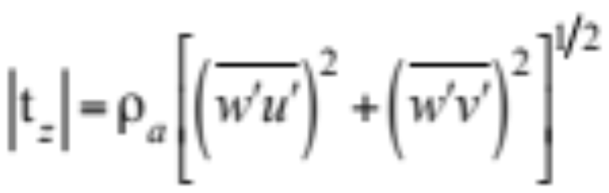
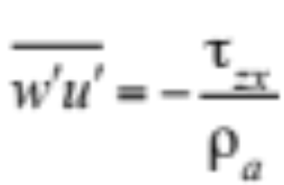
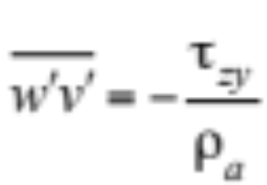
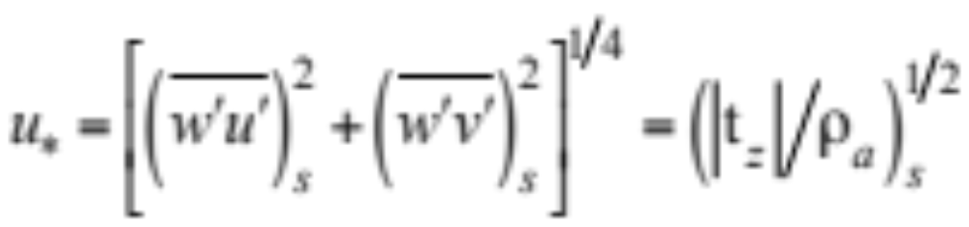
Momentum Fluxes
Magnitude of Reynolds stress at ground surface (8.2)
Kinematic vertical turbulent momentum flux (m² s⁻²) (8.3)
Friction wind speed (m s⁻¹) (8.8)
Scaling param. for surface-layer vert. flux of horiz. momentum

Slide 4
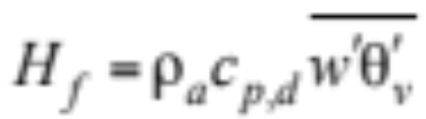
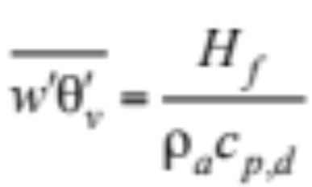
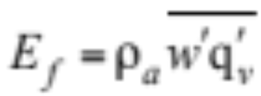
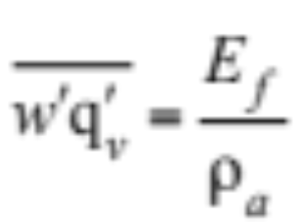
Heat and Moisture Fluxes
Vertical turbulent sensible-heat flux (W m⁻²) (8.4)
Kinematic vert. turbulent sensible-heat flux (m K s⁻¹) (8.5)
Vertical turbulent water vapor flux (kg m⁻² s⁻¹) (8.6)
Kinematic vert. turbulent moisture flux (m kg s⁻¹ kg⁻¹) (8.7)

Slide 5
Surf. Roughness Length for Momentum
Height above surface at which mean wind extrapolates to zero
Longer roughness length --> greater turbulence
Exactly smooth surface, roughness length = 0
Approximately 1/30 the height of the average roughness element protruding from the surface

Slide 6
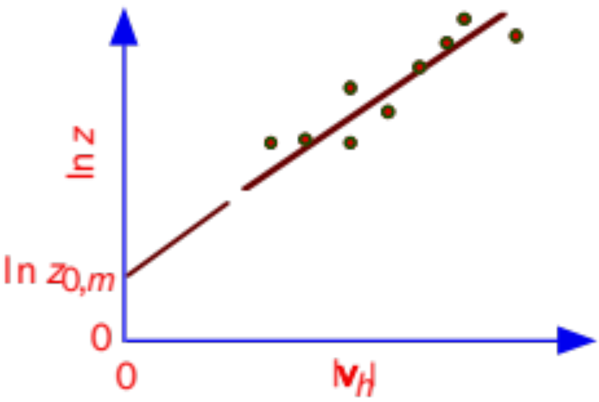
Surf. Roughness Length for Momentum
Method of calculating roughness length
1) Find wind speeds at many heights when wind is strong
2) Plot speeds on ln (height) vs. wind speed diagram
3) Extrapolate wind speed to altitude at which speed equals zero
ln z
Fig. 6.5

Slide 7
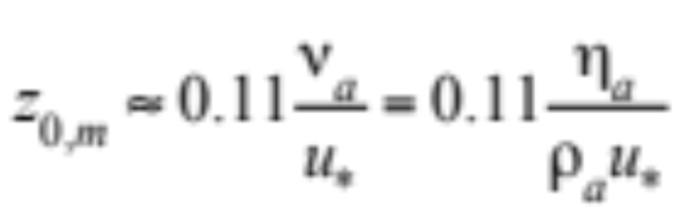
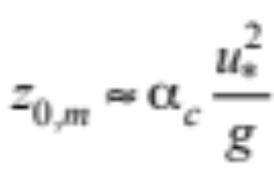
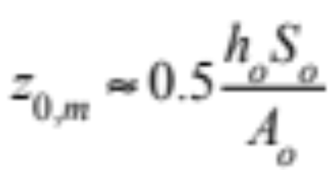
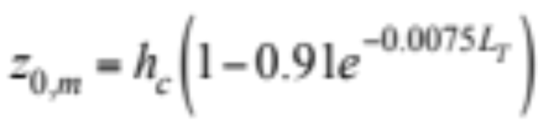
Roughness Length for Momentum
Over smooth ocean with slow wind (8.9)
Over rough ocean, fast wind (Charnock relation) (8.10)
Over urban areas containing structures (8.11)
Over a vegetation canopy (8.12)

Slide 8
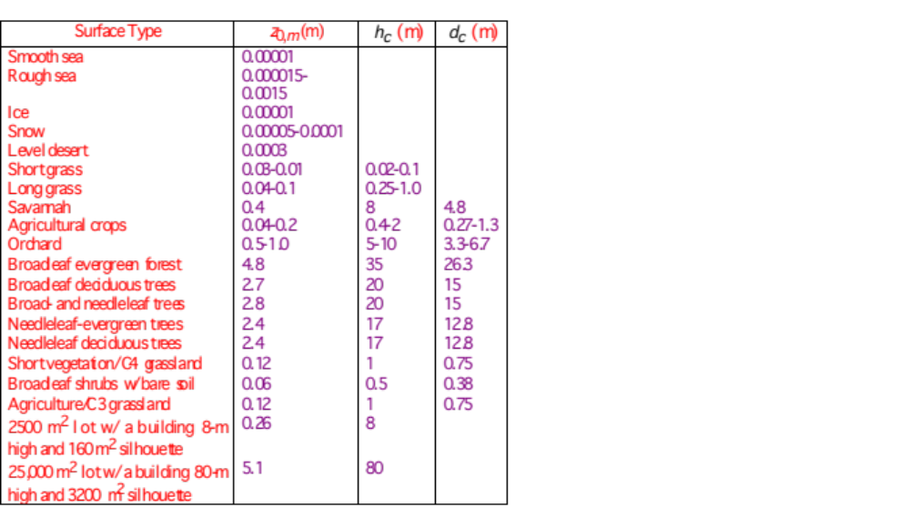
Roughness Length for Momentum
Table 8.1

Slide 9
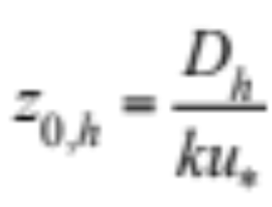
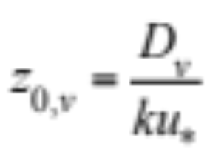
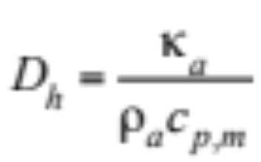
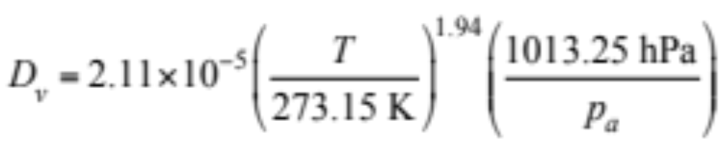
Roughness Length for Energy, Moisture
Surface roughness length for energy (8.13)
Surface roughness length for moisture (8.13)
Molecular thermal diffusion coefficient (8.14)
Molecular diffusion coefficient of water vapor (8.14)

Slide 10
Turbulence Description
Turbulence
Group of eddies of different size. Eddies range in size from a couple of millimeters to the size of the boundary layer.
Turbulent kinetic energy (TKE)
Mean kinetic energy per unit mass associated with eddies in turbulent flow
Dissipation Conversion of turbulence into heat by molecular viscosity
Inertial cascade
Decrease in eddy size from large eddy to small eddy to zero due to dissipation

Slide 11
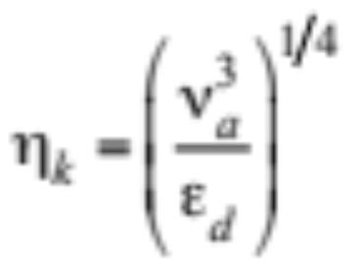
Turbulence Models
Kolmogorov scale (8.15)
Reynolds-averaged models
Resolution greater than a few hundred meters
Do not resolve large or small eddies
Large-eddy simulation models Resolution between a few meters and a few hundred meters Resolve large eddies but not small ones
Direct numerical simulation models Resolution on the order of the Kolmogorov scale
Resolve all eddies

Slide 12
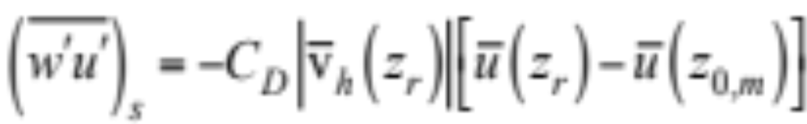
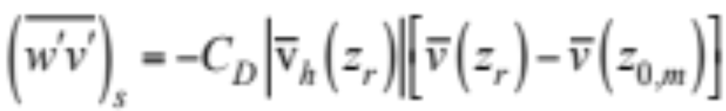
Kinematic Vertical Momentum Flux
Bulk aerodynamic formulae (8.16-7)
Diffusion coefficient accounts for
Skin drag: drag from molecular diffusion of air at surface
Form drag: drag arising when wind hits large obstacles
Wave drag: drag from momentum transfer due to gravity waves

Slide 13
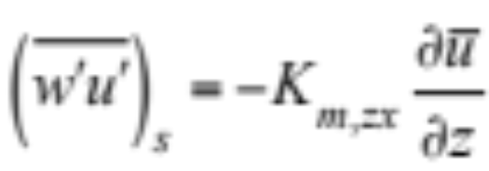
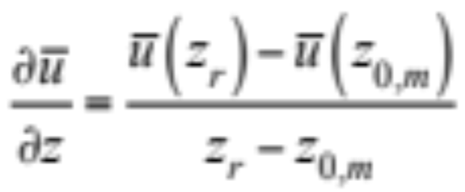
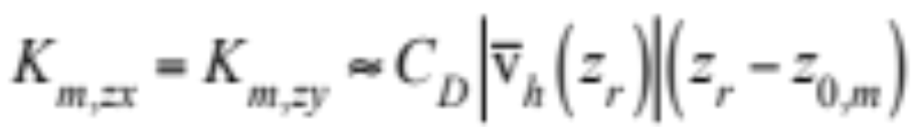
Kinematic Vertical Momentum Flux
Bulk aerodynamic formulae (8.18)
K-theory (8.18)
Wind speed gradient (8.19)
Eddy diffusion coef. in terms of bulk aero. formulae (8.20)

Slide 14
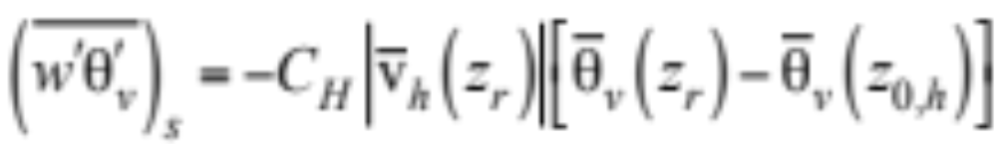
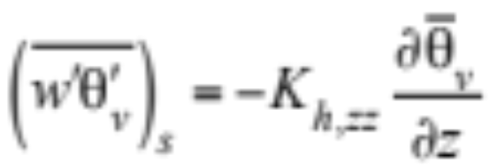
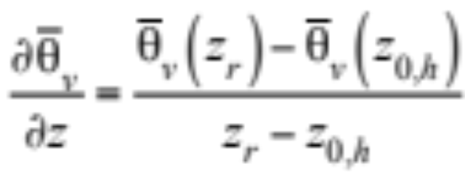
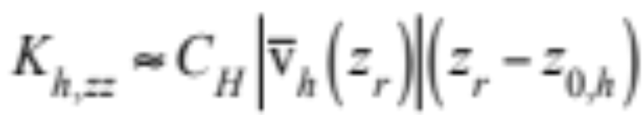
Kinematic Vertical Energy Flux
Bulk aerodynamic formulae (8.21)
K-theory (8.23)
Potential virtual temperature gradient (8.24)
Eddy diffusion coef. in terms of bulk aero. formulae (8.25)

Slide 15
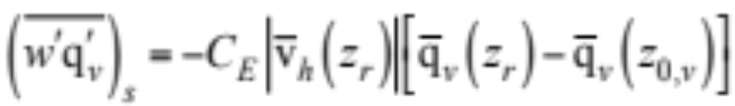
Vertical Turbulent Moisture Flux
Bulk aero. kinematic vertical turbulent moisture flux (8.26)
C_{E}≈C_{H} --> K_{v,zz} =K_{h,zz}

Slide 16
Similarity Theory
Variables are first combined into a dimensionless group.
Experiment are conducted to obtain values for each variable in the group in relation to each other.
The dimensionless group, as a whole, is then fitted, as a function of some parameter, with an empirical equation.
The experiment is repeated. Usually, equations obtained from later experiments are similar to those from the first experiment.
The relationship between the dimensionless group and the empirical equation is a similarity relationship.
Similarity theory applied to the surface layer is Monin-Obukhov or surface-layer similarity theory.

Slide 17
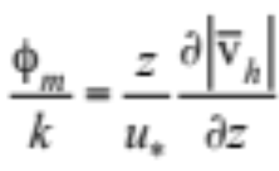
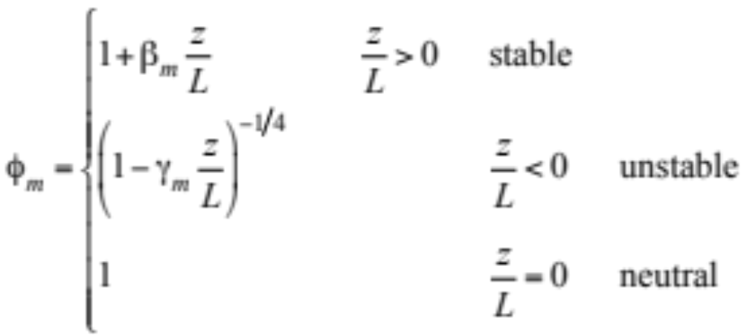
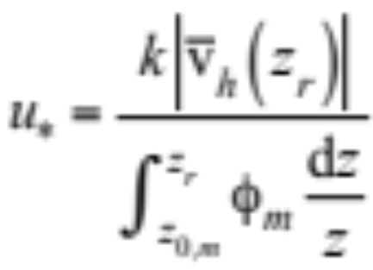
Similarity Relationship
Dimensionless wind shear (8.28)
Dimensionless wind shear from field data (8.29)
Integrate (8.28) from z_{0,m} to z_{r} (8.30)

Slide 18
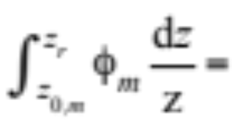
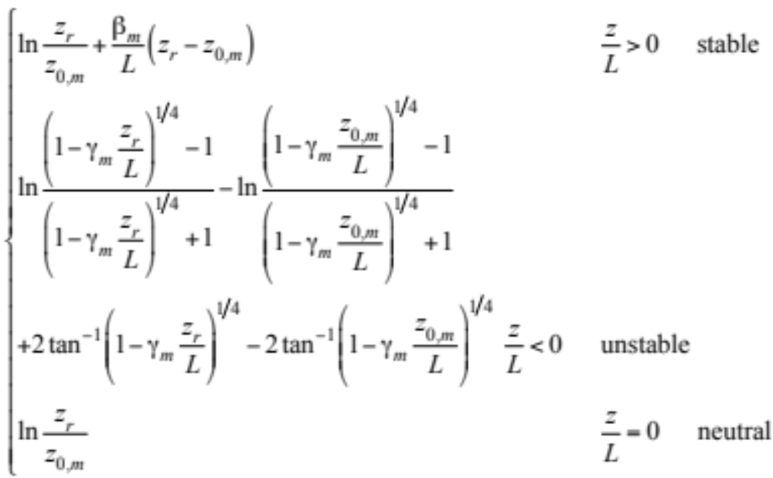
Integral of Dimensionless Wind Shear
Integral of the dimensionless wind shear (8.31)

Slide 19
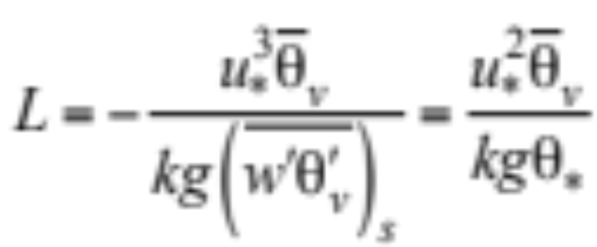
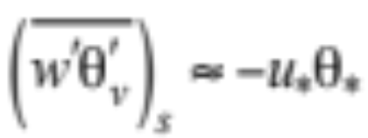
Monin-Obukhov Length
Height proportional to the height above the surface at which buoyant production of turbulence first equals mechanical (shear) production of turbulence. (8.32)
Kinematic vertical energy flux (8.33)

Slide 20
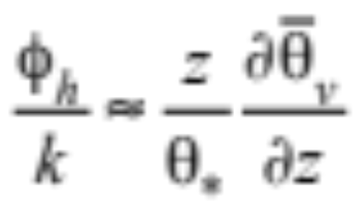
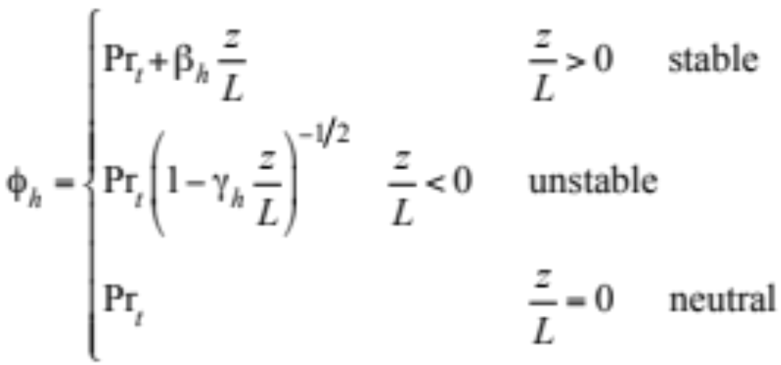
Potential Temperature Scale
Dimensionless temperature gradient (8.34)
Parameterization of θ* (8.35)

Slide 21
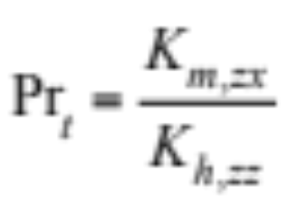
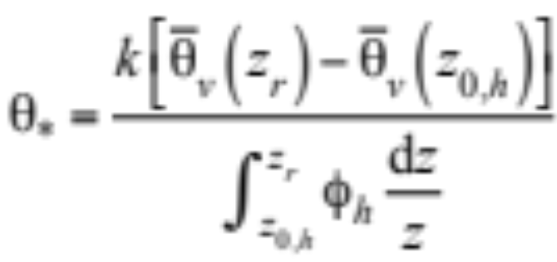
Potential Temperature Scale
Turbulent Prandtl number
Integrate (8.23) from z_{0,m} to z_{r} (8.37)

Slide 22
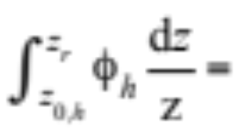
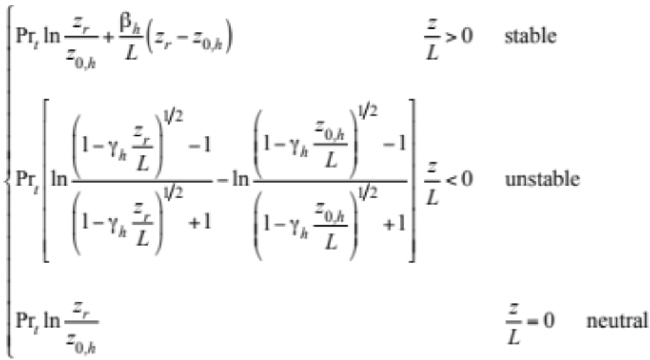
Integral of Dimensionless Temp. Grad.
Integral of dimensionless temperature gradient (8.38)

Slide 23
Equations to Solve Simultaneously
Solution requires iteration

Slide 24
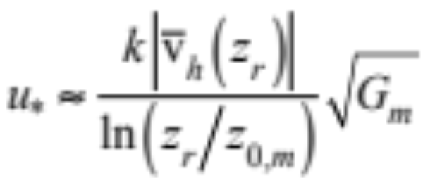
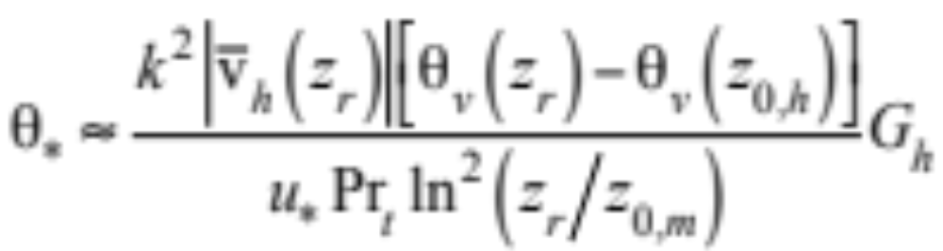
Noniterative Parameterization
Friction wind speed (8.40)
Potential temperature scale (8.40)

Slide 25
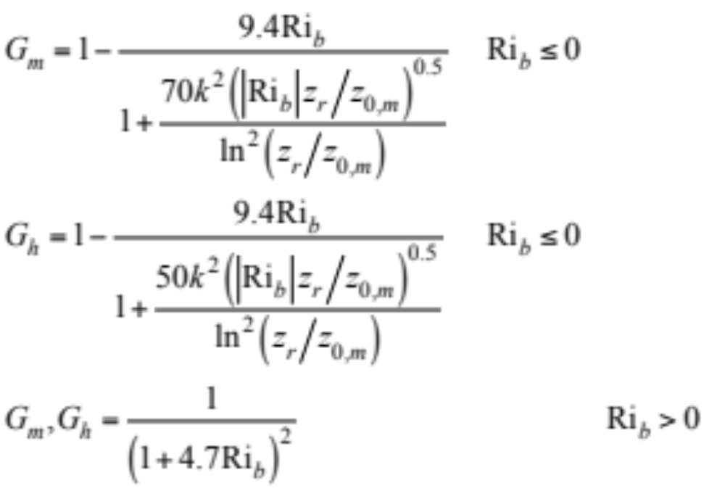
Scale Parameterization
Potential temperature scale (8.41)

Slide 26
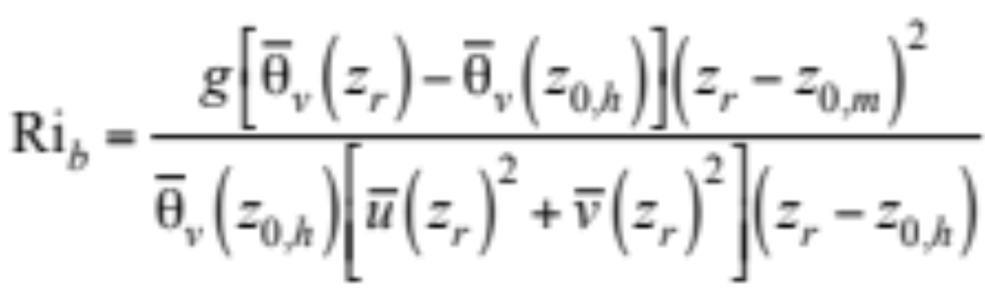
Bulk Richardson Number
Ratio of buoyancy to mechanical shear (8.39)

Slide 27
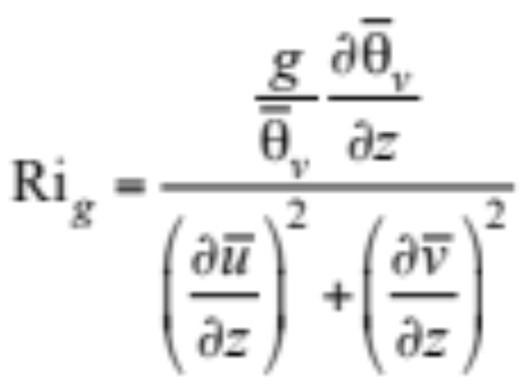
Gradient Richardson Number
(8.42)
Table 8.2. Vertical air flow characteristics for different Ri_{b} or Ri_{g}
Value of Ri_{b} or Ri_{g} | Type of Flow | Level of Turbulence Due to Buoyancy | Level of Turbulence Due to Shear
Large, negative | Turbulent | Large | Small
Small, negative | Turbulent | Small | Large
Small positive | Turbulent | None (weak stable) | Large
Large positive | Laminar | None (strong stable) | Small

Slide 28
Gradient Richardson Number
(8.42)
Laminar flow becomes turbulent when Ri_{g} decreases to less than the critical Richardson number (Ri_{c}) = 0.25
Turbulent flow becomes laminar when Ri_{g} increase to greater than the termination Richardson number (Ri_{T}) = 1.0

Slide 29



Similarity Theory Turbulent Fluxes
Friction wind speed (8.8)
Bulk aerodynamic kinematic momentum flux (8.16)
Friction wind speed (8.43)
Rederive momentum flux in terms of similarity theory (8.43)

Slide 30



Eddy Diff. Coef. for Mom. Similarity
K-theory kinematic turbulent momentum fluxes (8.18)
Similarity theory kinematic turbulent fluxes (8.44)
Combine the two (8.46)

Slide 31










Example Problem
z_{0,m} = 0.01 Pr_{t} = 0.95
z_{0,h} = 0.0001 m k = 0.4
u(z_{r})=10 m s⁻¹ v(z_{r})= 5 m s⁻¹
θ_{v}(z_{r})= 285 K θ_{v}(z_{0,h})= 288 K
---> = 11.18 m s⁻¹ ---> = -8.15 x 10⁻³
---> = 1.046 ---> = 1.052
---> = 0.662 m s⁻¹ ---> = -0.188 K
---> = -169 m
---> = 0.39 m² s⁻¹
---> = 0.41 m² s⁻¹ ---> = 0.95

Slide 32


Eddy Diff. Coef. for Mom. Similarity
Dimensionless wind shear (8.28)
Wind shear (8.46)
Combine expressions above (8.48)
kz = mixing length: average distance an eddy travels before exchanging momentum with surrounding eddies

Slide 33


Energy Flux from Similarity Theory
Vertical kinematic energy flux (8.49)
Surface vertical turbulent sensible heat flux (8.53)

Slide 34




Energy, Moisture Fluxes from Similarity
Vertical kinematic water vapor flux (8.49)
Surface vertical turbulent water vapor flux (8.53)
Dimensionless specific humidity gradient (8.51)
Specific humidity scale (8.52)

Slide 35


Logarithmic Wind Profile
Dimensionless wind shear (8.28)
Rewrite (8.57)
Integrate --> surface layer vertical wind speed profile (8.59)

Slide 36


Logarithmic Wind Profile
Influence function for momentum (8.61,2)

Slide 37


Logarithmic Wind Profile
Neutral conditions --> logarithmic wind profile (8.64)
Logarithmic wind profiles when u* = 1 m s⁻¹.
Height above surface (m)
Fig. 8.3

Slide 38



Potential Virtual Temperature Profile
Dimensionless potential temperature gradient (8.34)
Rewrite (8.58)
Integrate --> potential virtual temperature profile (8.60)

Slide 39


Potential Virtual Temperature Profile
Influence function for energy (8.61,3)

Slide 40

Vertical Profiles in a Canopy
Relationship among d_{c}, h_{c}, and z_{0,m}
ln z_{0,m}
Fig. 8.4

Slide 41



Vertical Profiles in a Canopy
Momentum (8.66)
Potential virtual temperature (8.67)
Specific humidity (8.68)

Slide 42
Local v. Nonlocal Closure Above Surface
Local closure turbulence scheme
Mixes momentum, energy, chemicals between adjacent layers.
Hybrid
E-λ
E-ε_{d}
Nonlocal closure turbulence scheme
Mixes variables among all layers simultaneously
Free-convective plume scheme

Slide 43



Hybrid Scheme
For momentum for stable/weakly unstable conditions (8.70)
Captures small eddies but not large eddies due to free convection --> not valid when Ri_{b} is large and negative
Mixing Length (8.71)
For energy

Slide 44



E (TKE)-λ Scheme
Prognostic equation for TKE (8.72)
Prognositc equation for mixing length (8.73)
Production rate of shear (8.74)

Slide 45




E-λ Scheme
Production rate of buoyancy (8.75)
Dissipation rate of TKE (8.76)
Diffusion coefficients (8.77)

Slide 46



E-ε_{d} TKE
Prognostic equation for dissipation rate (8.88)
Eddy diffusion coefficient for momentum (8.89)
Diagnostic equation for mixing length (8.90)

Slide 47



Heat Conduction Equation
Heat conduction equation (8.91)
Thermal conductivity of soil-water-air mixture (8.92)
Moisture potential
Potential energy required to extract water from capillary and adhesive forces in the soil (8.93)

Slide 48



Heat Conduction Equation
Density x specific heat of soil-water-air mixture (8.94)
Rate of change of soil water content (8.95)
Hydraulic conductivity of soil
Coefficient of permeability of liquid through soil (8.96)

Slide 49

Heat Conduction Equation
Diffusion coefficient of water in soil (8.97)

Slide 50



Heat Conduction Equation
Rate of change of ground surface temperature (8.98)
Rate of change of moisture content at the surface (8.99)
Surface energy balance equation (8.103)

Slide 51


Temp and Moisture in Vegetated Soil
Surface energy balance equation (8.103)
Surface irradiance (8.104)
Vertical turbulent sensible heat flux (8.105)

Slide 52



Temp and Moisture in Vegetated Soil
Vertical turbulent latent heat flux (8.106)
Temperature of air in foliage (8.109)
Specific humidity of air in foliage (8.110)

Slide 53



Foliage Temperature
Iterative equation for foliage temperature (8.115)
Sensible heat flux (8.116)

Slide 54



Foliage Temperature
Direct evaporation (8.117)
Transpiration (8.118)
Evaporation function (8.119)

Slide 55

Foliage Temperature
(8.122)

Slide 56

Temperature of Vegetated Soil
(8.125)

Slide 57

Modeled/Measured Temperatures
Fig. 8.5

Slide 58

Modeled/Measured Temperatures
Fig. 8.5

Slide 59

Modeled/Measured Temperatures
Fig. 8.5

Slide 60

Road Temperature
(8.128)

Slide 61

Temperatures of Soils and Surfaces
Fig. 8.5

Slide 62

Modeled/Measured Temperatures
Fig. 8.5

Slide 63



Snow Depth
(8.129)

Slide 64

Water Temperature
(8.130)

Slide 65

Sea Ice Temperature
(8.131)

Slide 66


Temperature of Snow Over Sea Ice
(8.134)

