Slide 1
Presentation Slides for
Chapter 7 of
Fundamentals of Atmospheric Modeling 2nd Edition
Mark Z. Jacobson
Department of Civil & Environmental Engineering
Stanford University
Stanford, CA 94305-4020
jacobson@stanford.edu
March 10, 2005

Slide 2
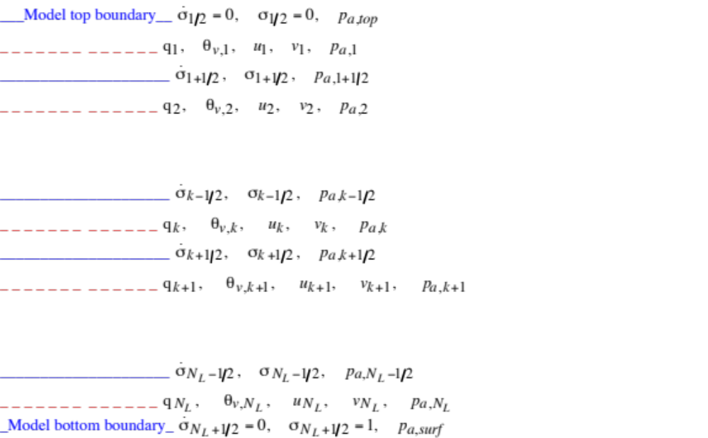
Vertical Model Grid
Fig. 7.1

Slide 3
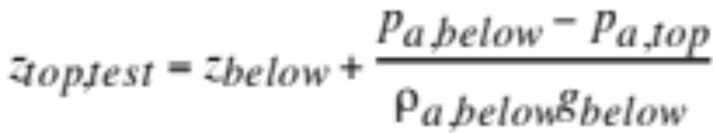
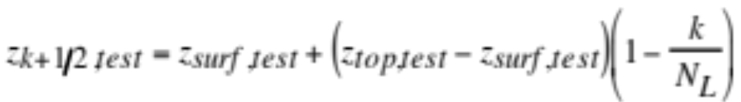
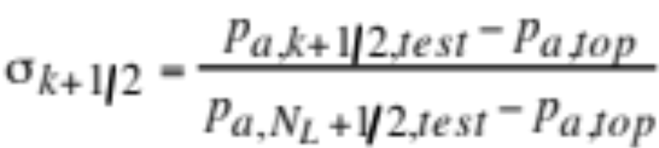
Estimating Sigma Levels
Estimate top altitude in test column (7.2)
z_{below} is altitude from App. Table B.1 just below p_{a,top}
Estimate altitude at bottom of each layer in test column (7.3)
Estimate pressure at each layer edge (2.41)
Find pressure from (2.41) --> sigma values (7.4)

Slide 4



Estimating Sigma Levels
Sigma values (7.4)
Model pressure at bottom boundary of layer (7.6)
Model column pressure (7.5)
Sigma thickness of layer (7.1)

Slide 5
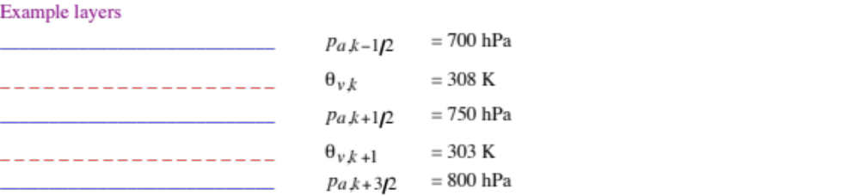
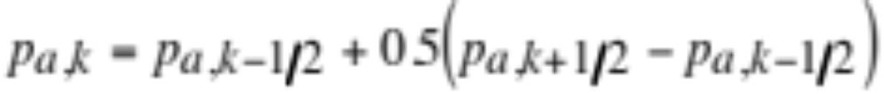
Layer Midpoint Pressure
Pressure at the mass-center of a layer (7.7)

Slide 6
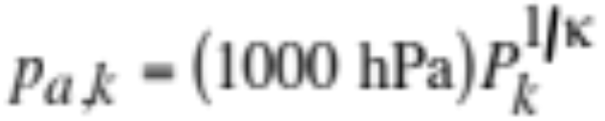
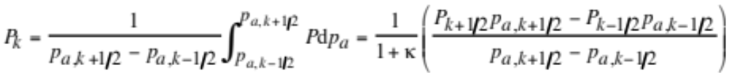
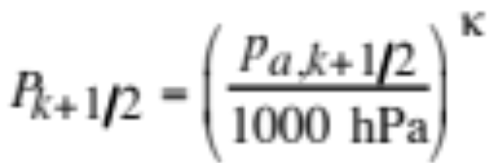
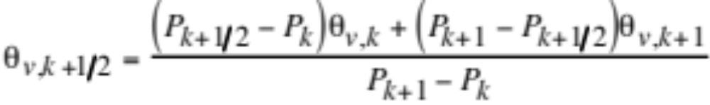
Layer Midpoint Pressure
Pressure where mass-weighted mean of P is located (7.10)
When θ_{v} increases monotonically with height
Mass-weighed mean of P (7.8)
Value of P at boundaries (7.9)
Consistent formula for θ_{v} at boundaries (7.11)

Slide 7
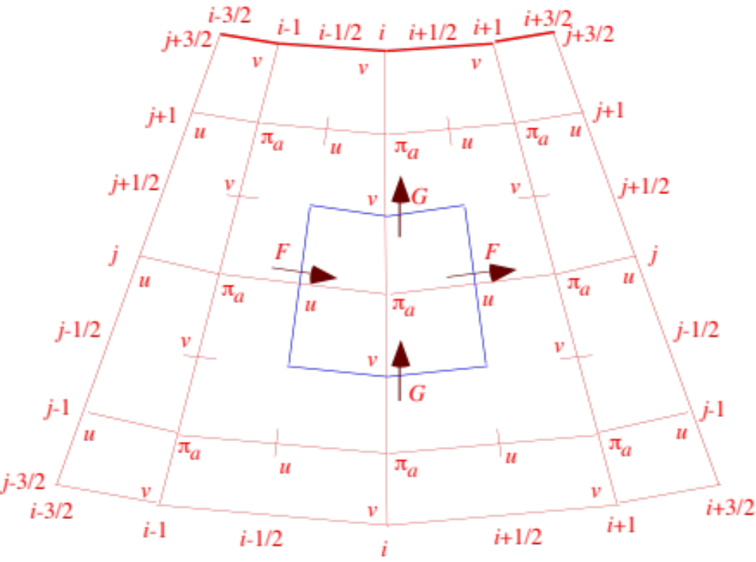
Arakawa C Grid
Fig. 7.2

Slide 8
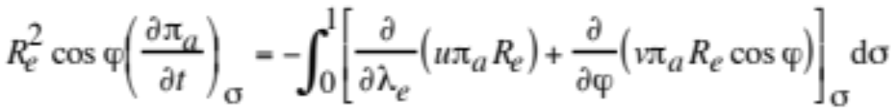
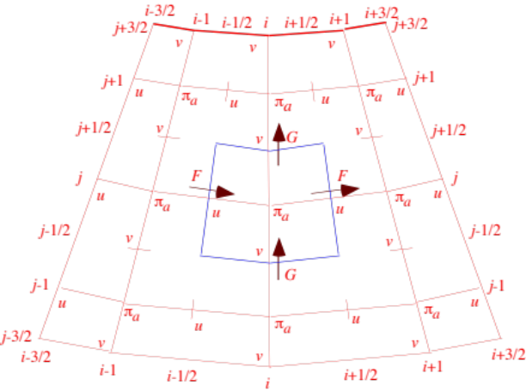
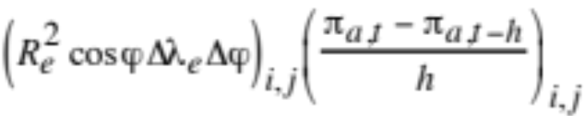
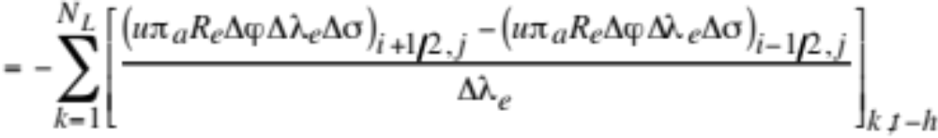
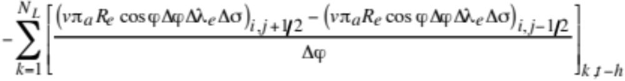
Continuity Equation For Air
Prognostic equation for column pressure (7.12)
First-order in time, second-order in space approx. (7.13)

Slide 9
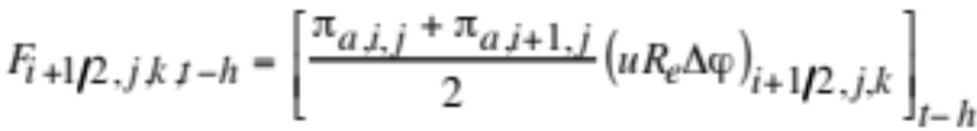
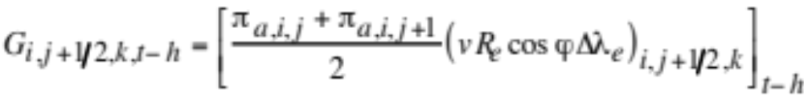
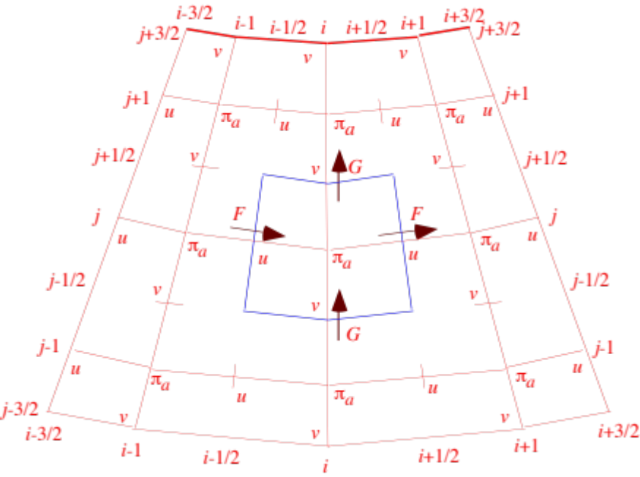
Prognostic Column Pressure
Horizontal fluxes in domain interior (7.15)

Slide 10
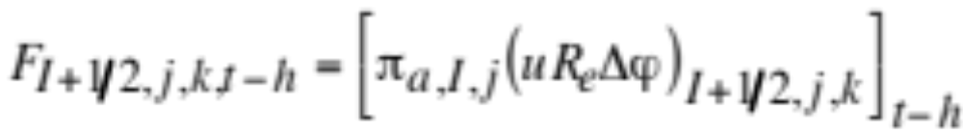
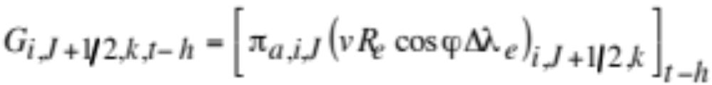
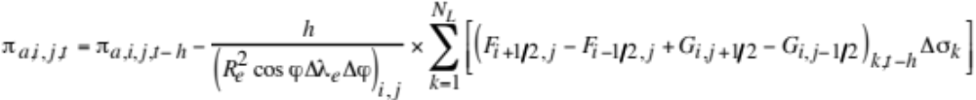
Prognostic Column Pressure
Horizontal fluxes at eastern and northern boundaries (7.17)
Equation for column pressure (7.14)

Slide 11
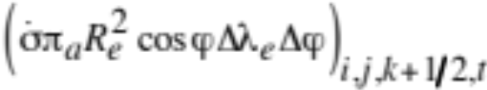
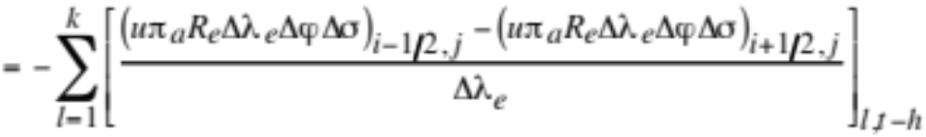
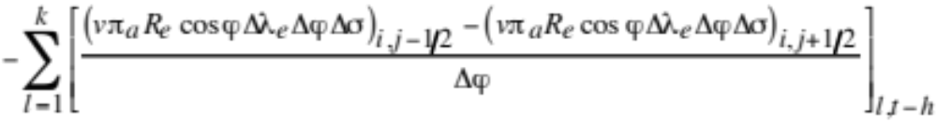
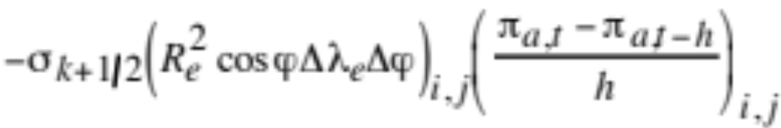
Diagnostic Vertical Velocity
Diagnostic equation for vertical velocity (7.19)
Finite difference equation (7.20)

Slide 12
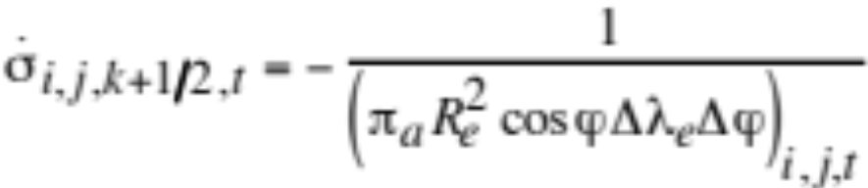
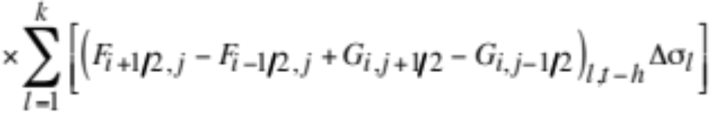
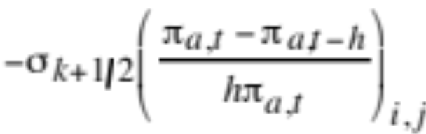
Diagnostic Vertical Velocity
Substitute fluxes and rearrange --> vertical velocity (7.21)

Slide 13
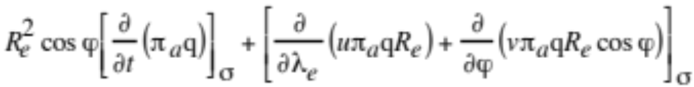
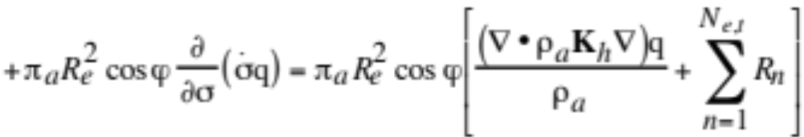
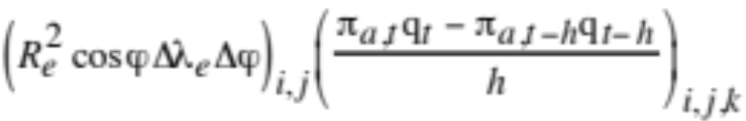
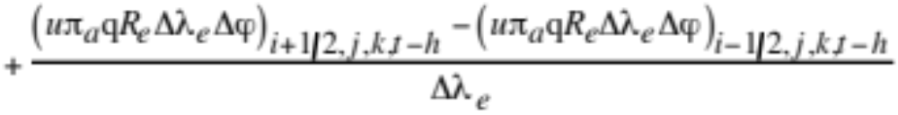
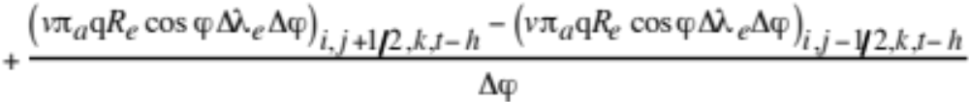
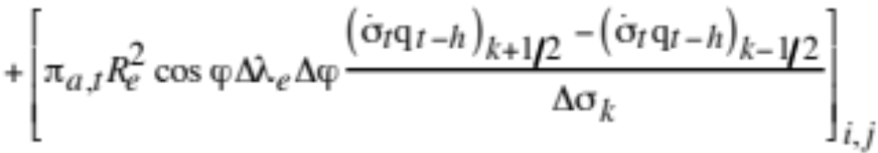
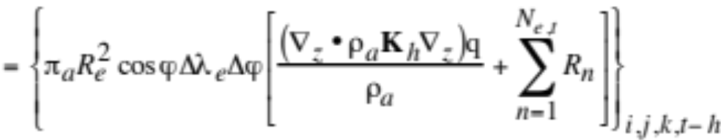
Species Continuity Equation
Species continuity equation (7.22)
Finite-difference form (7.23)

Slide 14
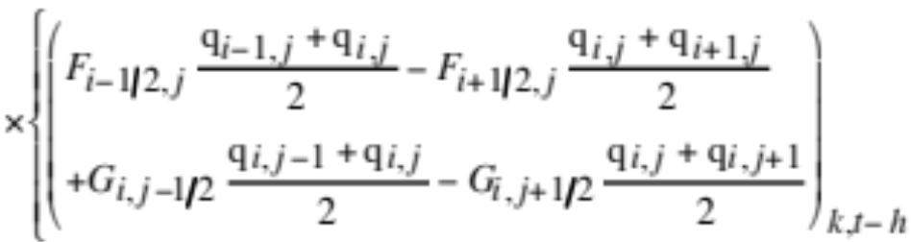
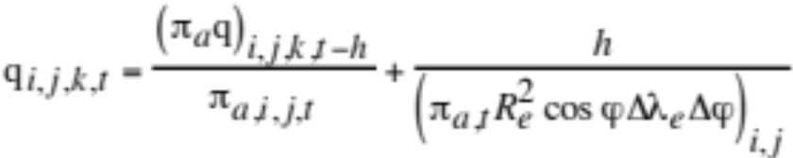
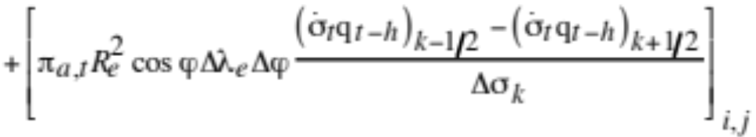
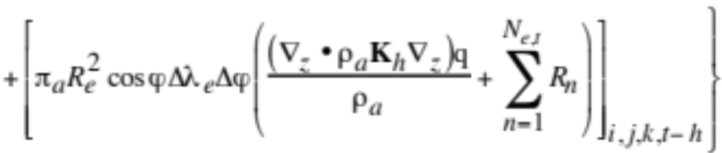
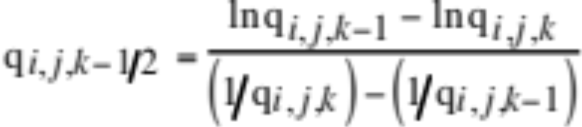
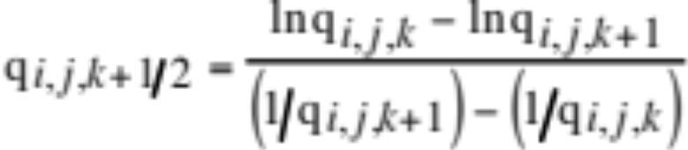
Species Continuity Equation
Substitute fluxes --> final continuity equation (7.24)
Mixing ratios at vertical top and bottom of layer (7.25)

Slide 15
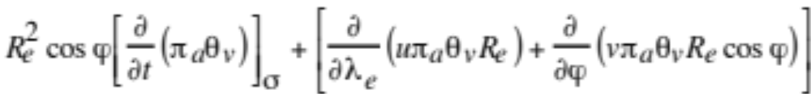
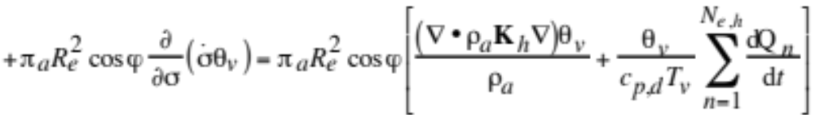
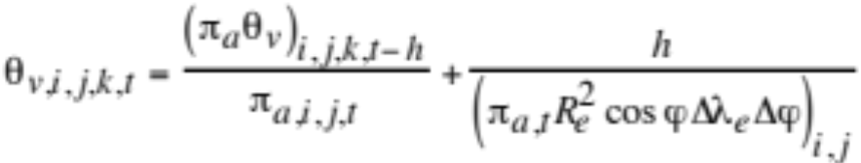
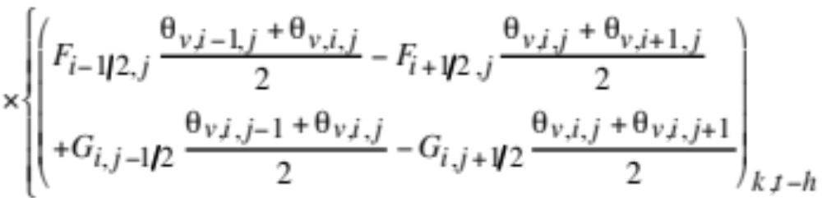
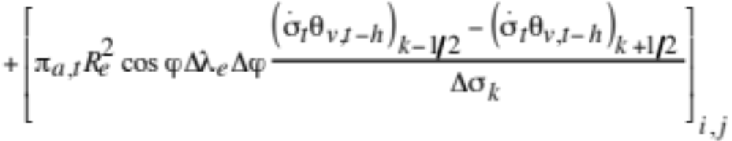
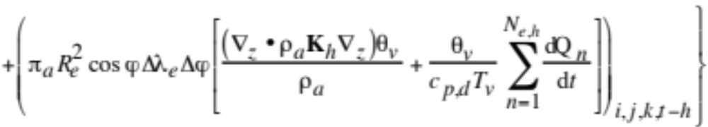
Thermodynamic Energy Equation
Continuous form (7.26)
Final finite difference form (7.27)

Slide 16
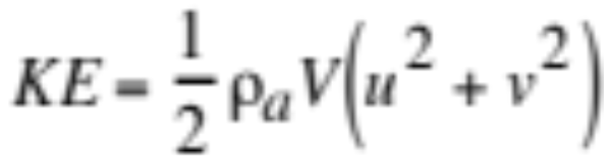
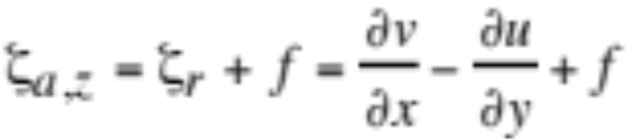


Conservation
Kinetic energy (7.28)
Absolute vorticity (7.29)
Enstrophy (7.30)
Relative error
Fig. 7.3

Slide 17

West-East Momentum Equation
Fig. 7.4

Slide 18


West-East Momentum Equation
Continuous form (7.31)

Slide 19

West-East Momentum Equation
Time-difference term (7.32)

Slide 20


West-East Momentum Equation
Column pressure multiplied by grid-cell area at u-point (7.38)
Grid-cell area (7.39)

Slide 21


West-East Momentum Equation
Horizontal advection terms (7.33)

Slide 22

West-East Momentum Equation
Interpolations for fluxes (7.41-7.44)

Slide 23

West-East Momentum Equation
Vertical transport of horizontal momentum (7.34)
U-values at bottom of layer (7.45)

Slide 24

West-East Momentum Equation
Interpolation for vertical velocity term (7.40)

Slide 25


West-East Momentum Equation
Coriolis and spherical grid conversion terms (7.35)

Slide 26

West-East Momentum Equation
Pressure gradient terms (7.36)

Slide 27

West-East Momentum Equation
Boundary conditions for pressure-gradient term (7.46)

Slide 28

West-East Momentum Equation
Eddy diffusion terms (7.37)

Slide 29

South-North Momentum Equation
Fig. 7.5

Slide 30

Vertical Momentum Equation
Hydrostatic equation
Geopotential at vertical center of bottom layer (7.61)
Geopotential at bottom of subsequent layers (7.62)
Geopotential at vertical midpoint of subsequent layers (7.63)

Slide 31





Time-Stepping Schemes
Time derivative of an advected species (7.64)
Matsuno scheme (7.65-6)
Explicit forward difference to estimate final value followed by second forward difference to obtain final value
Leapfrog scheme (7.67)
Fig. 7.6

Slide 32

Flow Around an Island
Dispersion of tracer in downtown Oklahoma City from simulation with nonhydrostatic z-coordinate model (t = 2,000 s)
Gerard Ketefian

Slide 33

3-D Nonhydrostatic Model
Dispersion of tracer in downtown Oklahoma City from simulation with nonhydrostatic z-coordinate model (t = 2,000 s; middle of 1st level)
Δx = 20 m
Δy = 20 m
Δz = 10 m
K_{x} = 2 m²/s
K_{y} = 2 m²/s
K_{z} = 0.2 m²/s
c [kg/kg]
Source
Gerard Ketefian

Slide 34

3-D Nonhydrostatic Model
Dispersion of tracer in downtown Oklahoma City from simulation with nonhydrostatic z-coordinate model (t = 2,000 s)
Z [m]
c [kg/kg]
Y [m]
Source
X [m]
Gerard Ketefian

Slide 35




30-Day Weather Predictions vs. Data
Results with no model spinup or data assimilation
Ozone
Pressure
RH
Temperature

Slide 36


Model vs. Measured Solar Radiation
Model predicted the location and magnitude of cloud reduction of sunlight for four days in a row

Slide 37








Modeled vs. Measured Paired in Space Monthly T and T_{d}
Data from FSL (2008)

Slide 38








Modeled vs. Measured Paired in Space Monthly Climatological Ozone
Data from Logan et al. (1999)

Slide 39

Modeled vs. Measured Thermal-IR
Data from Kiehl et al., 1998

Slide 40


Modeled vs. Measured Annual Precipitation
Data from Huffman et al.

Slide 41


Sample Height and Velocity Fields
Simulation of irrotational gravity waves in an annulus with an inviscid shallow water model
Gerard Ketefian

Slide 42

3-D Nonhydrostatic Model
Gerard Ketefian

