Slide 1
Presentation Slides for
Chapter 6 of
Fundamentals of Atmospheric Modeling 2nd Edition
Mark Z. Jacobson
Department of Civil & Environmental Engineering
Stanford University
Stanford, CA 94305-4020
jacobson@stanford.edu
March 10, 2005

Slide 2
ODEs and PDEs
Ordinary differential equation (ODE)
Equation with one independent variable
Partial differential equation (PDE)
Equation with more than one independent variable
Order
Highest derivative of an equation
Degree
Highest polynomial value of the highest derivative
Initial value problem
Conditions are known at one end of domain but not other
Boundary value problem
Conditions are known at both ends of domain

Slide 3
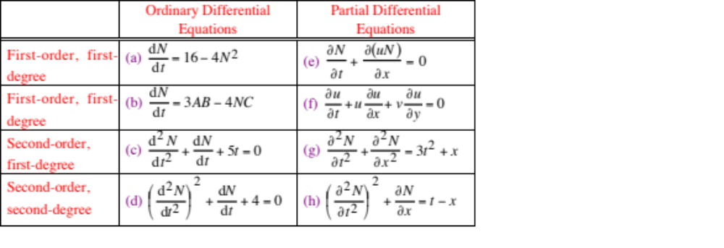
ODEs and PDEs

Slide 4
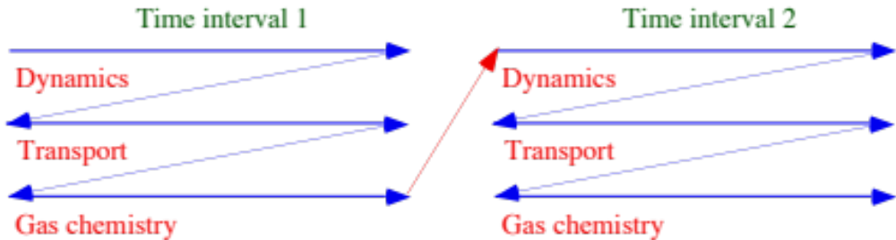
Operator Splitting Scheme
Fig. 6.1

Slide 5
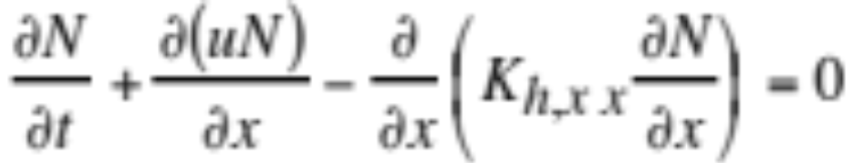
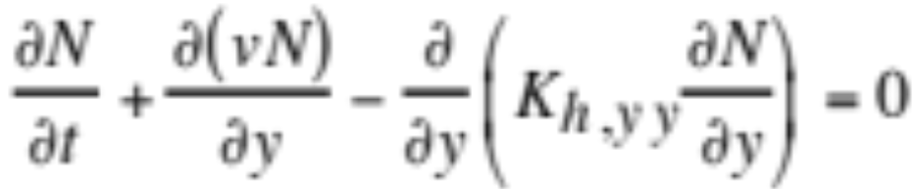
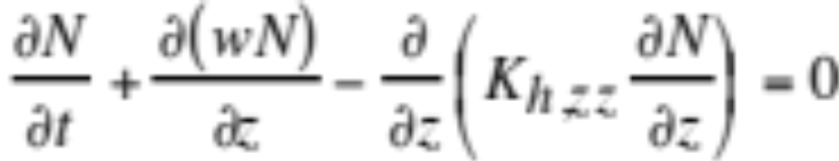
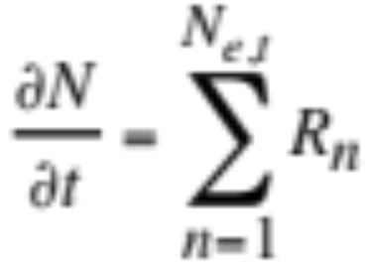
Operator Splitting
Operator-split advection-diffusion equations (6.1-6.3)
Operator-split external source/sink terms (6.4)

Slide 6
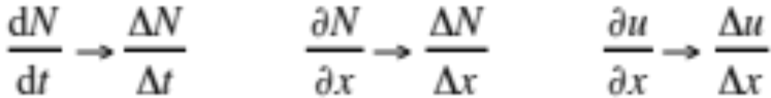
Finite-Difference Approximation
Replacement of continuous differential operator (d) with discrete difference analog (Δ) written in terms of a finite number of values along a temporal or spatial direction.
Examples:

Slide 7
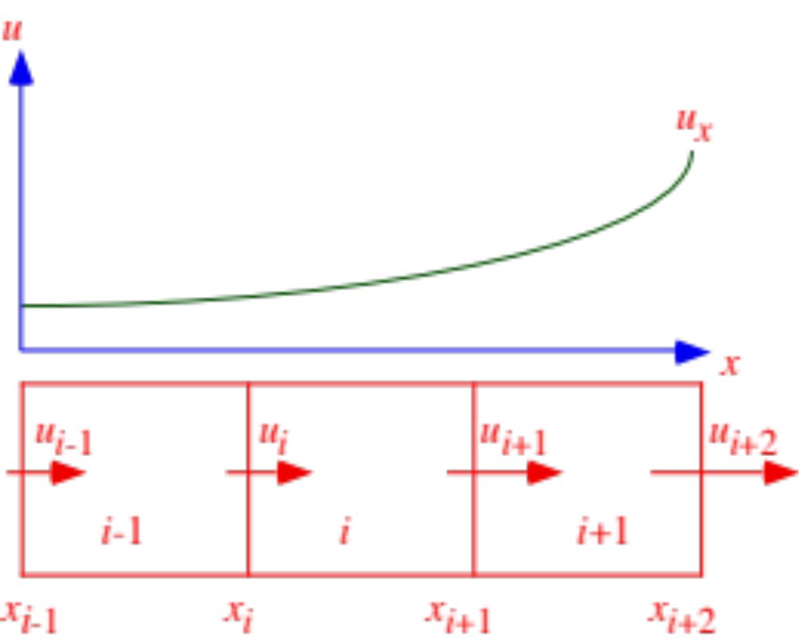
Finite Difference Example
First, replace continuous function u_{x} with a finite number of values in the x direction.
Fig. 6.2

Slide 8




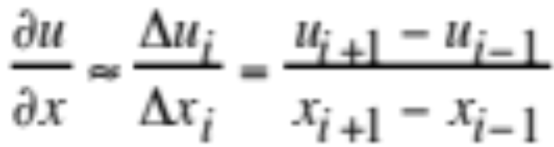
Finite Difference Approximation
Second, define differences of du at point x_{i}
-->
central difference
-->
forward difference
-->
backward difference
Central difference approximation to tangent slope at x_{i} (6.10)

Slide 9
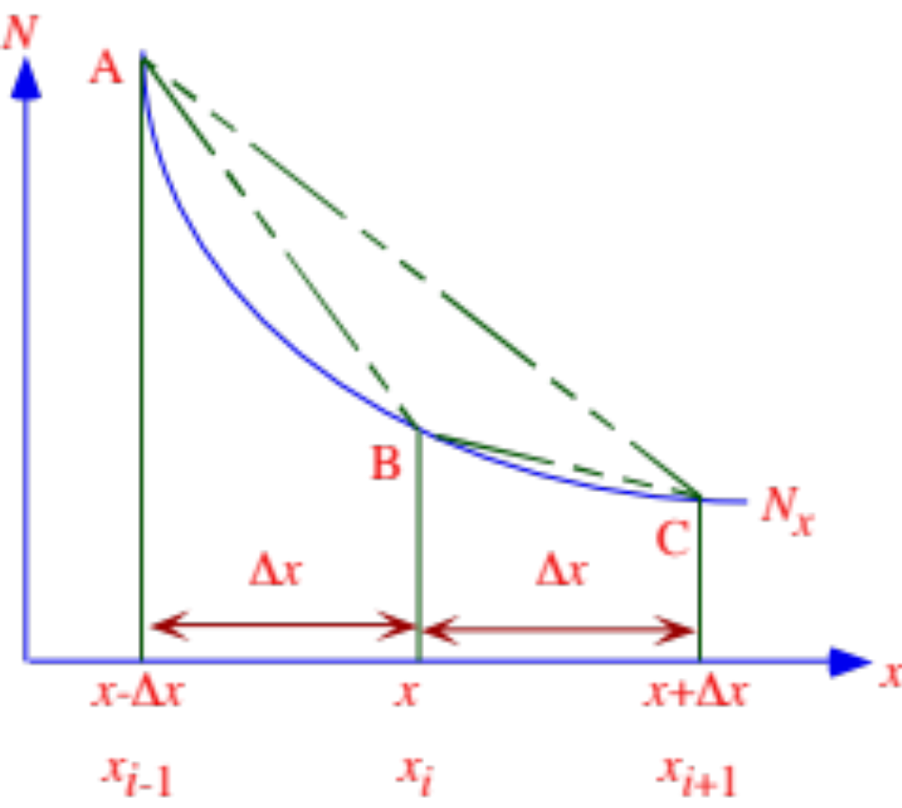
Finite-Difference Approximations
Central (AC), forward (BC), and backward (AB) approximations to slope of tangent at point B
Fig. 6.3

Slide 10
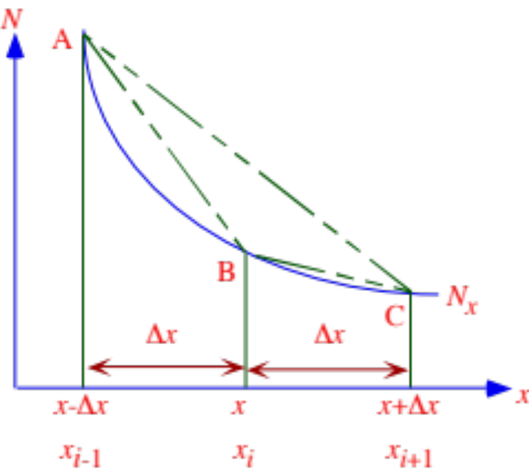
Taylor Series Expansion
Taylor series expansion at point x+Δx (6.11)
Taylor series expansion at point x-Δx (6.12)

Slide 11
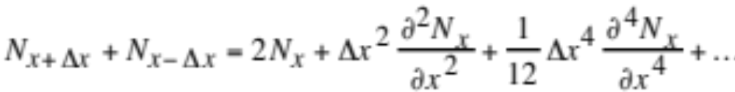
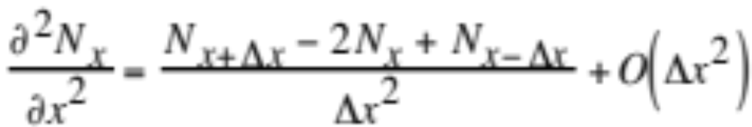
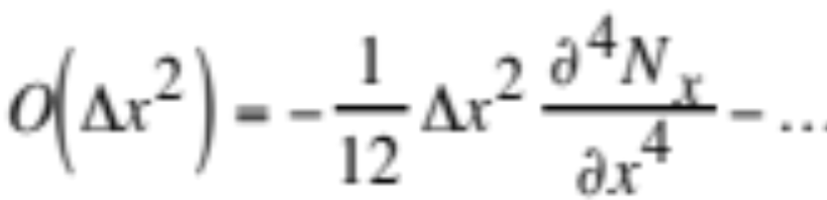
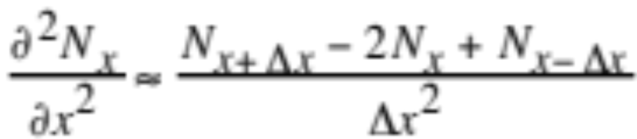
Finite Difference Approximations
Sum the Taylor series expansions (6.13)
Rearrange (6.14)
Truncation error (neglect 2nd-order terms and higher) (6.15)
2nd-order central difference approx. of 2nd derivative (6.16)

Slide 12
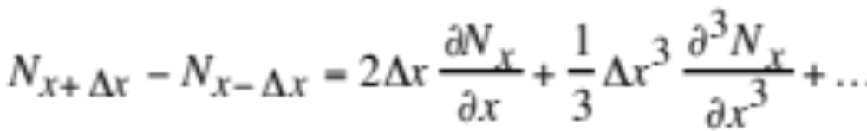
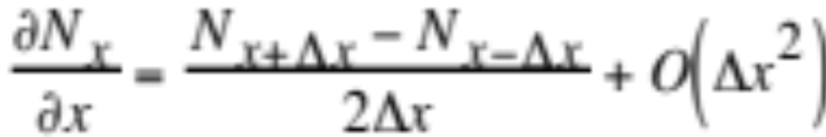
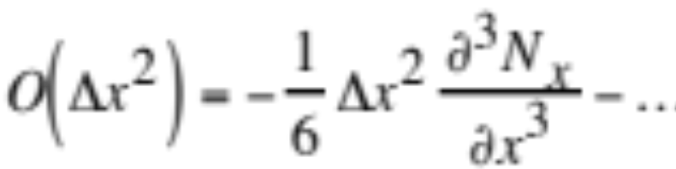
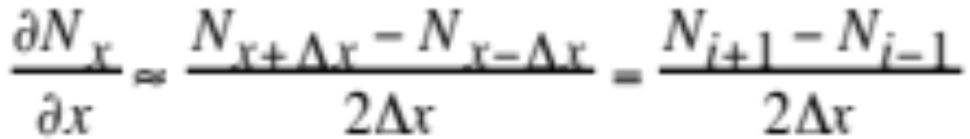
Finite Difference Approximations
Subtract the Taylor series expansions (6.17)
Rearrange (6.18)
Truncation error (6.19)
2nd-order central difference approx. of 1st derivative (6.20)

Slide 13
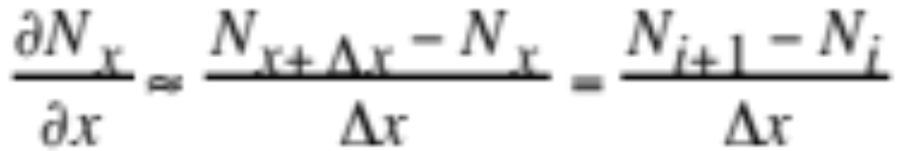
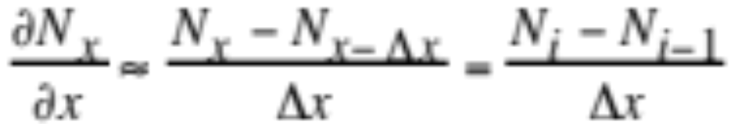
Finite Difference Approximations
First two terms of Taylor series
1st-order forward difference approx. of 1st derivative (6.21)
1st-order backward difference approx. of 1st derivative (6.22)

Slide 14
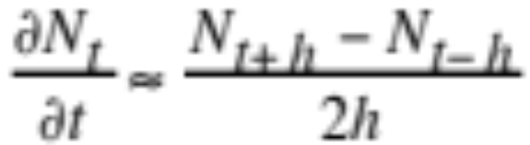
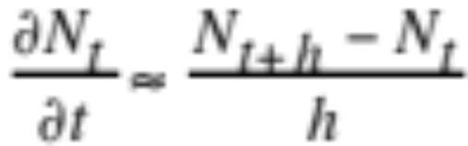
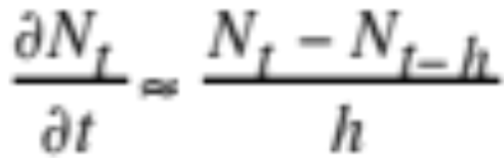
Differencing Time Derivative
Central, forward, backward difference approximations (6.23)

Slide 15
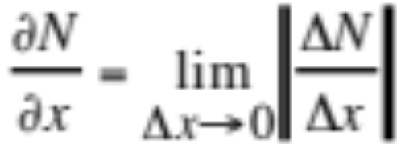
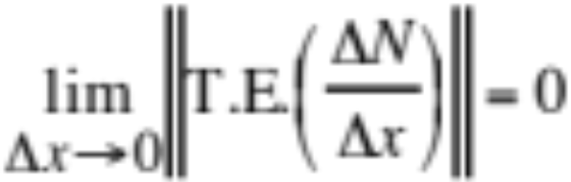
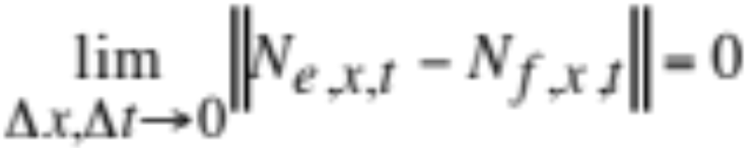
Consistency, Convergence
Convergence of finite difference analog (6.6)
Consistency of finite difference analog (6.7)
Convergence of overall solution (6.8)

Slide 16
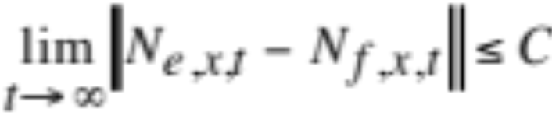
Stability
Stability (6.9)
Conditionally stable: Stable for limited time-step range
Unconditionally stable: Stable for all time steps
Unconditionally unstable: Unstable for all time steps
An unconditionally unstable scheme cannot be convergent overall, but individual finite-difference analogs in an unstable scheme may converge and may be consistent.
In other words, consistency and convergence of individual analogs do not guarantee stability.
Stability is guaranteed if a scheme is convergent overall and its finite-difference analogs are convergent and consistent.

Slide 17
Numerical Diffusion, Dispersion
Numerically diffusive scheme:
Peaks spread artificially across grid cells
Numerically dispersive (oscillatory) scheme:
Waves appear ahead of or behind peaks
Unbounded scheme:
Transported values artificially rise above the largest existing value or fall below the smallest existing value in domain.
Nonmonotonic scheme:
Gradients are not preserved during transport

Slide 18
High Order Approximations
Finite difference approximation of ∂^{m}N/∂x^{m}
Order of derivative = m
Approximation expanded across q discrete nodes
Minimum number of nodes = m + 1
Maximum order of approximation = q - m
Example
Order of derivative: m = 1
Number of nodes: q = 5
--> Order of approximation: q - m = 4

Slide 19
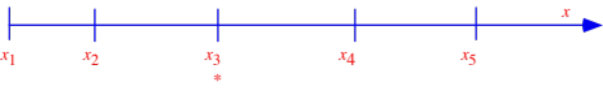

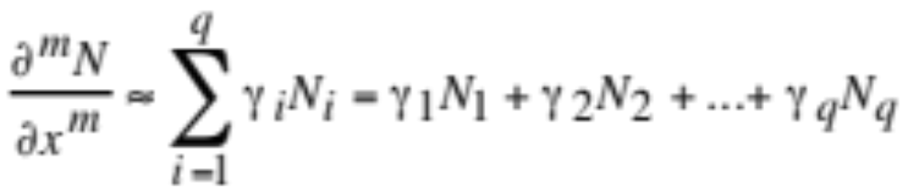
High Order Approximations
Grid spacing where q=5. Derivative is taken at x₃. Fig. 6.4
Distance between two nodes
Approximation to the m^{th} derivative across q nodes (6.24)

Slide 20
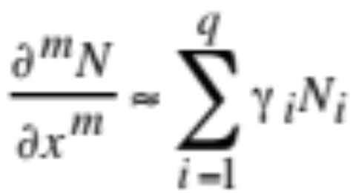
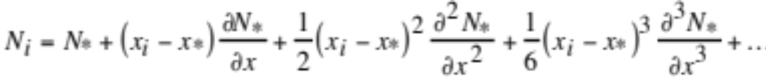
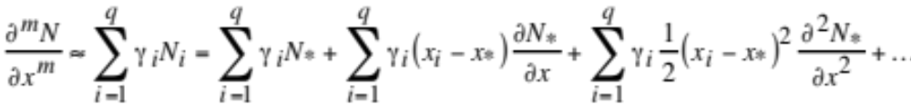
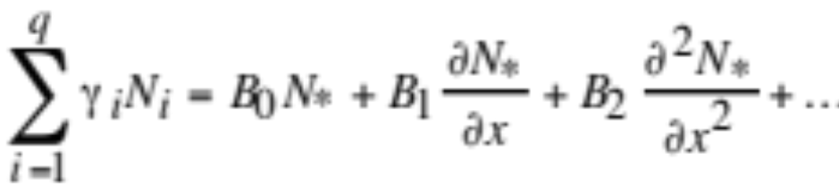
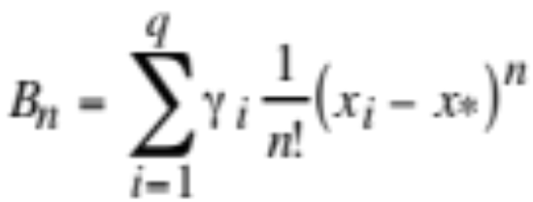
High Order Approximations
Approximation to the m^{th} derivative across q nodes (6.24)
Taylor series expansion for each node about point x* (6.25)
Combine (6.24) with (6.25) and gather terms (6.26)
Redefine (6.27)

Slide 21

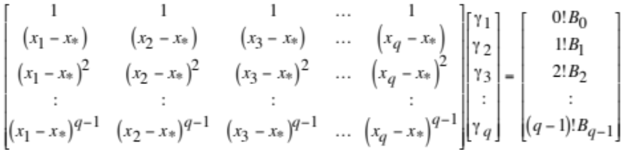
High Order Approximations
for n = 0…q - 1 (6.28)
Multiply (6.28) through by n! and set matrix (6.29)
Set B_{n}=0 for all n, except n = m
Set B_{n}=1 when n = m

Slide 22
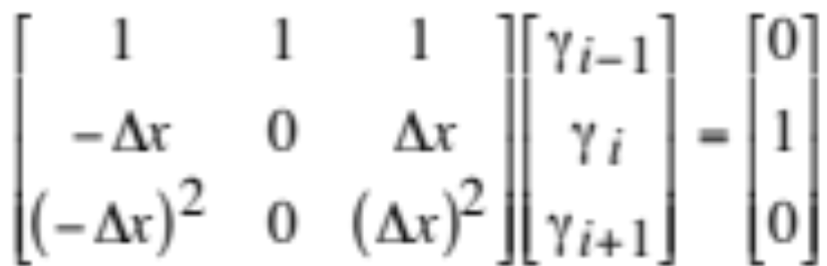
2nd-Order Central Diff. Approx.
Example
Find second-order central difference approx. to ∂N/∂x
Order of derivative: m = 1
Order of approximation: q - m = 2
--> Number of nodes: q = 3
Set matrix (6.32)

Slide 23
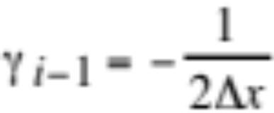
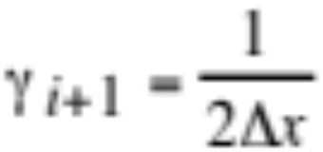

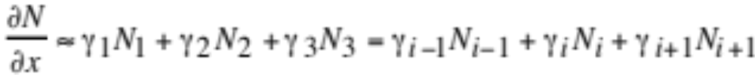
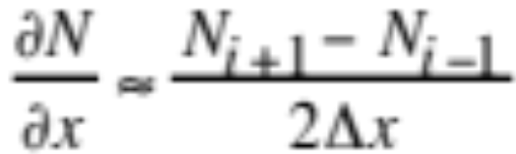
2nd-Order Central Diff. Approx.
Solve matrix
Apply the γ's to (6.24)
Substitute γ's to obtain central difference approx. Table 6.2 (c)

Slide 24
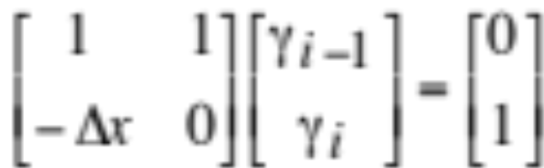
1st-Order Backward Diff. Approx.
Example
Find first-order backward difference approx. to ∂N/∂x
Order of derivative: m = 1
Order of approximation: q - m = 1
--> Number of nodes: q = 2
Set matrix (6.30)

Slide 25
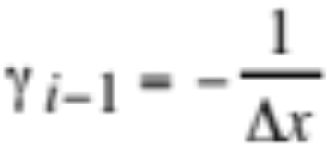
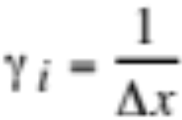
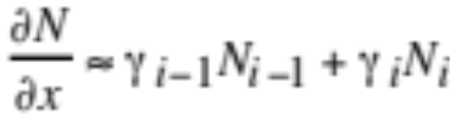
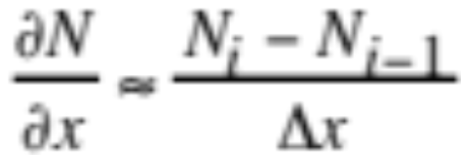
1st-Order Backward Diff. Approx.
Solve matrix
Apply the γ's to (6.24)
Substitute γ's to obtain backward difference approx. Table 6.2 (a)

Slide 26
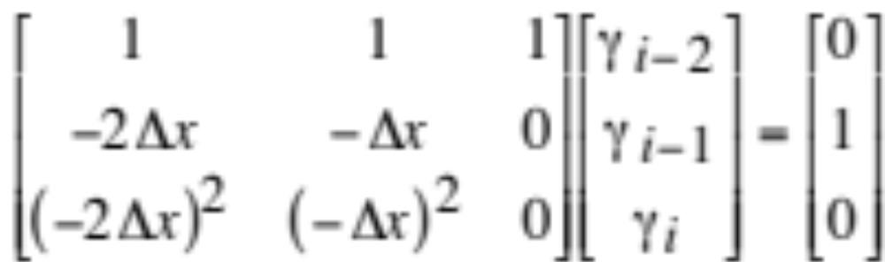
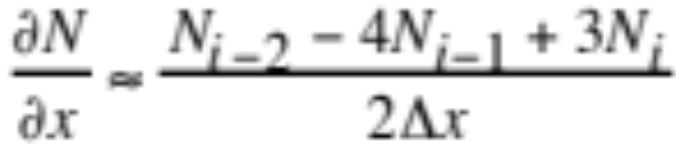
2nd-Order Backward Diff. Approx.
Example
Find second-order backward difference approx. to ∂N/∂x
Order of derivative: m = 1
Order of approximation: q - m = 2
--> Number of nodes: q = 3
Set matrix (6.32)
Solve (Table 6.2d)

Slide 27
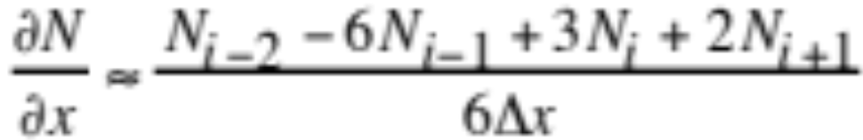
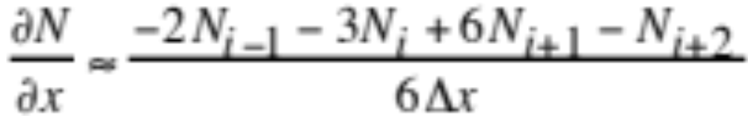


Higher-Order Approximations
Third-order backward difference (m = 1, q = 4) Table 6.2 (f)
Third-order forward difference (m = 1, q = 4) Table 6.2 (g)
Fourth-order backward difference (m = 1, q = 5) Table 6.2 (i)
Fourth-order forward difference (m = 1, q = 5) Table 6.2 (j)

Slide 28



Fourth-Order Approximations
Discretize around furthest cell
Fourth-order backward diff. scheme (m = 1, q = 5) Table 6.2 (k)
Fourth-order forward difference (m = 1, q = 5) Table 6.2 (l)

Slide 29


Fourth-Order Central Diff. Approx.
Fourth-order central difference of ∂N/∂x (m = 1, q = 5) (6.33)
Table 6.2 (h)

Slide 30


Fourth-Order Central Diff. Approx.
Fourth-order central difference of ∂²N/∂x² (m = 2, q = 5)
Table 6.2 (n)

Slide 31


Advection-Diffusion Eqn. Solutions
Species continuity equation in west-east direction (6.1)
CFL stability criterion for advection
Example:
Δx_{min}=5 km, |u_{max}|=20 m/s --> h=250 s (Hydrostatic model)
Δx_{min}=5 km, |u_{max}|=346 m/s --> h=14.5 s (Nonhydrostatic model)
Stability criterion for diffusion
Example:
Δz_{min}=20 m, K_{max}=50 m²/s --> h=8 s (in the vertical)

Slide 32


FTCS Solution
Forward in time, centered in space (FTCS) solution (6.35)
1st-order approximation in time
Unconditionally unstable for K=0, large K; otherwise conditionally stable

Slide 33




Advection-Diffusion Eqn. Solutions
Implicit solution: 1st-order approximation in time (6.36)
Unconditionally stable for all u, K
Rearrange and write in tridiagonal matrix form (6.37)
(6.38)

Slide 34

Advection-Diffusion Eqn. Solutions
Rearrange and write in tridiagonal matrix form (6.39)

Slide 35


Tridiagonal Matrix Solution
Matrix decomposition: (6.40)
i = 2..I
i = 2..I
Matrix backsubstitution: (6.41)
i = I -1..1, -1

Slide 36

Tridiagonal Matrix Solution
Matrix for solution for periodic boundary conditions (6.42)
Values at node I are adjacent to those at node 1

Slide 37

Crank-Nicolson Scheme
Crank-Nicolson form (6.44)
μ_{c} = Crank-Nicolson parameter
= 0.5 --> Crank-Nicolson solution (unconditionally stable all u, K)
2nd-order approximation in time
= 0. --> explicit (FTCS) solution
= 1 --> implicit solution

Slide 38






Crank-Nicolson Scheme
Tridiagonal form (6.45)

Slide 39
Leapfrog Scheme
2nd-order approximation in time (6.48)
Unconditionally unstable for all nonzero K; conditionally stable for linear equations when K=0; unstable for nonlinear equations

Slide 40
Matsuno Scheme
1st-order approximation in time
Conditionally stable for all u when K=0 or small; unconditionally unstable for large K
Prediction step (6.49)
Correction step (6.49)

Slide 41

Heun Scheme
2nd-order approximation in time (6.51)
Unconditionally unstable for all u when K=0 and K large; conditionally stable for other values of K
Prediction step same as first Matsuno step

Slide 42
Adams-Bashforth Scheme
2nd-order approximation in time (6.52)
Unconditionally unstable for all u when K=0 and K large; conditionally stable for other values of K.

Slide 43





Fourth-Order Runge-Kutta Scheme
Conditionally stable (6.53-5)

Slide 44



Fourth-Order Runge-Kutta Scheme

Slide 45

Convergence of Four Schemes
Error
(Ketefian and Jacobson 2004b) Fig. 6.5

Slide 46


Fourth-Order in Space Solution
Central difference implicit solution (6.56)
Write in Crank-Nicolson and pentadiagonal form

Slide 47


Variable Grid Spacing, Winds
Second-order central difference of advection term (6.57)
Solve matrix equation to obtain coefficients (6.58)

Slide 48



Variable Grid Spacing, Winds
Solve matrix equation to obtain coefficients (6.59)

Slide 49




Results From Diffusion Scheme
Infinite Diffusion
Limited Diffusion

Slide 50




Variable Grid Spacing, Diffusion
Expand analytical diffusion term (6.60)
Second-order central-difference approx. to terms (6.61)

Slide 51



Variable Grid Spacing, Diffusion
Solve matrix equation to obtain coefficients (6.63)

Slide 52
Variable Grid Spacing Solution
Crank-Nicolson form (μ_{c}=0.5--> 2nd order time, space) (6.66)
Coefficients for diffusion term (6.65)
Write in tridiagonal form

Slide 53



Two Dimensional Solution
Advection-diffusion equation in two dimensions (6.67)
Central difference approximation (6.68)
Solve

Slide 54

Semi-Lagrangian Method
Concentration at current time t and existing node x (6.69)
Values at time x-uh, t-h interpolated from existing nodes

Slide 55


Finite Element Method
Advection equation at node i (6.70)
Trial function = series expansion approximation to N (6.71)
= linear combination of basis functions
e_{j}(x) = basis function
j = trial space

Slide 56

Finite Element Method
Residual in advection equation (6.73)
Minimize residual (6.72)
Force its weighted average to zero over domain
e_{i}(x) = weight function
e_{i}(x) = e_{j}(x) --> Galerkin method of weighted residuals
e_{i}(x) ≠ e_{j}(x) --> Petrov-Galerkin technique

Slide 57





Finite Element Method
Substitute
into
to obtain (6.74)

Slide 58


Finite Element Method
Take time difference of (6.74) over three nodes (6.75)

Slide 59


Finite Element Method
Define basis functions as chapeau functions (6.76)
Solve each integral (6.77)

Slide 60

Finite Element Method
Substitute integral solutions back into (6.75) (6.78)
Solve with tridiagonal matrix solution -->
4th-order in space, 2nd order in time

Slide 61

Tests with a Finite Element Method
Preservation of a Gaussian peak during finite element transport after eight revolutions around a circular grid when uh/Δx= 0.02
Concentration
Fig. 6.8

Slide 62

Tests with a Finite Element Method
Preservation of a Gaussian peak during finite element transport after eight revolutions around a circular grid when uh/Δx= 0.6
Concentration
Fig. 6.8

Slide 63



Pseudospectral Method
Advection equation (6.87)
Represent solution with infinite Fourier series (6.88)
For t=0, integrate both sides of (6.88) from 0≤x≤L (6.89)

Slide 64



Pseudospectral Method
Truncate infinite series (6.90)
Central time-difference approximation of (6.90) (6.91)
Partial derivative of (6.90) with respect to space (6.92)

Slide 65


Pseudospectral Method
Substitute (6.91) and (6.92) into (6.87) (6.93)
Separate into K equations --> solve (6.94)

Slide 66

Traits of a Good Advection Scheme
Fig 6.9
Bounded
Nonoscillatory
Monotonic
Final shape after six rotations around a 2-D grid. Walcek (2000)

