Slide 1
Presentation Slides for
Chapter 5 of
Fundamentals of Atmospheric Modeling 2nd Edition
Mark Z. Jacobson
Department of Civil & Environmental Engineering
Stanford University
Stanford, CA 94305-4020
jacobson@stanford.edu
March 10, 2005

Slide 2
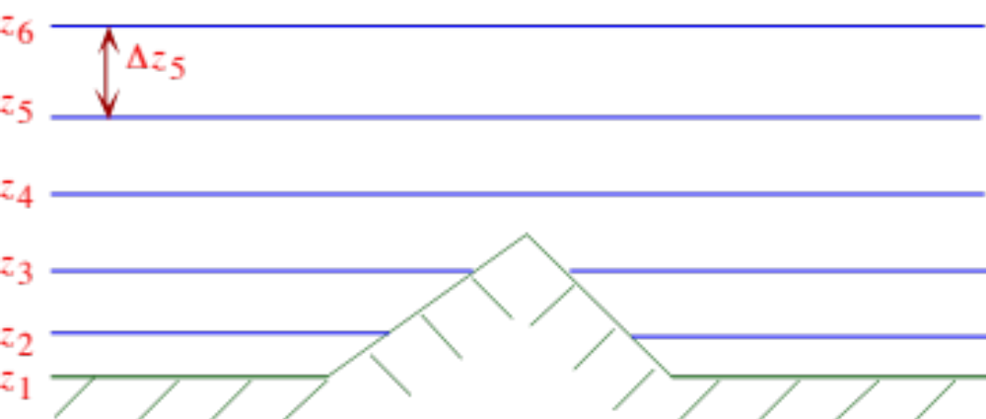
Altitude Coordinate Surfaces
Fig. 5.1

Slide 3

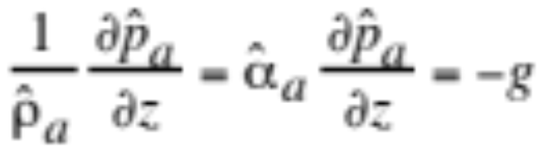
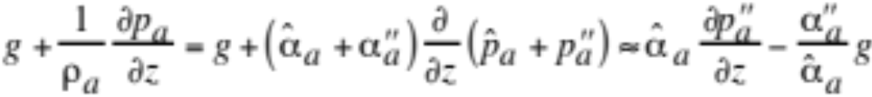
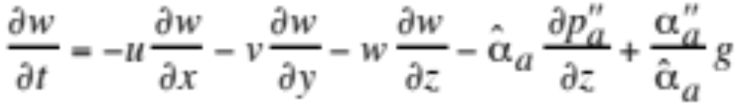
Equation for Nonhydrostatic Pressure
Decompose pressure into large-scale and perturbation term (5.1)
Large-scale atmosphere in hydrostatic balance (5.2)
Decompose gravitational and pressure gradient term (5.3)
Substitute (5.3) into vertical momentum equation (5.4)

Slide 4
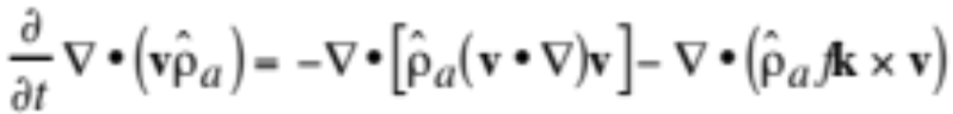
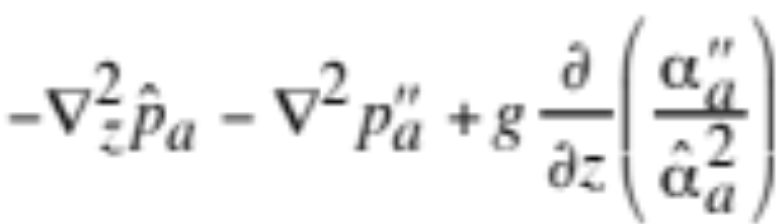
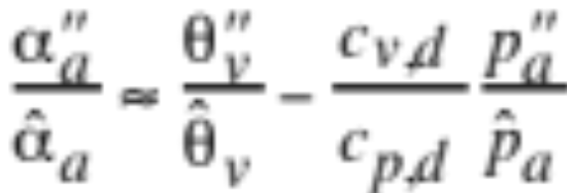
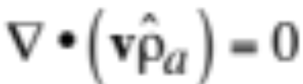
Equation for Nonhydrostatic Pressure
Take grad dot the sum of (5.4), (4.73), and (4.74) (5.5)
Note that (5.6)
Remove local derivative from continuity equation (5.7)
--> Anelastic continuity equation

Slide 5
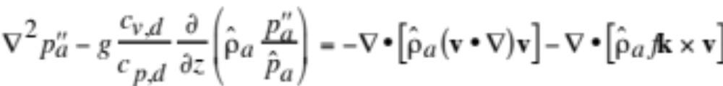
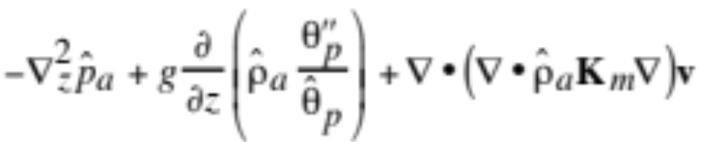
Equation for Nonhydrostatic Pressure
Substitute (5.6) and (5.7) into (5.5) (5.8)
--> Diagnostic equation for nonhydrostatic pressure

Slide 6
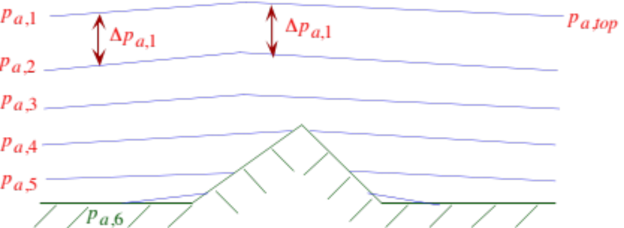
Pressure Coordinate Surfaces
Fig. 5.2

Slide 7
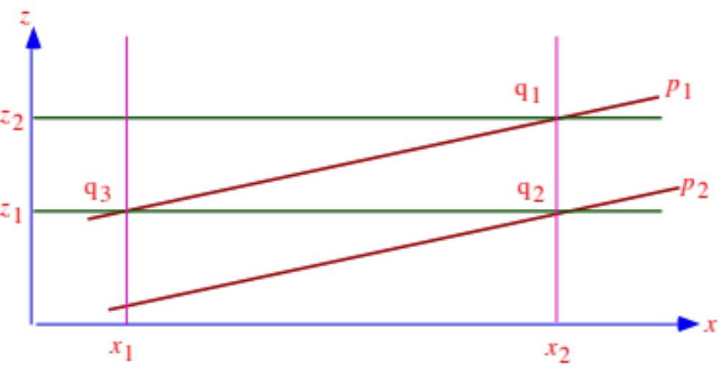
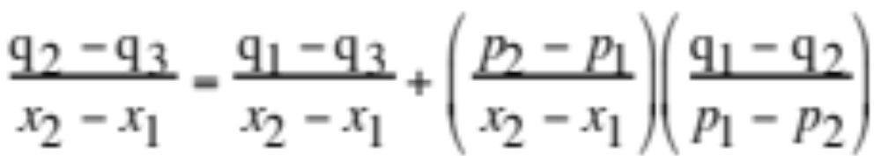
Intersections of z and p Surfaces
Fig. 5.3
Change in mass mixing ratio over distance (5.9)

Slide 8
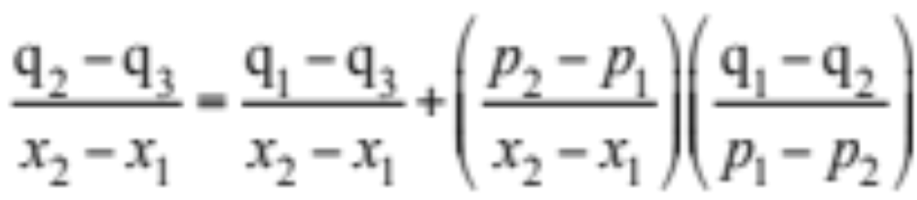
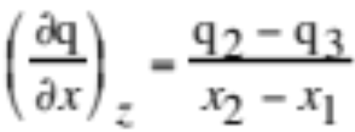
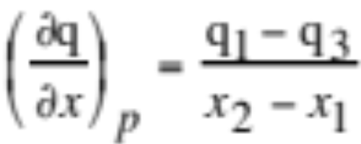
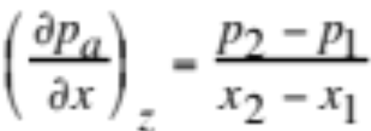
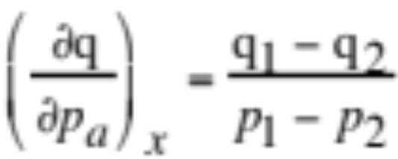
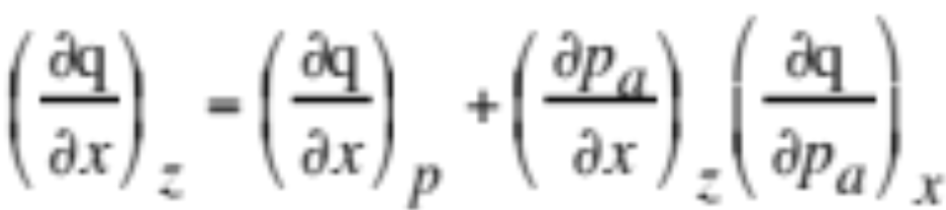
z to p Coord. Gradient Conversion
Change in mass mixing ratio over distance (5.9)
Approximate differences as x₂-x₁-->0, p₁-p₂-->0 (5.10)
Gradient conversion from the z to p coordinate (5.11)

Slide 9
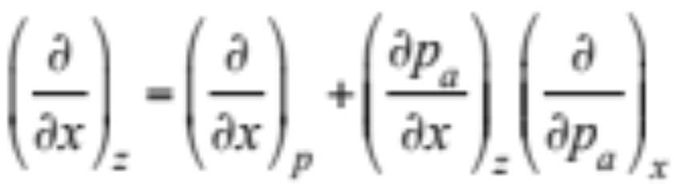
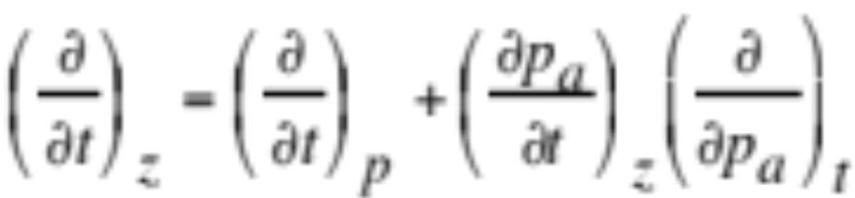
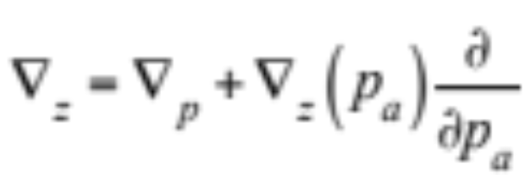
z to p Coord. Gradient Conversion
General equations (5.12)
Substitute time for distance (5.15)
Gradient conversion altitude to pressure coordinate (5.13)

Slide 10
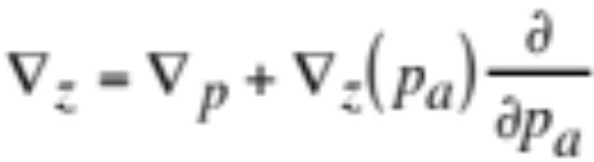
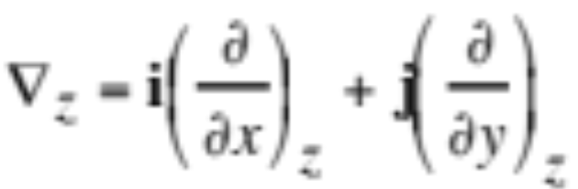
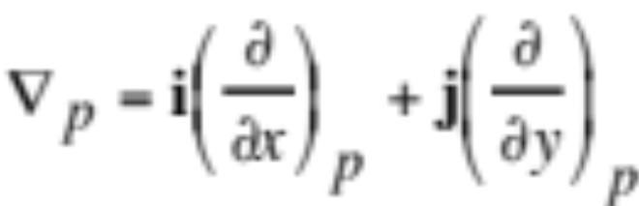
z to p Coord. Gradient Conversion
Gradient conversion altitude to pressure coordinate (5.13)
Horizontal gradient operator in the altitude coordinate (4.81)
Horizontal gradient operator in the pressure coordinate (5.14)

Slide 11
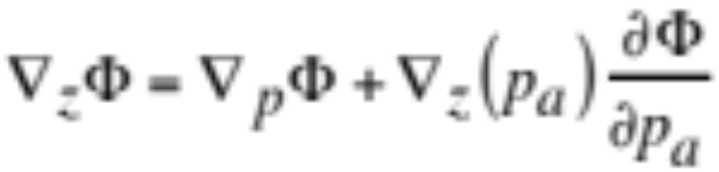

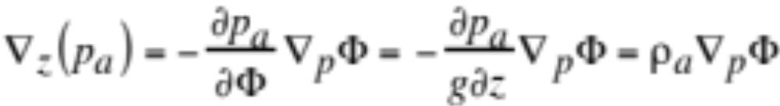
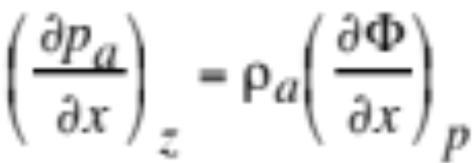
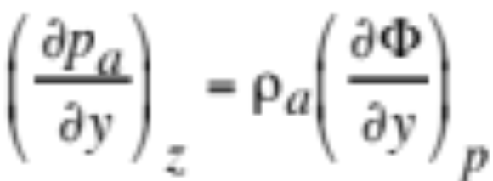
Geopotential Gradient
Take gradient conversion of geopotential
and note that
Rearrange gradient conversion (5.16)
--> pressure gradient proportional to altitude gradient (5.17)

Slide 12
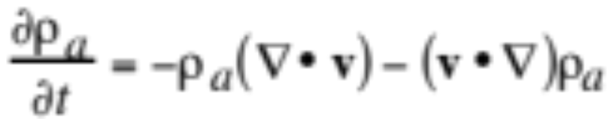
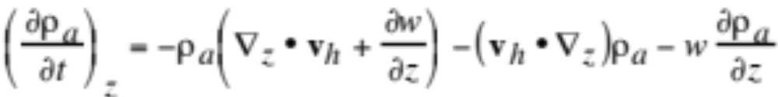
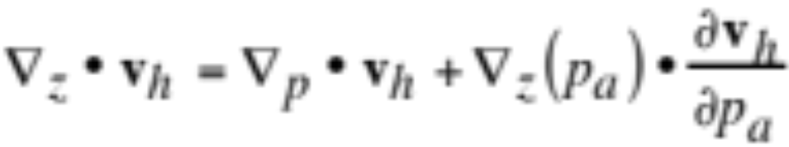
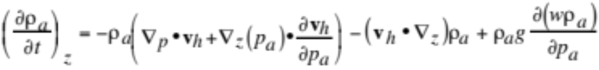
p Coordinate Continuity Eq. for Air
Continuity equation for air in the altitude coordinate (3.20)
Expand with horizontal operators (5.18)
Gradient conversion of velocity (5.19)
Substitute gradient conversion and hydrostatic equation (5.20)

Slide 13
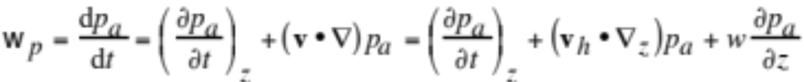
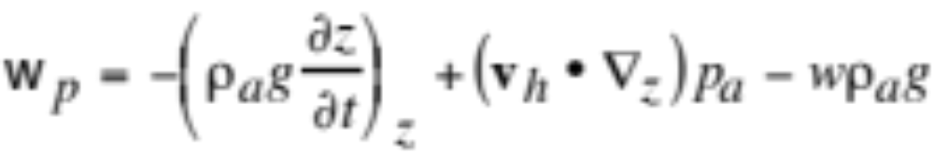
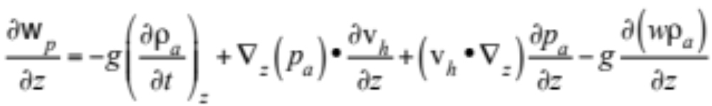
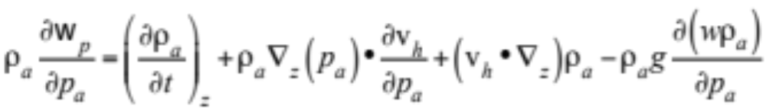
p Coordinate Continuity Eq. for Air
Vertical scalar velocity in the pressure coordinate (5.21)
Substitute ∂p_{a}/∂z=-ρ_{a}g (+w_{p} downward, +w upward) (5.22)
Differentiate vertical velocity with respect to altitude (5.23)
Substitute dz=-dp_{a}/ρ_{a}g (5.24)

Slide 14
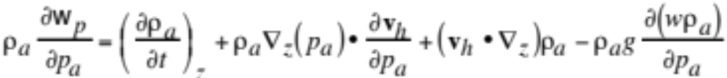
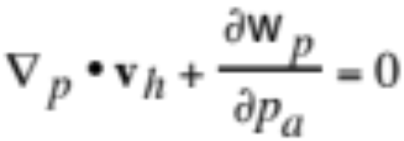
p Coordinate Continuity Eq. for Air
From two pages back (5.20)
From previous page (5.24)
Add (5.20) and (5.24) (5.25)

Slide 15
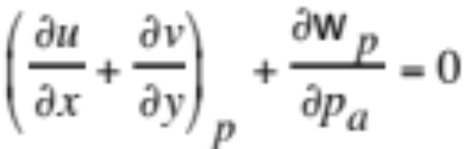
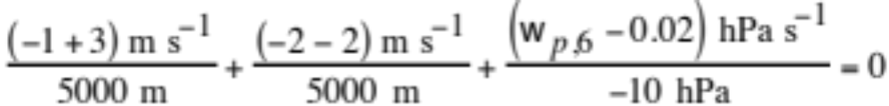
p Coordinate Continuity Eq. for Air
Expanded continuity equation (5.26)
Example 5.1
Δx = 5 km Δy = 5 km Δp_{a} = -10 hPa
u₁ = -3 (west) u₂ = -1 m s⁻¹ (east)
v₃ = +2 (south) v₄ = -2 m s⁻¹ (north)
w_{p,5} = +0.02 hPa s⁻¹ (lower boundary)
-->
--> w_{p,6} = +0.016 hPa s⁻¹ (downward)

Slide 16
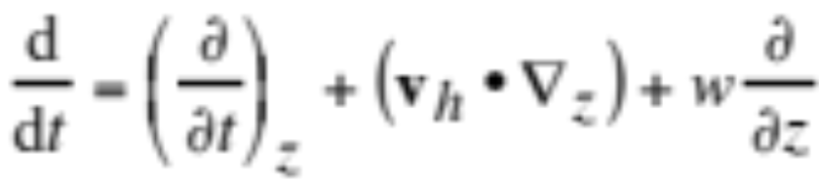
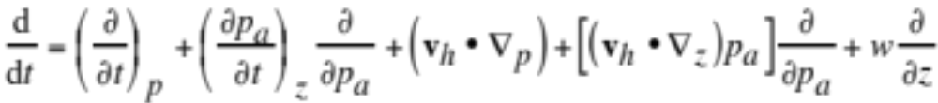
Total Derivative in p Coordinate
Total derivative in Cartesian-altitude coordinate (5.27)
Time derivative and gradient operator conversions (5.15, 13)
Substitute conversions into total derivative (5.28)

Slide 17
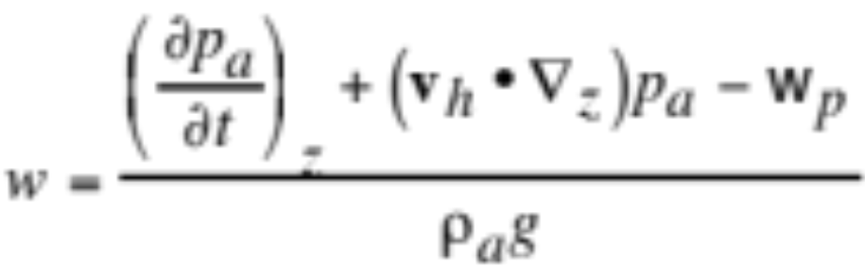
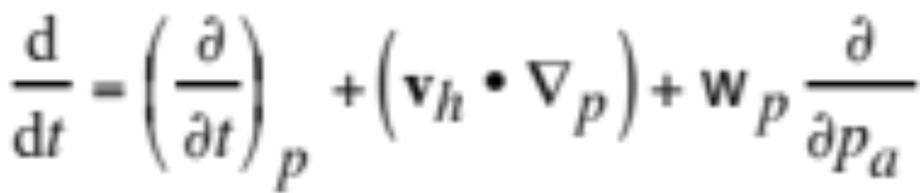
Total Derivative in p Coordinate
Total time derivative (5.28)
Vertical velocity in altitude coordinate from (5.21) (5.29)
Substitute (5.29) and hydrostatic equation into (5.28) (5.30)
--> total derivative in Cartesian-pressure coordinates

Slide 18
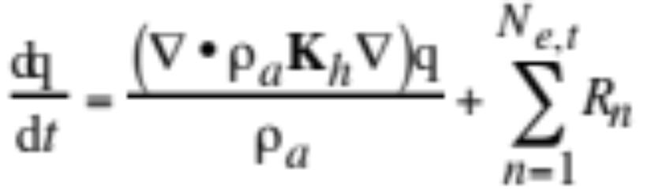
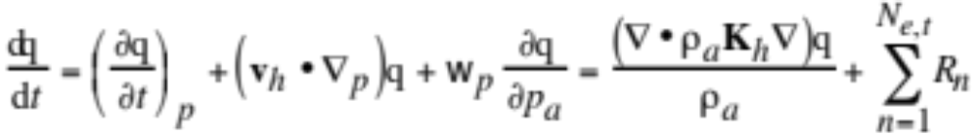
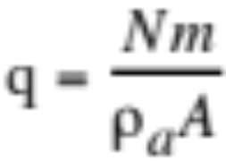
p Coordinate Species Cont. Equation
Species continuity equation in the altitude coordinate
Apply Cartesian-pressure coordinate total derivative (5.31)
Convert mass mixing ratio to number concentration (5.32)

Slide 19
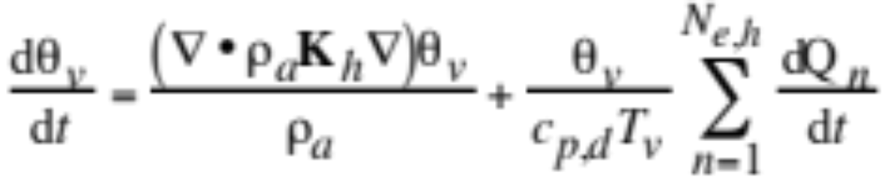
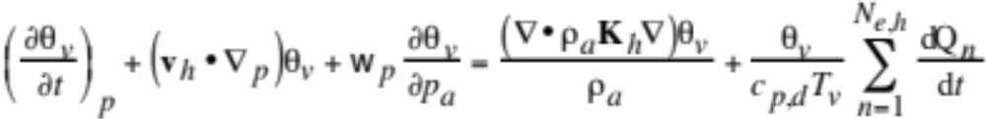
p Coordinate Thermo. Energy Eq.
Thermodynamic energy equation in the altitude coordinate
Apply Cartesian-pressure coordinate total derivative (5.34)

Slide 20



p Coordinate Horiz. Momentum Eq.
Horizontal momentum equation in the altitude coordinate
Substitute from (5.16)
Apply Cartesian-pressure coordinate total derivative (5.35)

Slide 21






p Coordinate Vert. Momentum Eq.
Assume hydrostatic equilibrium
Substitute
--> hydrostatic equation in the pressure coordinate (5.37)
Substitute κ=R’/c_{p},_{d} for final hydrostatic equation (5.38)

Slide 22





Geostrophic Wind in p Coordinate
Substitute (5.17)
into (4.79)
--> Geostrophic wind in the pressure coordinate (5.39)
Vector form (5.40)

Slide 23

Geostrophic Wind on a Surface of Constant Pressure
Fig. 5.4

Slide 24

Sigma-Pressure Coordinate Surfaces
Fig. 5.5

Slide 25



The Sigma-Pressure Coordinate
Definition of a sigma level (5.41)
Pressure difference between column surface and top
Pressure at a given sigma level (5.42)

Slide 26


Intersections of p, z and σ-p Surfaces
Fig. 5.7
Change in mixing ratio per unit distance (5.51)

Slide 27


Gradient Conversion p to σ-p Coord.
Change in mixing ratio per unit distance (5.51)
Gradient conversion from p to σ-p coordinate (5.52)
Generalize (5.53)

Slide 28





Gradient Conversion p to σ-p Coord.
Gradient conversion (5.53)
Gradient of sigma along surface of constant pressure (5.54)
Where
Substitute (5.54) into (5.53) (5.55)

Slide 29


σ-p Coord. Continuity Eq. for Air
Continuity equation for air in the pressure coordinate
Gradient conversion from p to σ-p coordinate (5.55)
Substitute gradient conversion and ∂p_{a}/∂σ=π_{a} (5.56)
p coordinate vertical velocity, where p_{a} = p_{a,top}+ π_{a}σ (5.58)

Slide 30

σ-p Coord. Vertical Velocity
p coordinate vertical velocity (5.58)
Sigma-pressure coordinate vertical velocity (+ is down) (5.57)

Slide 31





σ-p Coord. Continuity Eq. for Air
Material time derivative in the σ-p coordinate (5.59)
p coordinate vertical velocity (5.58)
Total derivative of π_{a} (note that ∂π_{a}/∂σ=0)
Substitute total derivative of π_{a} into (5.58) (5.60)
Take partial derivative (5.61)

Slide 32


σ-p Coord. Continuity Eq. for Air
Partial derivative of vertical scalar velocity (5.61)
Gradient conversion previously derived (5.56)
Substitute (5.61) into (5.56) (5.62)
--> continuity equation for air in σ-p coordinate
Convert to spherical-sigma-pressure coordinates (5.63)

Slide 33



Column Pressure
Continuity equation for air (5.62)
Rearrange and integrate (5.64)
Prognostic equation for column pressure (5.65)
Analogous equation in spherical-σ-p coordinates (5.66)

Slide 34


Vertical Scalar Velocity
Continuity equation for air (5.62)
Rearrange and integrate (5.67)
Diagnostic equation for vertical velocity (5.68)
Analogous equation in spherical-σ-p coordinates (5.69)

Slide 35



σ-p Coord. Species Continuity Eq.
Species continuity equation in Cartesian-z coordinates (3.54)
Material time derivative is sigma-pressure coordinate
--> Continuity equation in Cartesian-σ-p coordinates (5.70)

Slide 36



σ-p Coord. Species Continuity Eq.
Combine species and air continuity equations (5.72)
Apply spherical-coordinate transformations (5.73)

Slide 37


σ-p Coord. Thermodynamic En. Eq.
In Cartesian-altitude coordinates (3.76)
Apply the σ-p coordinate material time derivative (5.74)

Slide 38




σ-p Coord. Thermodynamic En. Eq.
Combine with continuity equation for air (5.75)
Apply spherical-coordinate transformations (5.76)

Slide 39


σ-p Coord. Momentum Equation
In Cartesian-altitude coordinates (4.70)
Material time derivative of velocity
Apply to horizontal momentum equation (5.77)

Slide 40



σ-p Coord. Momentum Equation
Pressure gradient term (5.78)
Substitute into momentum equation (5.79)

Slide 41


Coupling Hor./Vert. Momentum Eqs.
Hydrostatic equation in the pressure coordinate (5.80)
Re-derive specific density (5.82)

Slide 42




Coupling Hor./Vert. Momentum Eqs.
Combine terms above with momentum/continuity eqs. (5.83)
Now horizontal and vertical equations consistent (5.38)

Slide 43




σ-p Coord. Momentum Equation
U-direction momentum equation (5.86)
V-direction momentum equation (5.87)

Slide 44



Sigma-Altitude Coordinate
Sigma-altitude value (5.89)
Altitude difference between column top and surface
Altitude of a sigma surface (5.90)

Slide 45



Gradient Conversion
Gradient conversion between z and s-z coordinate (5.91)
Horiz. gradient of sigma along const. altitude surface (5.92)
Substitute into gradient conversion (5.93)

Slide 46




Conversions in s-z Coordinate
Time-derivative conversion between z and s-z coordinate (5.94)
Scalar velocity in the sigma-altitude coordinate (5.95)
where
Material time derivative in the sigma-altitude coordinate (5.96)

Slide 47




s-z Coord. Continuity Eq. For Air
Continuity equation for air in the z coordinate
Apply gradient conversion to horizontal velocity
Apply gradient conversion to air density
Substitute these terms into continuity equation above (5.97)

Slide 48




s-z Coord. Continuity Eq. For Air
Rewrite vertical velocity
Differentiate with respect to altitude (5.98)
Substitute ∂s/∂z=-1/Z_{t} (5.99)
Sub. , (5.99), ∂s/∂z=-1/Z_{t} into (5.97) (5.100)

Slide 49





Non/Hydrostatic Continuity Eq.
Substitute and compress --> (5.101)
Nonhydrostatic continuity equation for air in s-z coordinate
Hydrostatic equation in the s-z coordinate (5.102)
Substitute into (5.101) --> Hydrostatic continuity eq. (5.103)

Slide 50

s-z Coord. Species Continuity Eq.
Apply material derivative in the s-z coordinate to the continuity equation for a trace species in the z coordinate (5.104)

Slide 51

s-z Coord. Thermodynamic En. Eq.
Apply material derivative in the s-z coordinate to the thermodynamic energy equation in the z coordinate (5.106)

Slide 52



s-z Coord. Horiz. Momentum Eqs.
Horizontal equation in the z coordinate
Apply material time derivative of velocity (5.107)
Gradient conversion of pressure (5.108)
Substitute gradient conversion (5.109)

Slide 53




s-z Coord. Vertical Momentum Eq.
Sub. ∂s/∂z=-1/Z_{t} into z-coord. vertical momentum eq. (5.113)
Substitute
Another form of vertical momentum equation (5.114)

