Slide 1
Presentation Slides for
Chapter 4 of
Fundamentals of Atmospheric Modeling 2nd Edition
Mark Z. Jacobson
Department of Civil & Environmental Engineering
Stanford University
Stanford, CA 94305-4020
jacobson@stanford.edu
March 10, 2005

Slide 2
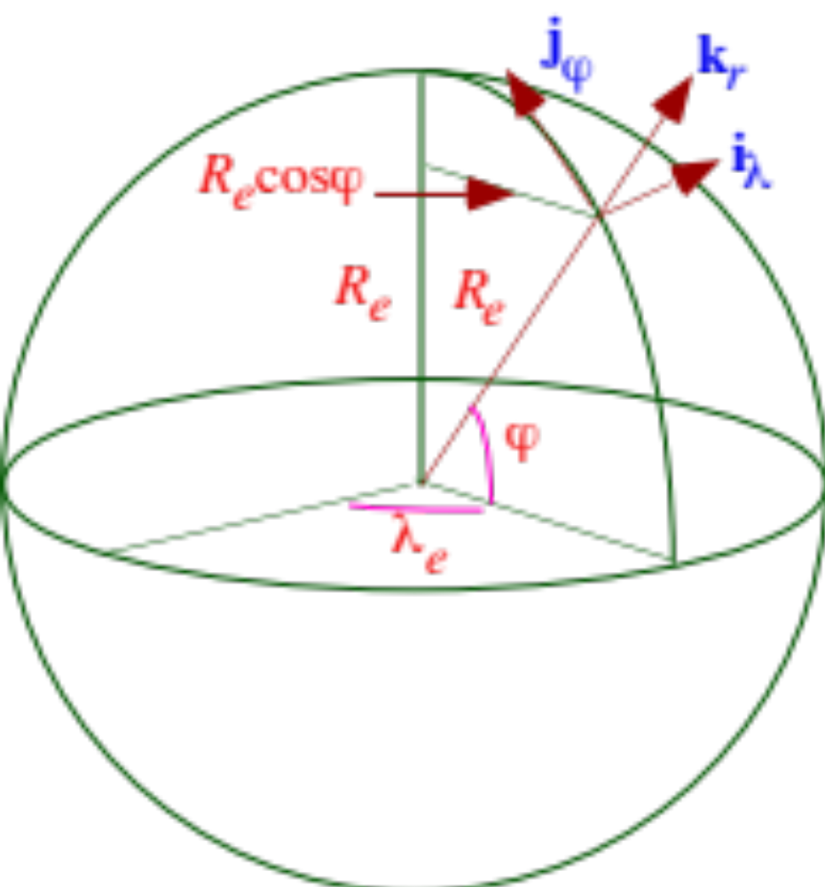
Spherical Horizontal Coordinates
Fig. 4.1

Slide 3
Spherical Coordinate Conversions
West-east and south-north increments (4.1)
Example 4.1 dλ_{e} = 5º = 5º x π / 180º=0.0873 rad
dϕ = 5º =0.0873 rad
ϕ = 30 ºN
--> dx = (6371 km)(0.866)(0.0873 rad) = 482 km
--> dy = (6371 km)(0.0873 rad) = 556 km

Slide 4
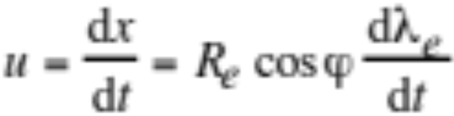
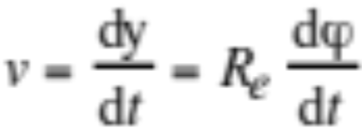
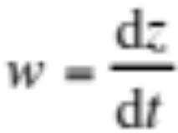
Spherical Coordinate Conversions
Spherical coord. total and horizontal velocity vectors (4.2)
Scalar velocities (4.3)

Slide 5
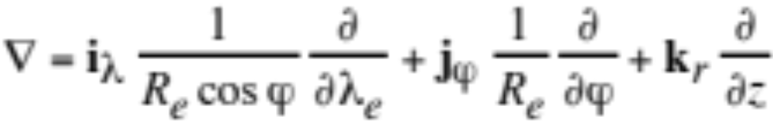
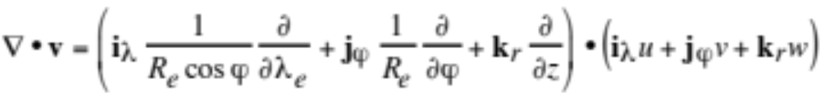
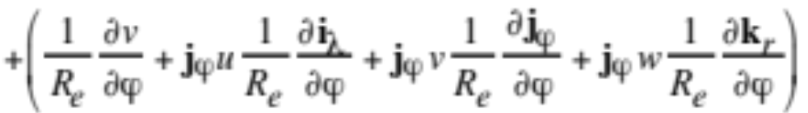
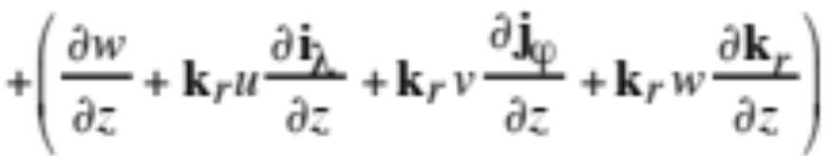
Spherical Coordinate Conversions
Gradient operator in spherical coordinates (4.4)
Dot product of gradient operator with velocity vector (4.5)

Slide 6
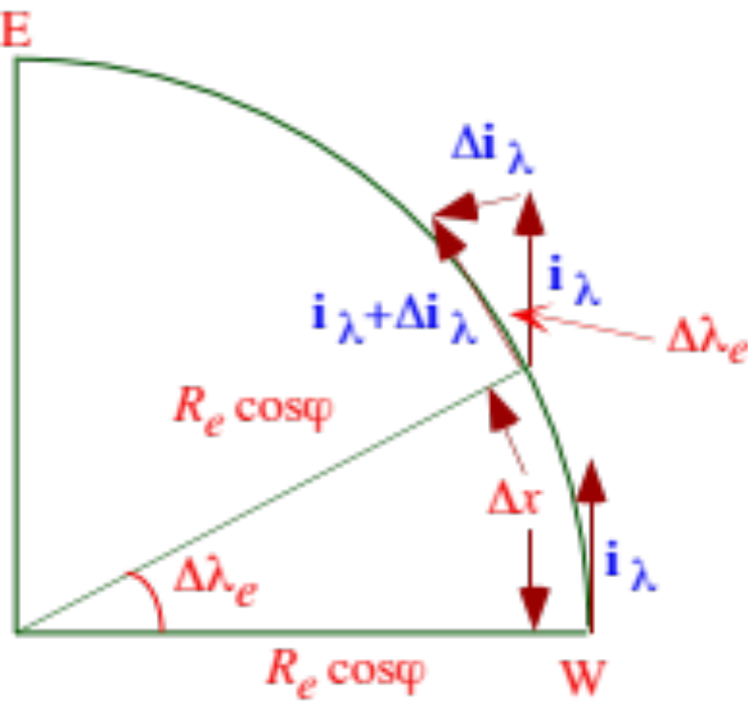
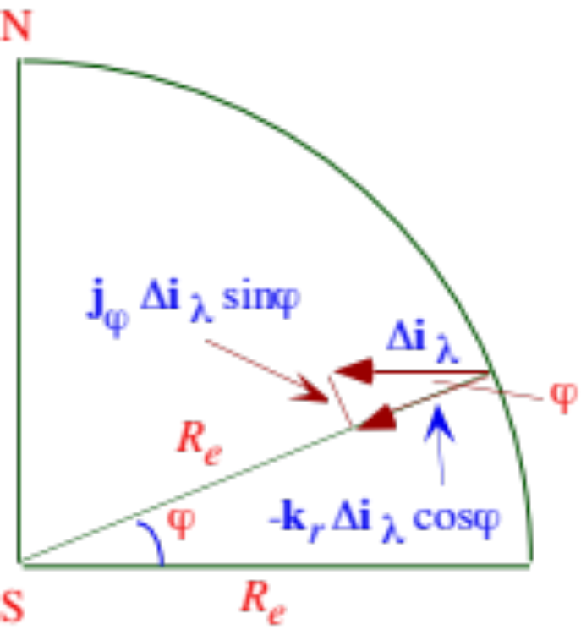

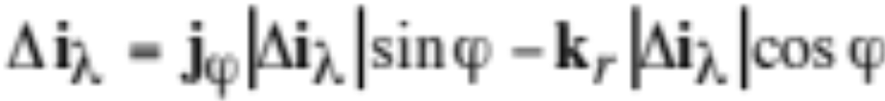
Spherical Coordinate Conversions
Top view
Side view
Fig. 4.2a,b
From Fig. 4.2a (4.6)
From Fig. 4.2b (4.7)

Slide 7
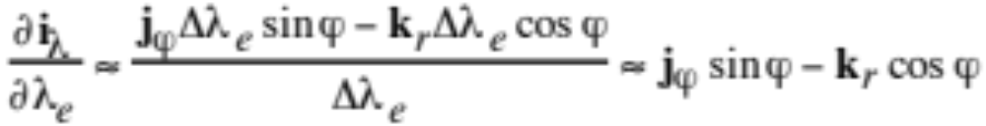
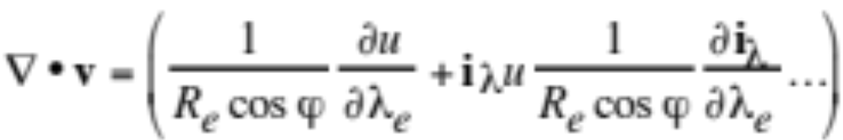
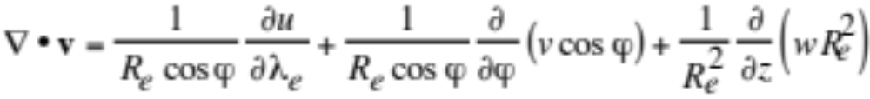
Spherical Coordinate Conversions
From Fig. 4.2a (4.6)
From Fig. 4.2b (4.7)
Substitute (4.6) into (4.7), divide by Δλ_{e} (4.8)
Dot product of gradient operator and velocity vector (4.5)
Substitute (4.8) and other terms into (4.5) (4.10)

Slide 8
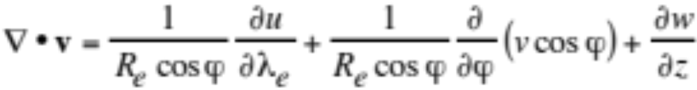
Spherical Coordinate Conversions
Assume R_{e} constant (4.11)

Slide 9
Inertial Reference Frame
Inertial reference frame
Reference frame at rest or at constant velocity, such as one fixed in space
Noninertial reference frame
Reference frame accelerating or rotating, such as on an object at rest on Earth or in motion relative to the Earth
True force
Force that exists when an observation is made from an inertial reference frame
-Gravitational force, pressure-gradient force, viscous force
Apparent (inertial) force
Fictitious force that appears to exist when an observation is made from a noninertial reference frame but is an acceleration from an inertial reference frame
-Apparent centrifugal force, apparent Coriolis force

Slide 10

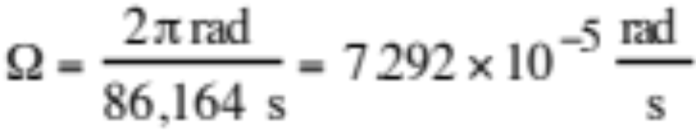
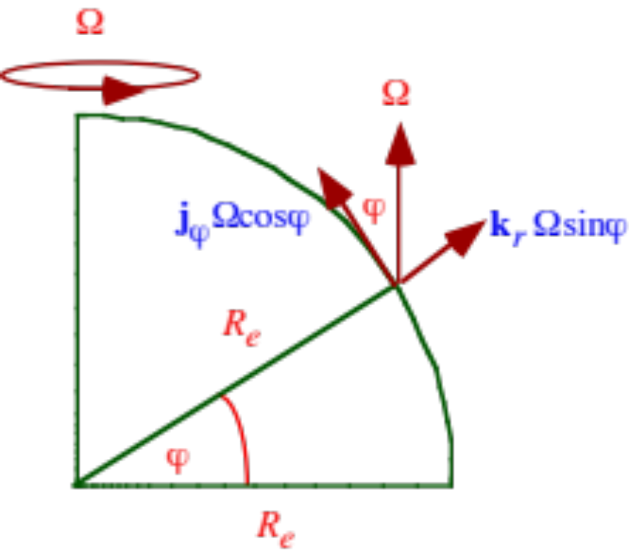
Angular Velocity
Angular velocity vector (4.14)
Angular velocity magnitude
Fig. 4.3

Slide 11

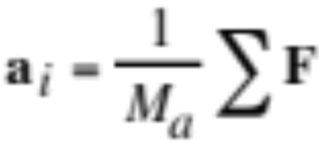

Newton’s Second Law of Motion
Newton’s second law of motion
Inertial acceleration (4.12)
Momentum equation in inertial reference frame
Expand left side of momentum equation (4.15,6)
Absolute velocity (4.13)

Slide 12
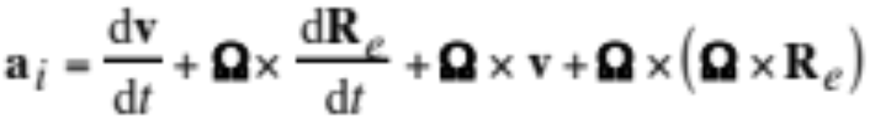

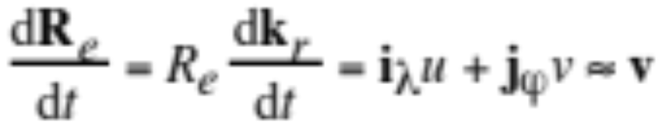
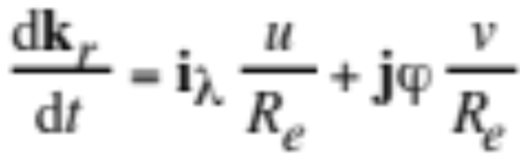
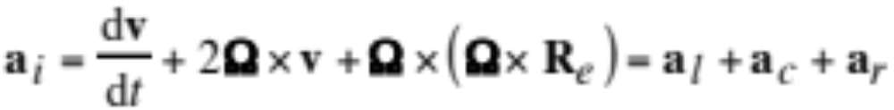
Inertial Acceleration
Inertial acceleration (4.16)
Vector giving radius of Earth (4.14)
Total derivative of radius of the Earth vector (4.17)
--> Inertial acceleration (4.18)

Slide 13
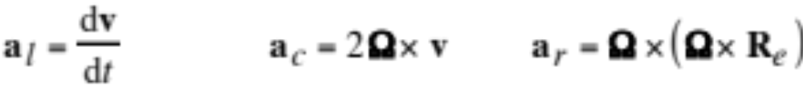
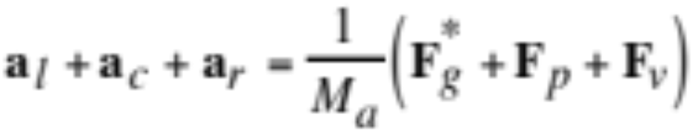
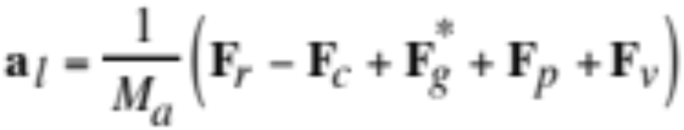
Inertial Acceleration
Local, Coriolis, Earth’s centripetal acceleration vectors (4.19)
Expand both sides of momentum equation (4.12) (4.20)
Treat Coriolis, centripetal accelerations as apparent forces
Momentum equation from Earth’s reference frame (4.21)

Slide 14
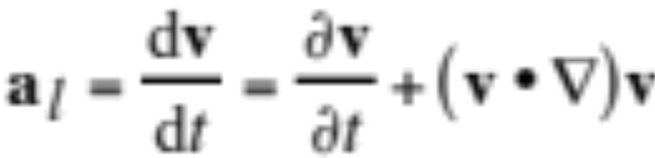
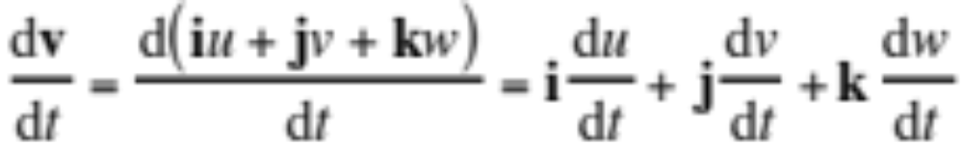
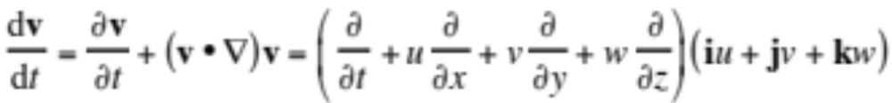
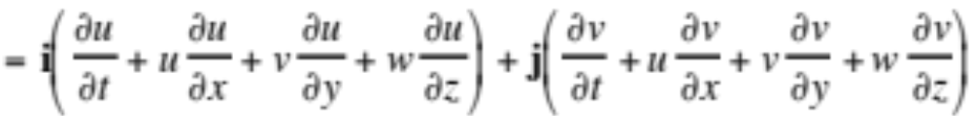
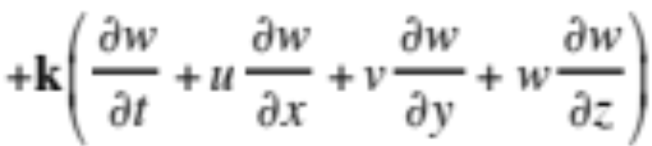
Local Acceleration
Expand local acceleration (4.22)
Expand left side in Cartesian/altitude coordinates (4.23)
Expand further in terms of local derivative (4.24)

Slide 15
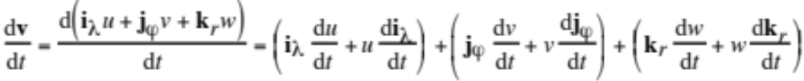
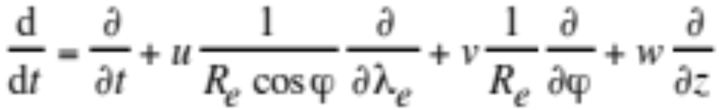
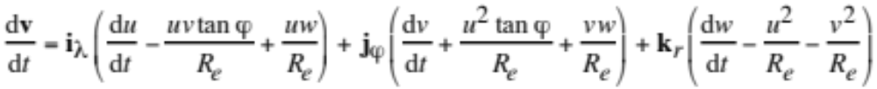
Local Acceleration
Expand left side in spherical-altitude coordinates (4.25)
Total derivative in spherical-altitude coordinates (4.26)
Total derivative of unit vectors (4.28)
Substitute into (4.25) (4.29)

Slide 16
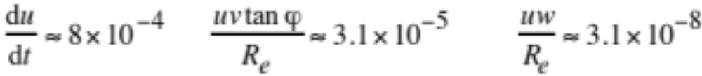
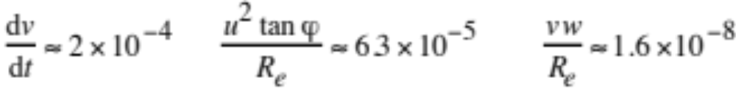
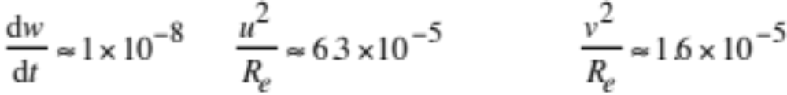
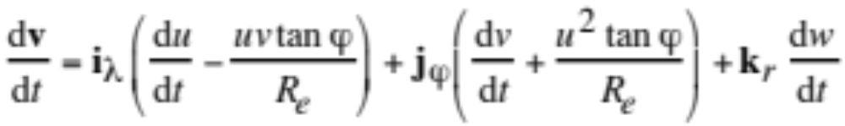
Example 4.2
u = 20 m s⁻¹ Δx = 500 km R_{e} = 6371 km
v = 10 m s⁻¹ Δy = 500 km ϕ = 45 ºN
w = 0.01 m s⁻¹ Δz = 10 km -->
Simplify local acceleration (4.30)

Slide 17
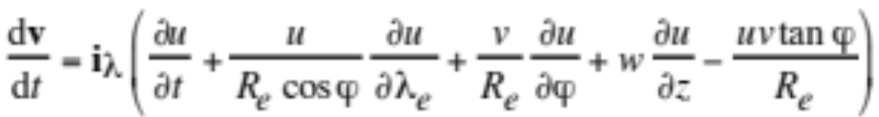
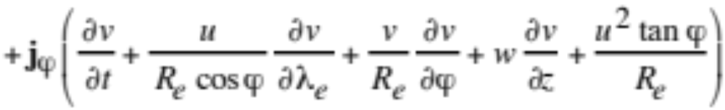
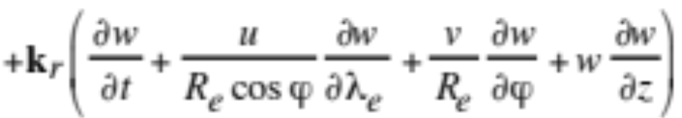
Local Acceleration
Local acceleration spherical-altitude coordinates (4.30)
Total derivative in spherical-altitude coordinates (4.26)
Local acceleration in spherical-altitude coordinates (4.31)

Slide 18
Apparent Coriolis Force
North Pole
B
B’
C
Direction
of Earth’s
rotation
A
D
A’
Equator
West
East
E
H
E’
F
F’
G
South Pole

Slide 19
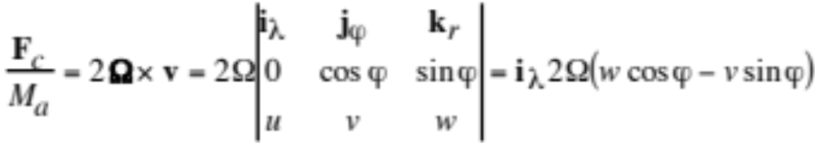
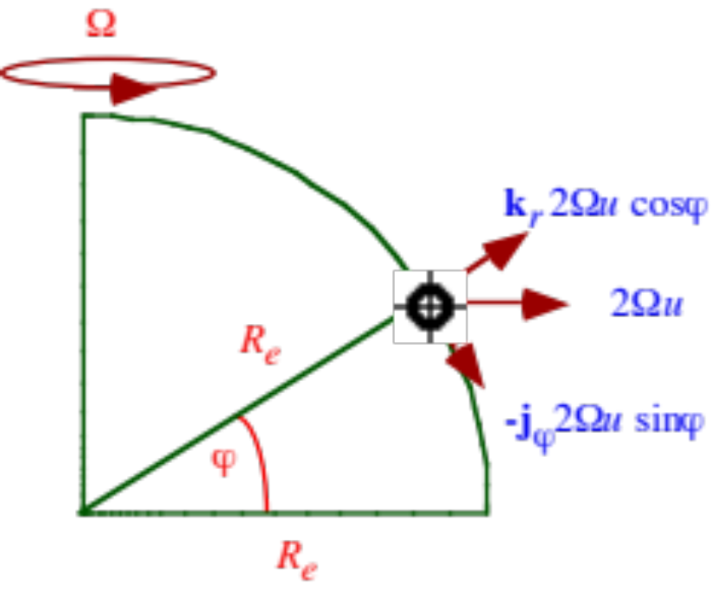

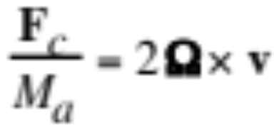

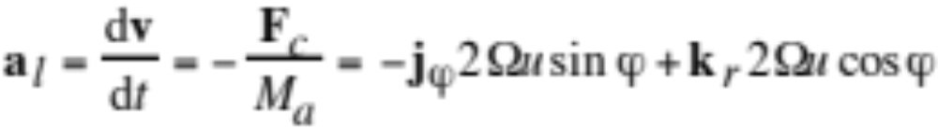
Apparent Coriolis Force
Apparent Coriolis force per unit mass (4.32)
Consider only zonal (west-east) wind (4.33)
Equate local acceleration (4.21) with Coriolis force
Fig. 4.5

Slide 20
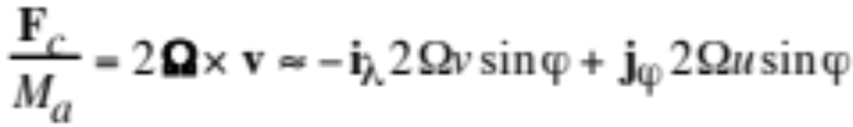

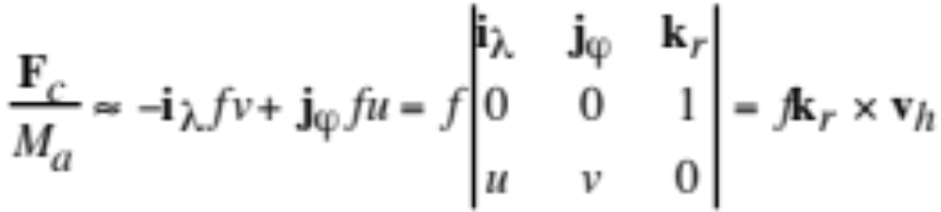
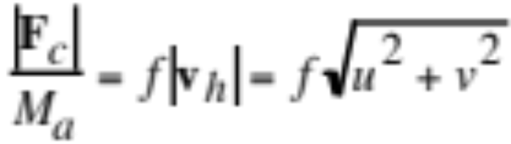
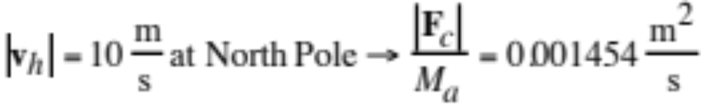
Apparent Coriolis Force
Eliminate vertical velocity term
Eliminate k term
--> Apparent Coriolis force per unit mass (4.34)
Coriolis parameter (4.35)
Rewrite (4.34) (4.36)
Magnitude
Example

Slide 21
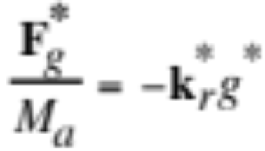
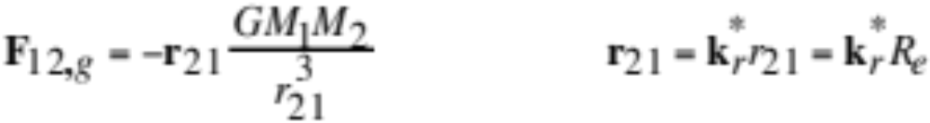


Gravitational Force
True gravitational force vector (4.37)
Newton’s law of universal gravitation (4.38)
True gravitational force vector for Earth (4.39)
Equate (4.37) and (4.39) (4.40)
M_{e}=5.98 x 10²⁴ kg, R_{e}=6370 km
-->g*=9.833 m s⁻²

Slide 22




Apparent Centrifugal Force
To observer fixed in space, objects moving with the surface of a rotating Earth exhibit an inward centripetal acceleration. An observer on the surface of the Earth feels an outward apparent centrifugal force.
Apparent centrifugal force per unit mass (4.41)
where

Slide 23



Effective Gravity
Add gravitational and apparent centrifugal force vectors (4.44)
Effective gravitational acceleration (4.45)
Fig. 4.6

Slide 24
Examples
g = 9.799 m s⁻² at Equator at sea level
= 9.833 m s⁻² at North Pole at sea level
--> 0.34% diff. in gravity between Equator and Pole
0.33% diff. (21 km) in Earth radius between Equator and Pole
--> Apparent centrifugal force has caused Earth’s Equatorial bulge
g = 9.8060 m s⁻² averaged over Earth’s topographical surface, which averages 231.4 m above sea level
Example 4.6 g = 9.497 m s⁻² 100 km above Equator
(3.1% lower than surface value)
--> variation of gravity with altitude much greater than variation of gravity with latitude

Slide 25




Geopotential
Work done against gravity to raise a unit mass of air from sea level to a given altitude. It equals the gravitational potential energy of air per unit mass.
Magnitude of geopotential (4.46)
Geopotential height (4.47)
Gradient of geopotential (4.48)
Effective gravitational force vector per unit mass (4.49)

Slide 26






Pressure-Gradient Force
Forces acting on box (4.50)
Sum forces
Mass of air parcel
Pressure-gradient force per unit mass (4.51)

Slide 27


Pressure-Gradient Force Example

Slide 28



Pressure-Gradient Force
Cartesian-altitude coordinates (4.52)
Spherical-altitude coordinates (4.53)
Example 4.8 z = 0 m --> p_{a} = 1013 hPa
z = 100 m --> p_{a} = 1000 hPa
ρ_{a} = 1.2 kg m⁻³
--> PGF in the vertical 3000 times that in the horizontal:

Slide 29


Viscosity
Viscosity in liquids
Internal friction when molecules collide and briefly bond. Viscosity decreases with increasing temperature.
Viscosity in gases
Transfer of momentum between colliding molecules. Viscosity increases with increasing temperature.
Dynamic viscosity of air (kg m⁻¹ s⁻¹) (4.54)
Kinematic viscosity of air (m² s⁻¹) (4.55)

Slide 30

Viscosity
Wind shear
Change of wind speed with height
Shearing stress
Viscous force per unit area resulting from shear
Shearing stress in the x-z plane (N m⁻²) (4.56)
Force per unit area in the x-direction acting on the x-y plane (normal to the z-direction)

Slide 31





Viscous Force
Shearing stress in the x-direction
Net viscous force on parcel in x-direction (4.58)
Viscous force after substituting shearing stress (4.59)

Slide 32

Viscous Force
Fig. 4.10
Viscous force as function of wind shear (4.59)

Slide 33



Three-Dimensional Viscous Force
Expand (4.58) (4.60)
Gradient term (4.61)

Slide 34

Viscous Force Example
Example 4.9 z₁ = 1 km u₁ = 10 m s⁻¹
z₂ = 1.25 km u₂ = 14 m s⁻¹
z₃ = 1.5 km u₃ = 20 m s⁻¹
T = 280 K ρ_{a} = 1.085 kg m⁻³
--> η_{a} = 0.001753 kg m⁻¹ s⁻²
--> Viscous force per unit mass aloft is small

Slide 35

Viscous Force Example
Example 4.10 z₁ = 0 m u₁ = 0 m s⁻¹
z₂ = 0.05 m u₂ = 0.4 m s⁻¹
z₃ = 0.1 m u₃ = 1 m s⁻¹
T = 288 K ρ_{a} = 1.225 kg m⁻³
--> η_{a} = 0.001792 kg m⁻¹ s⁻²
--> Viscous force per unit mass at surface is comparable with horizontal pressure-gradient force per unit mass

Slide 36






Turbulent Flux Divergence
Local acceleration (4.22)
Continuity equation for air (3.20)
Combine (4.62)
Decompose variables
Reynolds average (4.62) (4.65)

Slide 37



Turbulent Flux Divergence
Expand turbulent flux divergence (4.66)

Slide 38




Diffusion Coefficients for Momentum
Vertical kinematic turbulent fluxes from K-theory (4.67)
Substitute fluxes into turbulent flux divergence (4.68)

Slide 39


Diffusion Coefficients for Momentum
Turbulent flux divergence in vector/tensor notation (4.70)

Slide 40

Diffusion Coefficient Examples
Example 4.11 Vertical diffusion in middle of boundary layer
z₁ = 300 m u₁ = 10 m s⁻¹
z₂ = 350 m u₂ = 12 m s⁻¹
z₃ = 400 m u₃ = 15 m s⁻¹
K_{m} = 50 m² s⁻¹ -->
Example 4.12 Horizontal diffusion
y₁ = 0 m u₁ = 10 m s⁻¹
y₂ = 500 m u₂ = 9 m s⁻¹
y₃ = 1000 m u₃ = 7 m s⁻¹
K_{m} = 100 m² s⁻¹ -->

Slide 41

Momentum Equation Terms
Table 4.1

Slide 42

Momentum Equation
Momentum equation in three dimensions (4.71)

Slide 43






Momentum Equation in Cartesian-Altitude Coordinates
U-direction (4.73)
V-direction (4.74)
W-direction (4.75)

Slide 44





Momentum Equation in Spherical-Altitude Coordinates
U-direction
V-direction
W-direction (4.78)

Slide 45

Scaling Parameters
Ekman, Rossby, Froude numbers (4.72)
Example 4.13 ν_{a} = 10⁻⁶ m² s⁻¹ u = 10 m s⁻¹
x = 10⁶ m w = 0.01 m s⁻¹
z = 10⁴ m f = 10⁻⁴ s⁻¹
--> Ek = 10⁻¹⁴
--> Ro = 0.1
--> Fr = 0.003
Viscous accelerations negligible over large scales
Coriolis more important than local horizontal accelerations
Gravity more important than vertical inertial accelerations

Slide 46



Geostrophic Wind
Geostrophic Wind (4.79)
Elim. all but pressure-gradient, Coriolis terms in momentum eq.
Example 4.14 ϕ = 30º ρ_{a} = 0.00076 g cm⁻³
∂p_{a}/∂y = 4 hPa per 150 km
--> f = 7.292x10⁻⁵ s⁻¹
--> u_{g} = 48.1 m s⁻¹
Geostrophic Wind in cross-product notation (4.80)

Slide 47



Surface Winds
Fig. 4.11. Force and wind vectors aloft and at surface in Northern Hemisphere.
Horizontal equation of motion near the surface (4.82)

Slide 48


Boundary-Layer Winds
Fig. 4.12

Slide 49


Morning/Afternoon Observed Winds at Riverside
Pressure (hPa)
Pressure (hPa)
Fig. 4.13

Slide 50




Gradient Wind
Cartesian to cylindrical coordinate conversions (4.83)
Radial vector (4.86)
Fig. 4.14
Radial and tangential scalar velocities (4.86)

Slide 51




Gradient Wind
Fig. 4.15
Horizontal momentum equation without turbulence (4.91)
Remove local acceleration, solve (4.92)

Slide 52
Gradient Wind Example
Gradient wind speed (4.92)
Example 4.15 Low pressure near center of hurricane
∂p_{a}/∂R_{c} = 45 hPa per 100 km
R_{c} = 70 km ϕ = 15^{ο}
p_{a} = 850 hPa ρ_{a} = 1.06 kg m⁻³
--> v_{θ} = 52 m s⁻¹
--> v_{g} = 1123 m s⁻¹
High-pressure center
∂p_{a}/∂R_{c} = -0.1 hPa per 100 km
--> v_{θ} = -1.7 m s⁻¹
--> v_{g} = 2.5 m s⁻¹
--> pressure gradient and gradient wind lower around high-pressure center than low-pressure center.

Slide 53




Surface Winds Around Lows/Highs
Fig. 4.16
Momentum equations for surface winds (4.93)

Slide 54



Atmospheric Waves
Displacement (m)
Fig. 4.17
Displacement and amplitude (4.98)
Wavenumber and wavelength (4.95)

Slide 55


Atmospheric Waves
Wavenumber vector (4.94)
Frequency of oscillation (dispersion relationship) (4.97)
Phase speed c_{α} = speed at which all components of the individual wave travel along the direction of propagation.
Superposition principle
Displacement of a medium due to a group of waves of different wavelength equals the sum of displacements due to each individual wave in the group.
Envelope
Shape of the sum of the waves (shape of the group)

Slide 56



Group Velocity
Group velocity vector and group speed (4.99)
Velocity of envelope of group
Group scalar speeds (4.101)
where

Slide 57



Nondispersive/Dispersive Media
Nondispersive medium (4.103)
Phase speed independent of group speed
Dispersive medium
Phase speed dependent on group speed

Slide 58






Nondispersive/Dispersive Media
Sound waves Water waves
Fig. 4.18
Displacement (m)
Displacement (m)

Slide 59



Acoustic (Sound) Waves
Occur when a vibration causes alternating adiabatic compression and expansion of a compressible fluid, such as air. During compression/expansion, air pressure oscillates, causing acceleration to oscillate along the direction of propagation of the wave.
U-momentum equation (4.105)
Continuity equation for air (4.106)
Thermodynamic energy equation (4.107)

Slide 60


Acoustic (Sound) Waves
--> Revised thermodynamic energy equation (4.108)
Substitute (4.108) into continuity equation (4.106) (4.109)

Slide 61





Acoustic Wave Equation
Take time derivative of (4.109) and combine with momentum equation (4.106) --> acoustic wave equation (4.110)
Speed of sound under adiabatic conditions (4.111)
Solution to wave equation (4.112)
Dispersion relationship for acoustic waves (4.113)
Group speed equals phase speed --> nondispersive (4.114)

Slide 62



Acoustic-Gravity Waves
Gravity waves
When the atmosphere is stably stratified and a parcel of air is displaced vertically, buoyancy restores the parcel to its equilibrium position in an oscillatory manner.
Acoustic-gravity wave dispersion relationship found as follows:
Momentum equations retaining gravity (4.115)
Continuity equation
Thermodynamic energy equation from acoustic case

Slide 63


Acoustic-Gravity Waves
Acoustic-gravity wave dispersion relationship (4.116)
Acoustic cutoff frequency (4.117)

Slide 64


Acoustic-Gravity Waves
Fig. 4.19

Slide 65


Inertial Oscillation
When a parcel of air moving from west to east is perturbed in the south-north direction, the Coriolis force propels the parcel toward its original latitude in an inertially stable atmosphere and away from its original latitude in an inertially unstable atmosphere. In the former case, the parcel subsequently oscillates about its initial latitude in an inertial oscillation.
Horizontal momentum equations with Coriolis (4.121)
Integrate u-equation between y₀ and y₀+Δy (4.123)

Slide 66




Inertial Oscillations
Taylor-series expansion of geostrophic wind (4.124)
Substitute (4.124) into (4.123) (4.125)
Substitute (4.125) into v-momentum equation (4.126)
Inertial stability criteria in Northern Hemisphere (4.127)

Slide 67




Inertial Lamb and Gravity Waves
Inertial Lamb waves (4.128)
Inertial gravity waves (4.129)
Rossby radius of deformation (4.130)
L>λ_{R} --> velocity field adjusts to pressure field
Equivalent depth (4.131)

Slide 68

Geostrophic Adjustment
Fig. 4.20

Slide 69




Vorticity
Relative vorticity (4.132)
Vertical component of relative vorticity
Absolute vorticity
Potential vorticity (4.133)

Slide 70





Rossby Waves
Horizontal momentum equations (4.134)
Midlatitude beta-plane approximations (4.136)
Geopotential gradients on surfaces of constant pressure (4.138)
Separate variables into geostrophic/ageostrophic components

Slide 71



Rossby Waves
Rewrite momentum equations (4.140,1)
Combine geostrophic wind with geopotential gradients (4.142)

Slide 72



Rossby Waves
Substitute (4.42) into (4.40), (4.41) (4.143,4)
--> quasigeostrophic momentum equations
Subtract ∂/∂y of (4.143) from ∂/∂x of (4.144) (4.145)

Slide 73





Rossby Waves
Vertical velocity (4.146)
Substitute (4.146), u=u_{g}+u_{a}, v=v_{g}+v_{a} and
Continuity equation for incompressible air
to obtain (4.147)
Integrate from surface to mean tropopause height Δz_{t} (4.148)

Slide 74






Rossby Waves
Substitute (4.148) into (4.145) (4.149)
Geostrophic potential vorticity (4.150)
Expand (4.149) (4.150)
-> quasi-geostrophic potential vorticity equation
Wave solution (4.152)
Dispersion rel. for freely-propagating Rossby waves (4.152)

