Slide 1
Presentation Slides for
Chapter 2 of
Fundamentals of Atmospheric Modeling 2nd Edition
Mark Z. Jacobson
Department of Civil & Environmental Engineering
Stanford University
Stanford, CA 94305-4020
jacobson@stanford.edu
March 10, 2005

Slide 2
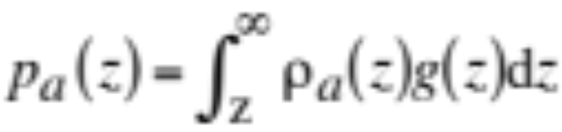
Hydrostatic Air Pressure
Weight per unit area of air overhead a given altitude (2.1)
p_{a} = air pressure (1 Pa=1 kg m⁻¹ s⁻² = 0.01 hPa=0.01 mb)
ρ_{a} = air density (kg/m³)
g = gravity (m/s²)
z = altitude (m)
Typical sea-level pressures:
  101,325 Pa =1013.25 hPa = 1013.25 mb = 1.01325 bar
  760 mm Hg = 760 torr
  29.9 in. Hg
  14.7 lb in⁻²
  10,300 kg m⁻²

Slide 3
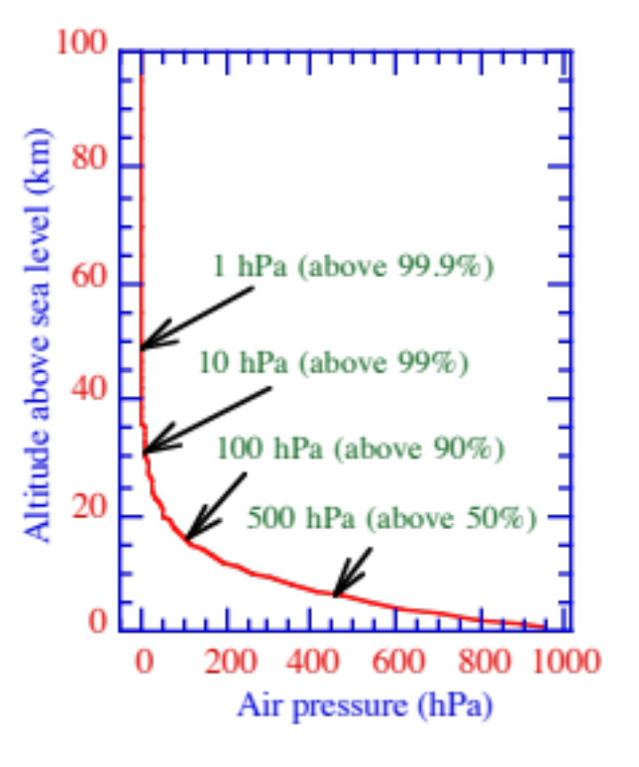
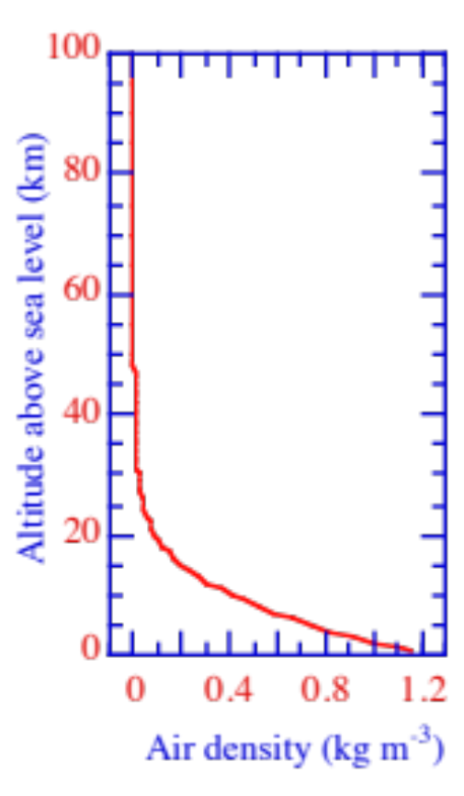
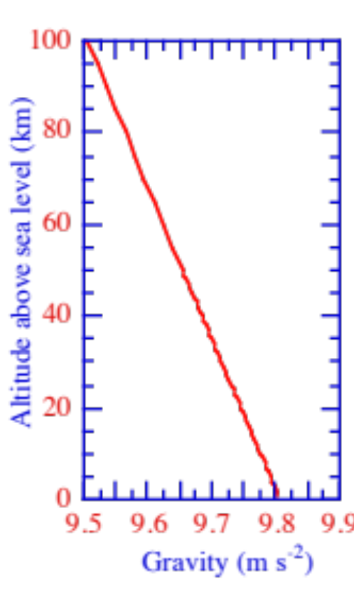
Pressure, Density, Gravity vs. Altitude
Altitude above sea level (km)
Altitude above sea level (km)
Altitude above sea level (km)
Figs. 2.1a-c

Slide 4
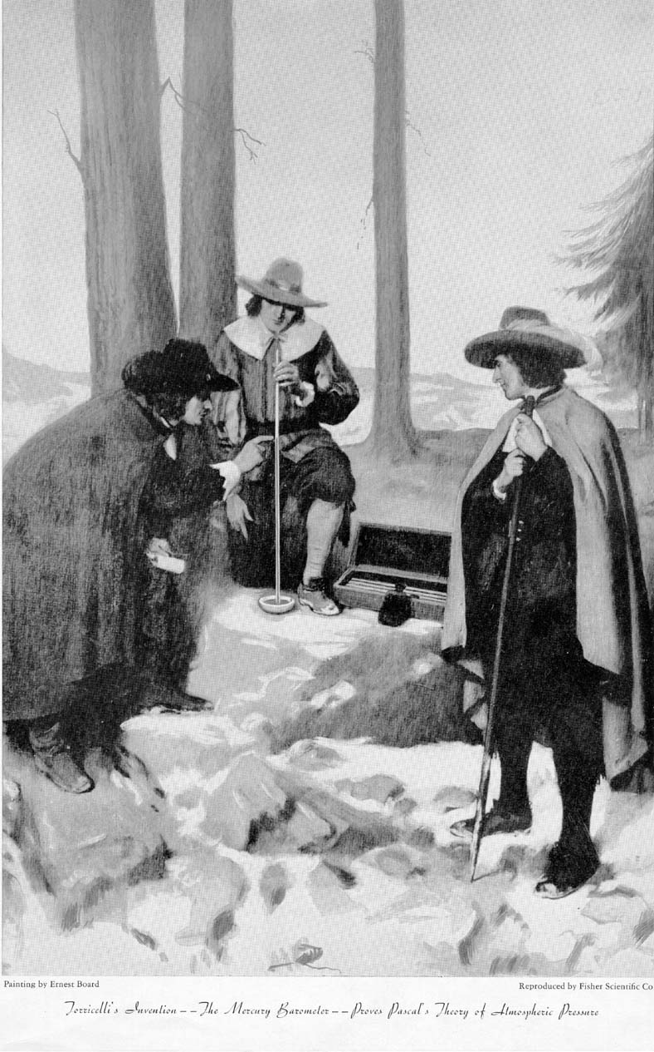
Toricelli's Experiment With Mercury Barometer
1643 Evangelista Torricelli records the first sustained vacuum and demonstrates that air pressure changes daily.
Height of fluid = Air pressure / (fluid density x gravity)
1648 Blaise Pascal and brother-in-law Florin Périer demonstrate that air pressure decreases with increasing altitude at Puy-de-Dôme, France.
Edgar Fahs Smith Collection, University of Pennsylvania Library

Slide 5
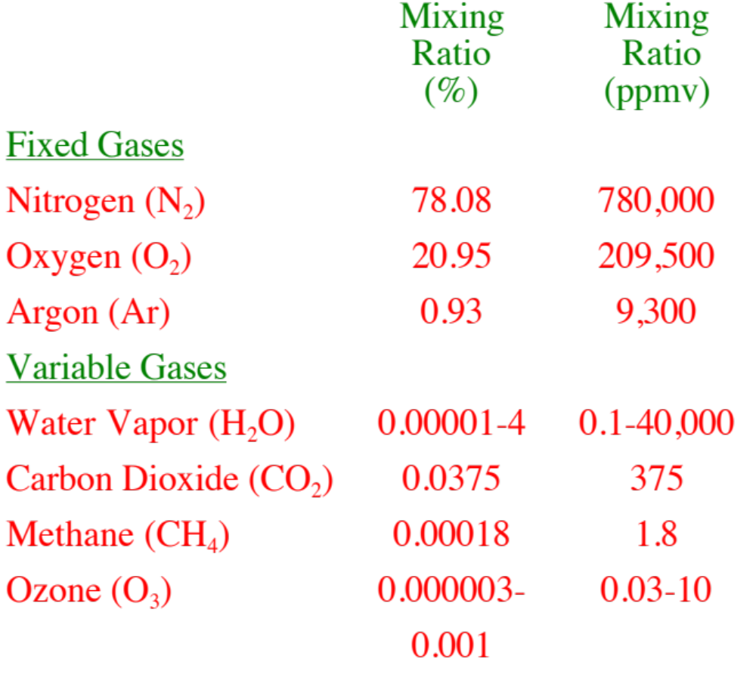
Current Composition of the Atmosphere
Table 2.1

Slide 6
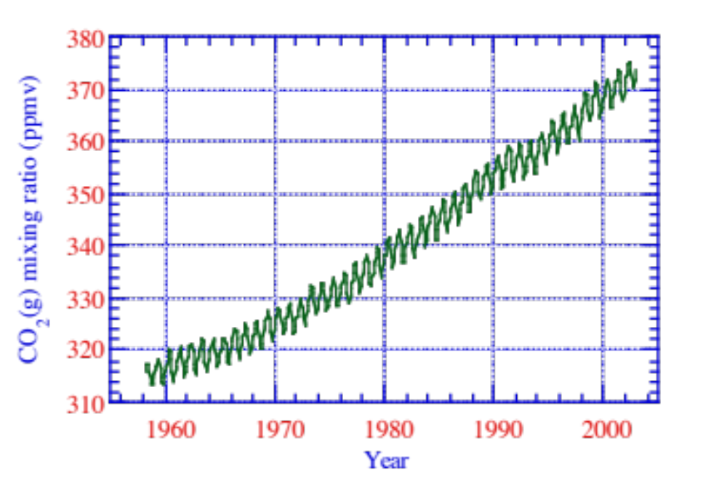
Carbon Dioxide Mixing Ratio
Carbon dioxide mixing ratio (ppmv)
Fig. 2.2

Slide 7
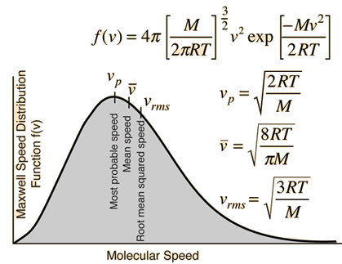
Definitions of Temperature
http://hyperphysics.phy-astr.gsu.edu/hbase/kinetic/kintem.html

Slide 8
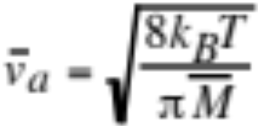
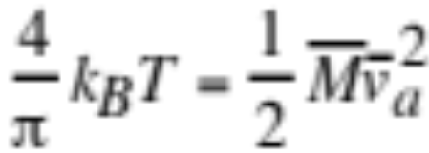
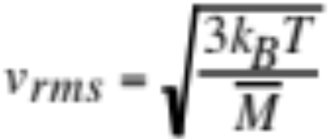
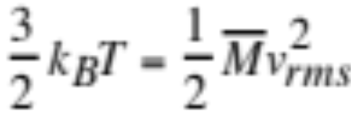
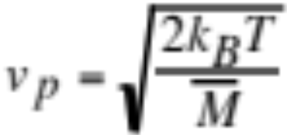
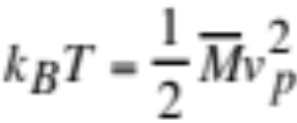
Definitions of Temperature
From average thermal speed of an air molecule (m/s) (2.3,2.4)
k_{B} = Boltzmann’s constant (kg m² s⁻² K⁻¹)
T = Absolute temperature (K)
M = mass of a single air molecule (kg molec^{.-1})
From root-mean-square speed
From most probable speed

Slide 9
Temperature-Example
Find thermal speeds at T=300 K, T=200K
Average speed
T=300 K --> 468.3 m/s (1685 km/hr)
T=200 K --> 382.4 m/s (1376 km/hr)
Root-mean-square speed
T=300 K --> 508.3 m/s
T=200 K --> 415.0 m/s
Most probable speed
T=300 K --> 415.0 m/s
T=200 K --> 338.9 m/s
Example 2.1

Slide 10
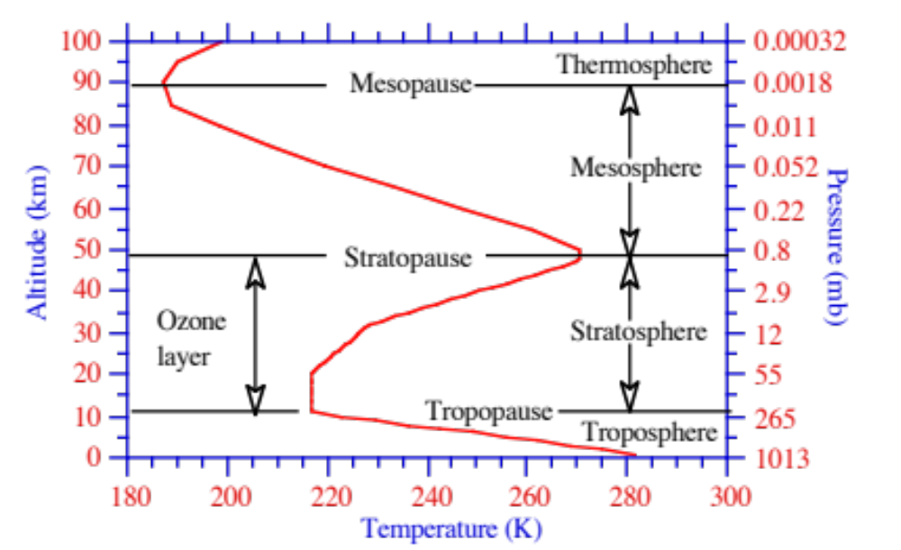
Temperature Versus Altitude
Altitude (km)
Pressure (mb)
Fig. 2.4

Slide 11
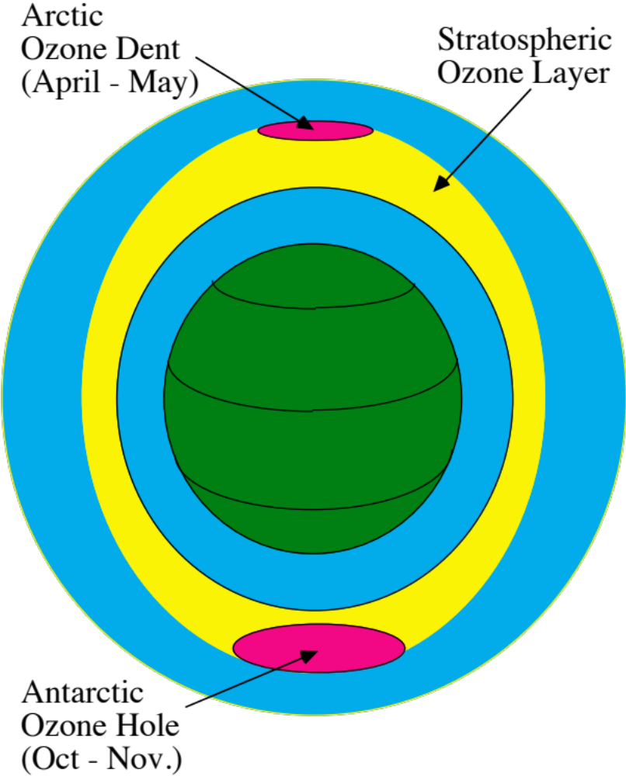
The Ozone Layer

Slide 12
Stratospheric Ozone Chemistry
Natural Ozone Production
O₂ + hν --> O(¹D) + O λ < 175 nm
O₂ + hν --> O + O 175 nm < λ < 245 nm
O(¹D)+M-->O+M
O + O₂ + M --> O₃ + M
Natural Ozone Destruction
O₃ + hν --> O₂ + O(¹D) λ < 310 nm
O₃ + hν --> O₂ + O λ > 310 nm
O₃ + O --> O₂ + O₂
(2.9)-(2.15)

Slide 13
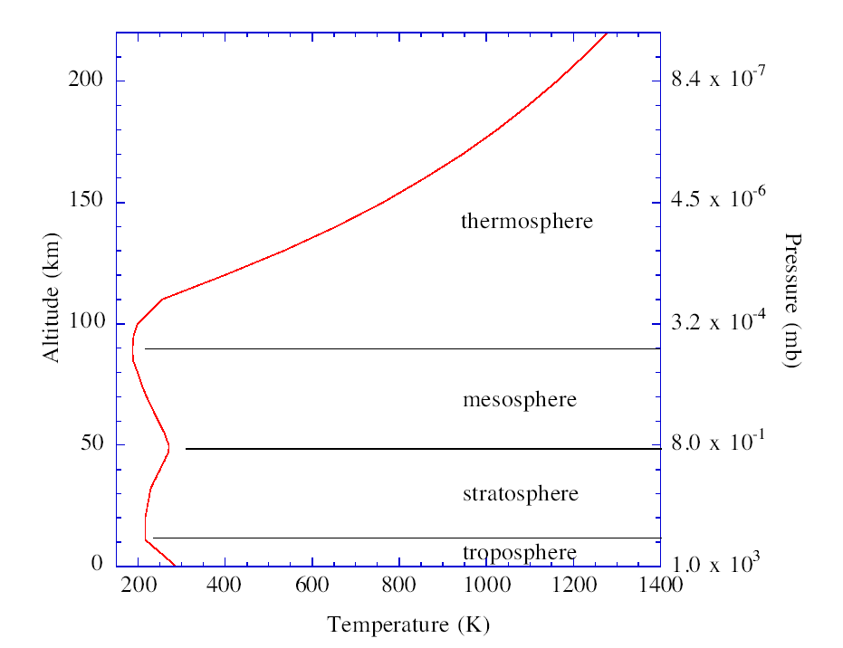
Temperature Structure

Slide 14
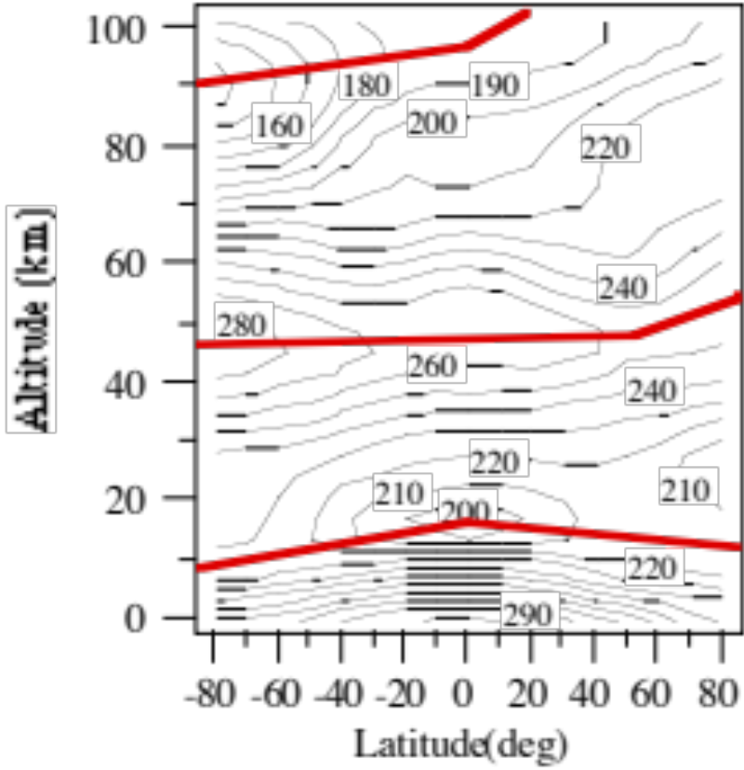
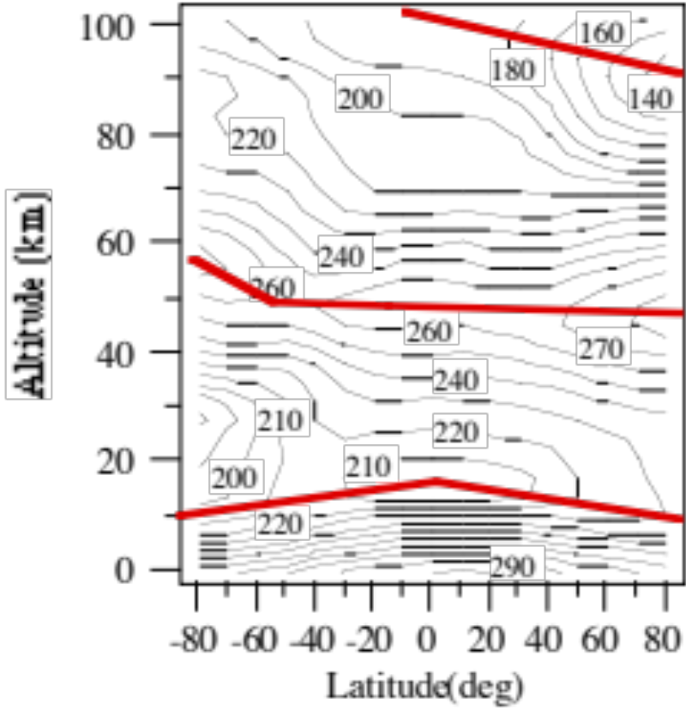
Zonally-Averaged Temperatures
January
July
Altitude (km)
Altitude (km)
Fig. 2.5a, b

Slide 15
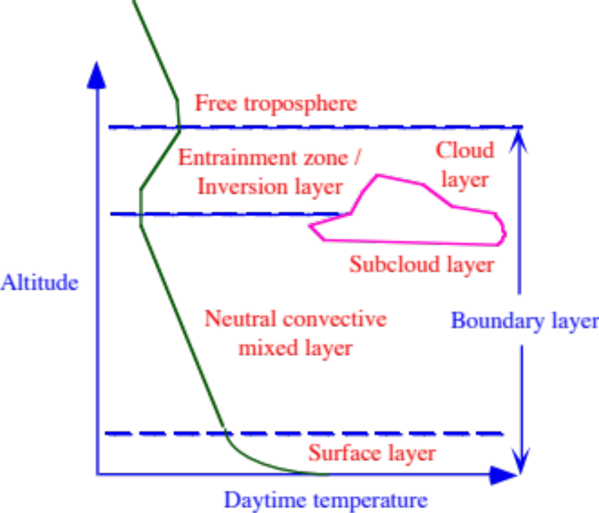
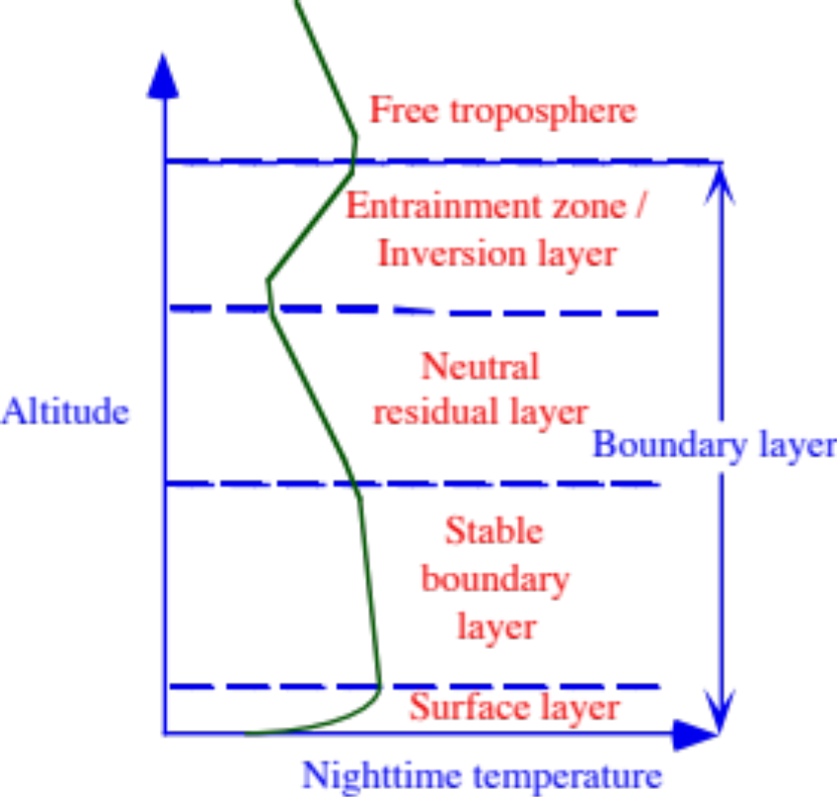
Boundary Layer
Daytime
Nighttime
Fig. 2.3a, b

Slide 16
Processes Affecting Temperature
Specific heat (J kg⁻¹ K⁻¹)
Energy required to increase the temperature of 1 kg of a substance 1 K
= 1004.67 for dry air
= 4185.5 for liquid water
= 1360 for clay
= 827 for sand
Lower specific heat
--> substance heats up faster upon addition of energy
--> soil heats up during the day more than does water

Slide 17
Processes Affecting Temperature Energy Transfer Processes
Conduction
  Transfer of energy from molecule to molecule
Convection
  Transfer of energy by the vertical mass movement of a fluid
Advection
  Horizontal propagation of the mean wind
Radiation
  Energy transferred in the form of electromagnetic waves

Slide 18
Conduction
Important only near the ground
Conductive Heat Flux (W m⁻²)
H_{c}=- κ ΔT / Δz (2.8)
κ = thermal conductivity (W m⁻¹ K ⁻¹) = 0.0256 for dry air = 0.6 for liquid water
= 0.92 for clay = 0.298 for sand
Δ = change in temperature (ºC)
Δz = change in altitude (m)
Near the ground
ΔT / Δz = -12 K / 0.001 m--> H_{c} =307 W m⁻²
Free troposphere
ΔT / Δz = -6.5 K / 1000 m--> H_{c}=0.00015 W m⁻²

Slide 19
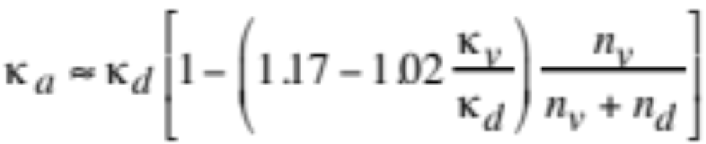
Thermal Conductivity
Dry air (2.5)
Water vapor (2.6)
Moist air (2.7)
n=number of moles

Slide 20
Turbulence
Buoyancy: lifting of low-density (warm) air in bath of cold air
Wind shear: variation of wind speed with height or distance
Eddy: swirling motion of air due to wind shear
Wind
Turbulence: chaotic air motion from eddies of different sizes
Thermal turbulence: turbulence due to buoyancy
Mechanical turbulence: turbulence due to wind shear or convergence/divergence

Slide 21
Convergence/Divergence
Convergence: horizontal net inflow of air into a region
L
Divergence: horizontal net outflow of air from a region
H

Slide 22
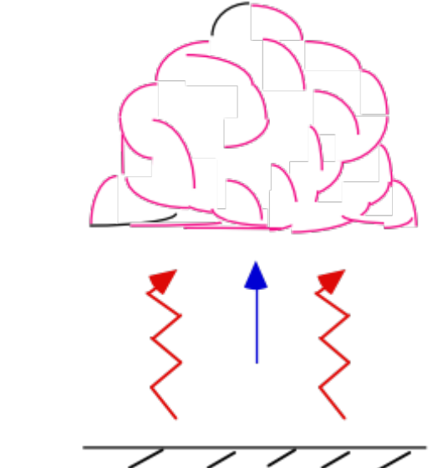
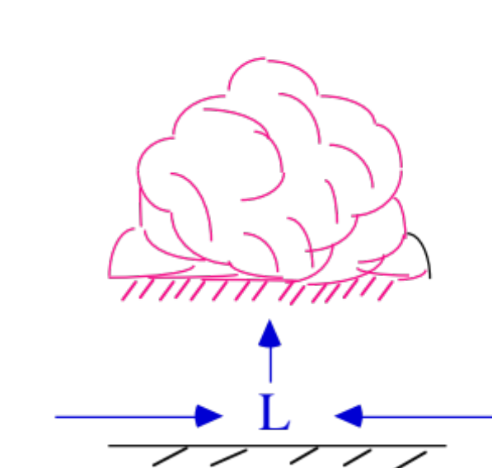
Convection
Vertical air motion
Free convection: vertical air motion due to thermal turbulence
Forced convection: vertical air motion due to mechanical turbulence

Slide 23
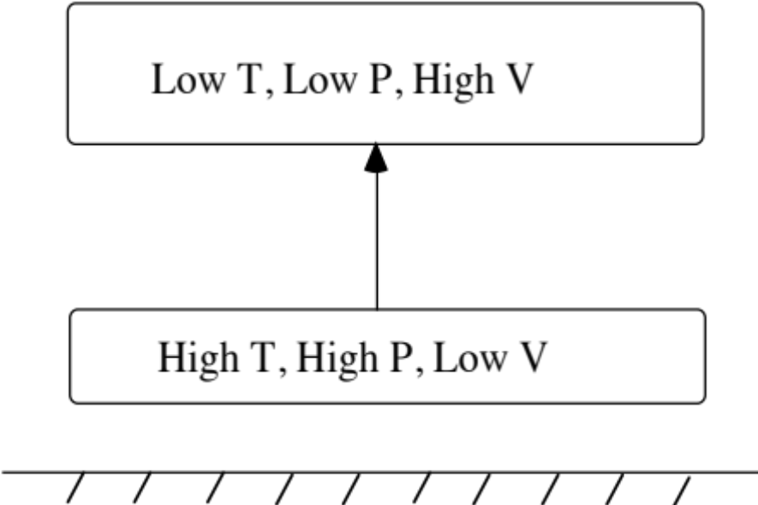
Equation of State
Boyle’s Law
    p~1/V at const. T
Charles’ Law
    V~T at const. p
Avogadro’s Law
    V~n at const. p, T
Ideal Gas Law
    pV=n R*T
Lifting of a parcel of air
(2.17)-(2.20)

Slide 24
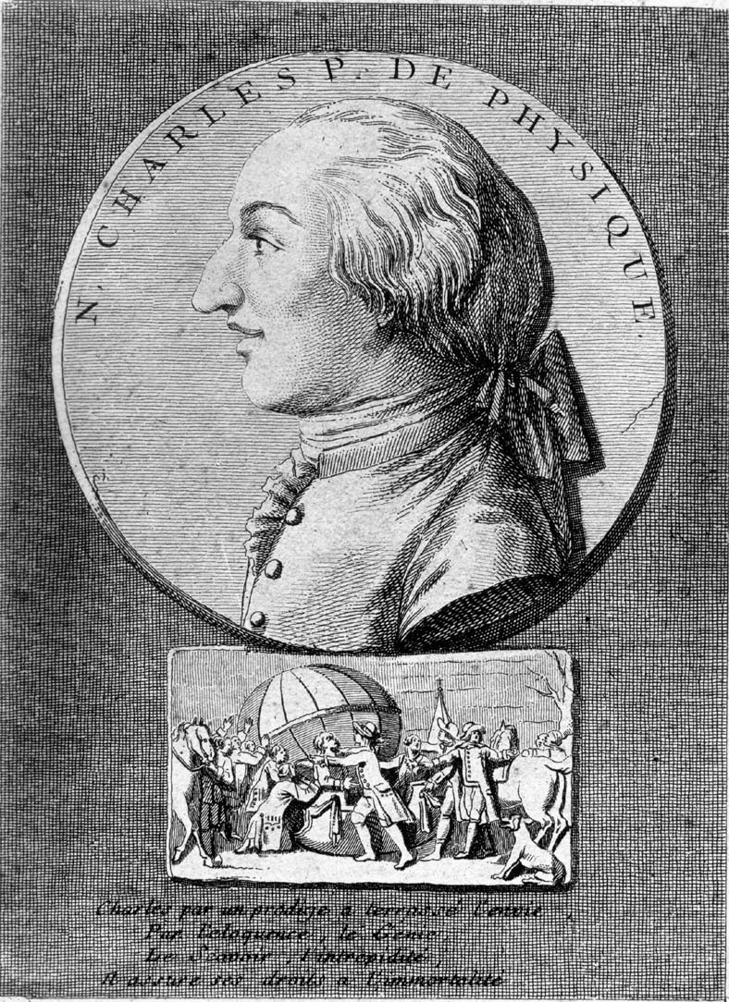
Jacques Charles (1746-1823)
June 4, 1783 Montgolfier brothers launch hot-air balloon in Annonay, France
August 27, 1783 Charles launches silk balloon filled with hydrogen in Paris
“The country people who saw it fall were frightened and attacked it with stones and knives so that it was much mangled” - Benjamin Franklin
November 21, 1783 Montgolfiers organize first manned hot-air balloon flight.
December 1, 1783 Charles in hydrogen-balloon flight.
“I had a pocket glass, with which I followed it until I lost sight, first of the men, then of the car, and when I last saw the balloon it appeared no bigger than a walnut” - Benjamin Franklin
Edgar Fahs Smith Collection, U. Penn. Lib.

Slide 25
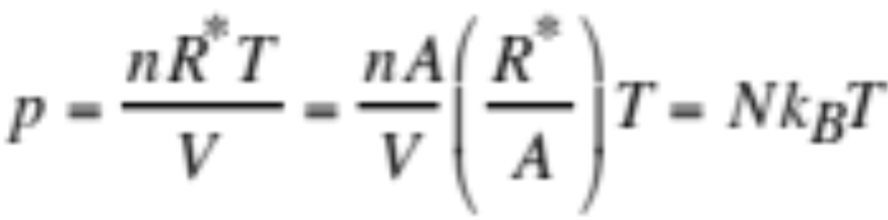
Equation of State
(2.20)
p = air pressure n = number of moles of gas
R* = gas const. (cm³ hPa mol⁻¹ K⁻¹) T = absolute temperature (K)
A = Avogadro’s num. (molec. mol⁻¹) N = gas conc. (molec. cm⁻³)
k_{B} = Boltzmann’s constant
(1.380658x10⁻¹⁹ cm³ hPa K⁻¹)
Example 2.3 p = 1013 hPa
T = 288 K
--> N = 2.55 x 10¹⁹ molec. cm⁻³
p = 1 hPa
T = 270 K
--> N = 2.68 x 10¹⁶ molec. cm⁻³

Slide 26
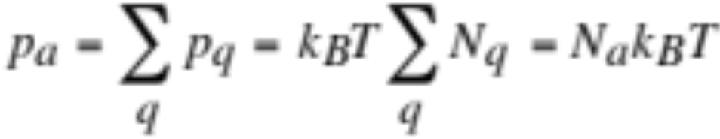



Dalton’s Law of Partial Pressure
Total air pressure equals the sum of the partial pressures of all the individual gases in the atmosphere
Total air pressure (hPa) (2.22)
Partial pressure of an individual gas (2.21)
Total air pressure equals partial pressures of dry plus moist air
Number concentration of total air

Slide 27
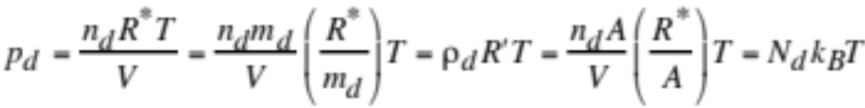
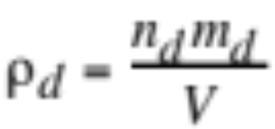
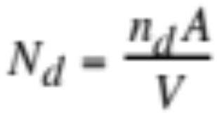
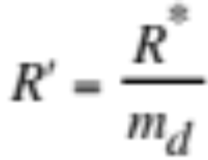
Equation of State for Dry Air
Partial pressure of dry air (hPa)
(2.23)
Dry air mass density (g cm⁻³)
Dry air number concentration (molec. cm⁻³)
Dry air gas constant (Appendix A)

Slide 28

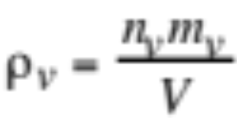
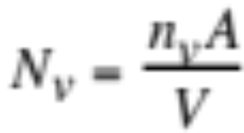
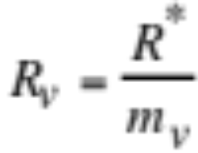
Equation of State for Water Vapor
Partial pressure of water vapor (hPa) (2.25)
Water vapor mass density (g cm⁻³)
Water vapor number concentration (molec. cm⁻³)
Gas constant for water vapor

Slide 29


Equation of State Examples
Example 2.4 p_{d} = 1013 hPa
T = 288 K
R’ = 2.8704 m³ hPa kg⁻¹ K⁻¹
--> ρ_{d} = 1.23 kg m⁻³
Example 2.5 p_{v} = 10 hPa
T = 298 K
R_{v} = 4.6189 m³ hPa kg⁻¹ K⁻¹
--> ρ_{v} = 0.00725 kg m⁻³

Slide 30
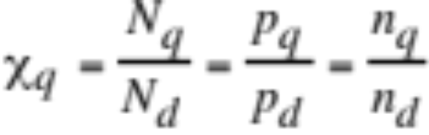
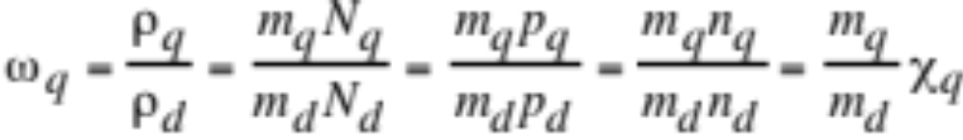
Volume and Mass Mixing Ratio
Volume mixing ratio (molec. of gas per molecule of dry air)
(2.29)
Mass mixing ratio (mass of gas per mass of dry air)
(2.30)
Example 2.6 - ozone
χ = 0.1 ppmv
m_{O3} = 48 g mol⁻¹ --> ω_{O3} = 0.17 ppmm
T = 298 K
p_{d} = 1013 hPa --> N_{d} = 2.55 x 10¹⁹ molec. cm⁻³
--> N_{O3} = 2.55 x 10¹² molec. cm⁻³
--> p_{O3} = 0.000101 hPa

Slide 31
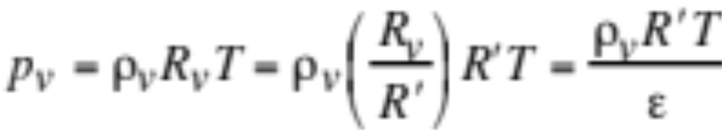
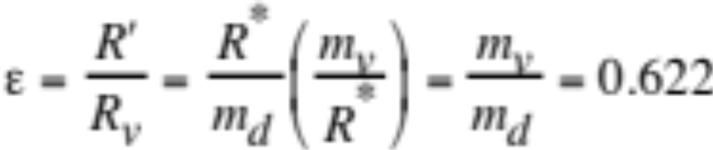
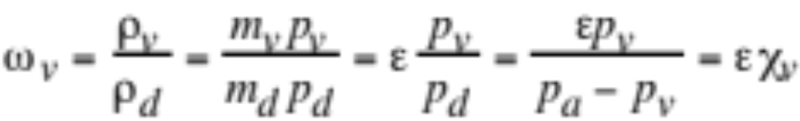
Mass Mixing Ratio of Water Vapor
Equation of state for water vapor
(2.27)
Mass mixing ratio of water vapor (mass-vapor per mass dry air)
(2.31)
Example 2.7
p_{v} = 10 hPa
p_{d} = 1013 hPa
--> ω_{v} = 0.00622 kg kg⁻¹ (0.622%)

Slide 32
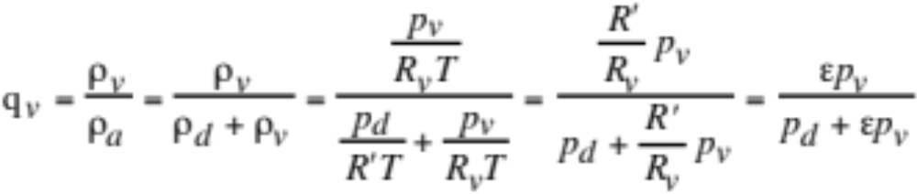
Specific Humidity
= Moist-air mass mixing ratio (mass of vapor per mass moist air)
(2.32)
Example 2.8
p_{v} = 10 hPa
p_{a} = 1010 hPa
--> p_{d} = 1000 hPa
--> q_{v} = 0.00618 kg kg⁻¹ (0.618%)

Slide 33
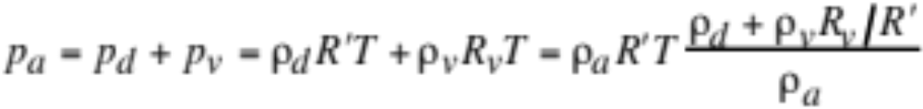
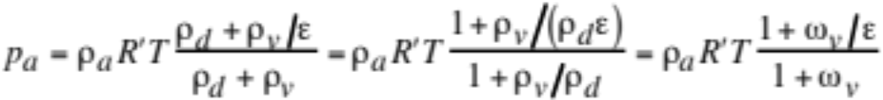

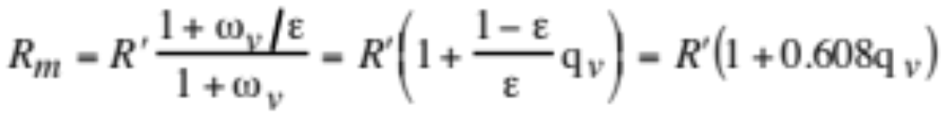
Equation of State for Moist Air
Total air pressure (2.34)
Gather terms (2.35)
Total air pressure (2.36)
Gas constant for moist air (2.37)

Slide 34
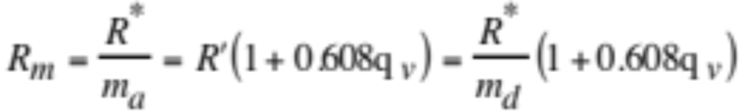
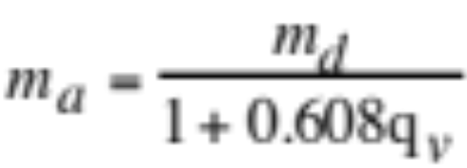
Equation of State for Moist Air
Gas constant for moist air (2.37)
Molecular weight of total air less than that of dry air (2.39)

Slide 35

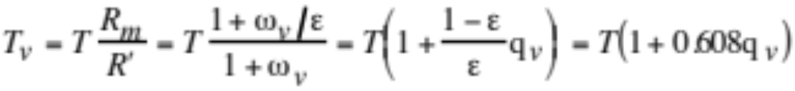
Virtual Temperature
Equation of state for moist air (2.36)
Virtual temperature
Temperature of dry air having the same density as a sample of moist air at the same pressure as the moist air. (2.38)

Slide 36
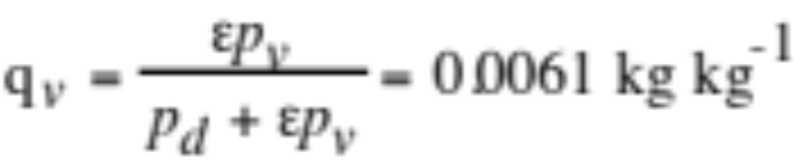
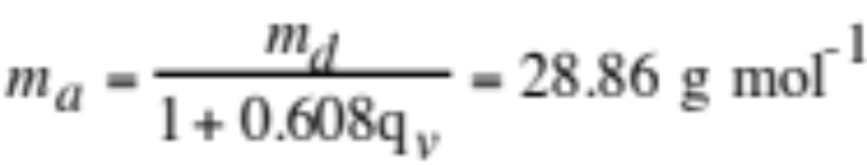

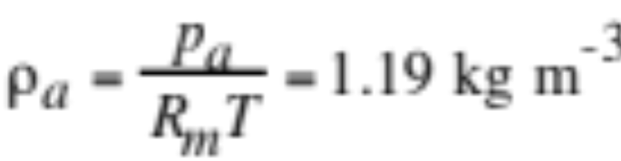
Moist Air Example
Example 2.9 p_{d} = 1013 hPa
p_{v} = 10 hPa
T = 298 K
-->

Slide 37

Hydrostatic Equation
Vertical equation of motion in absence of vertical acceleration
Upward pressure gradient balances downward gravity (2.40)
Use equation to calculate pressure at a given altitude (2.41)
Example 2.10
At sea level, p_{a,k+1} = 1013.25 hPa
ρ_{a,k+1} = 1.225 kg m⁻³
g_{k+1} = 9.8072 m s⁻²
--> At 100 m, p_{a,100m} = 1001.24 hPa
--> Air pressure decreases about 1 hPa per 10 m altitude

Slide 38



Pressure Altimeter
Measures pressure at unknown altitude with aneroid barometer
Combine hydrostatic equation with equation of state (2.42)
Assume constant temperature decrease with altitude
Assume free-tropospheric lapse rate
Assume standard atmosphere surface pressure, temperature
p_{a,s} = 1013.25 hPa T_{s} = 288 K

Slide 39


Pressure Altimeter
Integrate from p_{a,s} to p_{a} (2.43)
Rearrange for altitude as function of pressure (2.44)
Example 2.11
Pressure-altitmeter reading p_{a} = 850 hPa
--> z = 1.45 km

Slide 40




Scale Height
Height above a references height at which pressure decreases to 1/e its value at the reference height
Density of air from equation of state (2.45)
Mass of one air molecule
Combine (2.45) with hydrostatic equation (2.46)
Scale height (2.47)

Slide 41

Scale Height Equation
Integrate (2.46) at constant pressure (2.46)
Example 2.12
T = 298 K
--> H = 8.72 km
p_{a,ref} = 1013.25 hPa
z_{ref} = 0 km
z = 1 km
--> p_{a} = 903.5 hPa

Slide 42
Energy
Kinetic energy
Energy within a body due to its motion
Potential energy
Energy that arises due to an object’s position rather than motion
Gravitational potential energy
Potential energy obtained when an object is raised vertically
Internal energy
Kinetic and/or potential energy of atoms or molecules within an object
Work
Energy added to a body by the application of a force that moves the body in the direction of the force
Radiation
Energy transferred by electromagnetic waves

Slide 43

Latent Heat
Energy required to change a substance from one state to another
Fig. 2.6
  Condensation, freezing, deposition
    release energy --> warm the air
  Evaporation, melting, sublimation
    absorb energy --> cool the air

Slide 44



Latent Heat of Evaporation
Change of latent heat of evaporation with temperature (2.49)
Integrate (2.53)
Substitute constants (J kg⁻¹) (2.54)
Example 2.13
T = 273.15 K
--> L_{e} = 2.5x10⁶ J kg⁻¹
T = 373.15 K
--> L_{e} = 2.3x10⁶ J kg⁻¹

Slide 45

Specific Heat of Liquid Water
C_{W} (J kg ⁻¹ K⁻¹)
Fig. 2.7

Slide 46


Latent Heat of Melting
Change of latent heat of melting with temperature (2.50)
Integrate and substitute constants (J kg⁻¹) (2.55)
Example 2.14
T = 273.15 K
--> L_{m} = 3.34x10⁵ J kg⁻¹
T = 263.15 K
--> L_{m} = 3.12x10⁵ J kg⁻¹

Slide 47

Latent Heat of Sublimation
Change of latent heat of sublimation with temperature (2.50)
Integrate and substitute constants (J kg⁻¹) (2.56)

Slide 48




Clausius-Clapeyron Equation
Change of saturation vapor pressure with temperature (2.57)
Density of water vapor over particle surface (kg m⁻³)
Combine density with Clausius-Clapeyron equation (2.58)
Substitute latent heat of evaporation (2.59)

Slide 49


Clausius-Clapeyron Equation
Integrate (2.60)
Substitute constants (2.61)
Example 2.15
T = 253.15 K
--> p_{v,s} = 1.26 hPa
T = 298.15 K
--> p_{v,s} = 31.6 hPa

Slide 50


Saturation Vapor Pressure
Empirical parameterization (2.62)
Example 2.16
T_{c} = -20 ºC (253.15 K)
--> p_{v,s} = 1.26 hPa
T_{c} = 25 ºC (298.15 K)
--> p_{v,s} = 31.67 hPa
Vapor pressure (hPa)

Slide 51


Saturation Vapor Pressure Over Ice
Change of saturation vapor pressure with temperature (2.63)
Substitute latent heat of sublimation and integrate (2.64)

Slide 52


Saturation Vapor Pressure Over Ice
Empirical parameterization (2.65)
Example 2.17
T_{c} = -20 ºC (253.15 K)
--> p_{v,s} = 1.26 hPa
--> p_{v,I} = 1.04 hPa
Vapor pressure (hPa)

Slide 53


Condensation/Evaporation
Condensation when p_{v} > p_{v,s}
Evaporation when p_{v} < p_{v,s}
Fig. 2.9a,b

Slide 54


Formation of Rain in Cold Clouds
Ice Crystal (Bergeron) Process
Vapor pressure (hPa)
p_{v,s} over ice is less than that over liquid water
Water droplets evaporate, vapor flows to ice crystals
Ideal precipitation if 100,000 droplets per ice crystal

Slide 55


Relative Humidity
Relative humidity (percent) (2.66)
Saturation mass mixing ratio (2.67)
To increase relative humidity,
  increase partial pressure of water
  decrease temperature, which decreases p_{v,s}
To decrease relative humidity,
  lower partial pressure of water
  increase temperature

Slide 56

Relative Humidity Example
If T = 35°C and p_{v}=20 hPa
--> find p_{v,s} and f_{r}
p_{v,s}=56.2 hPa
Vapor pressure (hPa)
p_{v}=20 hPa
T=35°C
f_{r} = 100% x 20 hPa / 56.2 hPa
= 35.6%
Temperature (ºC)

Slide 57
Relative Humidity Example
If T = 24°C and f_{r} =80%
--> at what temperature does fog appear upon cooling the air
Vapor pressure (hPa)
T=20°C
p_{v,s}=29.6 hPa
p_{v}=23.7 hPa
p_{v} = 80% x 29.6 hPa / 100%
= 23.7 hPa
T=24°C
Temperature (ºC)

Slide 58


Dew Point
Temperature to which air must be cooled at constant water vapor partial pressure to be saturated over a liquid water surface
Dew point (K) (2.68)
Ambient water vapor mixing ratio
Example 2.17
p_{v} = 12 hPa
--> T_{D} = 282.8 K

Slide 59
Dew Point Example
T = 30°C and
p_{v}=20 hPa --> find T_{D}
Vapor pressure (hPa)
p_{v}=20 hPa
T_{D}
T
Temperature (ºC)

Slide 60
Dew Point Example
T_{D} = 16°C and f_{r} =83%
--> find p_{v} and p_{v,s}
Vapor pressure (hPa)
T_{D}
p_{v,s}=21.3 hPa
p_{v,s} = p_{v} x100% / f_{r}
= 21.3hPa
p_{v}=17.7 hPa
Temperature (ºC)

Slide 61


Morning/Afternoon Temperature/Dew Point at Riverside, Calif.
Air pressure (hPa)
Air pressure (hPa)
Figs. 2.11a,b

Slide 62





First Law of Thermodynamics
First law for atmosphere (2.69)
dQ* = change in energy (J) due to energy transfer
dU* = change in internal energy (J) of the air
dW* = work done by (+) or on (-) the air (J)
First law in terms of energy per unit mass (2.71)
M_{a} = mass of air (kg)

Slide 63



Change in Work
Work done by air during expansion (dV>0) or contraction of air
Work done per unit mass of air (2.72)
Specific volume of air (2.73)

Slide 64



Change in Internal Energy
Change in temperature of the gas multiplied by the energy required to change the temperature 1 K, without affecting the work done by or on the gas and without changing its volume.
Change in internal energy (2.74)
Conservation of energy (2.75)
-->Specific heat moist air at const. volume (J kg⁻¹ K⁻¹) (2.76)
Change in energy required to change temperature of 1 kg air 1K at constant volume

Slide 65




Different Forms of First Law
First law of thermodynamics (2.77)
Equation of state for moist air
Differentiate equation of state (2.78)
Combine (2.77) and (2.78) and c_{p,m}= c_{v,m} +R_{m} (2.79)

Slide 66




Different Forms of First Law
Specific heat of moist air at const. pressure (J kg ⁻¹ K⁻¹) (2.80)
Energy required to increase the temperature of 1 kg of air 1K without affecting air pressure
Virtual temperature (2.38)
First law in terms of virtual temperature (2.82)

Slide 67





Different Forms of First Law
Isobaric process (dp_{a}=0) (2.83)
Isothermal process (dT=0) (2.84)
Isochoric process (dα_{a}=0) (2.85)
Adiabatic process (dQ=0) (2.86)

Slide 68
Adiabatic/Diabatic Processes
Adiabatic process (dQ=0)
Process by which no energy is exchanged between a system (parcel of air) and its surroundings (atmosphere)
Parcel
of air
Diabatic processes (dQ>0 or <0)
Condensation/evaporation
Deposition/sublimation
Freezing melting
Radiative heating/cooling
Atmosphere

Slide 69
Dry adiabatic Expansion in Rising Air
1. Rising air expands
2. Expanding air cools
Rising air cools
Unsaturated air cools +9.8 K per 1 km rise in altitude
−−> dry adiabatic lapse rate
Γ_{d} = +9.8 K/km
278.2 K
1 km
288 K

Slide 70

Stability in Terms of Temperature
Compare parcel temperature with environmental temperature to determine stability
Unstable
Stable
Fig. 2.14

Slide 71




Dry Adiabatic Lapse Rate
Rewrite first law for adiabatic process
Differentiate with respect to altitude (2.89)
--> Dry adiabatic lapse rate in terms of virtual temperature
Rewrite first law for adiabatic process
Differentiate with respect to altitude (2.89)
--> Dry adiabatic lapse rate in terms of actual temperature

Slide 72



Potential Temperature
Substitute (2.91)
Integrate (2.92)
Exponential term (2.93)

Slide 73


Potential Temperature
Potential temperature of moist air (θ_{p,m}) (2.94)
Assume p_{a,0}=1000 hPa --> T₀=θ_{p,m}
Potential temperature of dry air (θ_{p}) (2.95)
Example 2.21
p_{d} = 800 hPa
T = 270 K
--> θ_{p} = 287.8 K

Slide 74

Temperature vs. Potential Temperature
Air pressure (hPa)
Air pressure (hPa)
Figs. 2.11a, 2.12

Slide 75


Potential Virtual Temperature
Potential virtual temperature (θ_{v}) (2.96)
Found by converting all moisture in a parcel to dry air, then bringing the parcel to 1000 hPa and determining its temperature
Virtual potential temperature (θ_{p,v}) (2.97)
Found by bringing a parcel to 1000 hPa, then converting all moisture to dry air and determining the parcel's temperature

Slide 76


Stability in Terms of θ_{v}
Altitude (km)
Fig. 2.15

Slide 77



Stability Criteria For θ_{v}
Potential virtual temperature (2.96)
Differentiate (2.101)
Take partial derivative with respect to height (2.102)
and substitute ∂p_{a} /∂z=-ρ_{a} g and Γ_{v}=- ∂T_{v} /∂z

Slide 78

Stability Criteria For θ_{v}
Substitute R’/p_{a}=1/ρ_{a}T_{v} and Γ_{d}=g/c_{p,d} (2.103)
Example 2.21
p_{a} = 925 hPa
T_{v} = 290 K
Γ_{v} = +7 K km⁻¹
--> θ_{v} = 296.5 K
--> ∂θ_{v} / ∂z = 3.07 K km⁻¹ --> stable

Slide 79



Brunt-Väisälä Frequency
Rewrite (2.103) (2.105)
Brunt-Väisälä frequency (2.106)
Stability criteria (2.107)
Example 2.25 T_{v} = 288 K
Γ_{v} = +6.5 K km⁻¹
--> Ν_{bv} = 0.0106 s⁻¹ --> stable
--> period τ_{bv} = 2π/ Ν_{bv} = 593 s

Slide 80


Isentropic Surfaces
Change in entropy
Isentropic surfaces occur when dS=0, which occurs when dQ=0 (adiabatic process), which occurs when θ_{v} is constant with distance or height. Isentropic surfaces slant northward in the Northern Hemisphere.
Fig. 2.13

