Slide 1
Presentation Slides for
Chapter 21 of
Fundamentals of Atmospheric Modeling 2nd Edition
Mark Z. Jacobson
Department of Civil & Environmental Engineering
Stanford University
Stanford, CA 94305-4020
jacobson@stanford.edu
March 31, 2005

Slide 2
Steps in Model Formulation
Define purpose of model
Determine scales of interest
Determine dimension of model
Select physical, chemical, dynamical processes treated
Select variables
Select computer architecture
Write code for model
Optimize memory and speed of model
Select time steps and time intervals
Set initial conditions

Slide 3
Steps in Model Formulation
11. Set boundary conditions
12. Select input data
13. Select ambient data for comparison
14. Interpolate data and model results for inputs and outputs
15. Select or write algorithms for statistics and graphics
16. Run model simulations
17. Run sensitivity tests
18. Improve model based on results

Slide 4
Number of Array Points in Model
(21.1)
Example 21.1:
Number of meteorological variables 10
Number of gases 100
Number of aerosol and hydrometeor distributions 5
Number of size bins per distribution 20
Number of components per size bin per distribution 30
Number of radiative variables: 2
Number of three-dimensional grid cells 50,000
Number of surface variables 6
Number of two-dimensional grid cells 2500
→ Number of array points required 156 million

Slide 5
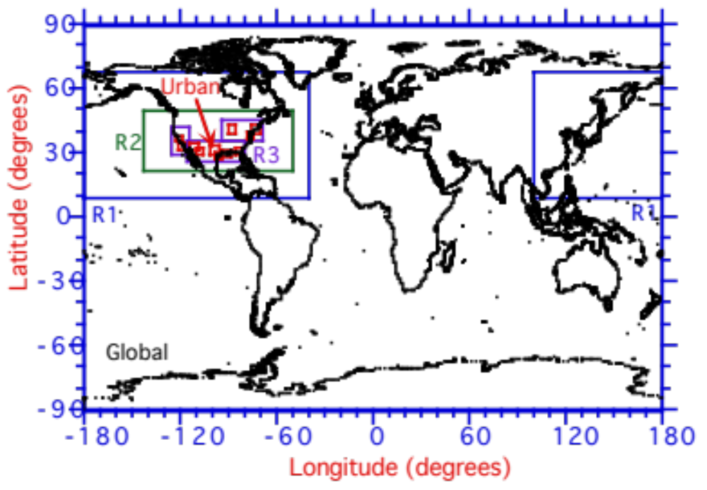
Example of Nested Domains
Latitude (degrees)
Fig. 21.1

Slide 6
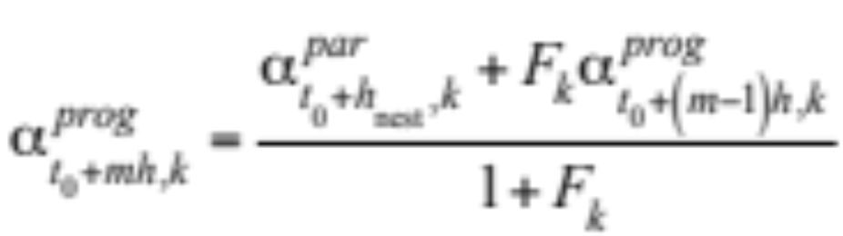
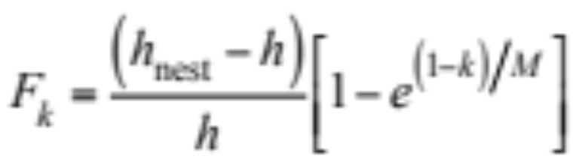
Nesting Boundary Conditions
Variable values in buffer zone of progeny domain (21.4)
Relaxation coefficient (21.5)

Slide 7
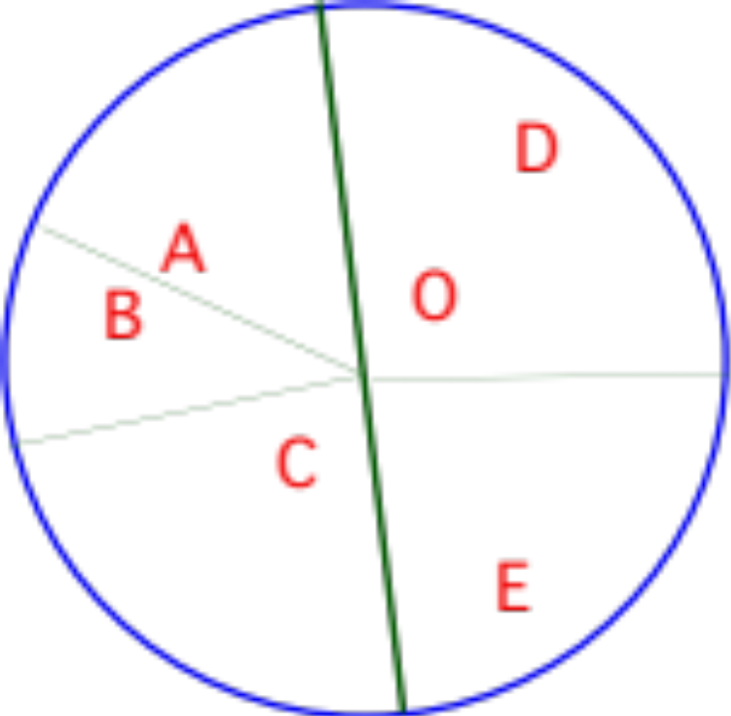
Inverse Square Interpolation
Domain of influence around point O. Letters A, B, C, D, and E represent locations where data are available for interpolation to point O. The lines represent division of the domain of influence into sectors.
r_{I}
Fig. 21.2b

Slide 8
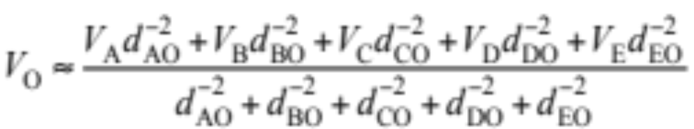
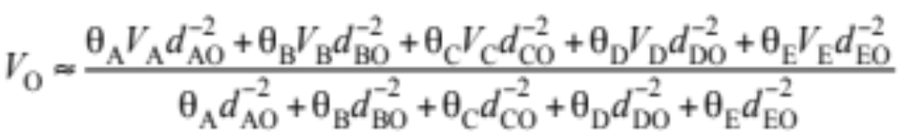
Inverse Square Interpolation
Inverse square interpolation (21.7)
Modified inverse square interpolation (21.6)

Slide 9
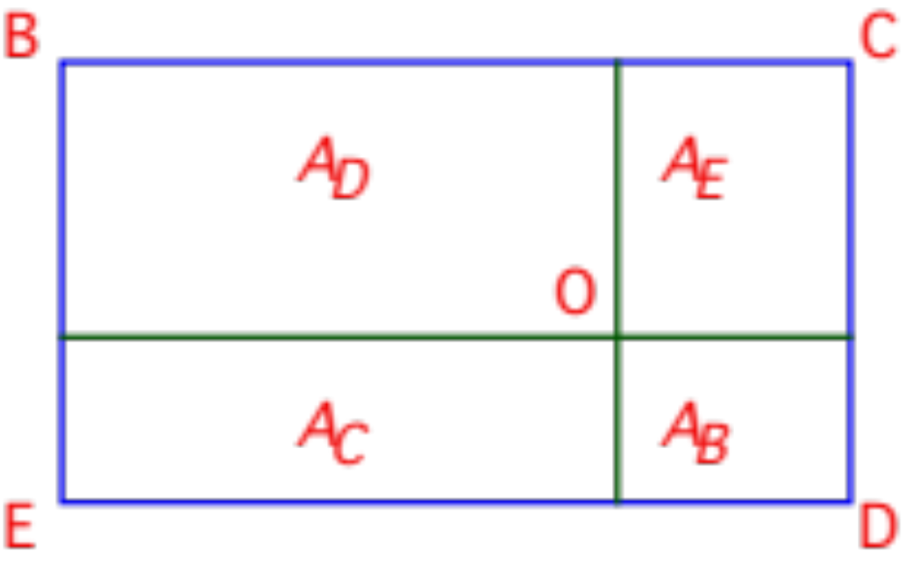
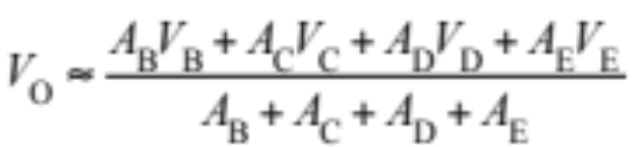
Bilinear Interpolation
Location of point O in a rectangle with points B, C, D, and E at the corners
(21.10)
Fig. 21.3

Slide 10
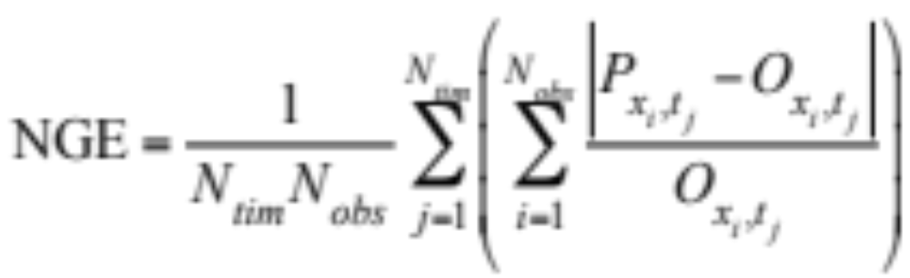
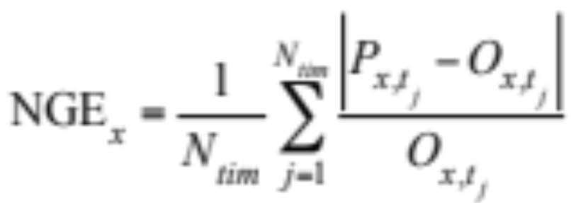
Statistics
Overall normalized gross error (21.11)
Location-specific normalized gross error (21.12)

Slide 11
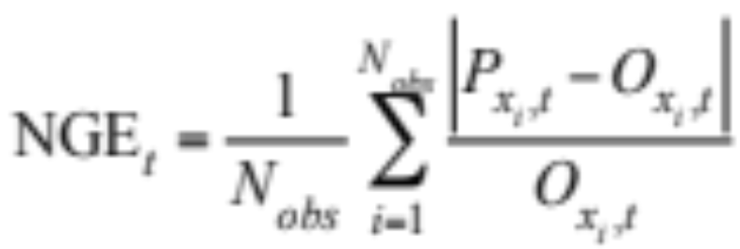
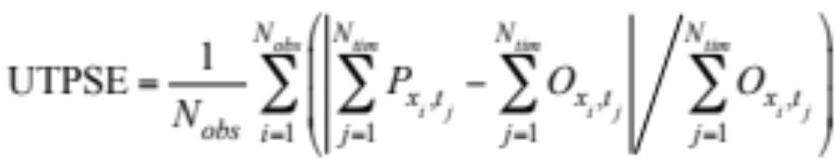
Statistics
Time-specific normalized gross error (21.13)
Unpaired-in-time, paired-in-space error (21.14)

Slide 12
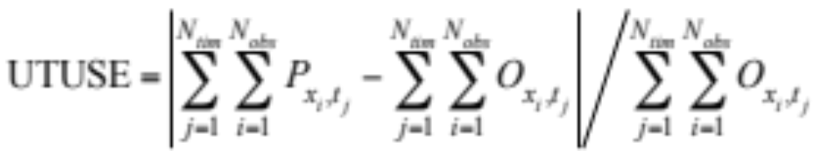
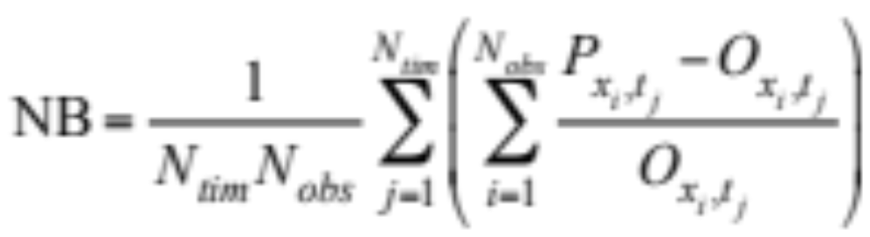
Statistics
Unpaired-in-time, unpaired-in-space error (21.15)
Normalized bias (21.16)

Slide 13
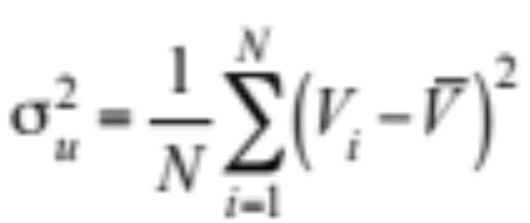
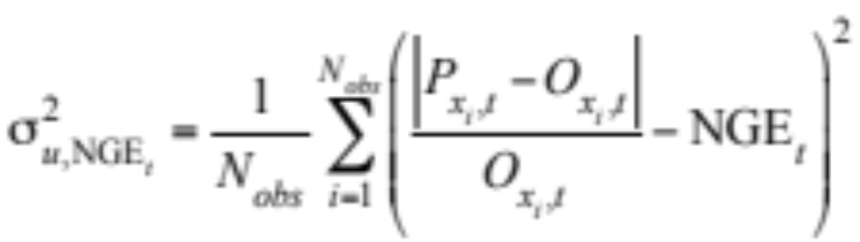
Statistics
Biased variance (21.17)
Biased variance of time-specific normalized gross error (21.18)

Slide 14
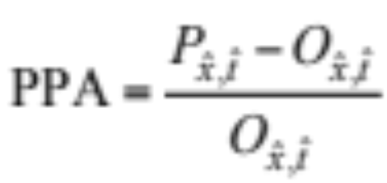
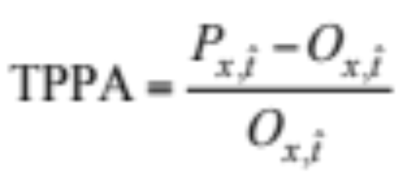
Statistics
Paired peak accuracy (21.19)
Temporally-paired peak accuracy (21.20)

