Slide 1
Presentation Slides for
Chapter 19 of
Fundamentals of Atmospheric Modeling 2nd Edition
Mark Z. Jacobson
Department of Civil & Environmental Engineering
Stanford University
Stanford, CA 94305-4020
jacobson@stanford.edu
March 31, 2005

Slide 2
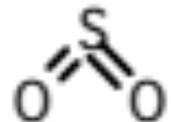
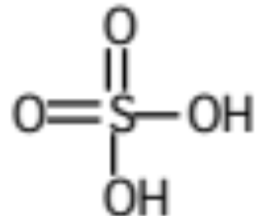
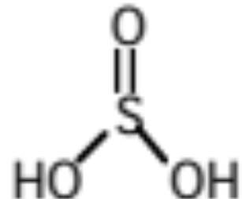
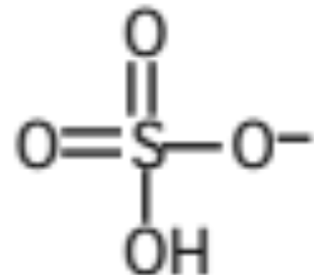
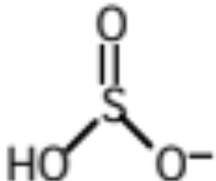
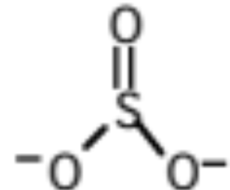
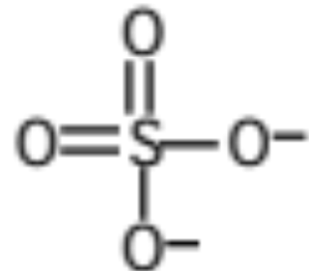
S(IV) and S(VI) Families
S(IV) Family
Sulfur dioxide
SO₂(g,aq)
S(VI) Family Table 19.1
Sulfurous acid
H₂SO₃(aq)
Sulfuric acid
H₂SO₄(g,aq)
Bisulfite ion
HSO₃⁻
Bisulfate ion
HSO₄⁻
Sulfite ion
SO₃²⁻
Sulfate ion
SO₄²⁻

Slide 3
Mechanisms of Converting S(IV) to S(VI)
Why is this important?
It allows sulfuric acid to enter or form within cloud drops and aerosol particles, increasing their acidity
Mechanisms
1. Gas-phase oxidation of SO₂(g) to H₂SO₄(g) followed by condensation of H₂SO₄(g)
2. Dissolution of SO₂(g) into liquid water to form H₂SO₃(aq) followed by aqueous chemical conversion of H₂SO₃(aq) and its dissociation products to H₂SO₄(aq) and its dissociation products.

Slide 4
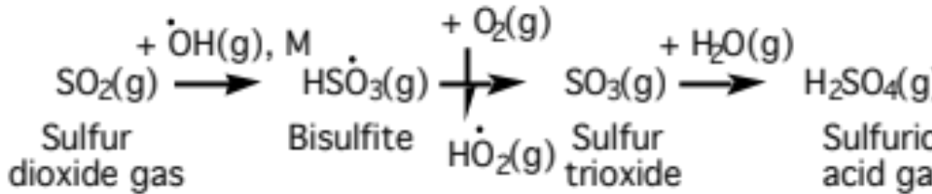
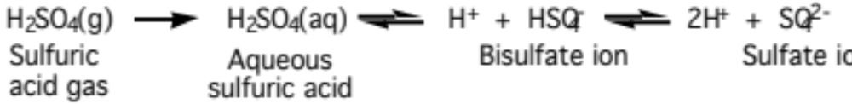
Gas-Phase Oxidation of S(IV)
Gas-phase oxidation of sulfur dioxide to sulfuric acid (19.1)
Condensation and dissociation of sulfuric acid (19.2)

Slide 5
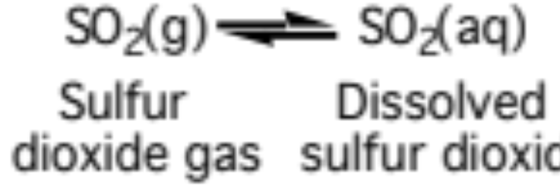
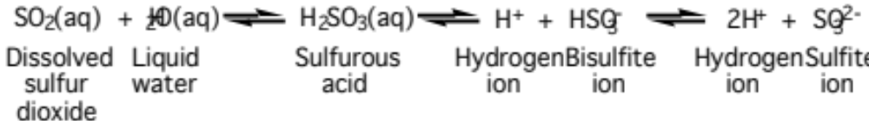
S(IV) Dissolution/Aqueous Oxidation
Dissolution of sulfur dioxide (19.3)
Dissociation of dissolved sulfur dioxide
At pH of 2-7, most S(IV) dissociates to HSO₃⁻ (19.4)

Slide 6
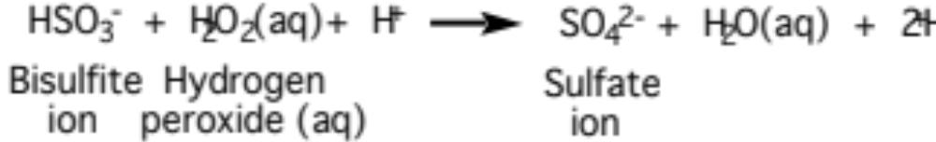
Aqueous Oxidation of S(IV)
Oxidation of S(IV) by hydrogen peroxide (19.5)
If [H₂O₂(aq)] > [S(IV)]
S(IV) is consumed within tens of minutes
If [S(IV)] > [H₂O₂(aq)]
H₂O₂(aq) is consumed within minutes

Slide 7

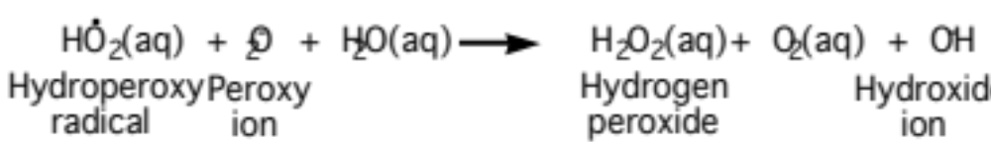
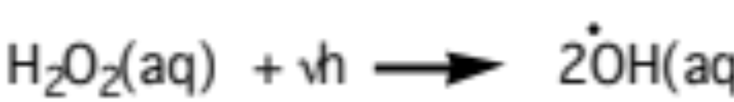
Hydrogen Peroxide Sources/Sinks
Sources of hydrogen peroxide (19.8, 19.9)
Sinks of hydrogen peroxide (19.6, 19.7)

Slide 8
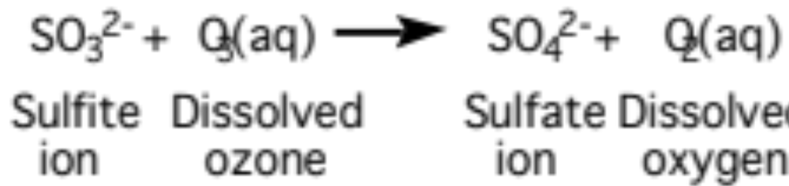
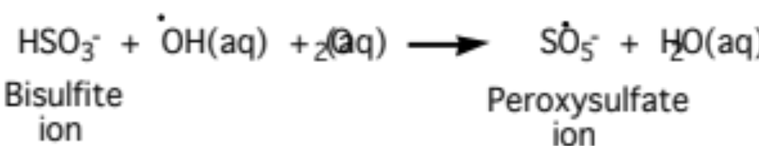
Aqueous Oxidation of S(IV)
Oxidation by ozone, important when pH > 6 (19.11)
Oxidation by hydroxyl radical, important when pH ≈ 5 (19.12)

Slide 9
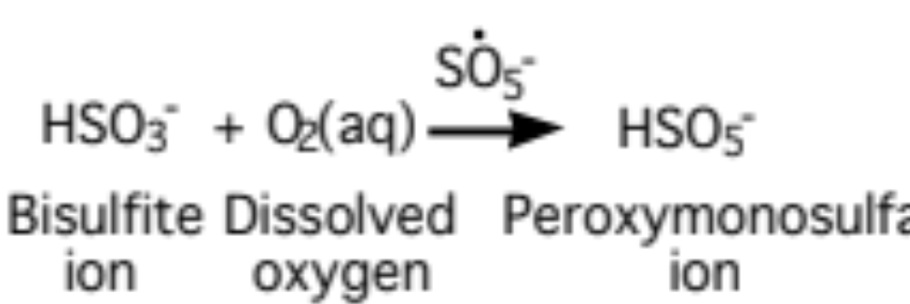
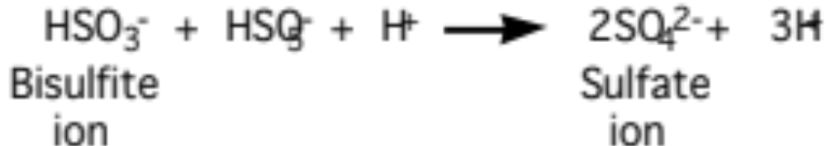
Aqueous Oxidation of S(IV)
Oxidation by oxygen, catalyzed by peroxysulfate ion (19.13)
Oxidation by the peroxymonosulfate ion (19.14)

Slide 10
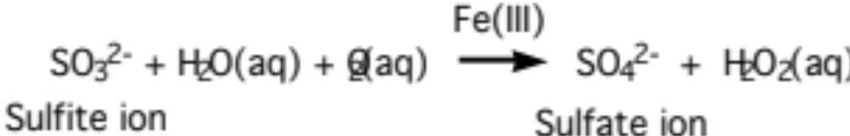
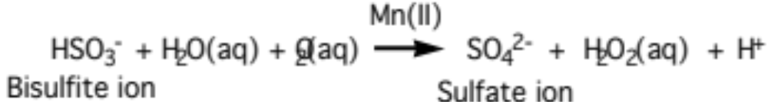
Aqueous Oxidation of S(IV)
Oxidation by oxygen, catalyzed by Fe(III)=Fe³⁺ (19.15)
Oxidation by oxygen, catalyzed by Mn(II) = Mn²⁺ (19.16)

Slide 11
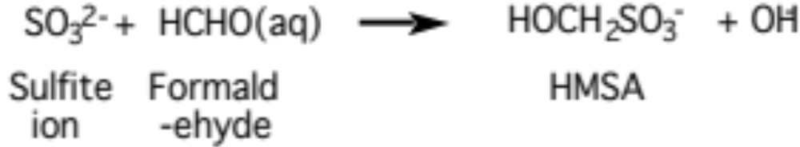
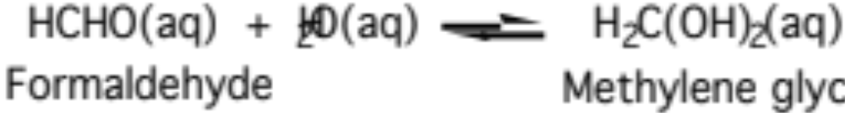
Aqueous Oxidation of S(IV)
Oxidation by formaldehyde (19.19)
Formaldehyde equilibrates with methylene glycol (19.17)

Slide 12
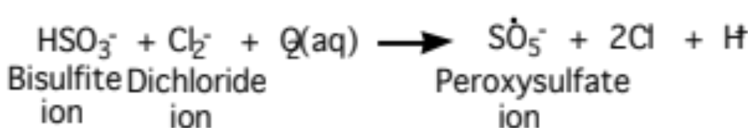
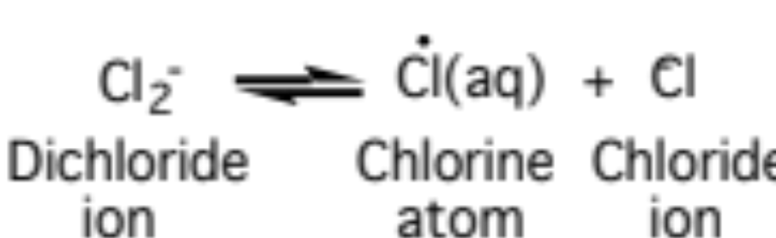
Aqueous Oxidation of S(IV)
Oxidation by dichloride ion (19.24)
Dichloride ion equilibrates with chlorine atom,ion (19.21)

Slide 13
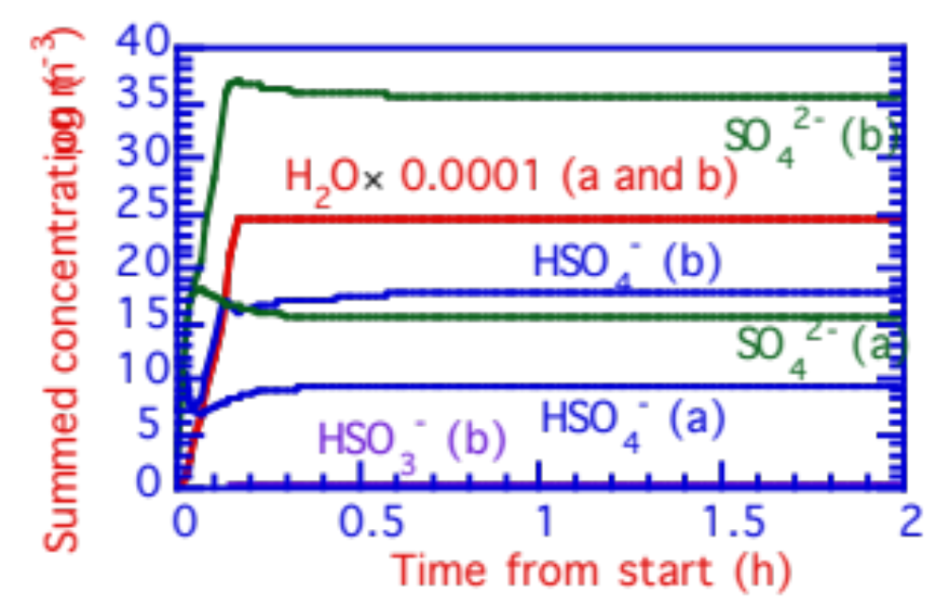
Cloud Conversion of S(IV) to S(VI)
Change in S(VI) content when SO₂(g) dissolved and (a) did not and (b) did react in a cloud. The conversion took < 10 minutes
Summed concentrations (μg m⁻³)
Fig. 19.1

Slide 14
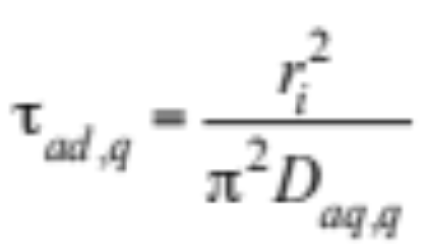
Diffusion Within a Drop
Characteristic time for aqueous diffusion in cloud drop (19.25)
Example 19.1:
d_{i} = 30 μm
---> τ_{ad,q} = 0.011 s
d_{i} = 10 μm
---> τ_{ad,q} = 0.0013 s
Reaction times for O₃(aq), NO₃(aq), OH(aq), Cl(aq), SO₄⁻, CO₃⁻, and Cl₂⁻ are shorter than are diffusion transport times

Slide 15
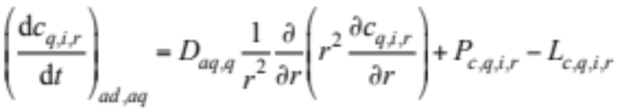
Diffusion Within a Drop
Time rate of change of concentration of species q in size bin i as a function of radius during diffusion (19.26)
Boundary condition
At drop center, ∂c_{q,i,r}/ ∂ r = 0

Slide 16
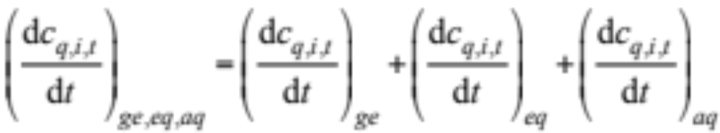
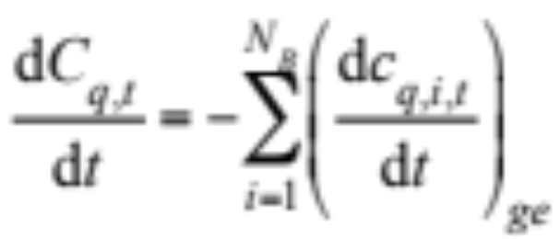
Aqueous Chemistry With Growth
Aqueous reactions stiffer than gas reactions
Aqueous reactions solved in more size bins than gas reactions
Aqueous concentrations coupled to growth and equilibrium
--> Either time split aqueous chemistry from other processes with a small splitting time step or solve aqueous chemistry together with other processes
Change in aerosol composition (19.27)
Corresponding conservation of gas equation (19.28)

Slide 17
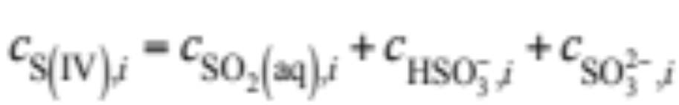
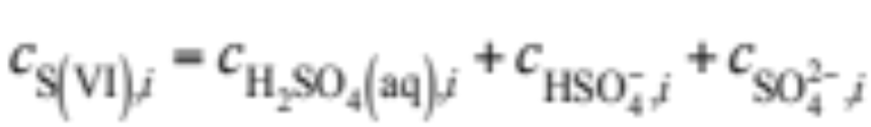
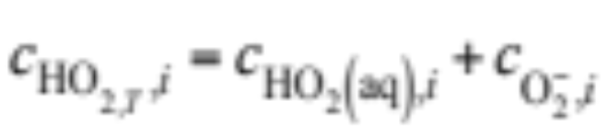
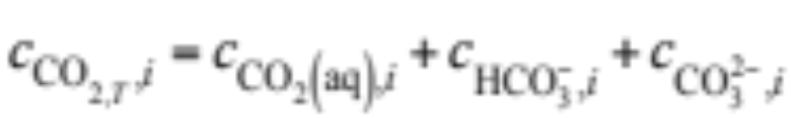
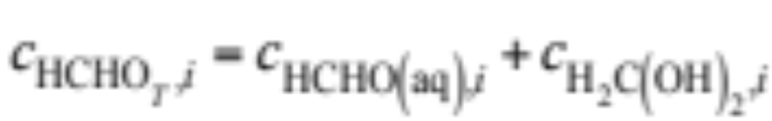
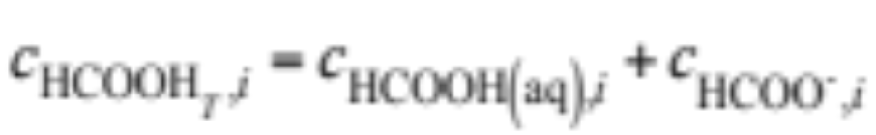
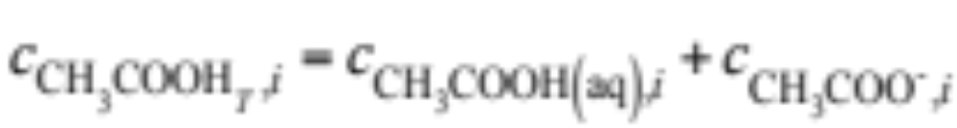
Aqueous Chemistry Families
Used for one type of numerical solution to aqueous chemistry
(19.29)-(19.35)

Slide 18
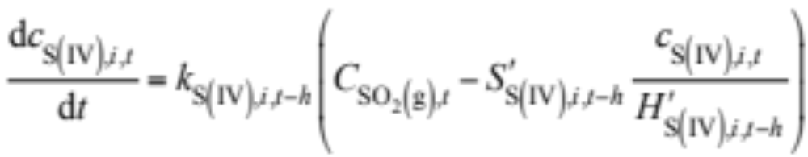
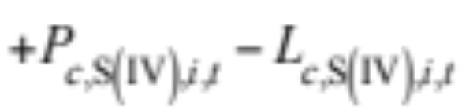
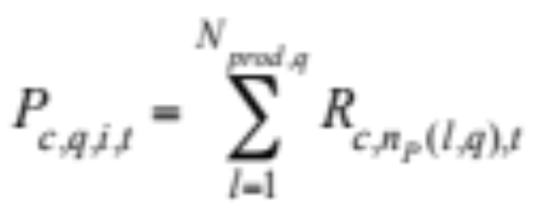
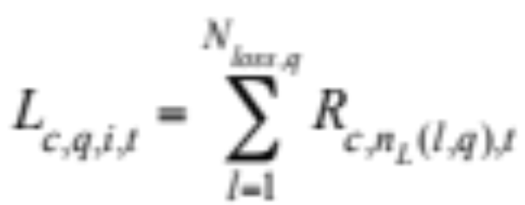
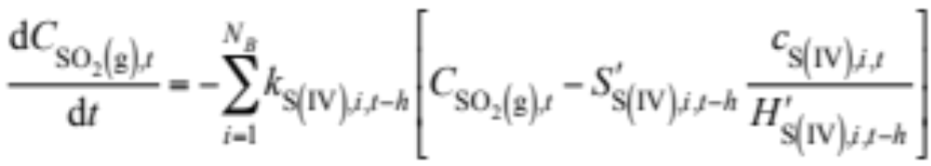
Growth/Aqueous Chemistry ODEs
Change in S(IV) due to aqueous chemistry (19.43)
Chemical production and loss terms (19.45)
Gas conservation equation (19.62)

Slide 19
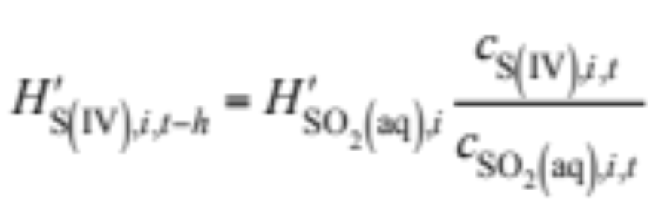
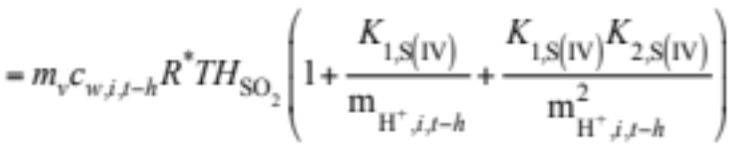
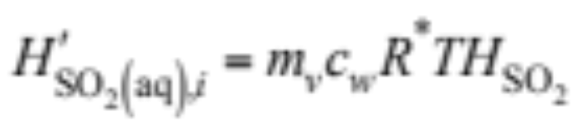
Growth/Aqueous Chemistry ODEs
Dimensionless effective Henry’s constant (19.44)
Dimensionless Henry’s constant (19.37)

Slide 20
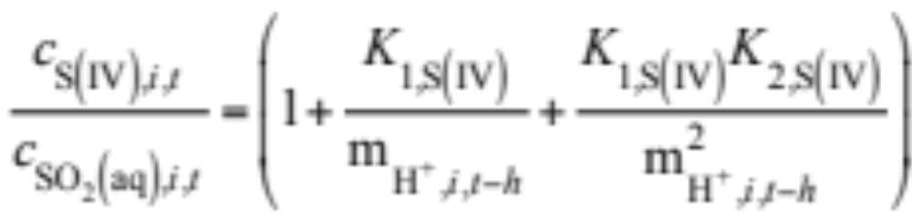
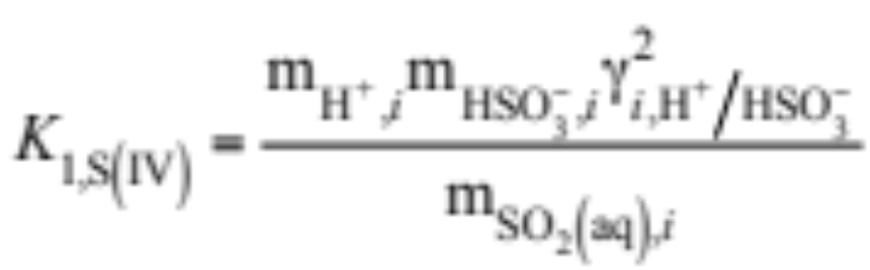
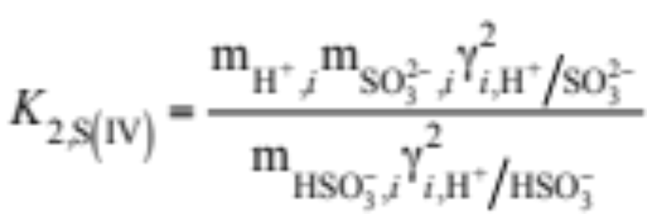
Growth/Aqueous Chemistry ODEs
Ratio of S(IV) to SO₂(aq) (19.38)
First and second dissociation constants of S(IV) (19.39)
(19.40)

Slide 21
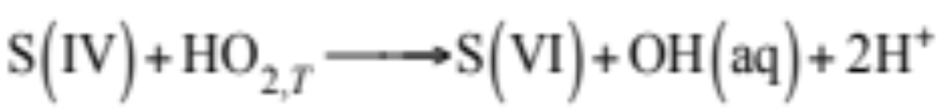
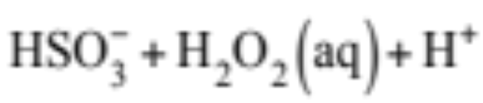
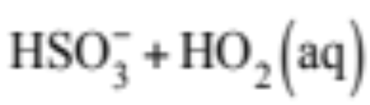



Chemical Loss Term
Consider aqueous reactions of family (19.46 - 7)
These represent individual aqueous reactions (19.48-52)

Slide 22


Chemical Loss Term
and their equilibrium partitioning (19.53-4)

Slide 23


Chemical Loss Term
Family loss rate (19.55)
Rate coefficient for S(VI)+H₂O₂(aq)+H⁺ (19.56)
Mole fraction of S(IV) partitioned to HSO₄⁻ (19.57)

Slide 24





Chemical Loss Term
Rate coefficient for S(VI)+HO₂(aq) (19.58)
Mole fraction of S(IV) partitioned to SO₄²⁻ (19.59)
Mole fraction of HO_{2,T} partitioned to HO₂(aq) and O₂⁻ (19.60-1)

Slide 25
Effect of Sparse-Matrix Reductions When Solving Growth/Aqueous ODEs
Dissolution/chemistry of 10 gases to 16 size bins, 11 species per bin.
Without With
Quantity Reductions Reductions
Order of matrix 186 186
Initial fill-in 34,596 1226
Final fill-in 34,596 2164
Decomp. 1 2,127,685 6333
Decomp. 2 17,205 1005
Backsub. 1 17,205 1005
Backsub. 2 17,205 973
Table 19.2

