Slide 1
Presentation Slides for
Chapter 18 of
Fundamentals of Atmospheric Modeling 2nd Edition
Mark Z. Jacobson
Department of Civil & Environmental Engineering
Stanford University
Stanford, CA 94305-4020
jacobson@stanford.edu
April 1, 2005

Slide 2
Cloud Formation
Altitude range (km) of different cloud-formation étages
Étage Polar Temperate Tropical
High 3-8 5-13 6-9
Middle 2-4 2-7 2-8
Low 0-2 0-2 0-2
Table 18.1

Slide 3
Fog
Cloud touching the ground
Radiation Fog
Forms as the ground cools radiatively at night, cooling the air above it to below the dew point.
Advection Fog
Forms when warm, moist air moves over a colder surface and cools to below the dew point.
Upslope Fog
Forms when warm, moist air flows up a slope, expands, and cools to below the dew point.

Slide 4
Fog
Evaporation Fog
Forms when water evaporates in warm, moist air, then mixes with cooler, drier air and re-condenses.
  Steam Fog
  Occurs when warm surface water evaporates, rises into cooler air, and recondenses, giving the appearance of rising steam.
  Frontal Fog
  Occurs when water from warm raindrops evaporates as the drops fall into a cold air mass. The water then recondenses to form a fog. Warm over cold air appears ahead of an approaching surface front.

Slide 5
Cloud Classification
Low clouds (0-2 km)
Stratus (St)
Stratocumulus (Sc)
Nimbostratus (Ns)
Middle clouds (2-7 km)
Altostratus (As)
Altocumulus (Ac)
High clouds (5-18 km)
Cirrus (Ci)
Cirrostratus (Cs)
Cirrocumulus (Cc)
Clouds of vertical development (0-18 km)
Cumulus (Cu)
Cumulonimbus (Cb)
stratus = "layer"
cumulus = "clumpy"
cirrus = "wispy"
nimbus = "rain"

Slide 6
Low Clouds
Stratus
A low, gray uniform cloud layer composed of water droplets that often produces drizzle.
Stratocumulus
Low, lumpy, rounded clouds with blue sky between them.
Nimbostratus
Dark, gray clouds associated with continuous precipitation. Not accompanied by lightning, thunder, or hail.

Slide 7
Middle Clouds
Altostratus
Layers of uniform gray clouds composed of water droplets and ice crystals. The sun or moon is dimly visible in thinner regions.
Altocumulus
Patches of wavy, rounded rolls, made of water droplets and ice crystals.

Slide 8
High Clouds
Cirrus
High, thin, featherlike, wispy, ice crystal clouds.
Cirrostratus
High, thin, sheet-like, ice crystal clouds that often cover the sky and cause a halo to appear around the sun or moon.
Cirrocumulus
High, puffy, rounded, ice crystal clouds that often form in ripples.

Slide 9
Clouds of Vertical Development
Cumulus
Clouds with flat bases and bulging tops. Appear in individual, detached domes, with varying degrees of vertical growth.
Cumulus humilis
Limited vertical development
Cumulus congestus
Extensive vertical development
Cumulonimbus
Dense, vertically developed cloud with a top that has the shape of an anvil. Can produce heavy showers, lightning, thunder, and hail. Also known as a thunderstorm cloud.

Slide 10
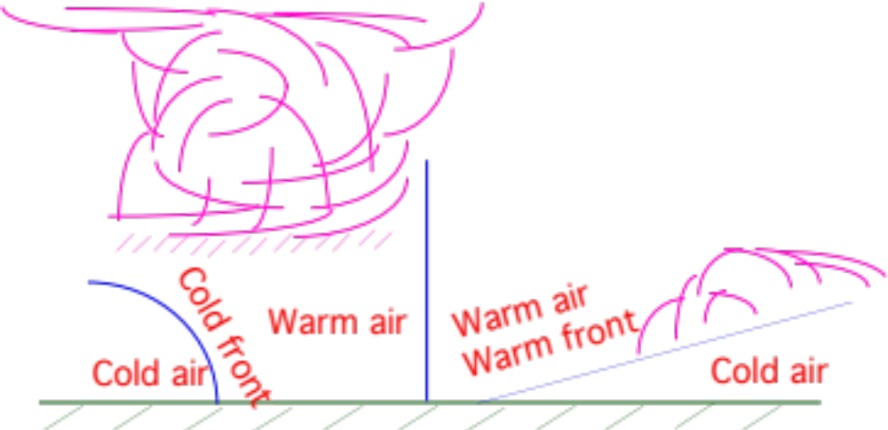
Cloud Formation
Cloud Formation Mechanisms
free convection
forced convection
orography
frontal lifting
Formation of clouds along a cold and warm front, respectively
Fig. 18.1

Slide 11
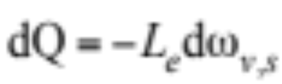
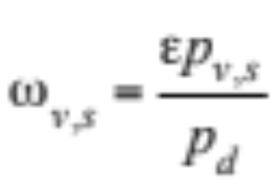
Pseudoadiabatic Process
Condensation, latent heat release occurs during adiabatic ascent
Adiabatic process
dQ = 0
Pseudoadiabatic process (18.1)
Saturation mass mixing ratio of water vapor over liquid water

Slide 12
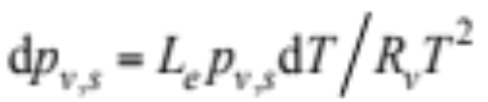
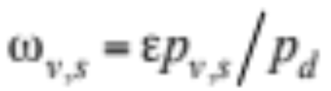
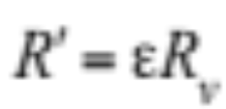
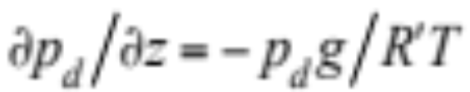
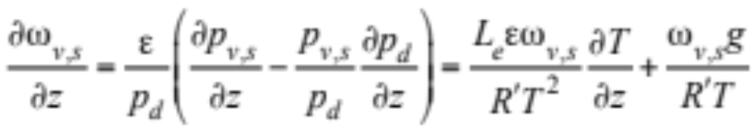
Pseudoadiabatic Process
Differentiate ω_{v,s}=ε p_{v,s}/p_{d} with respect to altitude, substitute
→
(18.5)

Slide 13
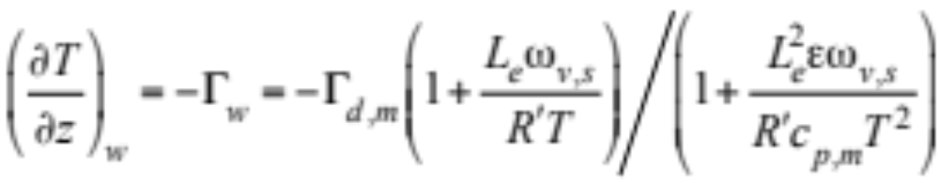
Pseudoadiabatic Process
Substitute (18.5) and Γ_{d,m}=g/c_{p,m} into (18.4) (18.6)
Example 18.1
p_{d} = 950 hPa
T = 283 K
---> p_{v,s} = 12.27 hPa
---> ω_{v,s} = 0.00803 kg kg⁻¹
---> Γ_{w} = 5.21 K km⁻¹
T = 293 K
---> Γ_{w} = 4.27 K km⁻¹

Slide 14
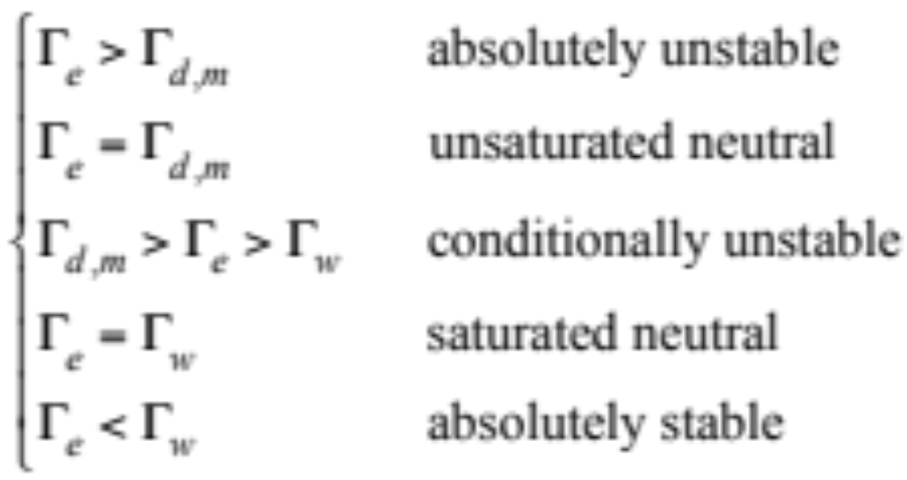
Dry or Moist Air Stability Criteria
(18.7)

Slide 15
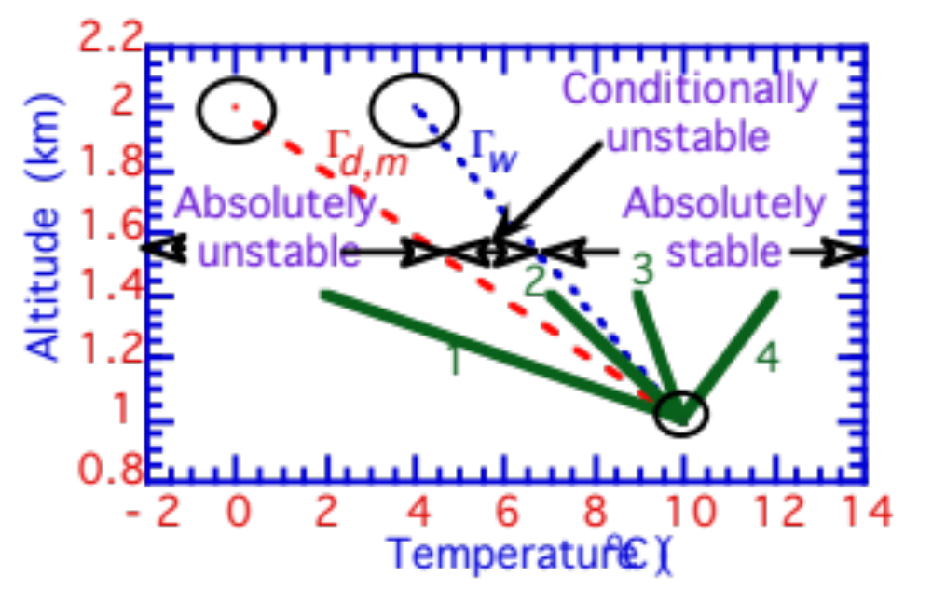
Stability in Dry or Moist Air
Altitude (km)
Fig. 18.2

Slide 16
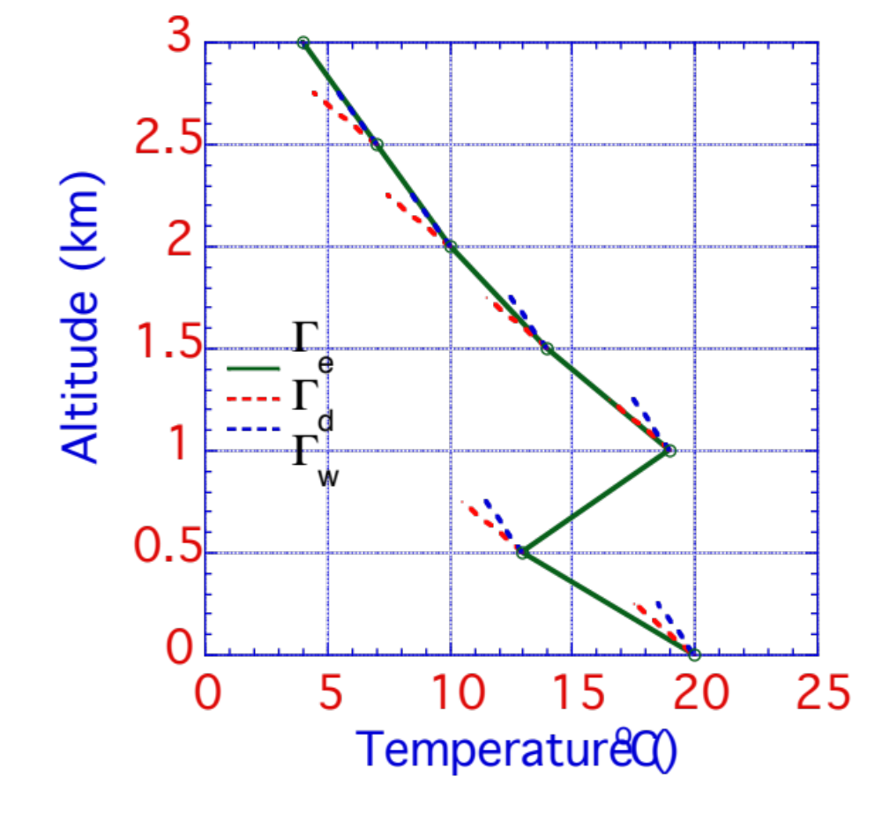
Stability in Multiple Layers
Saturated neutral
Saturated neutral
Conditionally unstable
Altitude (km)
Unsaturated neutral
Absolutely stable
Absolutely unstable
Fig. 18.3

Slide 17
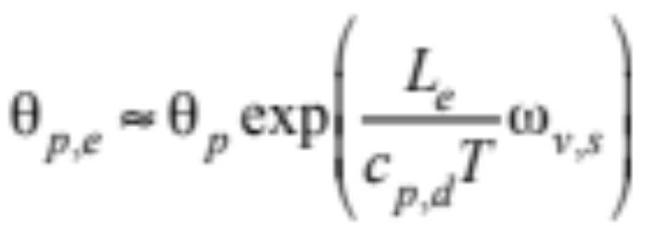
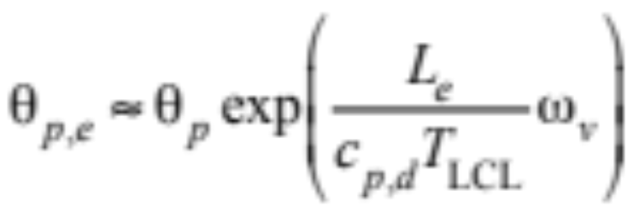
Equivalent Potential Temperature
Potential temperature a parcel of air would have if all its water vapor were condensed and the resulting latent heat were released and used to heat the parcel
Equivalent potential temperature in unsaturated air (18.8)
Equivalent potential temperature in unsaturated air (18.9)

Slide 18
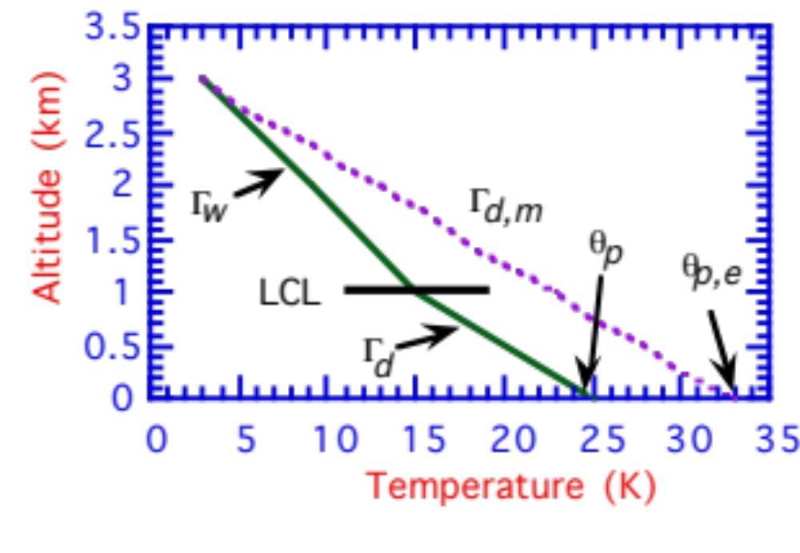
Equivalent Potential Temperature
Relationship between potential temperature and equivalent potential temperature
Altitude (km)
Fig. 18.4

Slide 19
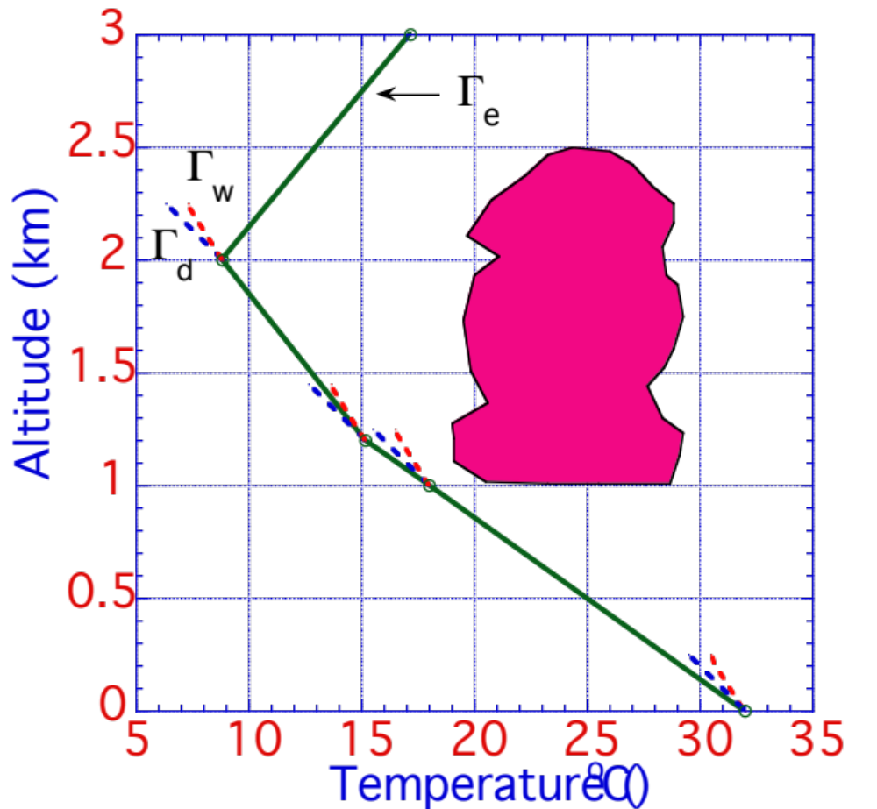
Cumulus Cloud Development
Cloud top
Cloud temperature
Altitude (km)
LCL
Temperature of
rising bubble
Dew point of
rising bubble
Fig. 18.5

Slide 20
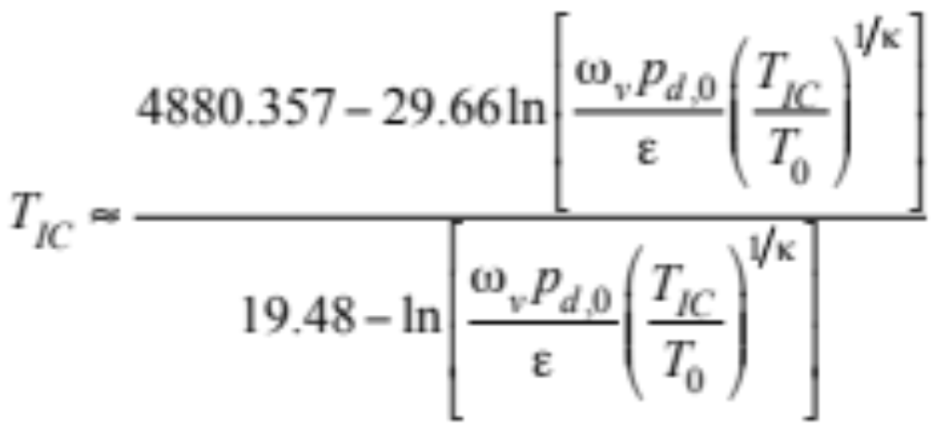
Isentropic Condensation Temperature
Temperature at the base of a cumulus cloud
Occurs at the lifting condensation level (LCL), which is that altitude at which the dew point meets parcel temperature.
Isentropic condensation temperature (18.11)

Slide 21
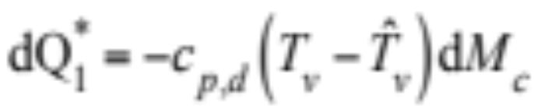
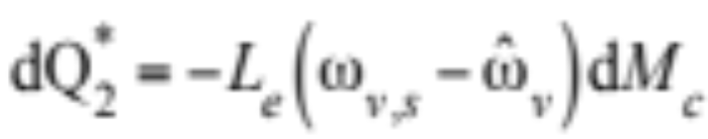
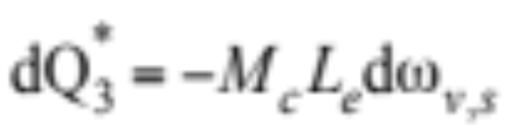
Entrainment
Mixing of relatively cool, dry air from outside the cloud with warm, moist air inside the cloud
Factors affecting the temperature inside a cloud
1) Energy loss from cloud due to warming of entrained, ambient air by the cloud (18.12)
2) Energy loss from cloud due to evaporation of liquid water in the cloud to ensure entrained, ambient air is saturated (18.13)
3) Energy gained by cloud during condensation of rising air (18.14)

Slide 22
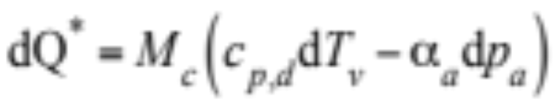
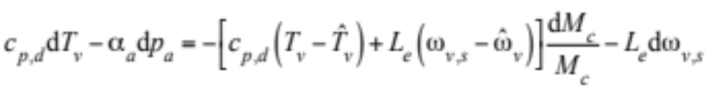
Entrainment
Sum the three sources and sinks of energy (18.15)
First law of thermodynamics (18.16)
Subtract (18.16) from (18.15) and rearrange (18.17)

Slide 23
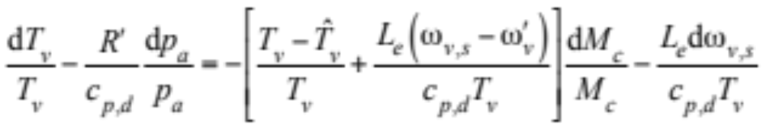
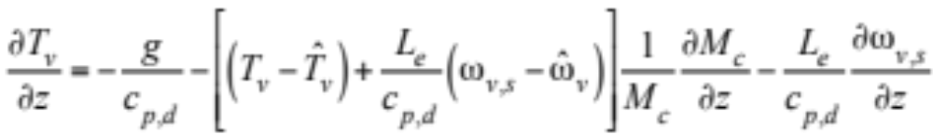
Entrainment
Divide by c_{p,d} T_{v} and substitute α_{a}=R’T_{v}/p_{a} (18.18)
Rearrange and differentiate with respect to height (18.19)
No entrainment (dM_{c} = 0) --> pseudoadiabatic temp. change

Slide 24
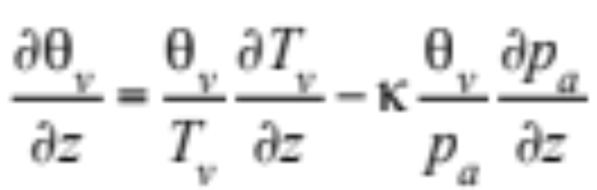
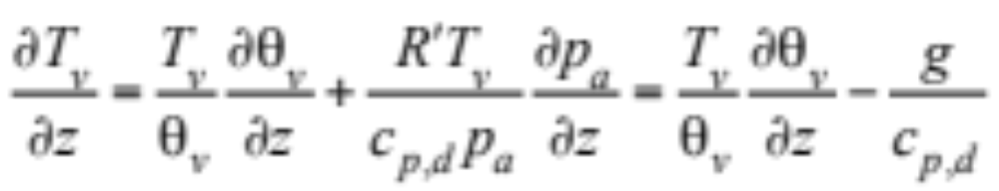
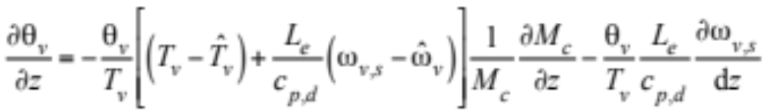
Cloud Vertical Temperature Profile
Change of potential virtual temperature with altitude (2.103)
Rearrange (18.20)
Substitute into (18.19)
--> change of potential virtual temperature in entrainment region

Slide 25
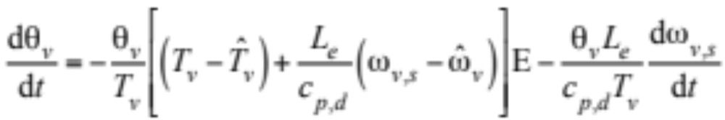
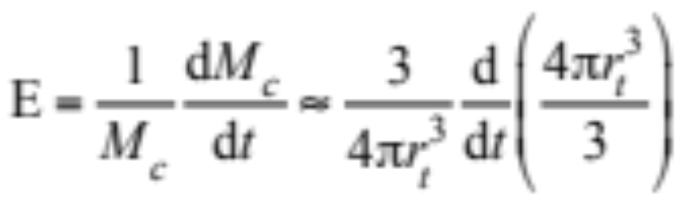
Cloud Thermodynamic Energy Eq.
Multiply through by dz and dividing through by dt (18.22)
Entrainment rate (18.23)

Slide 26
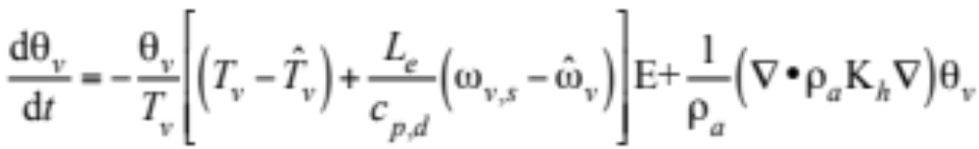
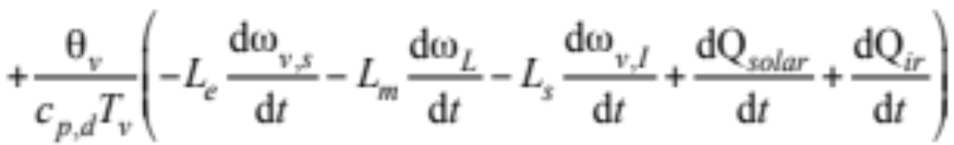
Cloud Thermodynamic Energy Eq.
Add terms to (18.22)
--> thermodynamic energy equation in a cloud (18.24)

Slide 27
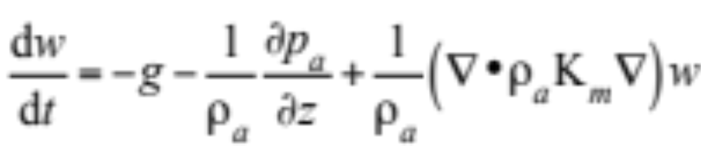
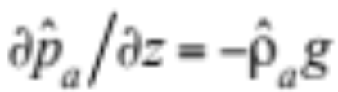
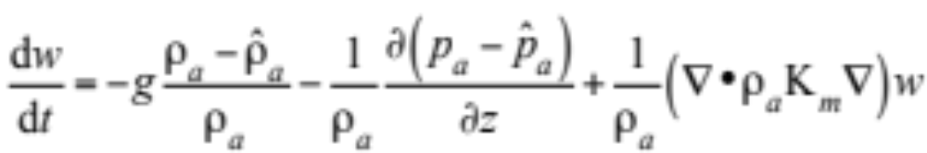
Cloud Vertical Momentum Equation
Vertical momentum equation in Cartesian / altitude coordinates (18.25)
Add hydrostatic equation, for air outside cloud (18.26)

Slide 28
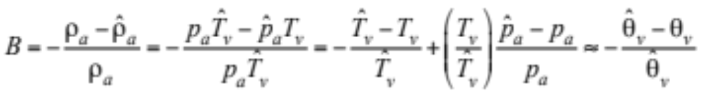
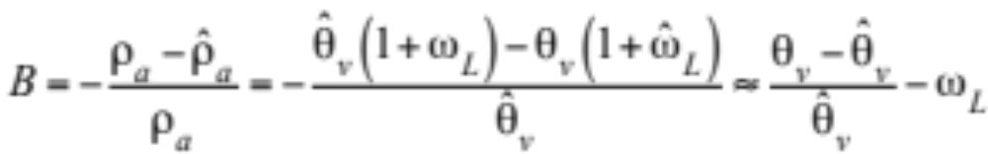
Cloud Vertical Momentum Equation
Buoyancy factor (18.27)
Adjust buoyancy factor for condensate (18.28)

Slide 29
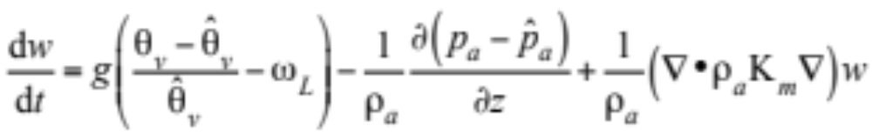
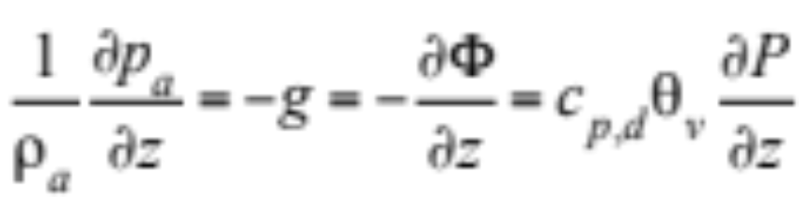
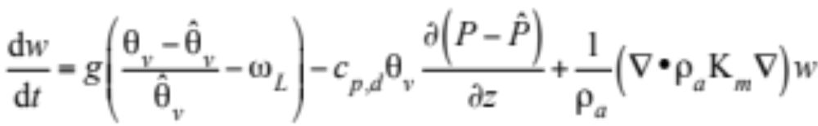
Cloud Vertical Momentum Equation
Substitute (18.28) into (18.26) (18.29)
Rewrite pressure gradient term (18.30)
Substitute (18.30) and (18.29)
--> vertical momentum equation in a cloud (18.31)

Slide 30
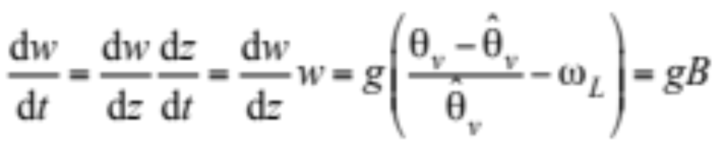
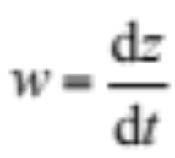

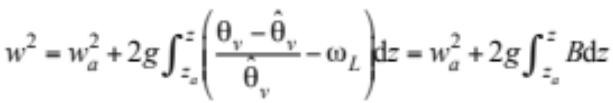
Simplified Vertical Velocity in Cloud
Simplify (18.31) for basic calculations
Ignore pressure perturbation and the eddy diffusion term (18.32)
where
Rearrange (18.32)
Integrate over altitude --> vertical velocity in a cloud (18.33)

Slide 31
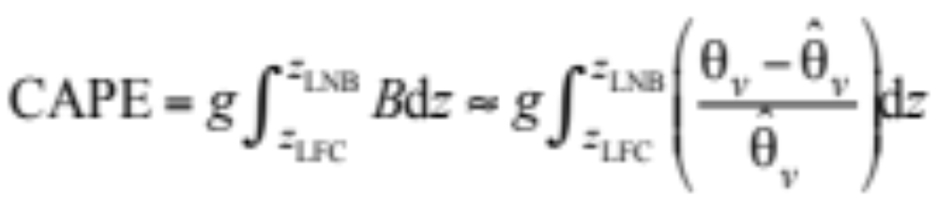
Convective Available Potential Energy
(18.34)

Slide 32
Cloud Microphysics
Assume clouds form on multiple aerosol particle size distributions
Each aerosol distribution consists of multiple discrete size bins
Each size bin contains multiple chemical components
Three cloud hydrometeor distributions can form
Liquid
Ice
Graupel
Each hydrometeor distribution contains multiple size bins.
Each size bin contains the chemical components of the aerosol distribution it originated from

Slide 33
Cloud Microphysics
Processes considered
Condensation/evaporation
Ice deposition/sublimation
Hydrometeor-hydrometeor coagulation
Large liquid drop breakup
Contact freezing of liquid drops
Homogeneous/heterogeneous freezing
Drop surface temperature
Subcloud evaporation
Evaporative freezing
Ice crystal melting
Hydrometeor-aerosol coagulation
Gas washout
Lightning

Slide 34
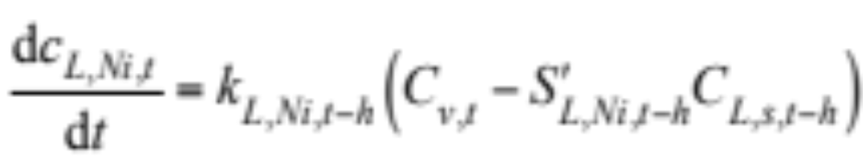

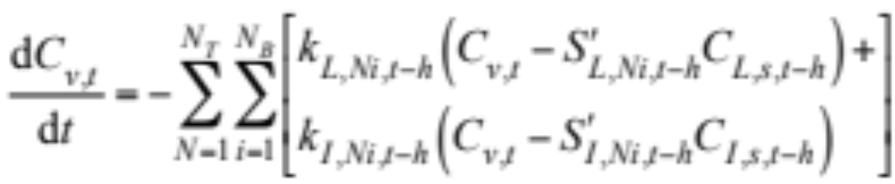
Condensation and Ice Deposition
Condensation/deposition onto multiple aerosol distributions
(18.35)
(18.36)
Water vapor-hydrometeor mass balance equation (18.37)

Slide 35
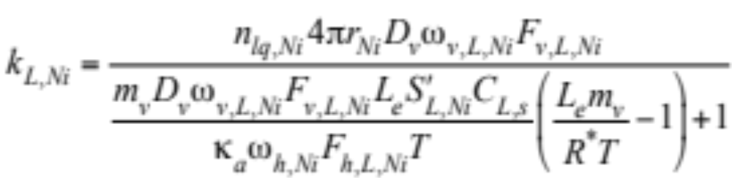
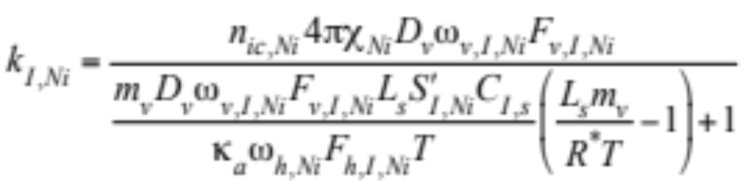
Vapor-Hydrometeor Transfer Rates
(18.38,9)

Slide 36
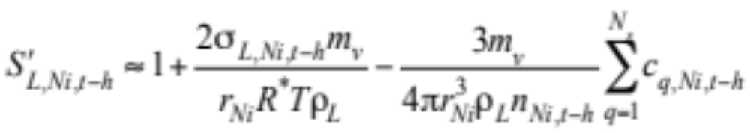
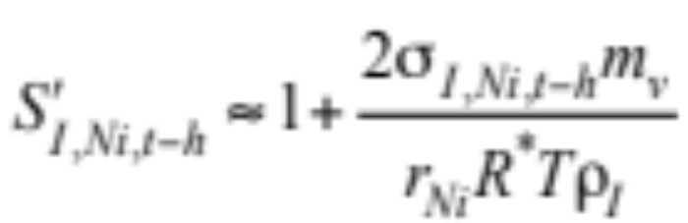
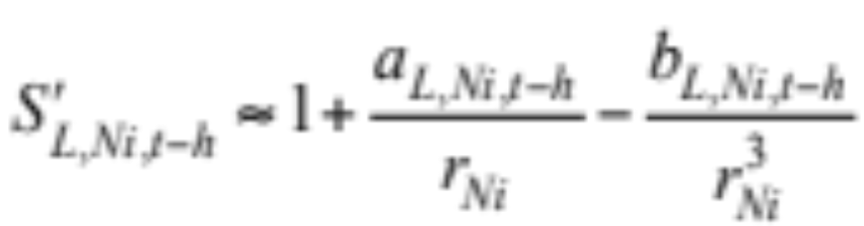
Köhler Equations
Liquid (18.40)
Ice (18.41)
Rewrite as (18.42)

Slide 37




Köhler Equations
(18.43)
Solve for critical radius and critical saturation ratio (18.44)

Slide 38


CCN and IDN Activation
Cloud condensation nuclei (CCN) activation (18.45)
Ice deposition nuclei (IDN) activation (18.46)

Slide 39




Solution to Growth Equations
Aerosol mole concentrations (18.47,8)
Mole balance equation (18.49)

Slide 40

Solution to Growth Equations
Final gas mole concentration (18.50)

Slide 41

Growth in Multiple Layers
Dual peaks when grow on multiple size distributions, each with different activation characteristic
dn (No. cm⁻³) / d log₁₀ D_{p}
Fig. 18.6

Slide 42

Growth in Multiple Layers
Single peaks when size distribution homogeneous
dn (No. cm⁻³) / d log₁₀ D_{p}
Fig. 18.6

Slide 43

Coagulation
Process by which particles collide and stick together
Integro-differential coagulation equation (15.1)

Slide 44

Monomer Size Distribution
Fig. 15.1

Slide 45


Coagulation Over Monomer Distribution
Coagulation equation over monomer size distribution (15.2)
Rewrite in fully implicit finite-difference form (15.3)

Slide 46





Coagulation Over Monomer Distribution
Finite-difference form (15.3)
Production rate (15.4)
Loss rate
-->
Rearrange (15.3) (15.5)

Slide 47



Semiimplicit Solution Over Monomer Size Distribution
Write loss rate in semi-implicit form (15.6)
-->
Substitute (15.6) into (15.3) (15.7)
Rearrange --> semiimplicit solution (15.8)
Treats number correctly but does not conserve volume

Slide 48
Semiimplicit Solution Over Monomer Size Distribution
Write loss rate in semi-implicit form (15.6)
-->
Substitute (15.6) into (15.3) (15.7)
Rearrange --> semiimplicit solution (15.8)
Treats number correctly but does not conserve volume

Slide 49


Semiimplicit Solution Over Arbitrary Size Distribution
Volume of intermediate particle (15.10)
Volume fraction of V_{i,j} partitioned to each model bin k (15.11)

Slide 50

Semiimplicit Solution Over Arbitrary Size Distribution
Incorporate fractions into (15.9) (15.12)

Slide 51


Semiimplicit Solution Over Arbitrary Size Distribution
Final particle number concentration (15.13)
Semiimplicit solution for volume concentration
when multiple components (15.14)

Slide 52

Self-Preserving Solution
Self-preserving versus semi-implicit solutions
dn (No. cm⁻³) / d log₁₀D_{p}
Fig. 15.3

Slide 53




Hydrometeor-Hydrometeor Coagulation
Final volume concentration of component or total particle
(18.53)

Slide 54


Hydrometeor-Hydrometeor Coagulation
Final number concentration (18.54)
Volume fraction of coagulated pair partitioned to a fixed bin (18.55)

Slide 55

Coagulation Over Multiple Structures
dn (No. cm⁻³) / d log₁₀D_{p}
Fig. 15.5

Slide 56

Coagulation Over Multiple Structures
dn (No. cm⁻³) / d log₁₀D_{p}
Fig. 15.5

Slide 57

Coagulation Over Multiple Structures
dn (No. cm⁻³) / d log₁₀D_{p}
Fig. 15.5

Slide 58

Drop Breakup Size Distribution
Drops breakup when they reach a given size
dM / M_{T} d log₁₀ D_{p}
Fig. 18.7

Slide 59



Contact Freezing
Final volume concentration of total liquid drop or its components (18.59)
(18.61)
Final volume concentration of a graupel particle in a size bin or of an individual component in the particle (18.60)

Slide 60


Contact Freezing
Final number concentrations (18.62)
(18.63)
Temperature-dependence parameter (18.64)

Slide 61



Homogeneous/Heterogeneous Freezing
Fractional number of drops of given size that freeze (18.65)
Median freezing temperature (18.66)

Slide 62

Homogeneous/Heterogeneous Freezing
Fitted versus observed median freezing temperatures
Median freezing temperature (ºC)
Fig. 18.8

Slide 63



Homogeneous/Heterogeneous Freezing
Time-dependent freezing rate (18.67)
Final number conc. of drops and graupel particles after freezing (18.68)
(18.69)

Slide 64


Homogeneous/Heterogeneous Freezing
Fractional number of drops that freeze (18.70)
Time-dependent median freezing temperature (18.71)

Slide 65






Drop Surface Temperature
Iterate for drop surface temperature at sub-100 percent RH
(18.72)

Slide 66

Drop Surface Temperature vs. RH
Air temperature = 283.15 K
Temperature (K)
Vapor pressure (hPa) and final RH x 10
Fig. 18.10

Slide 67

Drop Surface Temperature vs. RH
Air temperature = 245.94 K
Temperature (K)
Vapor pressure (hPa) and final RH
Fig. 18.10

Slide 68

Drop Surface Temperature vs. RH
Air temperature = 223.25 K
Temperature (K)
Vapor pressure (hPa) and final RH x 0.01
Fig. 18.10

Slide 69

Evaporative Freezing
When drops fall into regions of sub-100 percent RH below cloud base, they start to evaporate and cool. If the temperature is below the freezing temperature, the cooling increases the rate of drop freezing.
Incremental homogeneous/heterogeneous freezing due to evaporative cooling below a cloud base
dn (No. cm⁻³) / d log₁₀ D_{p}
Fig. 18.12

Slide 70


Evaporation
Reduction in volume due to evaporation/sublimation (18.73)
Reduction in precipitation size due to evaporation below cloud base
dn (No. cm⁻³) / d log₁₀ D_{p}
Fig. 18.11

Slide 71

Homogeneous/Heterogeneous Freezing
Simulated liquid and graupel size distributions with and without homogeneous/heterogeneous freezing after one hour
dn (No. cm⁻³) / d log₁₀ D_{p}
Fig. 18.9

Slide 72


Ice Crystal Melting
When an ice crystal melts in sub-100 percent relative humidity air, simultaneous evaporation of the liquid meltwater cools the particle surface, retarding the rate of melting. Thus, the melting temperature must be higher than that of bulk ice in saturated air.
Melting point (18.74)
Time-dependent change in particle mass due to melting (18.75)

Slide 73


Aerosol-Hydrometeor Coagulation
Final volume conc. of total aerosol particle or its components (18.76)

Slide 74



Aerosol-Hydrometeor Coagulation
Final volume conc. of total hydrometeor or aerosol inclusions (18.77)

Slide 75


Aerosol-Hydrometeor Coagulation
Final number concentrations (18.78)
(18.79)

Slide 76

Aerosol-Hydrometeor Coagulation
Below-cloud aerosol number and volume concentration before (solid lines) and after (short-dashed lines) aerosol-hydrometeor coagulation
dn (No. cm⁻³) / d log₁₀ D_{p}
dv (μm³ cm⁻³) / d log₁₀ D_{p}
Fig. 18.13

Slide 77


Gas Washout
Gas-hydrometeor equilibrium relation (18.80)
Gas-hydrometeor mass-balance equation (18.81)

Slide 78


Gas Washout
Final gas concentration in layer m (18.82)
Final aqueous mole concentration (18.83)

Slide 79



Lightning
Coulomb’s law (18.84)
Electric field strength (18.86)
Rate coefficient for bounceoff (18.87)

Slide 80


Lightning
Charge separation rate per unit volume of air (18.88)
Overall charge separation rate (18.91)

Slide 81



Lightning
Time-rate-of-change of the in-cloud electric field strength
(18.92)
Summed vertical thickness of layers (18.93)
Horizontal radius of cloudy region (18.94)

Slide 82


Lightning
Number of intracloud flashes per centimeter per second
(18.95)
Number of NO molecules per cubic centimeter per second
(18.96)

