Slide 1
Presentation Slides for
Chapter 17, Part 2 of
Fundamentals of Atmospheric Modeling 2nd Edition
Mark Z. Jacobson
Department of Civil & Environmental Engineering
Stanford University
Stanford, CA 94305-4020
jacobson@stanford.edu
April 1, 2005

Slide 2
Solvation and Hydration
Solvation
Bonding between solvent and solute in solution
Hydration
When solvent is liquid water, solvation is hydration
Hydration of cations --> lone pairs of electrons on oxygen atom of water attach to cations
Hydration of anions --> water molecule attaches to anion via hydrogen bonding

Slide 3
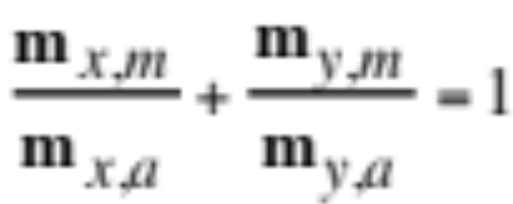
Water Equation
Quantify amount of hydration with empirical water equation
Zdanovskii-Stokes-Robinson (ZSR) equation
Example with two species, x and y (17.64)
m_{x,a}, m_{y,a} = molalities of x and y, alone in solution at given relative humidity
m_{x,m}, m_{y,m} = molalities of x and y, when mixed together, at same relative humidity

Slide 4
ZSR Equation
ZSR equation predictions for a sucrose (species x) - mannitol (species y) mixture at two different water activities.
m_{x,m}/m_{x,a} +
Case m_{x,a} m_{y,a} m_{x,m} m_{y,m} m_{y,m}/m_{y,a}
1 0.7751 0.8197 0.6227 0.1604 0.999
2 0.9393 1.0046 0.1900 0.8014 1.000
Table 17.2

Slide 5
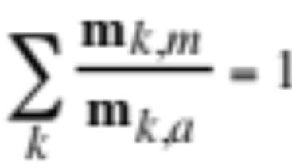
Water Equation
Generalized ZSR equation (17.64)
Polynomial expression for molality of electrolyte alone in solution at a given water activity (17.66)

Slide 6
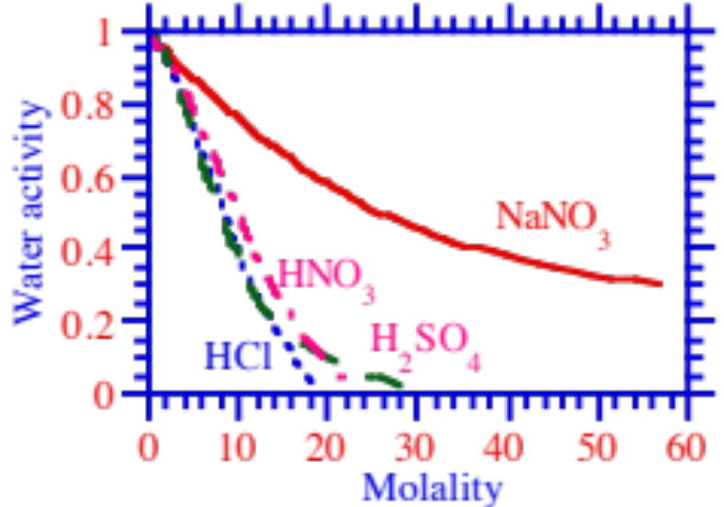
Water Equation
Water activities of several electrolytes at 298.15 K
Water activity
Fig. 17.4a

Slide 7
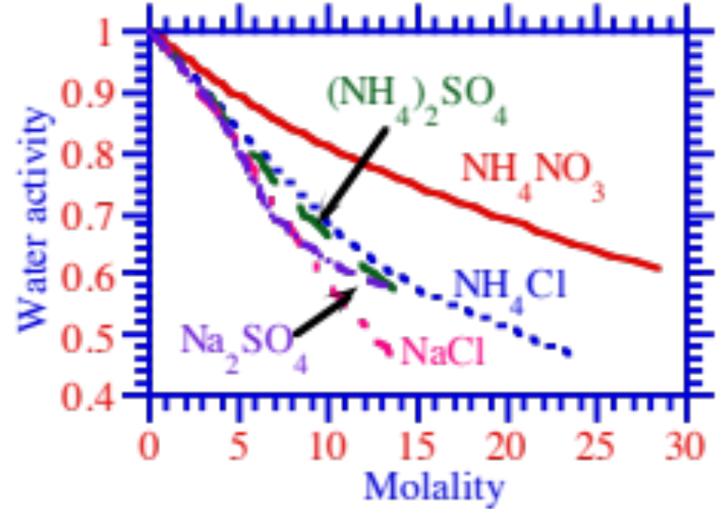
Water Equation
Water activities of several electrolytes at 298.15 K
Water activity
Fig. 17.4b

Slide 8
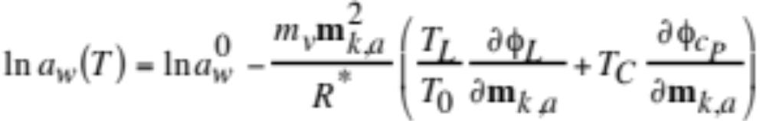
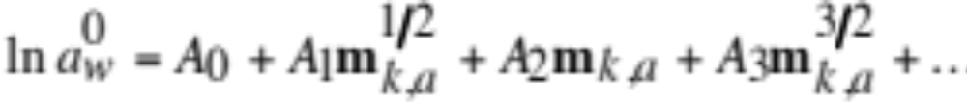
Temp. Dependence of Water Activity
Temperature dependence of binary water activity coefficients under ambient surface conditions is small.
Temperature dependence of water activity (17.67)
Polynomial for water activity at reference temperature (17.68)

Slide 9
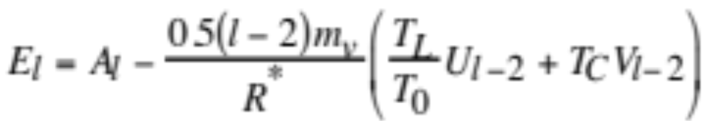
Temp. Dependence of Water Activity
Combine (17.67), (17.68), (17.54) (17.69-70)
Example
m_{HCl}= 16 m
T = 273 K
---> a_{w} = 0.09
T = 310 K
---> a_{w} = 0.11

Slide 10
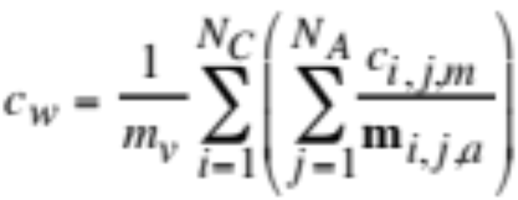
Practical Use of Water Equation
Rearrange (17.65) (17.71)
m_{i,j,a} = binary molalities of species alone in solution
c_{i,j,m} = hypothetical mol cm⁻³ of electrolyte pair when mixed in solution with all other components
In a model, ion concentrations known but hypothetical electrolyte concentrations unknown --> find hypothetical concentrations

Slide 11




Practical Use of Water Equation
Example 17.4:
6 μmol m⁻³ of H⁺, 6 μmol m⁻³ Na⁺
7 μmol m⁻³ of Cl⁻ , 5 μmol m⁻³ of NO₃⁻
Combine ions in a way to satisfy mole balance constraints
Concentrations that satisfy mole balance constraints (Table 17.3)
Case c_{HCl,m} c_{HNO3,m} c_{NaCl,m} c_{NaNO3,m}
1 6 0 1 5
2 4 2 3 3

Slide 12
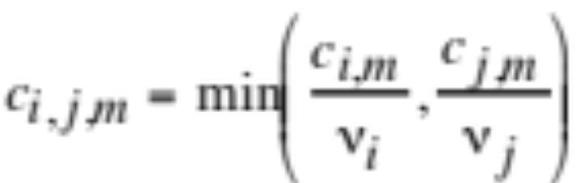
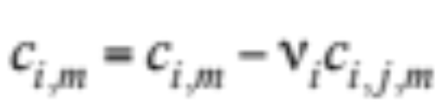
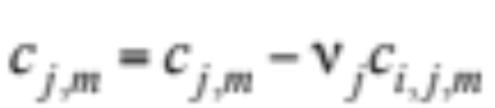
Practical Use of Water Equation
Automatic method to recombine ions into hypothetical electrolytes
Execute the following three equations, in succession, for each undissociated electrolyte, i,j
Electrolyte (17.72)
Cation
Anion

Slide 13
Deliquescence Relative Humidity
Deliquescence
Process by which a particle takes up liquid water, lowering its saturation vapor pressure
Deliquescence relative humidity (DRH)
The relative humidity at which an initially-dry solid first takes on liquid water during an increase in relative humidity. Above the DRH, the solid may not exist.
Crystallization relative humidity (CRH)
The relative humidity at which an initially-supersaturated aqueous electrolyte becomes crystalline upon a decrease in relative humidity.

Slide 14
Deliquescence Relative Humidity
DRHs and CRHs for several electrolytes at 298 K
Electrolyte DRH(%) CRH(%)
NaCl 75.28 47
Na₂SO₄ 84.2 57-59
NaHSO₄ 52.0 <5
NH₄Cl 77.1 47
(NH₄)₂SO₄ 79.97 37-40
NH₄HSO₄ 40 <5-22
NH₄NO₃ 61.83 25-32
KCl 84.26 62
Oxalic acid 97.3 51.8-56.7
In a mixture, the DRH of a solid in equilibrium with the solution is lower than the DRH of the solid alone
Table 17.4

Slide 15


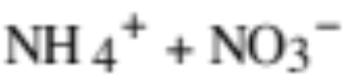
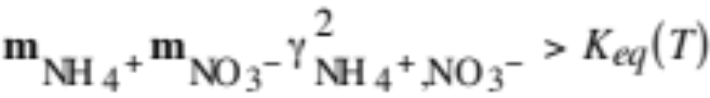
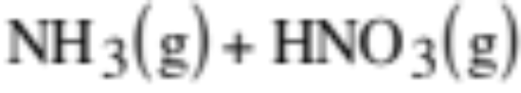
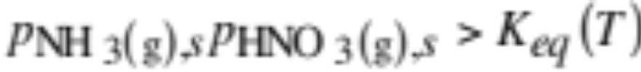
Solid Formation
Consider the equilibrium reaction
A solid forms when (17.73)
Consider the equilibrium reaction
A solid forms when (17.74)

Slide 16

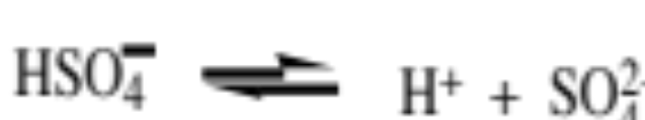
Example Equilibrium Problem
Consider two equilibrium reactions (17.75)
For equilibrium concentrations, solve
equilibrium constant equations
mole balance equations
charge balance equation
water equation
with Newton-Raphson iteration

Slide 17
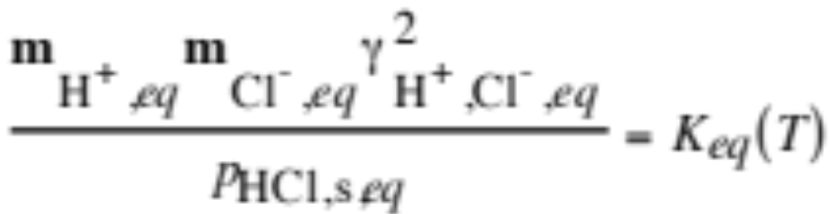
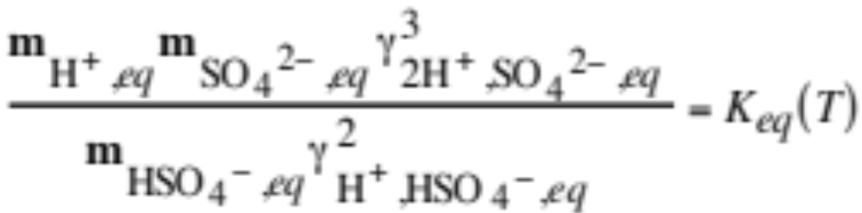
Example Equilibrium Problem
Equilibrium coefficient equations (17.76)

Slide 18
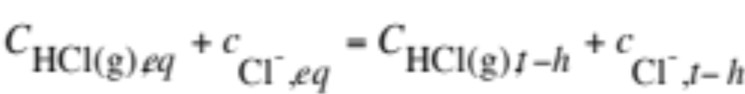
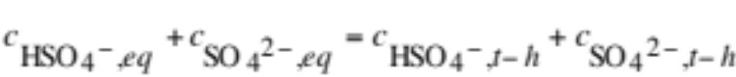
Example Equilibrium Problem
Mole balance equations (17.77)
(17.78)

Slide 19
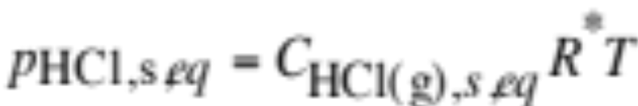
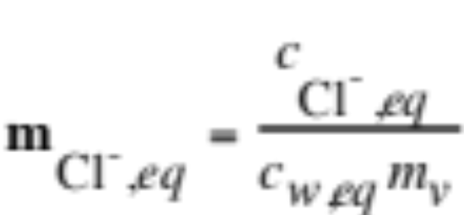
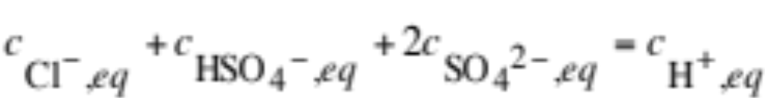
Example Equilibrium Problem
Vapor pressure as a function of mole concentration (17.79)
Molality as a function of mole concentration
Charge balance equation (17.80)

Slide 20
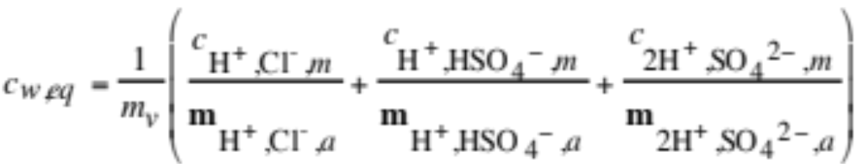
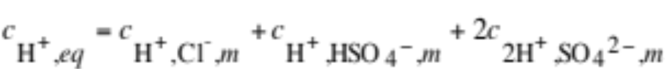
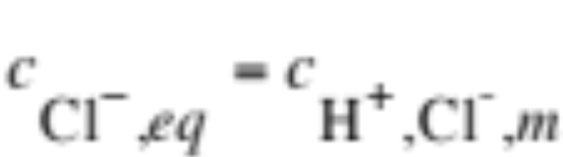
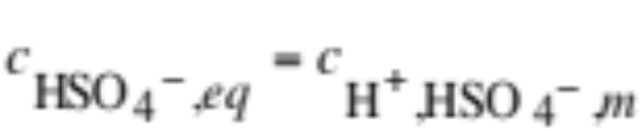
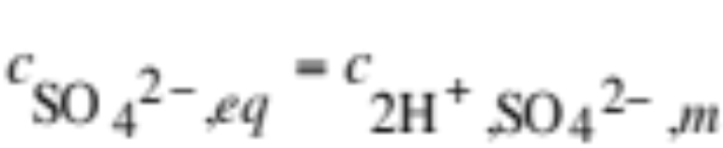
Example Equilibrium Problem
Water equation (17.81)
Hypothetical mole concentration constraints (17.82)

Slide 21



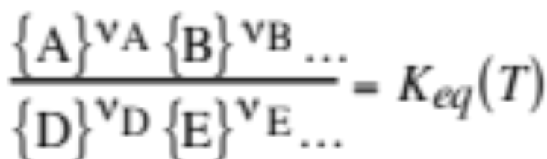
Mass-Flux Iterative Method
Solve each equation iteratively and iterate over all equations
Initialize species concentrations so that charge is conserved
No intelligent first guess required
Solution mass and charge conserving and always converges
Example solution for one equilibrium equation
Equilibrium equation and coefficient relation

Slide 22
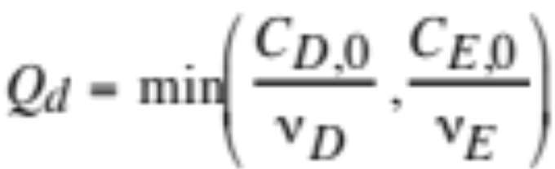
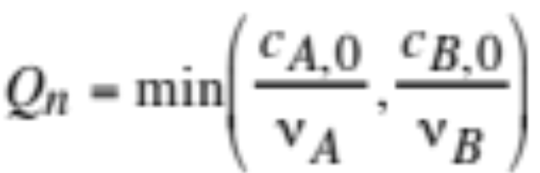


Mass-Flux Iterative Method
1) Calculate smallest ratio of mole concentration to moles in denominator and numerator, respectively (17.83)
2) Initialize two parameters

Slide 23




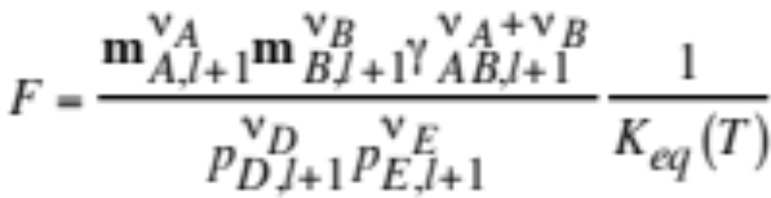
Mass-Flux Iterative Method
Add mass flux factor (Δx) to mole concentrations (17.84)
3) Compare ratio of activities to equilibrium coefficient (17.85)

Slide 24

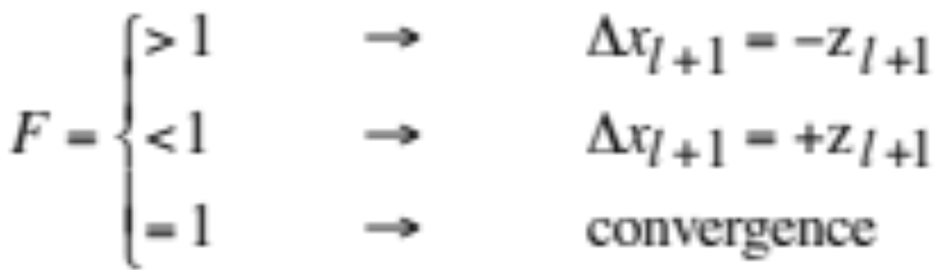
Mass-Flux Iterative Method
4) Cut z in half
5) Check convergence (17.86)
Return to (17.84) until convergence occurs

Slide 25
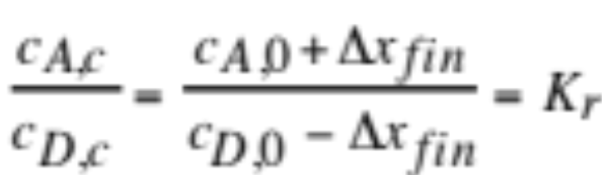
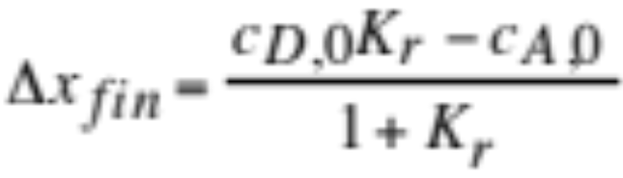


Analytical Equilibrium Iteration Method
Solve most equations analytically but iterate over all equations
Reactions of the form D⬄A
Solve the equilibrium equation (17.87)
Solution for change in concentration (17.88)
Final concentrations

Slide 26
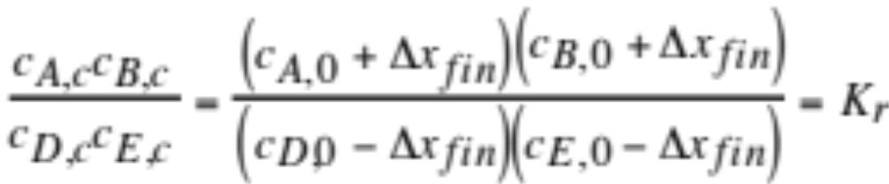
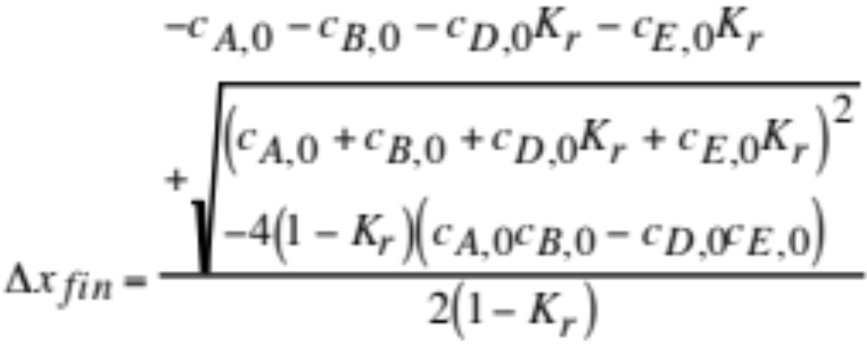
Analytical Equilibrium Iteration Method
Reactions of the form D+E⬄A+B
Solve the equilibrium equation (17.89)
Solution for change in concentration (17.90)

Slide 27


Analytical Equilibrium Iteration Method
Final concentrations

Slide 28
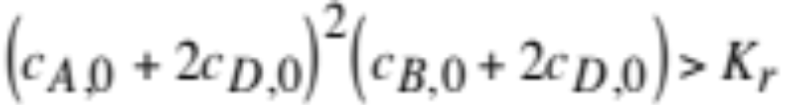
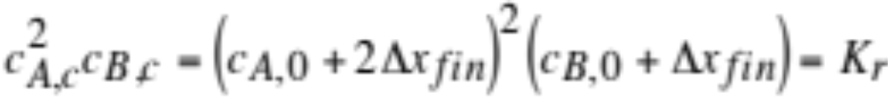
Analytical Equilibrium Iteration Method
Reactions of the form D(s)⬄2A+B
Check if solid can form (17.91)
If so, solve the equilibrium equation (17.92)

Slide 29
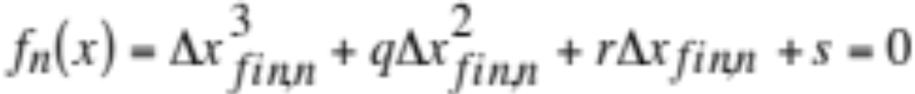
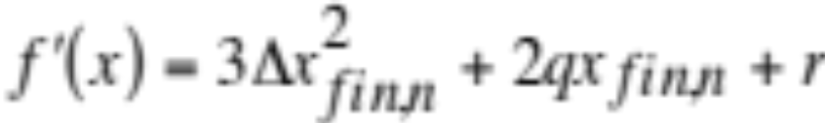

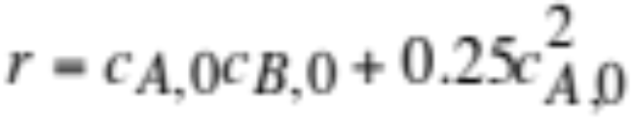
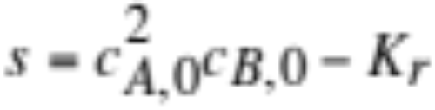
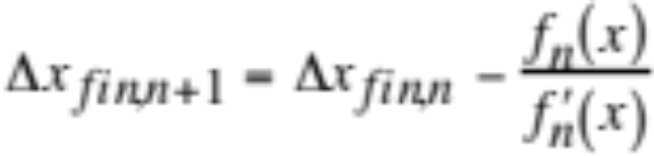
Analytical Equilibrium Iteration Method
Iterative Newton-Raphson procedure (17.93)

Slide 30



Analytical Equilibrium Iteration Method
Final concentrations

Slide 31
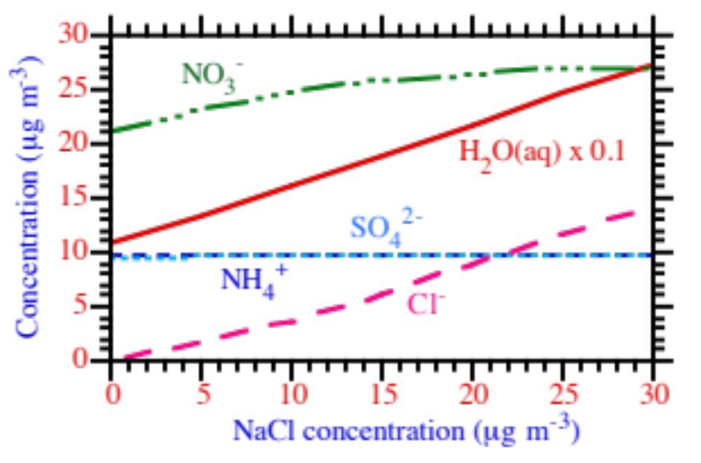
Equilibrium Solver Results
Aerosol composition versus NaCl concentration when the relative humidity was 90%. Other initial conditions were H₂SO₄(aq) = 10 μg m⁻³, HCl(g) = 0 μg m⁻³, NH₃(g) = 10 μg m⁻³, HNO₃(g) = 30 μg m⁻³, and T = 298 K.
Concentration (μg m⁻³)
Fig. 17.4

Slide 32
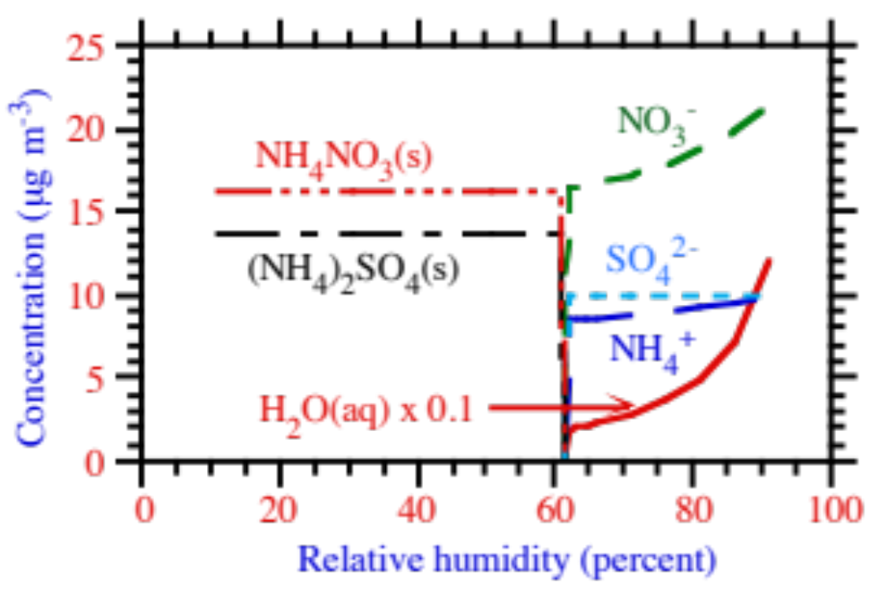
Equilibrium Solver Results
Aerosol composition versus relative humidity. Initial conditions were H₂SO₄(aq) = 10 μg m⁻³, HCl(g) = 0 μg m⁻³, NH₃(g) = 10 μg m⁻³, HNO₃(g) = 30 μg m⁻³, and T = 298 K.
Concentration (μg m⁻³)
Fig. 17.5

Slide 33
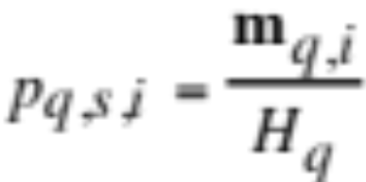
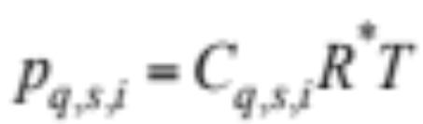
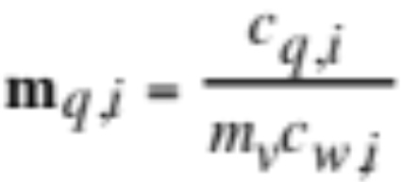
Dissolutional Growth
Saturation vapor pressure of gas q over particle size i (17.95)
Saturation vapor pressure as function of gas mole concentration (17.96)
Molality as function of particle mole concentration (17.97)

Slide 34
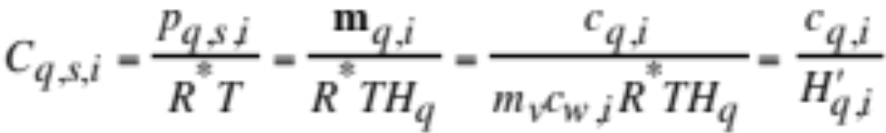

Dissolutional Growth
Substitute (17.95) and (17.97) into (17.96) (17.98)
where (17.99)

Slide 35


Dissolutional Growth
Condensational growth equations (16.67)
(16.68)

Slide 36


Dissolutional Growth
Substitute (17.98)
--> Dissolutional growth equations (17.100)
(17.101)

Slide 37



Analytical Predictor of Dissolution
Integrate (17.100) for final aerosol concentration (17.102)
Mole balance equation (17.103)
Substitute (17.102) into (17.103) (17.104)

Slide 38


Growth During Dissociation
Growth equation for hydrochloric acid (17.105)
Total dissolved chlorine (17.106)
Find saturation mole concentration from equilibrium expressions (17.107)
HCl⬄HCl(aq)
(17.108)
HCl(aq)⬄H⁺+Cl⁻

Slide 39




Growth During Dissociation
Equilibrium coefficient relations (17.107)
(17.108)
Equilibrium coefficient relations in terms of mole concentration (17.109)
(17.110)

Slide 40


Dissolution of Acids/Bases
Substitute saturation mole concentration into growth equation (17.111)
Mole balance equation (17.112)

Slide 41




Dissolution for Dissociating Species
Integrate (17.111) for final aerosol concentration (17.113)
Substitute (17.113) into (17.112) (17.114)

Slide 42




Solve for Ammonia/Ammonium
Charge balance equation (17.115)
where (17.116)
Mole balance equation (17.117)

Slide 43


Solve for Ammonia/Ammonium
Equilibrium expressions (17.118) NH₃(g)⬄NH₃(aq)
(17.119) NH₃(aq)+H⁺⬄NH₄⁺
Equilibrium coefficient expressions (17.118)
(17.119)

Slide 44






Solve for Ammonia/Ammonium
NH₄⁺/H⁺ activity coefficient relationship (17.120)
Equilibrium coefficient relations in terms of mole concentration (17.121,2)

Slide 45


Solve for Ammonia/Ammonium
Ion concentration in each size bin (17.124)
Substitute into mole-balance equation (17.125)

Slide 46



Solve for Ammonia/Ammonium
Iterate for ammonia gas concentration (17.126)
where (17.128)

Slide 47

Simulations of Growth/Dissociation
Initial distributions for simulation
dM (μg m⁻³) / dlog₁₀ D_{p}
dN (No. cm⁻³) / dlog₁₀ D_{p}
Fig. 17.7

Slide 48

Simulations of Growth/Dissociation
Aerosol concentrations, summed over all sizes, during nonequilibrium growth plus internal aerosol equilibrium at RH=90 percent when h=5 s.
Summed concentration (μg m⁻³)

Slide 49

Simulations of Growth/Dissociation
Same as previous slide, but h=300 s
Summed concentration (μg m⁻³)

Slide 50


Nonequilibrium Growth of Solids
Gas-solid equilibrium reactions (17.129)
NH₄NO₃(s)⬄NH₄(g)+HNO₃(g)
NH₄Cl(s)⬄NH₄(g)+HCl(g) (17.130)
Solids can form when (17.131)
(17.132)

Slide 51


Nonequilibrium Growth of Solids
Gas-solid equilibrium coefficient relation (17.133)
(17.134)

Slide 52


Nonequilibrium Growth of Solids
Growth equations for gases that form solids (solids formed during operator-split equilibrium calculation)

Slide 53

Simulations of Solid Growth
Time-dependent aerosol concentrations, summed over all sizes, during nonequilibrium growth plus internal aerosol equilibrium at RH=10 percent when h=5 s.
Summed concentration (μg m⁻³)
Fig. 17.8

Slide 54

Simulations of Solid Growth
Same as previous slide, but h=300 s
Summed concentration (μg m⁻³)
Fig. 17.8

