Slide 1
Presentation Slides for
Chapter 16 of
Fundamentals of Atmospheric Modeling 2nd Edition
Mark Z. Jacobson
Department of Civil & Environmental Engineering
Stanford University
Stanford, CA 94305-4020
jacobson@stanford.edu
March 30, 2005

Slide 2
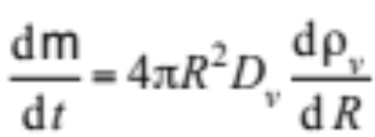
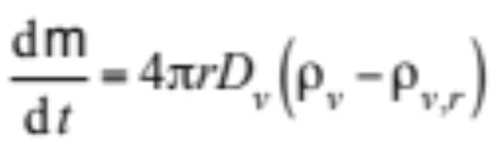
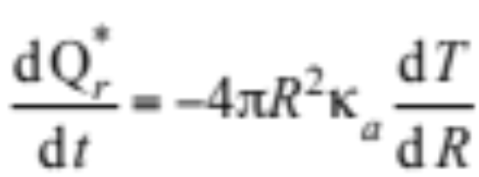
Mass Flux To and From a Single Drop
Rate of change of mass (g) of single pure liquid water drop
(16.1)
Integrate from drop surface to infinity (16.2)
Energy change at drop surface due to conduction (16.3)

Slide 3
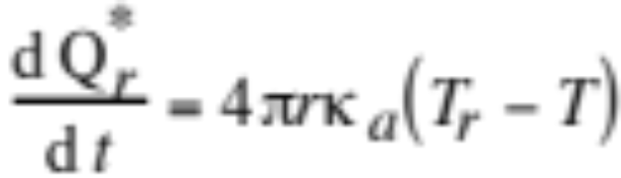
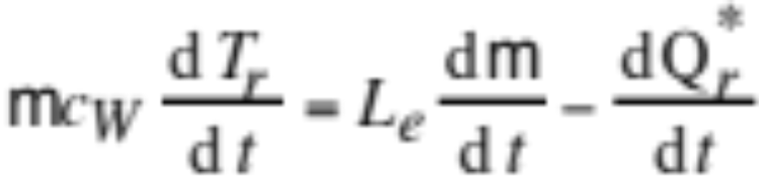
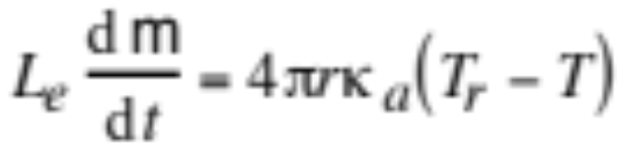
Mass Flux To and From a Single Drop
Integrate from drop surface to infinite radius (16.4)
Relate change in mass and energy at surface (16.5)
Combine (16.4) and (16.5) and assume steady state (16.6)

Slide 4

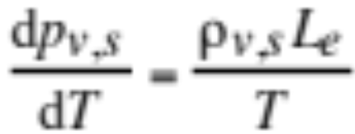
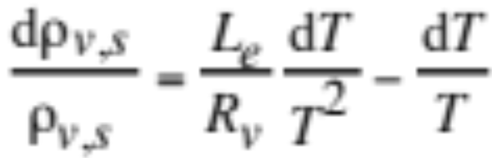
Mass Flux To and From a Single Drop
Combine equation of state at saturation
with Clausius Clapeyron equation
to obtain (16.7)

Slide 5
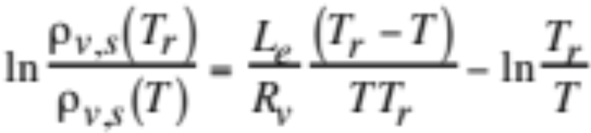
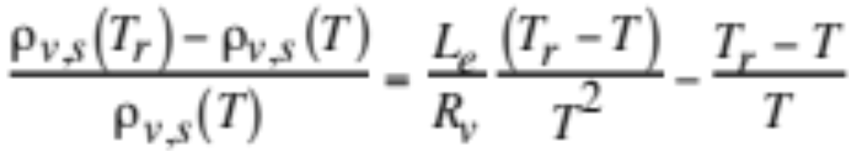
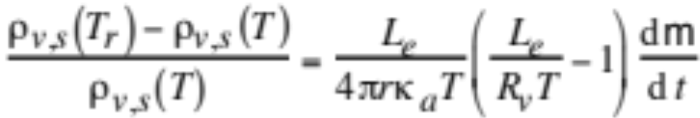
Mass Flux To and From a Single Drop
Integrate from infinite radius to drop surface (16.8)
Simplify assuming T≈ T_{r} (16.9)
Substitute (16.6)
into (16.9) -->
(16.10)

Slide 6
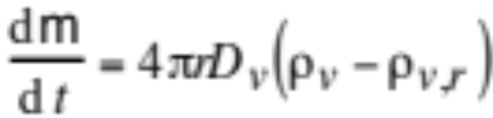
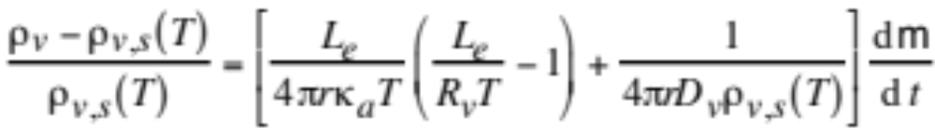
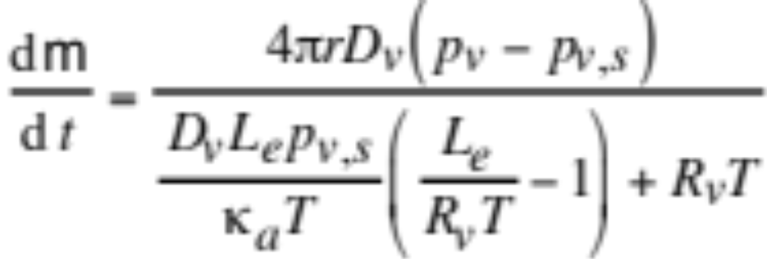
Mass Flux to and From a Single Drop
(16.2)
(16.10)
Substitute (16.2) into (16.10) (16.11)
Rearrange --> Mass-flux form of growth equation (16.12)

Slide 7
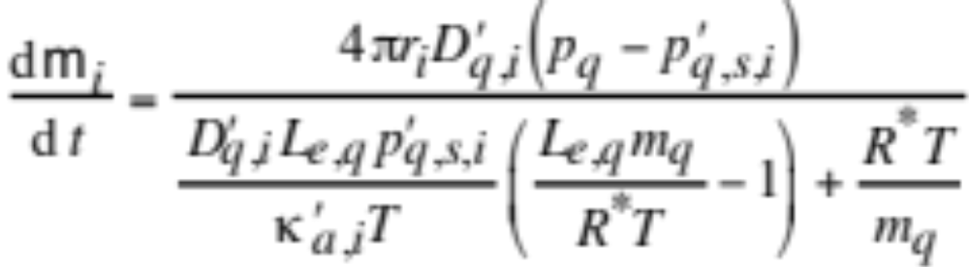
Mass Flux to and From a Single Drop
Mass-flux form of growth equation (16.12)
Rewrite equation for trace gases and particle sizes (16.13)

Slide 8
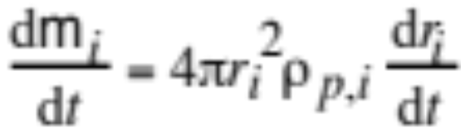
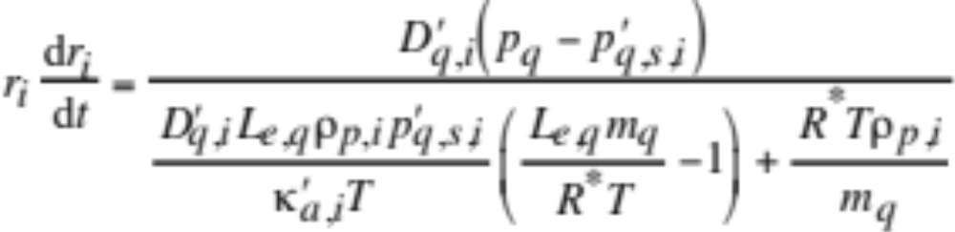
Fluxes to and From a Single Drop
Change in mass as a function of change in radius (16.14)
Radius-flux form of growth equation (16.15)

Slide 9
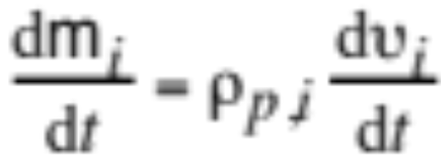
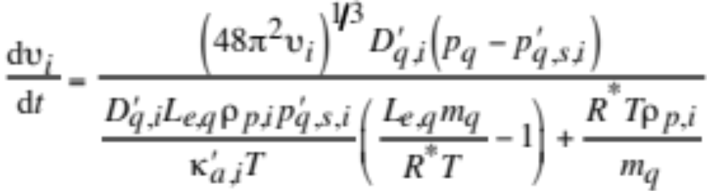
Fluxes to and From a Single Drop
Change in mass as a function of change in volume
Volume-flux form of growth equation (16.16)

Slide 10
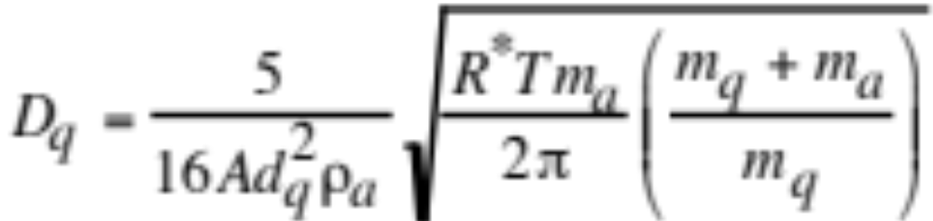
Gas Diffusion Coefficient
Molecular diffusion
Movement of molecules due to their kinetic energy, followed by collision with other molecules and random redirection.
Uncorrected gas diffusion coefficient (cm² s⁻¹) (16.17)

Slide 11
Collision Diameters and Diffusion Coefficients of Several Gases
Collision Diffusion
Diameter coefficient
Gas (10⁻¹⁰ m) (cm² s⁻¹)
____________________________________________
Air 3.67 0.147
Ar 3.58 0.144
CO₂ 4.53 0.088
H₂ 2.71 0.751
NH₃ 4.32 0.123
O₂ 3.54 0.154
H₂O 3.11 0.234
Table 16.1

Slide 12
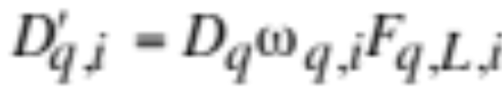
Corrected Gas Diffusion Coefficient
(16.18)

Slide 13
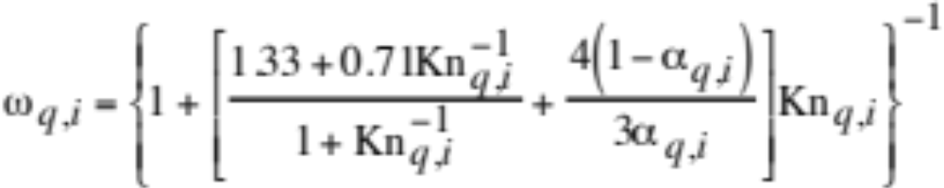
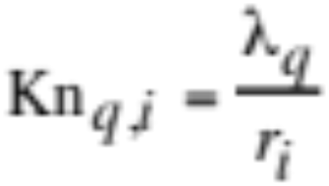
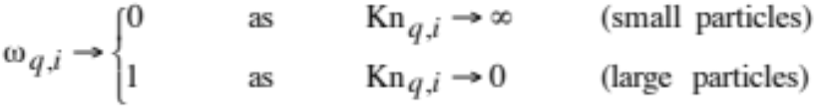
Corrected Gas Diffusion Coefficient
Correction for collision geometry, sticking probability (16.19)
Knudsen number for condensing vapor (16.20)
Mass accommodation (sticking) coefficient, α_{q,i}
Fractional number of gas collisions with particles that results in the gas sticking to the surface. From 0.01 - 1.0.

Slide 14
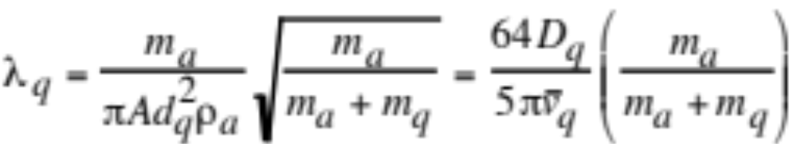
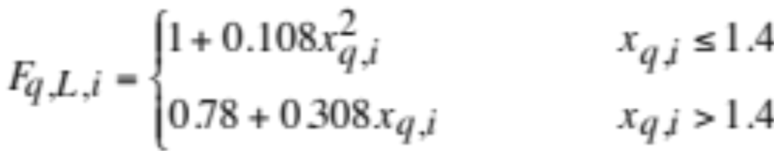
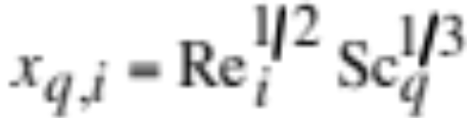
Corrected Gas Diffusion Coefficient
Mean free path of a gas molecule (16.23)
Ventilation factor (16.24)
Corrects for enhanced vapor transfer to a large-particle surface due to eddies sweeping vapor to the surface

Slide 15
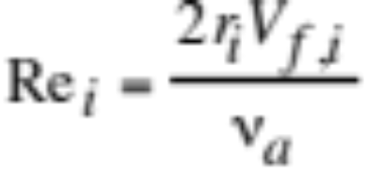
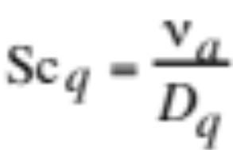
Corrected Gas Diffusion Coefficient
Particle Reynolds number
Gas Schmidt number (16.25)

Slide 16

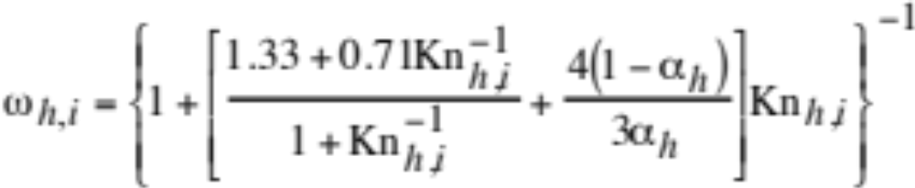
Corrected Thermal Conductivity
Corrected thermal conductivity of air (16.26)
Correction to conductivity for collision geometry and sticking probability (16.27)

Slide 17
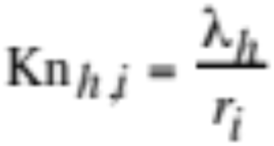
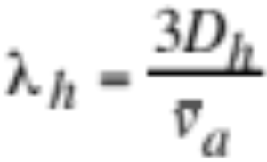
Corrected Thermal Conductivity
Knudsen number for energy (16.28)
Thermal mean free path (16.29)

Slide 18
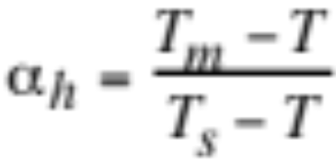
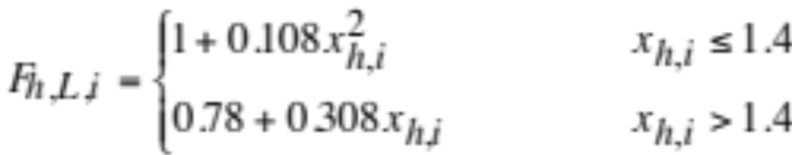
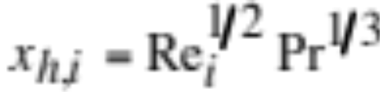
Corrected Thermal Conductivity
Thermal accommodation (sticking) coefficient
Fraction of molecules bouncing off surface of a drop that have acquired temperature of drop ≈ 0.96 for water. (16.30)
Ventilation factor (16.31)
Corrects for enhanced energy transfer to drop surface due to eddies

Slide 19
Corrected Saturation Vapor Pressure
Curvature (Kelvin) effect
Increases saturation vapor pressure over small drops.
Solute effect (Raoult’s Law)
The saturation vapor pressure of a solvent containing solute is reduced to that of the pure solvent multiplied by the mole fraction of the solvent in solution.
Radiative cooling effect
Decreases saturation vapor pressure over large drops

Slide 20
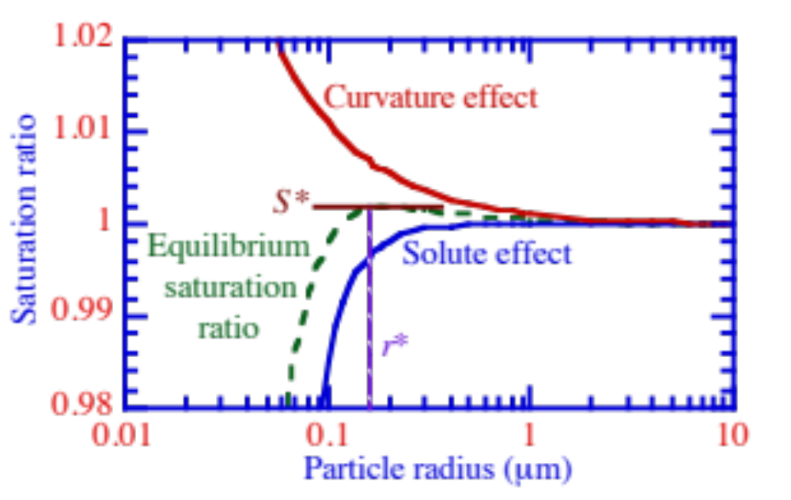
Curvature and Solute Effects
Saturation ratio
Fig. 16.1

Slide 21
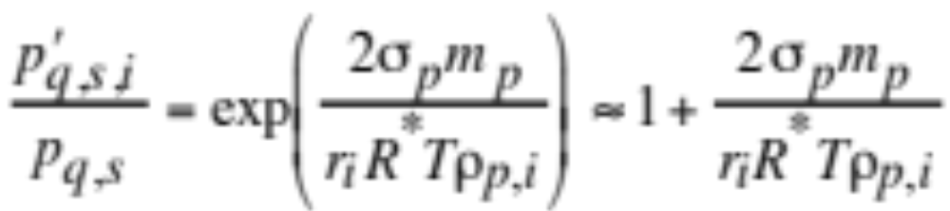
Curvature Effect
Saturation vapor pressure over a curved, dilute surface relative to that over a flat, dilute surface (16.33)
Note that exp(x)≈1+x for small x

Slide 22
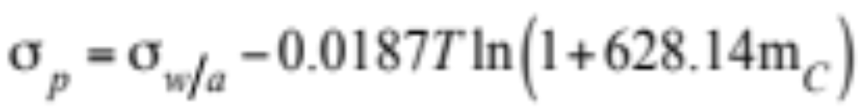
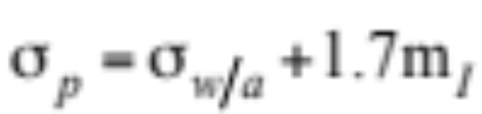
Curvature Effect
Surface tension of water containing dissolved organics (16.34)
Surface tension of water containing dissolved inorganic ions (16.35)

Slide 23
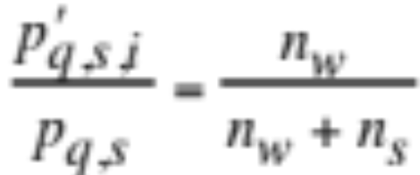
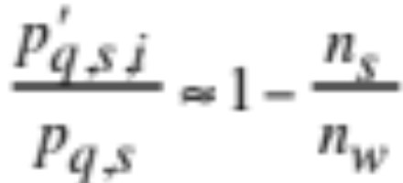
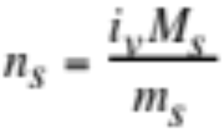
Solute Effect
Vapor pressure over flat water surface with solute relative to that without solute (Raoult's Law) (16.36)
Relatively dilute solution: n_{w} >>n_{s} (16.37)
Number of moles of solute in solution

Slide 24
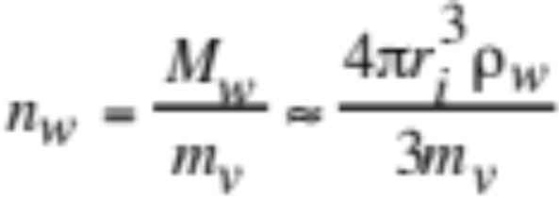
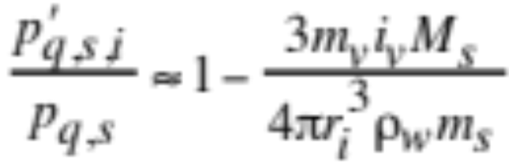
Solute Effect
Number of moles of liquid water in a drop (16.38)
Combine terms --> solute effect (16.39)

Slide 25
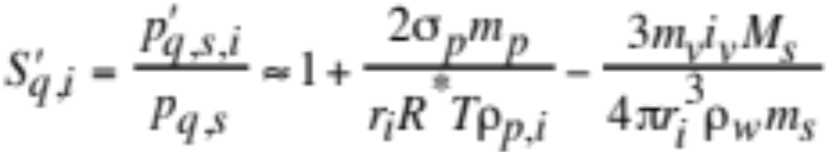
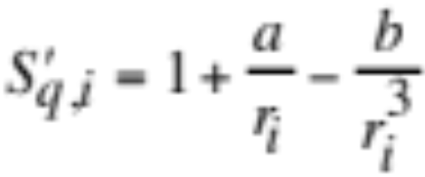
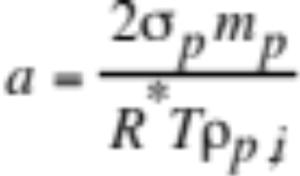
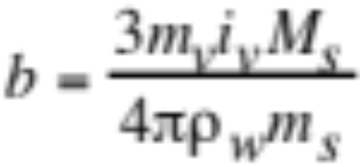
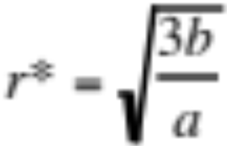
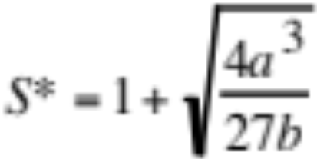
Köhler Equation
Combine curvature and solute effects --> Sat. ratio at equilibrium (16.40)
Simplify Köhler equation (16.42)
Set Köhler equation to zero --> (16.43)
Critical radius for growth and critical saturation ratio

Slide 26
Köhler Equation
Critical radii / supersaturations for water drops containing sodium chloride or ammonium sulfate at 275 K
Sodium chloride Ammonium sulfate
Solute mass (g) r* (μm) S*-1 (%) r* (μm) S*-1 (%)
0 0 ∞ 0 ∞
10⁻¹⁸ 0.019 4.1 0.016 5.1
10⁻¹⁶ 0.19 0.41 0.16 0.51
10⁻¹⁴ 1.9 0.041 1.6 0.051
10⁻¹² 19 0.0041 16 0.0051
Table 16.2

Slide 27


Radiative Cooling Effect
Saturation vapor pressure over a drop that radiatively heats/cools relative to one that does not (16.44)
Radiative cooling rate (W) (16.45)

Slide 28


Overall Equilibrium Saturation Ratio
Overall equilibrium saturation ratio for liquid water (16.46)
Equilibrium saturation ratio for gases other than liquid water (16.47)

Slide 29



Flux to Drop With Multiple Components
Volume of a single particle in which one species is growing (16.48)
Mass of a single particle in which one species is growing (16.49)
Time derivative of (16.47) (16.50)
since

Slide 30

Flux to Drop With Multiple Components
Combine (16.50) and (16.48) with (16.16) (16.51)
Rate of change in volume of one component in one multicomponent particle

Slide 31


Flux to a Population of Drops
Volume as a function of volume concentration
Substitute volumes into (16.49) (16.52)

Slide 32


Flux to a Population of Drops
Partial pressure in terms of mole concentration (16.53)
Vapor pressure in terms of mole concentration (16.53)

Slide 33

Flux to a Population of Drops
Combine (16.52) with (16.53) (16.54)
Effective diffusion coefficient (16.55)

Slide 34


Flux to a Population of Drops
Simplify effective diffusion coefficient for non-water gases (16.56)
Corresponding gas-conservation equation (16.57)

Slide 35

Matrix of Partial Derivatives for Growth ODEs
v_{q,1,t} v_{q,2,t} v_{q,3,t} C_{q,4}
v_{q,1,t}
v_{q,2,t}
v_{q,3,t}
C_{q,4}
(16.58)

Slide 36




Partial Derivatives For Matrix
(16.58)
(16.60)
(16.61)
(16.62)

Slide 37
Effect of Sparse-Matrix Reductions When Solving Growth ODEs
Condensation between gas phase and 16 size bins: N_{B} + 1 = 17
Without With
Quantity Reductions Reductions
Order of matrix 17 17
Initial fill-in 289 49
Final fill-in 289 49
Decomp. 1 1496 16
Decomp. 2 136 16
Backsub. 1 136 16
Backsub. 2 136 16
Table 16.3

Slide 38

Analytical Predictor of Condensation (APC) Solution For Solving Growth
Assume radius in growth term constant during time step
Change in particle volume concentration (16.63)
Define mass transfer coefficient (16.64)

Slide 39



APC Solution
Effective surface vapor mole concentration (16.65)
Volume concentration of a component (16.66)
Uncorrected surface vapor mole concentration

Slide 40


APC Solution
Substitute conversions into (16.63) and (16.57) (16.67)
(16.68)
Integrate (16.67) for final aerosol concentration (16.69)

Slide 41


APC Solution
Aerosol mole concentration (16.69)
Mole balance equation (16.70)
Substitute (16.69) into (16.70) (16.71)

Slide 42

APC Growth Simulation
Comparison of APC growth solution, when h = 10 s, with an exact solution. Both solutions lie almost on top of each other.
dv (μm³ cm⁻³) / d log₁₀D_{p}
Fig. 16.2

Slide 43


Solving Homogen. Nucl. with Cond.
Homog. nucleation rate converted to mass transfer rate (16.74)
Sum nucleation, condensation transfer rates in first bin (16.73)
Final number concentration in first bin after nucleation (16.74)

Slide 44

Homogeneous Nucleation with Condensation Simultaneously
dn (No. cm⁻³) / d log₁₀D_{p}
Fig. 16.3

Slide 45

Effect of Coagulation on Condensation
Growth plus coagulation pushes particles to larger sizes than does growth alone or coagulation alone
dn (No. cm⁻³) / d log₁₀D_{p}
Fig. 16.4

Slide 46

Effect of Coagulation on Condensation
Growth plus coagulation pushes particles to larger sizes than does growth alone or coagulation alone
dv (μm³ cm⁻³) / d log₁₀D_{p}
Fig. 16.4

Slide 47

Growth With Different Size Structures
Comparison of full-moving (FM) with moving-center (MC) results for growth-only and growth plus coagulation cases shown in Fig. 16.4(a)
dn (No. cm⁻³) / d log₁₀D_{p}
Fig. 16.5

Slide 48

Ice Crystal Growth
Rate of mass growth of a single ice crystal (16.76)

Slide 49


Ice Crystal Growth
Electrical capacitance of crystal (cm) (16.77)
a_{c,i} = length of the major semi-axis (cm)
b_{c,i} = length of the minor semi-axis (cm)

Slide 50


Ice Crystal Growth
Effective saturation vapor pressure over ice
Ventilation factor for falling oblate spheroid crystals (16.78)
x= x_{q,i} for ventilation of gas
x= x_{h,i} for ventilation of energy

