Slide 1
Presentation Slides for
Chapter 15 of
Fundamentals of Atmospheric Modeling 2nd Edition
Mark Z. Jacobson
Department of Civil & Environmental Engineering
Stanford University
Stanford, CA 94305-4020
jacobson@stanford.edu
March 30, 2005

Slide 2
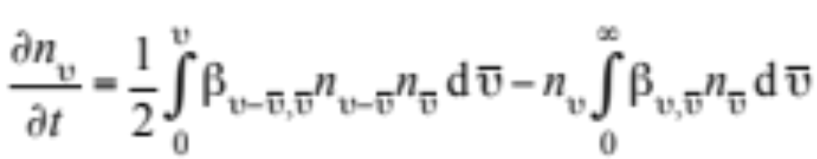
Coagulation
Process by which particles collide and stick together
Integro-differential coagulation equation (15.1)

Slide 3
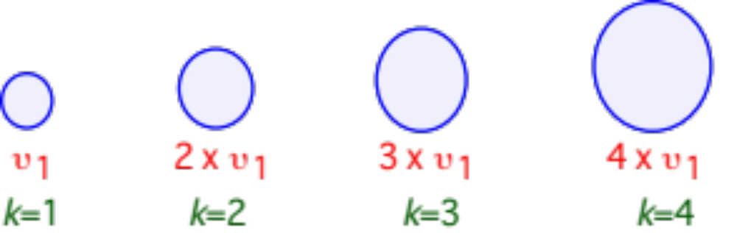
Monomer Size Distribution
Fig. 15.1

Slide 4
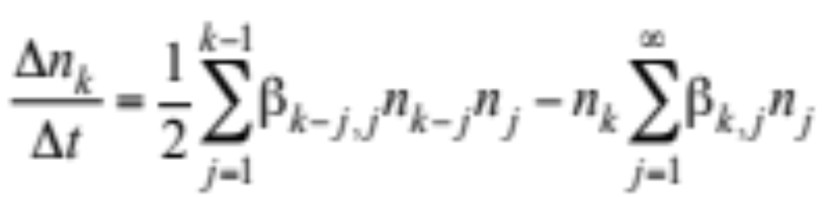
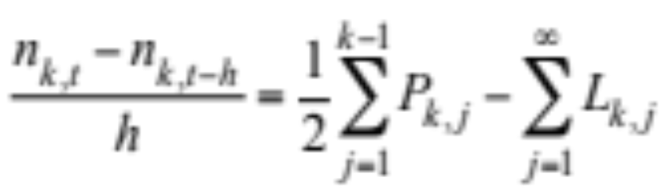
Coagulation Over Monomer Distribution
Coagulation equation over monomer size distribution (15.2)
Rewrite in fully implicit finite-difference form (15.3)

Slide 5

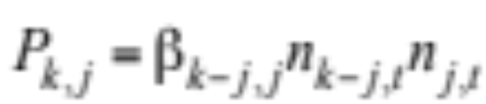
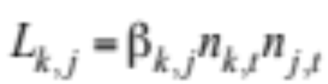
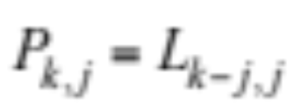
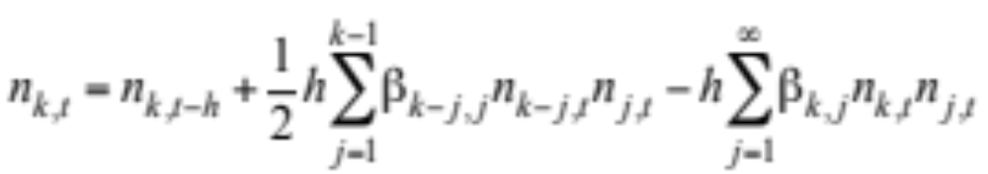
Coagulation Over Monomer Distribution
Finite-difference form (15.3)
Production rate (15.4)
Loss rate
-->
Rearrange (15.3) (15.5)

Slide 6
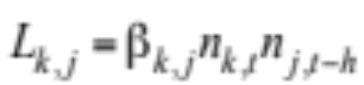
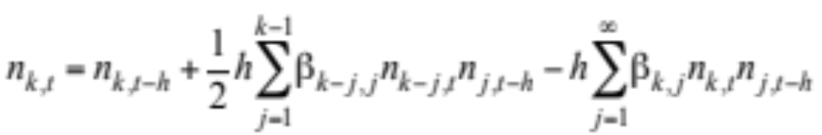
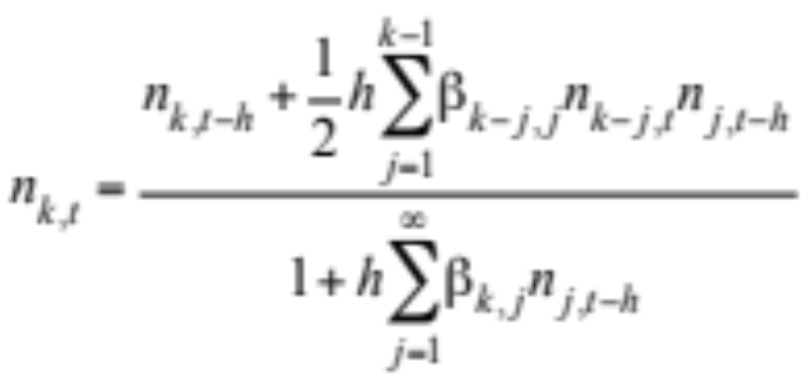
Semiimplicit Solution Over Monomer Size Distribution
Write loss rate in semi-implicit form (15.6)
-->
Substitute (15.6) into (15.3) (15.7)
Rearrange --> semiimplicit solution (15.8)
Treats number correctly but does not conserve volume

Slide 7
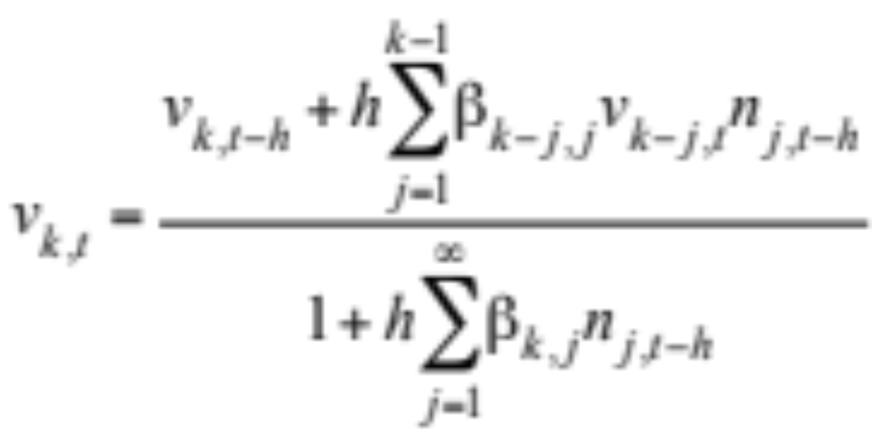
Semiimplicit Solution Over Monomer Size Distribution
Revise to conserve volume, giving up error in number (15.9)
where v_{k,t}=υ_{k}n_{k,t}

Slide 8
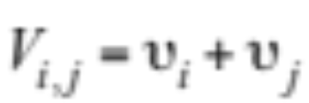
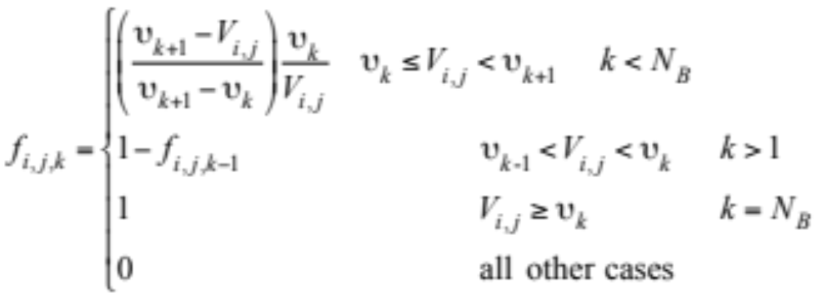
Semiimplicit Solution Over Arbitrary Size Distribution
Volume of intermediate particle (15.10)
Volume fraction of V_{i,j} partitioned to each model bin k (15.11)

Slide 9
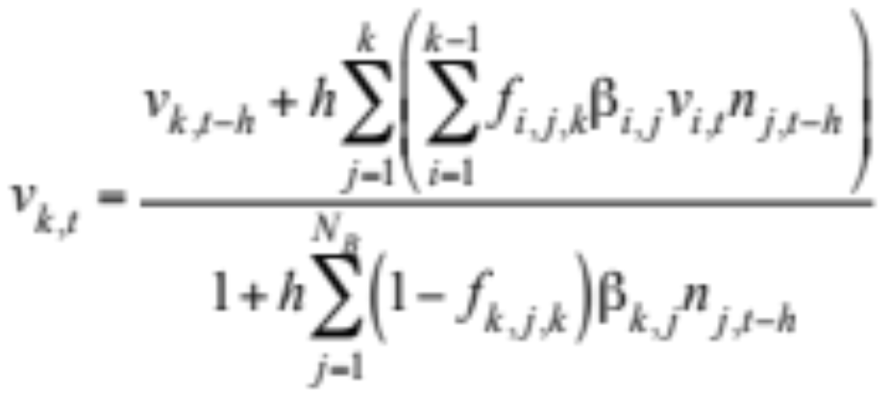
Semiimplicit Solution Over Arbitrary Size Distribution
Incorporate fractions into (15.9) (15.12)

Slide 10
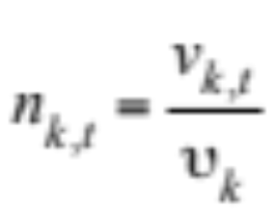
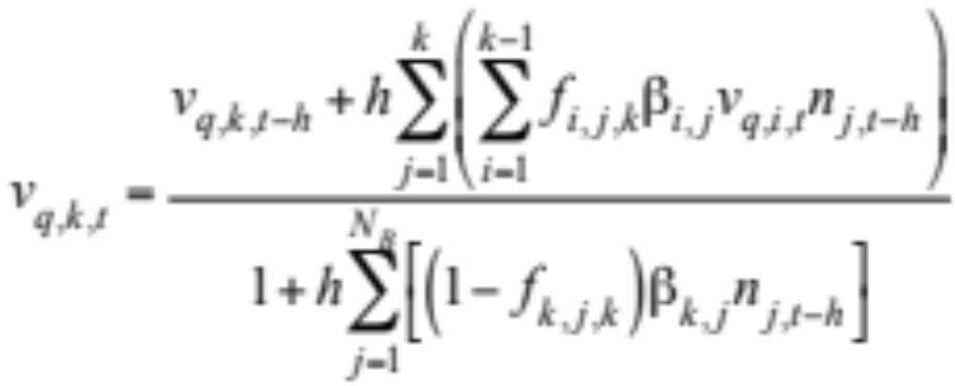
Semiimplicit Solution Over Arbitrary Size Distribution
Final particle number concentration (15.13)
Semiimplicit solution for volume concentration
when multiple components (15.14)

Slide 11
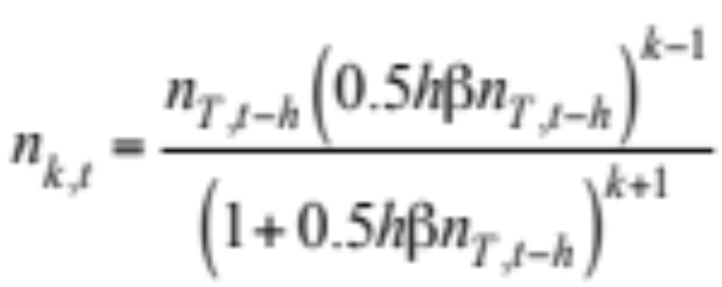
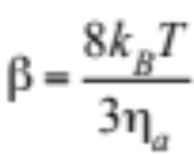
Smoluchowski’s (1918) Solution
Assumes initial monodisperse size distribution, a monomer size distribution during evolution, and a constant rate coefficient
(15.15)
Coagulation kernel (rate coefficient) (15.16)

Slide 12
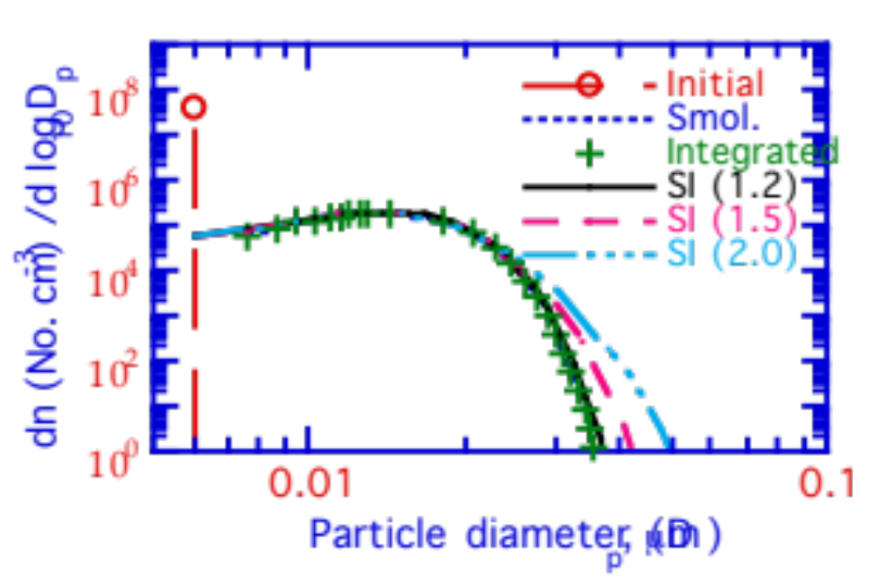
Smoluchowski’s (1918) Solution
Comparison of Smoluchowski's solution, an integrated solution, and three semi-implicit solutions
dn (No. cm⁻³) / d log₁₀D_{p}
Fig. 15.2

Slide 13
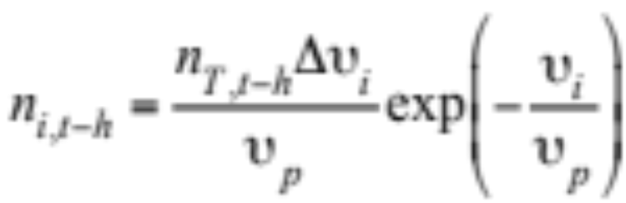
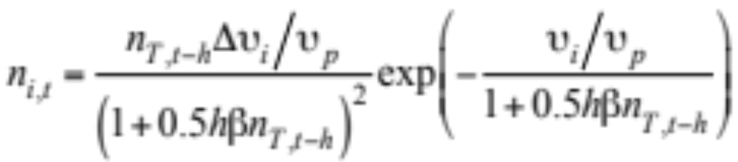
Self-Preserving Solution
Self-preserving size distribution (15.17)
Solution to coagulation over self-preserving distribution (15.18)

Slide 14
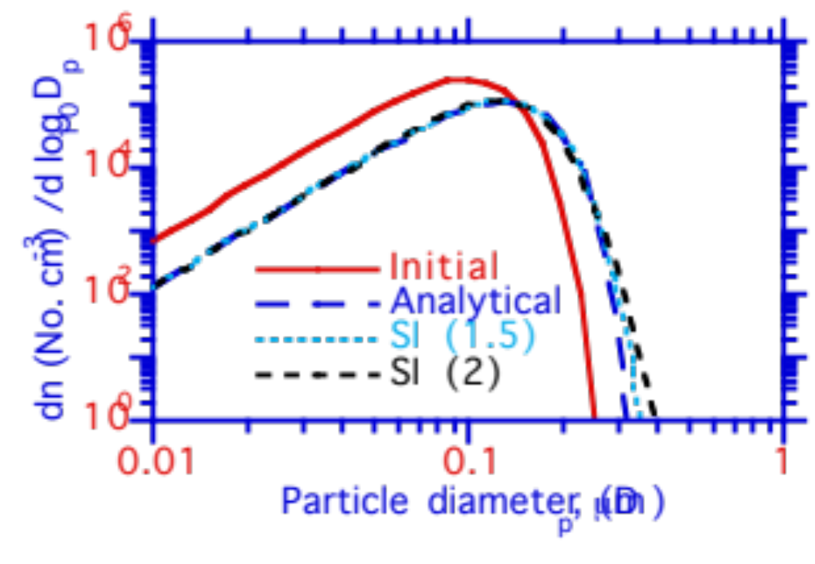
Self-Preserving Solution
Self-preserving versus semi-implicit solutions
dn (No. cm⁻³) / d log₁₀D_{p}
Fig. 15.3

Slide 15
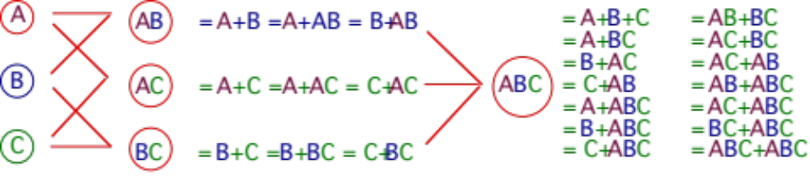
Coagulation Over Multiple Structures
Internal mixing among three externally-mixed distributions
Fig. 15.4

Slide 16
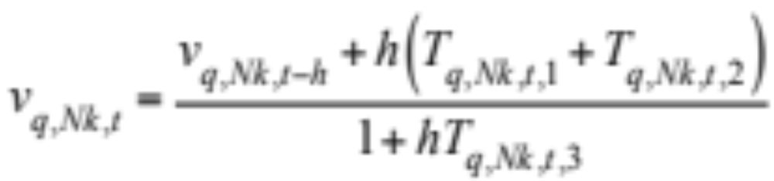
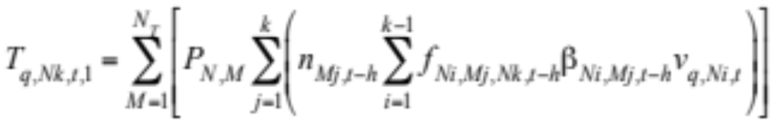
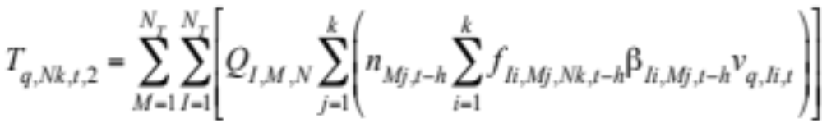
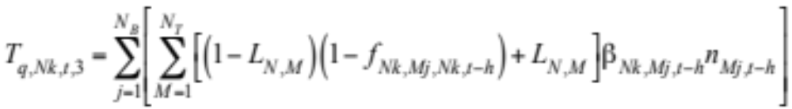
Coagulation Over Multiple Structures
Volume concentration of component q in bin k of distribution N (15.19)
N_{T} = number of distributions N_{B} = number of size bins

Slide 17
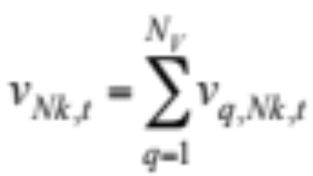
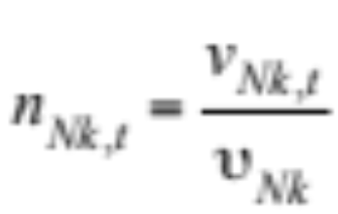
Coagulation Over Multiple Structures
Total volume concentration in bin k of distribution N (15.21)
Number concentration in bin k of distribution N (15.22)

Slide 18
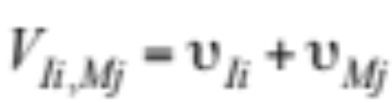
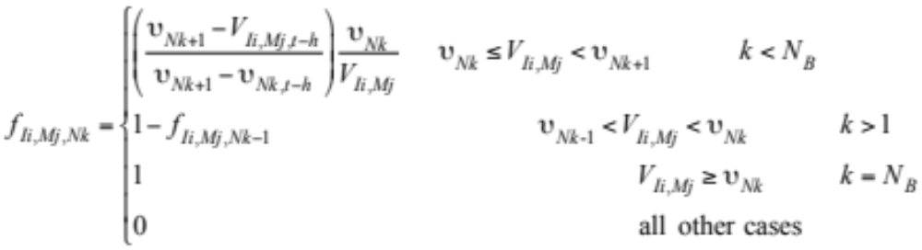
Coagulation Over Multiple Structures
Volume fraction of coagulated pair
partitioned into bin k of distribution N (15.20)

Slide 19
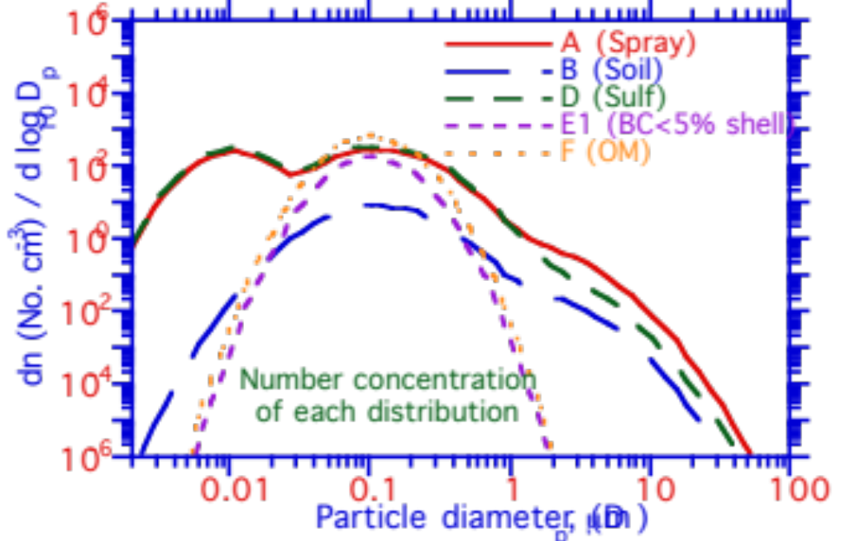
Coagulation Over Multiple Structures
dn (No. cm⁻³) / d log₁₀D_{p}
Fig. 15.5

Slide 20
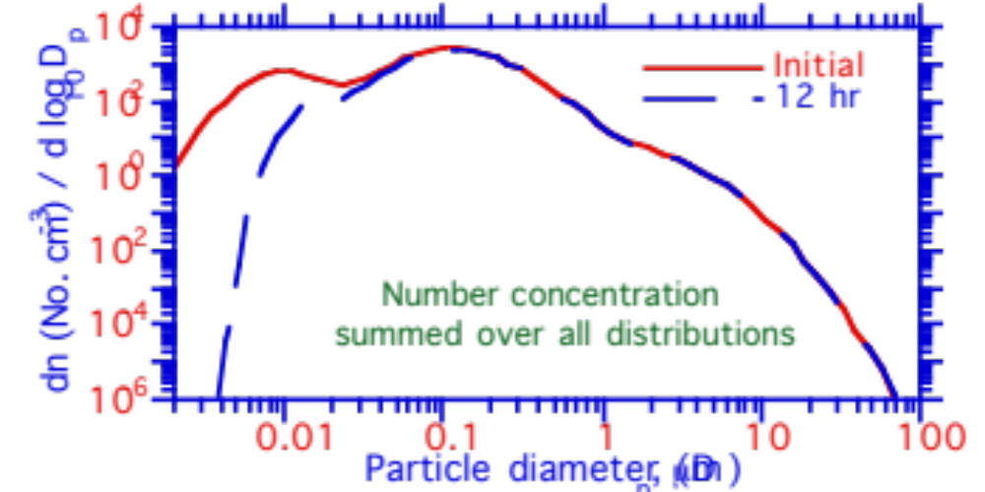
Coagulation Over Multiple Structures
dn (No. cm⁻³) / d log₁₀D_{p}
Fig. 15.5

Slide 21
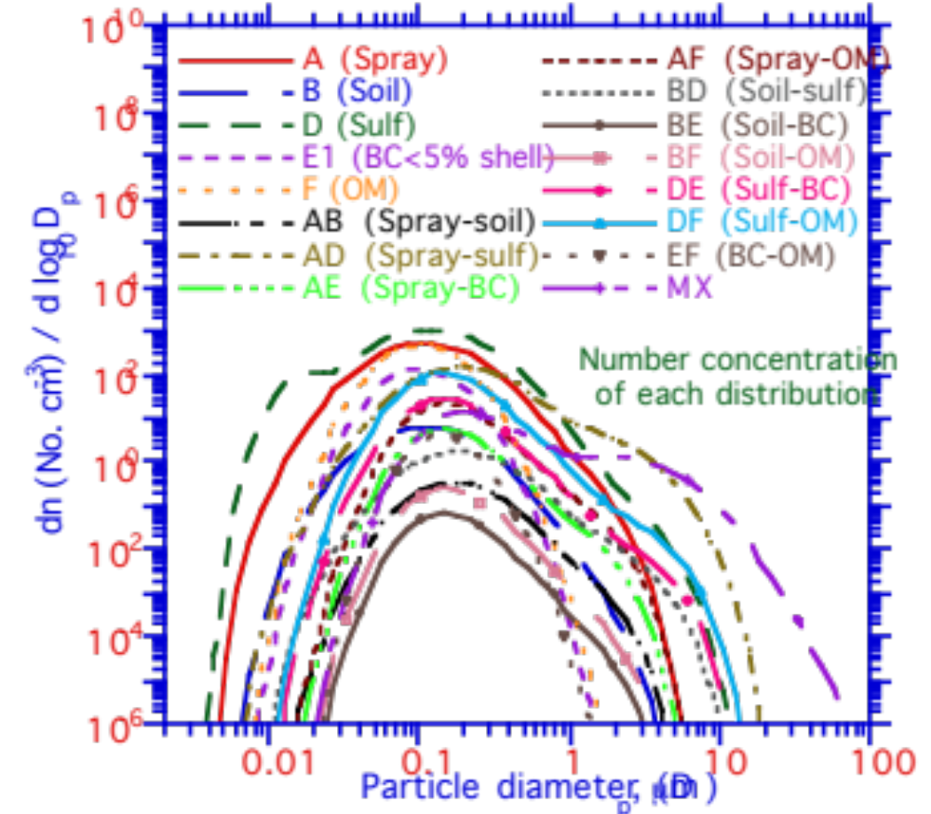
Coagulation Over Multiple Structures
dn (No. cm⁻³) / d log₁₀D_{p}
Fig. 15.5

Slide 22
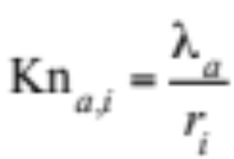
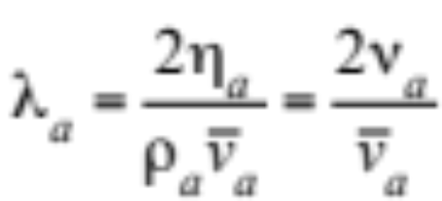
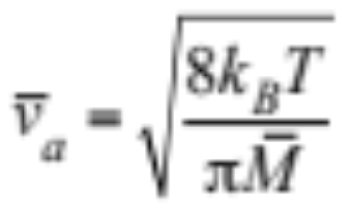
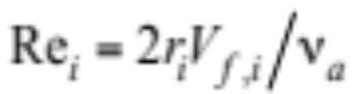
Particle Flow Regimes
Knudsen number for air (15.23)
Mean free path of an air molecule (15.24)
Thermal speed of an air molecule (15.25)
Particle Reynolds number (15.26)

Slide 23
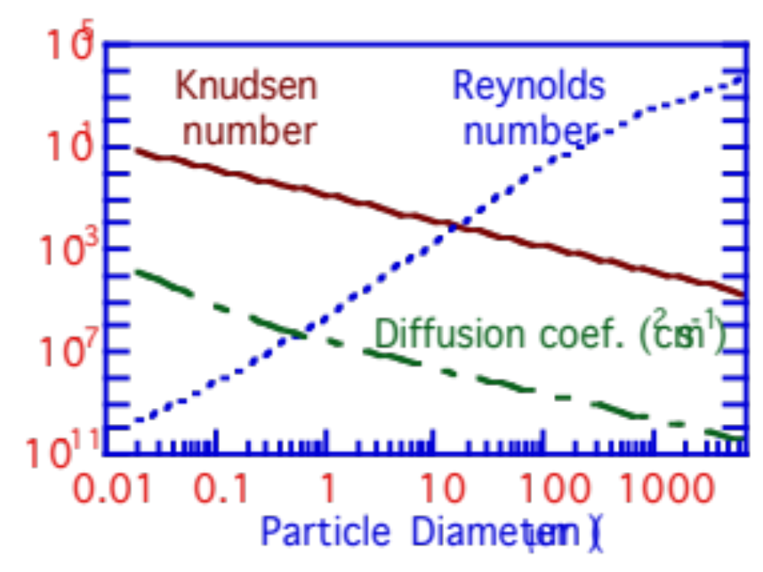
Particle Flow Regimes
T = 292 K, p_{a} = 999 hPa, and density = 1.0 g cm⁻³
Fig. 15.6

Slide 24
Particle Flow Regimes
Continuum regime
Kn_{a,i}« 1 --> r_{i} » mean free path of air molecules and particle resistance to motion is due to viscosity of the air.
Free molecular regime
Kn_{a,i} » 10 --> r_{i} « mean free path of air molecules and particle resistance to motion is due to inertia of air molecules hit by particles.

Slide 25
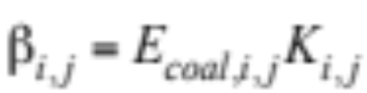
Coagulation Kernel
Coagulation kernel (rate coefficient)
    Brownian diffusion
    Convective Brownian diffusion enhancement
    Gravitational collection
    Turbulent inertial motion
    Turbulent shear
    Van der Waals forces
    Viscous forces
    Fractal geometry
    Diffusiophoresis
    Thermophoresis
    Electric charge
Kernel = product of coalescence efficiency and collision kernel (15.27)

Slide 26
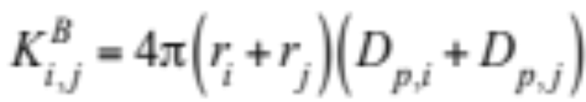
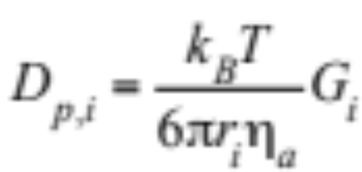
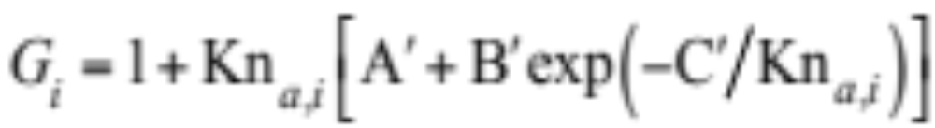
Brownian Diffusion Kernel
Brownian motion
Irregular motion of particle due to random bombardment by gas molecules
Continuum regime Brownian collision kernel (cm³ partic. s⁻¹) (15.28)
Particle diffusion coefficient (15.29)
Cunningham slip-flow correction to particle resistance to motion (15.30)

Slide 27
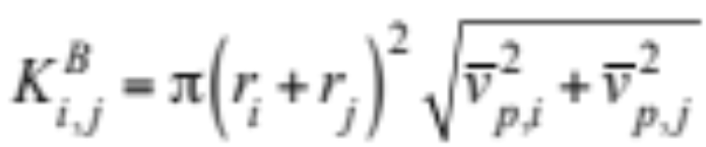
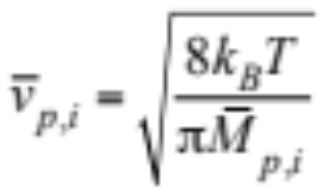
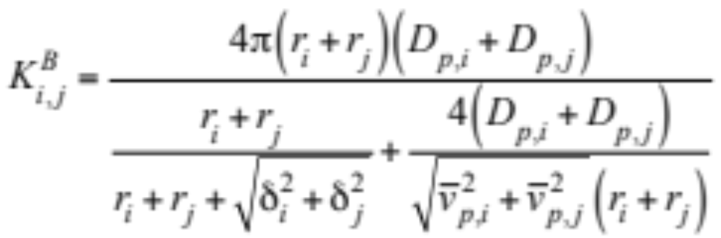
Brownian Diffusion Kernel
Free molecular regime Brownian collision kernel (cm³ partic. s⁻¹) (15.31)
Particle thermal speed (15.32)
Interpolate between continuum and free molecular regimes (15.33)

Slide 28
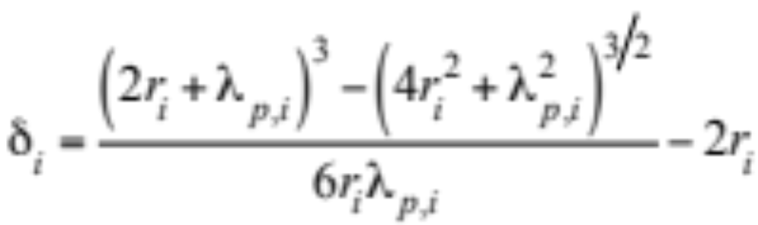
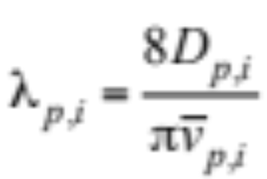
Brownian Diffusion Kernel
Mean distance from center of a sphere reached by particles leaving the sphere's surface and traveling a distance λ_{p,i}
(15.34)
Particle mean free path (cm) (15.34)

Slide 29
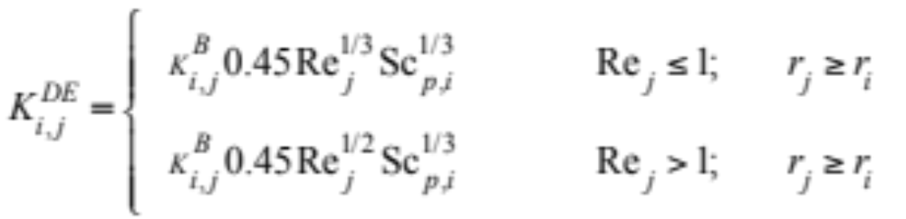

Brownian Diffusion Enhancement
Eddies created in the wake of a large, falling particle enhance diffusion to the particle surface
Brownian diffusion enhancement collision kernel (15.35)
Particle Schmidt number (15.36)

Slide 30


Gravitational Collection
Collision and coalescence when one particle falls faster than and catches up with another
Differential fall speed collision kernel (15.37)
Collection (coalescence) efficiency (15.38)
E_{coll,i,j} simplifies to
E_{Vi,j} when Re_{j} « 1 (viscous flows)
E_{Ai,j} when Re_{j} » 1 (potential flows)

Slide 31



Gravitational Collection
(15.39)
Stokes number
for r_{j}≥r_{i}

Slide 32


Turbulent Inertia and Shear
Collision kernel due to turbulent inertial motion
Collision between drops moving relative to air (15.40)
Collision kernel due to turbulent shear
Collisions due to spatial variations in turbulent velocities of drops moving with air (15.41)
Epsilon = dissipation rate of turbulent energy per gram (cm² s⁻³)

Slide 33


Comparisons of Coagulation Kernels
Coagulation kernels when particle of (a) 0.01 micron and (b) 10 μιχρον in radius coagulate at 298 K.
Kernel (cm³ particle⁻¹ s⁻¹)
Kernel (cm³ particle⁻¹ s⁻¹)
Fig. 15.7

Slide 34

Van der Waals/Viscous Forces
Van der Waals forces
Weak dipole-dipole attractions caused by brief, local charge fluctuations in nonpolar molecules having no net charge
Viscous forces
Two particles moving toward each other in viscous medium have diffusion coefficients smaller than the sum of the two
Van der Waals/viscous collision kernel (15.42)

Slide 35


Van der Waals/Viscous Forces
Free-molecular regime correction (15.43)
Free-molecular regime correction (15.44)

Slide 36


Van der Waals/Viscous Forces
Van der Waals interaction potential (15.46)
Particle pair Knudsen number (15.47)

Slide 37

Van der Waals/Viscous Forces
Van der Waals/viscous correction factor
Correction factor
Fig. 15.8

Slide 38


Fractal Geometry
Fractals
Particles of irregular, fragmented shape
Fractal (outer) radius of agglomerate (15.48)
Number of spherules in aggregate (15.49)

Slide 39


Fractal Geometry
Mobility radius (15.50)
Area-equivalent radius (15.51)

Slide 40

Fractal Geometry
Brownian collision kernel modified for fractals (15.52)

Slide 41

Modified Brownian Collision Kernels
Kernel (cm³ particle⁻¹ s⁻¹)
Fig. 15.9

Slide 42

Modified Brownian Collision Kernels
Kernel (cm³ particle⁻¹ s⁻¹)
Fig. 15.9

Slide 43

Effect on Aerosol Evolution
dn (No. cm⁻³) / d log₁₀D_{p}
Fig. 15.10

Slide 44

Effect on Aerosol Evolution
dn (No. cm⁻³) / d log₁₀D_{p}
Fig. 15.10

Slide 45



Measured v. Modeled Distributions Along Calder Road After Several Minutes
dN (No. cm⁻³) / dlog₁₀ D_{p}
dN (No. cm⁻³) / dlog₁₀ D_{p}
Particle diameter (μm)
Particle diameter (μm)
dN (No. cm⁻³) / dlog₁₀ D_{p}
Particle diameter (μm)

Slide 46
Diffusiophoresis/Thermophoresis/Charge
Diffusiophoresis
Flow of aerosol particles down concentration gradient of gas due to bombardment of particles by the gas as it diffuses down same gradient
Thermophoresis
Flow of aerosol particles from warm to cool air due to bombardment of particles by gases in presence of temperature gradient.
Electric charge
Opposite-charge particles attract due to Coulomb forces

Slide 47



Diffusiophoresis/Thermophoresis/Charge
Collision kernel for diffusiophoresis, thermophoresis, charge, other kernels
Mobility (15.54)
Particle diffusion coefficient (15.57)

Slide 48




Diffusiophoresis/Thermophoresis/Charge
Diffusiophoresis, thermophoresis, charge terms (15.58)
(15.59)
(15.60)
(15.61)

Slide 49

Collision Efficiency for Cloud-Aerosol Coagulation
Collision efficiency
Fig. 15.11

Slide 50

Collision Kernel for Cloud-Aerosol Coagulation
Kernel (cm³ particle⁻¹ s⁻¹)
Fig. 15.12

