Slide 1
Presentation Slides for
Chapter 13 of
Fundamentals of Atmospheric Modeling 2nd Edition
Mark Z. Jacobson
Department of Civil & Environmental Engineering
Stanford University
Stanford, CA 94305-4020
jacobson@stanford.edu
March 29, 2005

Slide 2
Sizes of Atmospheric Constituents
Mode Diameter (μm) Number (#/cm³)
Gas molecules 0.0005 2.45x10¹⁹
Aerosol particles
Small < 0.2 10³-10⁶
Medium 0.2-2 1-10⁴
Large 1-100 <1 - 10
Hydrometeor particles
Fog drops 10-20 1-1000
Cloud drops 10-200 1-1000
Drizzle 200-1000 0.01-1
Raindrops 1000-8000 0.001-0.01
Table 13.1

Slide 3
Particles and Size Distributions
Particle
Agglomerations of molecules in the liquid and / or solid phases, suspended in air. Includes aerosol particles, fog drops, cloud drops, and raindrops
Example 13.1. - Idealized particle size distribution
10,000 particles of radius between 0.05 and 0.5 μm
100 particles of radius between 0.5 and 5.0 μm
10 particles of radius between 5.0 and 50 μm
Example 13.2. Number of size bins needs to be limited
10⁵ grid cells
100 size bins
100 components per size bin
--> 10⁹ words = 8 gigabytes to store concentration

Slide 4
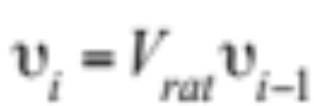
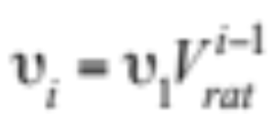
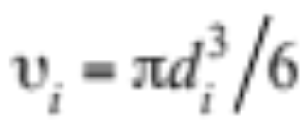
Volume Ratio Size Structure
Volume of particles in one size bin (13.1)
(13.2)
Volume-diameter relationship for spherical particles

Slide 5
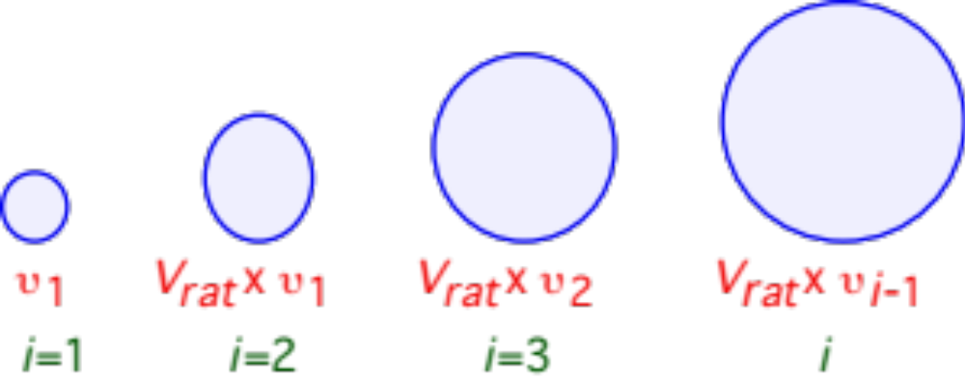
Volume Ratio Size Structure
Variation in particle sizes with the volume ratio size structure
Fig. 13.1

Slide 6
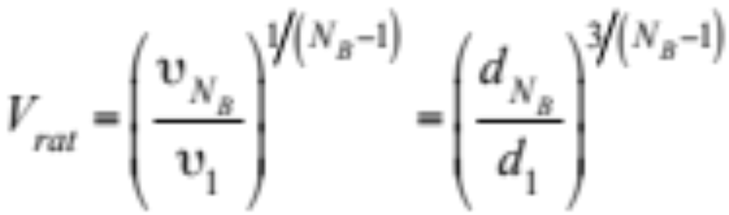
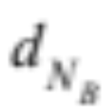
Volume Ratio Size Structure
Volume ratio of adjacent size bins (13.3)
Example 13.3.
d₁ = 0.01 μm
= 1000 μm
N_{B} = 30 size bins
---> V_{rat} = 3.29

Slide 7
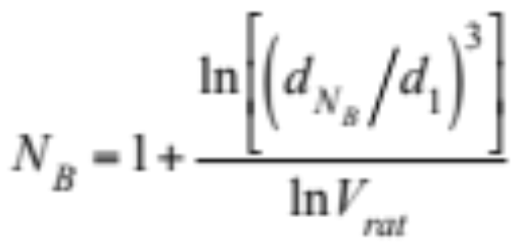
Volume Ratio Size Structure
Number of size bins (13.4)
Example 13.4.
d₁ = 0.01 μm
= 1000 μm
V_{rat} = 4
---> N_{B} = 26 size bins
V_{rat} = 2
---> N_{B} = 51 size bins

Slide 8
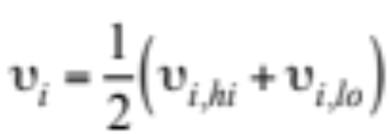
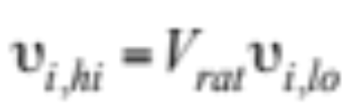
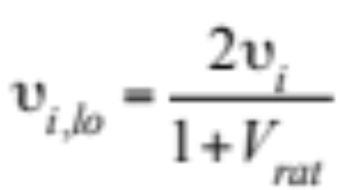
Volume Ratio Size Structure
Average volume in a size bin (13.5)
Relationship between high- and low-edge volume (13.6)
Substitute (13.6) into (13.5) --> low edge volume (13.7)

Slide 9
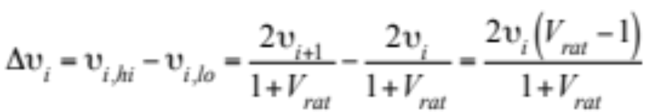
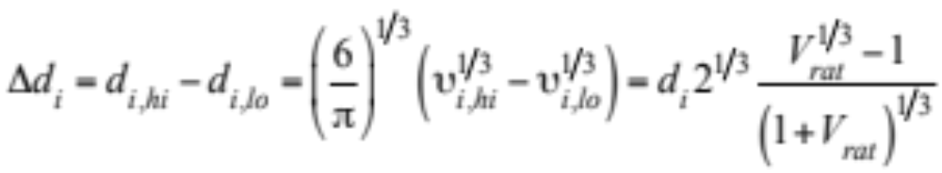
Volume Ratio Size Structure
Volume width of a size bin (13.8)
Diameter width of a size bin (13.9)

Slide 10
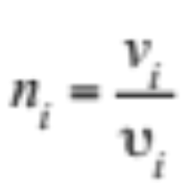
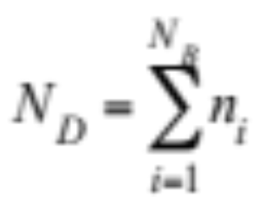
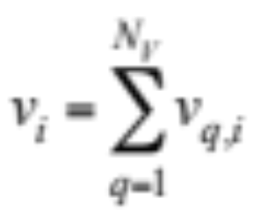
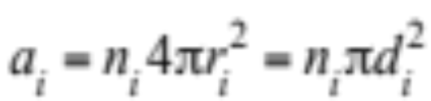
Particle Concentrations
Number concentration in a size bin (13.10)
Number concentration in a size distribution (13.11)
Volume concentration in a size bin (13.12)
Surface area concentration in a size bin (13.13)

Slide 11
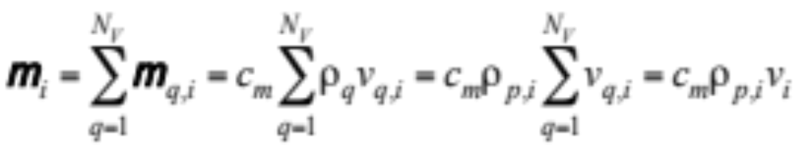
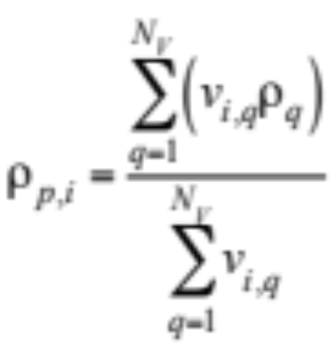
Particle Concentrations
Mass concentration in a size bin (13.14)
Volume-averaged mass density (g cm⁻³) of particle of size i (13.15)

Slide 12
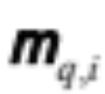

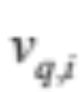
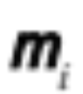




Particle Concentrations
Example 13.5
= 3.0 μg m⁻³ for water
= 2.0 μg m⁻³ for sulfate
d_{i} = 0.5 μm
= 1.0 g cm⁻³ for water
= 1.83 g cm⁻³ for sulfate
---> = 3 x 10⁻¹² cm³ cm⁻³ for water
---> = 1.09 x 10⁻¹² cm³ cm⁻³ for sulfate
---> = 5.0 μg m⁻³
---> = 4.09 x 10⁻¹² cm³ cm⁻³
---> = 6.54 x 10⁻¹⁴ cm³
---> = 62.5 partic. cm⁻³
---> = 4.8 x 10⁻⁷ cm² cm⁻³

Slide 13
Lognormal Distribution
Bell-curve distribution on a log scale
Geometric mean diameter
50% of area under a lognormal curve lies below it
Geometric standard deviation
68% of area under a lognormal curve lies between +/-1 one geometric standard deviation around the mean diameter

Slide 14
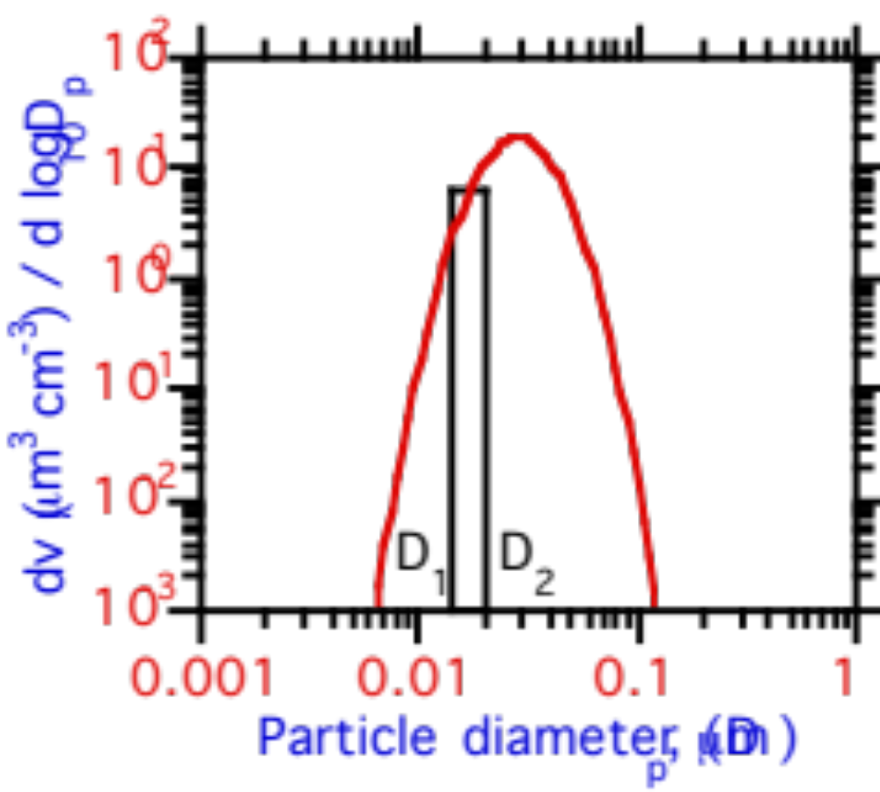
Lognormal Distribution
Describes particle concentration versus size
dv (μm³ cm⁻³) / d log₁₀ D_{p}
Fig. 13.2a

Slide 15
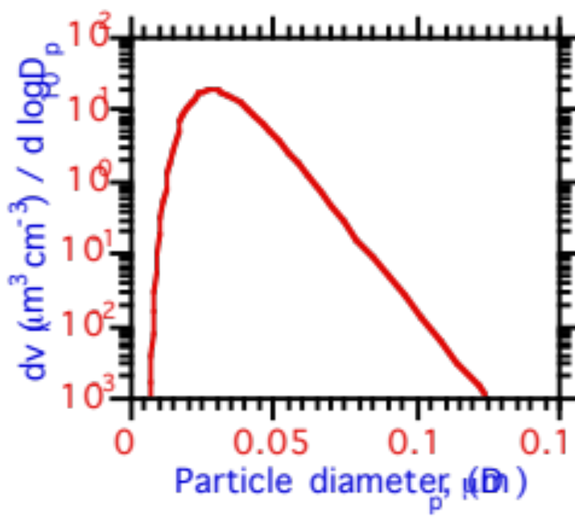
Lognormal Distribution
The lognormal curve drawn on a linear scale
dv (μm³ cm⁻³) / d log₁₀ D_{p}
Fig. 13.2b

Slide 16
Lognormal Parameters From Data
Low-pressure impactor -- 7 size cuts
0.05 - 0.075 μm 0.5 - 1.0 μm
0.075 - 0.12 μm 1.0 - 2.0 μm
0.12 - 0.26 μm 2.0- 4.0 μm
0.26 - 0.5 μm

Slide 17
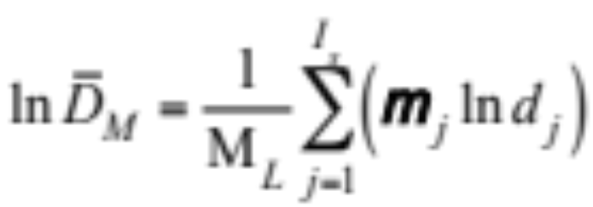
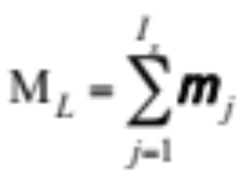
Lognormal Parameters From Data
Natural log of geometric mean mass diameter (13.16)
Total mass concentration of particles (μg m⁻³)

Slide 18
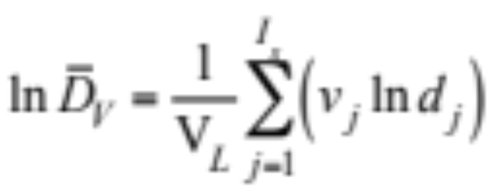
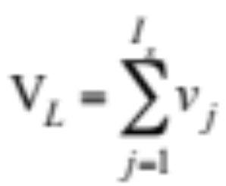
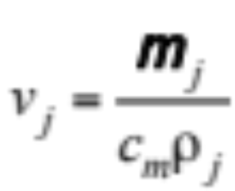
Lognormal Parameters From Data
Natural log of geometric mean volume diameter (13.17)
Total volume concentration of particles (cm³ cm⁻³)

Slide 19
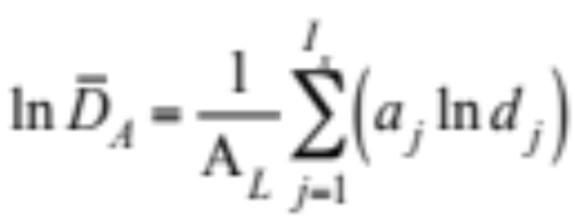
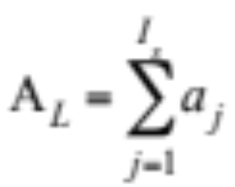
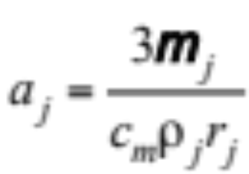
Lognormal Parameters From Data
Natural log of geometric mean area diameter (13.18)
Total area concentration of particles (cm² cm⁻³)

Slide 20
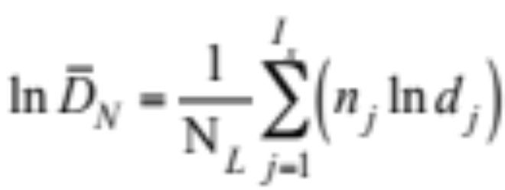
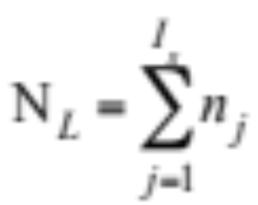
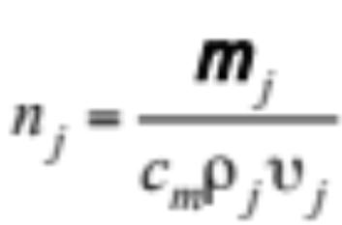
Lognormal Parameters From Data
Natural log of geometric mean number diameter (13.19)
Total number concentration of particles (partic. cm⁻³)

Slide 21
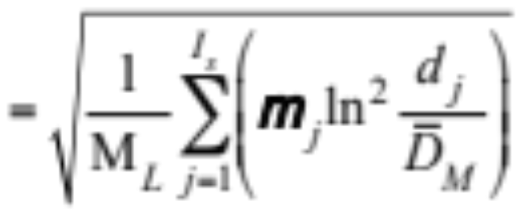
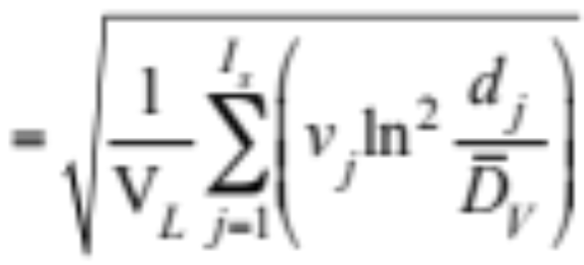
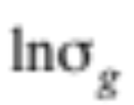
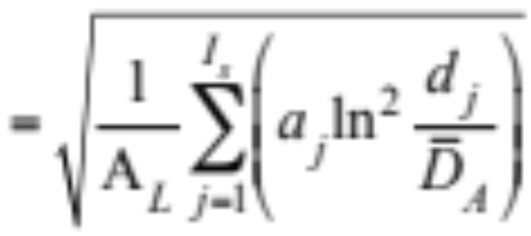
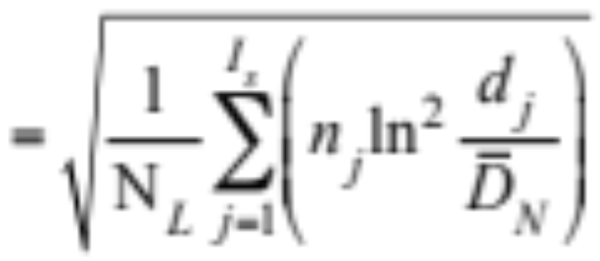
Lognormal Parameters From Data
Natural log of geometric standard deviation (13.20)

Slide 22
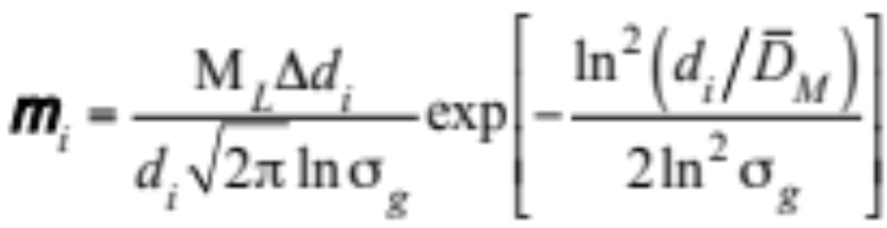
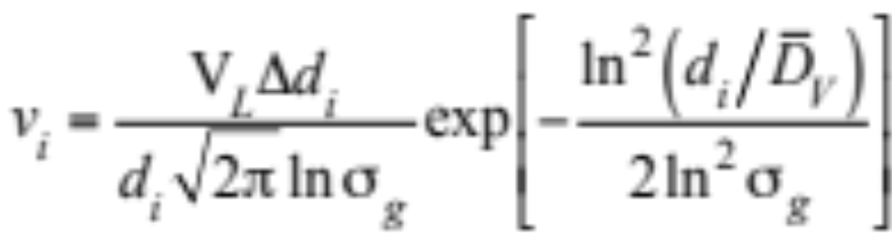
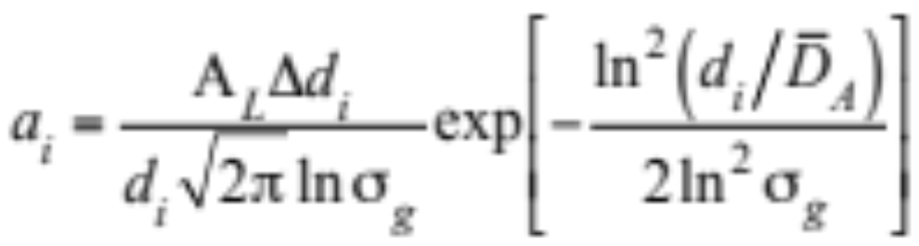
Redistribute With Lognormal Parameter
Redistribute mass concentration in model size bin (13.21)
Redistribute volume concentration (13.22)
Redistribute area concentration (13.23)

Slide 23

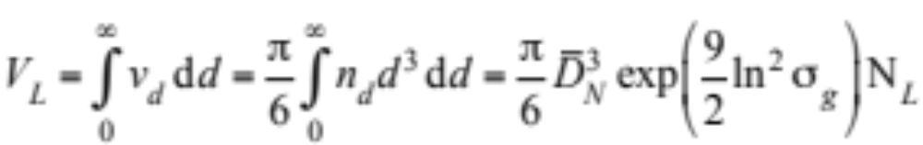
Redistribute With Lognormal Parameter
Redistribute number concentration (13.24)
Exact volume concentration in a mode (13.25)

Slide 24
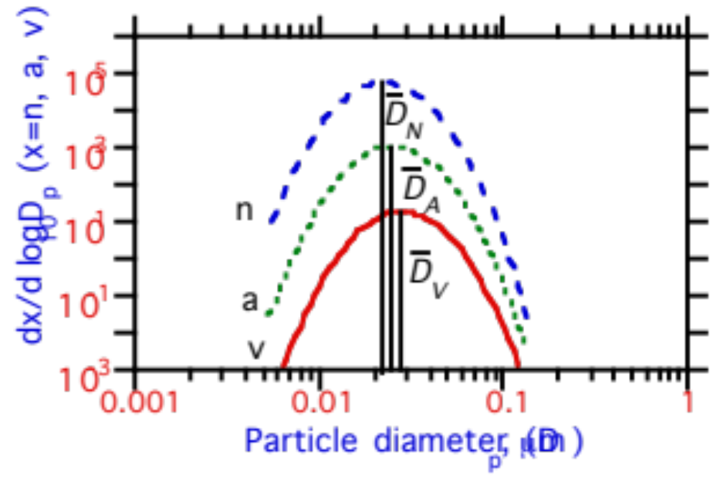
Lognormal Modes
Number (partic. cm⁻³), area (cm² cm⁻³), and volume (cm³ cm⁻³) concentrations distributed lognormally
dx / d log₁₀ D_{p} (x=n,a,v)
Fig. 13.3

Slide 25
Lognormal Param. for Cont. Particles
Nucleation Accumulation Coarse
Parameter Mode Mode Mode
σ_{g} 1.7 2.03 2.15
N_{L} (particles cm⁻³) 7.7x10⁴ 1.3x10⁴ 4.2
D_{N} (μm) 0.013 0.069 0.97
A_{L} (μm² cm⁻³) 74 535 41
D_{A} (μm) 0.023 0.19 3.1
V_{L} (μm³ cm⁻³) 0.33 22 29
D_{V} (μm) 0.031 0.31 5.7
Table 13.2

Slide 26
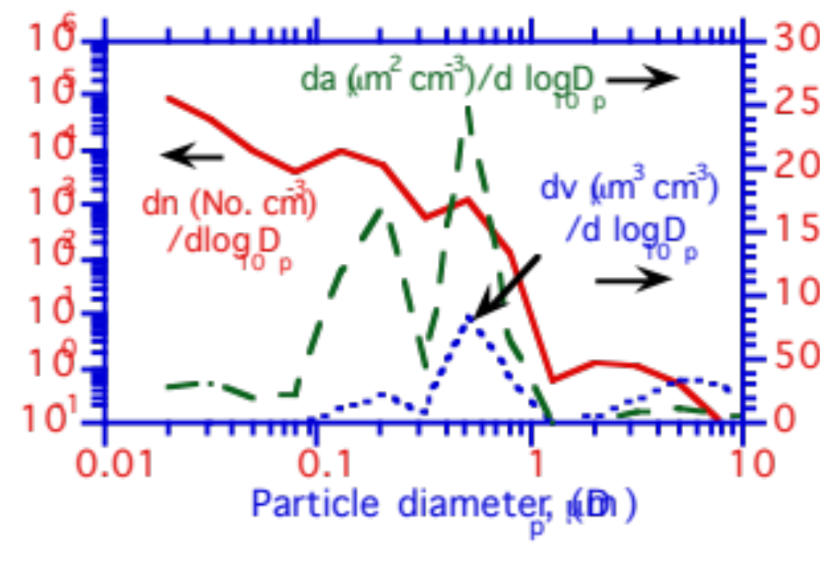
Quadramodal Size Distribution
Size distribution at Claremont, California, on the morning of August 27, 1987
Fig. 13.4

Slide 27
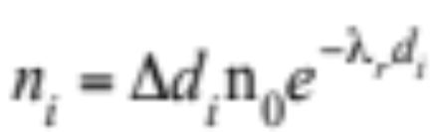
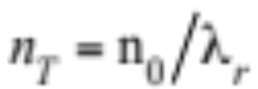
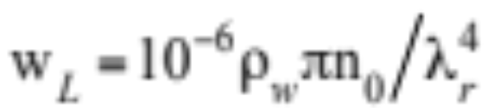
Marshall-Palmer Distribution
Raindrop number concentration between d_{i} and d_{i}+Δd_{i} (13.30)
Δd_{i}n₀ = value of n_{i} at d_{i} = 0
n₀ = 8.0 x 10⁻⁶ partic. cm⁻³ μm⁻¹
λ_{r} = 4.1x10⁻³ R^{−0.21} μm⁻¹
R = rainfall rate (1-25 mm hr⁻¹)
Total number concentration and liquid water content

Slide 28
Marshall-Palmer Distribution
Example 13.6.
R = 5 mm hr⁻¹
d_{i} = 1 mm
d_{i}+Δd_{i} = 2 mm
---> n_{i} = 0.00043 partic. cm⁻³
---> n_{T} = 0.0027 partic. cm⁻³
---> w_{L} = 0.34 g m⁻³

Slide 29
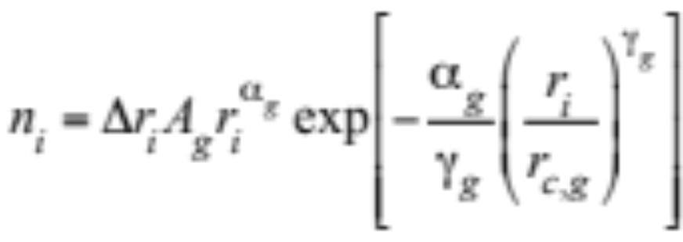
Modified Gamma Distribution
Number concentration (partic. cm⁻³) of drops in size bin i (13.30)

Slide 30
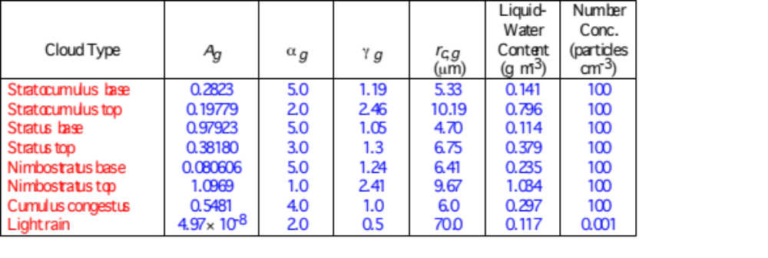
Modified Gamma Distribution Parameters
Table 13.3

Slide 31
Modified Gamma Distribution
Example 13.7.
Find number concentration of droplets between 14 and 16 μm in radius at base of a stratus cloud
---> r_{i} = 15 μm
---> Δr_{i} = 2 μm
---> n_{i} = 0.1506 partic. cm⁻³

Slide 32
Full-Stationary Size Structure
Average single-particle volume in size bin (υ_{i}) stays constant. When growth occurs, number concentration in bin (n_{i}) changes.
Advantages:
    Covers wide range in diameter space with few bins
    Nucleation, emissions, transport treated realistically
Disadvantages:
    When growth occurs, information about the original composition of the growing particle is lost.
    Growth leads to numerical diffusion

Slide 33

Full-Stationary Size Structure
Demonstration of a problem with the full-stationary size bin structure
Fig. 13.5

Slide 34
Full-Moving Structure
Number concentration (n_{i}) of particles in a size bin does not change during growth; instead, single-particle volume (υ_{i}) changes.
Advantages:
    Core volume preserved during growth
    No numerical diffusion during growth
Disadvantages:
    Nucleation, emissions, transport treated unrealistically
    Reordering of size bins required for coagulation

Slide 35

Full-Moving Structure
Preservation of aerosol material upon growth and evaporation in a moving structure
Fig. 13.6

Slide 36

Full-Moving Structure
Particle size bin reordering for coagulation
Fig. 13.7

Slide 37
Quasistationary Structure
Single-particle volumes change during growth like with full-moving structure but are fit back onto a full-stationary grid each time step.
Advantages and Disadvantages:
    Similar to those of full stationary structure
    Very numerically diffusive

Slide 38





Quasistationary Structure
After growth, particles in bin i have volume υ_{i}’, which lies between volumes of bins j and k
Partition volume of i between bins j and k while conserving particle number concentration (13.32)
and particle volume concentration (13.33)
Solution to this set of two equations and two unknowns (13.34)

Slide 39
Moving-Center Structure
Single-particle volume (υ_{i}) varies between υ_{i,hi} and υ_{i,lo} during growth, but υ_{i,hi}, υ_{i,lo}, and dυ_{i} remain fixed.
Advantages:
    Covers wide range in diameter space with few bins
    Little numerical diffusion during growth
    Nucleation, emission, transport treated realistically
Disadvantages:
    When growth occurs, information about the original composition of the growing particle is lost

Slide 40

Moving-Center Structure
Comparison of moving-center, full-moving, and quasistationary size structures during water growth onto aerosol particles to form cloud drops.
dv (μm³ cm⁻³) / d log₁₀ D_{p}
Fig. 13.8

