Slide 1
Presentation Slides for
Chapter 12 of
Fundamentals of Atmospheric Modeling 2nd Edition
Mark Z. Jacobson
Department of Civil & Environmental Engineering
Stanford University
Stanford, CA 94305-4020
jacobson@stanford.edu
March 29, 2005

Slide 2

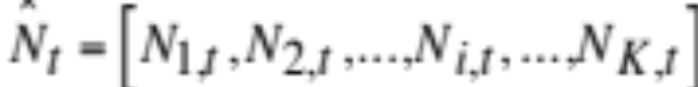
Initial Value Problems
Values are known at an initial time and desired at a final time
Concentration of species i is known at time t-h=0 (12.2)
Vector of concentrations at time t (12.1)

Slide 3
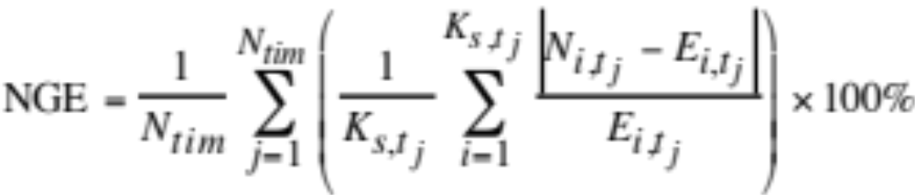
Properties of Good ODE Solvers
Accuracy
Mass conservation
Positive-definiteness
Speed
Normalized gross error (12.3)

Slide 4
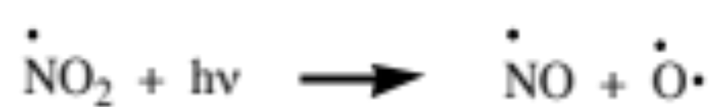
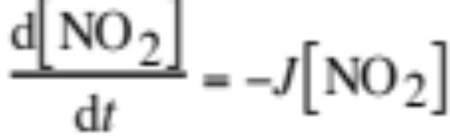
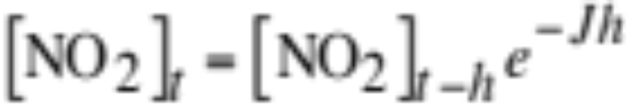
Analytical Solution to ODEs
Nitrogen dioxide photolysis (12.4)
Time rate of change of NO₂ concentration (12.5)
Analytical solution (12.6)
Example:
[NO₂]_{t-h} = 10¹⁰ molec. cm⁻³
J = 0.02 s⁻¹
---> [NO₂]_{t} = 10¹⁰ e^{-0.02t}

Slide 5
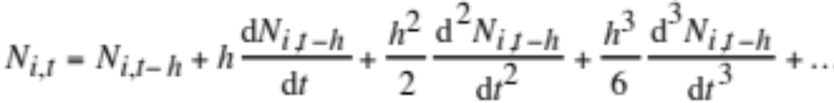
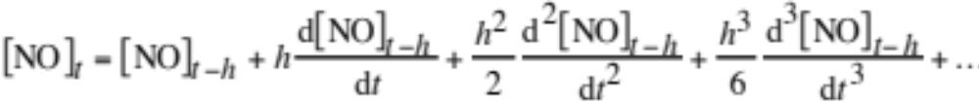
Taylor Series Solution to ODEs
Explicit Taylor series expansion for one species (12.7)
Taylor series expansion for NO₂ (12.8)

Slide 6
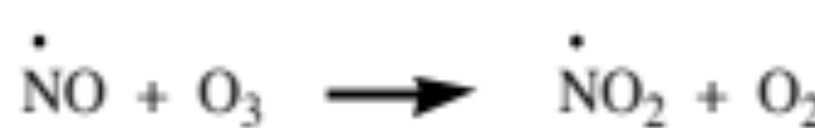
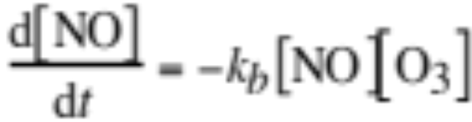
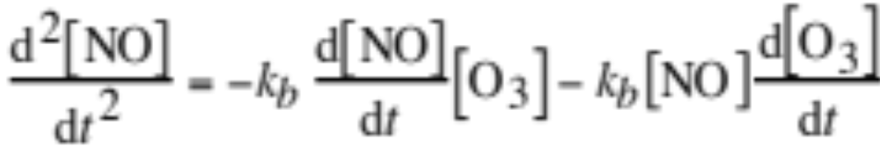
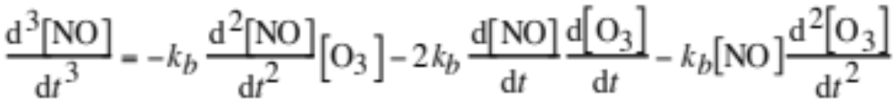
Taylor Series Example
Assume
(12.8-12.12)

Slide 7
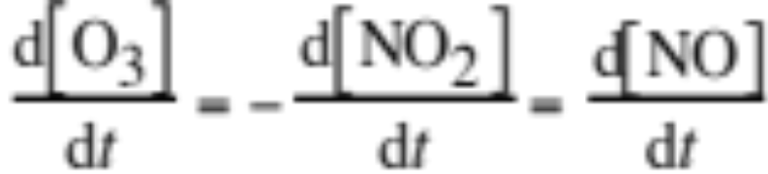
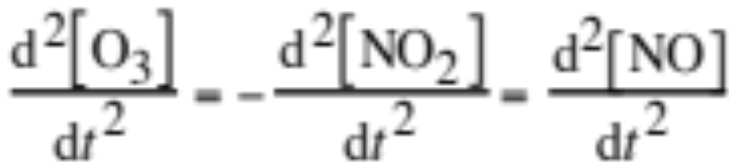
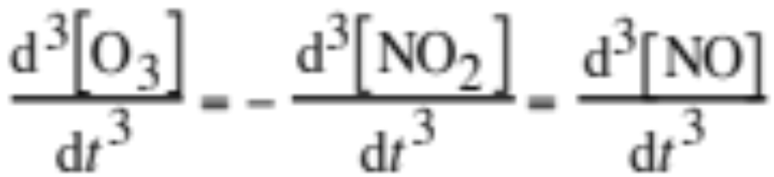
Taylor Series Solution
(12.13)
Disadvantages
Unstable unless small time step is used
High derivatives computationally demanding

Slide 8
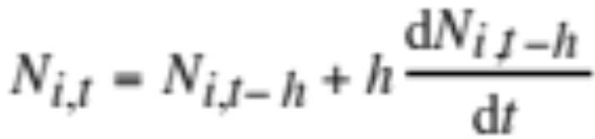

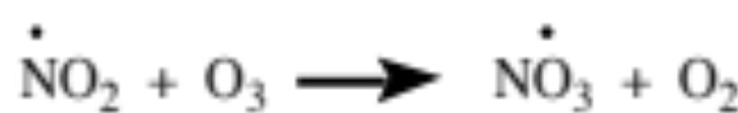
Forward Euler Solution to ODEs
Explicit forward Euler solution for an individual species (12.14)
Example set of three equations (12.15-17)
(k₁)
(k₂)
(J)
First derivative of NO₂ (12.18)

Slide 9
Forward Euler Solution to ODEs
First derivative of NO₂ (12.18)
Forward Euler equation (12.19)

Slide 10
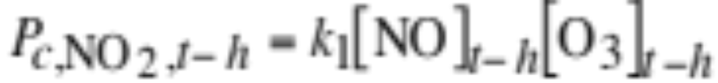
Forward Euler Solution to ODEs
Forward Euler equation (12.19)
Rewrite in terms of production and loss (12.20-22)
Advantages
Mass conserving, easy to calculate derivatives
Disadvantage
Unconditionally unstable

Slide 11
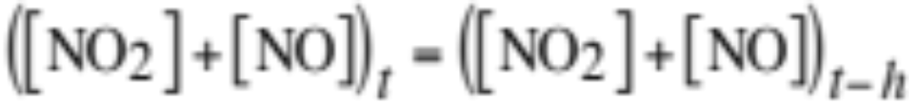
Mass Conservation of Forward Euler
Requirement for mass conservation of nitrogen (12.28)
Forward Euler concentrations of nitrogen species (12.24,6)

Slide 12
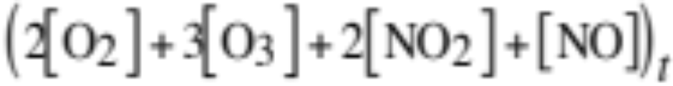
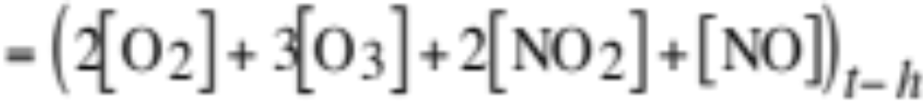
Mass Conservation of Forward Euler
Requirement for mass conservation of oxygen (12.29)
Forward Euler concentrations (12.24-7)

Slide 13
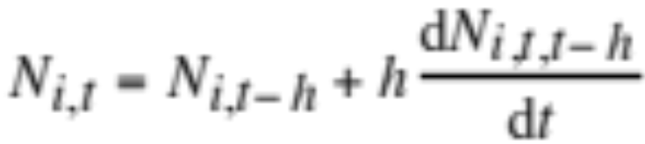
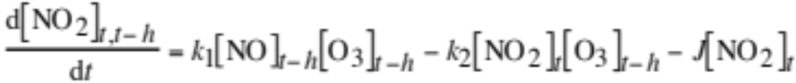
Backward Euler Solution to ODEs
Linearized backward Euler solution for one species (12.30)
Example set of three equations (12.15-17)
(k₁)
(k₂)
(J)
First derivative of NO₂ (12.31)

Slide 14
Backward Euler Solution to ODEs
First derivative of NO₂ (12.30)
Linearized backward Euler equation (12.32)

Slide 15
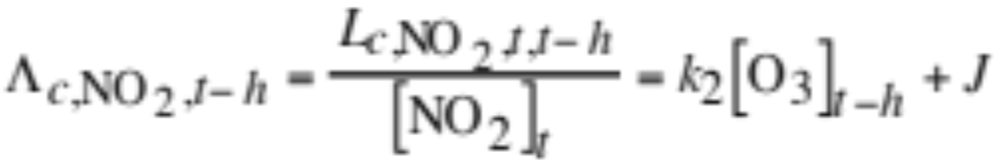
Backward Euler Solution to ODEs
Linearized backward Euler equation (12.32)
Rewrite in terms of production and loss (12.36)
Production term (12.33)
Loss term (12.34)
Implicit loss coefficient (12.35)

Slide 16
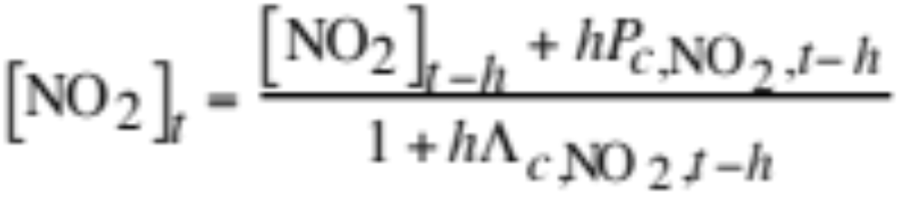
Backward Euler Solution to ODEs
Rearrange (12.37)
Advantages
Always gives positive solutions to chemical ODEs
Disadvantages
Requires a small time step for accuracy
Not mass conserving

Slide 17
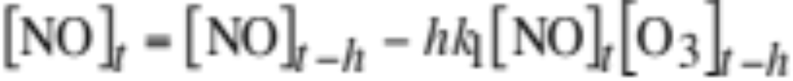
Backward Euler Solution to ODEs
Requirement for mass conservation of nitrogen (12.28)
Example of mass non-conservation of nitrogen (12.39)

Slide 18
Simple Exponential Solution to ODEs
Obtained by integrating a linearized first derivative.
Advantages
Always gives positive solutions to chemical ODEs
Easy to implement
Disadvantages
Requires a small time step for accuracy
Not mass conserving

Slide 19
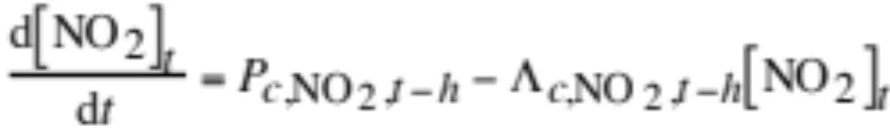
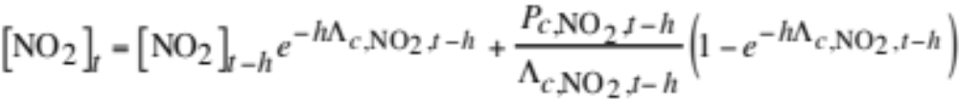
Simple Exponential Solution to ODEs
Linearized first derivative from backward Euler example (12.31)
Rewrite in terms of production and loss (12.43)
Integrate (12.44)

Slide 20
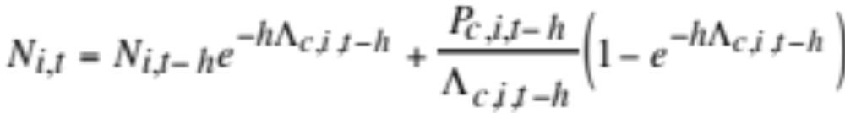

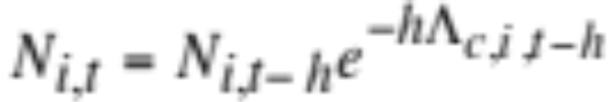
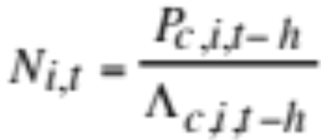
Simple Exponential Solution to ODEs
Generic solution (12.45)
When the implicit loss coefficient is zero (no loss term),
When the production term is zero,
When the implicit loss coefficient is large (short-lived species),
(steady state solution)

Slide 21
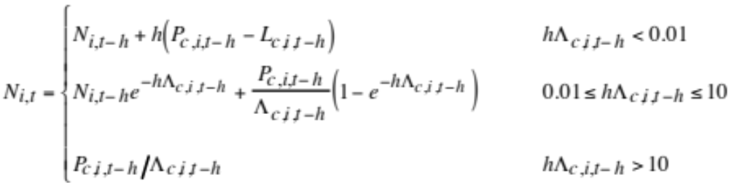
Quasi-Steady State Approximation
QSSA (12.46)
Use forward Euler for long-lived species
Use simple exponential for medium-lived species
Use steady-state solution for short-lived species

Slide 22
Multistep Implicit-Explicit (MIE) Solution
Premises:
The forward Euler and linearized backward Euler solutions converge to each other upon iteration.
Since the converged backward Euler is always positive, so is the converged forward Euler.
Since the converged forward Euler always conserves mass, so does the converged backward Euler
--> The MIE solution, which requires iteration, conserves mass and is positive definite.

Slide 23




Multistep Implicit-Explicit Solution
1) Set initial estimates to initial concentrations (12.49)
2) Set initial maximum estimates to initial values (12.50)
Maximum estimates are used to bound the backward Euler during the initial iteration steps.
3) Estimate reaction rates from backward-Euler values (12.51)
These equation apply for any iteration number m

Slide 24
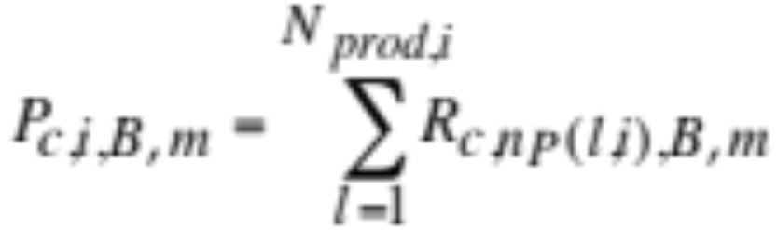
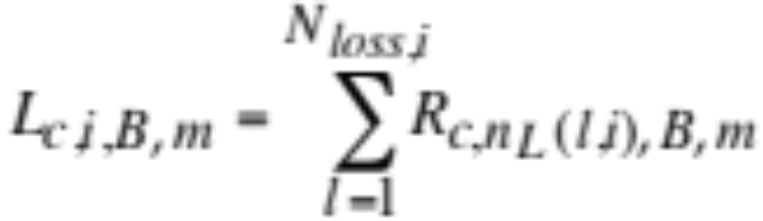
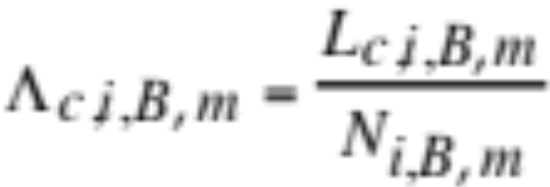
Multistep Implicit-Explicit Solution
4) Sum production, loss, implicit loss terms (12.53)
(12.55)
(12.57)

Slide 25
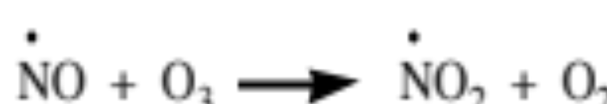
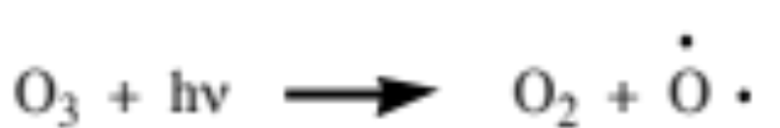
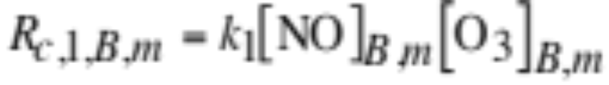
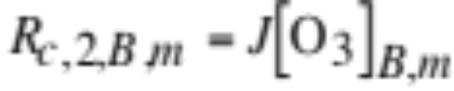
Multistep Implicit-Explicit Solution
Example reactions (12.47)
k₁
(12.48)
J
Estimate reaction rates. (12.52)

Slide 26
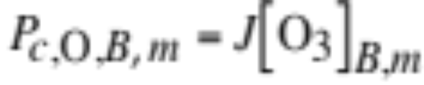
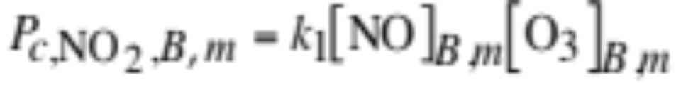
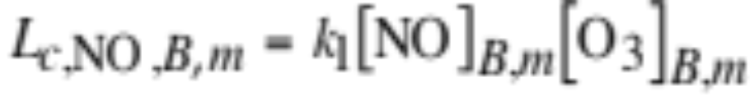
Multistep Implicit-Explicit Solution
Summed production terms (12.54)
Summed loss terms (12.56)

Slide 27
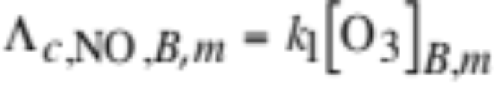
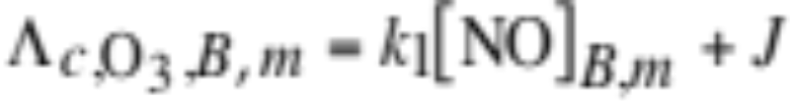
Multistep Implicit-Explicit Solution
Summed implicit loss coefficients (12.58)

Slide 28
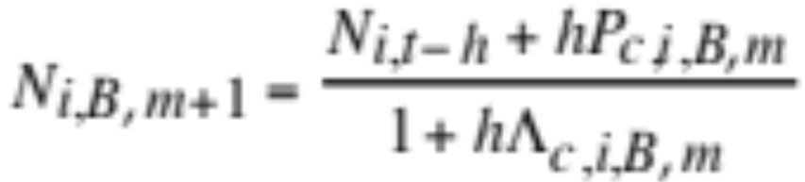
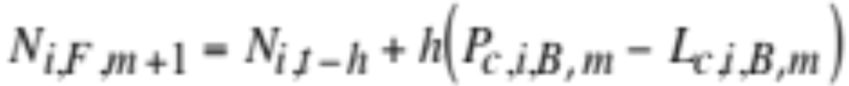
Multistep Implicit-Explicit Solution
5) Estimate concentrations with backward Euler (12.59)
6) Estimate concentrations with forward Euler (12.60)

Slide 29
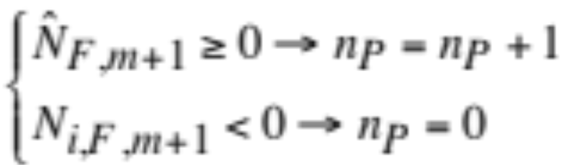
Multistep Implicit-Explicit Solution
7) Check convergence (12.61)
Method 1:
Each iteration, check whether all concentrations from forward Euler ≥ zero. If so, update a counter, n_{P} by 1. If one concentration < 0, reset n_{P} to 0.
When n_{P}=N_{P} (all concentrations from forward Euler exceed 0 for N_{P} iterations in a row), convergence has occurred
N_{P} = 5 for large sets of equations
= 30 for small sets of equations

Slide 30
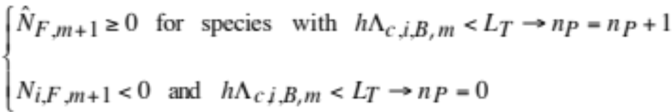
Multistep Implicit-Explicit Solution
7) Check convergence (12.62)
Method 2:
Each iteration, check whether all concentrations of medium- and long-lived species (those for which hL_{c,I,B,m}<L_{T}) from forward Euler ≥ zero. If so, update the counter n_{P} by 1. If one such concentration < 0, reset n_{P} to 0.
When n_{P}=N_{P}, convergence has occurred
L_{T} = 10²-10⁶

Slide 31
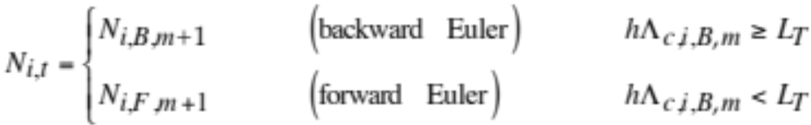
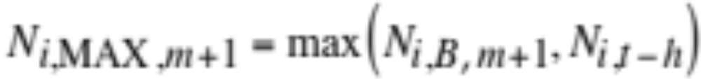
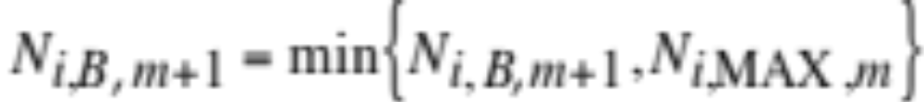
Multistep Implicit-Explicit Solution
8) Upon convergence, set final concentrations (12.63)
9a) Recalculate maximum for next iteration (12.64)
9b) Bound backward Euler for next iteration (12.65)
Note that this equation uses the MAX concentration from the previous iteration, not from the value just calculated.

Slide 32


Multistep Implicit-Explicit Solution
Demonstration that iterated forward Euler solutions converge to iterated backward Euler solutions and to positive numbers.
Converged backward Euler equation (12.66)
Converged forward Euler equation (12.64)
where
Thus, convergence of forward to backward Euler occurs when
which occurs upon iteration of backward Euler (12.68)

Slide 33

Convergence of Forward Euler (FE) to Backward Euler (BE) Upon Iteration
h = 10 seconds.
NO₂ and O₃ (molec. cm⁻³)
O (molec. cm⁻³)
Fig. 12.1

Slide 34

Comparison of MIE With Exact Solution
MIE solution (circles); exact solution (lines); h = 10 seconds.
Concentration (molec. cm⁻³)
Fig. 12.2

Slide 35

Effects of Time Step on MIE Solution
Time step sizes of 2, 10, 100, 500, and 1000 seconds are compared. Results in all cases are shown after 10,000 s.
No. of iterations required
Average error per species
Fig. 12.3

Slide 36




Gear’s Method
Discretize ODE time derivative over many past steps (12.69)
Rearrange for an individual species (12.70)
and for a set of species (12.70)
Set up predictor equation (12.71)

Slide 37





Gear’s Method
Simplify to (12.72)
where
(12.73)
Predictor matrix (12.77)
Jacobian matrix of partial derivatives (12.78)

Slide 38



Gear’s Method
Solve
for
then update concentration with (12.74)
Iterate until

Slide 39


Error Tests
Local error test (12.75)
Global error test (12.76)

Slide 40

Example Reactions and 1st Derivatives
Example reactions (12.79)
(12.80)
(12.81)

Slide 41




Example Reactions and 1st Derivatives
First derivatives of NO, NO₂, O, and O₃ (12.82)

Slide 42






Partial Derivatives
Partial derivatives of NO (12.83)
Partial derivatives of NO₂ (12.84)

Slide 43





Partial Derivatives
Partial derivatives of O (12.85)
Partial derivatives of O₃ (12.86)

Slide 44

Predictor Matrix
NO NO₂ O O₃
NO
NO₂
O
O₃
(12.87)

Slide 45

Substitute Partial Derivatives Into Predictor Matrix
NO NO₂ O O₃
NO
NO₂
O
O₃
(12.88)

Slide 46


Matrix Equation
(12.89)

Slide 47

Reordered Matrix
Place species with most partial derivatives at the bottom and fewest partial derivatives at the top of the matrix
(12.90)

Slide 48
Effect of Sparse-Matrix Reductions on Matrix Fill in and Number of Multiplies
1427 Gases, 3911 Reactions
Without With Percent
Quantity Reductions Reductions Reduction
Order of matrix 1427 1427 0
Initial fill-in 2,036,329 14,276 99.30
Final fill-in 2,036,329 17,130 99.16
Decomp. 1 967,595,901 47,596 99.995
Decomp. 2 1,017,451 9,294 99.09
Backsub. 1 1,017,451 9,294 99.09
Backsub. 2 1,017,451 6,409 99.37
Table 12.2

Slide 49
Vectorization of Inner Nested Loop
Vectorized inner loop
Nested Loop A
DO 105 NK = 1, NBIMOLEC
JSP1 = JPROD1(NK)
JSP2 = JPROD2(NK)
DO 100 K = 1, KTLOOP
TRATE(K,NK) = RRATE(K,NK) * CONC(K,JSP1)
* CONC(K,JSP2)
100 CONTINUE
105 CONTINUE

Slide 50
Vectorization of Inner Nested Loop
Non-vectorized inner loop
Nested Loop B
DO 105 K = 1, KTLOOP
DO 100 NK = 1, NBIMOLEC
JSP1 = JPROD1(NK)
JSP2 = JPROD2(NK) TRATE(K,NK) = RRATE(K,NK) * CONC(K,JSP1) * CONC(K,JSP2)
100 CONTINUE
105 CONTINUE

Slide 51


Stiffness Predictor
(12.91)
Number of backsubstitution calls as a function of the stiffness predictor. The more calls, the greater the stiffness of equations.
No. of backsubstitution calls
Fig. 12.4

Slide 52


Family Method
Organize short- and long-lived species into families, which are long-lived, solve for family concentration, then partition family concentrations into individual species concentrations
Odd oxygen family (12.92)
Odd hydrogen family (12.93)
Odd nitrogen family (12.94)
Odd chlorine family (12.95)

Slide 53




Family Method
Example of species cycling within odd oxygen family (12.96)

Slide 54





Solution with Family Method
(1) Calculate reaction rates and first derivatives of all species
(2) Sum production and loss terms of each family
(3) Apply forward Euler to family concentration
(4) Repartition species concentrations in the family
Example with 4 total species and 2 families (12.97)
Reactions in the system (12.98)
k_{a}
k_{b}
k_{c}

Slide 55




Solution with Family Method
First derivatives of A, B, C, and D (12.99)

Slide 56





Example Family Solution
First derivatives of each family as a whole (12.100)
Apply forward Euler to family concentration with (12.101)
For example, (12.102)

Slide 57


Partition Species in Family
Concentration of D equals second family concentration
Relate species to family concentration (12.103)

Slide 58





Repartitioning Species
Solve for A, B, and C, respectively (12.104)
Many ways to obtain partitioning ratios, and .

Slide 59




Estimating Partitioning Ratios
1) Assume each species in steady state (12.105)
---> Partitioning ratios of B and C are (12.106)

Slide 60



Estimating Partitioning Ratios
---> Final species concentrations (12.107)

Slide 61






Estimating Partitioning Ratios
2) First linearize the ODE of each species -- (12.108)
-- then integrate with simple exponential method -- (12.109)
---> plug results into partitioning ratios

Slide 62



Estimating Partitioning Ratios
3) First write each species ODE in finite difference form -- (12.110)

Slide 63

Estimating Partitioning Ratios
-- then rearrange finite difference equations into a matrix -- (12.111)
---> then solve the matrix for [A]_{t}, [B]_{t}, and [C]_{t} and plug results into partitioning ratios

Slide 64



Example
Add bimolecular reaction to the system
Linearized, finite difference forms of A, B, and C (12.112)
(12.113)
(12.114)

Slide 65

Example With Bimolecular Reaction
Resulting matrix (12.115)
---> then solve the matrix for [A]_{t}, [B]_{t}, and [C]_{t} and plug results into partitioning ratios

