Slide 1
Presentation Slides for
Chapter 11, Part 2 of
Fundamentals of Atmospheric Modeling 2nd Edition
Mark Z. Jacobson
Department of Civil & Environmental Engineering
Stanford University
Stanford, CA 94305-4020
jacobson@stanford.edu
March 28, 2005

Slide 2
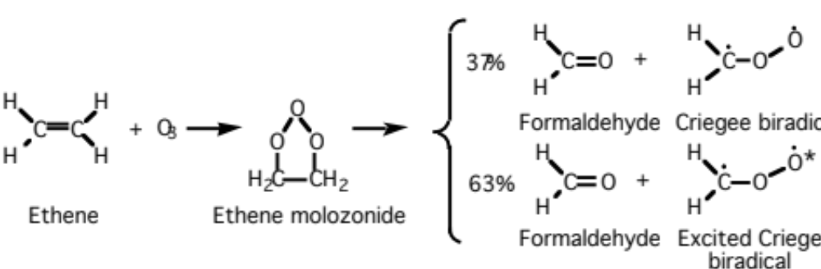
Alkene Reaction With Ozone
Ethene (11.89)

Slide 3
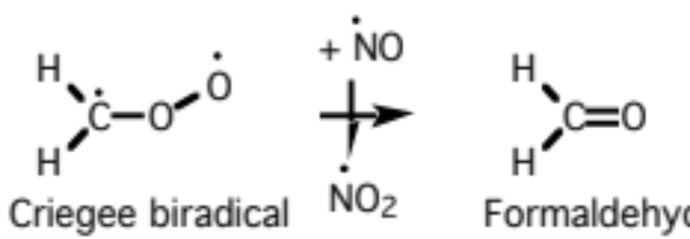
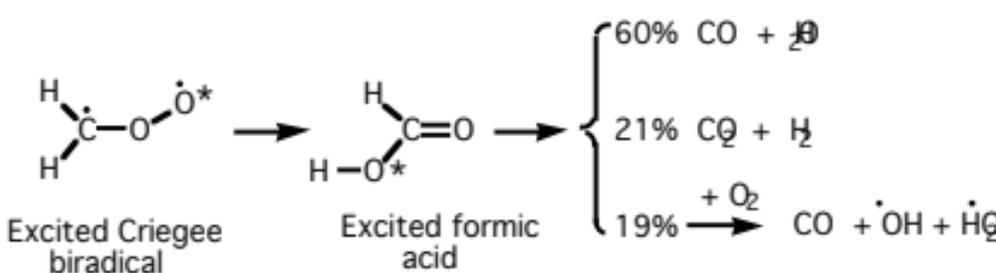
Alkene Reaction With Ozone
Criegee biradical reaction (11.90)
Excited criegee biradical decomposition (11.91)

Slide 4
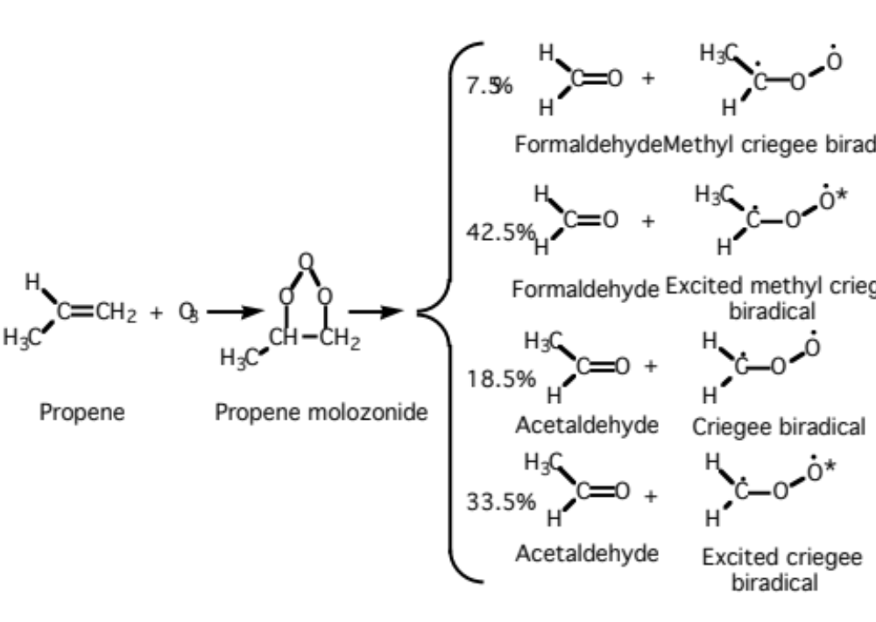
Alkene Reaction With Ozone
Propene (11.92)

Slide 5
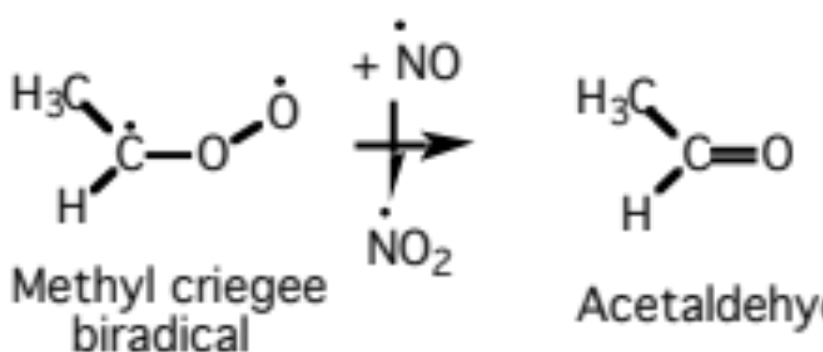
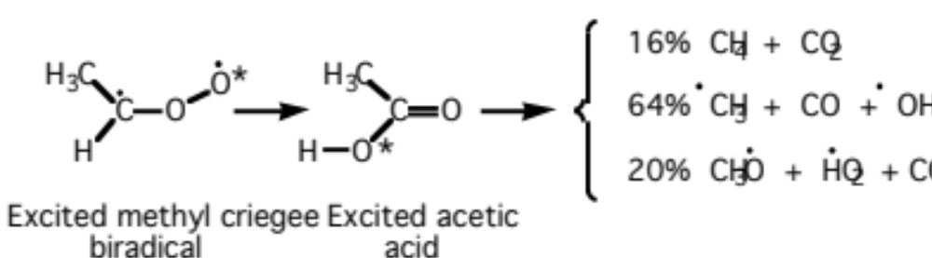
Alkene Reaction With Ozone
Methylcriegee biradical reaction (11.93)
Excited methylcriegee biradical decomposition (11.94)

Slide 6
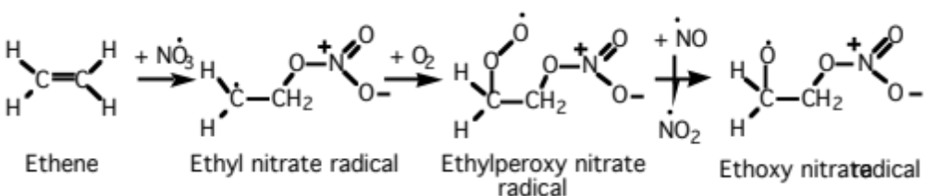
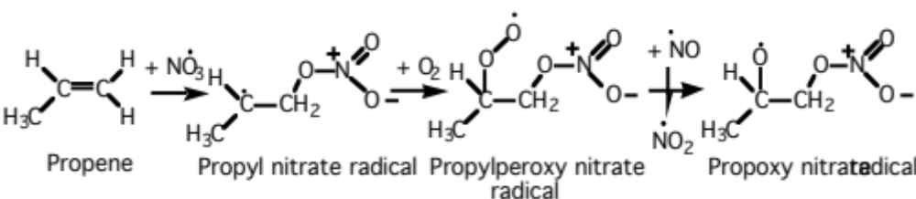
Alkene Reaction With Nitrate
Ethene --> nitrated organic radicals (11.95)
Propene --> nitrated organic radicals (11.96)

Slide 7
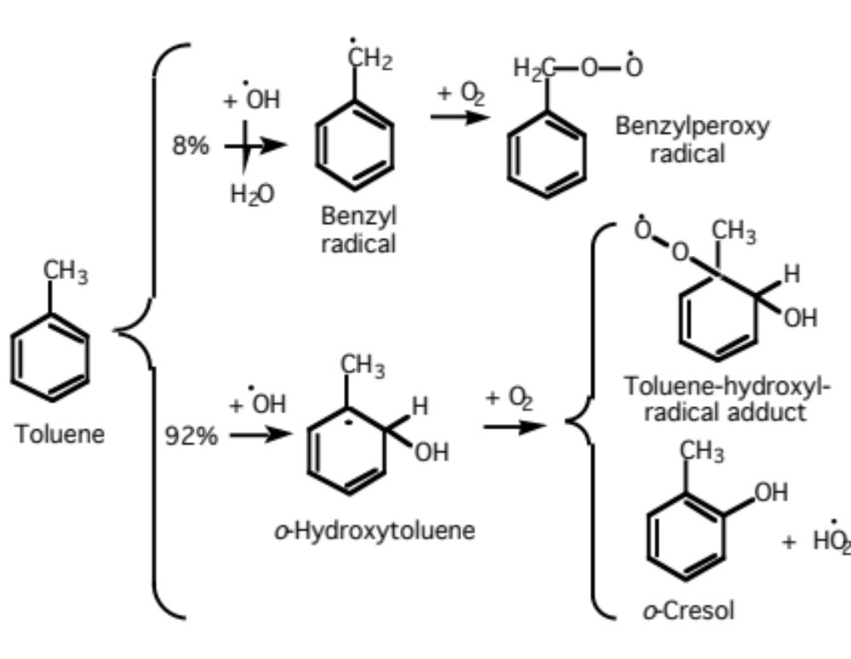
Aromatic Reaction With OH
Toluene oxidation (11.97)

Slide 8
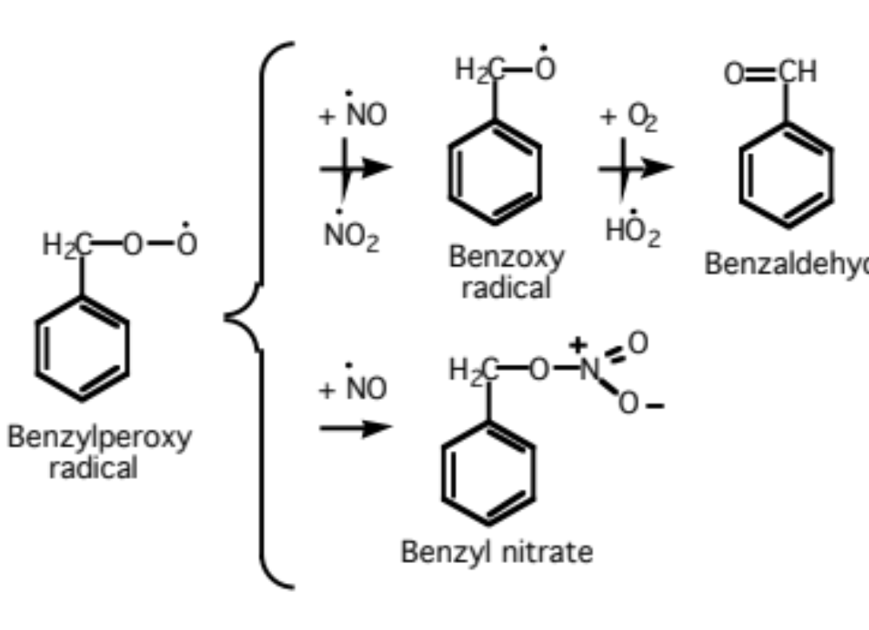
Aromatic Reaction With OH
Benzylperoxy radical reaction with NO (11.98)

Slide 9
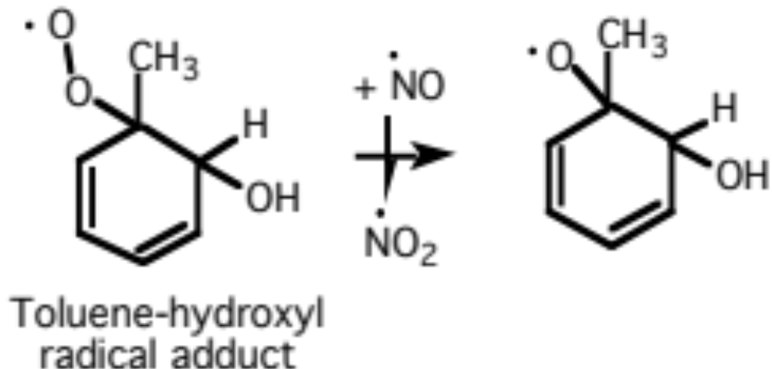
Aromatic Rxn With Hydroxyl Radical
Toluene-hydroxyl radical adduct reaction (11.99)

Slide 10
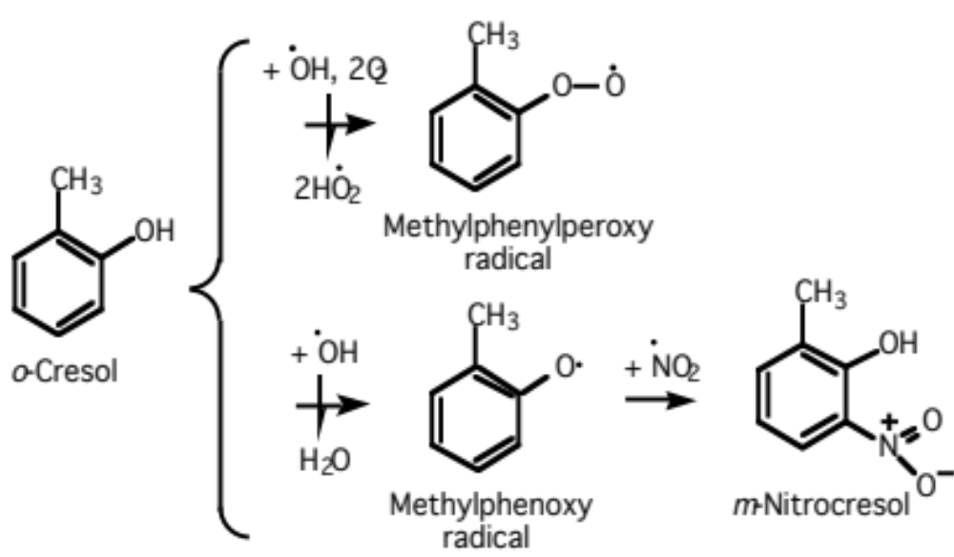
Fate of Cresol
Cresol --> methylphenylperoxy radical and nitrocresol (11.100)

Slide 11
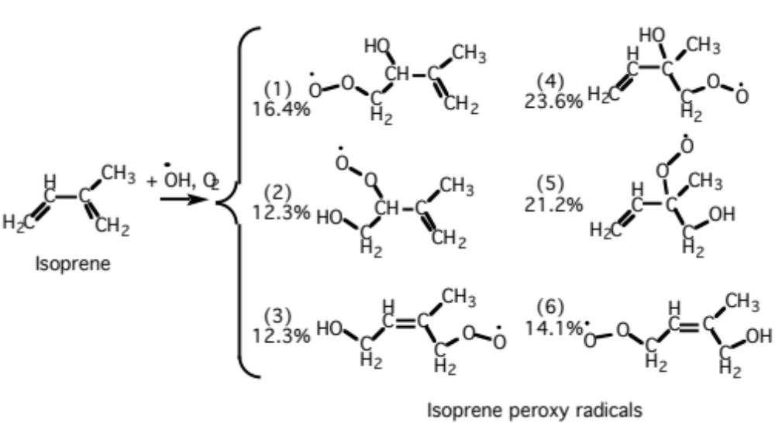
Isoprene Reaction With OH
(11.101)
All six products convert NO to NO₂

Slide 12
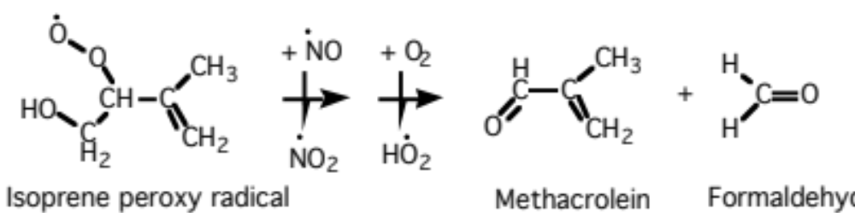
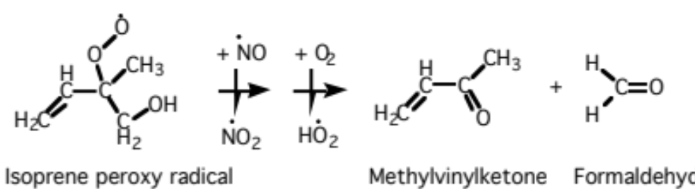
Fate of Isoprene Products
Methacrolein production via second product (11.102)
Methylvinylketone production via fifth product (11.103)

Slide 13
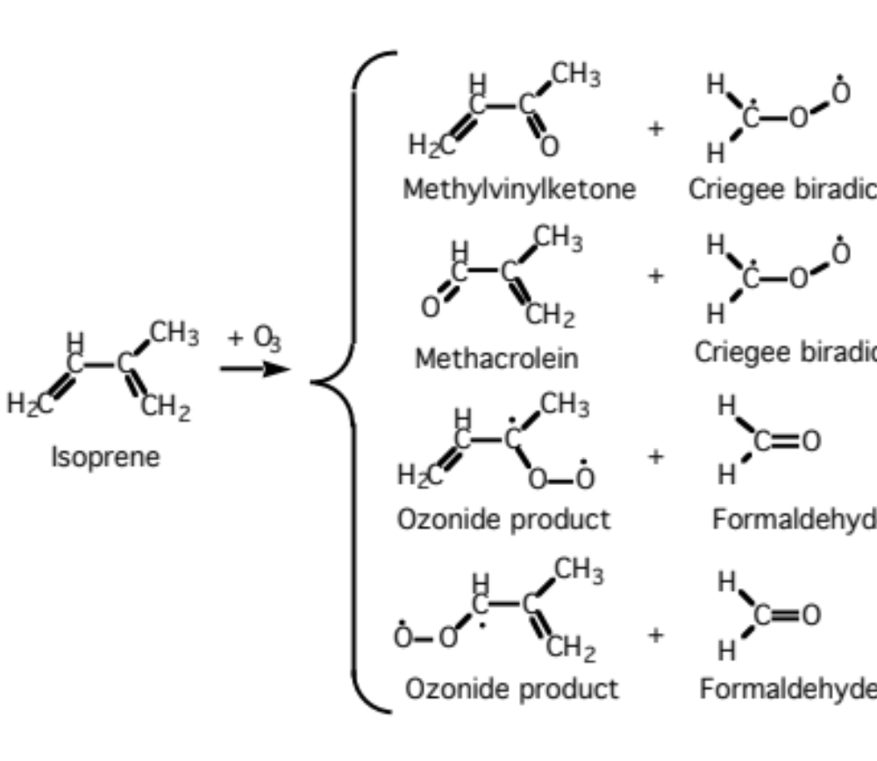
Isoprene Reaction With Ozone
(11.104)

Slide 14
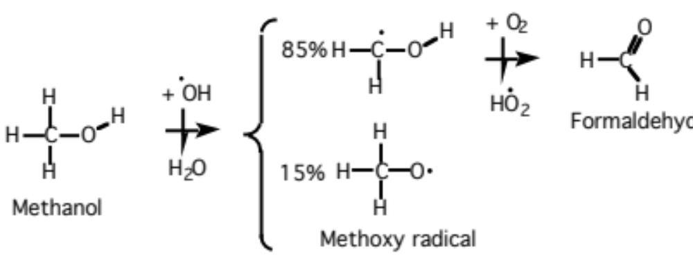
Alcohol Reactions
Methanol oxidation by OH (36-h lifetime) (11.105)

Slide 15
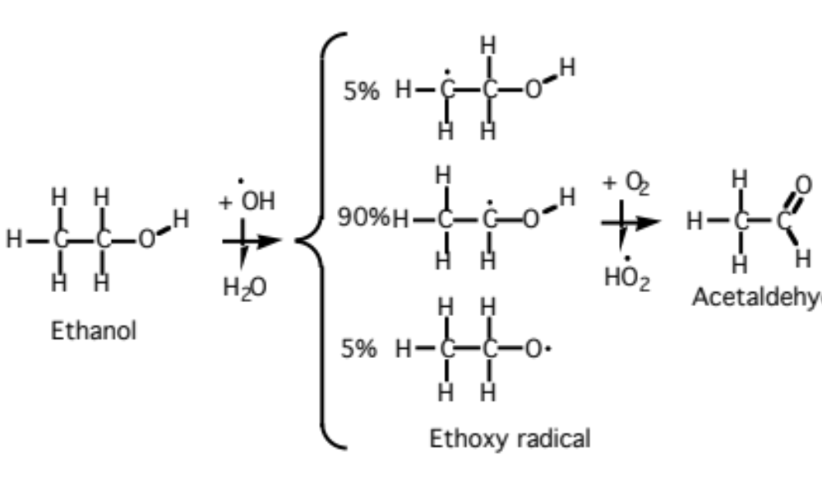
Alcohol Reactions
Ethanol oxidation by OH (10-h lifetime) (11.106)

Slide 16
Carbon Bond Lumping
Organic gases lumped into surrogate groups
PAR (paraffins) -- Single carbon atoms with a single-bond between them
OLE (olefins) -- Terminal carbon atom pair with a double-bond between the two atoms
ALD2 -- Non-terminal carbon atom pairs with a double bond attached to one of the carbons and terminal two-carbon carbonyl groups [C-C(=O)H]
KET -- Single carbon ketone groups (C=O)
TOL (toluene) -- 7-carbon aromatics
XYL (m-xylene) -- 8-carbon aromatics
ISOP (isoprene) -- Terpenes
UNR -- Unreactive

Slide 17
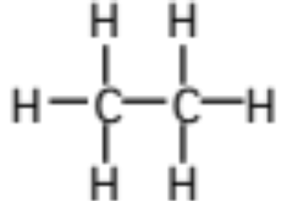
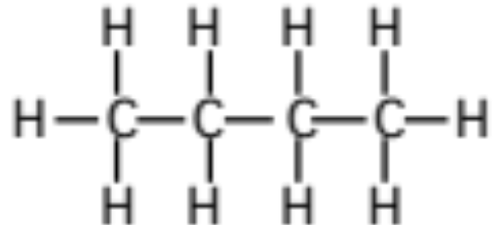
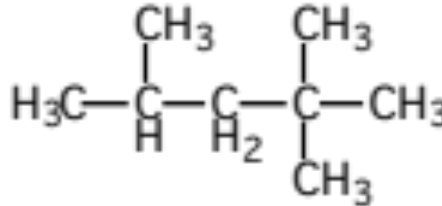
Carbon Bond Lumping
Ethane : 0.4 PAR + 1.6 UNR
n-Butane : 4 PAR
2,2,4-Trimethylpentane : 8 PAR
Table 11.7

Slide 18
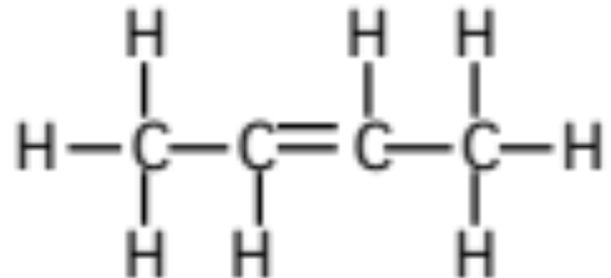
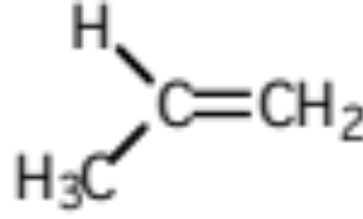
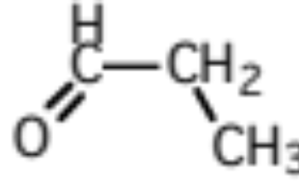
Carbon Bond Lumping
Trans-2-butene : 2 ALD2
Propene : 1 PAR + 1 OLE
Propionaldehyde : 1 PAR + 1 ALD2
Table 11.7

Slide 19
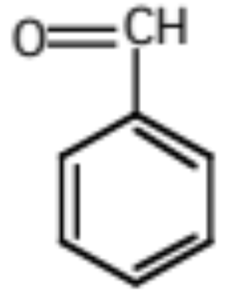
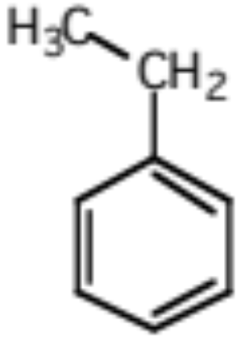
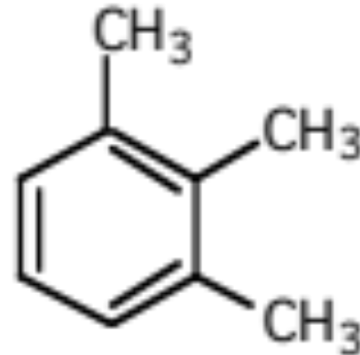
Carbon Bond Lumping
Benzaldehyde : 1 ALD2 + 5 UNR
Ethylbenzene : 1 PAR + 1 TOL
1,2,3-Trimethylbenzene : 1 PAR + 1 XYL
Table 11.7

Slide 20
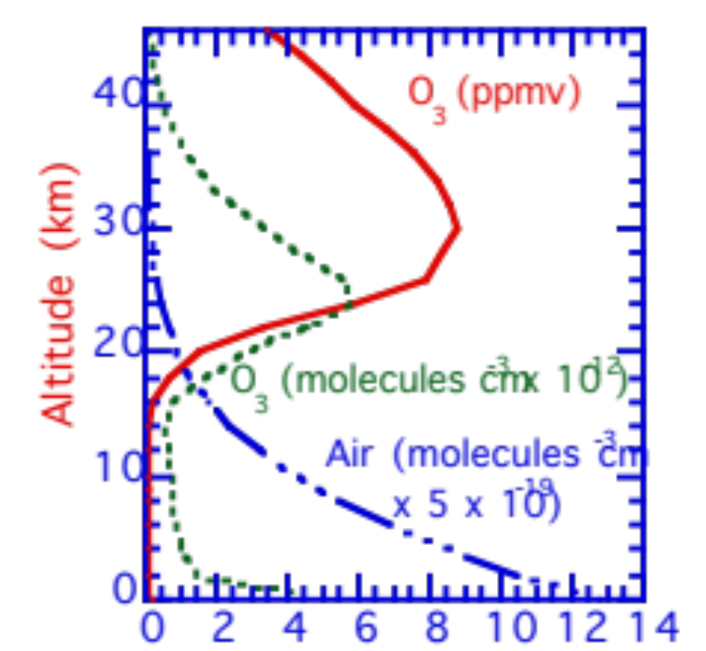
Vertical Profile of Ozone
Altitude (km)
Fig. 11.3

Slide 21
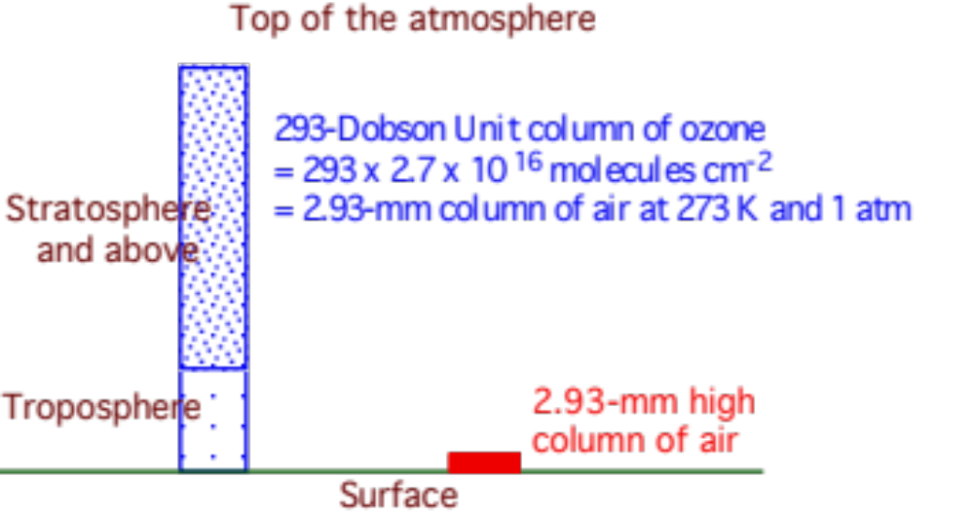
Column Abundance of Ozone
Fig. 11.4

Slide 22
Stratospheric Chemistry
Ozone mixing ratios
stratosphere ≈ 10 ppmv
free troposphere ≈ 40 ppbv
urban air ≈ 0.05 - 0.3 ppmv
Ozone production in the stratosphere
Oxygen photolysis (11.107-8)

Slide 23
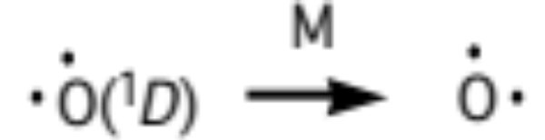
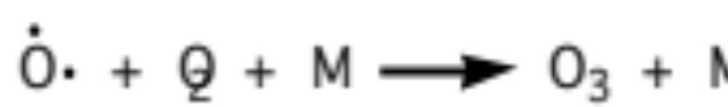
Stratospheric Chemistry
Natural ozone formation (11.110)
(11.109)
Ozone photolysis (11.111)
(11.112)

Slide 24
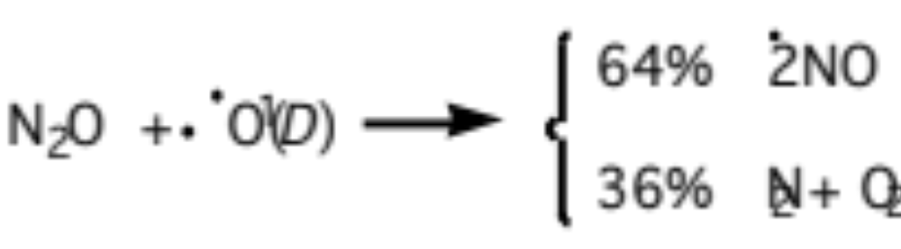
Natural Ozone Destruction by NO_{x}
Nitrous oxide reaction: 10% of N₂O destruction (11.113)
Nitrous oxide photolysis: 90% of N₂O destruction (11.114)

Slide 25
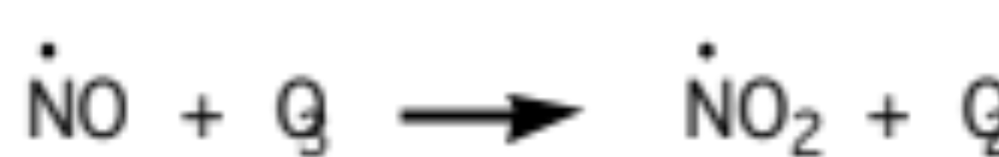
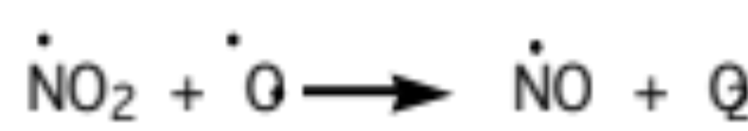
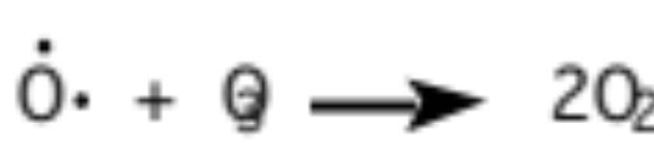
Natural Ozone Destruction by NO_{x}
NO catalytically destroys ozone in upper stratosphere (11.115-7)

Slide 26
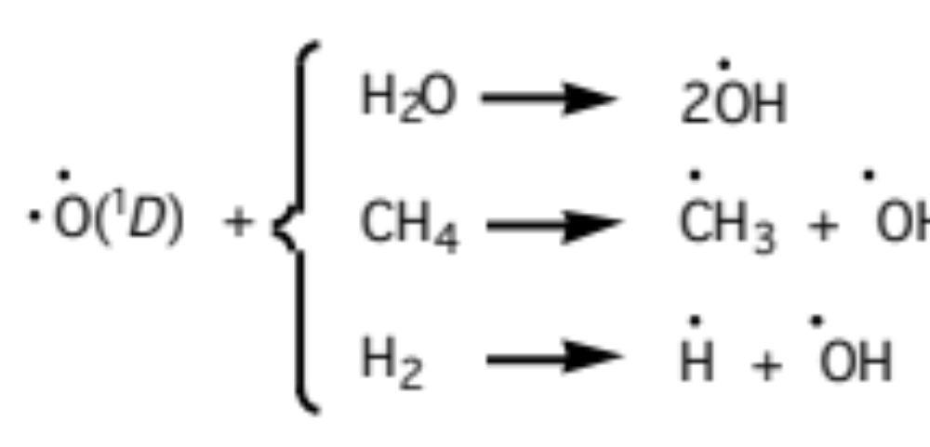
Natural Ozone Destruction by HO_{x}
Hydroxyl radical formation in stratosphere (11.115)

Slide 27
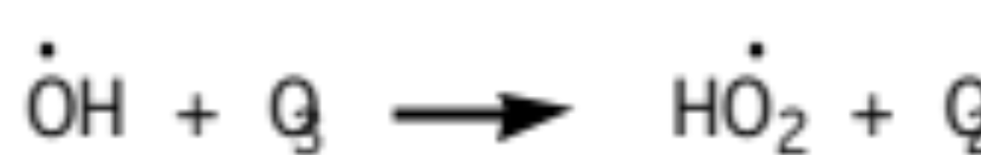
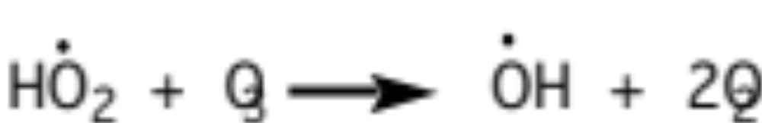
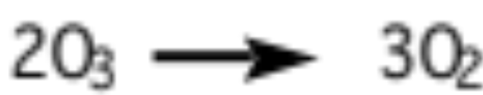
Natural Ozone Destruction by HO_{x}
OH catalytically destroys ozone in lower stratosphere (11.121-3)

Slide 28
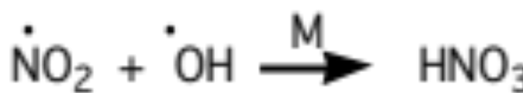
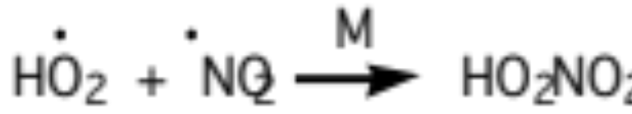
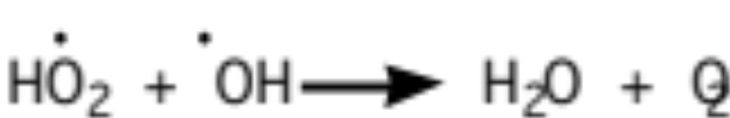
Removal of HO_{x} and NO_{x}
(11.118)
(11.119)
(11.124)
Nitric acid and peroxynitric acid photolysis are slow

Slide 29
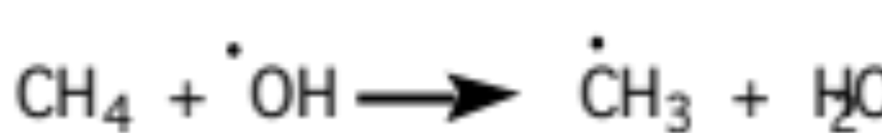
Stratospheric Source of Water Vapor
(11.125)

Slide 30
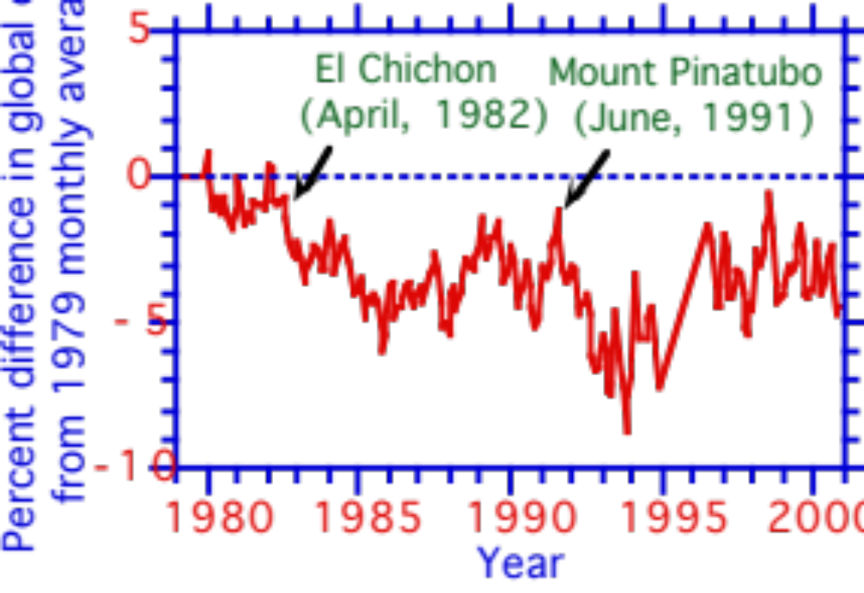
Changes in Monthly-Averaged Global Ozone From 1979-2001
Percent difference in global ozone
from 1979 monthly average
Fig. 11.5

Slide 31
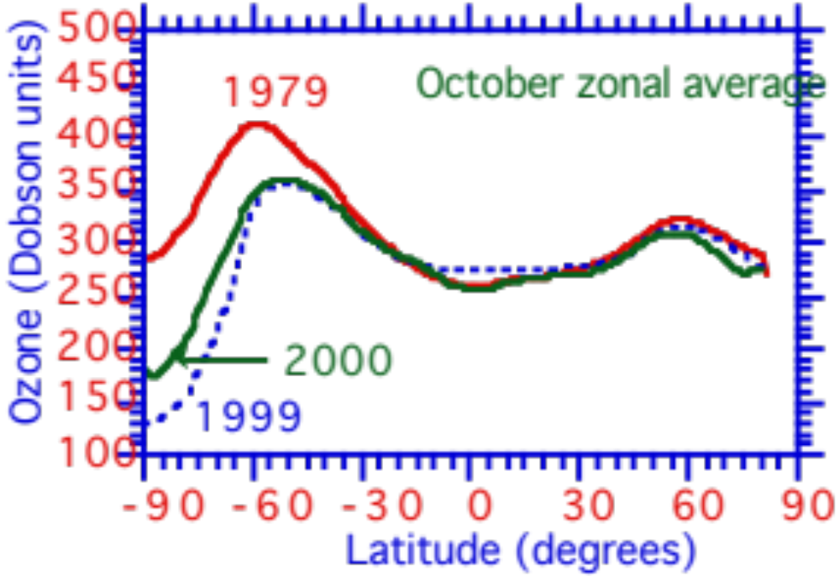
Variation with Latitude of October Zonally-Averaged Ozone in ‘79, ‘99, ‘00
Ozone (Dobson units)
Fig. 11.6

Slide 32
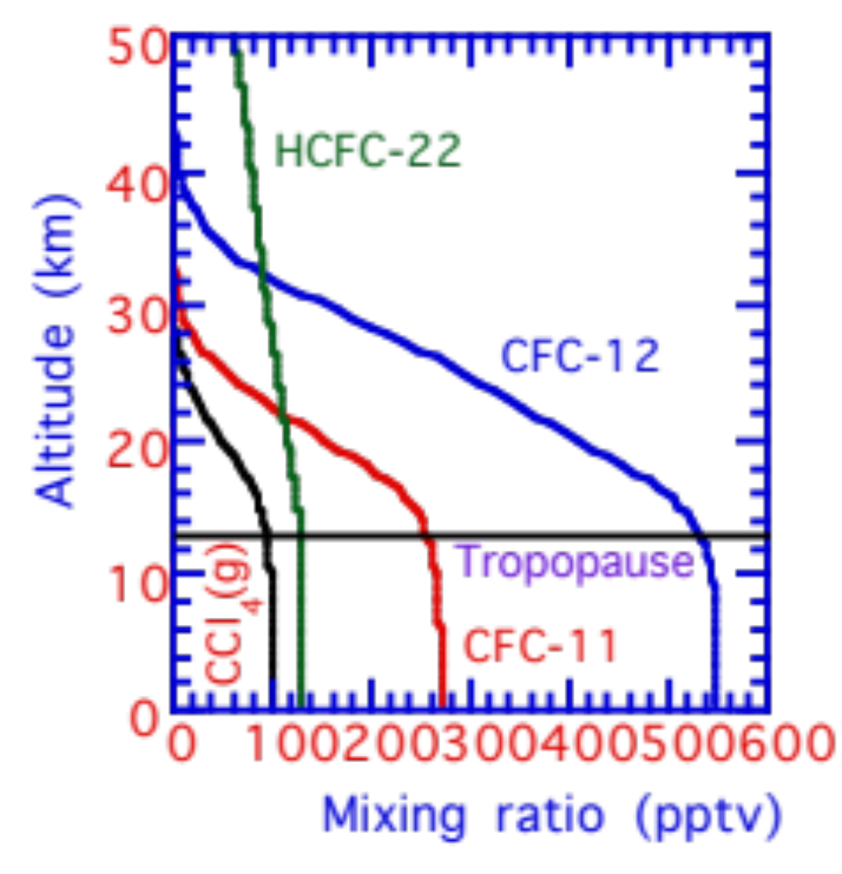
Variation with Altitude of CFCs and Other Chlorinated Compounds
Altitude (km)
Fig. 11.7

Slide 33
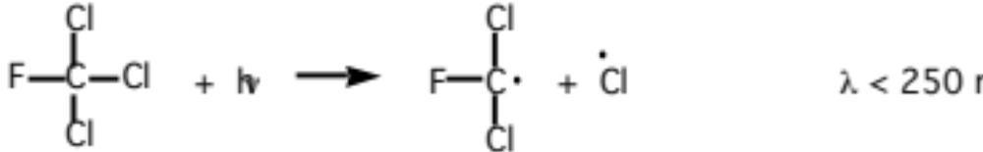
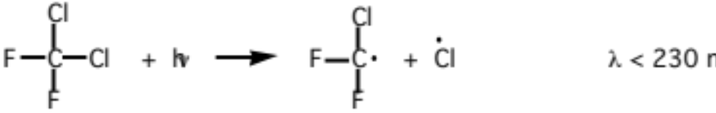
Variations With Altitude of CFCs and Other Chlorinated Compounds
Photolysis of chlorinated compounds above 20 km (11.126)
(11.127)

Slide 34
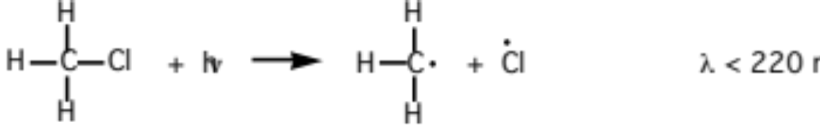
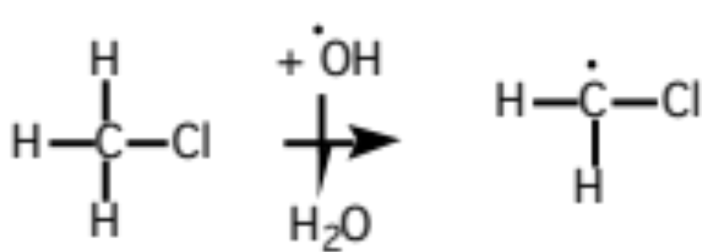
Natural Sources of Chlorine
Methyl chloride photolysis (11.130)
Methyl chloride scavenging by hydroxyl radical (11.128)

Slide 35
Chlorine Emission to Stratosphere
Chemical Percent emission to stratosphere
Anthropogenic sources
CFC-12 (CF₂Cl₂) 28
CFC-11 (CFCl₃) 23
Carbon tetrachloride (CCl₄) 12
Methyl chloroform(CH₃CCl₃) 10
CFC-113 (CFCl₂CF₂Cl) 6
HCFC-22 (CF₂ClH) 3
Natural sources
Methyl chloride (CH3Cl) 15
Hydrochloric acid (HCl) 3
Total 100
WMO (1994)

Slide 36


Ozone Destruction by Chlorine
Chlorine catalytic ozone destruction cycle (11.130)
(11.131)
(11.132)
Only 1% of chlorine is typically active as Cl or ClO

Slide 37


Conversion of Active Chlorine to Reservoirs
Conversion of Cl and ClO (11.133)
(11.134)

Slide 38


Conversion of Reservoirs to Active Chlorine
HCl reservoir leaks (11.135)
ClONO₂ reservoir leaks

Slide 39

Ozone Destruction by Bromine
CH₃Br = methyl bromide (produced biogenically in the oceans and anthropogenically as soil fumigant)
Photolysis of methyl above 20 km (11.137)

Slide 40


Ozone Destruction by Bromine
Catalytic ozone destruction by bromine (11.138-40)

Slide 41


Conversion of Active Bromine to Reservoirs
Conversion of Br and BrO (11.141)
(11.142)

Slide 42


Conversion of Reservoirs to Active Bromine
HBr and BrONO₂ reservoir leaks (11.143)

Slide 43

Change in Size of Antarctic Ozone Hole
Ozone minimum (Dobson units)
Ozone hole area (10⁶ km²)
Fig. 11.8

Slide 44
Polar Stratospheric Cloud Reactions
Type I Polar Stratospheric Clouds (PSCs)
nitric acid and water
temperature of formation < 195 K
diameter ≈ 0.01 - 3 μm
number concentration ≈ 1 particle cm⁻³
Type II Polar Stratospheric Clouds
Water ice
temperature of formation < 187 K
diameter ≈ 1 - 100 μm
number concentration ≈ 0.1 particle cm⁻³

Slide 45
Polar Stratospheric Cloud Reactions
Reactions on Polar Stratospheric Cloud Surfaces (11.145-9)

Slide 46


Surface Reaction Rates
First-order rate coefficient (s⁻¹) (11.150)
Thermal speed of impinging gas (cm s⁻¹) (11.151)

Slide 47
Reaction Probabilities
Fractional loss of a species from the gas phase due to reaction with a particle surface. Accounts for diffusion of the gas to the surface and reaction with the surface.
Reaction Probability
Reaction Type I PSC Type II PSC
ClONO₂(g) + H₂O(a) 0.001 0.3
ClONO₂(g) + HCl(a) 0.1 0.3
N₂O₅(g) + H₂O(a) 0.0003 0.01
N₂O₅(g) + HCl(a) 0.003 0.03
HOCl(g) + HCl(a) 0.1 0.3
Table 11.9

Slide 48
Polar Ozone Destruction
Cl₂ and HOCl photolysis in early spring (11.161-2)
Chlorine nitrite photolysis in early spring (11.163)

Slide 49




Polar Ozone Destruction
Catalytic ozone destruction by dimer mechanism (11.164-7)

Slide 50



Polar Ozone Destruction
A second catalytic cycle that involves bromine (11.169-72)

Slide 51


Conversion of Cl Reservoirs to Active Cl
Fig. 11.9

Slide 52

Ozone Regeneration
Change in globally-averaged ozone column abundance during two global model simulations in which all ozone was initially removed and chlorine was present and absent, respectively.
Average global ozone column
(Dobson units)
Fig. 11.10

Slide 53


Regeneration of Ozone Vertical Profile
Time-evolution of modeled profile of ozone (a) mixing ratio and (b) number concentration at 34ºN latitude, starting with zero ozone.
Altitude (km)
Altitude (km)
Fig. 11.11

