Slide 1
Presentation Slides for
Chapter 11, Part 1 of
Fundamentals of Atmospheric Modeling 2nd Edition
Mark Z. Jacobson
Department of Civil & Environmental Engineering
Stanford University
Stanford, CA 94305-4020
jacobson@stanford.edu
March 21, 2005

Slide 2
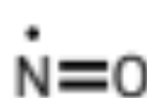

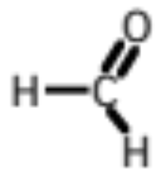
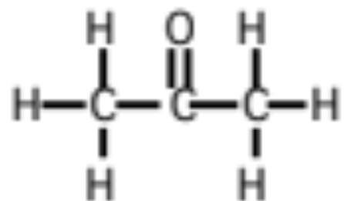
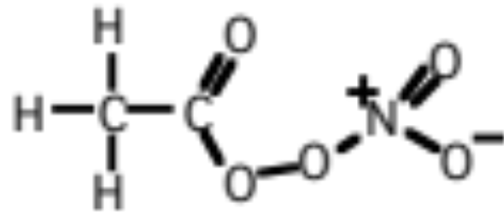
Types of Gases
Inorganic gases
Contain O, N, S, Cl, Br, and maybe H or C, but not both
Nitric oxide --
Carbon dioxide --
Organic gases
Contain both H and C, but may also contain other atoms
Formaldehyde --
Acetone --
Peroxyacetylnitrate --

Slide 3
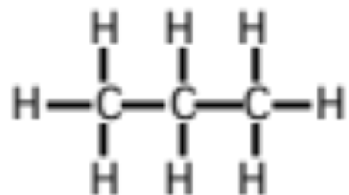
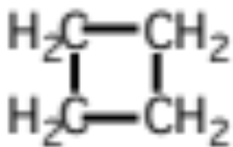
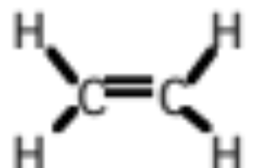
Hydrocarbons
Organic gases that contain only hydrogen and carbon
Alkanes - Carbons bonded by a single bond
Propane --
Cycloalkanes - A ring of alkanes
Cyclobutane --
Alkenes - Carbons bonded by a double bond
Ethene (ethylene) --

Slide 4
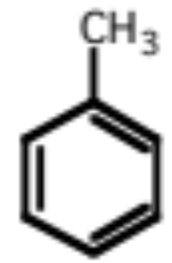
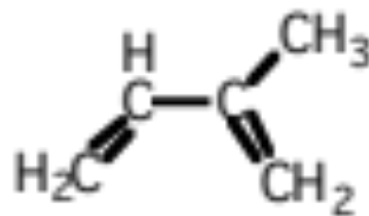
Hydrocarbons
Aromatics - Carbons that form a benzene ring
Toluene --
Terpenes - Biogenic hydrocarbons
Isoprene --

Slide 5
Definitions
Non-methane hydrocarbons (NMHC)
Hydrocarbons, except for methane
Oxygenated hydrocarbons
Hydrocarbons with oxygenated functional groups, such as aldehydes, ketones, alcohols, acids, and nitrates, added to them
Reactive organic gas (ROG)
The sum of oxygenated hydrocarbons and NMHC
Total organic gas (TOG)
The sum of ROG and methane

Slide 6
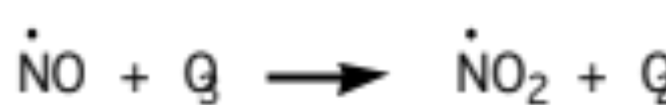
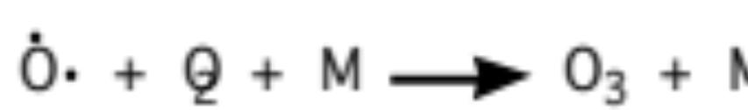
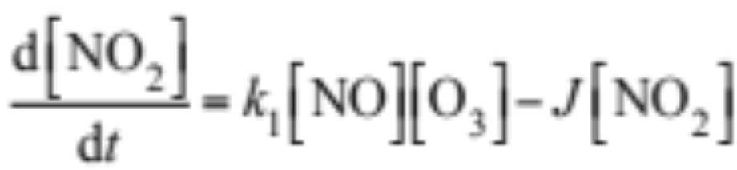
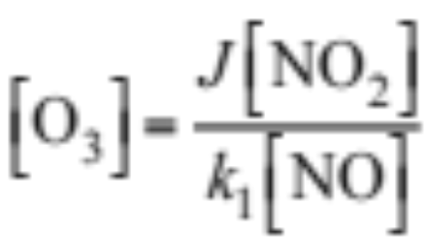
Photostationary State Relationship
(11.1)
(11.2)
(11.3)
Time rate of change of nitrogen dioxide (11.4)
Steady state --> photostationary state relationship (11.5)

Slide 7
Photostationary State Relationship
Example 11.1:
Estimate ozone mixing ratio when
p_{a} = 1013 hPa T = 298 K
χ_{NO} = 5 pptv χ_{NO2} = 10 pptv
k₁ = 1.8x10⁻¹⁴ cm³ molec.⁻¹ s⁻¹ J = 0.01 s⁻¹
Solution:
[O₃] = 1.1x10¹² molec. cm⁻³
N_{d} = 2.46 x 10¹⁹ molec. cm⁻³
χ_{O3} = 44.7 ppbv

Slide 8
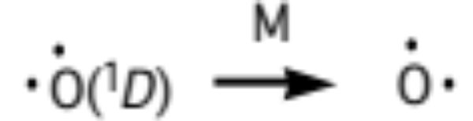
Other Reactions Affecting Ozone
Photodissociation of ozone (11.6)
(11.7)
Conversion of excited to ground-state atomic oxygen (11.8)

Slide 9
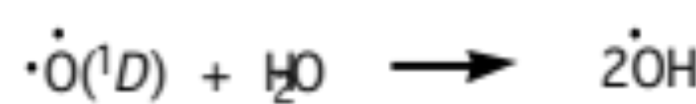
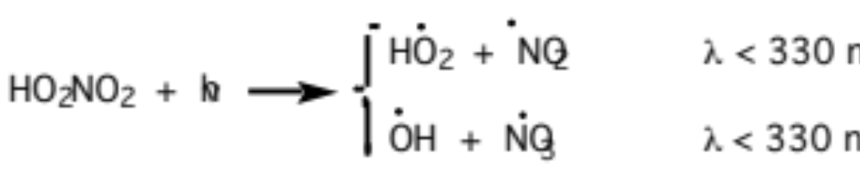
Hydroxyl Radical Sources
Major (11.9)
Minor (11.10-13)

Slide 10
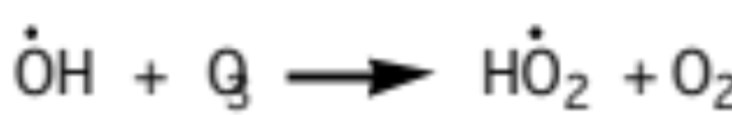
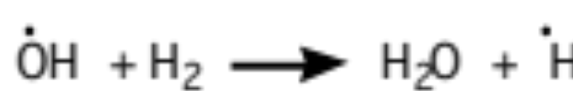
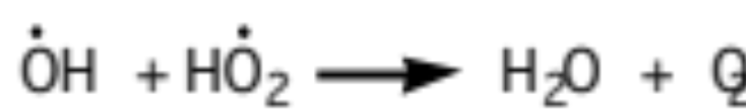
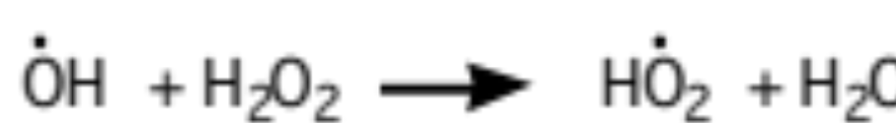
Scavenging by Hydroxyl Radical
(11.14-17)

Slide 11
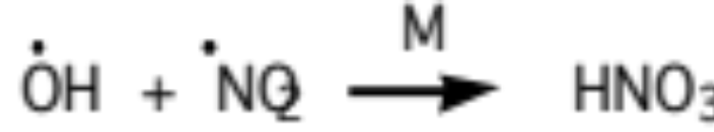
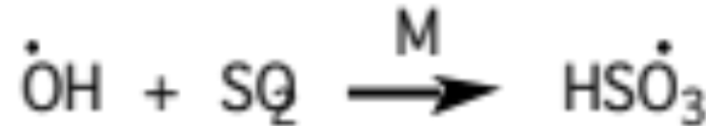
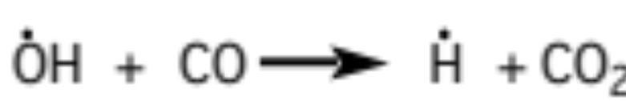
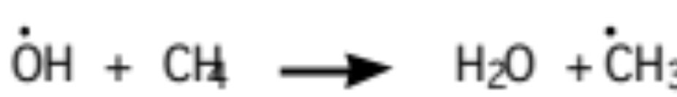
Scavenging by Hydroxyl Radical
(11.19-23)

Slide 12
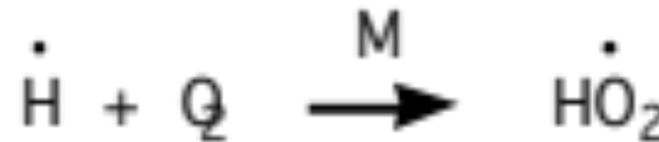
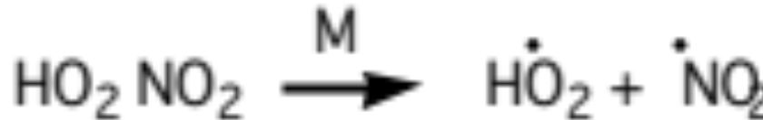
Hydroperoxy Radical Production
(11.27)
(11.28)

Slide 13
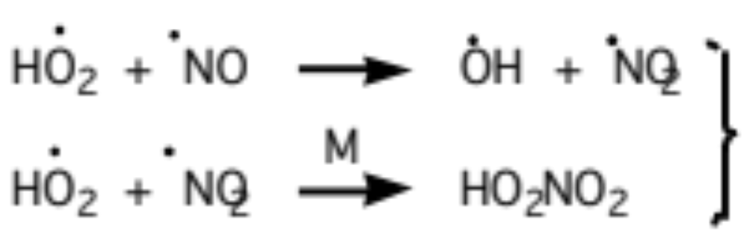
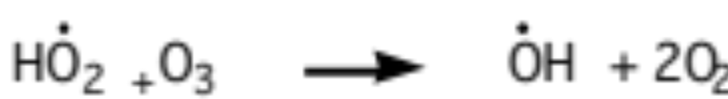
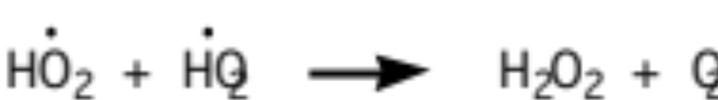
Hydroperoxy Radical Loss
Hyrdoxyl radical reactions in presence of NO (11.29)
(NO > 10 pptv)
(11.30)
(NO 3-10 pptv)
(11.31)
(NO < 3 pptv)

Slide 14
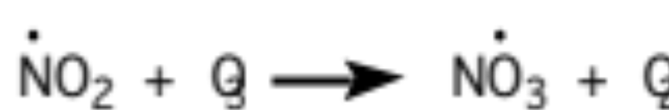
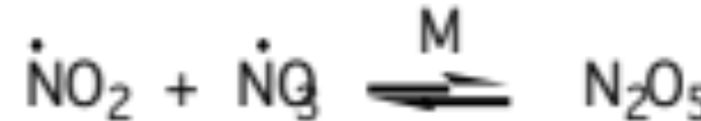
Nighttime Nitrogen Chemistry
Production of nitrate radical (11.32)
Dinitrogen pentoxide formation / decomposition (11.33)

Slide 15
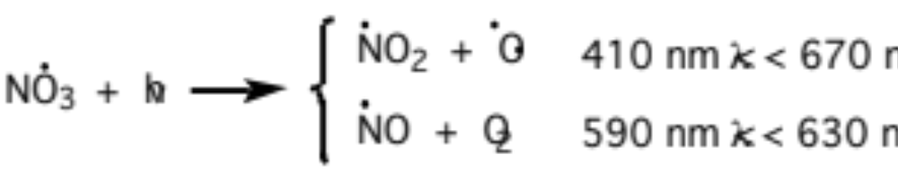
Nighttime Nitrogen Chemistry
Dinitrogen pentoxide reaction (11.34)
Morning photolysis (11.36)
Morning nitrate radical photolysis (lifetime of minutes) (11.35)

Slide 16
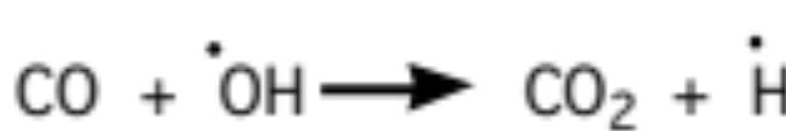
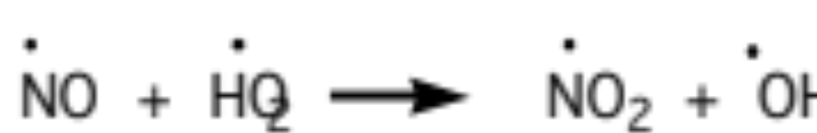
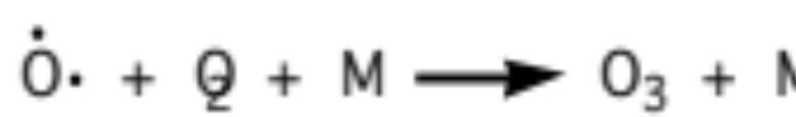
Ozone From Carbon Monoxide
(11.37-41)

Slide 17
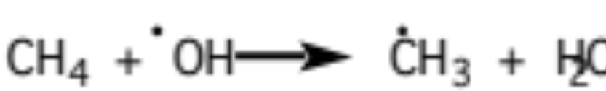
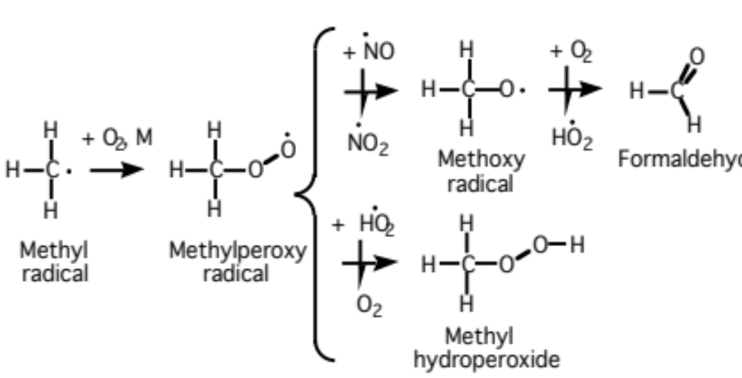
Ozone Formation From Methane
(11.42)
(11.43)
(11.40)
(11.41)

Slide 18
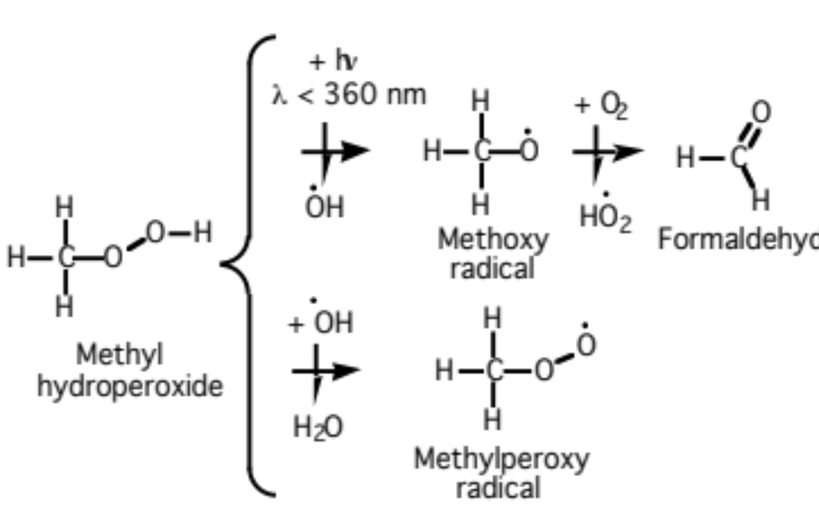
Methyl Hydroperoxide Decomposition
(11.44)

Slide 19
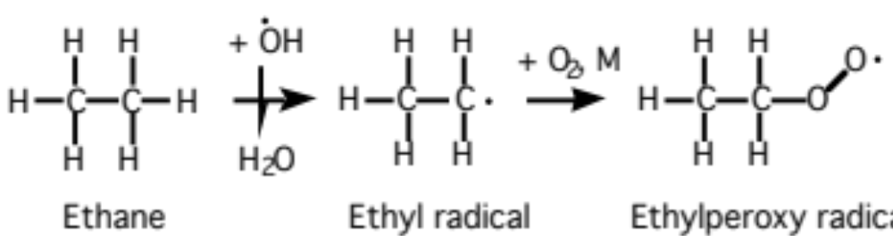
Ethane Oxidation
Methylperoxy radical production and loss (11.45)

Slide 20
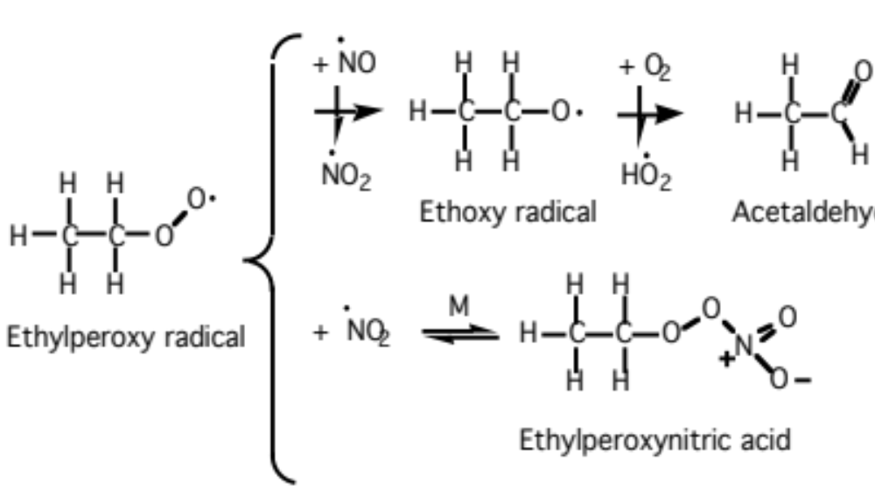
Ethane Oxidation
(11.46)

Slide 21
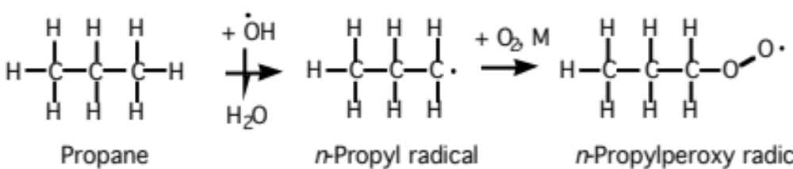
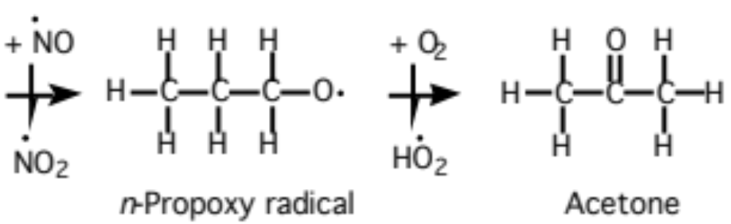
Propane Oxidation
Methylperoxy radical production and loss (11.47)

Slide 22
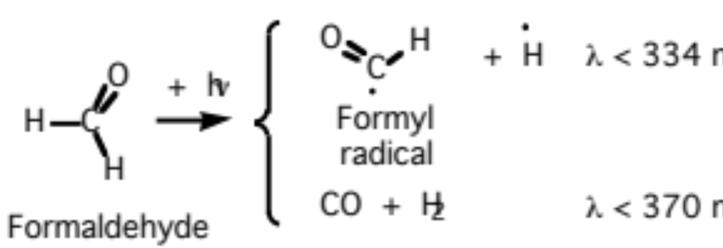
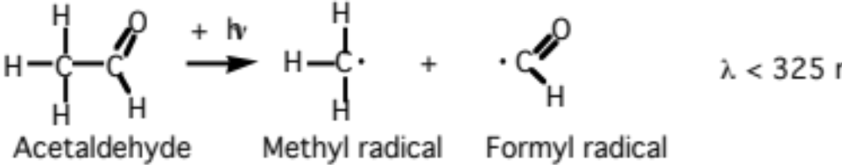
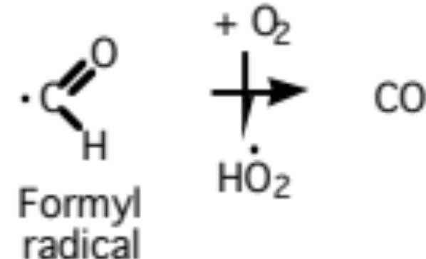
Formaldehyde/Acetaldehyde Photolysis
Formaldehyde (11.48)
Acetaldehyde (11.49)
Eormyl radical (11.50)

Slide 23
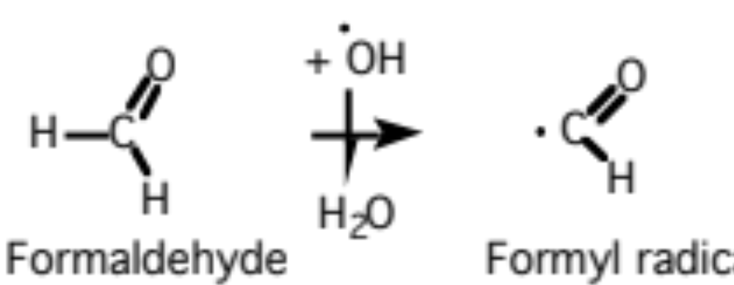
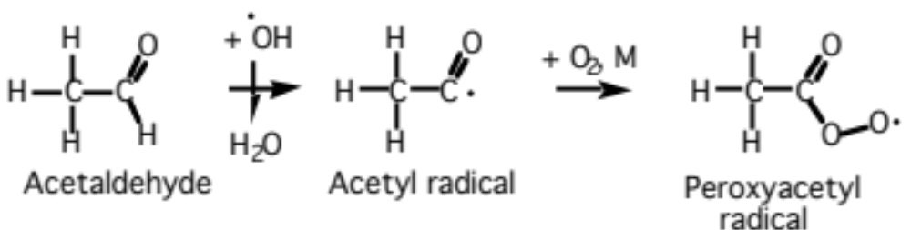
Formaldehyde/Acetaldehyde Reaction
Formaldehyde (11.51)
Acetaldehyde (11.52)

Slide 24
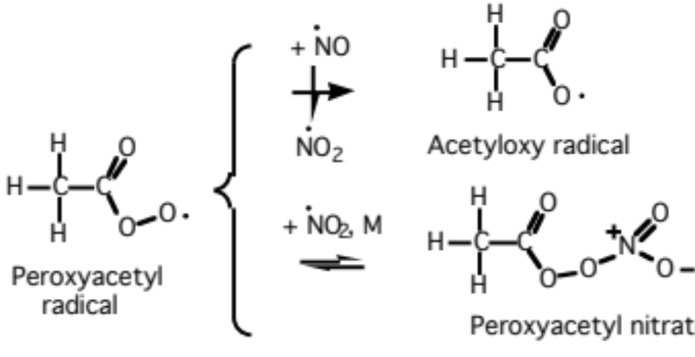
Formaldehyde/Acetaldehyde Reaction
PAN formation (11.53)

Slide 25
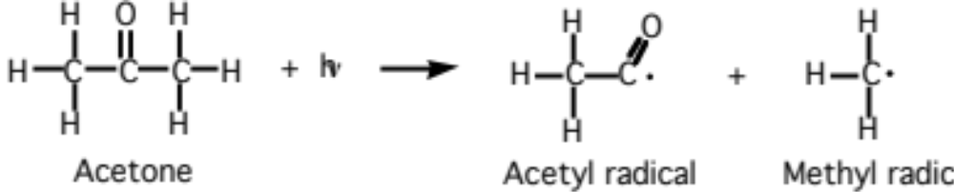
Acetone Photolysis
(11.55)

Slide 26
Sulfur Photochemistry
Biogenic sulfur
H₂S -- hydrogen sulfide
CH₃SH -- methyl sulfide
CH₃SCH₃ -- dimethyl sulfide (DMS)
CH₃SSCH₃ -- methyl disulfide
Volcanic sulfur
CS₂ -- carbon disulfide
OCS -- carbonyl sulfide
SO₂ -- sulfur dioxide
H₂S -- hydrogen sulfide

Slide 27
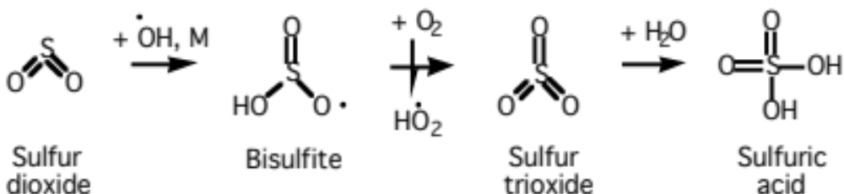
Sulfur Photochemistry
Sulfuric acid formation from sulfur dioxide (11.74)

Slide 28


DMS Abstraction Pathway
Sulfur dioxide production from dimethyl sulfide (DMS) (11.56)

Slide 29

DMS Abstraction Pathway
Methanethiolate radical reaction (11.57)

Slide 30

DMS Abstraction Pathway
Methanethiolate oxy radical reaction (11.58)

Slide 31


DMS Abstraction Pathway
Sulfur dioxide production from sulfur oxide (11.59)
Sulfur dioxide production from sulfur oxide (11.60)

Slide 32

DMS Addition Pathway
Methanethiolate oxy radical reaction (11.61)

Slide 33

DMS Addition Pathway
Methanesulfenic acid oxidation (11.62)

Slide 34


DMDS Reaction
OH addition (11.63)
Photolysis (11.64)

Slide 35


Biogenic Sulfur
Hydrogen sulfide oxidation (11.65)
Hydrogen sulfide radical reaction (11.66)
Sulfur dioxide production from sulfur oxide (11.59)

Slide 36



Volcanic Sulfur
Sulfur monoxide production from carbonyl sulfide (11.68)
(11.69)
(11.70)

Slide 37



Volcanic Sulfur
Sulfur oxide production from carbon disulfide (11.71)
(11.72)
(11.73)

Slide 38



Urban Photochemistry
Ozone production in smog (11.75-8)

Slide 39

Ozone Isopleth
0.32
0.08
0.24
NO_{x} (ppmv)
0.16
Contours are ozone (ppmv)
Fig. 11.1

Slide 40

Sea Breeze
Wind speed (m s⁻¹)
Fig. 11.2

Slide 41


Source/Receptor Regions in Los Angeles
Volume mixing ratio (ppmv)
Volume mixing ratio (ppmv)
Fig. 11.2

Slide 42
Daily Los Angeles Emission (1987)
Gas Emission (tons/day) Percent of total
Carbon monoxide 9796 69.3
Nitric oxide 754
Nitrogen dioxide 129
Nitrous acid 6.5
Total NO_{x}+HONO 889.5 6.3
Sulfur dioxide 109
Sulfur trioxide 4.5
Total SO_{x}(g) 113.5 0.8
Alkanes 1399
Alkenes 313
Aldehydes 108
Ketones 29
Alcohols 33
Aromatics 500
Hemiterpenes 47
Total ROGs 2429 27.2
Methane 904 6.4
Total emission 14,132 100
Table 11.2

Slide 43

Percent Emission by Source
Nitric oxide from combustion (11.79)
Source Category CO(g) NO_{x}(g) SO_{x}(g) ROG
Stationary 2 24 38 50
Mobile 98 76 62 50
Total 100 100 100 100
Table 11.4

Slide 44
Organic Gases Emitted in Greatest Abundance in Los Angeles (1987)
1. Methane
2. Toluene
3. Pentane
4. Butane
5. Ethane
6. Ethylene
7. Octane
8. Xylene
9. Heptane
10. Propylene
11. Chloroethylene
12. Acetylene
13. Hexane
14. Propane
15. Benzene
Table 11.3

Slide 45
Most Important Gases in Smog in Terms of Ozone Reactivity and Abundance
1. m- and p-Xylene
2. Ethene
3. Acetaldehyde
4. Toluene
5. Formaldehyde
6. i-Pentane
7. Propene
8. o-Xylene
9. Butane
10. Methylcyclopentane
Table 11.6

Slide 46
Lifetimes of ROGs Against Loss in Urban Air
ROG Species Phot. OH HO₂ O NO₃ O₃
n-Butane --- 22 h 1000 y 18 y 29 d 650 y
trans-2-butene --- 52 m 4 y 6.3 d 4 m 17 m
Acetylene --- 3 d --- 2.5 y --- 200 d
Formaldehyde 7 h 6 h 1.8 h 2.5 y 2 d 3200 y
Acetone 23 d 9.6 d --- --- --- ---
Ethanol --- 19 h --- --- --- ---
Toluene --- 9 h --- 6 y 33 d 200 d
Isoprene --- 34 m --- 4 d 5 m 4.6 h
Table 11.5

Slide 47

OH Sources in Polluted Air
Early morning source (11.80)
Mid-morning source (11.81)
(11.82)
(11.83)
(11.84)

Slide 48

Hydroxyl Rad. Sources in Polluted Air
Afternoon source (11.88)
(11.86)

Slide 49

Alkene Reaction With Hydroxyl Radical
Ethene oxidation (11.87)

Slide 50

Alkene Reaction With Hydroxyl Radical
Ethanoloxy radical oxidation (11.88)

