Slide 1
Presentation Slides for
Chapter 10 of
Fundamentals of Atmospheric Modeling 2nd Edition
Mark Z. Jacobson
Department of Civil & Environmental Engineering
Stanford University
Stanford, CA 94305-4020
jacobson@stanford.edu
March 21, 2005

Slide 2
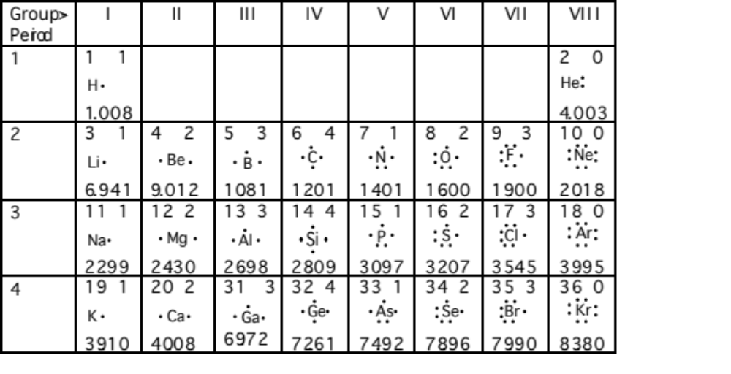
Elements of Periodic Table and Their Lewis Symbols
Table 10.1

Slide 3
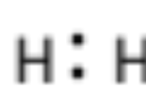

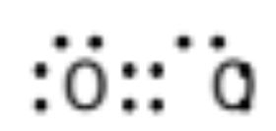

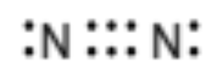

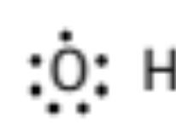
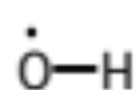
Lewis Structures
Molecular hydrogen
Molecular oxygen
Molecular nitrogen
Hydroxyl radical

Slide 4
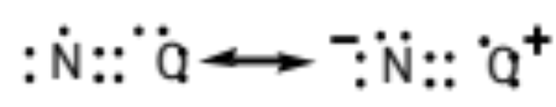
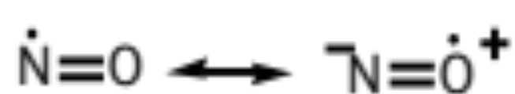
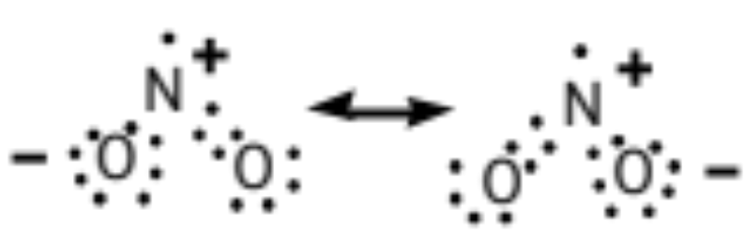
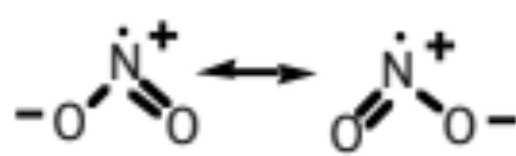
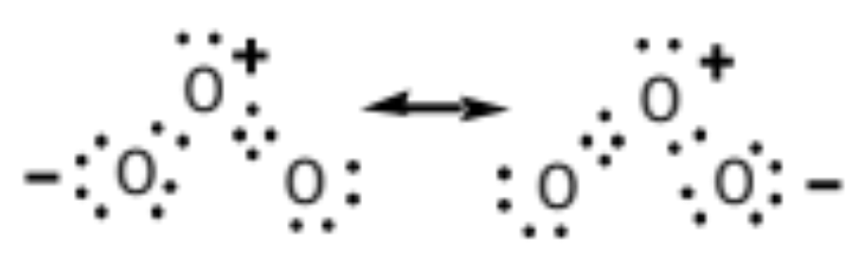
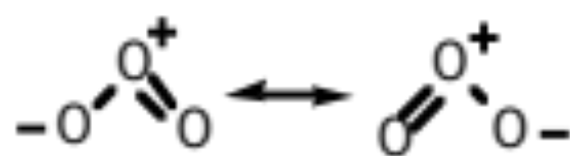
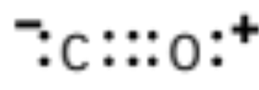
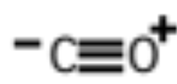
Lewis Structures
Nitric oxide
Nitrogen dioxide
Ozone
Carbon monoxide

Slide 5
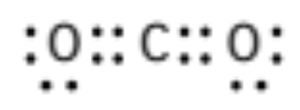

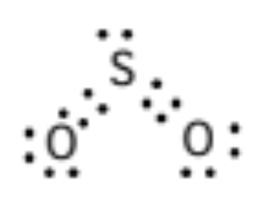
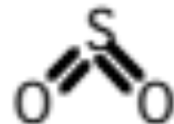
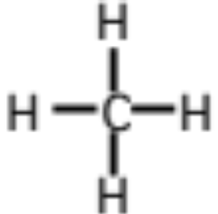
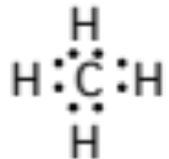
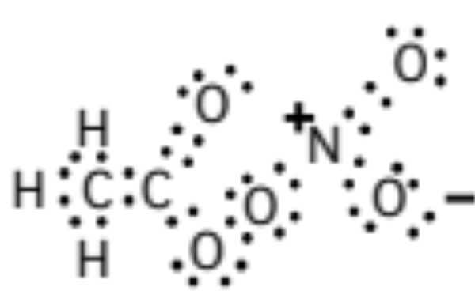
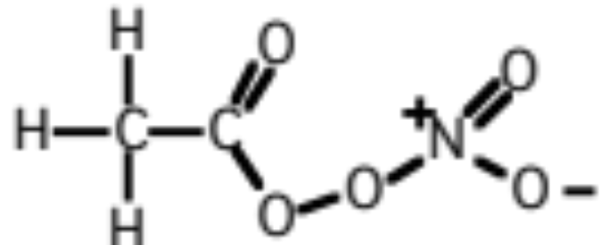
Lewis Structures
Carbon dioxide
Sulfur dioxide
Methane
Peroxyacetyl nitrate (PAN)

Slide 6
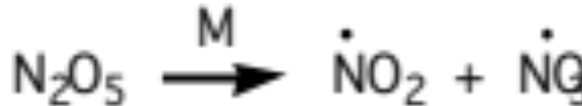
Chemical Reactions
Elementary unimolecular photolysis reaction (10.1)
NO₂ + hν → NO + O
λ < 420 nm
Elementary bimolecular thermal decomposition reaction (10.2)
N₂O₅ + M → NO₂ + NO₃ + M
Nonelementary bimolecular thermal decomposition reaction (10.3)

Slide 7


Chemical Reactions
Elementary bimolecular collision reaction (10.4)
CH₄ + OH → CH₃ + H₂O
Termolecular combination reaction (10.5)
NO₂ + NO₃ + M → N₂O₅ + M
derived from a pair of elementary bimolecular reactions

Slide 8
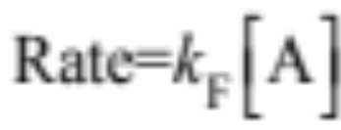
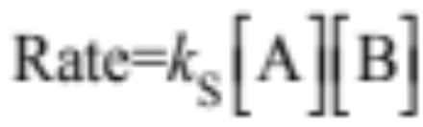
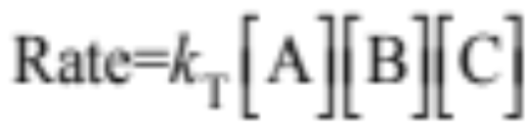
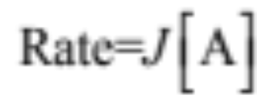
Reaction Coefficients and Rates
Reaction rates with 1st-, 2nd-, 3rd-order rate coefficients (10.8)
Rates for photolysis reaction (10.9)

Slide 9

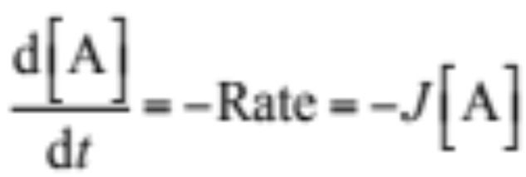
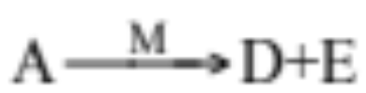
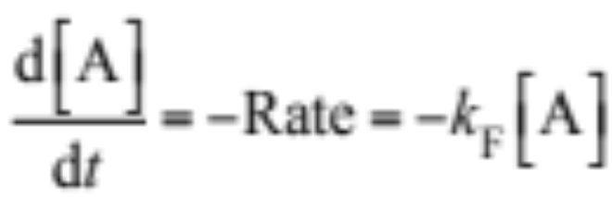
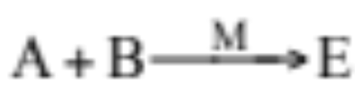
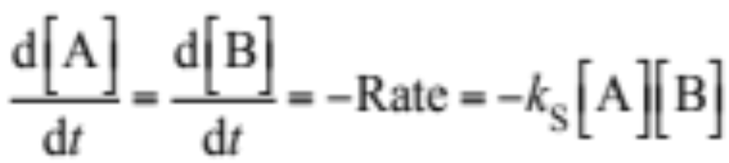
Rate of Change of Reactant Conc.
Photolysis reaction, (10.10)
Nonelementary bimolecular reaction, (10.11)
Nonelementary termolecular reaction, (10.12)

Slide 10

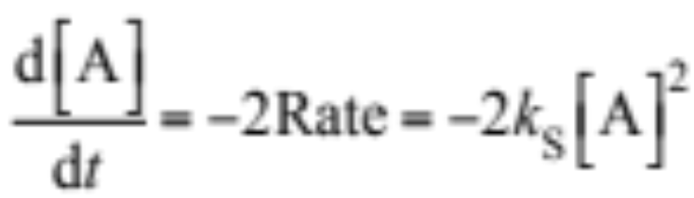

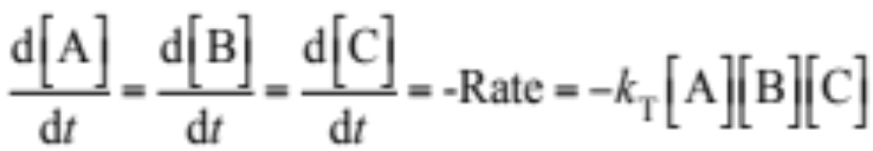
Rate of Change of Reactant Conc.
Elementary bimolecular reaction, (10.13)
Elementary termolecular reaction, (10.14)

Slide 11
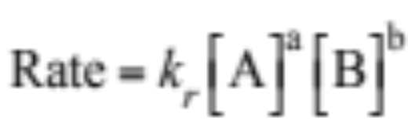

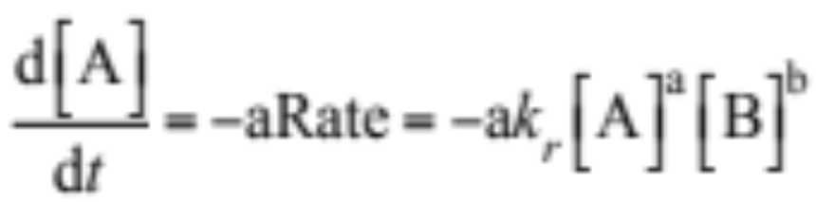
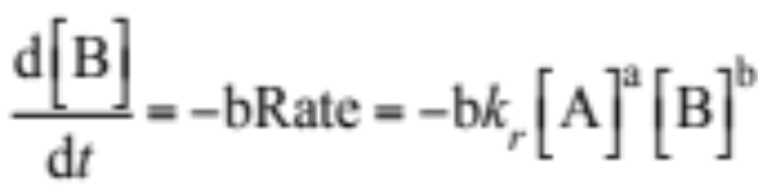
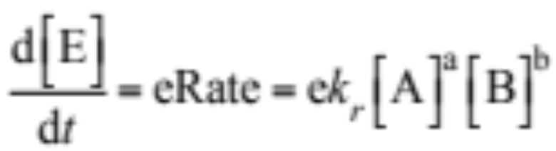
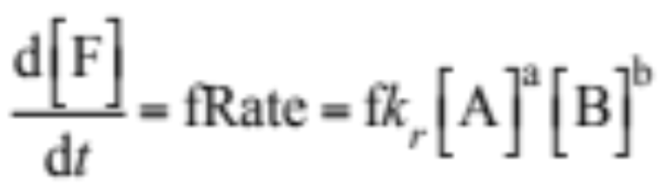
Rate of Change of Concentration
Generalized reaction, (10.16)
Rate of change of reactant concentration (10.17)
Rate of change of product concentration (10.18)

Slide 12

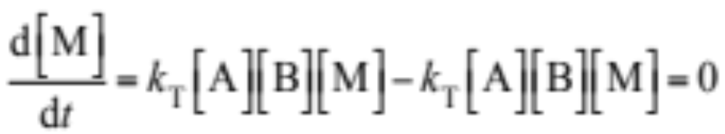
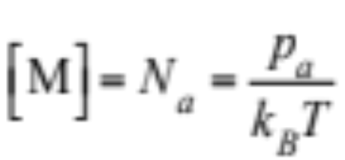
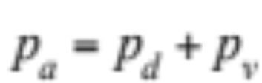
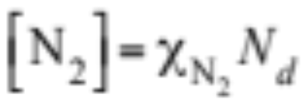
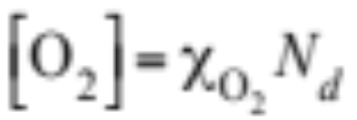
Third Bodies
Elementary termolecular combination reaction
Rate of change of third body (10.19)
Number concentration of air molecules (molec. cm⁻³) (10.20)
Number concentration of nitrogen and oxygen (10.21)

Slide 13
Third Bodies
Example 10.1:
Calculate the number concentration of M, N₂, and O₂ when T = 278 K and p_{a} = 920 hPa and the air is dry
Solution:
[M] = 2.40 x 10¹⁹ molec. cm⁻³
N_{N2} = 1.87x 10¹⁹ molec. cm⁻³
N_{O2} = 5.02 x 10¹⁸ molec. cm⁻³

Slide 14
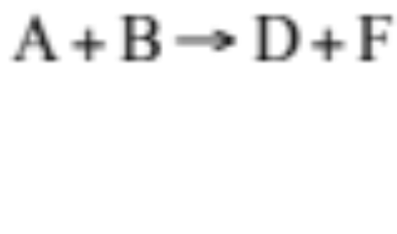
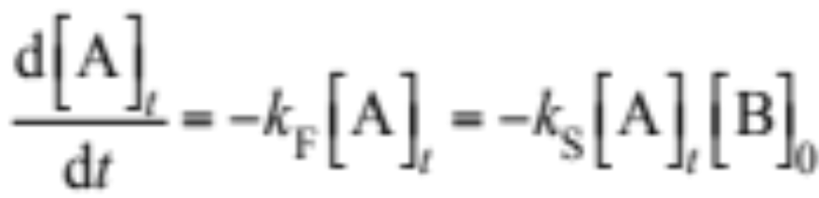
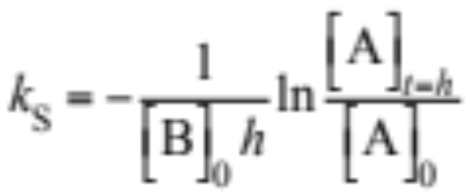
Rate Coefficients from Kinetic Analysis
Elementary bimolecular collision reaction
Expose small quantity of A to large quantity of B --> maximum loss of B is [A]
Rate of loss of A (10.22)
Integrate (10.23)

Slide 15
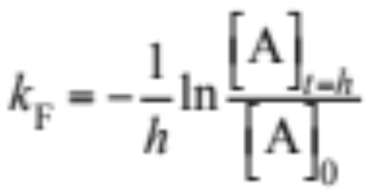
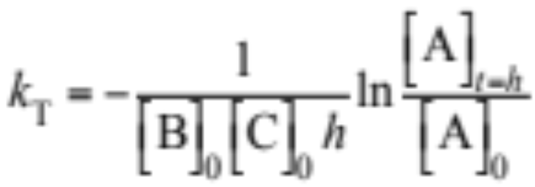
Rate Coefficients from Kinetic Analysis
Unimolecular reactions (10.24)
Termolecular reactions (10.24)

Slide 16
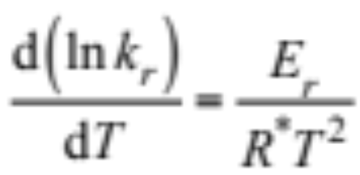
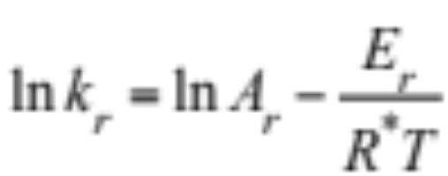
Arrhenius Equation
Temperature-dependence of a reaction rate coefficient (10.25)
Activation energy
Smallest amount of energy required for reacting species to form an activated complex or transition state before products are formed
Integrate (10.25) (10.26)

Slide 17


Arrhenius Equation
Measure k_{r} vs. T --> plot to find A_{r} and E_{r}
Useful form of Arrhenius equation (10.27)
Fig. 10.1

Slide 18





Temperature Dependence
E_{r} ≈0 --> collisional prefactor strongly depends on T (10.28)
B_{r} found by fitting equation to data
Example 10.2:
NO + O₃ → NO₂ + O₂
cm³ molec.⁻¹ s⁻¹ at T = 298 K
O + O₂ + M → O₃ + M
cm⁶ molec.⁻² s⁻¹ at T = 298 K

Slide 19



Pressure-Dependence of Reactions
Rate of pressure-dependent reaction (10.30)
Low pressure limit rate coefficient x M (10.31)
High pressure limit rate coefficient (10.32)

Slide 20
Pressure-Dependence of Reactions
Example 10.3:
OH + NO₂ + M → HNO₃ + M
p_{a} = 140 hPa
T = 216 K
[M] = 4.69 x 10¹⁸ molec. cm⁻³
F_{c} = 0.43
--> k_{0,T} = 2.60 x 10⁻³⁰(300/T)^{2.9} cm⁶ molec.⁻² s⁻¹
--> k_{0,T} [M] = 2.47 x 10⁻¹¹
--> k_{∞,T} = 8.16 x 10⁻¹¹ cm³ molec.⁻¹ s⁻¹
--> k_{r} = 1.11 x 10⁻¹¹ cm³ molec.⁻¹ s⁻¹

Slide 21


PAN Rate Coefficient
PAN rate coefficient as a function of pressure and temperature, respectively
PAN rate coefficient (s⁻¹)
PAN rate coefficient (s⁻¹)
Fig. 10.2

Slide 22


Photolysis Coefficient
(10.35)
Photoprocesses (10.36)

Slide 23


Photolysis Rate Coefficients
Pressure (hPa)
Pressure (hPa)
Fig. 10.3

Slide 24
Set of Reactions
NO + O₃ → NO₂ + O₂ (10.37)
O + O₂ + M → O₃ + M (10.38)
NO2 + hν → NO + O (10.39)
NO₂ + O → NO + O₂ (10.40)

Slide 25




Reaction Rates
(10.37)
(10.38)
(10.39)
(10.40)

Slide 26


ODEs For Set of Reactions
(10.41)
(10.42)
(10.43)
(10.44)

Slide 27


Production and Loss for Reaction Set
Production term for NO (10.45)
Loss term for NO (10.45)

Slide 28

E-folding Lifetime
E-folding lifetime
Time a species takes to have its concentration reduced to 1/e its original value
Overall lifetime (s) (10.46)

Slide 29




E-folding Lifetime
Unimolecular reaction
First derivative
E-folding lifetime occurs when (10.47)
E-folding lifetime (10.48)

Slide 30



E-folding Lifetime
Bimolecular reaction
Loss rate of species A
E-folding lifetime (10.49)

Slide 31


E-folding Lifetime
Termolecular reaction
E-folding lifetime (10.50)

Slide 32


Stiff System of Equations
Example 10.4:
CH₄ + OH --> CH₃ + H₂O
k = 6.2 x 10⁻¹⁵ cm³ molec⁻¹ s⁻¹ at 298K
[OH.] = 5.0 x 10⁵ molec. cm⁻³
---> = 10.2 years
O(¹D) + N₂ --> O + N₂
k = 2.6 x 10⁻¹¹ cm³ molec⁻¹ s⁻¹ at 298K
[N₂] = 1.9 x 10¹⁹ molec. cm⁻³
---> = 2 x 10⁻⁹ seconds
---> stiff set of equations

Slide 33




Half-Lifetime
Unimolecular reaction
Half-lifetime occurs when (10.51)
Solve for half-lifetime (10.52)
Bimolecular reaction (10.53)
Termolecular reaction (10.53)

