Slide 1

Innovate with Stanford:
Dr. Avnesh Thakor PORTFOLIO
Apr 2024
Notes:
Ying-Li

Slide 2
Elevator Pitch
It’s all about precision when it comes to using new innovative delivery techniques for advanced therapies
The IRIS lab has developed and validated novel techniques, bioscaffolds, and ultrasound technologies, for the delivery of islet cell transplant and advanced gene and cell therapies for tissue injury in the setting of kidney, lung, pancreatic, bowel and brain diseases.
Stanford is seeking licensees, research partners/sponsors, or investors for the development and/or commercialization of these technologies

Slide 3
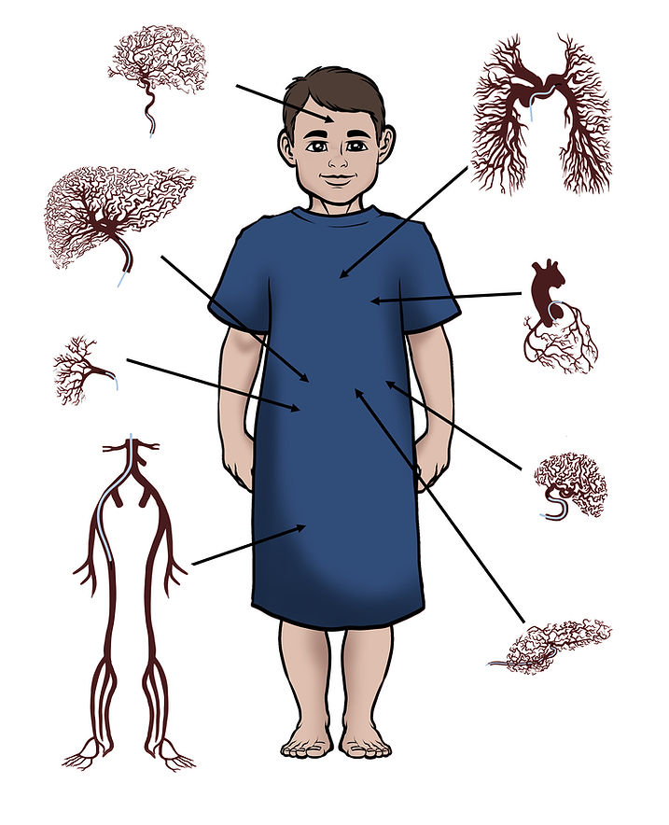
Interventional Radiology Innovation at Stanford (IRIS)
Dr. Avnesh Thakor, MD, PhD
  Adult and pediatric Interventional Radiologist and Physician-Scientist
  Member, Royal College of Radiologists
  Fellow of the Society of Interventional Radiology
Focus on mesenchymal stem cells
  Orchestrate tissue regeneration
  Produce and secrete extracellular vesicles (EVs), a cell-free therapy
  MSCs/MSC-EVs have pro-angiogenic, anti-inflammatory, immunomodulatory, anti-fibrotic and bioenergetic properties
Focused on lung disease, kidney injury, diabetes, pancreatic disease, IBD, other inflammatory diseases (e.g. Alzheimer’s)

Slide 4
IRIS Lab Research Areas
Precision Therapy
Precision Delivery
Precision Diagnosis

Slide 5
Advancing islet transplantation with specialized bioscaffolds

Slide 6
Bioscaffold Technologies
Docket | Title | Publication | Patent Apps | Stage | Slide
S18-259 | An Oxygen-Generating Collagen-Based Cryogel Bioscaffold for Pancreatic Islet Transplantation (+MSCs!) | Adv Funct Mater., 2020 | PCT published 2020 | In vivo data | 8
S20-274 | A Bioscaffold Platform for Improved Islet Transplantation | ACS Appl. Bio Mater., 2020 | PCT published 2023 | In vivo data | 9
S18-432 | Enhanced Transplantation of Pancreatic Islets via Controlled Nutrient Delivery System | Paper resubmitted | PCT published 2022 | In vivo data | 10
S21-284 | Localized Drug Delivery Graphene Bioscaffolds for Co-Transplanation of Islets and Mesenchymal Stem Cells | Sci Adv., 2021 | US published 2023 | In vivo data | 11

Slide 7
Advancing islet transplantation with specialized bioscaffolds
Innovative and clinically translatable solutions that will maintain islet health and survival during and following their transplantation
  A novel collagen-based cryogel 3D matrix that incorporates an oxygen generator to prevent islet hypoxia (S18-259)
  A bioscaffold with pores to house the cryogel and islets for/during delivery (S20-274)
  A nutrient generator in the form of a mesoporous silica nanoparticle that releases amino acids which can be combined with the above bioscaffold (S18-432)
  Can be modified/used to deliver mesenchymal stem cells or co-deliver with islets (S18-259, S21-284)
Each of these technologies has been shown to facilitate islet engraftment, function and survival to allow them to reserve hyperglycemia in diabetic animals
This platform can also be used with stem cell derived beta cells and can be scaled and produced conforming to GMP guidelines for human use

Slide 8
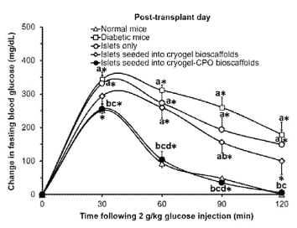
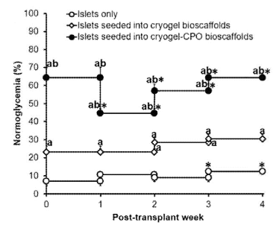
S18-259: An Oxygen-Generating Collagen-Based Cryogel Bioscaffold for Pancreatic Islet Transplantation
Summary: Bioscaffold comprised of collagen and calcium peroxide (CPO) used to facilitate islet transplantation. The CPO is added to generate oxygen, an essential nutrient for islets, while macropores allow for islet migration. This has also been tested using MSCs!
Patent: PCT published 2020
Publication: Adv Funct Mater., 2020
Stage of Development: In vivo data

Slide 9
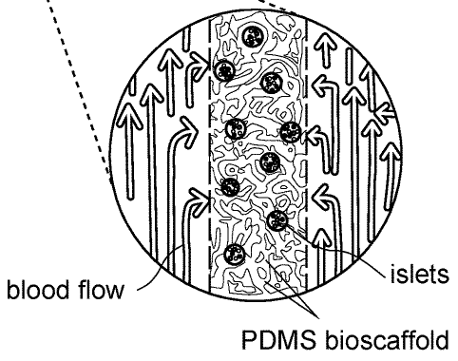
S20-274: A Bioscaffold Platform for Improved Islet Transplantation
Summary: An intravascular catheter with interior PDMS bioscaffold for use in islet transplantation. The PDMS allows for even distribution of cells in the catheter lumen while blood flows through side holes of catheter, placed in a spiral corkscrew pattern.
Patent: PCT published 2023
Publication: ACS Appl. Bio Mater., 2020
Stage of Development: In vivo data

Slide 10
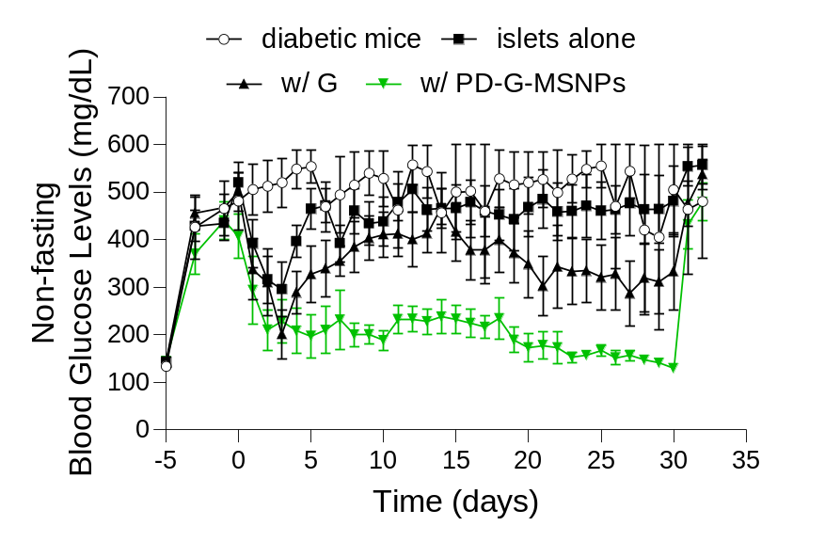
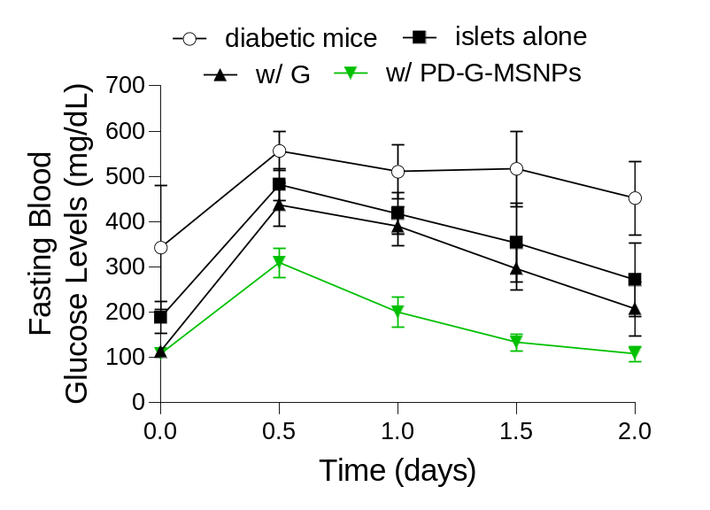
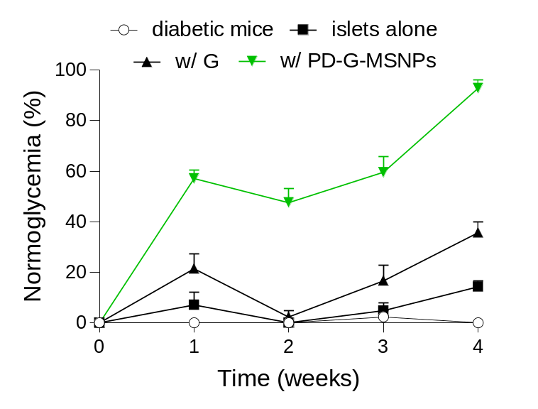
S18-432: Enhanced Transplantation of Pancreatic Islets via Controlled Nutrient Delivery System
Summary: A mesoporous silica nanoparticle (MSNP) platform for use in islet transplantation. It incorporates glutamine in NP, an essential amino acid, and its porosity allows for islet migration.
Patent: PCT published 2022
Publication: Paper resubmitted
Stage of Development: In vivo data

Slide 11
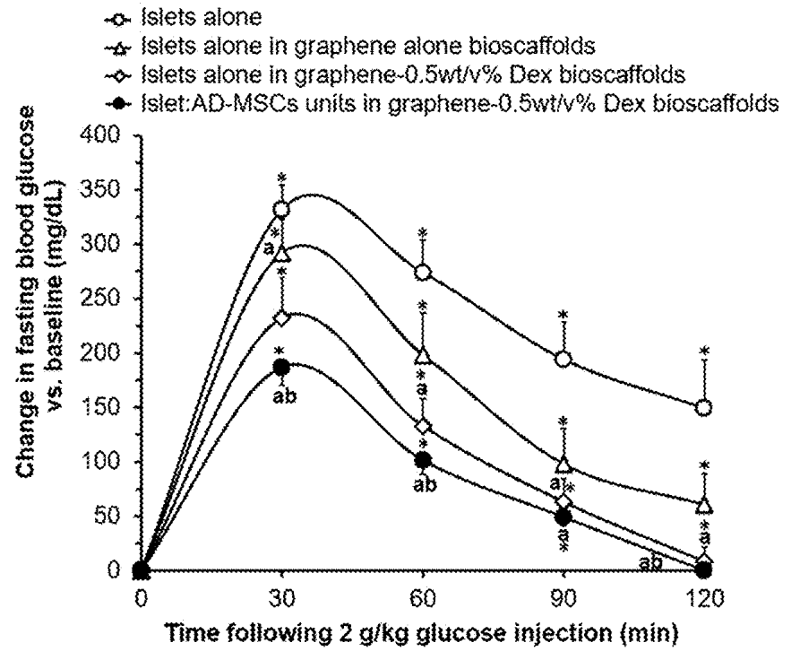
S21-284: Localized Drug Delivery Graphene Bioscaffolds for Co-Transplanation of Islets and Mesenchymal Stem Cells
Summary: A bioscaffold comprised of a 3D graphene matrix coated in dexamethasone (Dex) for use in co-transplantation of islets and MSCs. The macropores accommodate cells.
Patent: US published 2023
Publication: Sci Adv., 2021
Stage of Development: In vivo data

Slide 12
Advancing transplant & dialysis with ultrasound, EVs, catheters

Slide 13
Ultrasound and EV Technologies
Docket | Title | Publication | Patent Apps | Stage | Slide
S19-089 | Focused Ultrasound to enhance function and engraftment of pancreatic islets following transplantation | Scientific Reports, 2019 | PCT published 2020 | In vivo data | 15
S20-070 | Kidney tissue regeneration using pulsed focused ultrasound (pFUS) therapy with MSCs and/or MSC-Evs | Stem Cell Res Ther, 2020 | PCT published 2021 | In vivo data | 16
S21-374 | Targeted locoregional delivery of therapeutic extracellular vesicles with enhanced bioenergetic profile | No Publication | PCT published 2023 | In vivo data | 17

Slide 14
Advancing transplant & dialysis with ultrasound, EVs, catheters
Non-invasive or minimally invasive therapies using pFUS, targeted vesicles, and catheters that offer more precise, efficient, and potentially less risky treatment options.
In Brief:
Focused ultrasound (pFUS)
  Pancreatic islet transplantation: pFUS improves the success of transplanting pancreatic islets for diabetes treatment, helping transplanted cells function better and engraft in the body (S19-089)
  Kidney regeneration: Using mesenchymal stem cells (MSCs) or their extracellular vesicles (MSC-EVs) to promote kidney repair, pFUS helps these regenerative elements work more effectively (S20-070)
Extracellular vesicle delivery: Delivering therapeutic particles (extracellular vesicles) to specific areas of the body for targeted treatment with improved effectiveness (S21-374)

Slide 15
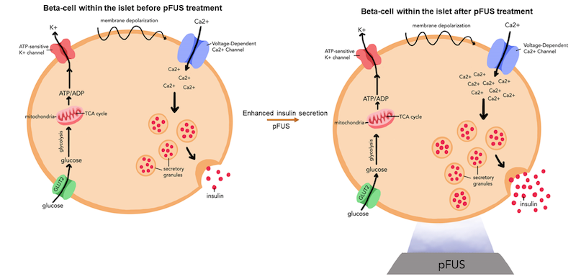
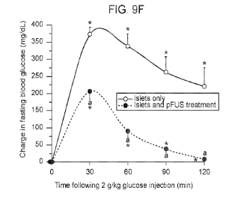
S19-089: Focused Ultrasound to enhance function and engraftment of pancreatic islets following transplantation
Summary: A method of using pulsed focused ultrasound (pFUS) on islets that enhances function and engraftment of pancreatic islets after transplantation. Usually, 60% of islets are lost within first 2 weeks following transplantation.
Patent: PCT published 2020
Publication: Scientific Reports, 2019
Stage of Development: In vivo data

Slide 16
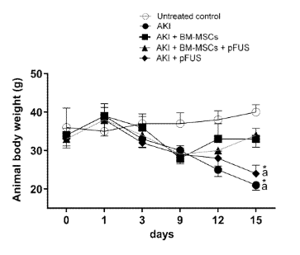
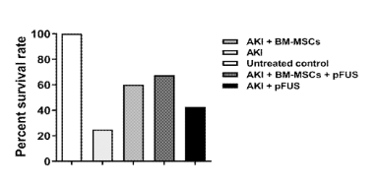
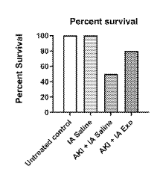
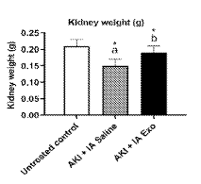
S20-070: Kidney tissue regeneration using pulsed focused ultrasound (pFUS) therapy with MSCs and/or MSC-EVs
Summary: A method of treating acute kidney disease (AKI) by administering pFUS with therapeutic MSCs or MSC-derived extracellular vehicles (EVs, sometimes exosomes or Exo). The pFUS are added to enhance the function of EVs.
Patent: PCT published 2021
Publication: Stem Cell Res Ther, 2020
Stage of Development: In vivo data

Slide 17
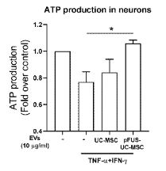
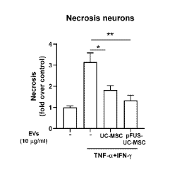
S21-374: Targeted locoregional delivery of therapeutic extracellular vesicles with enhanced bioenergetic profile
Summary: A method of treating disease by administering EVs derived from MSCs pre-treated with pFUS. Tested in acute respiratory disease and acute kidney disease.
Patent: PCT published 2023
Publication: No publication
Stage of Development: In vivo data
ATP production in neurons after inflammatory cocktail (TNF a and IFN-y) treatment where pFUS-UC-MSCs showed improvement in ATP generation compared to UC-MSC-EVs and reduced the cell death suggested by decrease in necrosis

Slide 18
For these novel IRIS lab technologies, Stanford is seeking:
Licensees to commercialize one or more of these technologies
Research partners/sponsors to develop and commercialize one or more of these technologies
Investors to help fund and support the creation of a start-up company around one or more of these technologies

Slide 19



Contact Us
415 Broadway Street, 2nd Floor,
Redwood City, CA 94063
otl.stanford.edu
otl-connect@stanford.edu
SPOTLIGHT Newsletter

