Slide 1
K. Language Maintenance in Canada
Mihyon Jeon
York University

Slide 2
Content
Koreans in Canada
Language ecology and policy in Canada
Study
  Research question
  Method
  Participants
  Results
Conclusion

Slide 3
Koreans in Canada
141,895 Koreans in 2006 (Statistics Canada)
  Out of 5 million visible minorities (16.2 % )
  34% of Koreans came to Canada between 2000 and 2006
  223,322 in 2009 (South Korea’s Ministry of Foreign Affairs and Trade)
  Cf. 1.7 million (0.6% of American populations)

Slide 4
Koreans in Canada: Generational breakdown
Koreans
total population of ethnic origin
First generation: over 90%
Second generation: 8.3%
Third generation: 0.8%
First generation: 23.9%
Second generation: 15.6%
Third generation: 60.5%

Slide 5
Language ecology of Canada
Two official languages: English and French
Breakdown of mother tongues speakers
  58%: English
  22%: French
  The remainder
    Indigenous languages
    Heritage languages including Korean

Slide 6
Language policies
Official Language Act of 1969
  Made English and French Canada’s official languages
  Equality of status and equal rights and privileges
Cultural Enrichment Program (1977)
  Support for the teaching of non-official languages
  Public resistance to the establishment of heritage language classes at public expense
  Some heritage language classes: partially publically funded

Slide 7
Language maintenance and shift
language shift within three generations (Fishman, 1989)
  Native language speaking first generation
  Bilingual second generation
  Dominant language speaking third generation
Recent trend: language shift within two generations (Wiley, 2001)

Slide 8
Language shift
Communication problems b/t parents and children
Alienation of children from parents
Loss of language resources

Slide 9
Three factors of language maintenance
Societal factor
  Social institutions and media
Contact factor
  Individuals’ daily interactions with language
    Interpersonal contact & non-interactive contact through media
Attitudinal factor
  Individual beliefs about language: socially constructed and shared

Slide 10
The study: Research question
How do societal, contact and attitudinal factors relate to Korean language maintenance/shift among Korean Canadians?

Slide 11
Methods
Survey
137 second and 1.5 generation Korean Canadians in the Greater Toronto Area (GTA)
  50 born in Canada (out of 116)
  64 born in Korea; 2 in the third country
    average length of stay in Canada: 10 years
3 undergraduate research assistants: as a focal point

Slide 12
Survey
(1) English and Korean language proficiency
(2) demographic details
(3) use of Korean and English
(4) media and literacy exposure
(5) Korean language education
(6) language attitudes toward Korean, English, and bilingualism

Slide 13
Results: Korean and English proficiency
Self-assessment of four skills of Korean & English: 5 point Likert scale
  How well do you speak Korean/English?
  1 for not well at all; 5 for very well
Cloze test
  A paragraph with ten blanks with four answer keys for each question: one for Korean and the other for English

Slide 14
language proficiency: self assessment
Korean
English
Listening: 3.94 (SD=1.096)
Speaking: 3.37 (SD=1.270)
Reading: 3.21 (SD=1.439)
Writing: 2.93 (SD=1.29)
Listening: 4.68 (SD=.564)
Speaking: 4.58 (SD=.748)
Reading: 4.58 (SD=.678)
Writing: 4.25 (SD=.730)

Slide 15
Language proficiency: Cloze test
Korean
English
2.20 (SD=2.495)
5.95 (SD=2.879)

Slide 16
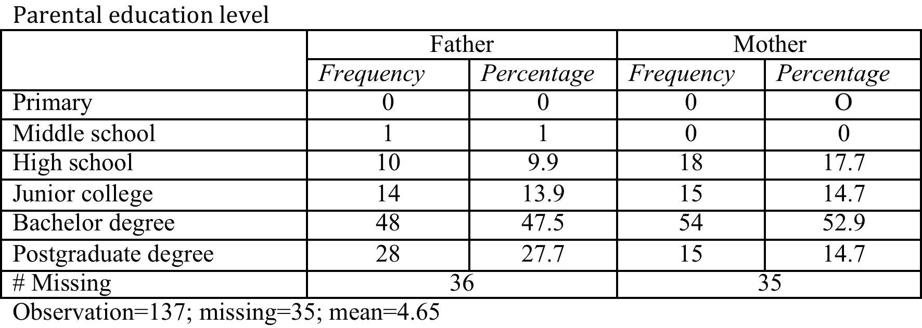
Parental education level

Slide 17
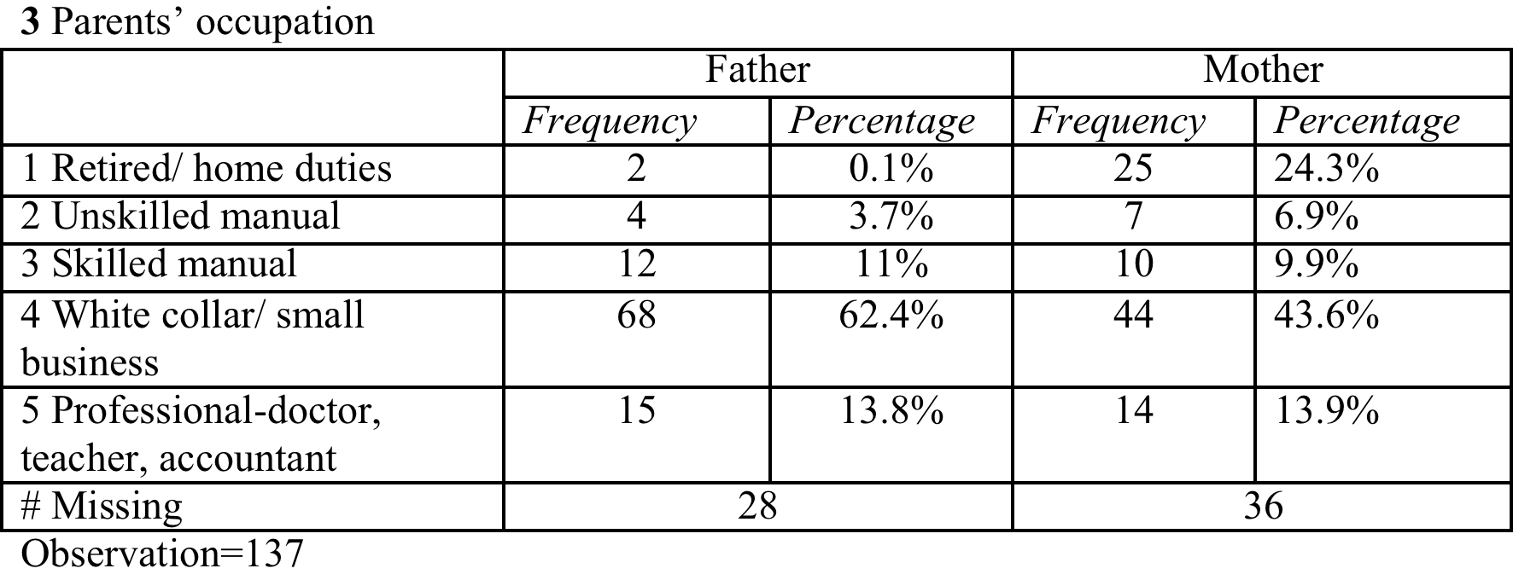
Parents’ occupation

Slide 18
Parental education level and K. language proficiency
the fathers’ education level showed a slightly higher correlation with their children’s Korean language proficiency (Pearson correlation= .290, p < 0.01) than did the mothers’ education level (Pearson correlation = .248, p < 0.01).

Slide 19
Family language use & proficiency
7 point Likert scale
  1 for exclusively English; 2 almost always English; 3 mostly English; 4 Korean and English equally; 5 mostly Korean; 6 almost always Korean; 7 exclusively Korean
Language use at home & Correlation b/t language use and Korean language proficiency
  Most Korean with first born child; least with third born
  Mostly English among sibling

Slide 20
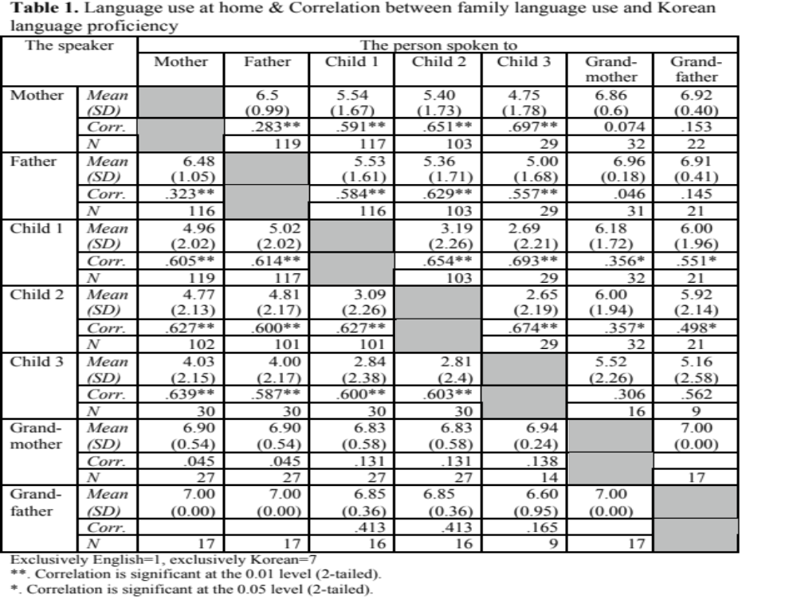

Slide 21
Language use in other domains
the domain of relatives: 4.53 (SD=2.04)
Mostly English in other domains
  church: 2.96 (SD=1.79)
  friends: 2.00 (SD=1.60)
  doctor’s office: 1.24 (SD=1.61)
  restaurant: 1.89 (SD=1.24)
Pattern of language shift from Korean to English

Slide 22
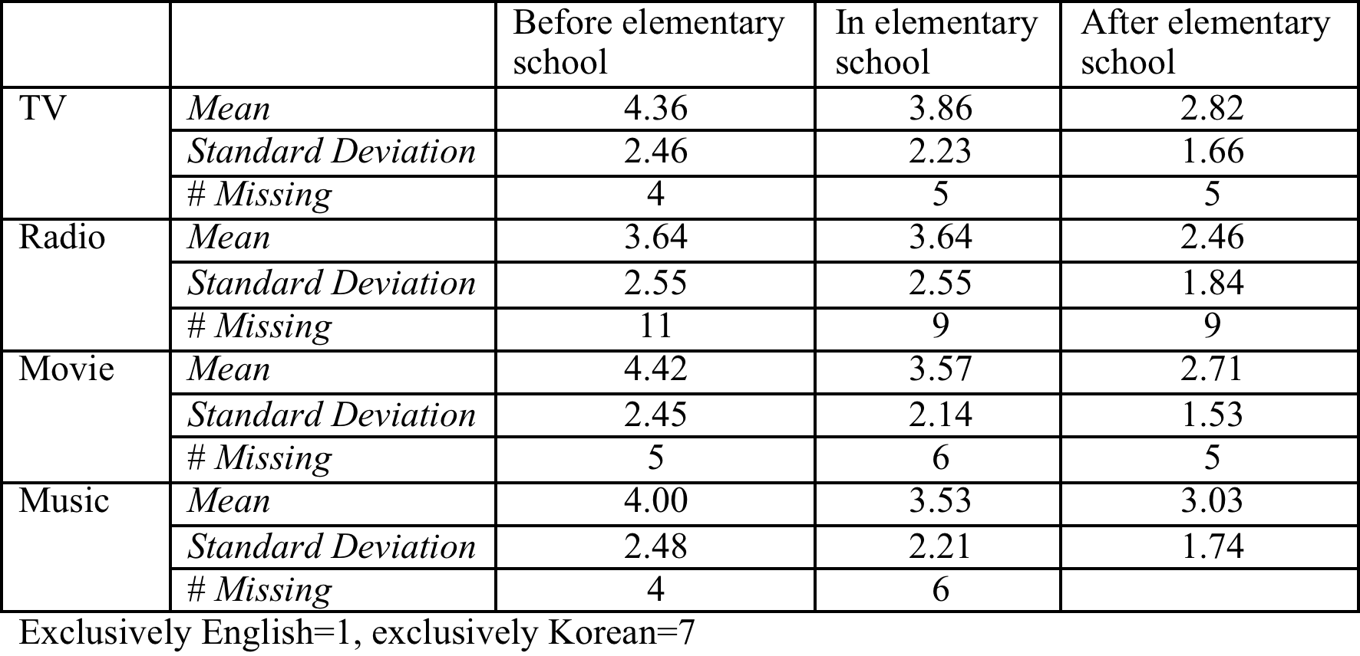
Media exposure

Slide 23
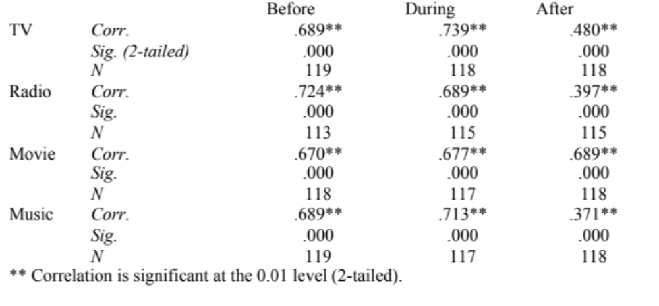
Media exposure and proficiency

Slide 24
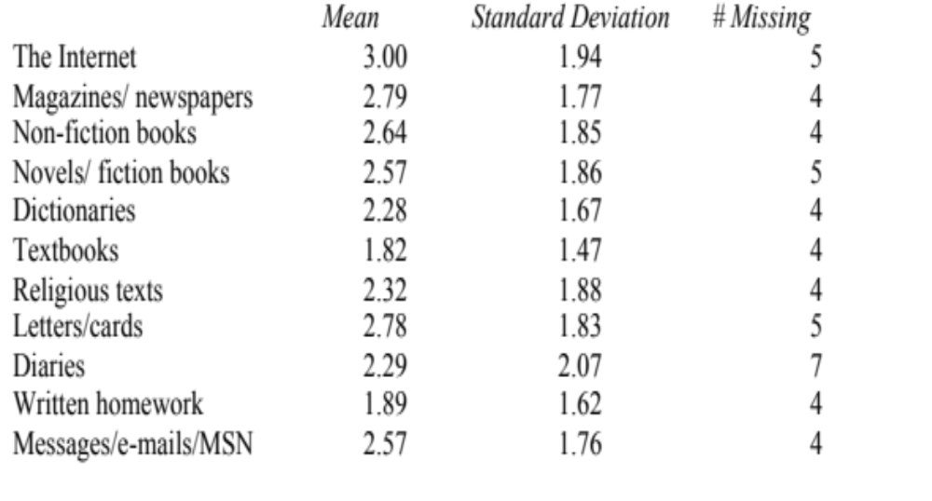
Literacy practice

Slide 25
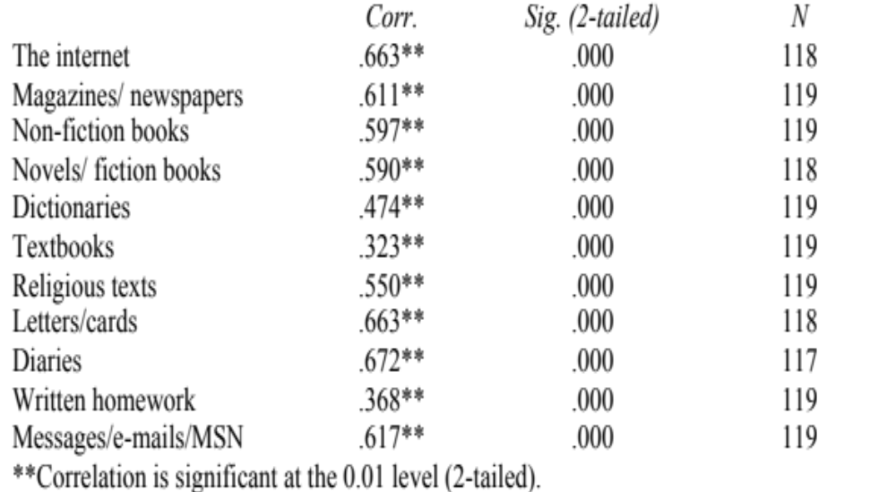
Literacy practice and proficiency

Slide 26
Media exposure & literacy practice
More expose to English media than to Korean media
Use more English than Korean in literacy practice
Strong correlation b/t Korean proficiency and media exposure/literacy practice in Korean

Slide 27
Korean language education
71.3% (92 out of 129): their parents taught them Korean
Why?
  Maintaining Korean ethnic identity
  Communication with family members
  Better job opportunities

Slide 28
Korean language education
How?
  Parents spoke to children in Korean (50%)
  Sent children to Korean language school (37%)
  Sent children to Korea (20%)
  Read to children in Korean (19.4%)
Effective?
  Yes
    t (49.20)=2.211, p=0.032.

Slide 29
Korean language school
54% (27 out of 50) 2nd generation
66.6% (14 out of 21) 1.5 generation Korean Canadians who came to Canada before the age of 8
Average length of attendance: 3 years and 8 months
Average 1.7 days and 4.7 hours per week
Types: 41 public schools, 13 non-profit organization, 22 religious organization (21 church; 1 Buddhist temple)
Effective:
  Yes
    t (79.844)=2.542, p=0.013

Slide 30
Language attitudes
5 point Likert scale: 1 for strongly disagree; 5 for strongly agree
13 questions for Korean; 12 questions for English; 2 questions for bilingualism
Results I: attitudes and correlation

Slide 31
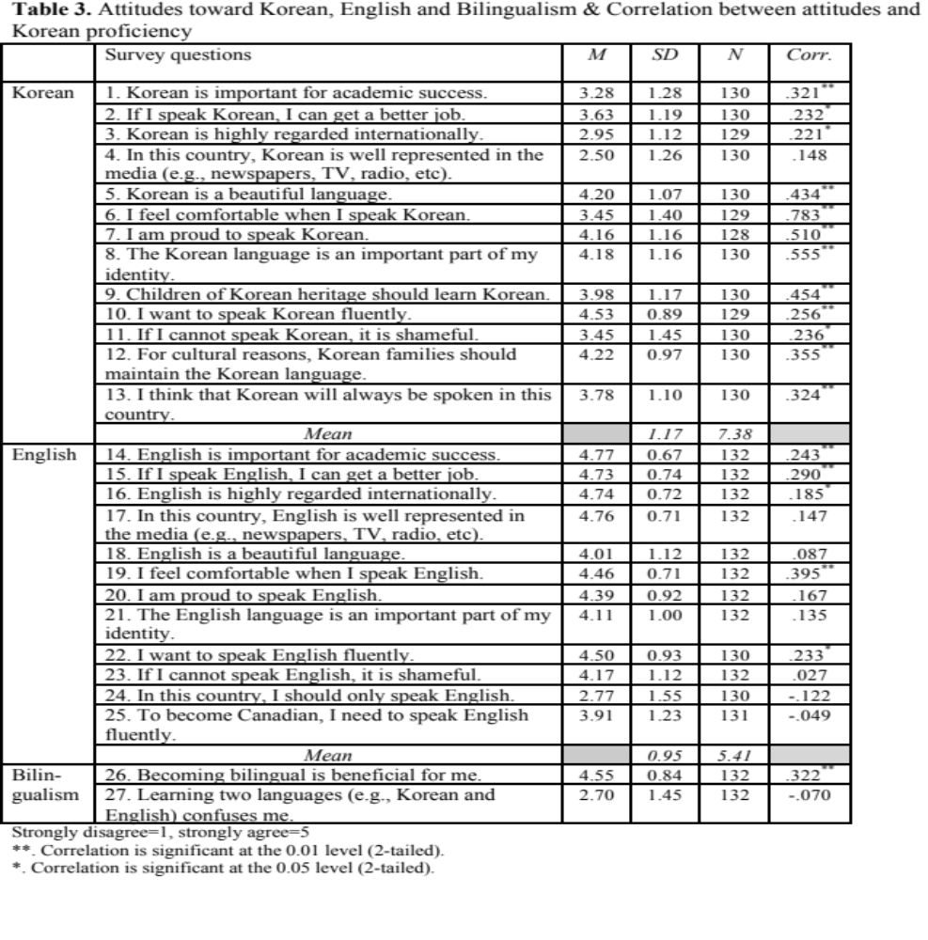

Slide 32
Attitudes and Proficiency
Korean
English
Comfort: p=.783, p <0.01
K as part of identity: p.555
K pride: p=.510
beautiful language: p=.434
Comfort: p=.395, p <0.01
Better job: p=.290
Academic success: p=.243

Slide 33
Language attitudes and proficiency
positive attitudes toward both English and Korean
  attitudes toward English (4.27) is slightly higher than Korean (3.71).
Relationship between attitudes toward Korean and Korean proficiency: particular strong and convincing
Relationship between attitudes toward English and English proficiency: weak

Slide 34
Attitudes and proficiency
Comport in speaking English & Korean proficiency
  Pearson correlation = -.371, p<0.01
English identity & Korean proficiency
  Pearson correlation = -.280, p<0.01

Slide 35
Language use and language attitudes
Mother and children
  First born: Pearson correlation = .402, p< 0.01
  Second born: Pearson correlation = .396, p< 0.01
  Third born: Pearson correlation = .702, p< 0.01
Father and children
  First born: Pearson correlation = .378, p< 0.01
  Second born: Pearson correlation = .386, p< 0.01
  Third born: Pearson correlation = .564, p< 0.01
Between siblings
  First born and second born: Pearson correlation = .645, p< 0.01)

Slide 36
Language use and language attitudes
Between siblings
  First born and second born: Pearson correlation = .645, p< 0.01)
  First born and third born: Pearson correlation = .693, p< 0.01
Between parents
  No significant effect on child’s language attitudes

Slide 37
Conclusion
Pattern of language shift from Korean to English
Overwhelmingly strong correlation between Korean language proficiency and;
  Korean language use in the family and in different domains
  exposure to Korean media and literacy practices in Korean
  Korean language education and attendance to Korean language school
  Positive attitudes toward Korean

