Slide 1
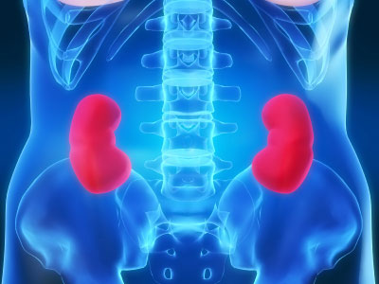
Chronic Kidney Disease
Chronic Kidney Disease is a slow loss of renal function over time. This leads to a decreased ability to remove waste products from the body and perform homeostatic functions.

Slide 2
Epidemiology
CKD affects about 26 million people in the US
Approximately 19 million adults are in the early stages of the disease
  On the rise do to increasing prevalence of diabetes and hypertension
Total cost of ESRD in US was approximately $40 billion in 2008

Slide 3
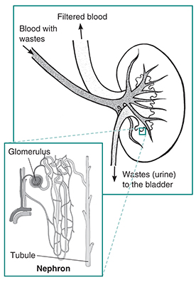

Slide 4
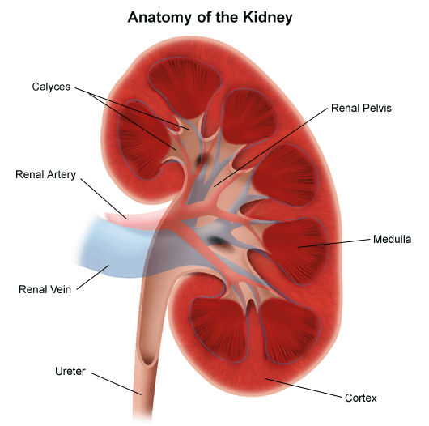
Clinical Definition
Glomerular Filtration Rate of less than 60 ml/minute per 1.73m² per body surface area (normal is 125ml/min) .
Presence of kidney damage, regardless of the cause, for three or more months
Notes:
Things that cause kidney disease:
-Glomerulonephritis, a group of diseases that cause inflammation and damage to the kidney's filtering units. These disorders are the third most common type of kidney disease.
-Inherited diseases, such as polycystic kidney disease, which causes large cysts to form in the kidneys and damage the surrounding tissue.
-Malformations that occur as a baby develops in its mother's womb. For example, a narrowing may occur that prevents normal outflow of urine and causes urine to flow back up to the kidney. This causes infections and may damage the kidneys.
-Lupus and other diseases that affect the body's immune system.
-Obstructions caused by problems like kidney stones, tumors or an enlarged prostate gland in men.
-Repeated urinary infections.

Slide 5
Measuring kidney function eGFR: MDRD calculation
eGFR = 175 x SerumCr^{-1.154} * age^{-0.203} * 1.212 (if patient is black) * 0.742 (if female)
Creatinine is a muscle waste product that is cleared by kidney filtration.
Low kidney function leads to high levels of creatinine.
Amount of muscle influences amount of creatinine made. High levels of muscle gives higher creatinine baseline, independent of kidney function.
Older people produce less creatinine from their muscles.
African Americans produce more creatinine.
Women produce less creatinine
10% error from true GFR

Slide 6
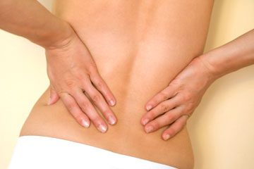
CKD Symptoms
Hematuria (blood in urine)
Flank pain
Edema
Hypertension
Signs of uremia
Lethargy and fatigue
Loss of appetite
If asymptomatic may have elevated serum creatinine concentration or an abnormal urinalysis

Slide 7
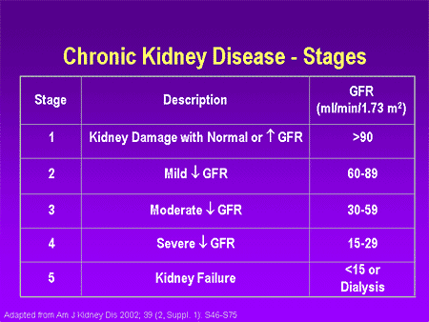

Slide 8
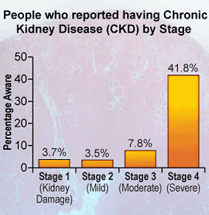
In the early stages of CKD, people do not notice any symptoms. The disease often develops so slowly that many people don't realize they're sick until the disease is advanced. In 2006, CKD was responsible for the death of nearly 45,000 people, ranking as the ninth leading cause of death in the United States.
However, the risk for kidney disease can be reduced by preventing – when possible – diabetes and high blood pressure and managing these conditions when present.

Slide 9
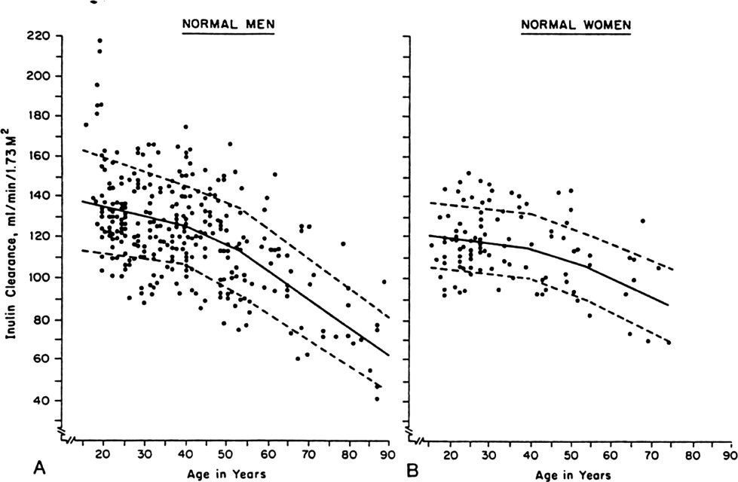
Kidney function declines with age in humans
Glomerular
Filtration
Rate
Poor kidney function is a risk factor for death from major age-related diseases:
-Chronic kidney disease
-Cardiovascular disease
-Stroke
-Type 2 Diabetes
Levey et al. 2009; Fan et al. 2011
Notes:
I work specifically on kidney aging so I’d like to highlight two important reasons why kidneys are a particularly important organ for aging. The first reason is that kidneys show a quantifiable decline in a key biomarker of function with age as shown on these scatter-plots showing that glomerular filtration rate (a biomarker of how well kidneys filter the blood) declines steadily with age.
The second important point is that poor kidney function is a major risk factor for leading causes of age-related death in humans- most notably chronic kidney disease as well as cardiovascular disease, stroke and type 2 diabetes which are collectively among the leading causes of death in the U.S.

Slide 10
Risk Factors
Age of more than 60 years
Hypertension and Diabetes
  Responsible for 2/3 of cases
Cardiovascular disease
Family history of the disease.
Race and ethnicity
    Highest incidence is for African Americans
    Hispanics have higher incidence rates of ESRD than non-Hispanics.
Notes:
_followed by American Indians and Alaska Natives, then Asian Americans and native Hawaiians and other Pacific Islanders, and finally Caucasians.

Slide 11
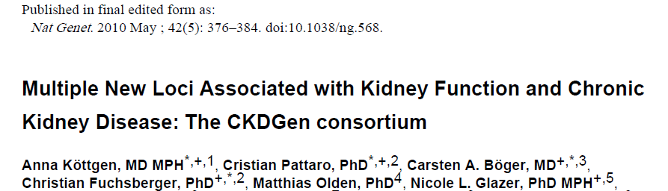
Meta-analysis of genome-wide association data from 20 Studies
67,093 Caucasian individuals
Serum creatinine (eGFRcrea), cystatin C (eGFRcys), and CKD (eGFRcrea <60 ml/min/1.73m²; n = 5,807 CKD cases).
20 new loci

Slide 12
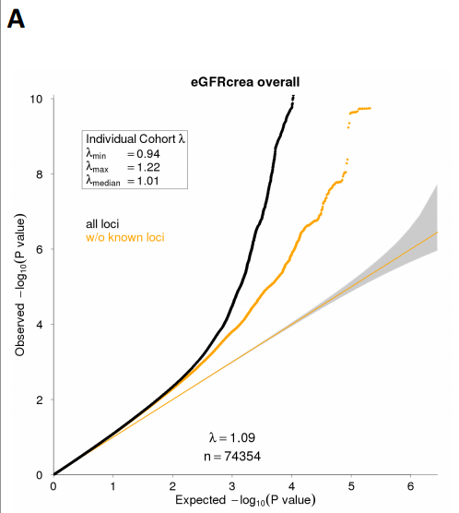

Slide 13
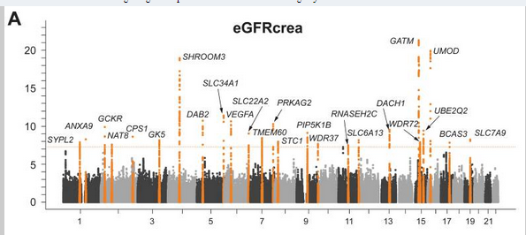

Slide 14
UMOD
Uromodulin (UMOD) is the most abundant protein in urine.
SNP rs12917707 is a weak allele in the UMOD locus
  Affects expression
  Risk allele is 18% frequency
  Associated with chronic kidney disease
Strong alleles in UMOD alter the structure of the protein, preventing its release from kidney cells. Abnormal buildup of uromodulin may trigger the self-destruction (apoptosis) of cells in the kidneys, causing kidney disease.
    These strong alleles are autosomal dominant and cause
      medullary cystic kidney disease-2 (MCKD2),
      glomerulocystic kidney disease with hyperuricemia
      isosthenuria (GCKDHI)
      familial juvenile hyperuricemic nephropathy (FJHN).
common variants of genes responsible for severe, monogenic disorders may be associated with milder presentations in the general population

Slide 15
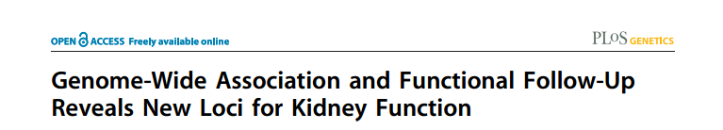
Meta-analysis of genome-wide association data from 20 Studies
130K Caucasian individuals
Serum creatinine (eGFRcrea)
6 new loci for CEU
For African Americans, over 95% of SNPs were observed to have the same effect direction in cross-ethnic analyses.

Slide 16
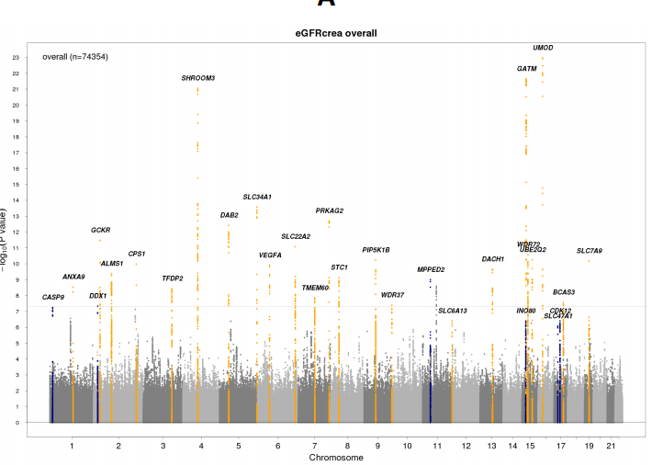

Slide 17
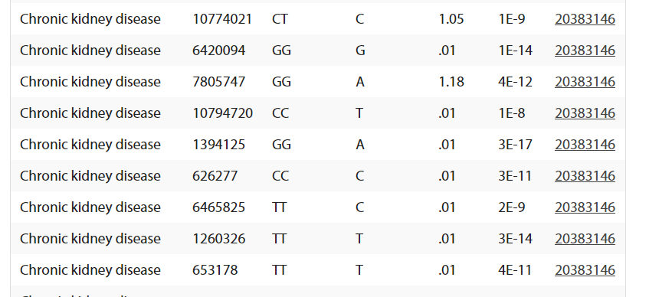
Chronic Kidney Disease
SNP
genotype
risk allele
OR
Pvalue
link

Slide 18
How to make a Genetic Risk Score
1. Count alleles

Slide 19
Chronic Kidney Disease
SNP
genotype
risk allele
Score
Running
Score
1 1
2 3
0 3
0 3
0 3
2 5
0 5
2 7
2 9 out of 18 possible

Slide 20
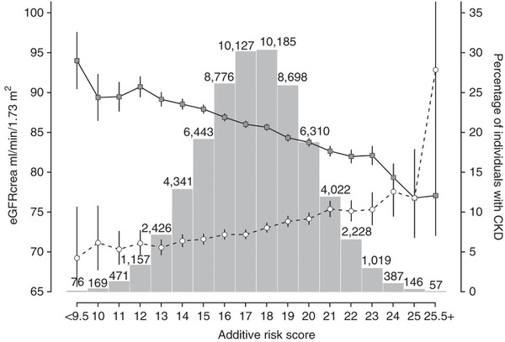
Summing the risk alleles
16 loci account for 1.4% of the variation in eGFRcrea.

Slide 21
How to make a Genetic Risk Score
Count alleles
Weight using odds ratios

Slide 22
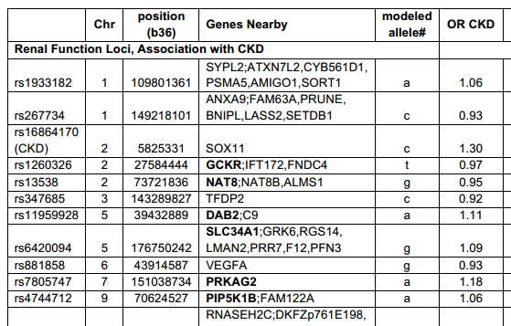
Chronic Kidney Disease
Weight by odds ratios
Odds ratio ≈ effect size
But odds ratio affected by allele frequency, so can’t really compare two alleles
(They could have at least tried!)

Slide 23
How to make a Genetic Risk Score
Count alleles
Weight using odds ratios
Weight by increased likelihood

Slide 24
Recall from Class GWAS
Odds Ratio ≠ Increased Risk
 |  | P-value | OR | IR
Lactose Intolerance | rs4988235 | .09 | 2.7 | 1.2
Eye Color | rs7495174 | .0093 | inf | inf
Asparagus | rs4481887 | .084 | 2.35 | 1.18
Bitter Taste | rs713598 | .000498 | 0.22 | 0.519
Earwax | rs17822931 | .004 | 4.6 | 2.6
Increased Risk can be multiplied together.
Usually don’t know increased risk in case/control study

Slide 25
How to make a Genetic Risk Score
Count alleles
Weight using odds ratios
Weight by increased likelihood
Linear Regression

Slide 26
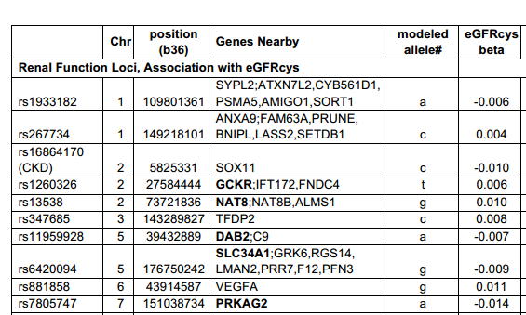
GRS using linear regression
eGFR = (-.006)(#A alleles at rs1933182) + (.004)(#C alleles at rs267734) + …
Kottgen et al. should have used this!!

Slide 27
How to make a Genetic Risk Score
Count alleles (bad)
Weight using odds ratios (OK)
Weight by increased likelihood (good)
Linear Regression (good)

Slide 28
Other Genetic Risk Scores
Disease | SNPs | Method | Result | Date
Type 2 diabetes | 18 | Logistic regression. | The genotype score resulted in the appropriate risk reclassification of, at most, 4% of the subjects. | 2008
Type 2 diabetes | 20 | # alleles | AUC = .54 | 2010
Myocardial Infarction | 3 | # alleles | AUC with clinical predictors = .67 AUC with clincial predictors and GRS = .68 | 2011
Coronary Heart Disease | 13 | Linear regression | bottom quintile vs top quintile = 1.66 increased risk adjusting for traditional risk factors | 2010
Cardiovascular disease | 101 | # alleles | No improvement over clinical parameters | 2011

Slide 29
Inflammatory Bowel/Crohn’s Disease
Signs and symptoms include:
Diarrhea. Diarrhea is a common problem for people with IBD.
Fever and fatigue. Many people with IBD experience a low-grade fever. You may also feel tired or have low energy.
Abdominal pain and cramping. Inflammation and ulceration can affect the normal movement of contents through your digestive tract and may lead to pain and cramping. You may also experience nausea and vomiting.
Blood in your stool. You might notice bright red blood in the toilet bowl or darker blood mixed with your stool. You can also have bleeding you don't see (occult blood).
Reduced appetite. Abdominal pain and cramping, as well as inflammation, can affect your appetite.
Unintended weight loss. You may lose weight and even become malnourished because you cannot properly digest and absorb food.

Slide 30
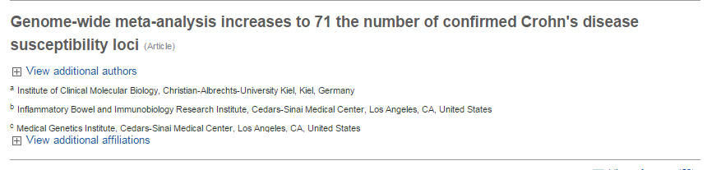
Crohn’s/Inflammatory Bowel disease
6,333 cases and 15,056 controls
followed up the top association signals in 15,694 cases, 14,026 controls and 414 parent/offspring trios.
Combined with previously confirmed loci, the results described here identify a total of 71 distinct loci with genome-wide significant evidence for association with Crohn’s disease.

Slide 31
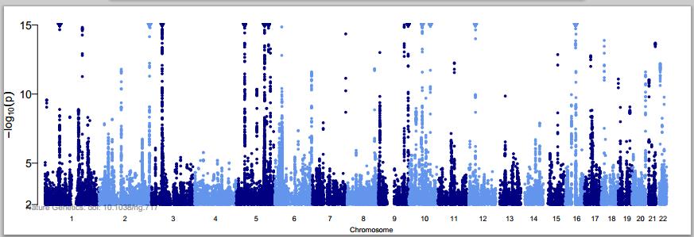
71 Inf. Bowel Disease loci

Slide 32
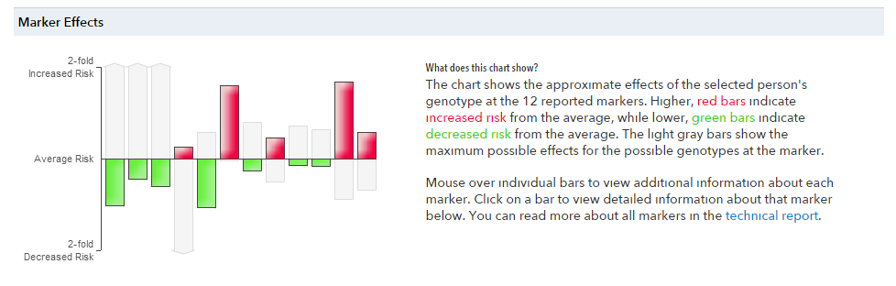
Crohn’s disease
12 markers
23andme.com

Slide 33
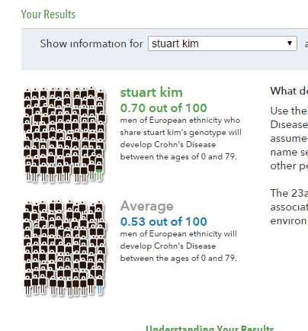
Crohn’s disease
23andme.com

Slide 34
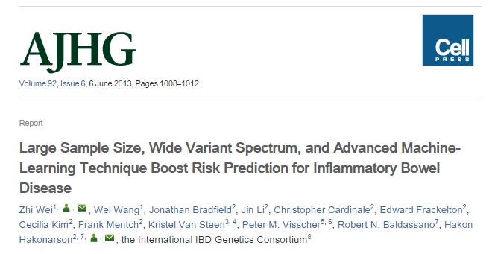
Inflammatory Bowel Disease
Genetic Risk Score

Slide 37
Crohn’s Genetic Risk Score
Preselection. p values > 10⁻⁴ and minor allele frequency (MAF) < 0.01. As a result, 10,799 SNPs survived.
Training. penalized logistic regression (LR). 573-SNP Crohn’s Disease predictive model
Testing. AUC of 0.864 (95% CI = [0.8573, 0.8692])! This is the best prediction performance ever reported for Crohn’s Disease.

Slide 38
Crohn’s disease Genetic Risk Score
The sensitivity of our model in predicting CD was 71% and specificity was 83%.
Assuming 2.5% prevalence for relatives of CD patients implies a positive predictive value of 10% and a negative predictive value of 99%.

