Slide 1
Discrete Ordinates Method
(S_{N})
Ari Frankel

Slide 2
Overview
Current implementation (Soleil-MPI)
  Particle homogenization
  Intensity
  Sweeps
  Iterative solver
  Special PSAAP requirements
MATLAB sample code
Parallelization methods

Slide 3
Radiation Solver: Why Bother?
Optically thin is very easy…
But misses what happens when particle loading is increased, more complex physics
  Particles “shadow” each other, scattering, etc.
Extensions to other problems
  Radiation hydrodynamics
  Neutron/electron transport
  These applications are far more expensive than any fluid dynamics problem
  Challenging due to all-to-all data dependence

Slide 4
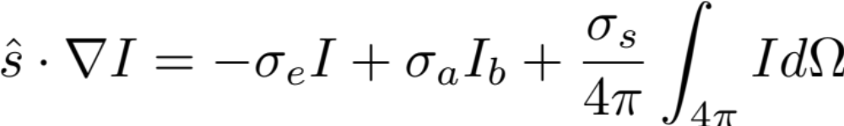
The RTE
Here it is:
Intensity depends on 3 spatial variables and 2 angular variables
(θ,φ)
dΩ
(x,y,z)

Slide 5
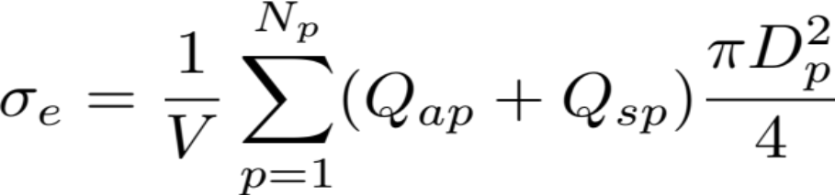
Particle homogenization
Coefficients determined by scalar particle concentration/size
Current choice: box counting

Slide 6
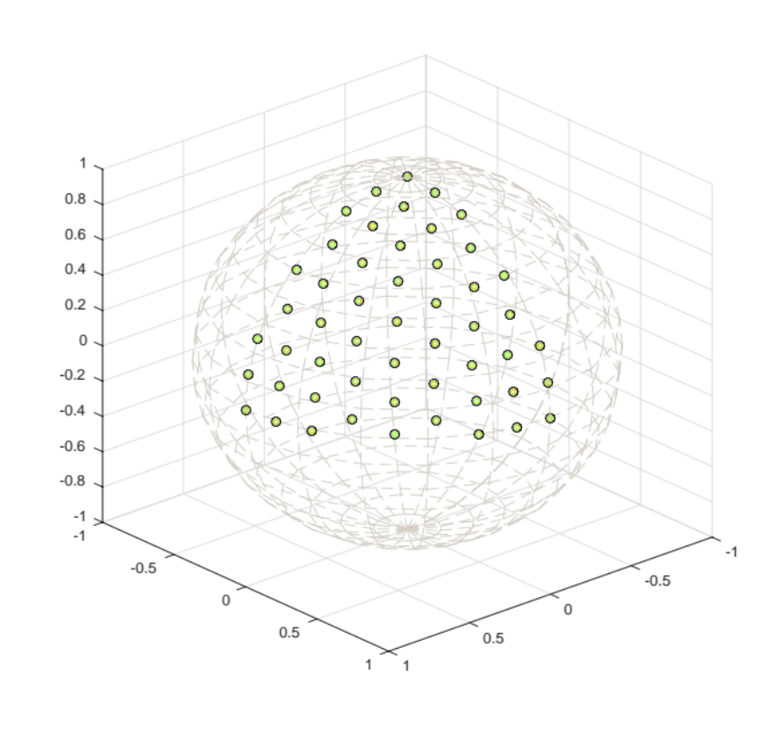
Discrete Ordinates Method
Discretize angular domain on unit sphere with point collocation
Tabulated quadrature
sets read in to code,
weights and angles
(s_{i},w_{i})
Data: I(angle)(x,y,z)
350 angles total in this set

Slide 7
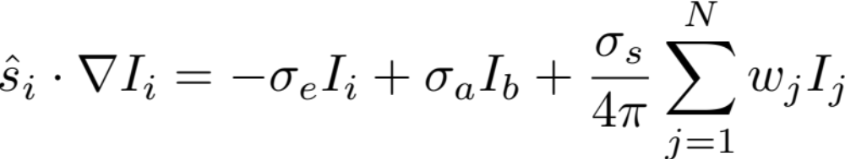
Discrete ordinates method
Now: system of coupled first-order PDEs
Could discretize in space, put in to matrix solver…
But bandwidth/size of system is huge
Standard method: iterate on summation

Slide 8

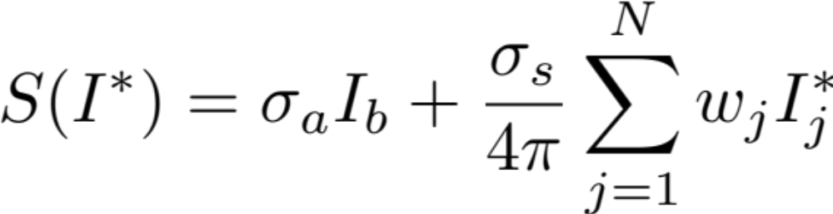
Source iteration
Iterative method:
Decoupled system of IVPs
For our problems, typically takes less than 10 iterations to converge

Slide 9
I_{i}^{b+1/2}
I_{i}^{a-1/2}
I_{i}^{a,b,c}
I_{i}^{a+1/2}
I_{i}^{b-1/2}

Slide 10

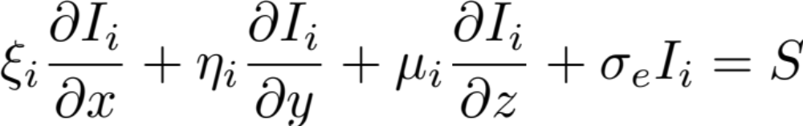
Sweeps
These problems can be solved directly
Finite difference/volume on structured grid, index (a,b,c):

Slide 11
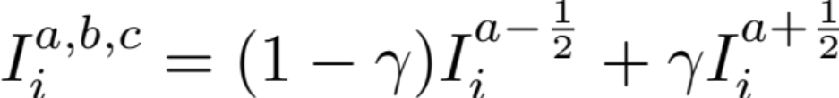
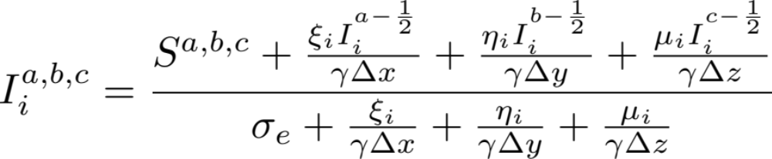
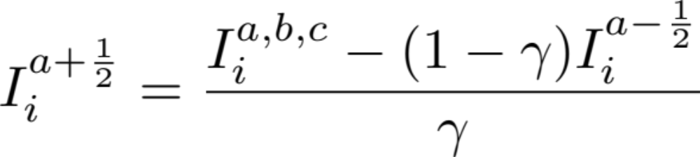
Sweeps
Auxiliary relation, choose γ=1/2

Slide 12
Sweeps
The sweep:
  For a given angle, determine sweeping direction and starting cell (corner, in Cartesian grid)
  For each sequential cell:
    Compute cell-centered intensity from entering intensities
    Compute outgoing intensities
Depending on direction,
incoming and outgoing indices change

Slide 13
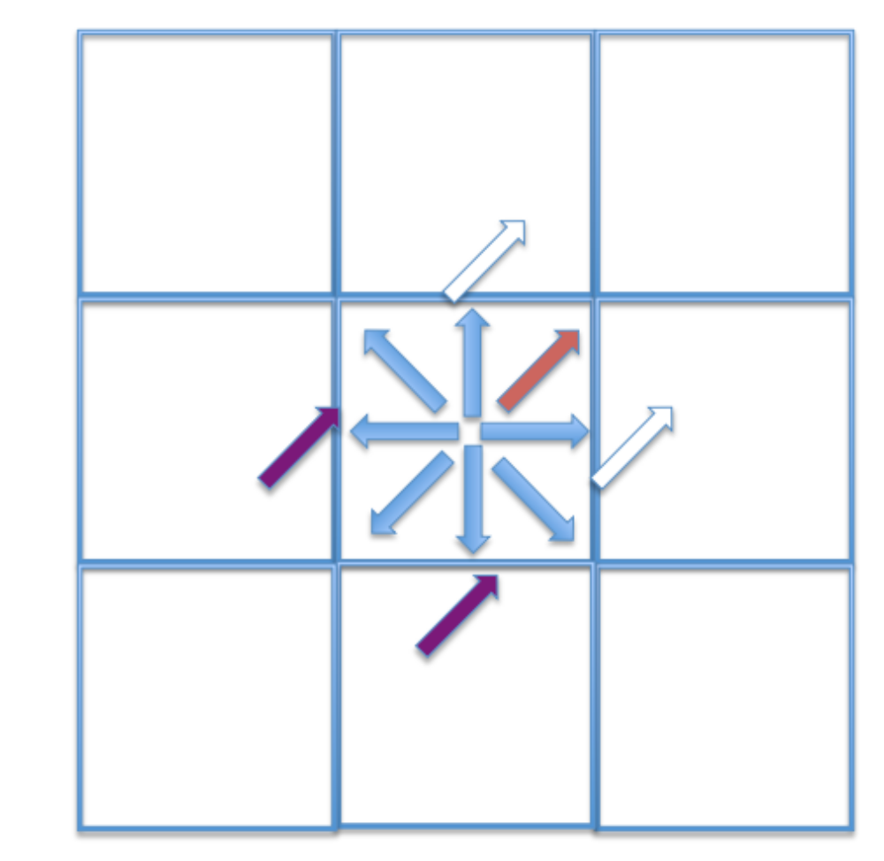
Step 1: integration
Solving for:
Assumed known:
Known:

Slide 14
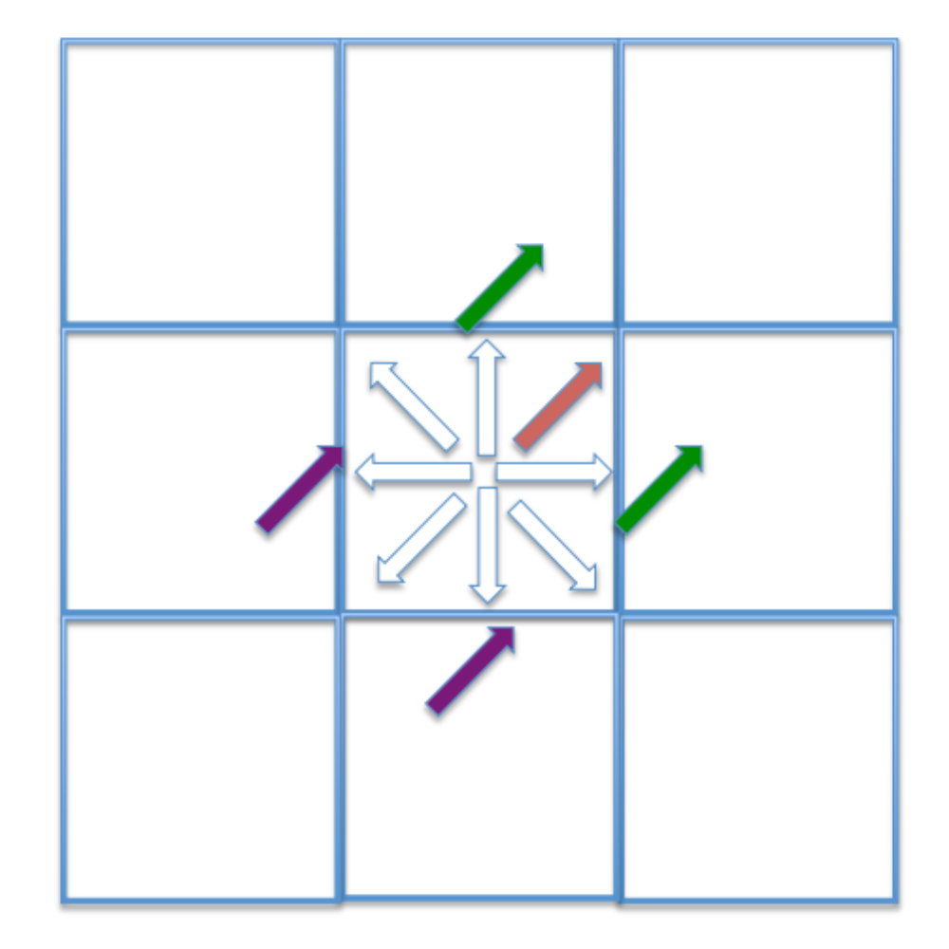
Step 2: extrapolation
Solving for:
Known:

Slide 15
Iteration
The solver:
  Make initial guess for intensity
  While not converged:
    Compute source function for each cell
    Sweep all directions to compute new intensity
    Determine residual, update guess
Guaranteed to converge!
  Diagonally dominant, bounded spectral radius independent of grid size and quadrature
When done, can compute heat transfer for a particle from intensity field

Slide 16
Special PSAAP Reqs.
Quadrature size: ~350 in cases so far, anticipate needing more in extrapolatory case
Different grids!
  Radiation spatial grid can be coarser than fluid grid
Boundary conditions!
  Lasers are highly collimated/focused
  Assuming perfectly aligned along perpendicular axis of channel
  Quadrature sets I’m using have an angle on y-axis, just set initial y-angle value to I_{o}
Solution frequency!
  Kinda expensive; solve once per time step currently

Slide 17
Code Walkthrough
MATLAB, 2D DOM solver
  Will make code available to anybody who wants it
  Will write a Python version if needed

Slide 18
Parallelization
Parallel sweeps
  Sweeps are inherently serial process
  Angles are independent in single iteration
  “Pipeline” the angles asynchronously
  Wavefront algorithm
    Non-blocking receive from upstream proc
    Sweep sub-domain
    Non-blocking send to downstream proc

Slide 19
Parallel Sweeps
The CPU layout
Sweep 12
angles
Subdomain

Slide 20
Parallel Sweeps
3 |  |  |  |  |  |  | 4
1 |  |  |  |  |  |  | 2

Slide 21
Parallel Sweeps
7 | 3 |  |  |  |  | 4 | 8
3 |  |  |  |  |  |  | 4
1 |  |  |  |  |  |  | 2
5 | 1 |  |  |  |  | 2 | 6

Slide 22
Parallel Sweeps
11 | 7 | 3 |  |  | 4 | 8 | 12
7 | 3 |  |  |  |  | 4 | 8
3 |  |  |  |  |  |  | 4
1 |  |  |  |  |  |  | 2
5 | 1 |  |  |  |  | 2 | 6
9 | 5 | 1 |  |  | 2 | 6 | 10

Slide 23
Parallel Sweeps
 | 11 | 7 | 3 | 4 | 8 | 12
11 | 7 | 3 |  |  | 4 | 8 | 12
7 | 3 |  |  |  |  | 4 | 8
3 |  |  |  |  |  |  | 4
1 |  |  |  |  |  |  | 2
5 | 1 |  |  |  |  | 2 | 6
9 | 5 | 1 |  |  | 2 | 6 | 10
 | 9 | 5 | 1 | 2 | 6 | 10
Imminent
collisions!

Slide 24
Parallel Sweeps
Domain decomposition matters!
    Volumetric versus long columns can impact scalability
    Lab people prefer long column
    But we have a CFD code that prefers volumetric
Collisions
    If/when CPU ends up with multiple angles at the same time, what to do?
    Decide on priority
Idling is possible if number of angles is very small
Yet:
  I got about 30% strong scaling efficiency from 1->4096 CPUs on Mustang (LANL)
  Texas A&M had about 70% weak scaling on Jaguar (ORNL) (1M CPUs)

Slide 25
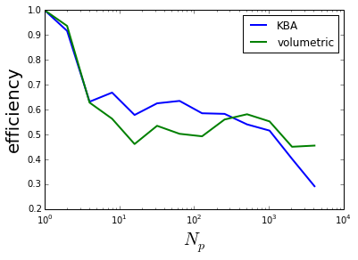
Strong Scaling, Mustang (LANL)
￼
200x200x200 grid
350 angles
~10 sweeps

Slide 26
SNAP (LANL)
S_{N} Application Proxy
Solves similar problem in similar way
Fancier features:
  Vectorized sweeps (sweep multiple angles at the same time)
  Different domain decompositions
  Hybrid architectures
Solves slightly more complex problem

Slide 27
Conclusions
DOM is a big problem
Iterative solver has nice convergence properties
Sweeps are bottleneck
  Scaling is a challenge

Slide 28
Alternatives to parallel sweeps
There are no alternatives
(But actually, here are some alternatives):
  Matrix solvers (HYPRE/PetSc/Trilinos… )
    Pros: Straightforward, black box solver
    Cons: Expensive, not studied extensively, convergence may be difficult, requires interfacing with outside libraries
  Inexact Parallel Block-Jacobi
    Pros: Only local sweeps, highly scalable
    Cons: VERY slow convergence for our cases
  Pseudo-time stepping
    Pros: Straightforward, scalable
    Cons: VERY slow convergence, will require more communications

Slide 29
Alternatives to DOM
Outside of DOM:
  Method of characteristics
    Similar to DOM, but requires tracing along lines through domain
    Likely more expensive
  Monte Carlo Ray Tracing
    May utilize particle-based infrastructure, each ray is independent
    Parallelization: by ray, by domain decomp., or mixed
    Most expensive option, variance decreases as 1/N
  Spherical harmonic expansions
    System of coupled elliptic PDEs in space
    Also expensive to formulate and solve in matrix
  Diffusion- lowest order spherical harmonic expansion
    Helmholtz equation
    Not a convergent/accurate solution, requires smoothing/regularization of particles

