Slide 1
Studaudio
Team 1: Yasser, Blain, Nolawi, and Yarency

Slide 2
Studaudio
Allowing Users to School On-The-Go with Audio

Slide 3

2. Studaudio Overview
The Problem
Pain Points:
Struggles with time management
External stress from work and school
Lack of connection with other students
Our Solution
Allows students to complete class requirements on-the-go (commuting, taking care of family, etc)
Increases accessibility to note taking and note sharing between students
Notes:
Convert assignments in text to audio vice versa
Treat readings like podcasts
Complete assignments verbally

Slide 4
3. Values In Design

Slide 5
Our Product’s Values
Workflow Efficiency
    Feature: Recording notes and having them transcribed to text, recording answers and having them transcribed into text
Simplicity and User-friendliness
    Feature: straightforward navigation options (Notes, assignments, and readings)
Notes:
Workflow Efficiency
Reducing the number of steps required to complete common activities (note taking and work submission)
Simplicity and User-friendliness
Use clear, large fonts and icons, and minimize clutter. Avoid complex navigation.
Successfully submitting work can boost one's self-esteem and confidence. The sense of accomplishment and pride associated with submitting quality work is a valuable psychological aspect.

Slide 6
Our Product’s Values
Community Engagement
    Feature: sharing notes button on task 3 (complex task)
Text to Speech (Accessibility)
    Feature: having a text to speech feature that allows users to have the questions played out loud to them.
Notes:
Fostering peer support through encouraging information sharing
Help users listen to their recorded notes or listen to the assignment questions, which can be especially beneficial for those with visual impairments

Slide 7

Design Features and Value Tensions
Workflow Efficiency vs. Simplicity and User-friendliness
Simplicity and User-friendliness vs. Text to Speech
Notes:
Define the values you intend to encode in your product
Which design features or decisions express these values?
Do any value tensions arise as a consequence of your design decisions?
Value tensions between
Workflow Efficiency vs. Simplicity and User-friendliness
Efficiency: To enhance workflow efficiency, we introduce features that reduce the number of steps required for common activities such as note taking or submitting work online.
Simplicity and User-friendliness: For older adults, a straightforward and user-friendly interface is essential. Complex workflows and features may cause confusion.
The tension arises when trying to streamline processes to the point where features may not be intuitive to use, and it might introduce complexity and reduce user-friendliness for older students, a domain that is not always tech-savvy. Balancing efficiency with simplicity is crucial.
Workflow Efficiency vs. Self-Esteem and Confidence
Efficiency: An overly efficient and minimalistic design for Studaudio might minimize user involvement in tasks, potentially reducing their sense of accomplishment.
Self-Esteem and Confidence: Encouraging a sense of accomplishment can boost self-esteem, confidence, and belonging and make them feel great about their learning journey.
The tension emerges when an efficient/super minimalistic design makes tasks too simple or automatic, and it may potentially undermine the user's sense of personal achievement. Because of this, striking a balance is important to ensure that users feel in control and empowered in their learning process as older students who have returned to school.
Simplicity and User-friendliness vs. Text to Speech
Simplicity and User-friendliness: A simple and user-friendly design often focuses on visual elements like clear fonts and icons, and making sure everything is easy to read and navigate.
Text to Speech: While text-to-speech can aid users with visual impairments, it introduces a new layer of complexity related to audio interfaces.
The tension arises when adding text-to-speech functionality may require additional elements in the interface, potentially complicating the design as we work towards the hi-fidelity prototype. Maintaining a balance between simplicity and accessibility is essential.

Slide 8
4. Tasks

Slide 9
Tasks
Simple: Submitting an assignment
Moderate: Converting a file into an audio format
Complex: Creating and sharing audio notes from a class
Notes:
Simple: Studaudio empowers seamless audio-to-text transcription for productivity on-the-go.
Moderate: Studaudio facilitates the conversion of PDF text to audio, ensuring information is accessible in multiple formats, catering to varied learning preferences.
Complex: Lastly, Studaudio goes beyond the ordinary. It enables users to upload and share notes seamlessly, fostering a collaborative learning environment.

Slide 10
5. Usability goals & key measurements
Notes:
2 usability goals and 2 key measurements identified in Assignment 5
How is your product progressing towards hitting these goals?

Slide 11
Usability goals
Learnability
Looking to prioritize intuitive design, clear instructions, and minimal learning curve
Consistency
Consistency in design and interaction patterns can help users predict how the product works
How we’re contributing to these goals:
Reflecting feedback on confusion in our revisions
Consistent font sizing, object sizing, color use
Consistent presence of important buttons
Notes:
Making sure our design reflects the feedback given to us
Ensure that font-choices, object sizing, and color themes are consistent throughout the app
Ensuring that important buttons are consistent throughout app

Slide 12
Key Measurements
Time Spent on Task
Goal: Decrease time spent on task
Error Rate
Goal: Minimizing errors made when completing tasks
How we’re contributing to these goals:
Incorporating feedback
Removing duplicate/error-prone buttons
Iterative testing
Notes:
Revising tasks to incorporate feedback from testers
Ensuring that there are no buttons that are confusing or have the potential to cause error (submit and done buttons)
Continuing to test the prototype with further participants resulting in iterative updates and changes to prototype

Slide 13
6. Changes made from low-fi in A5

Slide 14
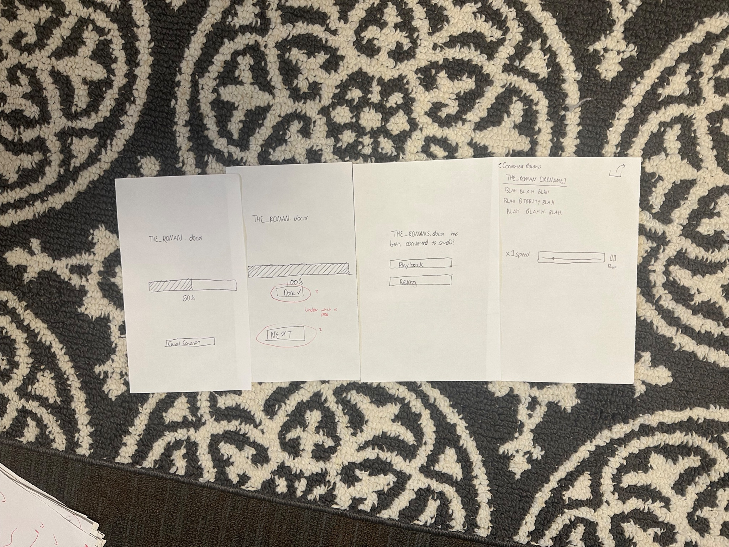
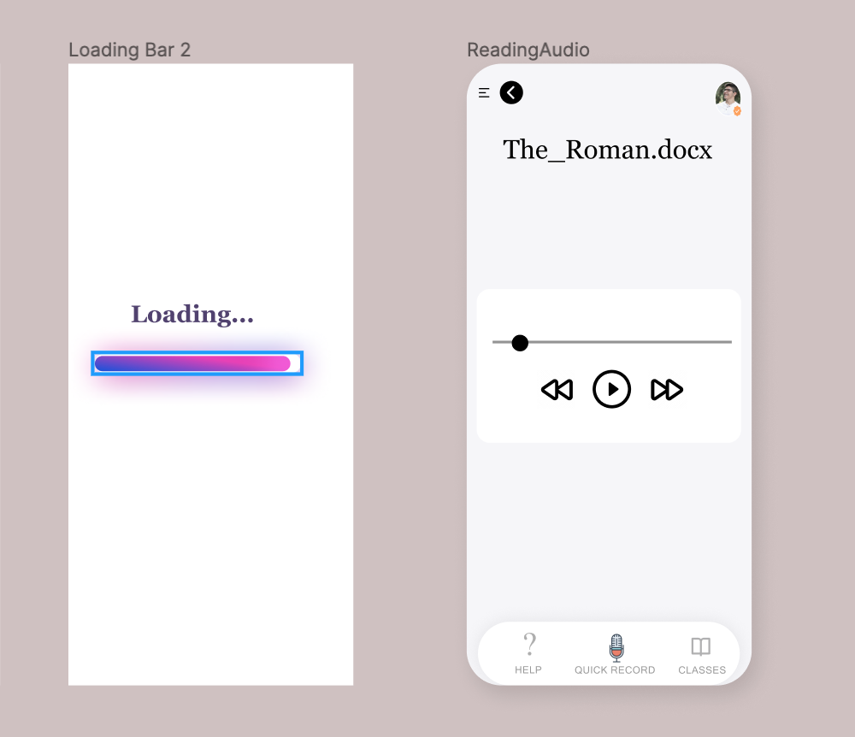
Reducing Buttons And Slides (Moderate) Pt. 1
Notes:
Removed buttons in Moderate task
The “Done” vs “next” button were confusing to users (direct suggestion and feedback from 2 Foothill college students)
Also some noted that it took a while from when the download had finished to actually be able to access the text
Removed the whole screen so that once a user had downloaded the reading, they could immediately access it.

Slide 15
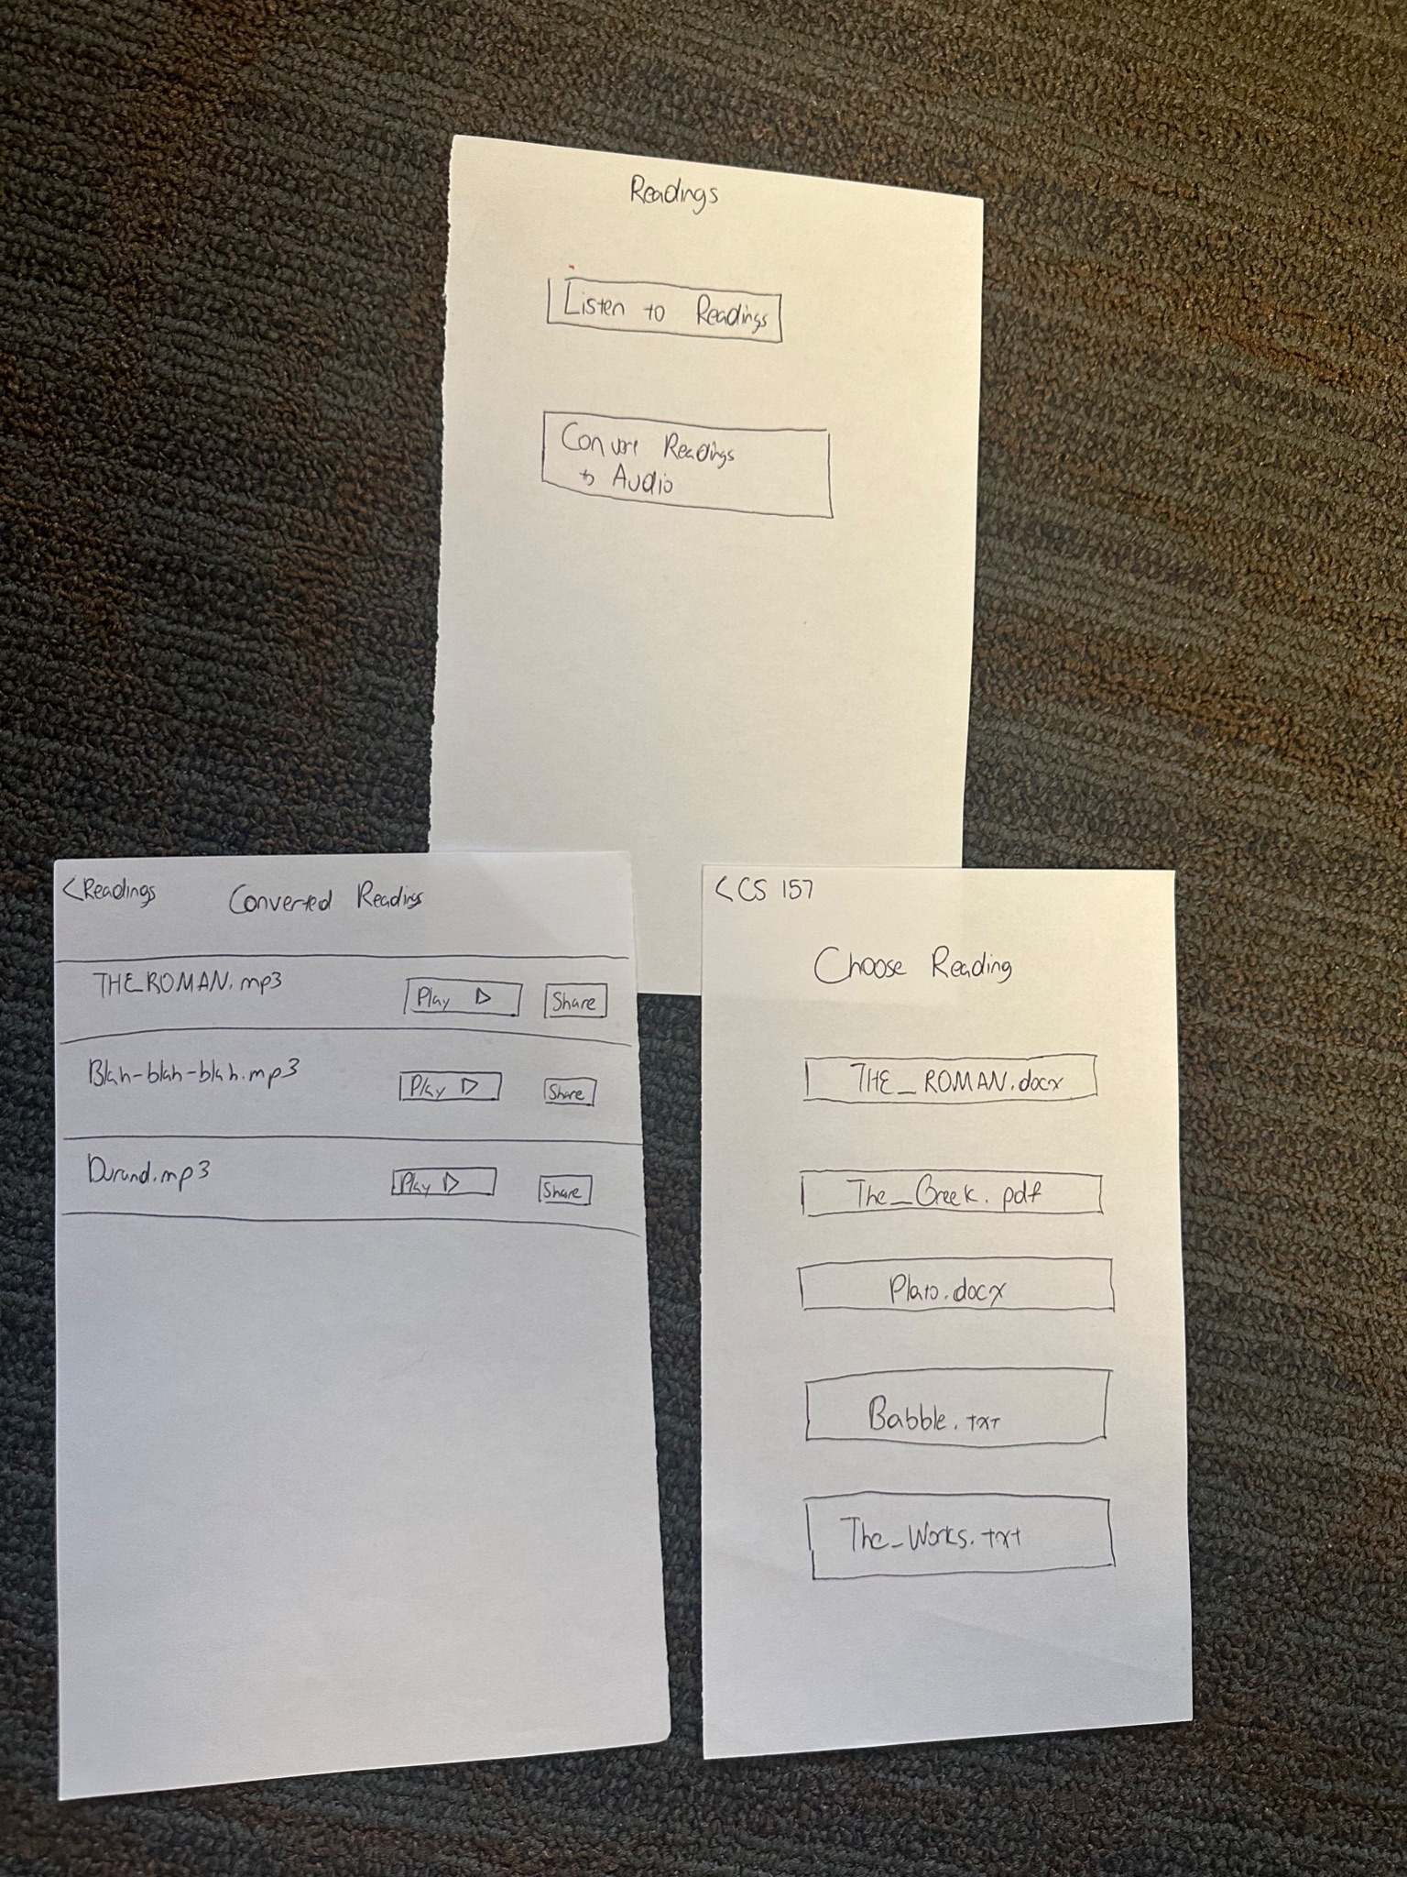
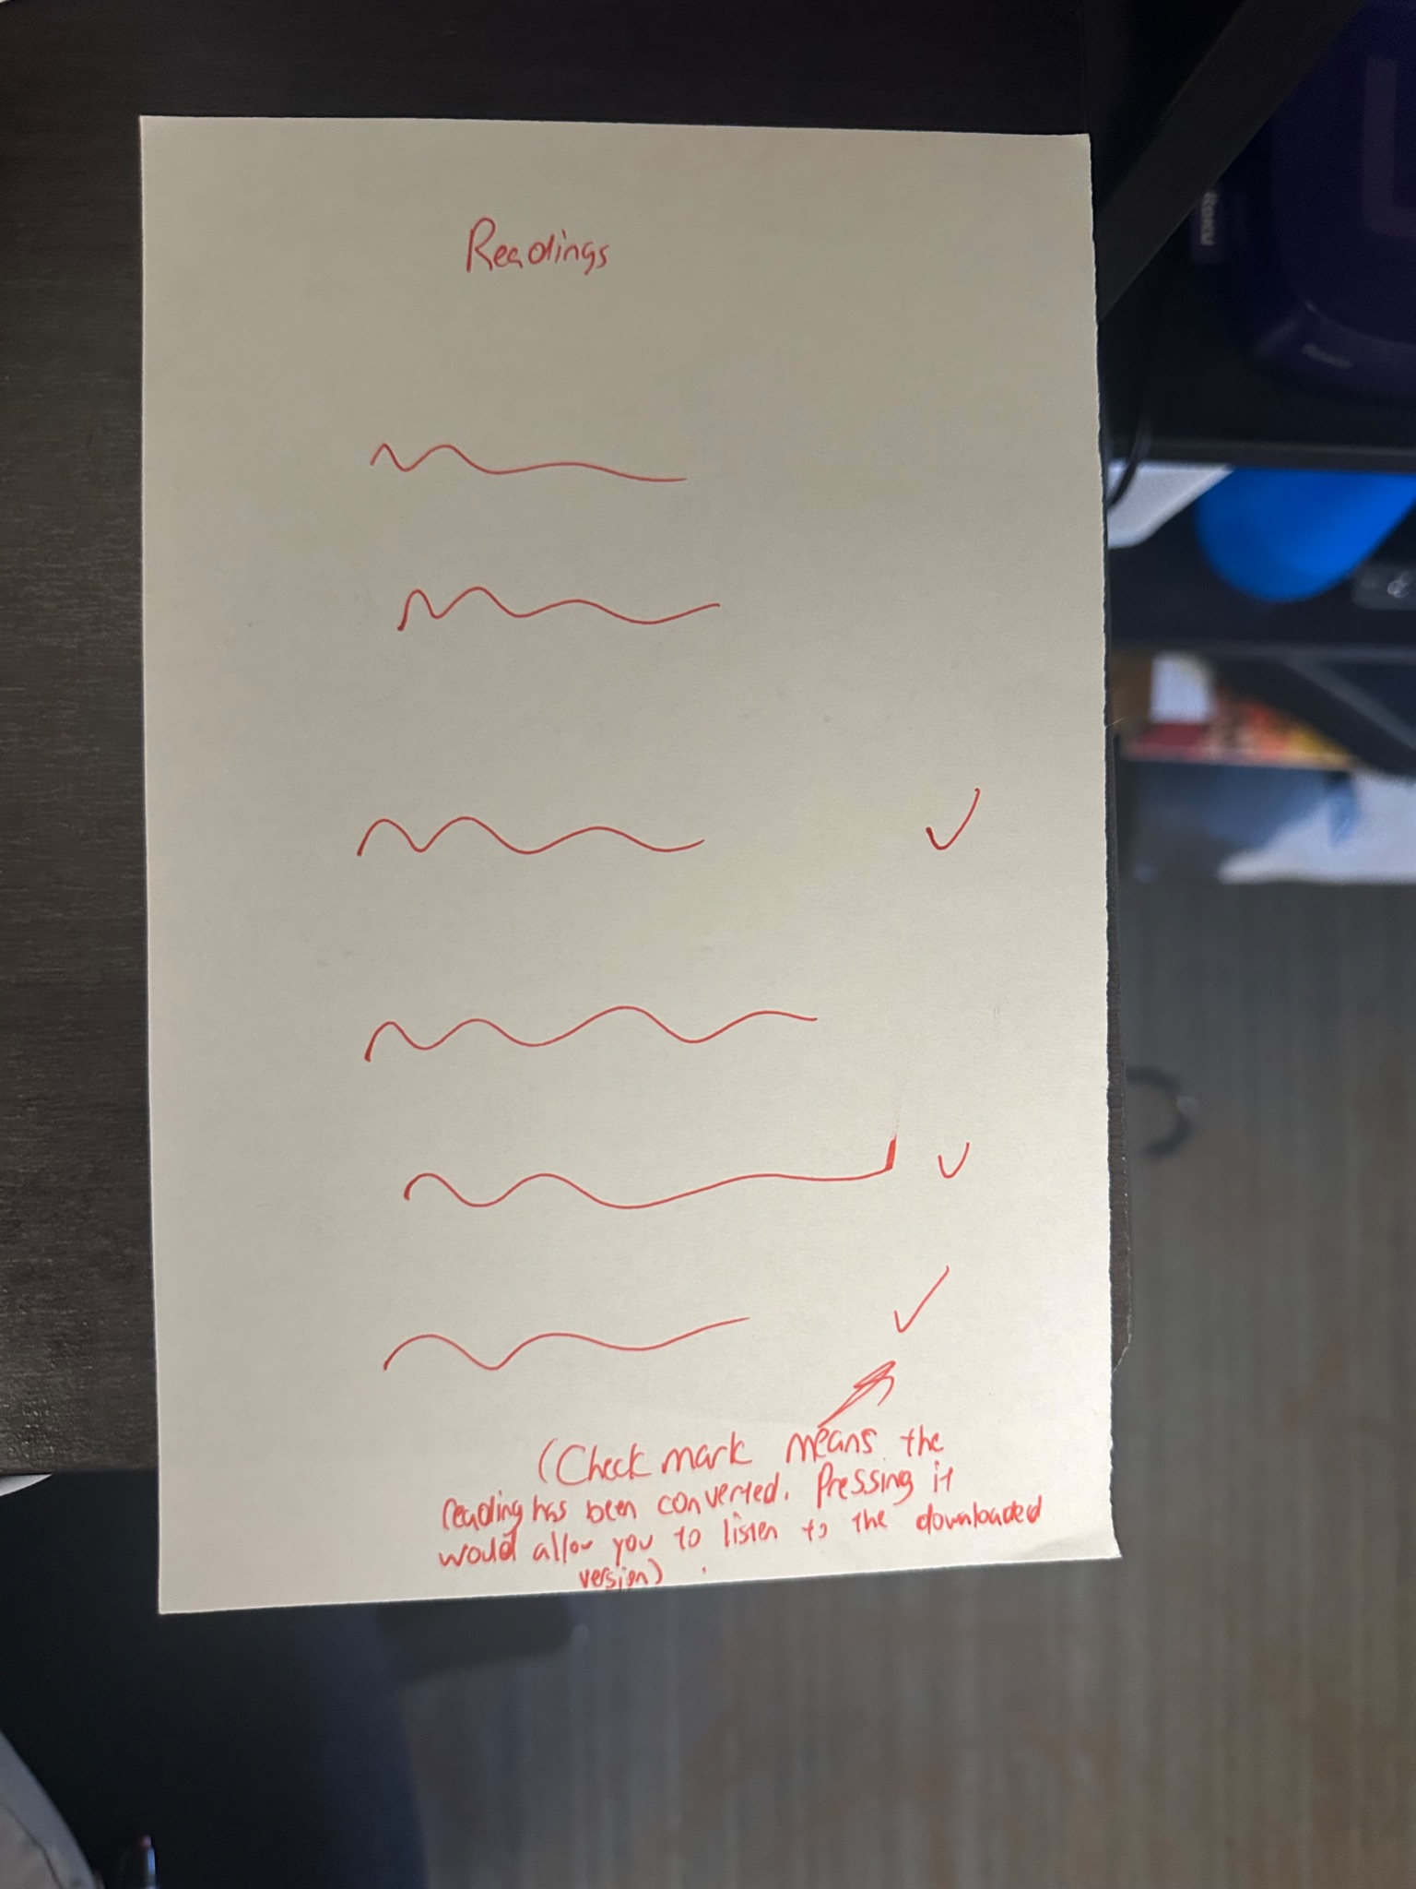
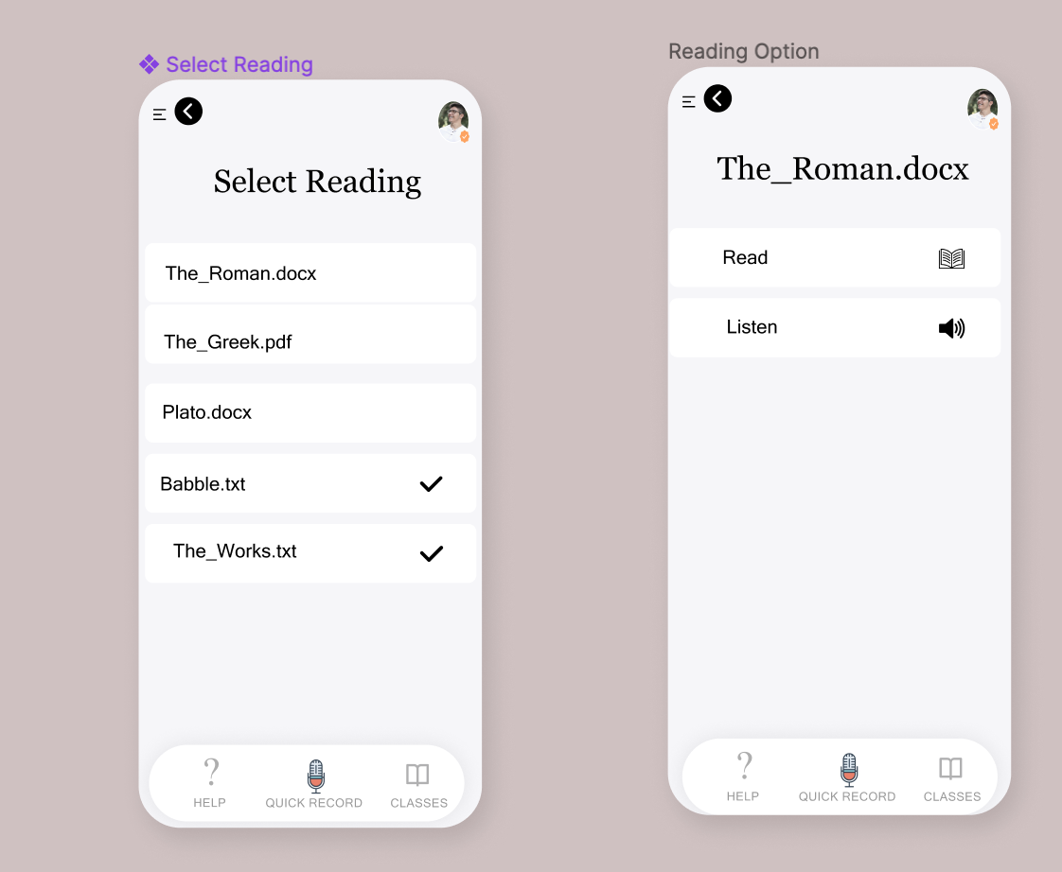
Reducing Buttons And Slides (Moderate) Pt. 2
Notes:
Confusion on “convert readings” vs. “listen to readings”
By making it all one screen with check marks to show converted readings, we reduced the amount of thinking a user would have to do

Slide 16
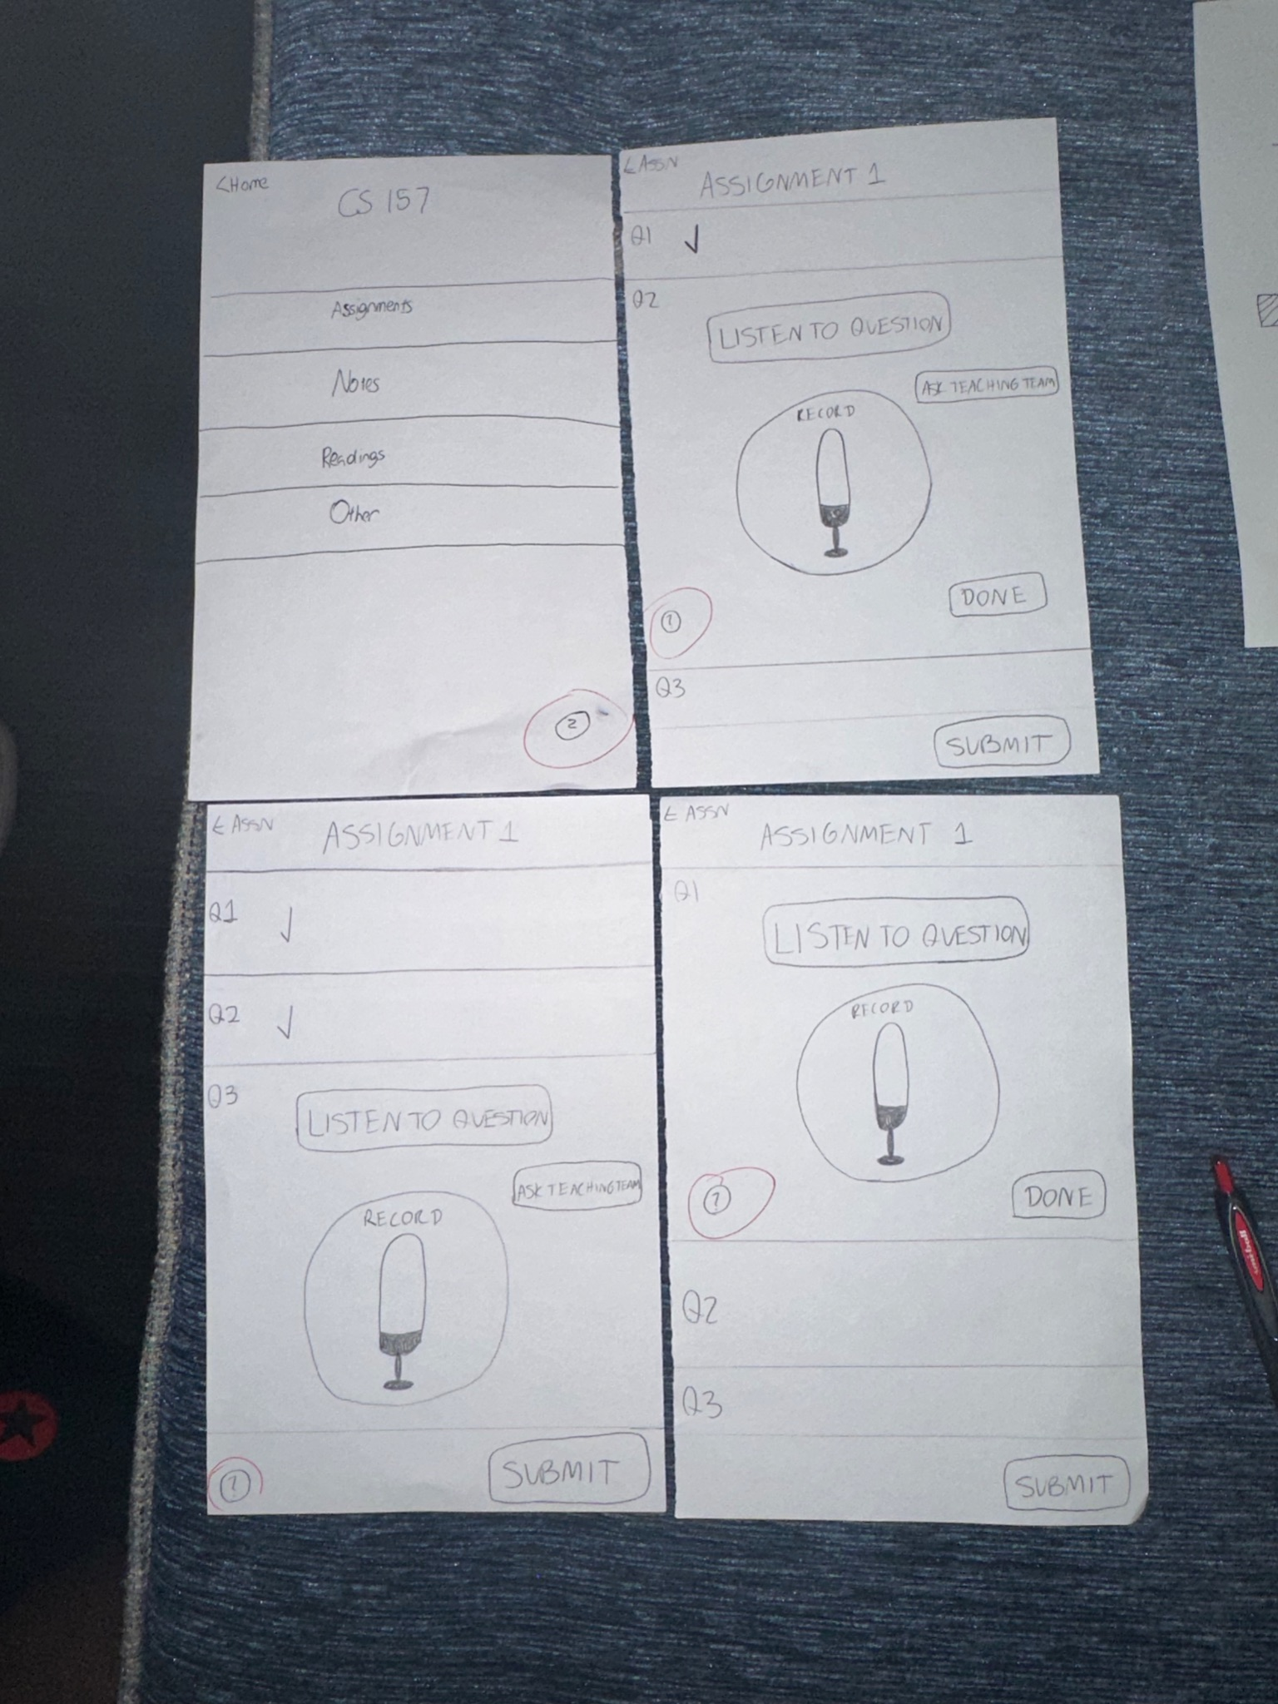
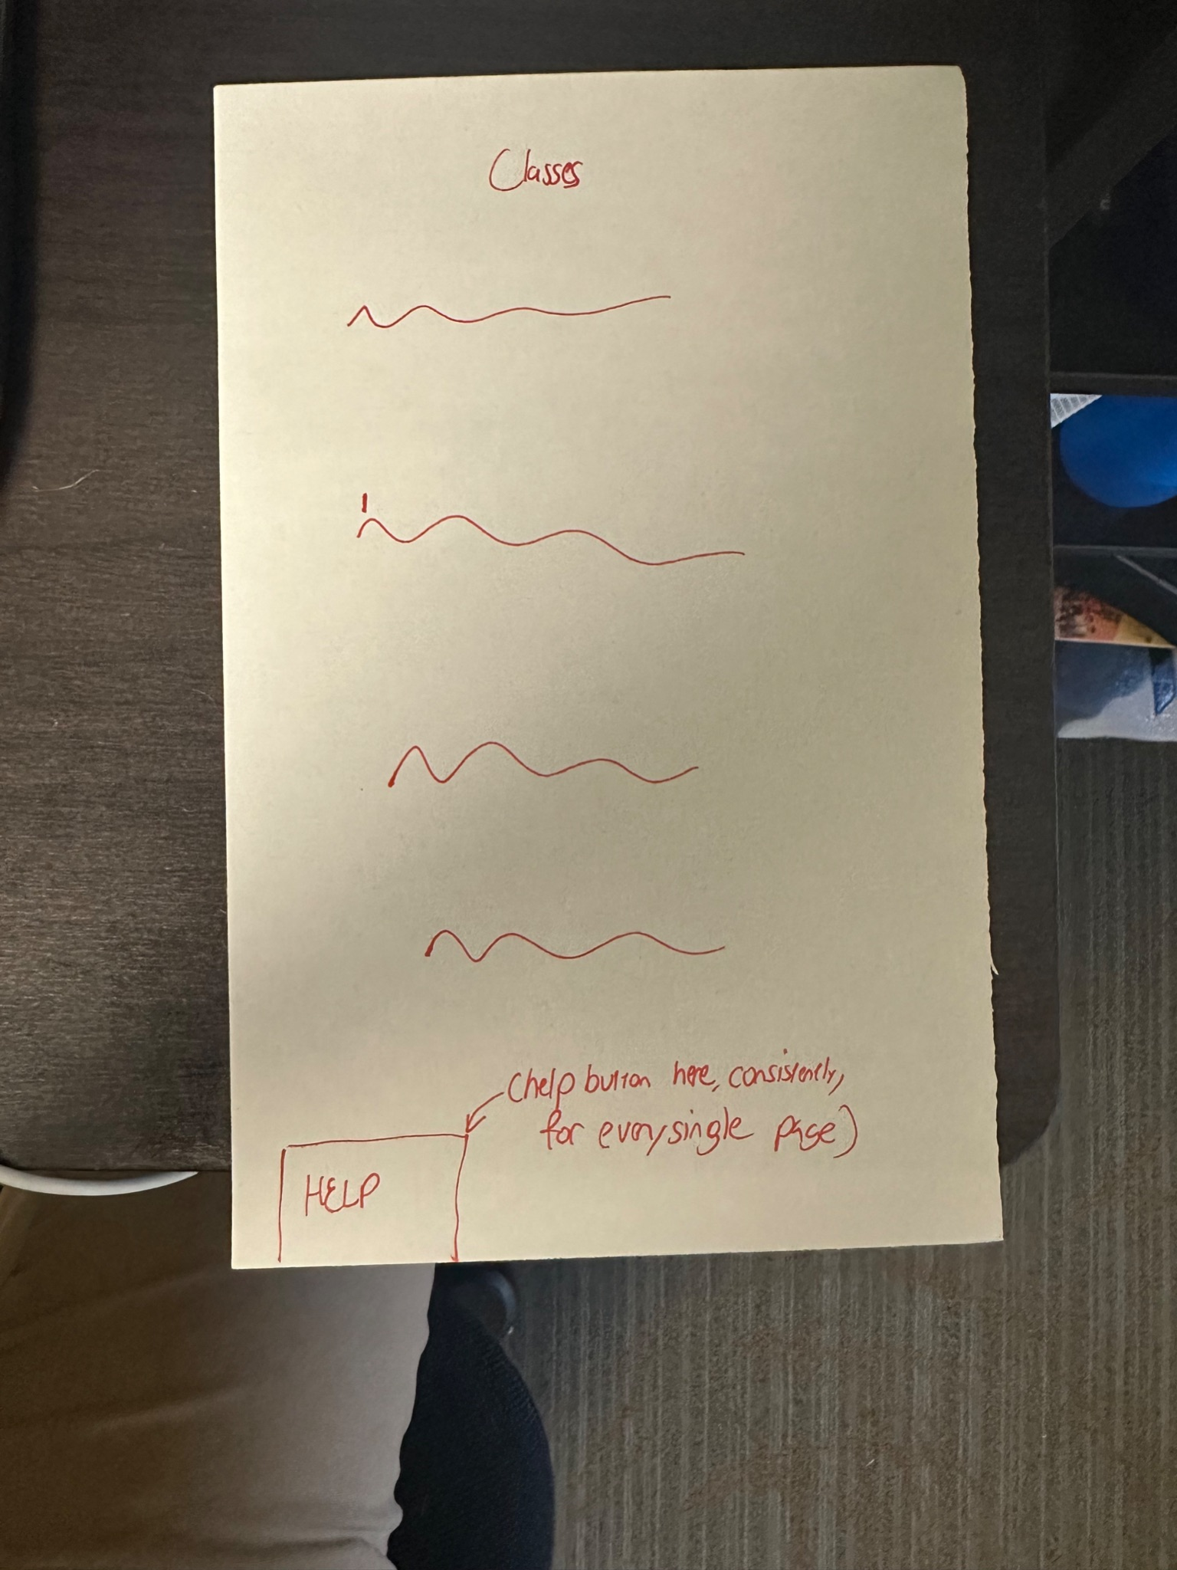
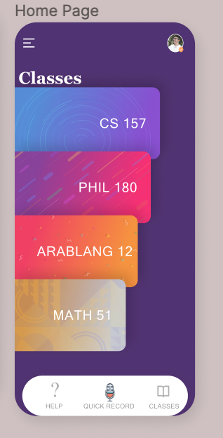
Help Button Overdone(Entire prototype)
Notes:
Help button
Initial Low-fi had “help” buttons everywhere on Assignments page
Confusing to users as to whether it was helping different parts of the project, etc.
Pointed out by 1 foothill college student, and all four developers agreed that help button needed to be simplified
By including a single help button for the entire app, we’ve simplified the user experience by having the option be in a consistent space on the page.

Slide 17
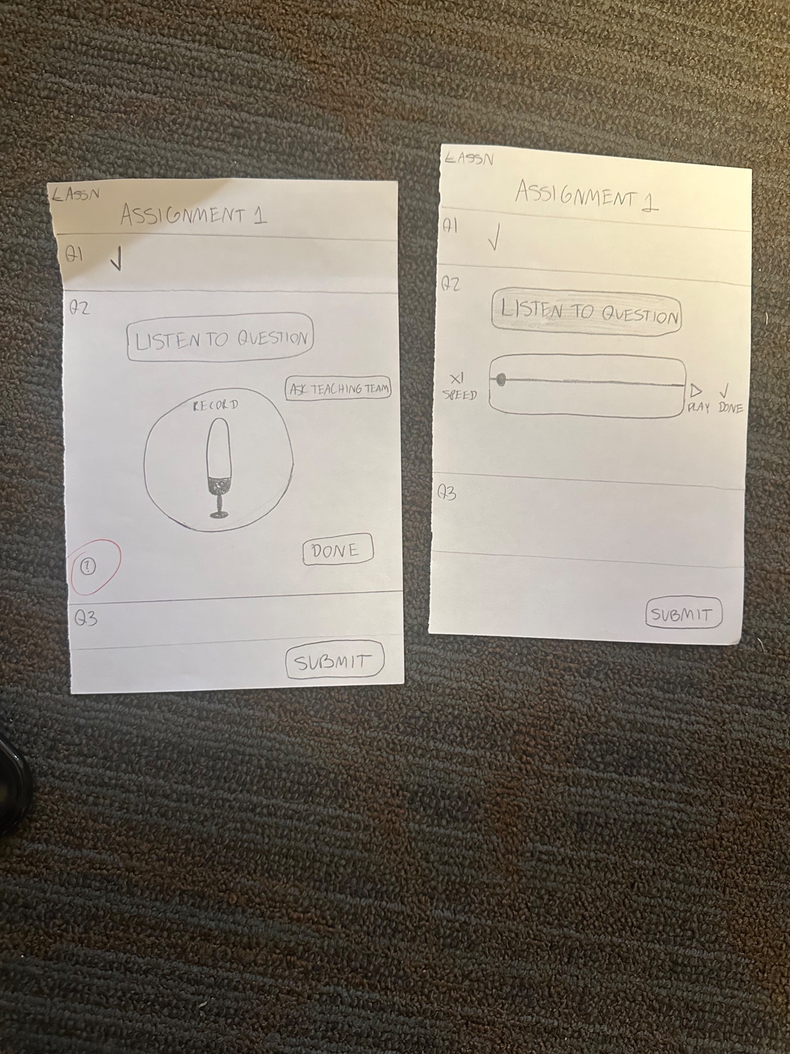
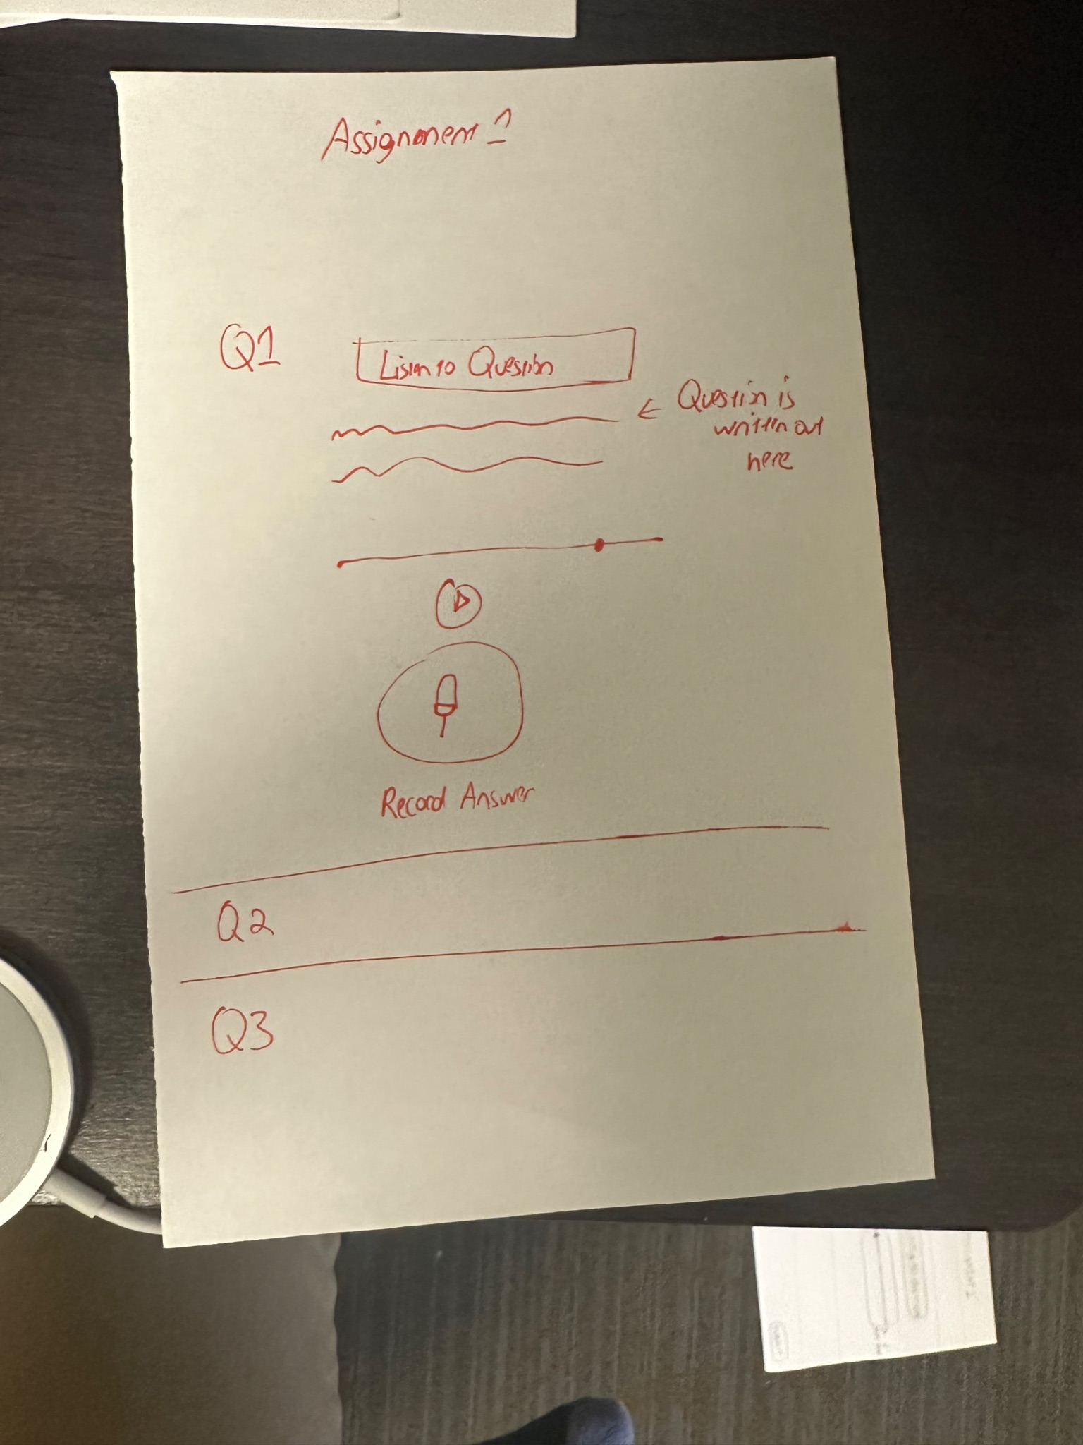
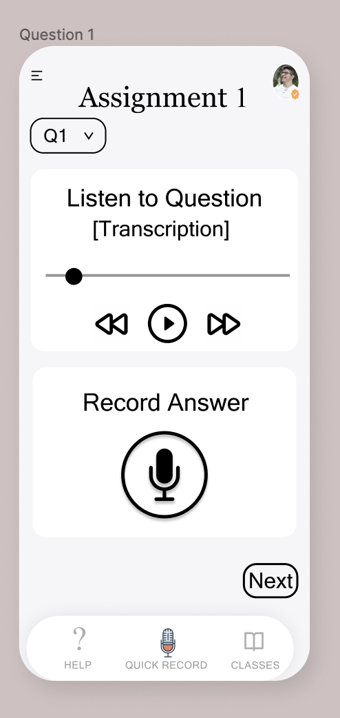
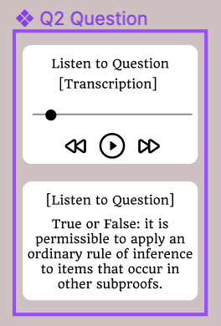
Question Written Out (Simple)
Notes:
2 Users (foothill college students) noted that they would like to be able to see the questions written out, even if they have the option to listen to them
We added this so they can see it.
Suggestion was incorporated due to its value when commuting in non-driving scenarios such as taking bus or carpooling

Slide 18
Future Implementations
Playback Speed button
Add feature to manually edit transcribed text through typing
  Could also be potentially edited through audio in the future

Slide 19
Revisions => Usability Goals & Measurements?
How these changes aid in progressing forward with usability goals and measurements:
One help button => ease use of app, consistent throughout
Less crowded app and reduced yet straightforward buttons increases learnability
Decisions make it more likely for users to finish their tasks quicker and with less errors
Decisions executed based on UI testing behaviors we noted:
Confusion with “next” and “done” buttons in task 2
  Reduced io just one button
Took suggestions into consideration for writing out questions
  Less for users to remember
Notes:
A lot of these revised sketches and examples can be found in the slides prior to these. This slide is meant to highlight our motives for incorporating design changes.
How these changes aid in progressing forward with usability goals:
One help button => ease use of app
Less crowded app and reduced yet straightforward buttons increases learnability for non-technical users
Decisions executed based on UI testing behaviors we noted:
Confusion with “next” and “done” buttons in task 2
Reduced it to just one button
Took suggestions into consideration for writing out questions
Makes it easier for users, who can see a question rather than having to remember it when trying to answer.

Slide 20
7. Medium-fi task flows
Notes:
1 task flow per task
Annotated screenshots from your medium-fi prototype (arrows indicating transitions, relevant labeling, captioning, etc.)

Slide 21
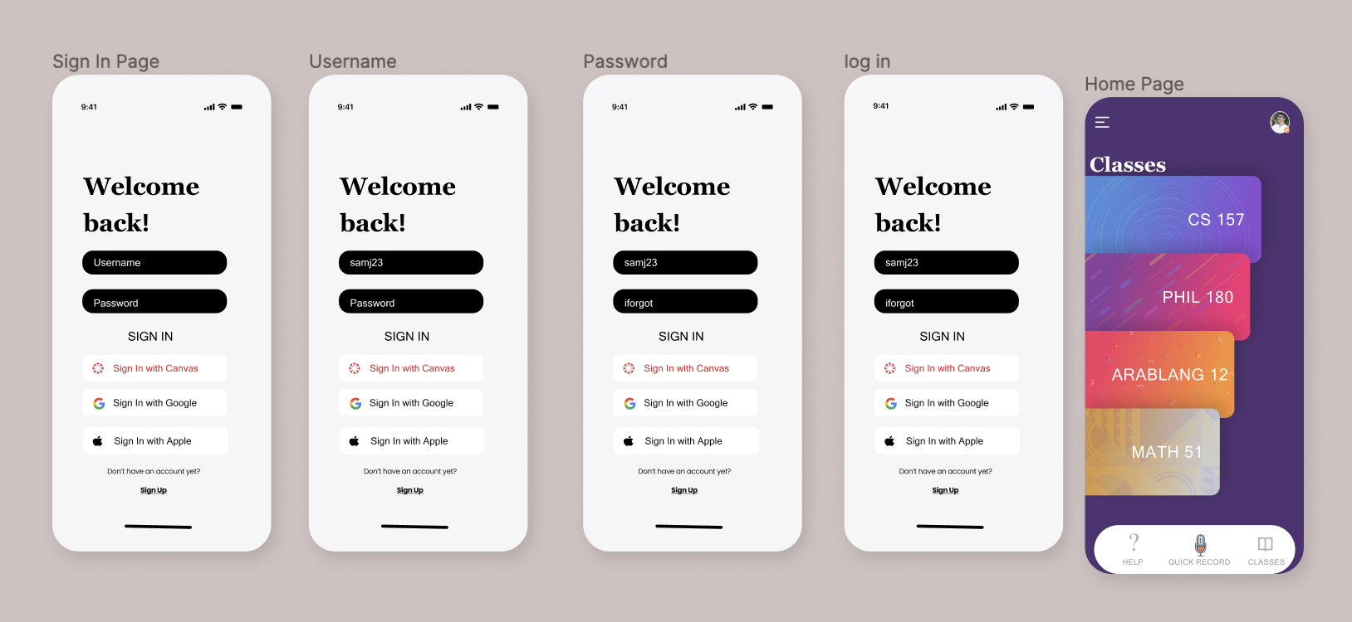
** = can create account with Canvas
Homepage with classes once logged in
Sign-in
Can press on any class & it takes you to new screen
**
Help = page with tutorials on how to use app
Quick access to record audio notes
Notes:
1 task flow per task
Annotated screenshots from your medium-fi prototype (arrows indicating transitions, relevant labeling, captioning, etc.)

Slide 22
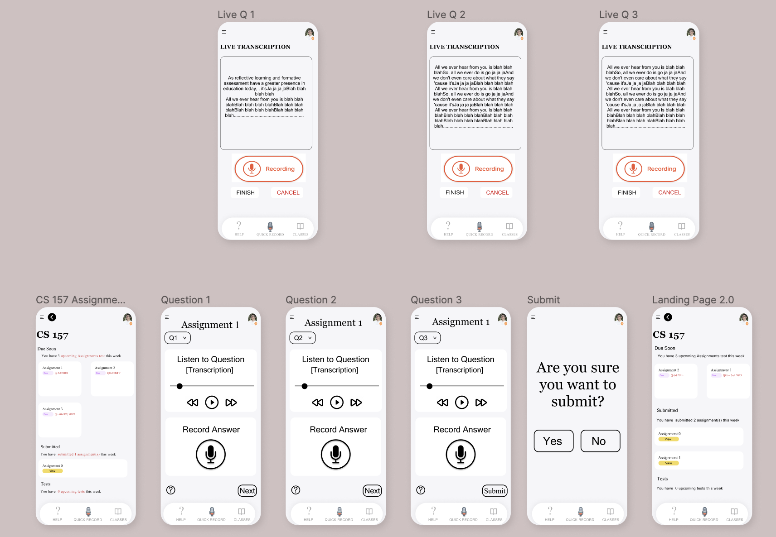
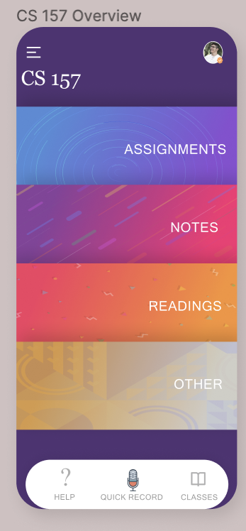
Simple Task
Notes:
1 task flow per task
Annotated screenshots from your medium-fi prototype (arrows indicating transitions, relevant labeling, captioning, etc.)

Slide 23
Simple Task
Main page of CS157 once you select it in navigation of classes
Assignments takes you to assignments page for cs157
Record answers to assignment 1
Record answers to assignment 1, q2
Record answers to assignment 1, q3
Assignment 1 for cs157
Shows submitted assignments
** confirmation button to submit assignment
Notes:
1 task flow per task
Annotated screenshots from your medium-fi prototype (arrows indicating transitions, relevant labeling, captioning, etc.)

Slide 24
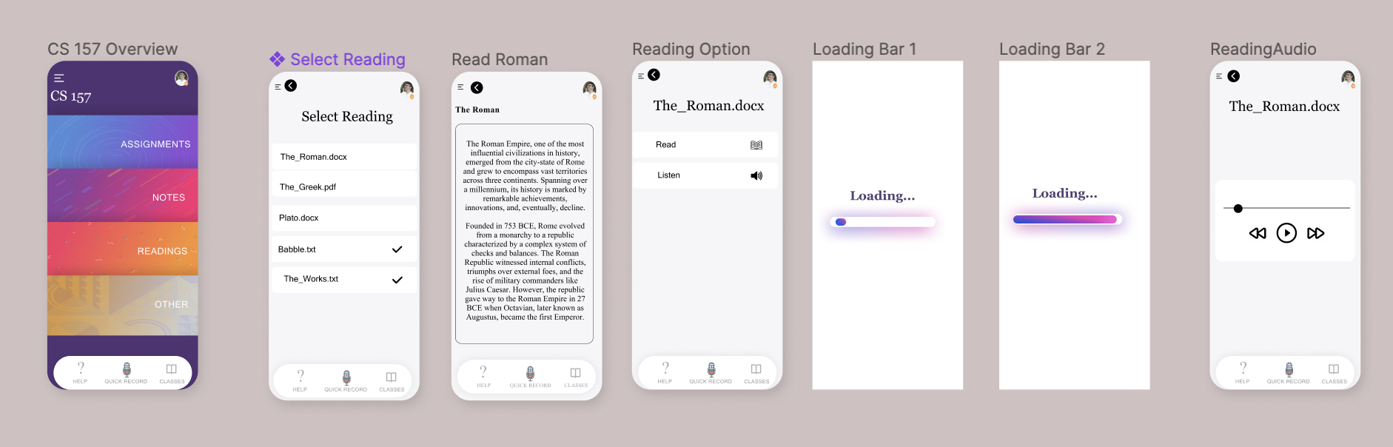
Moderate Task
Notes:
1 task flow per task
Annotated screenshots from your medium-fi prototype (arrows indicating transitions, relevant labeling, captioning, etc.)

Slide 25
Moderate Task
Select reading -> loading bar 1 -> loading bar 2. This process converts the reading file into an mp3 file
** what it looks like to listen to the audio
Uploaded reading file
Once reading file has been converted to mp3, users can choose to listen or to read it
Notes:
1 task flow per task
Annotated screenshots from your medium-fi prototype (arrows indicating transitions, relevant labeling, captioning, etc.)

Slide 26
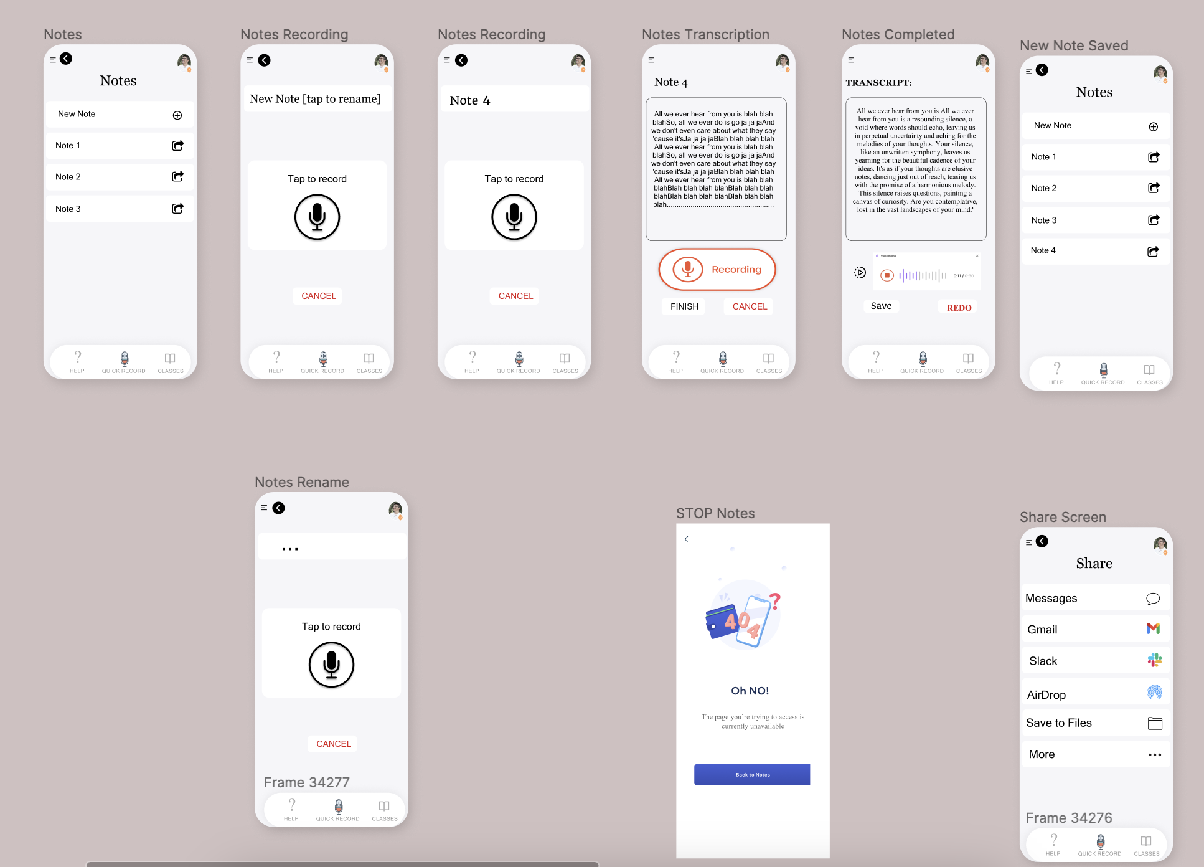
Complex Task
Notes:
1 task flow per task
Annotated screenshots from your medium-fi prototype (arrows indicating transitions, relevant labeling, captioning, etc.)

Slide 27
Complex Task
User makes a new note
User renames new note
User starts recording audio note & it’s being transcribed to text
User starts from CS157 homepage and navigates to “Notes”
*
Saved note
**
** = Cancel discards note in progress and takes you back to Notes Recording page
Option to rename note
* = playback speed (not implemented yet)
Share notes button
Notes:
1 task flow per task
Annotated screenshots from your medium-fi prototype (arrows indicating transitions, relevant labeling, captioning, etc.)

Slide 28
8. Prototype implementation

Slide 29

Tools, Pros & Cons, and Limitations
Tool we used: Figma
Pros of Figma | Cons of Figma
Easy to use Flexibility in designing UI Easy to connect screens to create ideal user flows Collaborate with team members on same prototype | Cannot incorporate audio Cannot be used offline Less realistic animations Subscription needed to access fonts and other features

Slide 30


Tools, Pros & Cons, and Limitations
Limitations in our design:
Left out audio use (conversion of text to audio, playback speed)
App currently designed to only work with Canvas
App is not fully functional (not all buttons clickable)
Notes:
The app is currently designed to work only for students with access to canvas, as Canvas would allow us to access things such as a user’s course list and list of readings that we can’t find in other places. This limits our users to Canvas users only as of now. One of our stretch goals is to add other platforms such as Blackboard, so that every student has their school’s online course platform on our app. In addition, one big portion of our app is its usage of audio, namely allowing students to submit assignments, create notes, and listen to readings purely through the recording of their audio and transforming text into audio playable versions. However, Figma currently does not support the use of audio, and there are no current prototyping tools available to workaround this. Though there exists a plugin to support audio, it would require every user testing the prototype to install this plugin, resulting in unnecessary work for the tester. Thus, as a workaround we simulated this audio experience by adding titles like “recording in progress” and displaying the microphone so that users still understand the functionality. Finally, we only added functionality to the screens that are needed to execute the three core tasks outlined above. Thus, there are several buttons that do not work such as clicking on the help button or the quick record button. Because we are focused on prototyping the parts of the app that most users will be accessing (submitting an assignment, listening to a reading, and creating a new note), these additional features were not fully fleshed out in this prototype.

Slide 31


Tools, Pros & Cons, and Limitations
Hard-Coded features
User profile & information
Courses & corresponding content (Assignments, notes, readings, etc)
Wizard-of-Oz features
Conversion of text into audio
Submission of assignments (syncing StudAudio with Canvas)
Notes:
Hard-coded features:
User profile & information
Why? As we currently do not have a backend system with a list of users, we had to hard code a sample user as seen in the log-in page in order to test the main components of the app
Courses & Corresponding Content (assignments, notes, readings, etc)
Why? Similarly with the user, because we do not have a database to store the user and all of their course-related information, we had to hard-code sample courses in order to demonstrate the three key tasks
Wizard-Of-Oz Items
Conversion of text into audio
We are unable to utilize an API in Figma to take in an actual pdf and convert it into an audio format as outlined in task 2. Thus, we needed to “fake” this and are currently simulating the ability to play an mp3 file of the converted reading
Submission of assignments
When a user clicks submit after answering all the questions on an assignment, we magically update the Assignment home screen to move the assignment from the due soon section to the submitted section with the understanding that the assignment is also now submitted on Canvas. In reality we would need to sync the app and its data to Canvas so that the assignment is not only submitted on StudAudio, but also on Canvas. However, due to the limitations of figma we are unable to actually provide this connection

Slide 32
9. Appendix / Link to Figma

