Slide 1
Education For Adults
Blain, Nolawi, Yarency, Yasser

Slide 2
Project Name and Value Proposition
Who we are: connectEd
  Our app is based around connecting older adults together so we wanted to include the word connect somewhere in the name
  Focusing not just on any older adult, but specifically connecting adult learners who are taking the same courses or attending the same schools
    Thus, we are combining the social and educational benefits of learning into one -> connection + education -> connectEd
Value Proposition
  connecting people through learning

Slide 3
Problem Solution Overview
Primary User:
Older adult learners looking to connect with classmates in-person
Problem:
As discovered during our interviews, older adults want to form in-person connections, regardless of whether they are taking courses in-person or virtually. Older students have the pain points of feeling socially disconnected from their peers and lacking a strong sense of community, and don’t have the resources to easily foster new connections
Solution:
A platform that connects older adult students to classmates taking the same courses, giving suggestions of students based on interests, age, geographic location, and classes. Also allow students to form or attend larger group social events such as study groups or supports students to host their own event

Slide 4

Market Research: Slack
What’s Slack?
Slack is a top-down chat organization - even within groups it can come off as administrative, rather than natural
What hasn’t worked for Slack
Information Overload: keeping up with numerous channels may be overwhelming
Notification Fatigue: too many notifications can cause fatigue, cause users to miss important messages
Work-life balance: can blur the boundaries between work, school, and personal life. May cause difficulty in disconnecting from the platform to relax
Complexity: numerous feathers, integrations, and customization options can be overwhelming for non-tech savvy users
Privacy Concerns: conversations are stored and accessed by administrators. Users may have concerts about the privacy security of their messages
Misuse: may have irrelevant or excessive messages, off-topic conversations

Slide 5
Market Research: Slack
What has worked for them?
Real time messaging: allows instant messaging and real-time communication
Organization and Search: provides structured way to organize conversions into channels
Customization: allows users to create channels, set notification preferences
File sharing: simple to share files and work across devices
Channel-Based Communication: provides structures way to organize conversations
Mobile-Accessibility: ensures users can access messages and information wherever they are

Slide 6
Market Research: Slack
What makes your solution concept unique?
Slack is a top-down chat organization - even within groups it can come off as administrative, rather than natural. Not many classes use Slack.

Slide 7

Market Research: Canvas
What’s Canvas?
Central platform for teachers to assign homework, communicate with students, and manage their class
What hasn’t worked for Canvas
User Interface: canvas user interface unintuitive or difficult to navigate for non-tech savvy older adults
Lack of Customization: Canvas may limit the level of customization available to instructors and students, making a personalized and flexible learning experience more difficult
Limited Mobile Experience: the mobile app version of Canvas might not be as user-friendly or feature-rich as the desktop version
  can be a drawback for users who prefer mobile learning
Instructor Practices: a students experience with Canvas is heavily influenced by the practices and choices of their instructors
  Instructors who do not effectively utilize Canvas may lead to a negative perception of the platform
Course Content: if the course content and materials are not well-organized or engaging, students may associate their dissatisfaction with the learning experience with the platform itself

Slide 8
Market Research: Canvas
What’s Canvas?
Central platform for teachers to assign homework, communicate with students, and manage their class
What has worked for Canvas
Collaboration Features: has features like discussion boards, group assignments, and peer reviews
Accessibility: ensures that users with disabilities can use, provides screen reader and keyboard navigation
Grading and Assessment: efficient grading features for instructors, provides valuable feedback for students
Integration Capabilities: integrates third-party tools and services that can improve learning
Institutional Integration: many educational institutions have adopted canvas, consistent platform for students

Slide 9
Market Research: Canvas
What makes connectED unique:
connectED aims to increase the engagement of students with their education by instilling confidence in olders students to create connections that will lead to opportunities in partnerships and group work, which enhance their learning journey. This solution aims to veer from having to work with class portals where with administration involved

Slide 10
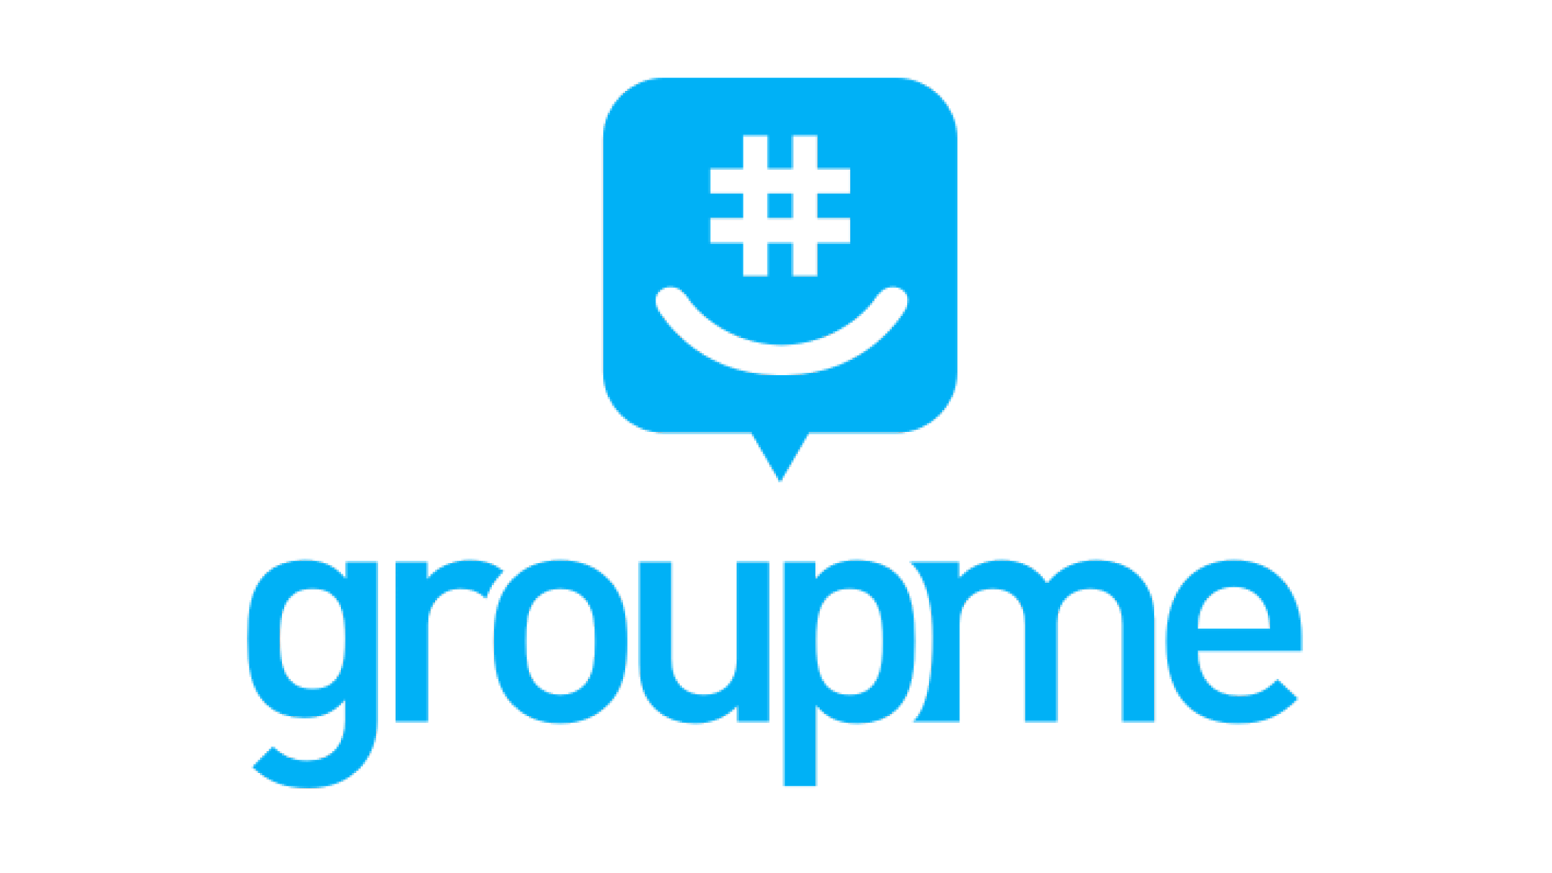
Market Research: GroupMe
What is GroupMe?
Group messaging app that allows users to create and join groups with others, similar to whatsApp; Commonly used by students in educational institutions like Stanford.
What hasn’t worked for GroupMe?
Limited Features: primarily a messaging app, lacks advanced features found in other messaging platforms
Spam and Unwanted Messages: large groups can create spam chats and cause fatigue in the user
Intrusive Notifications: difficult to turn off notifications for really active groups
Lack of End-to-End Encryption: messages could be potentially accessed by third parties
Reliance on phone numbers: inconvenient for adult students who don’t want to reveal their phone number
Overcrowded Public Groups: large groups can be overcrowded and catholic, making it difficult to have meaningful discussions or interactions

Slide 11
Market Research: GroupMe
What has worked for GroupMe?
Cross-Platform Compatibility: available on various platforms, IOS, Android, and the Web
Simplicity: straightforward and easy-to-use interface, even for those who aren’t tech savvy
Accessibility: accessible without requiring students to create account or remember another username and password and can join using their phone number
Media Sharing: students can share text messages, images, and videos
Search Functionality: enables users to find past messages and content within groups
Free to Use: free of cost, accessible to broad audience

Slide 12
Market Research: GroupMe
What makes your solution concept unique?
GroupMe is user-led, meaning that a student wanting to create a group chat with their classmates needs to go through the effort of manually adding every student, and continuing to moderate the groupchat. Our solution solves this by removing the effort needed to create these chats as the user will automatically be added to groups containing all their classmates for each class
What are the implications on your solution?
Encourages students to meet face to face, rather than just through messages.
Implications involve changing the norms of socializing, empowering connections and group work.
Some implications that may compromise is user safety, depending if users abuse the platform for exploitive behavior. We will have a report button to combat this in order to incentivize users to report any strange or inappropriate behavior.

Slide 13
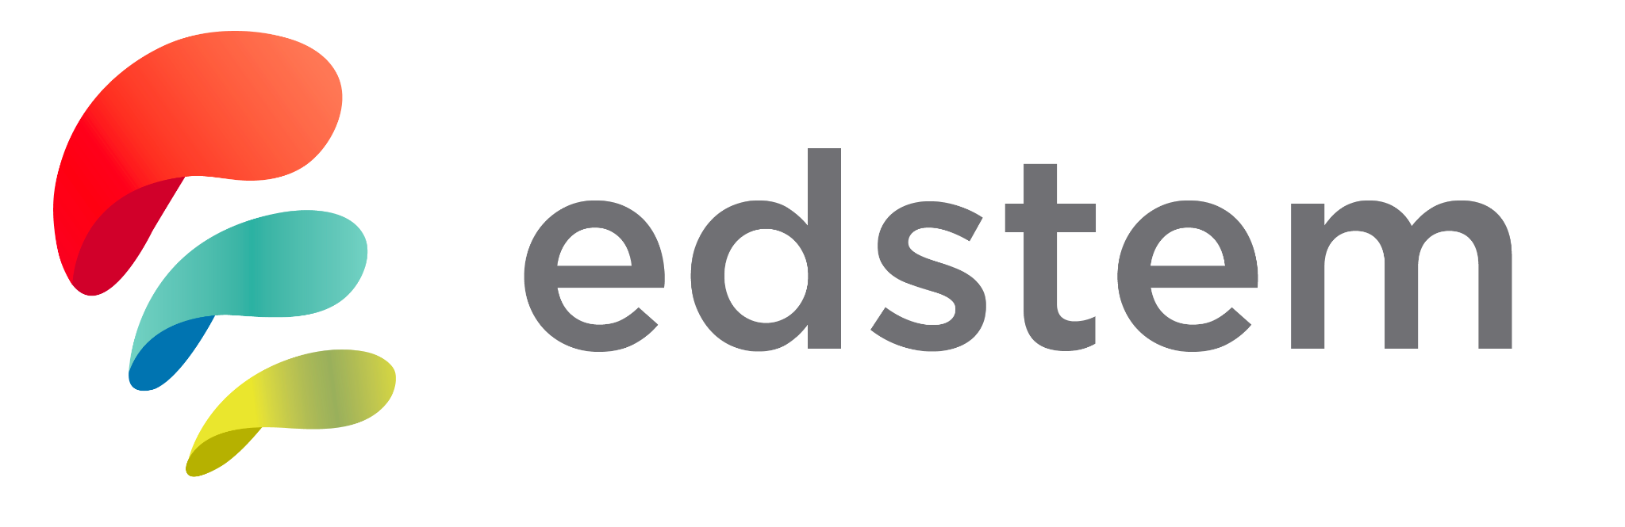
Market Research: EdStem
What’s EdStem?
Ed Discussion is an online threaded discussion platform that allows instructors and students to interact asynchronously by posting text comments and questions, files, and more to discussion forums.
What hasn’t worked for them?
Limited Features: capabilities may not meet the specific needs of some education or institutions
Limited Content or Resources: availability of educational content, resources, or support materials within EdStem may not be as extensive as some students would like
User Support: students who face difficulties or have questions may not receive timely or adequate support from Administrators
Data Privacy and Security Concerns: concerns about privacy and security if EdStem handles sensitive student or institutional data

Slide 14
Market Research: EdStem
What has worked for EdStem?
Asynchronous: students can ask non-urgent questions to administrators
Cross-platform compatibility: works with the Web, IOS, and Android
Communication: allows students to communicate with each other through commenting under each others threads
Option for anonymity: students can post questions to the entire thread and choose to remain anonymous

Slide 15
Market Research: EdStem
What makes your solution concept unique?
We encourage face to face interaction
Students can rely more on in-person interactions to get their questions answered
Instills confidence in students when it comes to making connections

Slide 16
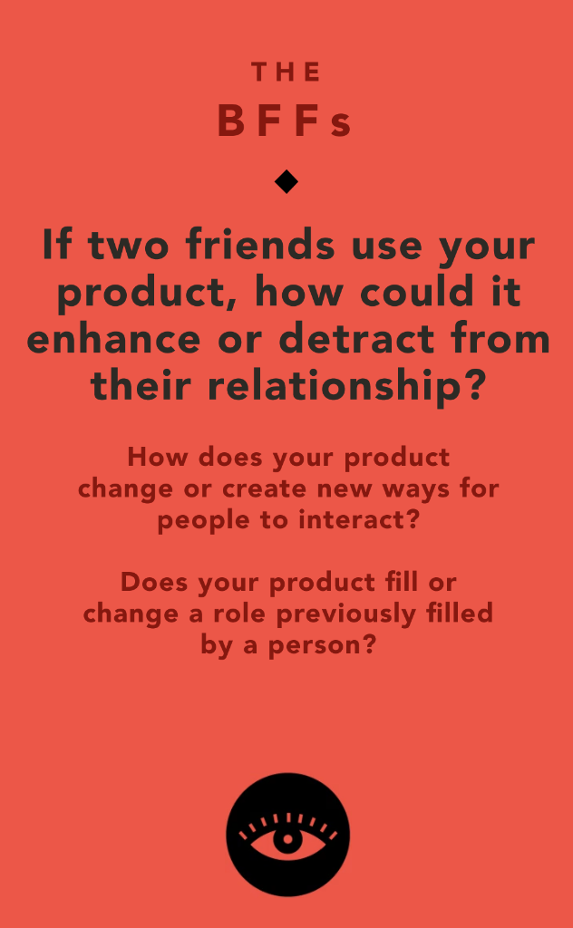
Values in Design - Stakeholders & Ethics

Slide 17
THE BFFS - Ethical Implication
If two friends use your product, how could it enhance or detract from their relationship?
Enhance: provide a way to connect with other students along with themselves if they’re in a class together
Detract: If they’re in a class together, maybe involving other people could hurt their individual relationship
  Note: This does not seem like a likely occurrence, but it’s worth thinking about
An interesting way to look at this is through the lens of current friends

Slide 18
THE BFFS - Q1
How does your product change or create new ways for people to interact?
  Provides a platform for students to find their classmates
  Platform for students to attend and host larger group socials and events, leading to community building
  Allows students to meet others in their class at individual and group level
  Moves connections from online to in-person, even for virtual students, through using location to find nearby classmates

Slide 19
The BFFs - Q2
Does your product fill or change a role previously filled by a person?
  Sometimes you need a mutual friend to introduce two strangers, but this app helps breaks that barrier and allows you introduce yourself to a stranger
  Like-minded people using the app, wanting to connect with other older students

Slide 20

Values in Design - Stakeholders & Ethics

Slide 21
BIG BAD WOLF - Ethical Implication
What could a bad actor do with your product?
  With the right information, a bad actor could cause damage
    Having the location of users could lead to safety risks for users
    Identifying information could also allow some form of identity threat
  Really makes us consider the risk-reward of geolocation
    If we go through with that feature, it needs to be especially secure
    Maybe it’s worth just having users input their own location information and completely bypass using any tracking location features.

Slide 22
BIG BAD WOLF: Q1
What does predatory and exploitative behavior look like with your product?
Stalking and tracking the location of users
Getting familiar with their schedule and whereabouts
Hacking the accounts of users and potentially scamming classmates
  Phishing

Slide 23
BIG BAD WOLF: Q2
What product features are most vulnerable to manipulation?
Geolocation feature
  We need geolocation so people can find study groups nearby
  If geolocation is hacked, someone can know your whereabouts and put the safety of the user at risk.
Identifying Information
  Knowing someone’s name, email, and phone number could lead to risk taken on by the user

Slide 24
BIG BAD WOLF: Q3
Who could be targeted by your product?
Middle Aged Older Students (less tech savvy)
  These are the main users of our product
  Their locations and identifying info could be accessed, putting them at risk
Families of these students
  Indirectly affected
  What if the bad actor decides to come to their house?

Slide 25

Stakeholders
Direct:
Older adult learners
Educators / professors
Colleges & universities
Us (creators/developers of app)
Indirect
Families of adults using app
Competitors/sites in same space (Canvas, GroupMe, etc)
Notes:
Direct Stakeholders
1. Older Adult Learners: The primary direct stakeholders are the older adults using the app. They will directly benefit from the app’s features and are the target group for the platform
2. Educators and Instructors: Professors and instructors, TAs, tutors, and others who work with older adult learners are also direct stakeholders. They may use or recommend the app to facilitate communication and collaboration among their students
3. App Developers: Our team is creating, developing and maintaining the app and thus are direct stakeholders. We need to ensure that the platform works well and meets the needs of older adults in education
4. Educational Institutions If the app is implemented in partnership with educational institutions or colleges, then these institutions will be direct stakeholders and responsible for integrating the app into their curriculum and supporting older adult learners.
Indirect Stakeholders:
1. Families and Caregivers: The families and caregivers of older adult learners are interested in and directly affected by the well-being and success of their loved ones using the app but are not the primary users themselves.
2. Competitors: Competitors will be affected by the success of our platform: if we are introducing novel ideas that seem to work well for a large audience, competitors may update their app to remain competitive

Slide 26

Simple Tasks
User wants to be able to see other users also taking the same courses
User wants to make a connection and message another user taking the same course
Notes:
Explanation:
The core idea of the app is to connect students to other adults who are also taking the same courses as them. Thus, most users will be using the app to form connections with other students in their courses. Therefore, these tasks of forming connections must be easy to accomplish and are listed as simple

Slide 27
Moderate Tasks
User wants to edit their profile information about themselves to get ready to connect with other users in the school
  Edit age/ DOB, current career, phone number, city of location, interests
User now has connections with 5 other users. User wants to get to know their connections better and host larger group socials or events
Notes:
Explanation:
Being able to update one’s date of birth, or change their listed interests on their profile are all necessary, but is not something the user is likely to be doing regularly. Thus, editing profile information should be accessible, but take more steps/be less visible than connecting with a classmate should
Hosting and attending group events are important for community building, but less students will be hosting events in comparisons to connections formed. Thus, hosting and advertising an event on the app will require more steps in terms of displaying the location, invitees, topic, etc

Slide 28
Complex Tasks
User wants to pin their favorite personal and group chats to make it easier to access for future reference. User finds that they are getting many messages so they want to mute group chats.
Notes:
Though the ability to pin or mute chats is beneficial, it is not a necessity and will not affect any core elements of the app, and is not a goal most users will have for the app. Thus, for the users who value pinning or muting chats, it will require the user to be more accustomed to the user interface and be more complicated than simply forming a connection

Slide 29
Tasks Displayed in Concept Video (in-order)
User wants to form a connection with another student taking the same course
User wants to meet more people and form a larger community -> find group events like study group
User wants to update their location to expand their network and meet new people taking the same courses as them while in a new location

Slide 30
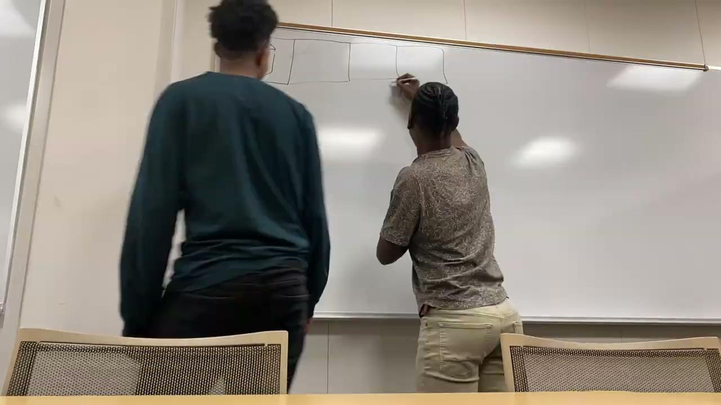
Concept Video Boards

Slide 31
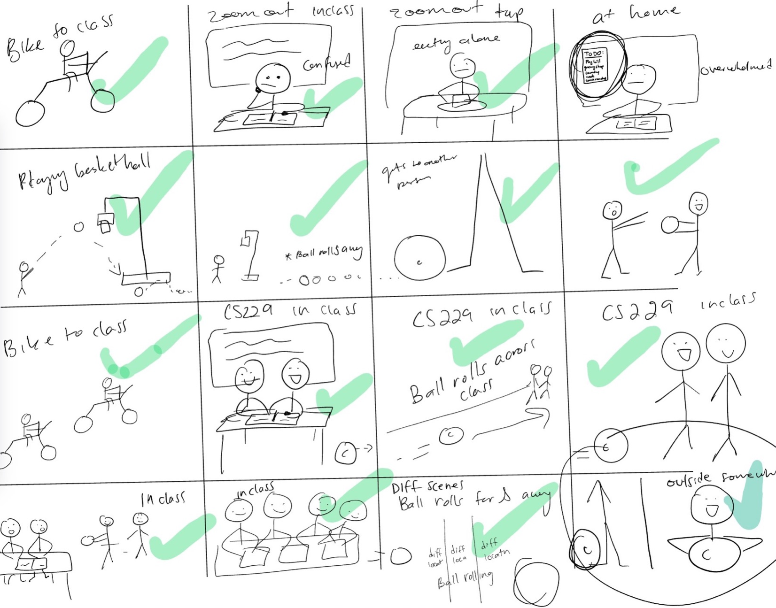
Final
Storyboard

Slide 32
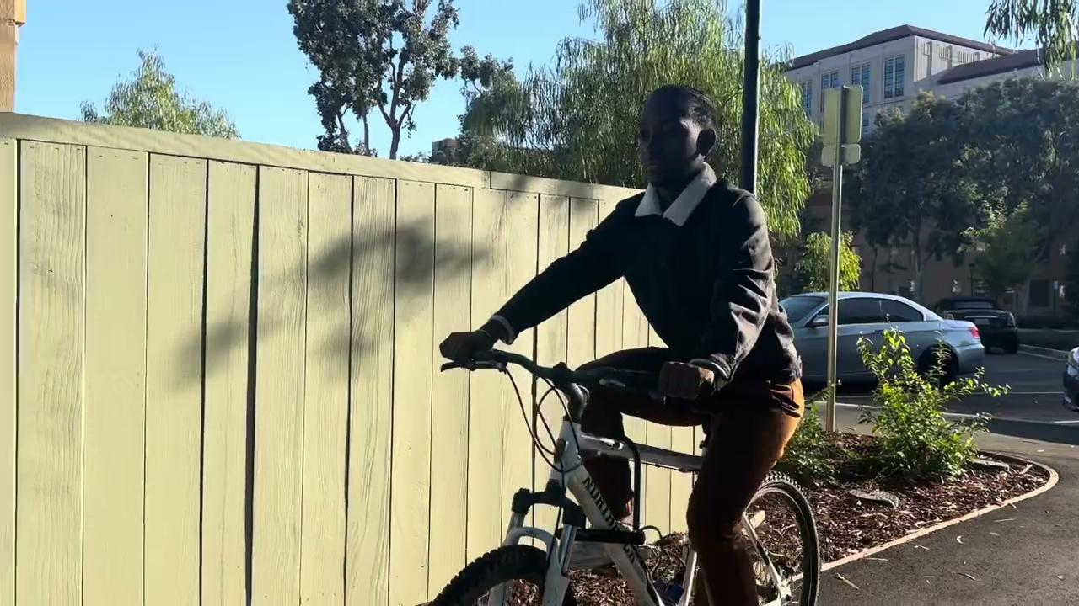
Concept Video

Slide 33

Youtube Link to Concept Video

Slide 34
Appendix
Task Process
Storyboard Process
Tasks generation
Storyline Brainstorm
StoryBoard version 1
Further ethical implications

Slide 35
Task Process
Each member wrote 3 tasks
  Simple
  Moderate
  Complex
We put tasks together in a document
  Together we analyzed tasks and discussed how they tied into our solution
Selected tasks
  As a team, we selected task that made most sense with our solution and the experience of the user

Slide 36
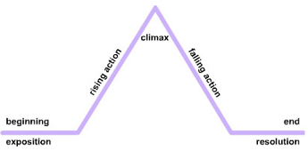
Storyboard Process
Set a timer for 30 minutes and brainstormed context for our storyline
  Picked out the actors
  Used the “yes and…” method to generate multitude of ideas
  Selected ideas that had strong ties with our mission to increase community within older students and reduce stress
  Tied in three tasks
White board and dry-erase marker
  We began drafting our storyboard!

Slide 37
Example of Task Generation
Simple:
  The user can discover other older students taking similar classes or are in the same location.
  The user can add their courses, location, and other basic information
  User has received other user profiles as suggestions for connecting. User wants to view the other user’s profile. They do so to determine if they are taking same classes and if they want to connect with other user
  they send a connection request to another user (kind of like linkedIn) to be friends. They are now friends and have each other on contact list within platform and can message each other
  User can find classmates taking the same courses as them, and reach out/message them
Moderate
  The user can connect with other older students or join a groupchat of other students taking the same classes or are in the same location
  The user can request/not select to connect with other older students. The user can also add class/general resources to the groupchats they’re apart of.
  User is new to taking a course and does not know anyone. After class, User wants to create a basic profile about themselves to get ready to connect with other users in the school
    Age/ DOB, current career, phone number, City of location, interests
  User can create a study group based on their location
    Find classmates who are in the same school and living on campus, but also virtual students can find classmates living in the same city as them
Complex
  The user can create group chat(s), and upload documents.
  User now has connections with 5 other users. Users want to get to know their connections better. User wants to create a group social for connections to have a meal together before their next class.
  Users can host group socials to build a bigger community
    Dinner social
    Attend on campus events
  User wants to block classmates that they do not want to message/receive messages from
  User wants to restrict location to only be viewable by certain classmates?

Slide 38
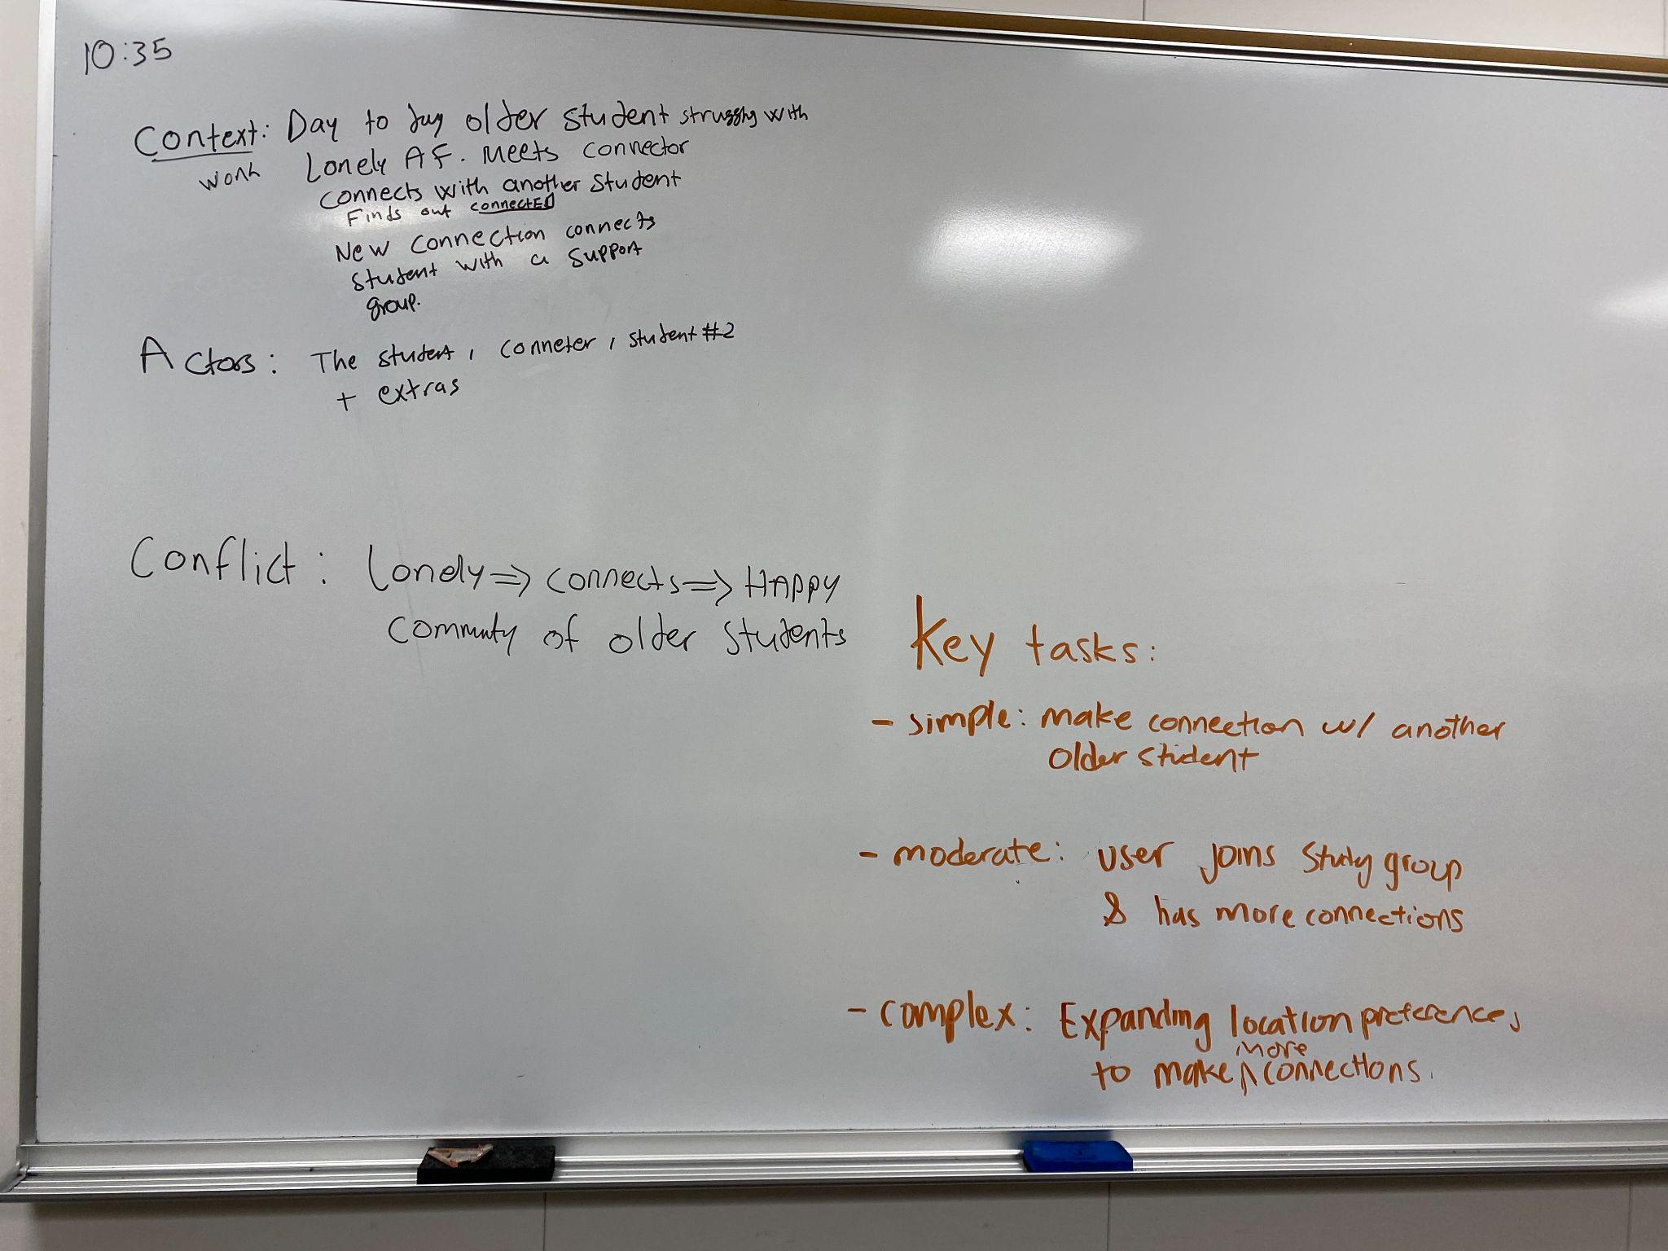

Slide 39
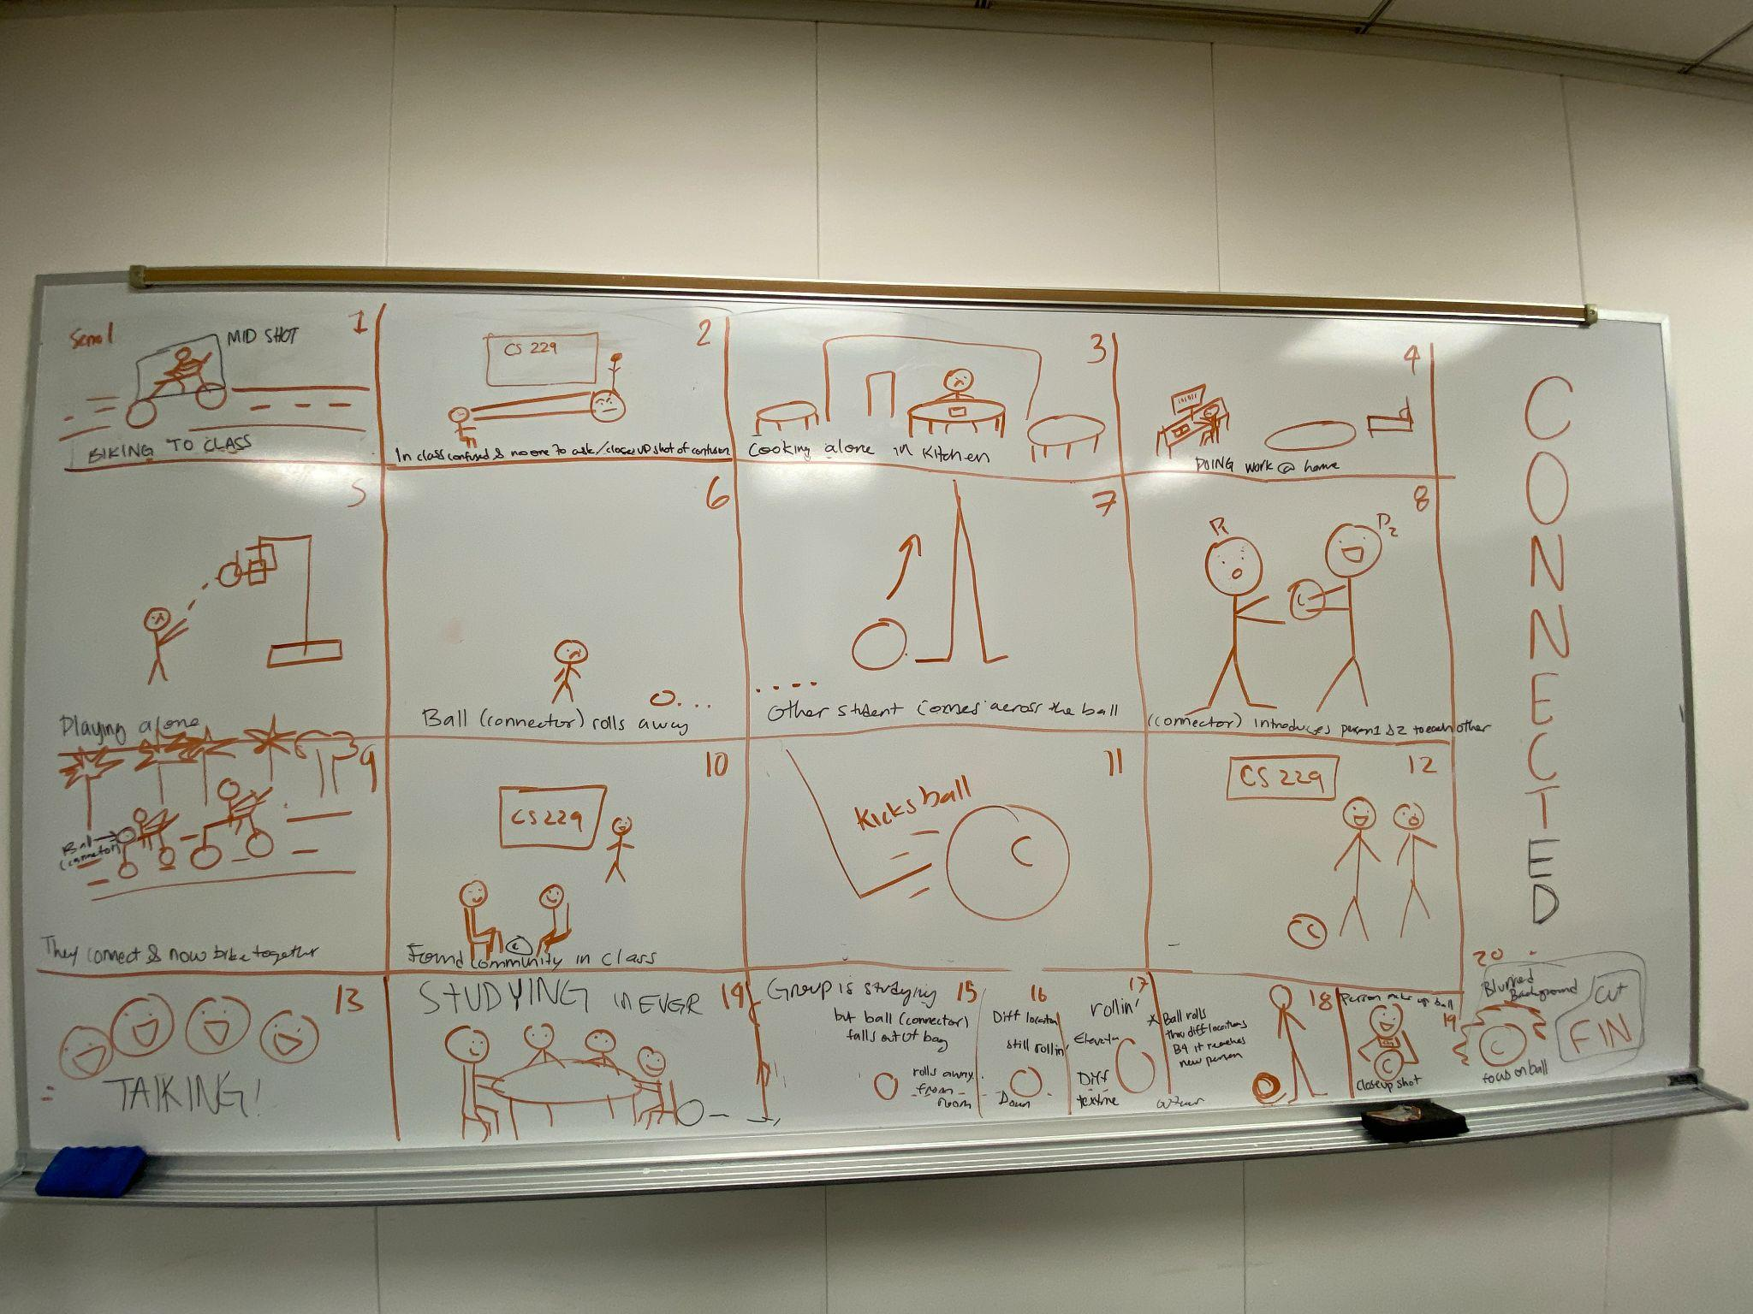
Appendix

Slide 40
Further Ethical Implications

Slide 41
Ethical Implications Pt. 1
Negative Ethical Implications:
Exclusivity and Cliques: There is a risk that this approach might inadvertently lead to exclusivity and cliques, leaving some students feeling left out or marginalized. Ensuring that the approach is inclusive and doesn't foster discrimination/exclusion is essential
Privacy Concerns: Facilitating connections between students should be done with consideration for privacy and consent. Sharing students' personal information without their consent can raise ethical concerns
Pressure to Conform: Encouraging students to connect might inadvertently pressure some students to conform to specific norms or groups, which may not align with their values or interests
Safety: Bad actors may take advantage of geolocations and target students, putting their safety at risk

Slide 42
Ethical Implications Pt. 2
Positive Ethical Implications:
Promoting Inclusivity: Encouraging students to connect and collaborate can create a more inclusive and diverse learning environment, where students from various backgrounds and experiences can work together
Building Confidence: Boosting the confidence of older students can be empowering and foster a positive self-image, which is ethically commendable
Fostering Collaboration: Encouraging collaboration and group work can prepare students for real-world teamwork, an essential skill for many professions
Reducing Administrative Burden: If the solution reduces the need for excessive administration and class portals, it may free up teachers and administrators to focus more on teaching and supporting students

