Slide 1
Assignment 3: Sell-In
Anavi, Shardul, Saniya, Sara

Slide 2

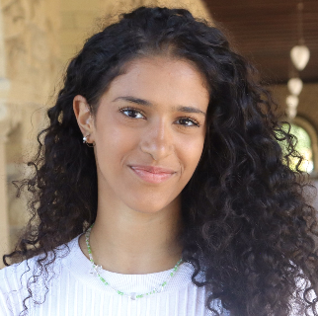


Our Team
Anavi Baddepudi
Sara Bukair
Saniya Vashist
Shardul Sapkota
Computer Science
AI track ‘25
Computer Science
HCI track ‘25
SymSys
HAI Track ‘25
First year Computer Science PhD

Slide 3
Table of contents
01
02
03
Recap and Solution Pivot
Project Information
Tasks
04
Video Planning

Slide 4
Recap
Our Previous Solutions
Social impact scorecard
Notifying people about local volunteer activities
Marketplace for volunteers to get compensated
Our Chosen Solution
A personalized social impact scorecard and a marketplace for volunteers to get compensated for their work by encouraging big companies to sponsor their projects.

Slide 5
Recap
Social impact scorecard and marketplace: What didn’t work?
We found that our HMWs and solutions strayed away from our the insights we had gotten from our needfinding and POVs. To get to the root of our problem, we had to make our target users college students rather than working professionals.

Slide 6
Pivot
Revisiting our needfinding interviews and POVs
Insights from our interviews
One of our interviewees, a Stanford CSRE student, pursuing a path on social impact expressed her worry about future employment possibilities and having a risky career choice.
“My passions are not always aligned with the social impact work [that’s available]” – Arpan, Google SWE
Our POVs/HMWs
Our POVs and HMWs aimed at making social impact work less fatiguing and having an external motivation added to the social impact work.
Revisiting the interview with the CSRE student, we also found a common theme among our interviewees of this need to de-risk social impact related employment at the college level.
Our Solution
Our EP #2 tested the assumption around people more willing to do impact work if the opportunity is nearby.
We felt that we could expand on this solution to address our new insights by adding mentorship and networking aspects focused on social impact opportunities.

Slide 7
Problem & New Solution Overview
Problem:
Upon entering university, students forego their social impact passions in pursuit of high paying, but less meaningful, jobs
Nonprofits, governments, and social enterprises need more talent
Solution
A platform that aims to establish a dedicated pipeline for social impact work for undergraduate students, focusing on mentorship, internships, and community

Slide 8
Project Name
Sell In
Keep students from “selling out” and instead, sell in
We wanted a name that directly challenged the notion of selling out while also providing a platform that allows people to buy-in on alternative opportunities to work on social impact related ventures

Slide 9
Value Proposition
Turn Your Passion Into Purpose
We want social impact to be aligned with people’s passions so they can do impactful work for the long term
We want to leverage their skills to help small and local non profits that are dedicated to systemic change
Keep students from selling-out, by providing mentorship and resources for students that are passionate about service-related causes
Sanity Check
One-liner is catchy and memorable, yet specific to our mission

Slide 10
Bridging the gap between
Support and Resources
Social Impact Work

Slide 11
The Need
There is no platform specifically designed to connect college students with social impact opportunities, mentorship, and communities

Slide 12
The Benefit
Support students in their social impact passions, help them discover their new ones
Help them avoid selling out
Equip them with social-good opportunities

Slide 13
Mentorship
Internship
Community
1
2
3

Slide 14
Market Research
What is out there?

Slide 15

LinkedIn
Professional network on the internet. Helping people find the right jobs or internship, connect with others
What they do well:
Offers a wide range of opportunities across all industries
Large network of professionals on the platform
Offers certificates and trainings
Have a distinct user profile that is an online brand/resume
Great online messaging system
What doesn’t work
Lacks customized matching for social impact opportunities
Not tailored towards students
Doesn’t incorporate hands-on and mentorship match program

Slide 16
LinkedIn
Sell-In’s Differentiation
Enables users to:
Connect with experienced mentors in the field of social impact.
Discover internships or job opportunities aligned with their passions, akin to platforms like computer forum updates or Handshake but tailored for this sector.
Engage with a community of like-minded individuals, serving a purpose similar to career fairs or networking events.
Implications for our app
Offering certifications for students would be beneficial to ensure the integrity and validity of the platform

Slide 17

Handshake
Platform specifically for college students to find jobs.
What they do well:
User friendly platform for college students
Partner with universities and employers to streamline and simplify the recruiting process
Easy application process for opportunities
User profiles
Review and rating system for opportunities
What doesn’t work
Lacks customized matching for social impact opportunities
Doesn’t incorporate hands-on and mentorship match program
Doesn’t incorporate certificate or training programs

Slide 18
Handshake
Sell-In’s Differentiation
Enables users to:
Focus on Social Impact: Our platform is specialized for social impact work, while Handshake caters to various industries.
Mentorship: Sell In prioritizes connecting users with social impact mentors, a feature not central to Handshake.
Community Building: Sell In fosters a community around social impact, whereas Handshake is more employer-student oriented.
Tailored Opportunities: We offer listings exclusively for social impact, while Handshake includes diverse job types.
Specialized Events: We host events specific to social impact, differing from Handshake's general career events.
Customized Experience: We also provide a niche experience for social impact enthusiasts, offering more tailored resources than Handshake.
Implications for our app
Review and Rating System: Introduce a system where users can leave reviews and ratings for mentors, internships, or job roles they've been associated with. This can help others in making informed decisions.

Slide 19


People Grove
Mentorship platform connection students to alumni
Used by Stanford Alumni Mentoring
What they do well:
Wide range of features on career opportunities and connections all tied through stanford alumni already working at those places
Articles and posts on getting started and navigating different career paths from alumni
Chat feature to reach out to connections
What doesn’t work
More general purpose search and connect platform that is focused on career development
Personalized recommendation is a miss– based on interests and courses limit exposure to non-major career/connection suggestions
Encourages quick/informal meetings than lifelong mentor-mentee relationships
Notes:
What doesnt work:

Slide 20
People Grove
Sell-In’s Differentiation
Enables users to:
Connect with mentors who are not just affiliated with Stanford’s community/alumni network
Find opportunities beyond jobs/internships like long term projects
Focus on matching skilled students with small, local non profits who can benefit from their contributions
Explore social impact opportunities at various stages of their college years
Implications for our app
Articles and chat: While our emphasis is on encouraging in person meetings between mentor-mentee to develop long term relationships, we really like the feature of allowing mentees to reach out to potential mentors via chat as an initial screening/meeting set up tool to lower the burden of reaching out. We also would like to have feature to include several articles and posts dedicated to social impact and how different mentors navigated their careers in this area.

Slide 21

DoSomething.org
A youth activism platform targeted to high school students to encourage them to work on social good
What doesn’t work:
Doesn’t address the need for long term social impact work
No way for students to learn how to navigate a career in social impact area
Opportunities not customized to students interests/skills
What they do well:
Provide scholarship to students going to college in exchange for doing volunteer work
UI Design and messaging focuses on youths, making it clear who their power users are
Good use of incentivization to push college going students to think about community service

Slide 22
DoSomething.org
Sell-In’s Differentiation
Enables users to:
Find mentors who can provide guidance to first year college students
Search and explore volunteer opportunities that is more aligned with their skills
Create a community of other volunteers who are also invested in a similar impact related career
Implications for our app
We liked how DoSomething.org uses scholarships and volunteer credits as a way to compensate students while also balancing the financial necessities that students might have. While we want to focus on long term impact, it would be a good idea to explore what compensation models we could introduce to help students get into social impact work in the first place (like matching salary with tech jobs after graduation).
We especially liked how they made it clear from the get go who this app is for which we aim to incorporate in our platform design as well.

Slide 23
Some additional market research on apps working on social impact not directly related to students

Slide 24

Impact WayV
Social Media Platform that unites people, businesses and nonprofits. The platform enables users to effect, engage in and share social impact on a global scale and create a community.
What doesn’t work:
Individual impact is quantified only by looking at social media post interactions
Target audience is broad and generalized
Doesn’t work to make individual connections between mentor-mentee, only students
What they do well:
Social network aspect of engaging like-minded users and organization through their social media platform
Quantifying CSR performance of companies and comparing against a benchmark

Slide 25
Impact WayV
Sell-In’s Differentiation
Enables users to:
Create a community that is catered more towards college students than general public
Directly reach out to mentors specific to their interests and social impact aspirations than have to explore the platform like a social network
Implications for our app
While social networking promotes engagement between like-minded people, the interactions online may not translate into actions as people might feel good just for “engaging” with a cause.
Instead, we can focus on connecting like minded people to learn new skills or volunteer together with a shared experience

Slide 26

VolunteerMatch
A platform to recruit volunteers for non-profits. People can find opportunities based on location and domain.
What they do well:
Automate the workflow of posting/re-posting opportunities on behalf of the NGOs
Easy to search for options that are nearby using zipcodes
Lists popular volunteer organizations based on past volunteers
What doesn’t work:
Feels too general purpose and hard to navigate with so many options available
Doesn’t factor availability when showing opportunities
Opportunities still need to be applied for through the NGO’s owns platforms/emails, etc

Slide 27
VolunteerMatch
A platform to recruit volunteers for non-profits. People can find opportunities based on location and domain.
Sell-In’s Differentiation
Factors in people’s availabilities so students can stay flexible with their schedule
People can apply for the opportunities through the app itself
Implications for our app
While only showing personalized recommendations based on some algorithm takes away people’s agency, not having any personalization also makes it overwhelming to find the right opportunity. With Sell-In and it’s personalization, we can make the search specific to students’ interests with an option to explore should they choose to.
Incorporate location specific and local opportunities

Slide 28

Goodera
Helps companies enable their employees to volunteer with thousands of nonprofits in 100+ countries
What they do well:
Provides virtual volunteering options, crucial in the context of a pandemic and remote work environments
Offers customized solutions that cater to the specific CSR needs and goals of different businesses
What doesn’t work
Focuses on employees, not students
Focuses on one-off giving activities like during employee onboarding or town halls
Exclusive to companies, doesn’t have a mobile app and can’t be accessed by other like-minded people outside corporations
Doesn’t partner with universities

Slide 29
Goodera
Helps companies enable their employees to volunteer with thousands of nonprofits in 100+ countries
Sell-In’s Differentiation
Focus is not for employees, but students as well
  Promoting access and engagement to anyone who has access to the app
Provides students with a chance to explore opportunities not just to contribute towards NGOs but also to enhance their own learning and growth.
Implications for our app
Goodera accommodating virtual volunteer opportunities speaks to the larger goal for making social impact accessible to people with different backgrounds. This ties to ensuring there are a diverse range of long term opportunities that people can sustainably engage in depending on their situation.

Slide 30

Key Competitor Analysis Matrix
 |  |  |  |  | Sell-In
Match with a mentor
Customized social impact specific jobs/internships search
Get job referral from mentor through the app
Create and attend impact related career fairs/networking events

Slide 31
Values in Design
Inclusivity
  Students from all backgrounds are encouraged to join and use their skills to help
Empathy
  Students develop empathy for the nonprofits and projects they work with
Community
  Students feel like they are a part of a network of social good (helping the NGOs and society, and using those skills to help their companies)
Meaning
  Students find meaning through their social impact work and gain access to mentorship
Flexibility
  Opportunities are tailored to the students goals and schedules as well as nonprofits needs. Our platform should be fun, and not feel like work.
Long-term impact and sustainability
  Not just a 1-time volunteer event, but a sustainable cycle of giving with meaning
Learning by doing
  Encouraging lifelong learning of students through real-world projects, not just classes
Knowledge sharing and expanding
  Have students share their own skills and knowledge with nonprofits and vice versa
Step outside comfort zone
  Encourage students to try new things, develop new skills, and work on projects they may not have exposure to in their day to day academic life

Slide 32
Stakeholders Overview
Direct
Students
Mentors who have dedicated their careers to social impact
NGOs they’re paired with
Indirect
Communities the nonprofits are helping
Students’ schools
Centers for Career and Professional Development

Slide 33
Ethical Implications
Work ↔ Compensation
  Encouraging students to give back without compensation introduces ethical risks. Is it fair to have people work on projects without payment?
  Solution: We will make these projects mutually beneficial for all parties involved. Students will feel impact with these opportunities, and gain new skills and experiences in the process.
Student Involvement ↔ Lack of inclusivity
  If we limit this platform to just students, is this platform inclusive?
  Solution: Encourage anyone, at all stages of their lives/careers can give back. We can market to struggling students, but not limit this platform to only them.

Slide 34
Tasks
Simple
  Find and connect with a mentor devoted to social impact work
Moderate
  Get referrals through the mentor and find opportunities that are custom to your skill and passions
Complex
  Organize and attend networking events/career fair with non profits for social impact opportunities

Slide 35
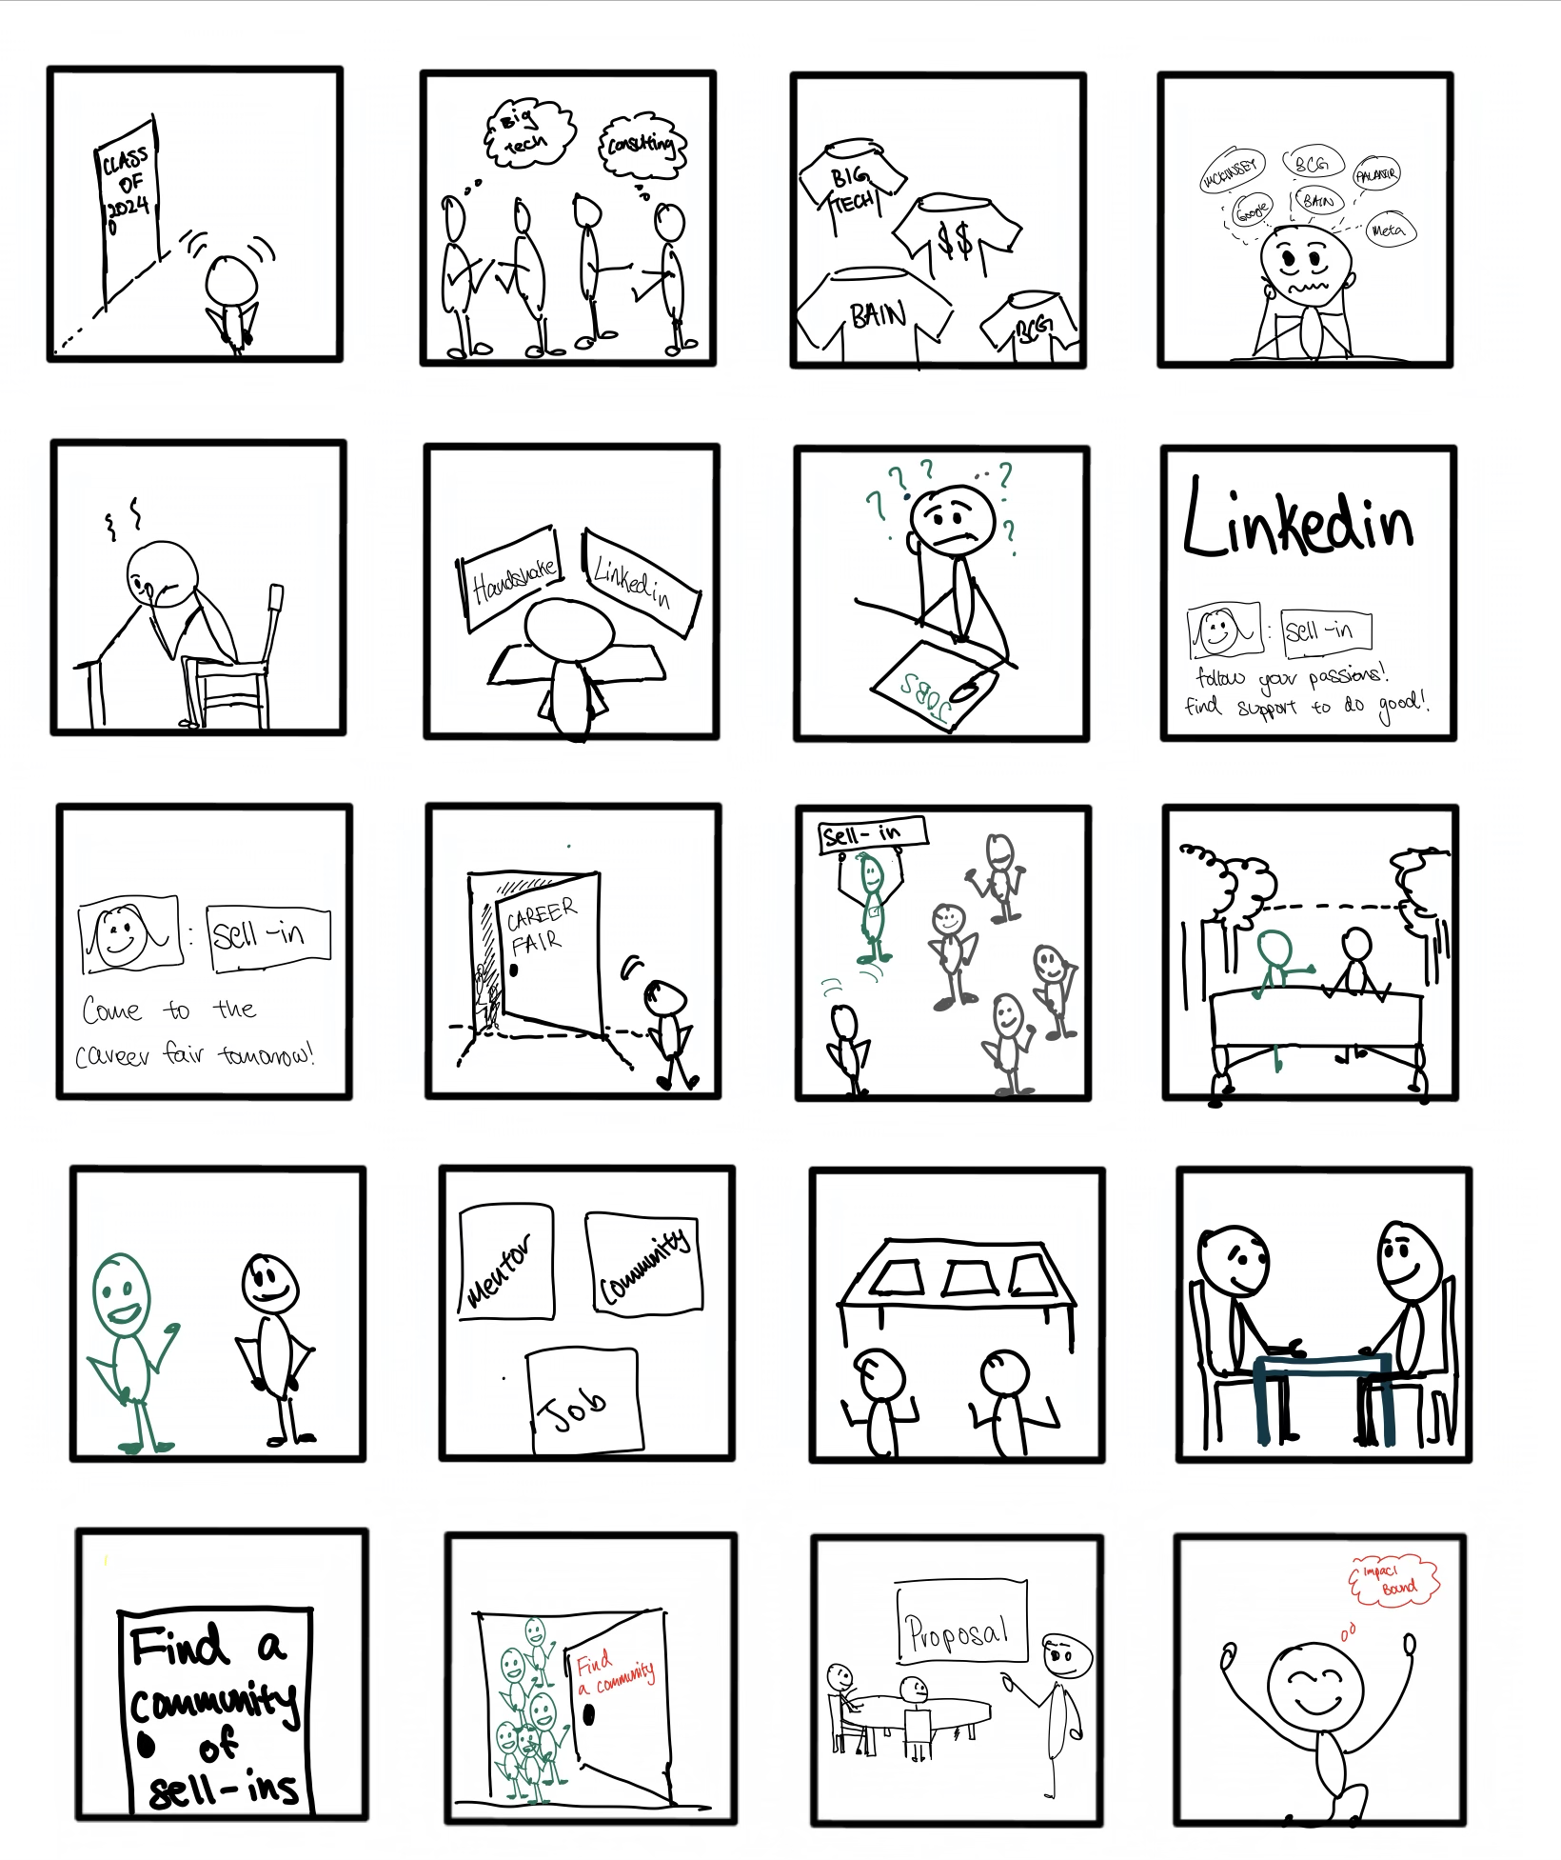
Video Storyboards

Slide 36
Video
https://youtu.be/KbqmG_meQI0

