Slide 1

CS 147
Assignment 1
Needfinding

Slide 2

Contents
01
Introduction
02
Needfinding methodology
03
Interview results
04
Analysis
05
Summary

Slide 3
Our Team
Saniya Vashist, Anavi Baddepudi, Sara Bukair, Shardul Sapkota
Problem Domain
Young professionals learning about social impact opportunities

Slide 4
Money
Social Impact

Slide 5

Sell out

Slide 6
Sell out

Slide 7
Sell out
Sell in

Slide 8


Needfinding Methodology
Interviewer recruitment process

Slide 9
Participants
Arpan
Veenaa
Samuel
Lalitha
Sana
VP
Oversees innovation hubs across Asia
Non-user
SWE
Coding for social good
Average user
CSRE major from Ghana
Education reform and policy
Extreme user
Stanford Professor (Twi)
Board certified and interfaith Chaplain
Non-user
Founder of a social impact org
Corporate social responsibility expert
Non-user

Slide 10
Questions
Arpan
SWE
In-Person
Shardul - Interviewer
Saniya - Notetaker
Compensation: Meal
01
02
Factors affected decision for corporate work
Engaging with community while working at Google
03
04
Making an impact outside of work while working a tech job
Future goals

Slide 11
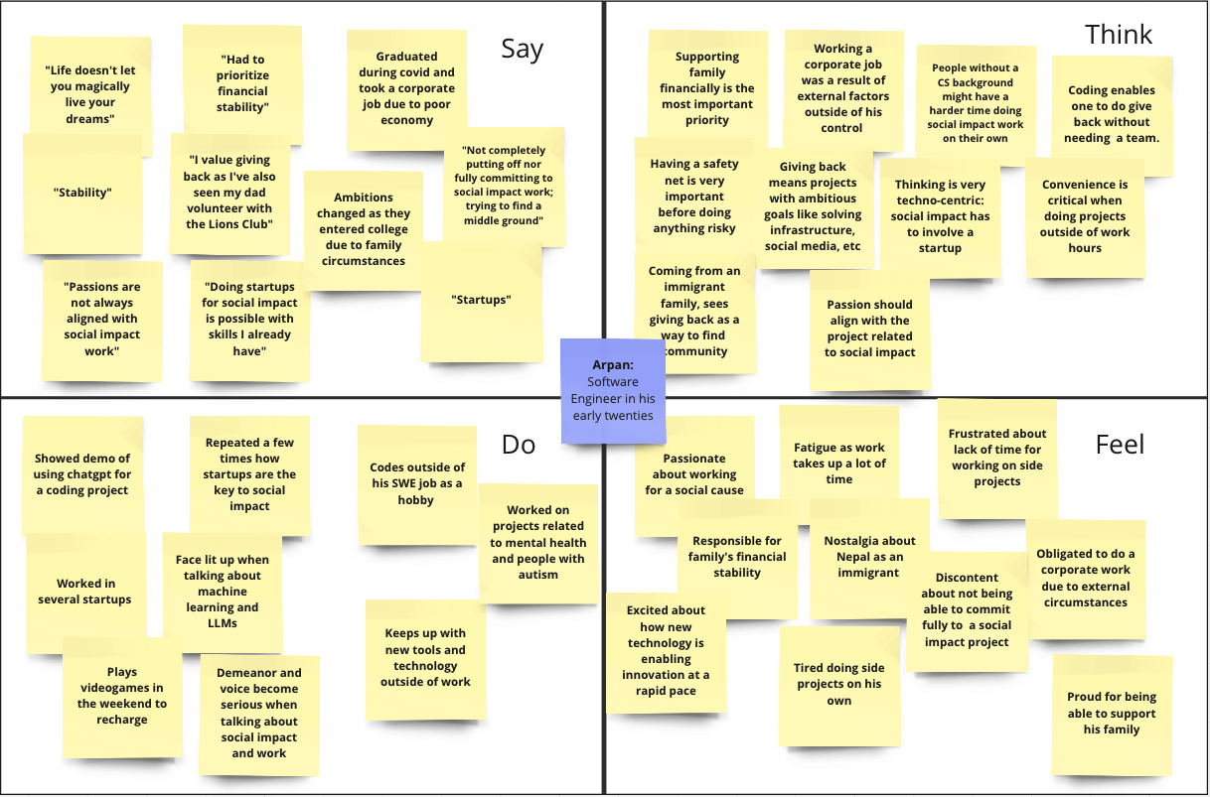

Slide 12
Key Quotes
Arpan
“Life doesn’t let you magically live your dreams”
“My passions are not always aligned with my social impact work”
“As an immigrant, social impact and giving back was a way for me and my family to find community”

Slide 13
Questions
Veenaa A.
Stanford Student
In-Person
Anavi - Interviewer
Sara - Notetaker
Compensation: Meal
01
02
Pursuing a path focused on social impact
Balancing passions with conventional jobs
03
04
Tools used for social impact work
Future goals

Slide 14
Key Quotes
Veenaa
“Social impact work is great, but not a safe, viable career choice”
“I never doubted my end goal. At least this way, I am making a difference”

Slide 15
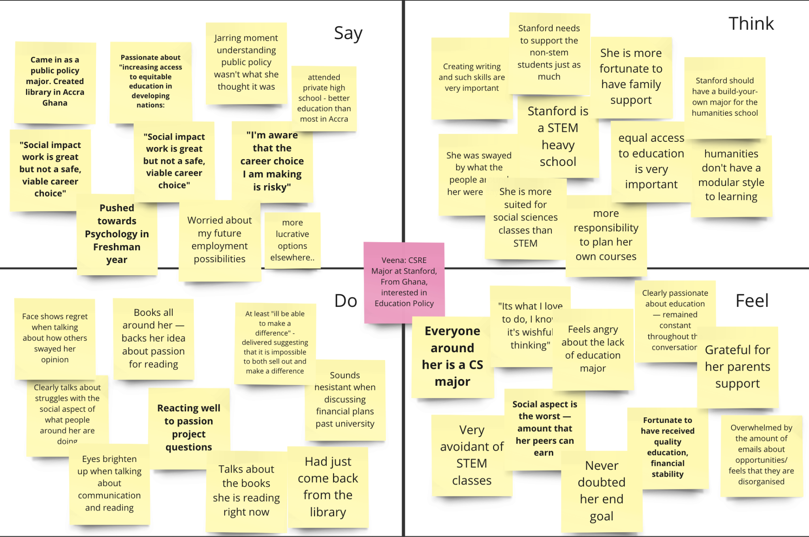

Slide 16
Questions
Samuel
Stanford Professor
In-Person
Sara - Interviewer
Saniya - Notetaker
Update on project
01
02
"Selling out" culture among college students
Balance their desire for financial success and career stability
03
04
Personal career trajectory
Views on work and fulfillment

Slide 17
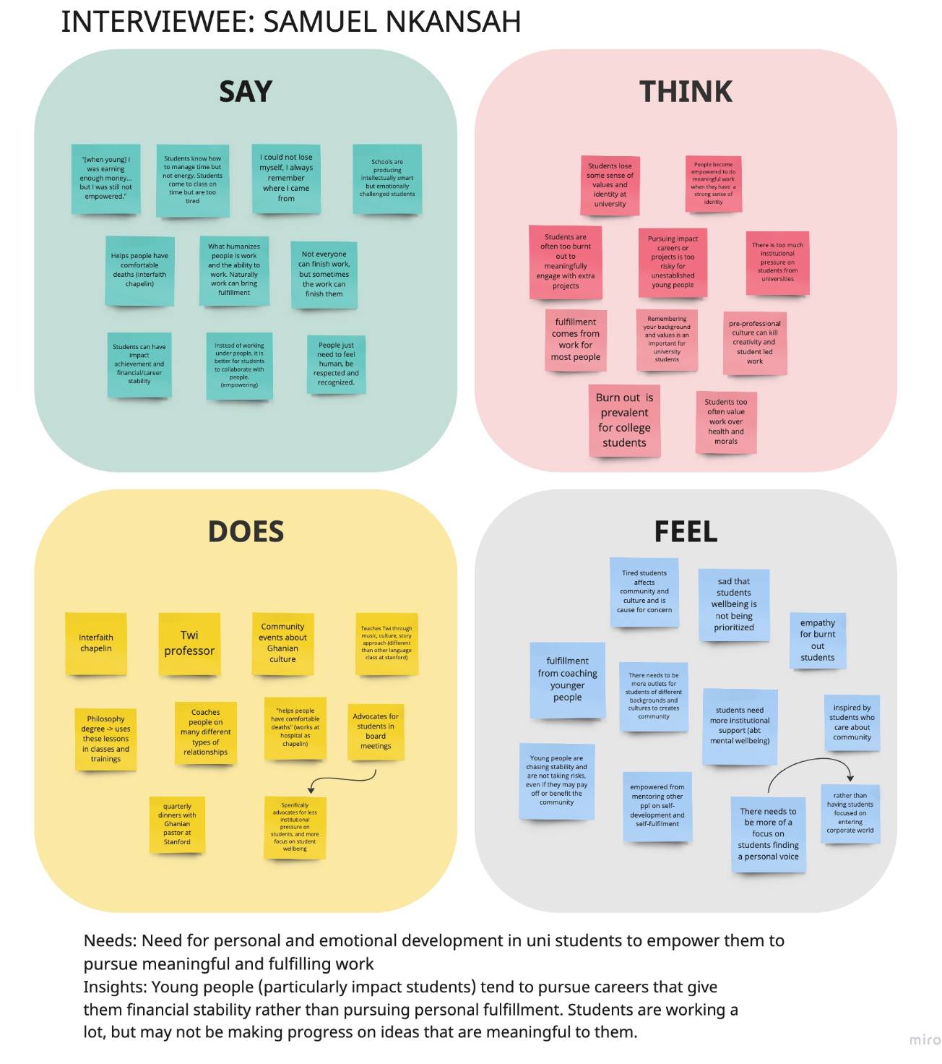

Slide 18
Key Quotes
Samuel N.
“I was earning enough money but I was still a young guy. My work was not empowering and not fulfilling.”
“Students know how to manage time well, but they don’t know how to manage energy. Students will come to class on time but be very tired or burnt out.” Samuel
“I could not lose myself. I know the cooking pot and river that fed me. I always remember where I came from.” Samuel
“There is so much pressure on young men and women in this generation. Schools are producing students who are intellectually smart but emotionally challenged.” Samuel

Slide 19
Questions
Lalitha
VP of an enterprise software company
Zoom
Anavi - Interviewer
Sara - Notetaker
Update on project
01
02
Struggles of social impact startups
Diversity in social impact innovation
03
04
Financial stability and positive social impact
Social impact start-up profitability

Slide 20
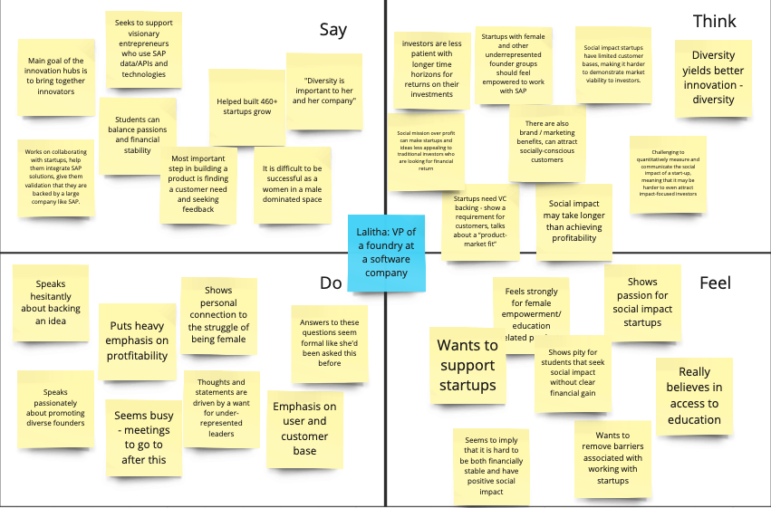

Slide 21
Key Quotes
Lalitha
“Balancing passion and financial stability when pursuing social entrepreneurship as a student can be challenging. “
“Social impact startups have limited customer bases, making it difficult to demonstrate market viability”

Slide 22
Questions
Sana
Founder of social impact org
Zoom
Sara - Interviewer
Shardul - Notetaker
Update on project
01
02
Youth role in social impact
Burnout among social entrepreneurs
03
04
Young people involvement in community service
Difficulties faced by youth pursuing social good

Slide 23
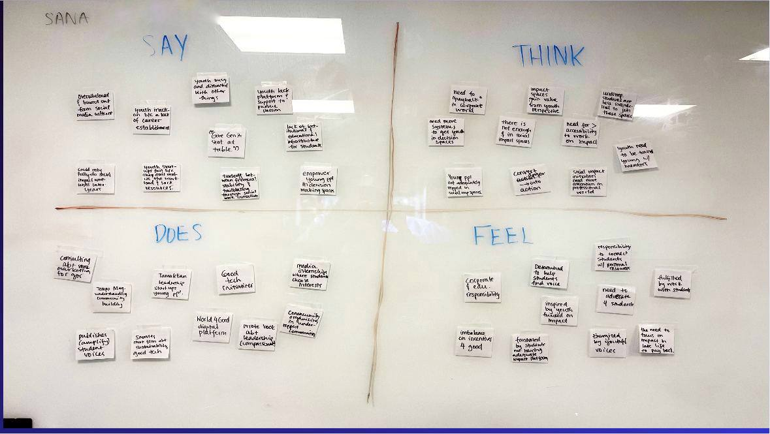

Slide 24
Key Quotes
Sana
“I really want to make a difference and I’ve reached a point in my life where I feel like this is my main purpose.”
“A lot of positions of leadership are linked to power and money. Young people are not there yet, so they don’t have the means to dominate these spaces.”

Slide 25
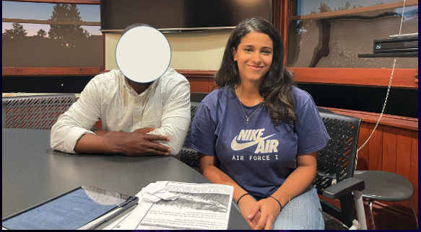
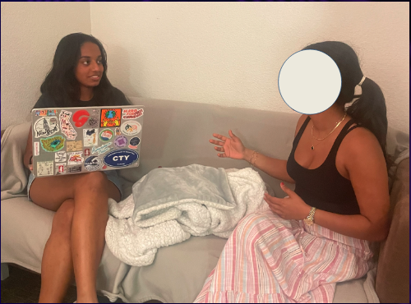
Interview results

Slide 26
Surprises
CS majors think that coding is the best, and only skill, for social impact
Stanford humanities majors feel pressured to align with their peers in STEM
Pity for students/projects that seek social impact without clear financial gain
“Selling out” v.s. making an impact (mutually exclusive or inclusive)
People need to be reminded of where they came from to make a difference

Slide 27

Analysis
Key Insights

Slide 28
Insights
Observations and Inferences
Tendency to wait to be financially stable and later in career to do social impact work
Social impact work fulltime is difficult and risky
Impact provides fulfillment
Social impact is difficult to quantify for investors

Slide 29
Summary and Takeaways
Desire for youth, young professionals, and adults to find fulfillment and social impact in work
Tradeoff between financial success and social impact
Difficulties in finding and accessing social impact opportunities
  Full time or on the side
Need more resources for young people to pursue social impact endeavors while in corporate america
Social impact work needs to be made more accessible

Slide 30
Next Steps
01
02
Speak to young that have pursued social impact full time career or on the side
Assess correlation between financial security and social impact work
03
04
“How Might We” statements to brainstorm solutions
Develop prototypes

Slide 31
Education is the passport to the future, for tomorrow belongs to those who prepare for it today.
Malcolm X

Slide 32
Appendix
Interview Questions
https://docs.google.com/document/d/1ZxVyWy81WssbDLW9cF6E5EPSvYvPjEq-iguZaMKym3I/edit?usp=sharing
Summary of Insights
https://docs.google.com/document/d/1Klho8eDEpWJQ_QgvxYpANeEqHDat2KdACWKP81ot0do/edit?usp=sharing
Empathy Maps
https://miro.com/app/board/uXjVNeYUrIw=/?share_link_id=721583013289
https://miro.com/app/board/uXjVNdxWl8c=/?share_link_id=588931375520
https://miro.com/app/board/uXjVNdws2rU=/?share_link_id=406337757239

