Slide 1
A1: Needfinding!
Ashley, Daphne, Eliza, Leon

Slide 2
01
Intro

Slide 3
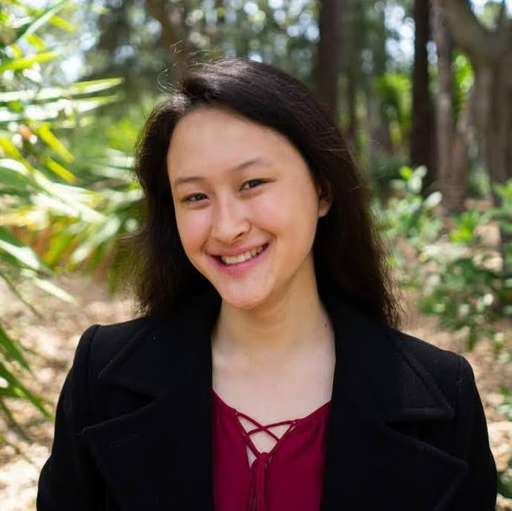
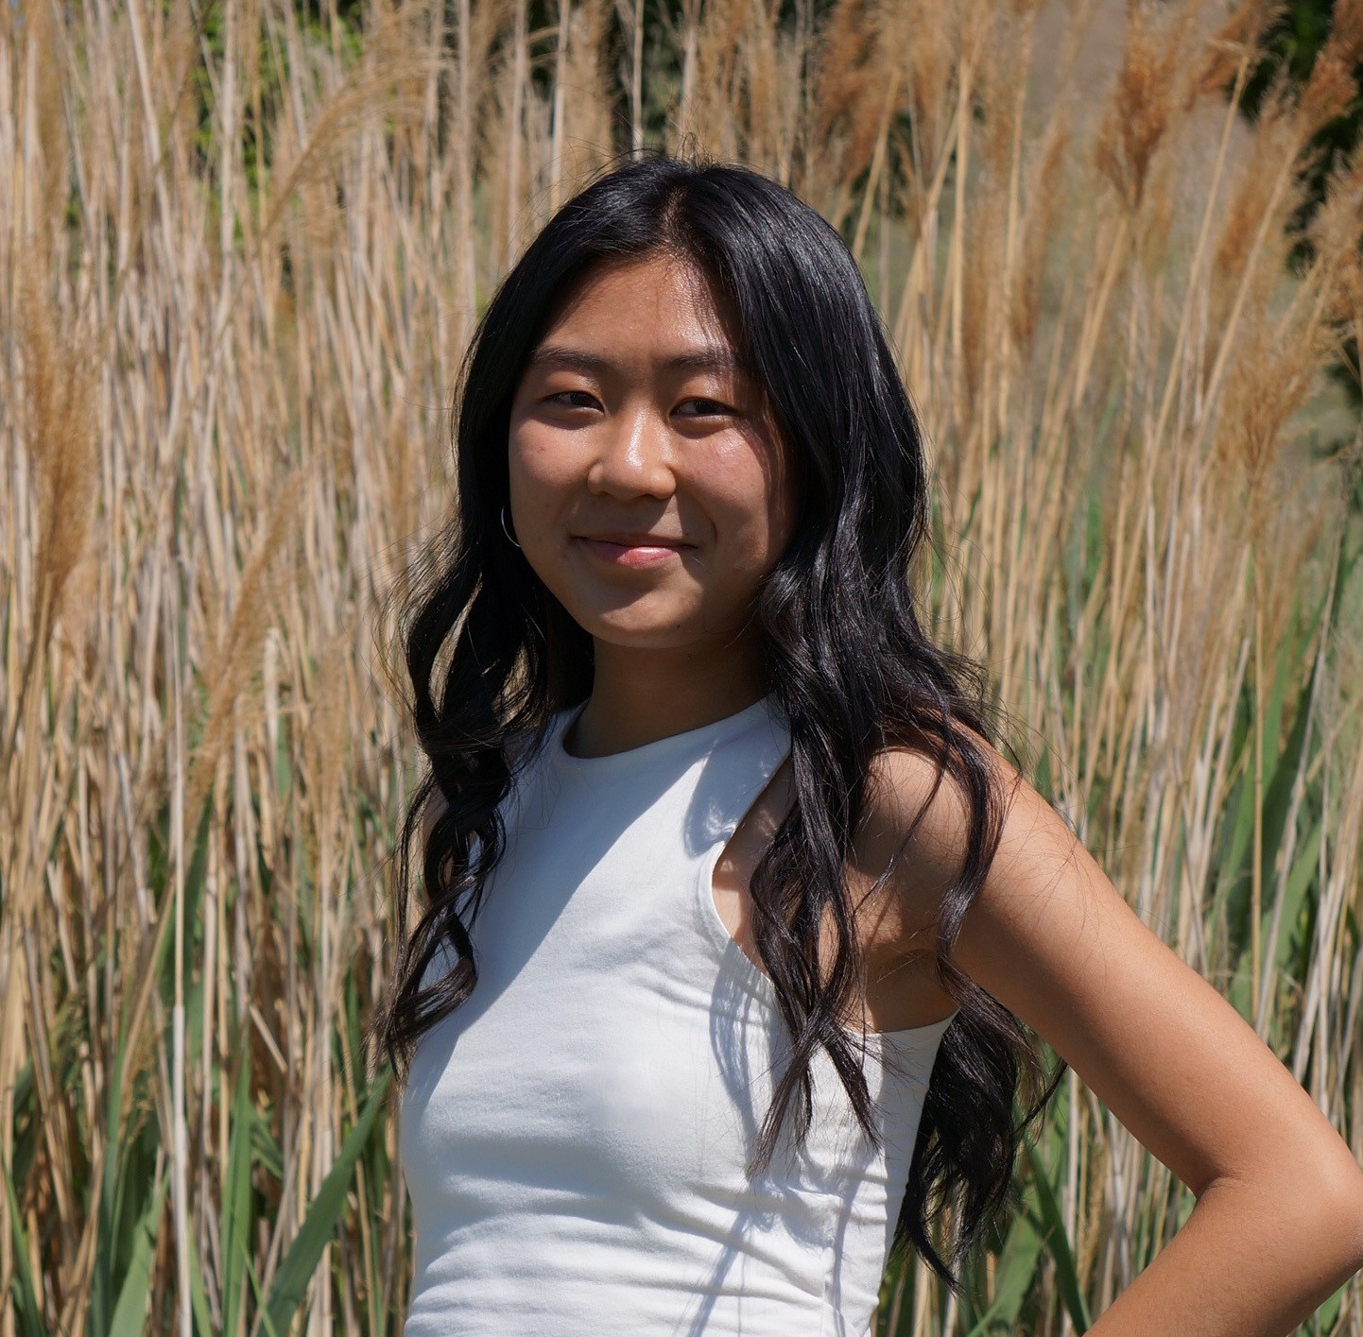
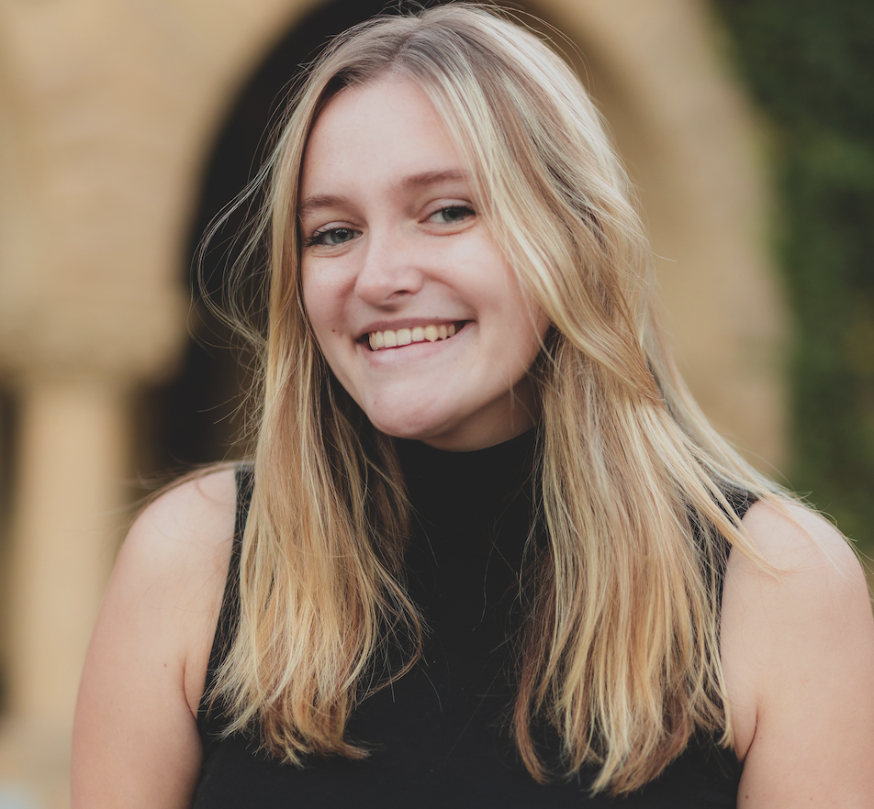
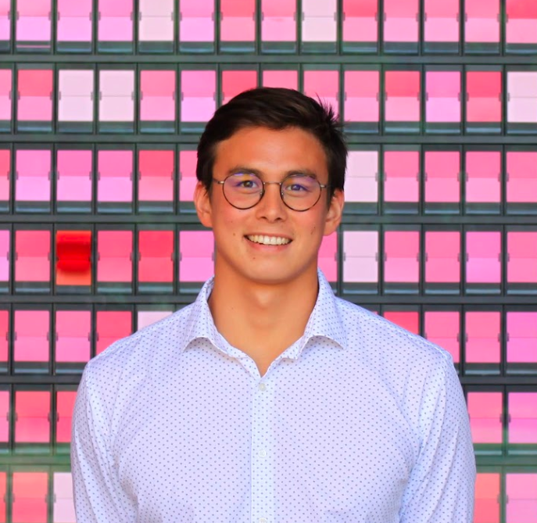
OUR TEAM
Ashley Chen
Daphne Liu
Eliza Gallagher
Leon MacALister
Senior
Computer Science
Los Angeles, CA
Junior
Computer Science
Salt Lake City, UT
Junior
Computer Science
Louisville, KY
Coterm
Computer Science
Sydney, Australia

Slide 4
03
Results & Analysis

Slide 5
PROBLEM DOMAIN
Reducing mental overhead through assistance or streamlining of routines, scheduling, or planning

Slide 6
02
Needfinding Methodology

Slide 7
Interview Logistics
5 Interviews: 3 in person, 2 on Zoom
Apparatus: Zoom transcribe, even for the in-person interviews
Questions that we asked all interviewees:
  What is your background?
  If you could automate some things from your day to day life, what would they be?
  What are some skills at previous roles that you take to make your life easier?
  Can you give us a tour of what apps you use to start and go about your day?
Asked specific questions tailored to each interviewee

Slide 8
Participants
01
02
03
04
05
Rebecca
Michael
Kimmie
Xiaokun
Mario
Event Planner at the OSE
Startup Co-founder
Senior at Palo Alto HS
Head of an AI Dev Team
Mech-E
Masters Student

Slide 9
01
Rebecca
🗣️: Ashley
📝: Daphne
📍: Stanford Office of Student Engagement
Why
Professional in logistics and planning, incorporates lots of planning in personal life
[Extreme User]- Professional planner w/ADHD
How
Went to OSE and asked
Key Questions
Asked her specifically about the best/worst part about event planning, and how that changes the way she lives her everyday life
Event Planner at the OSE

Slide 10
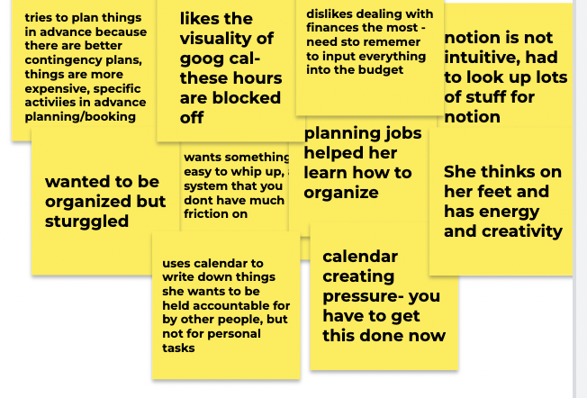
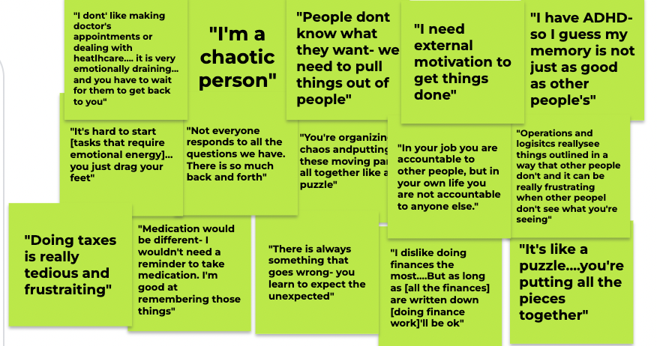
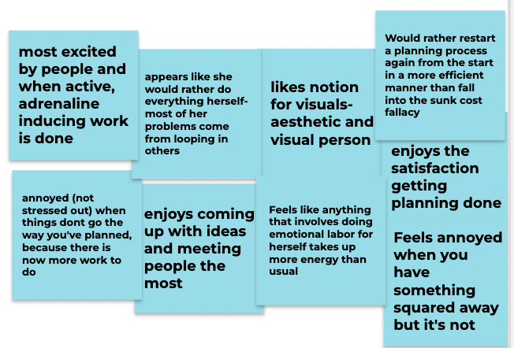
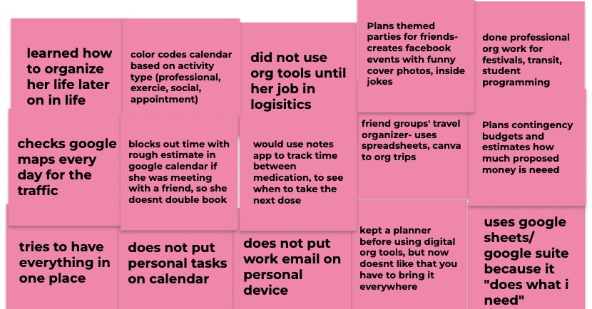
Rebecca
Says
Thinks
Does
Feels

Slide 11
Insights
Observations
Inferences
Likes that planning things “locks” the time in for her, but does not put the most important things (like medication) on her calendar
Enjoys planning things for others and her friends, but has no motivation to plan things for herself
Thinks apps like Notion are sometimes difficult to navigate, instead resorts to Excel sheets/word docs
Finds it hard to plan things when there is no direct cue involved (ex: recording down finances)
Sees her calendar as more of a motivator than a second brain
Likes involving others in her planning, but it is often her biggest source of frustration from their unpredictability
Personal tasks add in emotional energy and removes external motivation
Resorts to tools with less friction in their use (like google sheets vs notion) for personal use, versus tools aimed at aesthetics or complex planning

Slide 12
02
Michael
🗣️: Daphne
📝: Eliza
📍: Zoom
Why
Juggled startup work and school work simultaneously
Co-founded a startup that does something that we feel is within our problem domain (automating the job search process)
How
DMed on Instagram
Key Questions
Asked him about how he came up with his startup idea and what tools he used to juggle his workload
Startup cofounder and (previously full time student)

Slide 13
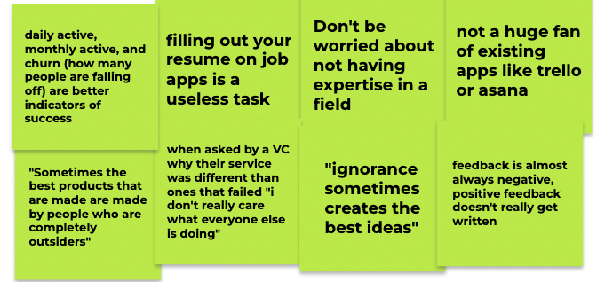
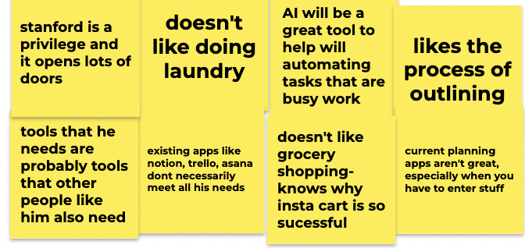
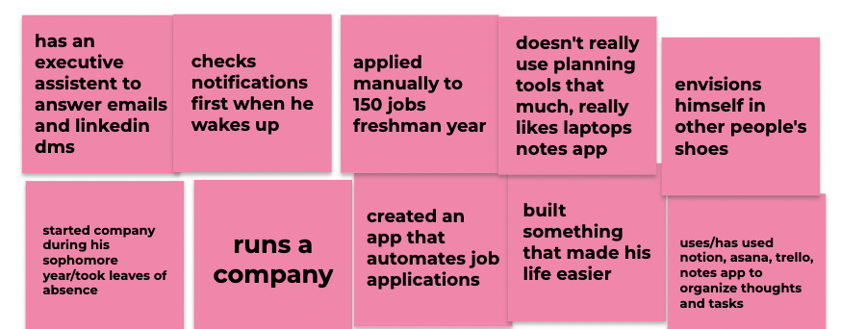
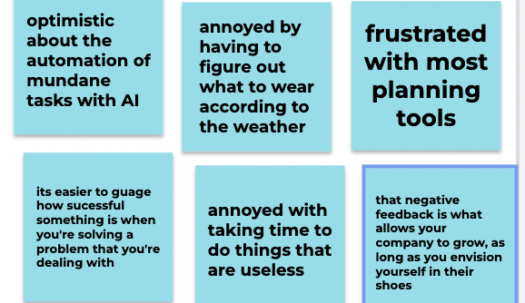
Michael
Says
Thinks
Does
Feels

Slide 14
Insights
Observations
Inferences
Uses iPhone Notes app a lot, also Asana, Trello but isn’t a huge fan
Hates doing laundry, cooking/cleaning, grocery shopping, lots of everyday tasks
For his startup, built something that would make his life easier because he “doesn't like to waste time doing things that are useless”
Sometimes solutions that are more simple, like iPhone Notes are more helpful for bigger tasks than complicated software like Asana or Trello
Finds tasks that are busywork, cumbersome, or repetitive to be “useless”
Focuses much more on outcome than the process (esp related to menial tasks)

Slide 15
03
Kimmie
🗣️: Eliza
📝: Ashley
📍: Peet’s Town and Country
Why
Alternative academic experience- Highly organized, juggling multiple commitments + college apps
How
Reached out through mutuals
Key Questions
What’s a habit you recently adopted, and one that you recently dropped?
Where does the exact source of your stress come from?
Paly High Senior

Slide 16
Kimmie
Observations
Inferences
Enjoys how simple google calendar is and how you only need to think about small customizations
Finds writing down tasks to often be enough to remember to do them- the list itself is not necessary after that
Less stressed out after her tasks are planned out
Wanted most to remove frequent but menial tasks
Familiarity, ease of use is more important than amount of features, customization, or aesthetics
Uses the calendar as an assistant to help her remember when things are to be done, and then uses her calendar as a rigid unchangeable guideline to dictate her day
Stressed out when the timing of an event is unknown or if an event is not planned
Dislikes having to do more menial thinking than necessary- setting alarms, ordering the same food each day, etc.

Slide 17
04
Xiaokun
🗣️: Leon
📝: Eliza
📍: Zoom
Why
Chosen because of leadership position in software company (utility, gas/water software). Assume he is hyper-aware of time efficiency, own schedule and other’s schedules
How
Recruited on LinkedIn via outreach to Engineering leads in the Bay Area
Key Questions
With the amount of freedom you have as team leader, how do you prioritize tasks and stay organised?
What are some key timesaving strategies did you employ to maximize productivity during crunchtime?
Head of AI Eng. Team at Sun-Net

Slide 18
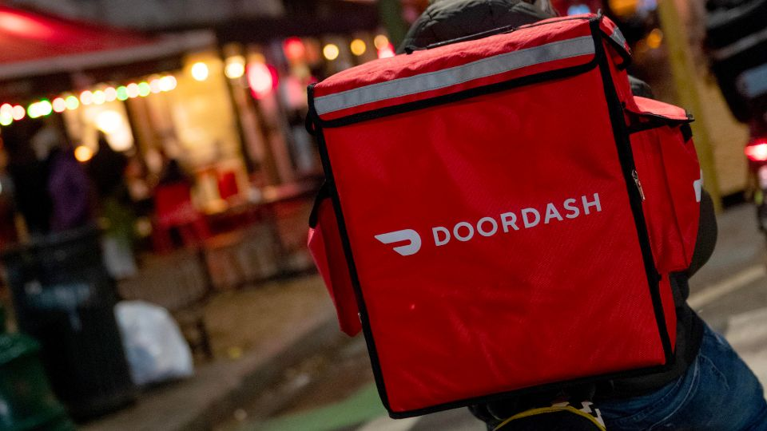
Insights
Observations
Inferences
Work-oriented- 100 hours a week at some points during development crunch time, and had to find ways to streamline his life to be geared towards work
  Ordering food instead of cooking, laundry service
Said that when ordering food, he found he wasted time on deciding what to eat
Uses just a long page of notion since doesn’t really need to stay organized
Will only plan what is necessary, as he aims to spend mental energy on work
Wants decisions and physical tasks he doesn’t consider a priority to be to be made for him
Generally needs help with completing menial tasks so he can be hyper-focused on work

Slide 19
05
Mario
🗣️: Leon
📝: Daphne
📍: Rains Apartments, Stanford
Why
Chosen to get a college student perspective, who also was a head of a Fraternity and has been an RA (or equivalent) since sophomore year (MIT)
How
Sourced via cold outreach through graduate student email list at Stanford
Key Questions
What do you think is the most stressful component of being an engineering student at Stanford?
How do you stay connected with your fraternity, friends from MIT and people back home?
Second Year Graduate Mech-E

Slide 20
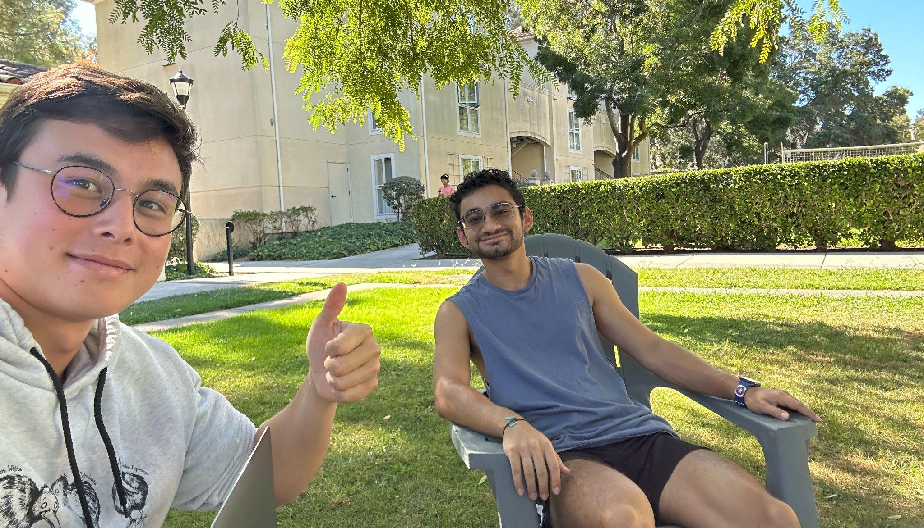
Insights
Observations
Inferences
Schedules are never set in stone, so has inconsistent workout schedules and socialization
Has found it very difficult to remember to stay in-touch with people from MIT and back-home
Religiously uses google calendar but things like chores and laundry take up time
Chaotic scheduling for large groups of people
Dichotomy between expected time in tasks, actual time used, and wanted time
Overbooks days, leaving little to no time to do tasks that seem straightforward (like calling, going to the gym, socializing)
Most disturbed when he finds that he has forgotten to call a friend or reply to an email (relationship based tasks)
Most setbacks are beyond his personal control → usually circumstances or other people
Would benefit from having less chores to worry about

Slide 21
04
Summary

Slide 22
Key Learnings
Existing planning solutions don’t satisfy these people
  People want tools that help simplify their lives, but don’t have the energy to set up elaborate systems tailored just for them
  Will pass over complexity for less friction, visual aspects
Users voiced frustrations at small, frequent tasks- especially on ones that:
  Require emotional labor (adds personal aspect)
  Involve collaborating with other people (adding unpredictability)
  Involve personal choices w/ simple decision-making (decision fatigue)
How might we reduce overall mental toll without continuing to add onto one’s bandwidth?
→ thinking wrt to making small decisions and how those add up

Slide 23
What’s next?
More interviews!
  Extreme users → neurodivergent people
  People who generally struggle with a lack of planning
  Dig deeper into what kind of trivial things build up and bother people the most
HMW statements
Prototyping

Slide 24
Thanks!!!

Slide 25
06
Appendix

Slide 26
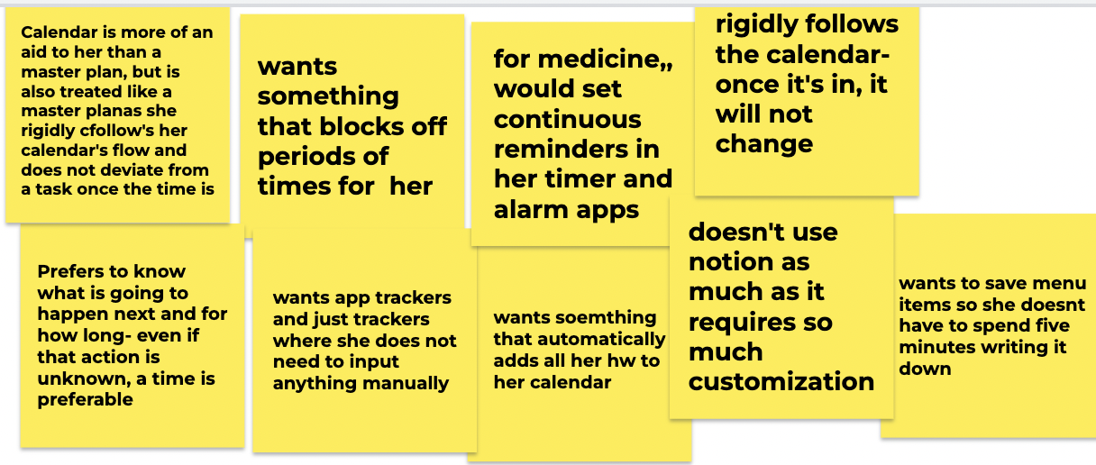
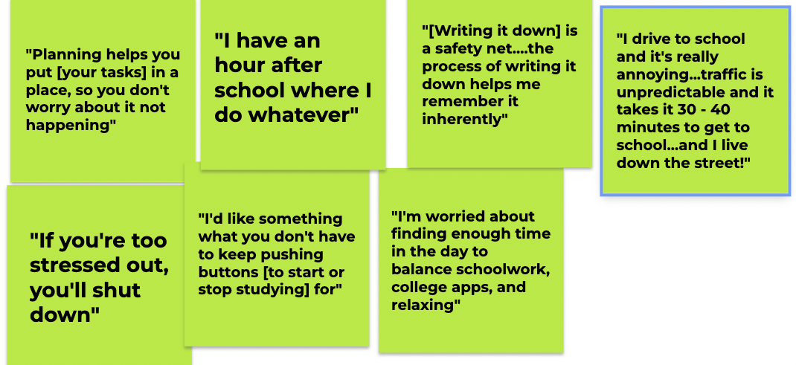
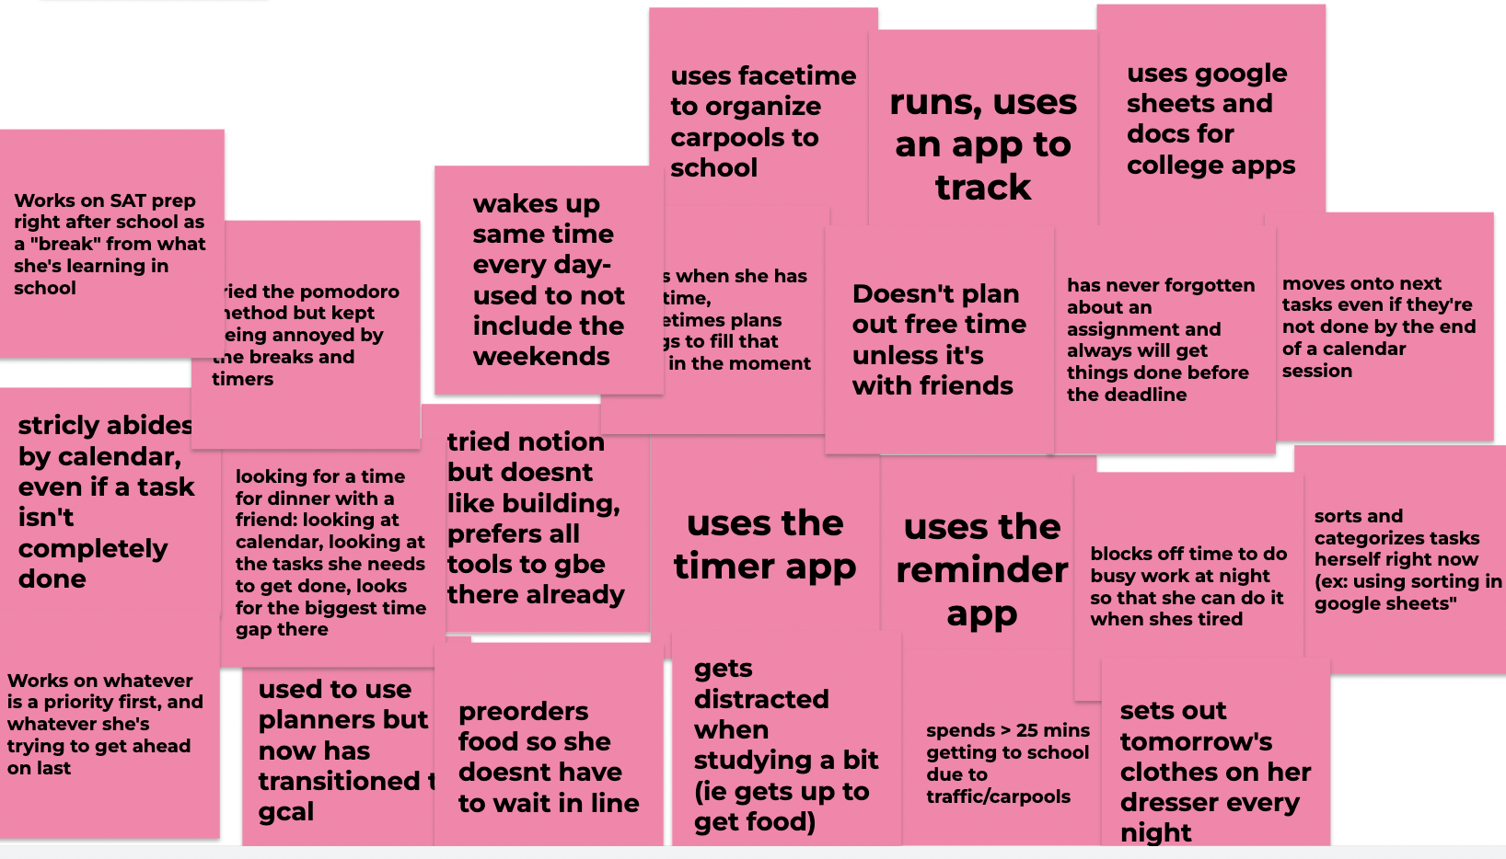
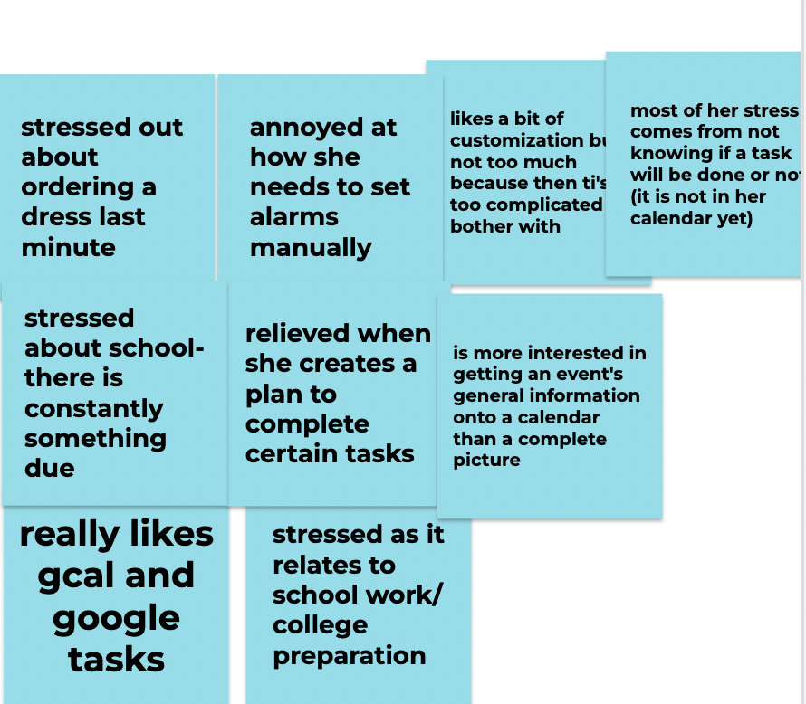
Kimmie
Says
Thinks
Does
Feels

Slide 27
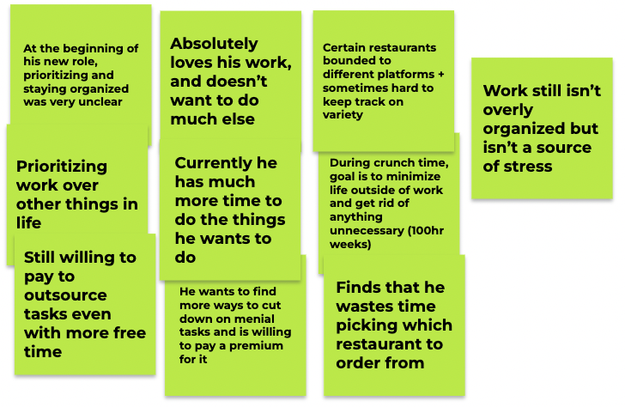
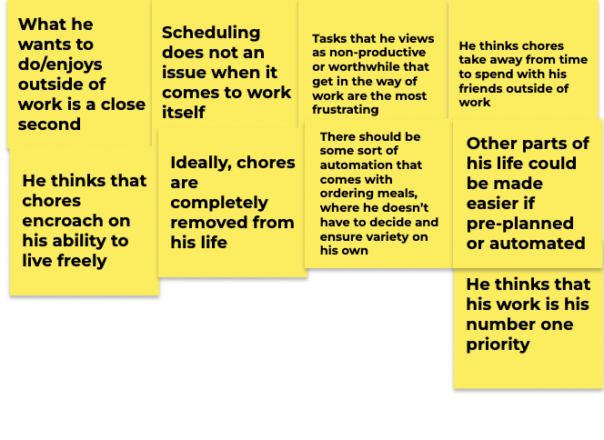
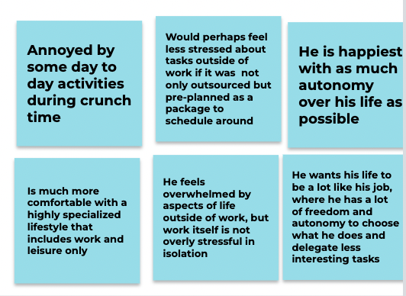
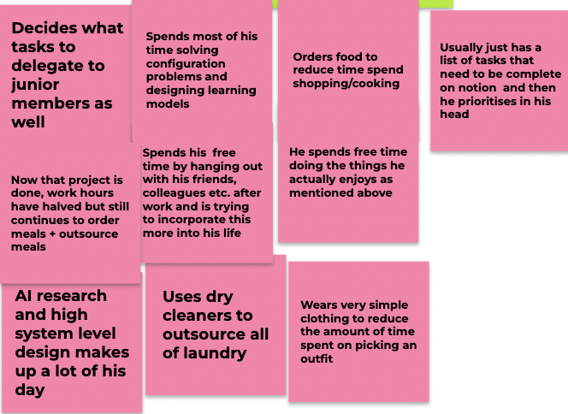
Xiaokun
Says
Thinks
Does
Feels

Slide 28
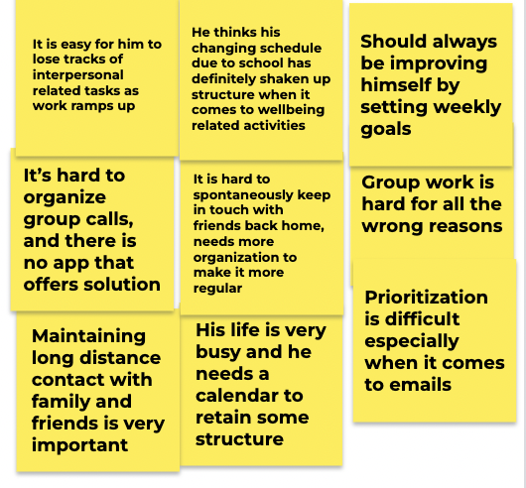
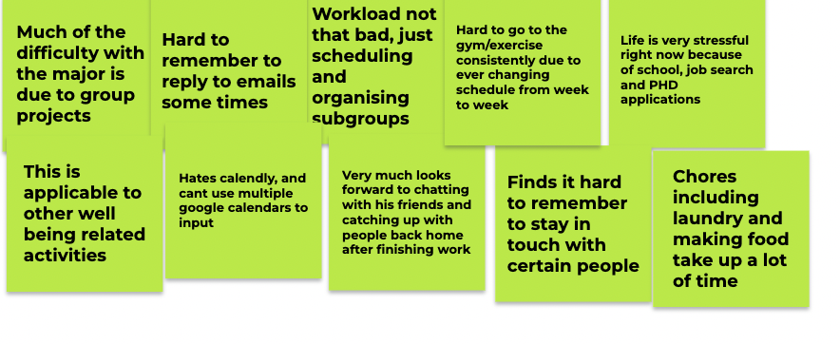
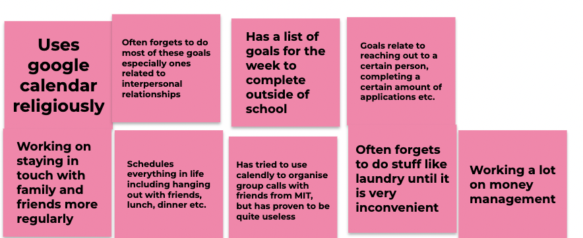
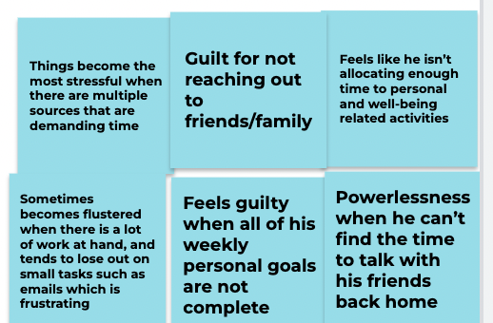
Mario
Says
Thinks
Does
Feels

