Slide 1
playdate!
sachin allums
nicole segaran
mena hassan
kevin tran

Slide 2
Table of contents
01
02
03
Project name and problem solutions
Market research
Stakeholders and Ethics

Slide 3
Table of contents
04
05
06
Tasks
Video Storyboard
Video Link

Slide 4
01
Project name and problem solutions

Slide 5
Project Name
• Wanted to capture childlike energy
• Emphasize in person interactions
• Liked one HMW statement about making
adult playdates
• Settled on using playdate as the name!

Slide 6
playdate
Strengthen your friendships, today!

Slide 7

The Problem
Young adults in their 20s struggle to maintain friendships across new environments, often because they are unsure how to make novel plans or reach out

Slide 8
Our Solution
Strengthen young adults’ friendships by providing them with unique experiences and giving them a deadline to do them
Contribute, share, and browse fun and niche plans for both themselves and others to complete together

Slide 9
02
Market Research

Slide 10
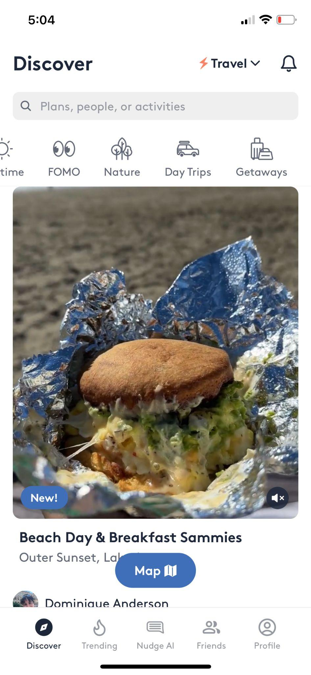
Nudge
A platform where people share fun things to do locally
What works for our problem space
Easy and quick filtering of tasks catered to one’s preferences
Engaging video posts and high-quality planning
Effective search engine for niche requests
What doesn’t work
Privacy and limited visibility settings
Friends and trending page is cluttered and visually confusing
User activity and retention are poor

Slide 11
Lessons from nudge
Filtering
Privacy
Giving users the power to filter plans is huge
Users value only sharing what they’re doing with close friends

Slide 12
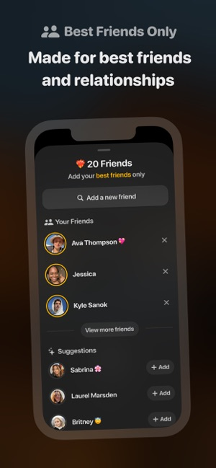
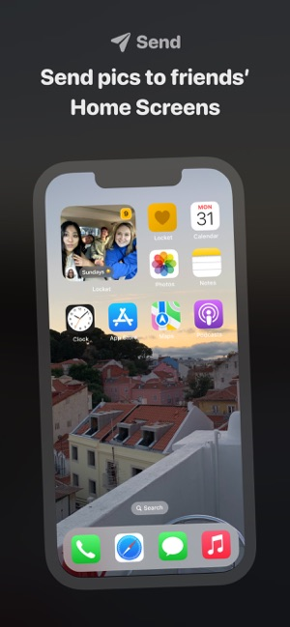
Locket
Live pictures from your best friends
What works for our problem space
Maintaining close friends/family
  Limit of 20 friends
Low effort engagement
  See pictures of what friends are doing and start conversation over it
No public friends count
What doesn’t work
Can only limit widget to either one person or everyone (no groups)
Very little customization
No lasting convos (only about current photos)

Slide 13
Locket Takeaways:
Customizable plans and lasting conversations are what we should strive for

Slide 14
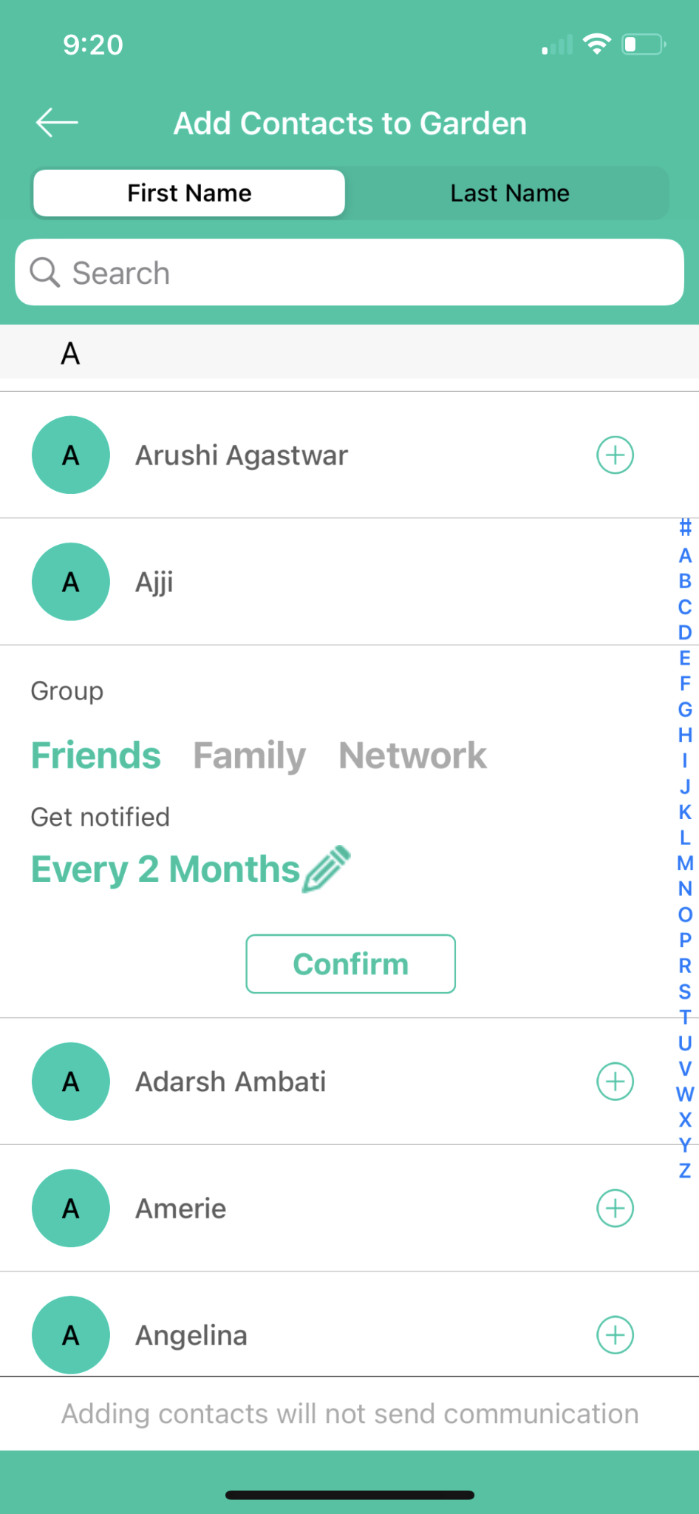
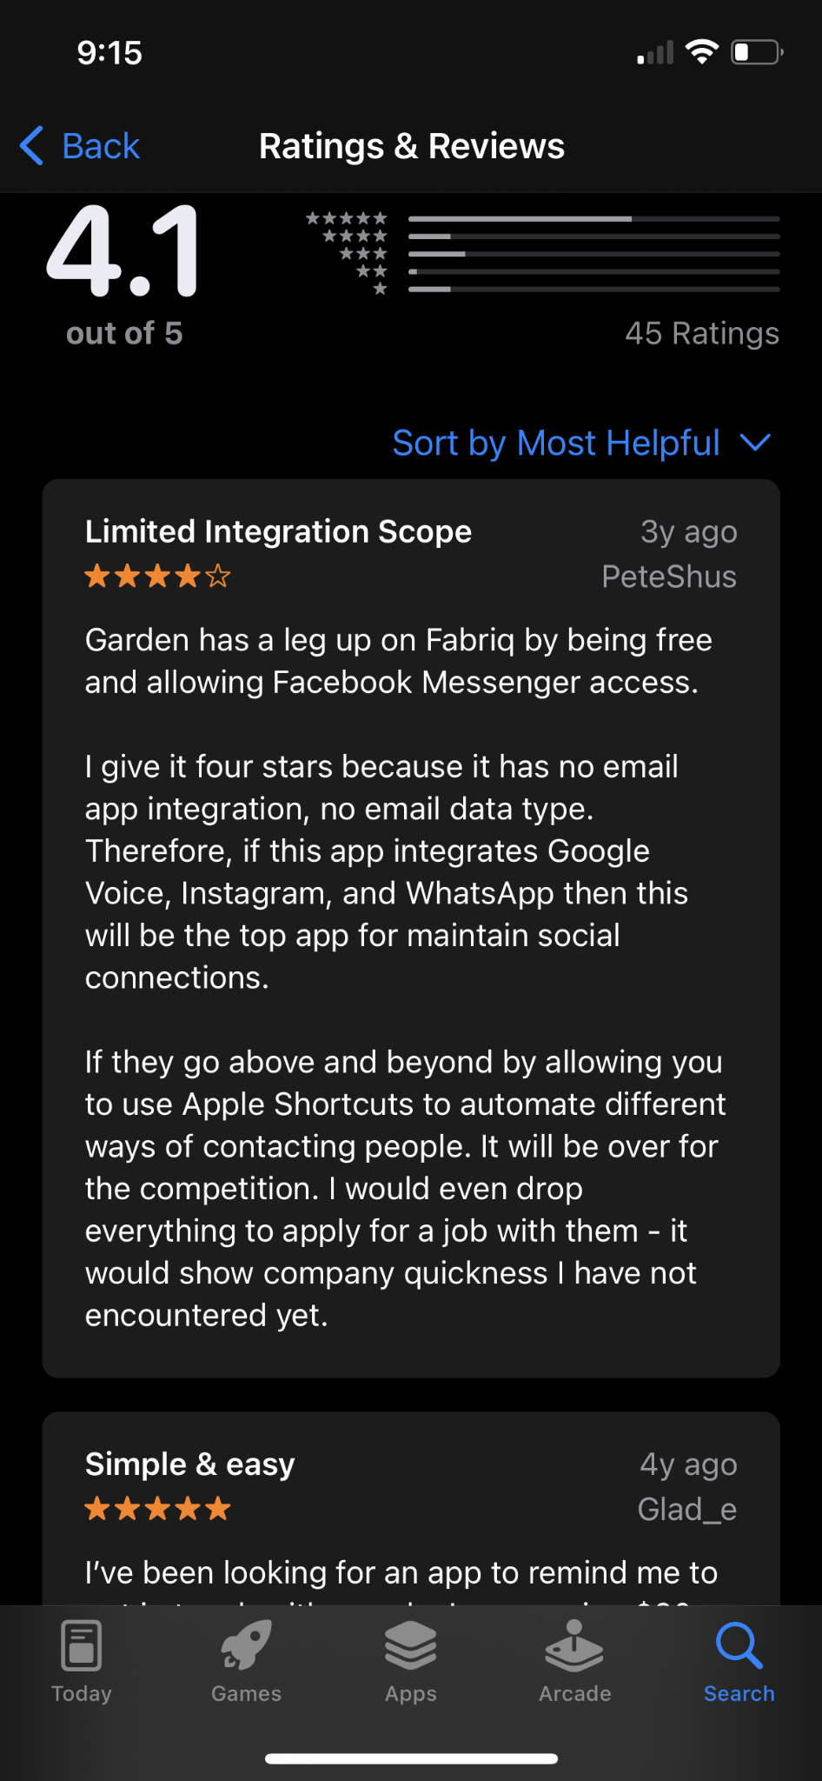
Garden
Personal Relationship Management
What works for our problem space
Sets up regular reminders to meet up with friends
Simple way to turn online relationships into in person connections
Can log notes or put in media documenting each interaction
What doesn’t work
No sense of urgency to make good on the nudge to reach out
No interactivity with other users

Slide 15
Garden Lesson
Have users interact with each other and keep a record of what they’ve done either through posts or something else

Slide 16

Clay
Customer Relationship Management
What works for our problem space
Integrates with all of your contacts
Can find out when you last hung out with someone
Enables logging interactions and saving notes about them
What doesn’t work
One person can have 1000 other people in their network
People use this more professionally and as an opportunity to expand their social network
$20 a month

Slide 17
Clay Takeaways
Contacts
Network
Integrating easily with contacts you already have is huge
We want to avoid having playdate become an in-person version of LinkedIn

Slide 18
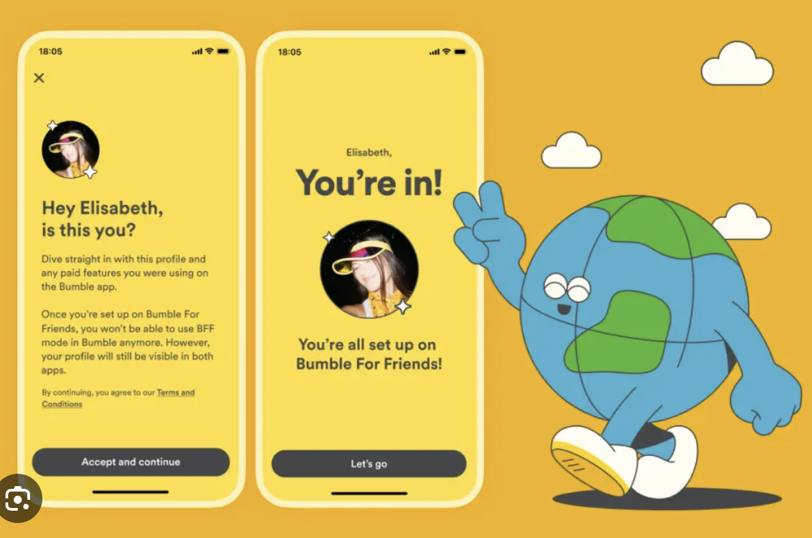
Bumble Friends and Bumble IRL
Meet new friends in your area
What works for our problem space
Specific to your interests or hobbies
Bumble IRL lets people know about events happening that are specific to their location
What doesn’t work
Strangers rather than friends
People are matched based on compatibility of a person rather than planning around an activity
No crowd-sourced knowledge for plans

Slide 19
Bumble Lesson:
Crowd-sourced knowledge is how playdate can distinguish itself

Slide 20







Find events in your area
Reminds you to hang out with people
Filter plans based on interests
Look back on what you’ve done
Private profiles can still easily use app
Keep in touch with close friends

Slide 21
How we differentiate
Playdate gives a sense of urgency to friendship that other apps don’t

Slide 22
03
Stakeholders
and Ethics

Slide 23

Direct Stakeholders
Actual users and people who contribute to making plans on the app. Also, friends and family members who join in on the playdates!

Slide 24

Indirect Stakeholders
Companies who want to plug niche experiences that use their product and mental health professionals who might have fewer clients needing their services due to users strengthening their friendships

Slide 25
Ethical Implications

Slide 26
Ethical Implications
By giving people an easy template for how to create an interesting, meaningful experience with a friend, we might diminish the value in being a thoughtful planner. Taking the time and energy to be creative about planning an event won’t be a skill that our app encourages because people will have crowdsourced, high quality plans at their fingertips, which might make friends bitter towards people who aren’t willing to put more effort into a friendship than our app might provide.

Slide 27
Ethical Implications
By having features that allow one to see events local to a specific area, we might leave out rural users
Encouraging solely in person interactions leaves out friendships that can only interact online

Slide 28
Potential Solutions
We plan on having the majority of the plans that playdate proposes be activities that one could do anywhere to account for rural users. We also hope to give people enough freedom to still be creative in the plans that playdate suggests so that friends can still be thoughtful and show their care for each other. We finally hope that online friends can save plans so that they can execute them when they meet in person.

Slide 29
04
Tasks

Slide 30
Simple Task: Find new ideas
Audrey wants to brainstorm new ways to connect with her friends in person, but she isn’t sure where to start
playdate solves this simple task by showing videos and ideas that other people have had for platonic dates and suggesting them to people

Slide 31
Moderate Tasks
See what friends are doing
Make novel plans with friends
Akshay wants to know what his friends are doing, but doesn’t want to see superficial experiences that he could find on social media
Nicole wants to have carefully planned out activities to do with her friends that she only knows in one context.

Slide 32
Moderate Tasks Explanation
Seeing what a friend is doing requires that a person either sees them in-person or sees experiences that aren’t just superficial social media posts. Rather than seeing someone’s highlights from the entire year (as one might see on Instagram), we hope that playdate can make these highlights more frequent and therefore more indicative of what a person is actually doing by putting them into a scrollable format.
Making novel plans with others requires brainstorming what to do, finding a place to do it in, finding people to do it with, and finding a time. Playdate aims to solve this by setting a deadline for people to complete an activity (that could be specific to their area).

Slide 33
Complex Tasks
Filter Ideas Based on Interests
Share experiences with others
Kaitlyn is looking for elaborate ways to connect with others but Nicole A. might be looking for low stakes ways to keep in touch
Nicole T. wants to share the things with friends that are important to her in a way that isn’t obnoxious

Slide 34
Complex Tasks Explanation
Filtering plans based on budget, interest, or other constraints can be difficult to find the perfect match. Playdate aims to make this process easy to do by putting all of these variables in one place and giving the user the ability to filter out different plans.
Sharing experiences with others can be difficult if you never see that friend in person. By posting one’s “playdate” and sharing their ideas with others, we hope to facilitate the process of sharing experiences with all of our users.

Slide 35
05
Video Storyboard

Slide 36
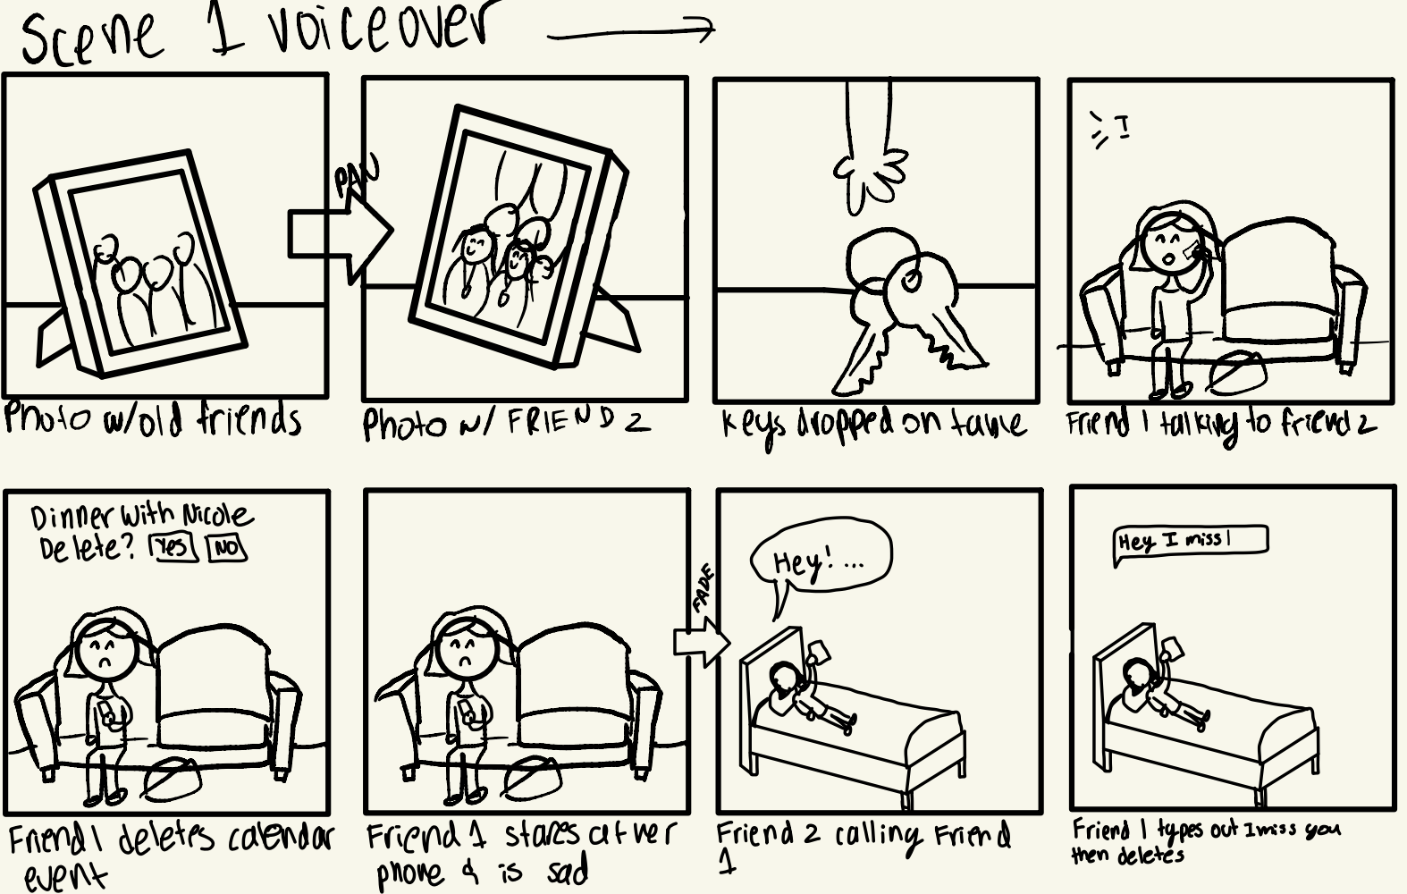

Slide 37
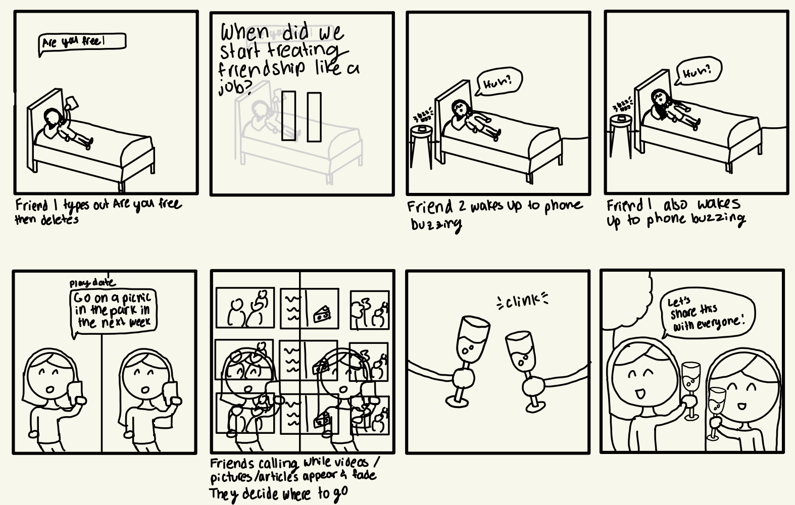

Slide 38
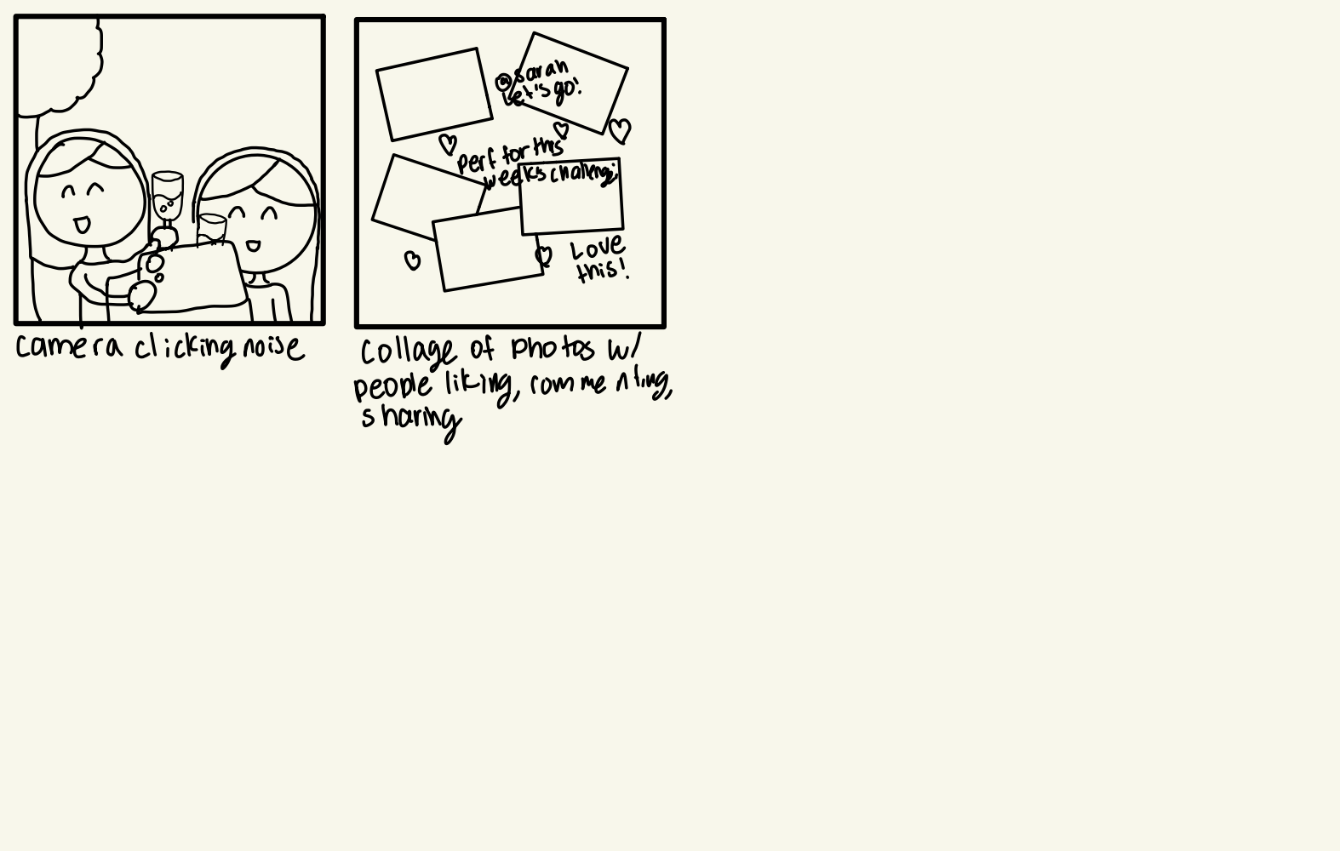

Slide 39
06
Video Link

Slide 40
Appendix

Slide 41
Appendix Links
Recording Photos
Recording Videos
Tentative App Logo
Brainstorm Document
Video Music

