Slide 1
Playdate
An app that puts the forever in Best Friends Forever

Slide 2
Table of contents
01
02
03
04
05
06
Introduction
Needfinding
POVs + HMWs
Solutions + Assumptions
Experience Prototypes
What’s Next?

Slide 3
Introduction

Slide 4
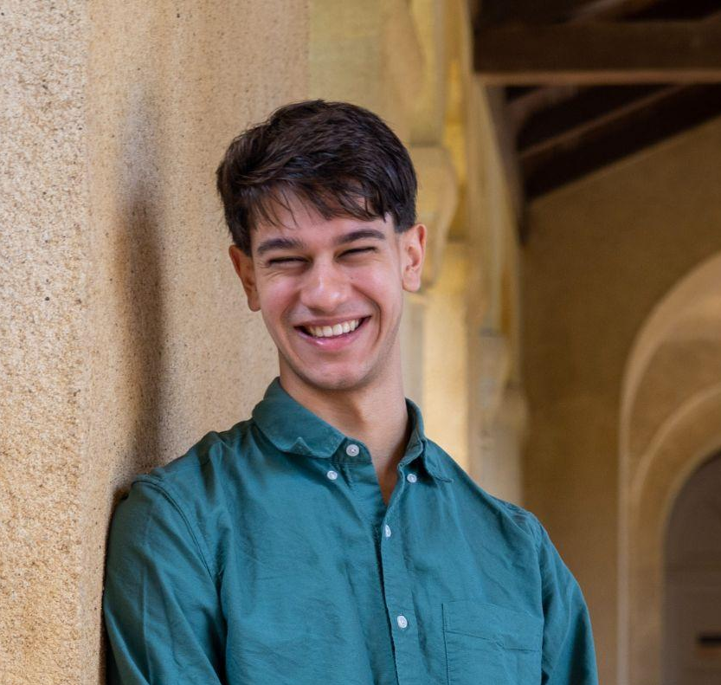
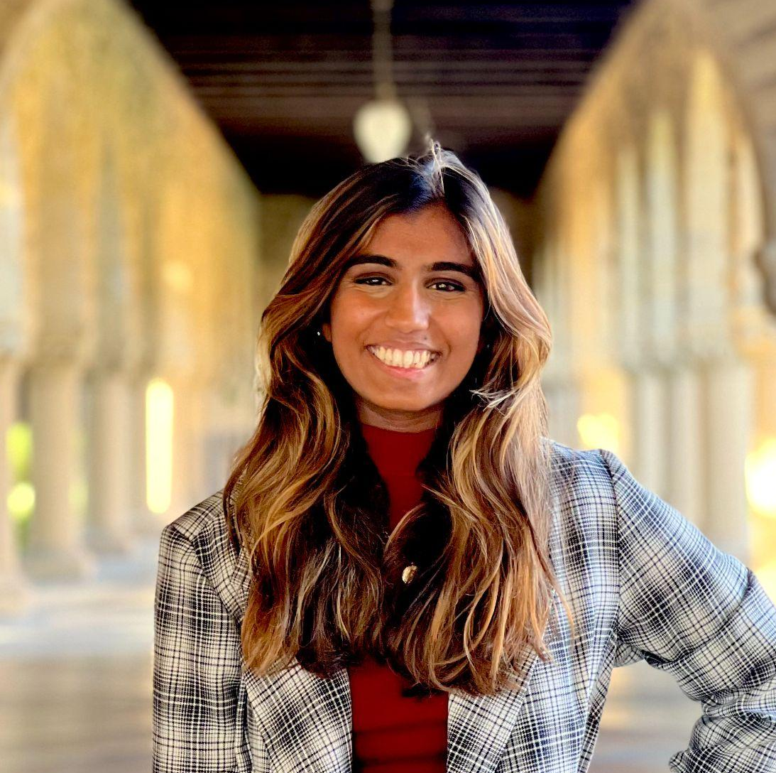
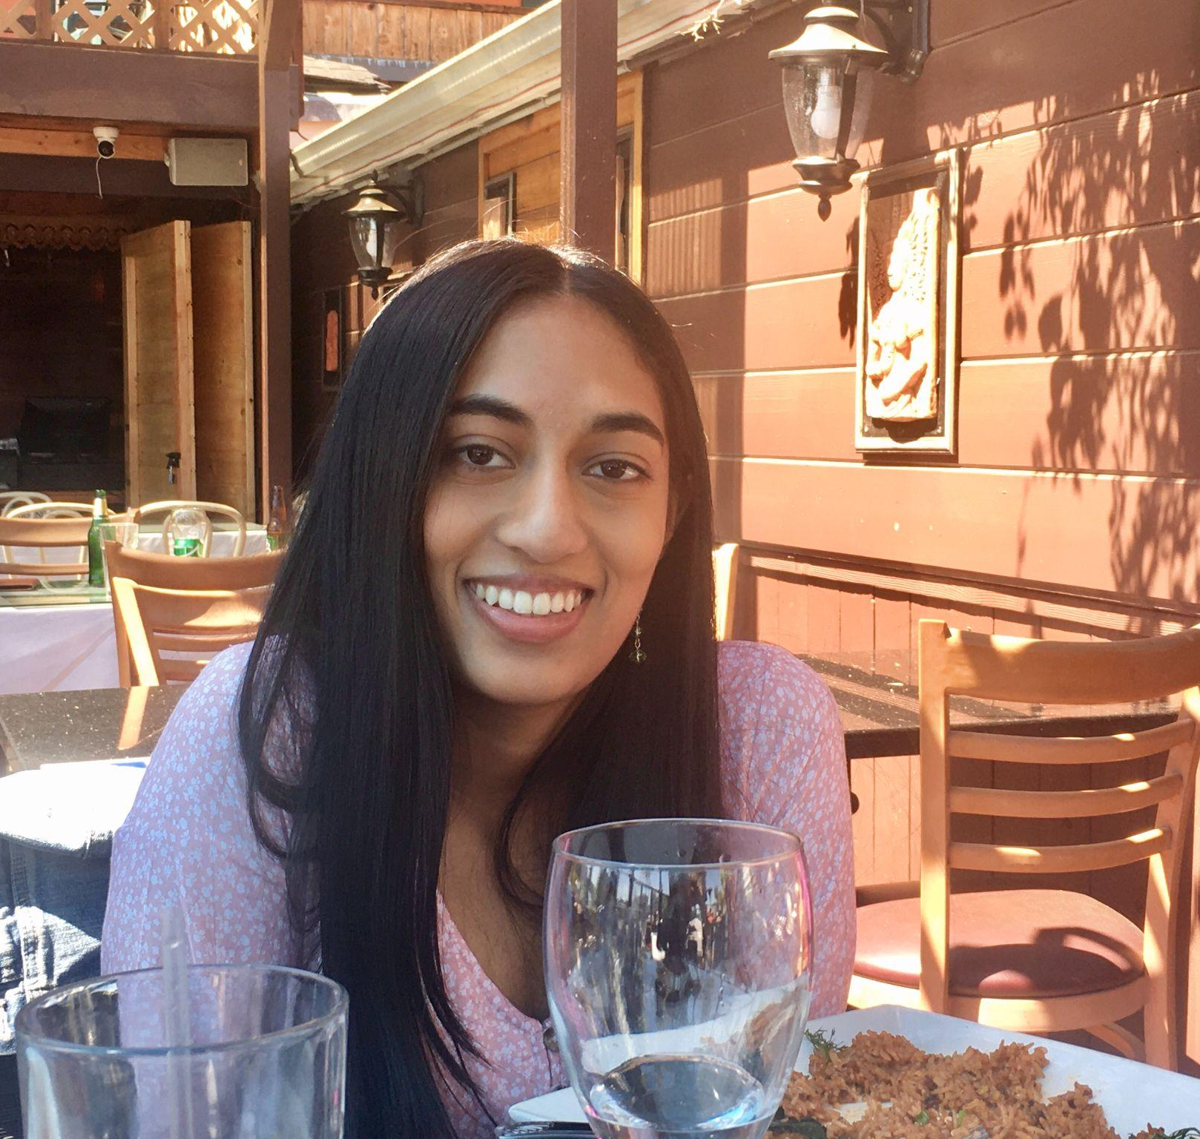
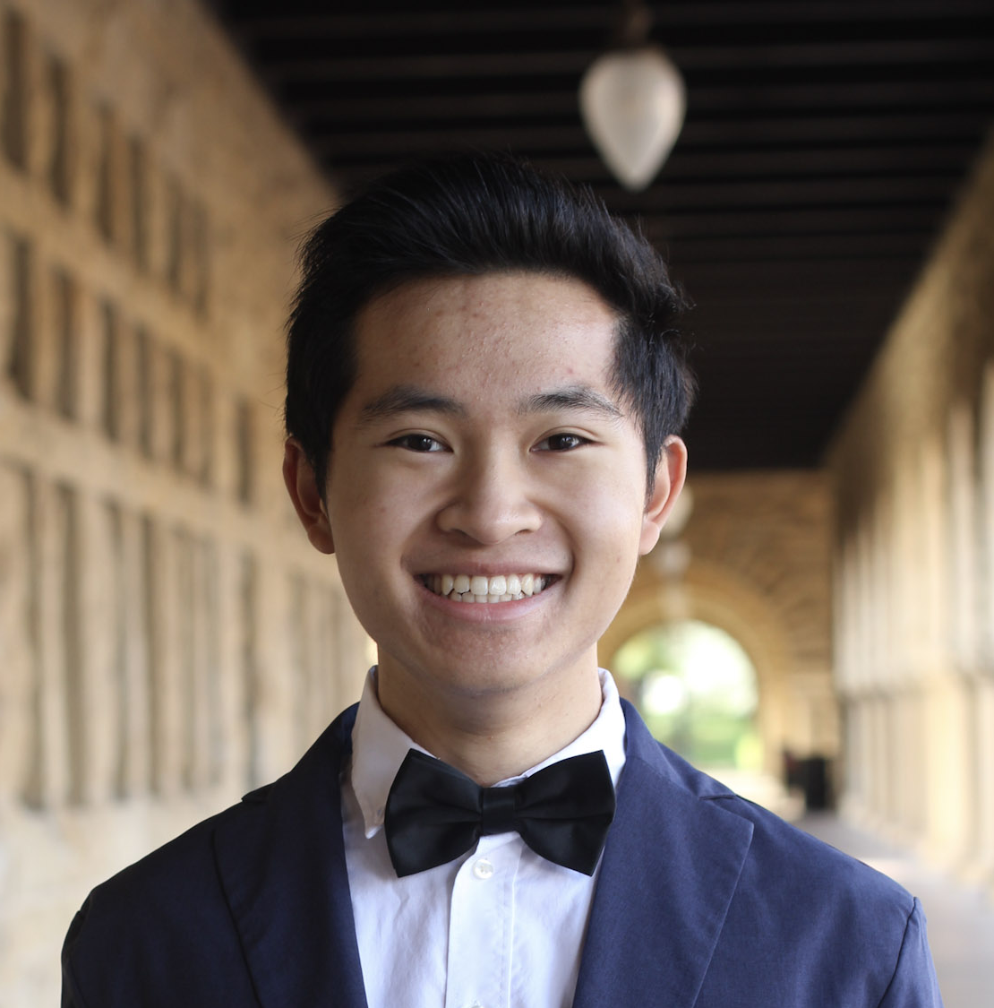
Our Team
Sachin Allums (he/him)
Nicole Segaran (she/her)
Mena Hassan (she/her)
Kevin Tran (he/they)
Notes:
But before I get into the details of the project, I want to introduce you to my lovely team. I’m Sachin, a junior studying Symsys and education. This is nicole, who is studying cs, education, and creative writing. This is Mena, who is studying CS, and finally this is Kevin who is studying psychology and also potentially coterming in CS

Slide 5

I feel like I have no friends here
We NEED to hang it’s been so long!
Hey, it’s been a while
…
I really miss you…
How can we build a product that facilitates people’s friendships?
How can we build a product that helps people maintain friendships that are important to them?

Slide 6
Needfinding

Slide 7
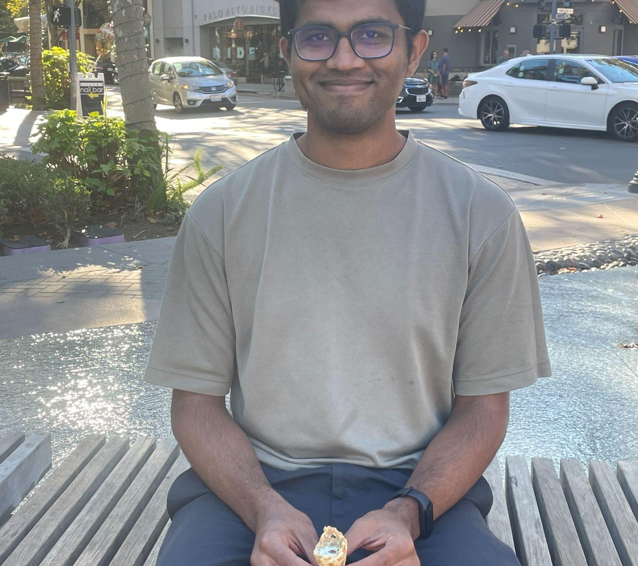
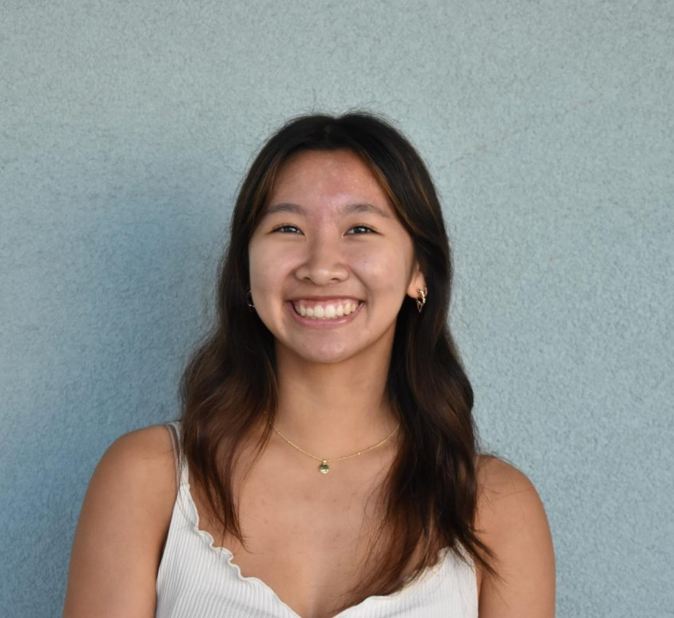
Who We Talked To
Akshay (he/him)
Software Engineer
Kaitlyn (she/her)
High School Senior
Notes:
Wanted to focus on our more target users

Slide 8
“Does our Life Intersect?”
Maintaining friendships (or not) is an intentional choice
Whether a friendship continues relies on the commitment of both individuals
When considering who his close friends were, Akshay cared less about distance + frequency of meet-ups and more about whether the quality
Social media disincentivizes maintaining one-on-one connections because “you already know everything about their life”

Slide 9
“I Send Pictures Everyday”
Low commitment, one-on-one digital interactions are a valuable way of staying connected even when you can’t see each other
When planning in-person activities with long-distance friends, likes to make them “elaborate” and “quality”
Uses social media to generate ideas for hangouts

Slide 10
POVs + HMWs

Slide 11
Audrey
Nicole T.
We met…
Audrey, a recent college grad pursuing EdTech
We were surprised to notice…
she often made friends through common interests + proximity, but she wanted more friends who aligned with her values
We wonder if this means…
people need a method for connecting to people who have a similar outlook on life
It would be game changing…
to create social environments that connects people based on values over convenience
We met…
Nicole T., a physics grad student at Stanford
We were surprised to notice…
she tends to make friends with people who shared experiences + interests even though she wants more diverse friendships
We wonder if this means…
people need help connecting to others with different backgrounds
It would be game changing…
provide an accessible way for people to build friendships with people from different experiences

Slide 12
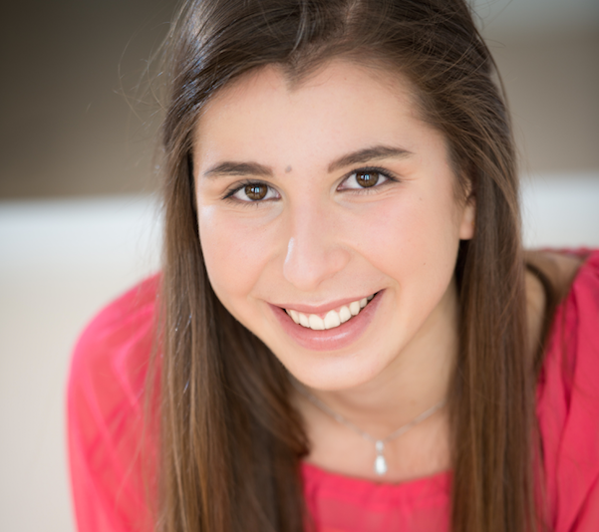
Nicole T.
We met…
Nicole T., a 3rd- yr grad student at Stanford deeply involved in sports communities
We were surprised to notice…
many of her friendships were anchored to one particular context, and she struggled to maintain those friendships across new contexts
We wonder if this means…
people need help scaffolding friendships that persist across situational changes
It would be game changing…
to help people introduce new experiences and contexts to their friendships, building more robust relationships overall
Notes:
10 HMWS:
HMW introduce novelty into pre-existing friendships?
HMW reduce the activation energy for reaching out after situational changes have occurred?
HMW reduce the activation energy for trying out new experiences with friends?
HMW support people in maintaining friendships WHILE they transition to new contexts in their lives?
HMW facilitate friendships that are centered around unique and niche hobbies or interests to foster deeper, more lasting connections?
HMW develop a system for tracking, visualizing, and thus normalizing the evolution of friendships over time and context changes?
HMW provide resources for individuals to better understand and embrace the concept of multiple contexts within their friendships, promoting adaptability and resilience?
HMW we facilitate friends who are meeting in different contexts than usual?
HMW we “bring back from the dead” friendships that are dying out due to locational separation?
HMW we remind people to reach out to their friends as they go through life changes?

Slide 13
HMW introduce novelty into pre-existing friendships?
From Nicole T.’s POV…

Slide 14
Akshay
We met…
a 28-year-old SWE who moved 5 months ago
We were surprised to notice…
in spite of feeling as if he knew more about his friends because of social media, he felt less inclined to reach out to them
We wonder if this means…
people need incentivization to reach out even though they know everything about each other
It would be game changing…
to create a low stakes way for people to continue connecting and learning about each other, beyond the surface level knowledge that social media provides
Notes:
10 HMWS:
HMW nudge people to be curious about each other beyond the information that social media provides?
HMW provide low cost ways of making niche + meaningful experiences?
HMW create social media posts that require more meaningful audience interaction?
HMW design a system that rewards individuals for maintaining deeper, ongoing connections with friends they already know a lot about through digital platforms?
HMW give people a scaffold for learning more about each other?
HMW enable users to set personal relationship goals and milestones with their friends to make the process of deepening connections more tangible and achievable?
HMW we leverage and amplify a person’s own internal curiosity to encourage them to continue connecting with friends?
HMW reduce the stigma to suggest in-person interactions?
HMW we mitigate the harm social media incurs on a user’s motivation to reach out?
HMW we make online communication more genuine?

Slide 15
HMW nudge people to be curious about each other beyond the information that social media provides?
From Akshay’s POV…

Slide 16
Kaitlyn
We met…
An 18-yr old HS senior who loves social media
We were surprised to notice…
when communicating online, she prefers a low stakes interactions, but in-person she loves making elaborate plans
We wonder if this means…
people maintain friendships differently digitally vs in-person
It would be game changing…
leverage these differences to make translating friendships across digital and in-person interactions easier
Notes:
10 HMWS:
HMW foster interactions that can continue both digitally and in-person?
HMW create an easy way to communicate daily digitally with friends that feels similar to in person interaction?
HMW help people make spontaneous, in-person plans?
HMW we reduce the anxiety of transitioning between online conversations to in-person plans?
HMW facilitate low-stakes digital interactions?
HMW we help people set expectations for digital and in-person interactions?
HMW we reduce the barrier of reaching out to friends digitally?
HMW facilitate the organization of in-person events that are inspired by online interactions, allowing friends to experience the fun and creativity of their digital conversations in real life?
HMW personalize someone’s feed to help them get inspiration for better digital and in-person interactions?
HMW help people translate ther in-person experience to digital interactions?

Slide 17
HMW foster interactions that can continue both digitally and in-person?
From Kaitlyn’s POV…

Slide 18
Solutions + Assumptions
Notes:
Wanted to focus on three types of engagement: frequent low-stakes digital engagement, moderate effort in-person interactions, and highly meaningful in-person interactions

Slide 19
Create an app that nudges people to try out new lowkey “playdate” ideas + sets a deadline!
HMW introduce novelty into pre-existing friendships?

Slide 20
Assumption!
Does having a deadline make you more likely to follow through with a plan?

Slide 21
HMW nudge people to be curious about each other beyond the information that social media provides?
Create an app that sends a daily, meaningful question for a user to answer and share with their friends

Slide 22
Assumption!
Do people want a daily incentive to check in with their friends?

Slide 23
Create an app that helps you plan your own ELABORATE “playdates” using crowdsourced information
HMW foster interactions that can continue both digitally and in-person?

Slide 24
Assumption!
Do people value having insider information about what to do with friends?

Slide 25
Experience Prototypes

Slide 26
Participants
Focused on Target Users
  Age Range: 18 - 30
  Expressed difficulty maintaining friendships
  College-aged, recent grad
Recruited via Convenient Sampling
Notes:
While this facilitates people who live in dense, urban locations with disposable income and a preexisting, local friend group may disadvantage low-income, rural populations who may need help with facilitating friendships the most

Slide 27
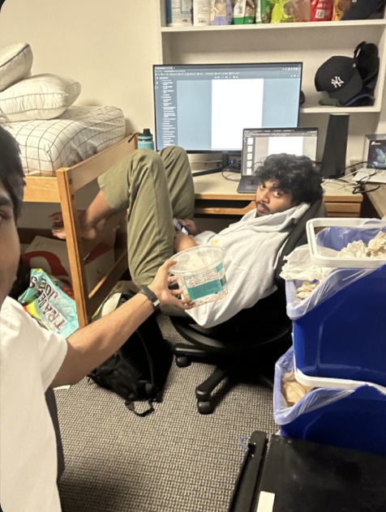
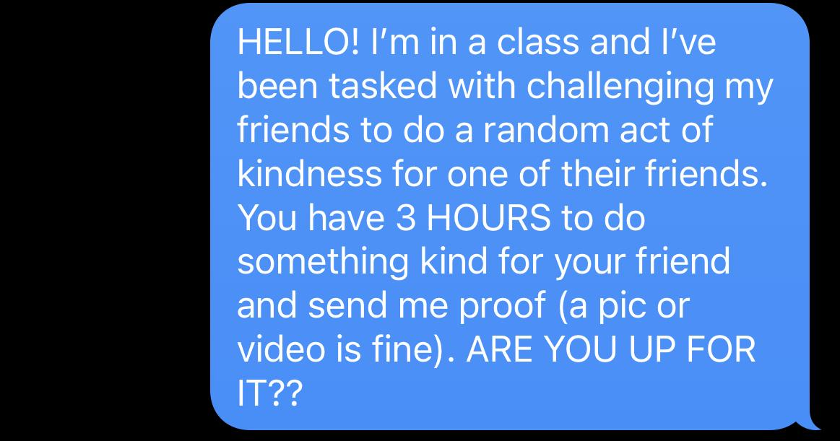
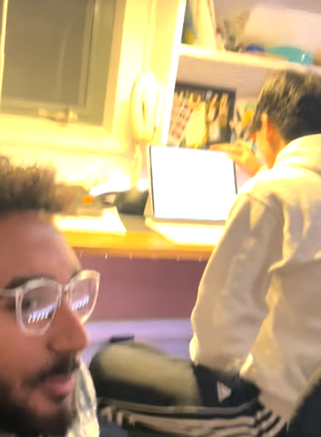
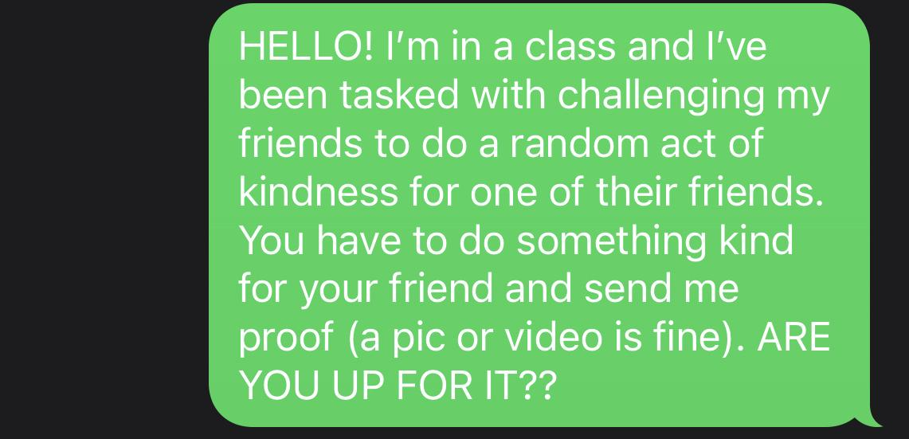
Does having a deadline make you more likely to follow through with a plan?
Setup
Participants Recruited
Successful Participants
3
2
Deadline
2
0
No Deadline

Slide 28
Do people want a daily incentive to check in with their friends?
Qualitative Interviews
How often do you text your friends on average?
Close: daily to weekly
Loose: on avg. once a week
How do you usually start a conversation with your friends?
Close friends have topic in mind
Loose friends fall back on generic topics
How satisfied are you with the quality and depth of your conversations with friends?
Feel unsatisfied with depth of digital interactions among loose friends
Sometimes people don’t want meaningful digital convos
Notes:
Highly dependent digital interactions + preferences when maintaing close + loose friendships

Slide 29
Do people want a daily incentive to check in with their friends?
Satisfaction after Daily Question
Out of the four subjects:
Two participants got a response
  One rated their satisfaction High after the following conversation
  One rated their satisfaction Low after the following conversation
Two participants had no response

Slide 30
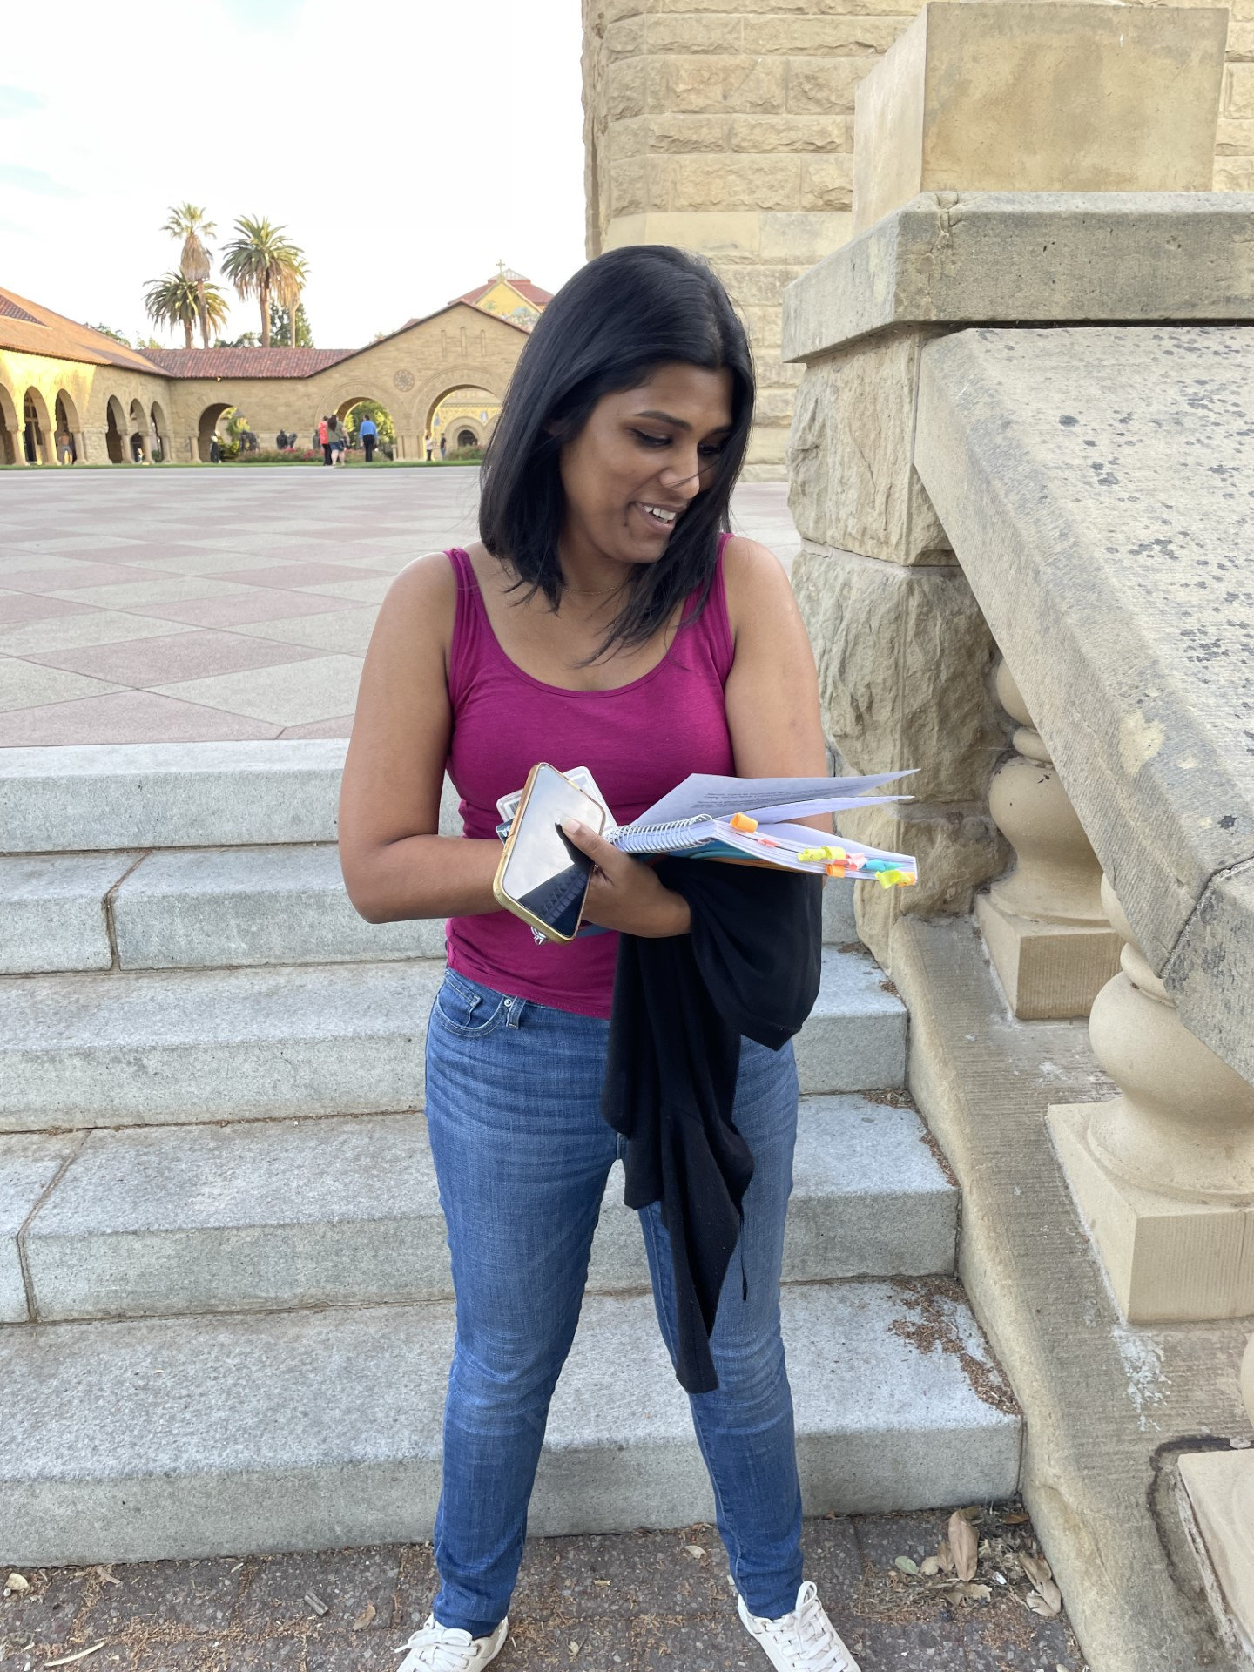
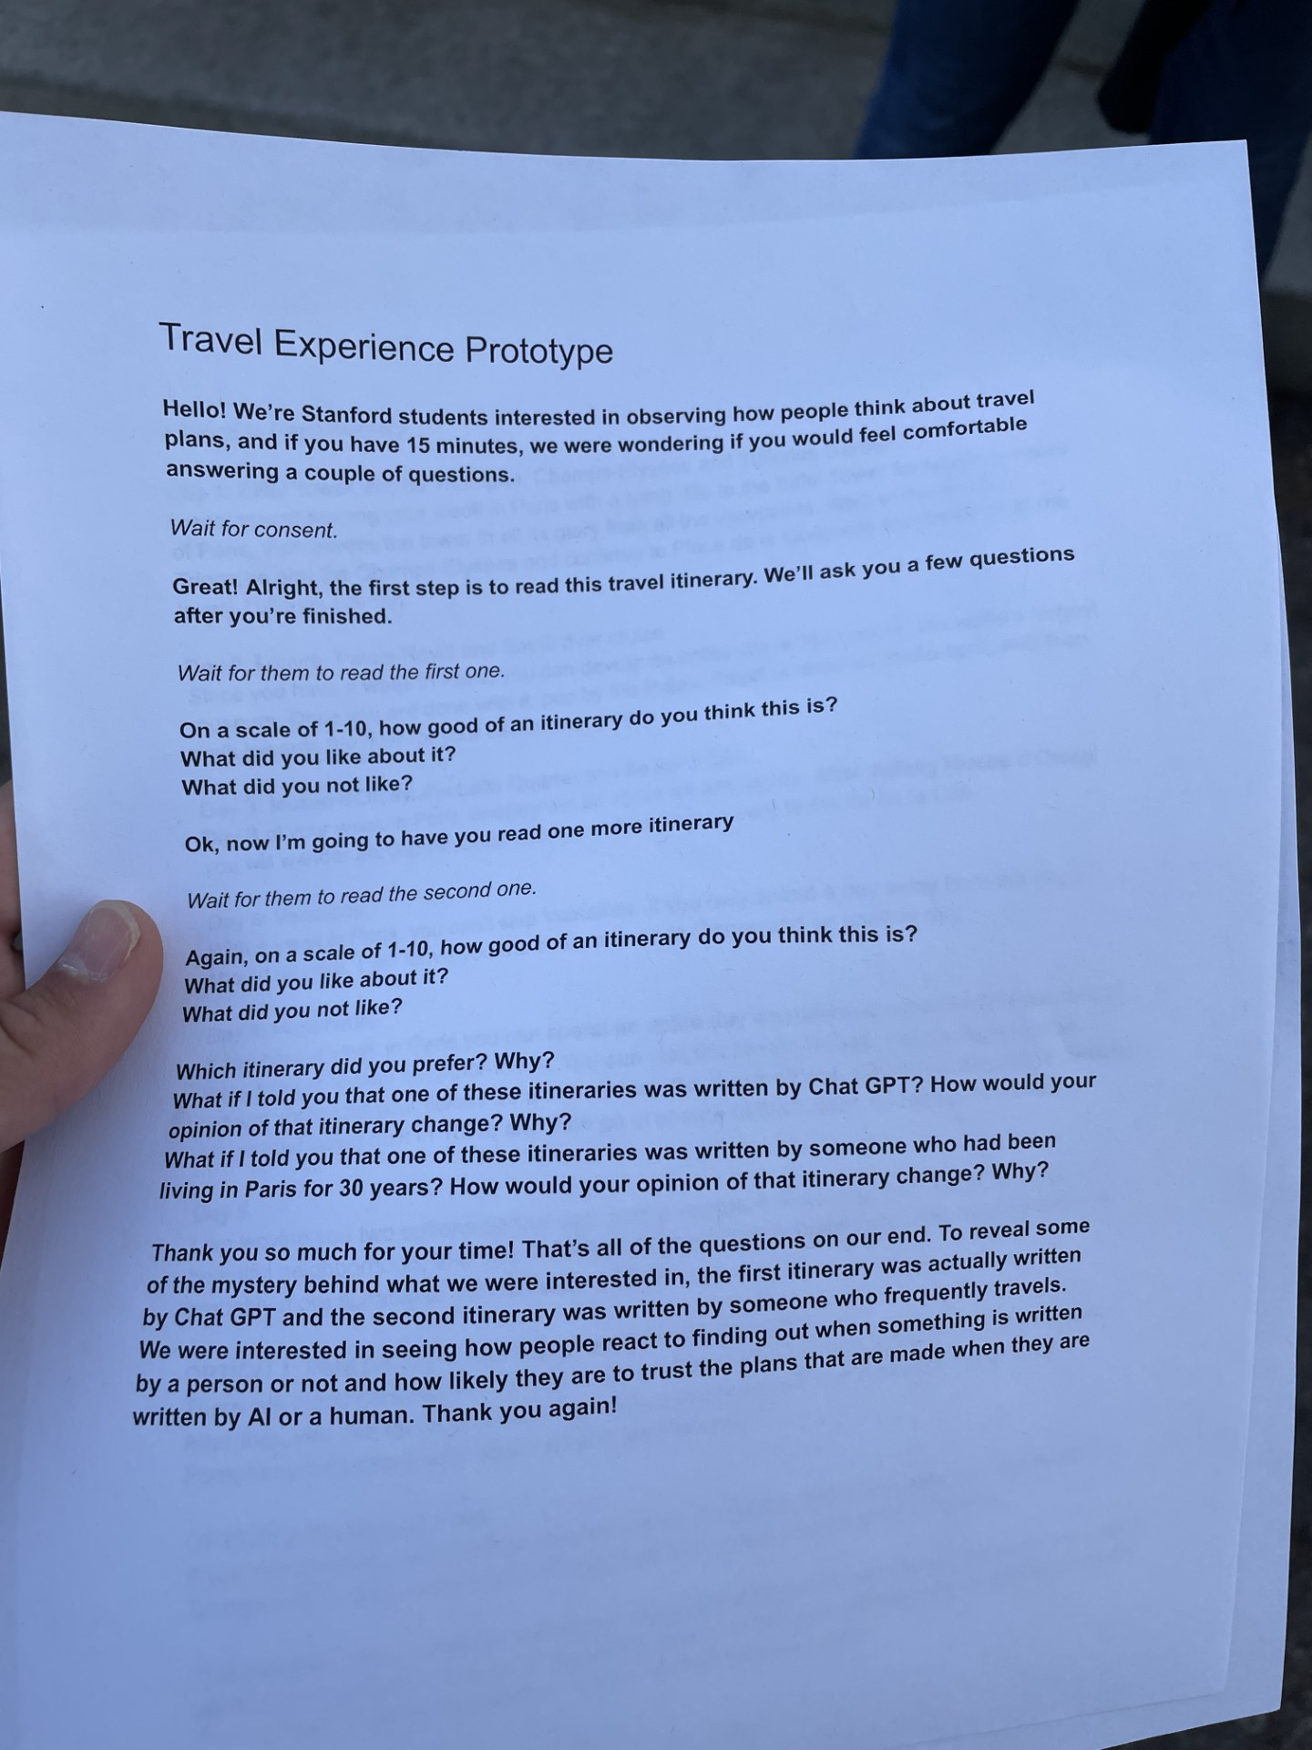
Do people value having insider information about what to do with friends?
Qualitative Assessment
On a scale of 1-10, how would you rate how effective this travel itinerary is?
What if I told you that one of these itineraries was written by Chat GPT? How would this affect your ratings?
What if I told you that one of these itineraries was written by someone who lived in Paris for 30 years?
Notes:
Rated the itineraries approximately the same
Upon learning that one was written by a local though felt more confident in that one and opted to choose the one made with insider info over chatGPT

Slide 31
New Insights!
Deadlines DO make an impact on whether someone will follow up on a plan
Daily questions are an inconvenient + unsuccessful way to facilitate communication
  People don’t prioritize meaningful digital interactions
People really value insider info when making plan itineraries
Notes:
While this facilitates people who live in dense, urban locations with disposable income and a preexisting, local friend group may disadvantage low-income, rural populations who may need help with facilitating friendships the most

Slide 32
Takeaways

Slide 33
Next Steps + Ethics
Moving forward with Solution 1 and 3
Ethical Implications
  Emphasis on in-person “playdates” make it difficult for long-distance friends to connect
  Cost may still be a contributing factor against planning meaningful interactions
  Dependence on crowdsourcing makes it more difficult for users from less populated areas to be benefitted

Slide 34
Our Users
Current solutions serve people who…
  Have disposable income
  Live in densely populated locations
  Have preexisting, local friend group
Current solutions leave out people who…
  Are low-income
  Live in rural or less populated areas
  Are far away from existing connections
Notes:
Not serving the peeps who need it the most

Slide 35
Questions Going Forward:
How can we incorporate left out users?
How can we scaffold the kinds of digital interactions our users are interested in?

Slide 36
Appendix

Slide 37
Links to documents
Brainstorming for Solutions
Itinerary Experience Prototype
Folder of Interview Notes and other materials
Images of Brainstorming Process

