Slide 1
Relationships Refreshed
Sachin Allums, Mena Hassan,
Nicole Segaran, and Kevin Tran
Notes:
Hi everyone! I’m Sachin and today I’m going to tell you a little bit about our project tentatively titled Relationships refreshed

Slide 2
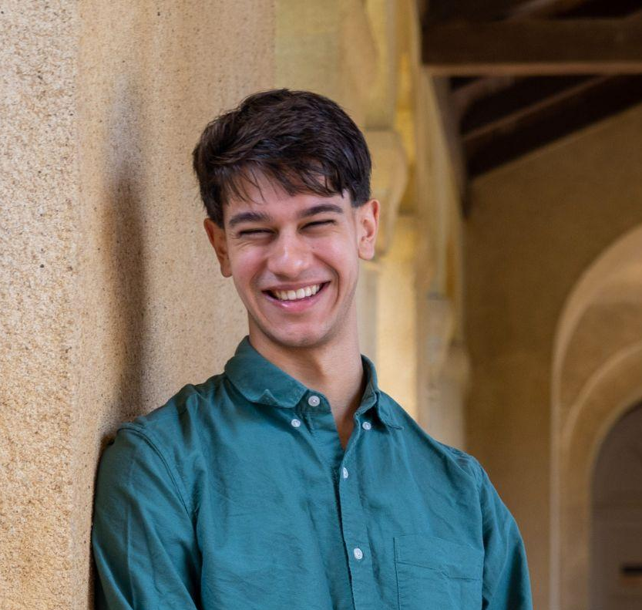
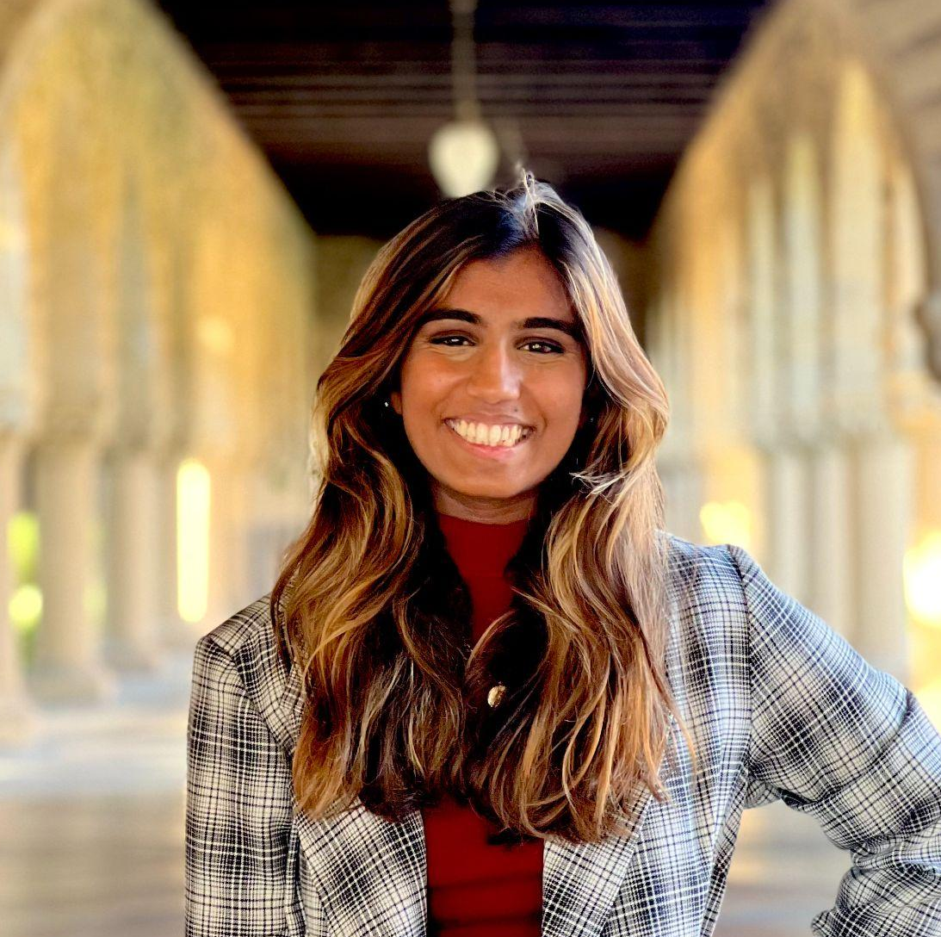
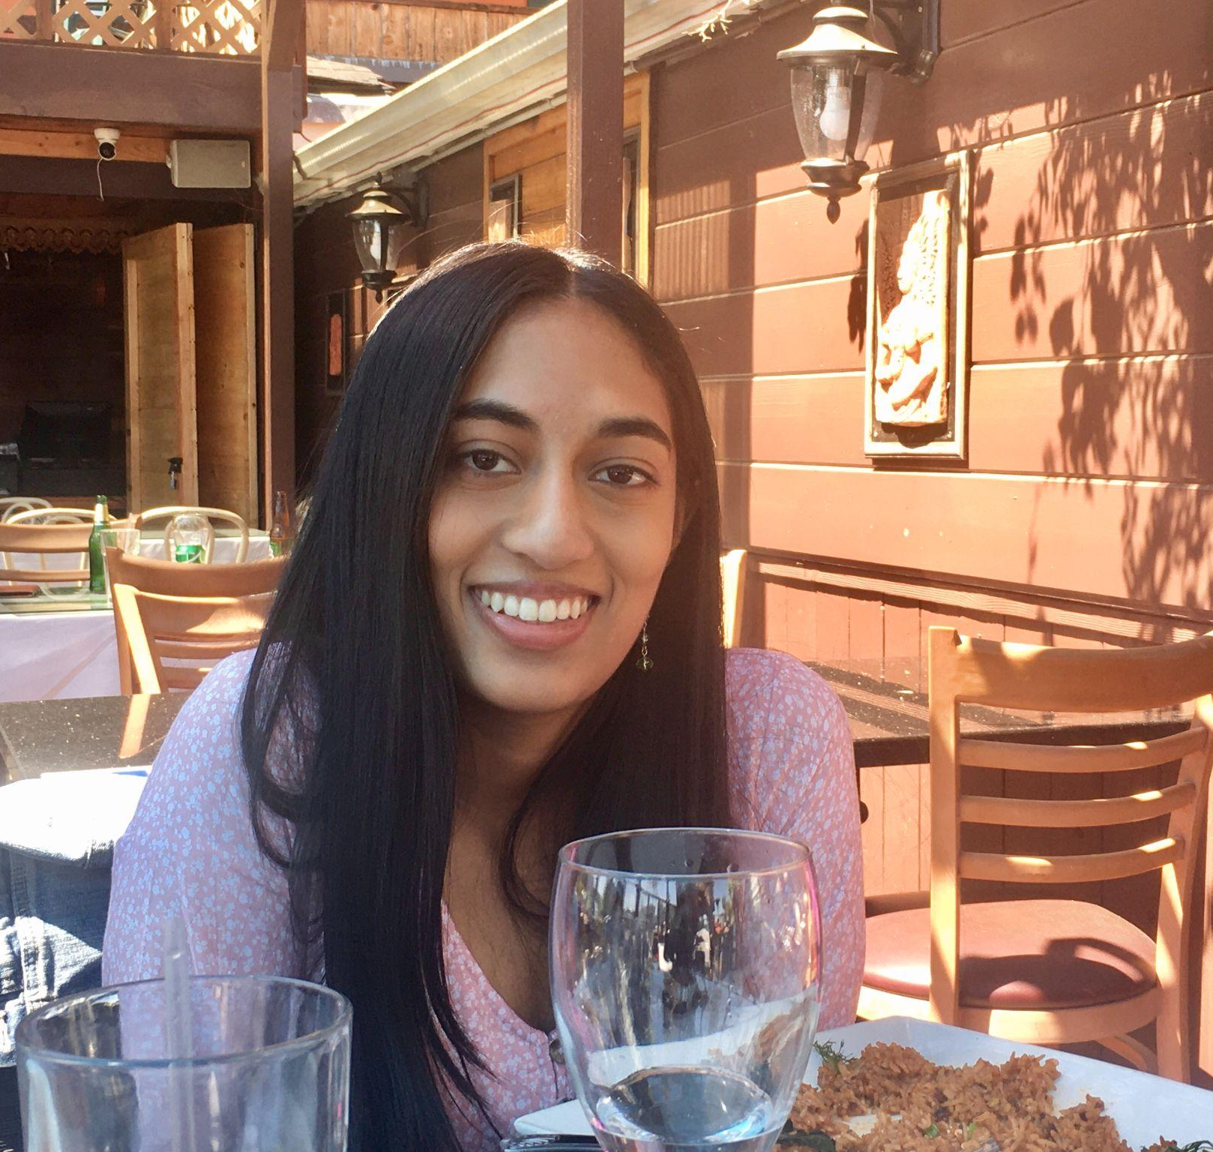
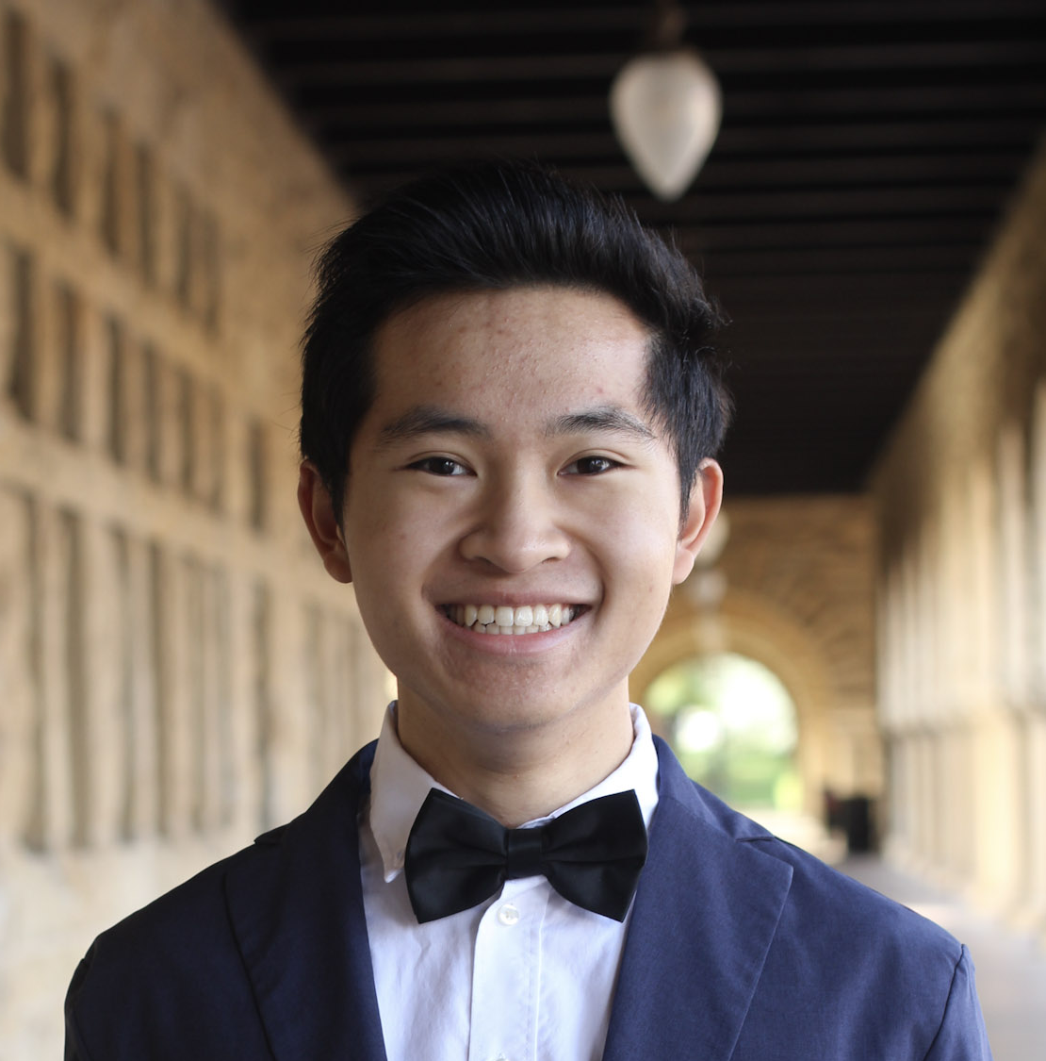
Our Team
Sachin Allums (he/him)
Nicole Segaran (she/her)
Mena Hassan (she/her)
Kevin Tran (he/they)
Notes:
But before I get into the details of the project, I want to introduce you to my lovely team. I’m Sachin, a junior studying Symsys and education. This is nicole, who is studying cs, education, and creative writing. This is Mena, who is studying CS, and finally this is Kevin who is studying psychology and also potentially coterming in CS

Slide 3
Domain Selection
Notes:
We all banded together for this project because we were interested in similar ideas about what makes people tick

Slide 4

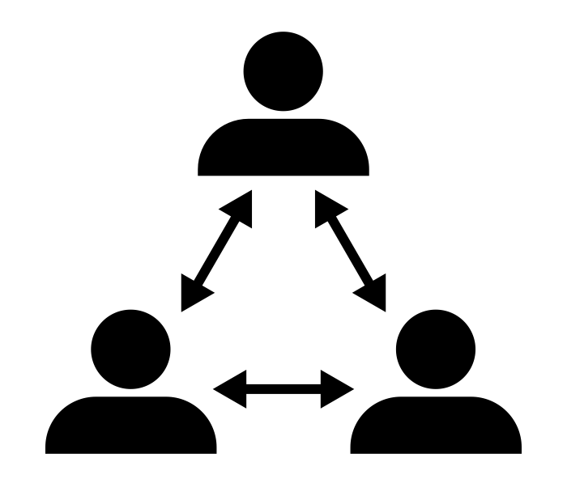

Education
Relationships
Environments
Notes:
And all of our conversations surrounding this project began with education. All of us have had extensive experience either working in, participating in, or observing the educational space, and we originally wanted education to be a core part of the users we interviewed and the ultimate form of our project. After discussing further, we all realized that, perhaps more so than our interest in education was our belief in the power of relationships, specifically how they grow, how people reflect on them, and how people rely on them for support. This finally introduced the conversation of how our friendships and relationships might change once we exit an educational sphere, and this spurred our final conception of our project. We were interested in how people craft these friendships in new environments and contexts. While we initially interested in relationships more broadly, we realized that while there are a ton of romantic dating apps out there, very few focus in and specialize on friendship.

Slide 5
Friendship in new contexts
Notes:
And this is how we arrived at our target domain: Friendship in new contexts.

Slide 6
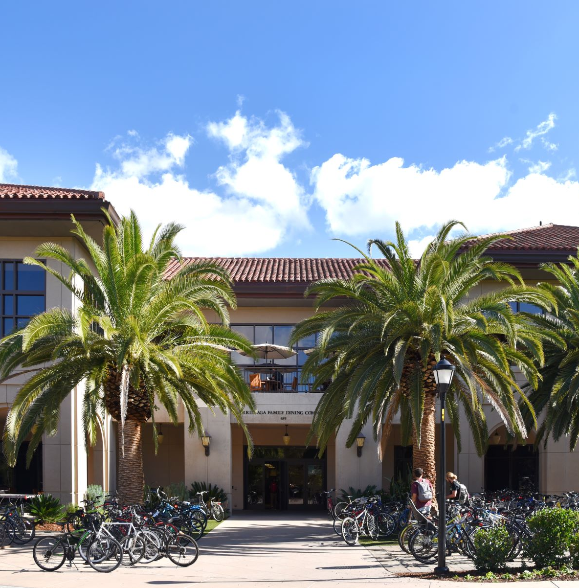
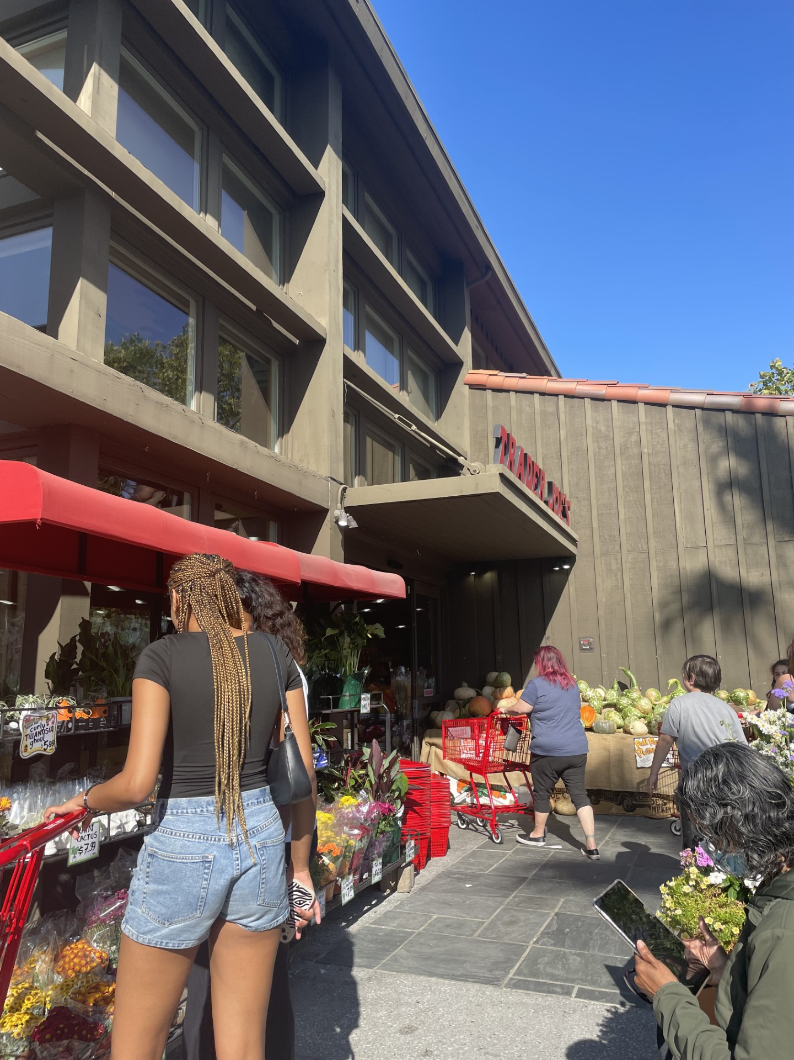

Participant Recruitment
Notes:
In order to find participants for this domain, we went to Town and Country and interviewed people at Trader Joe’s, met with some participants over zoom, and also hosted an interview over a meal at arillaga dining

Slide 7
Participant Selection
Target Users: Post grads and young people
Extreme Users: Married with children
Non-users: Young people uninterested in new friendships
Notes:
We were primarily interested in people recently graduated from college and young users more broadly, but we wanted to give a voice to people who are married with children because their conception of friendship is based both on how they navigate social relationships and how their kids navigate them. These users would likely have more stable relationships since they wouldn’t be constantly placed into new contexts and situations.

Slide 8
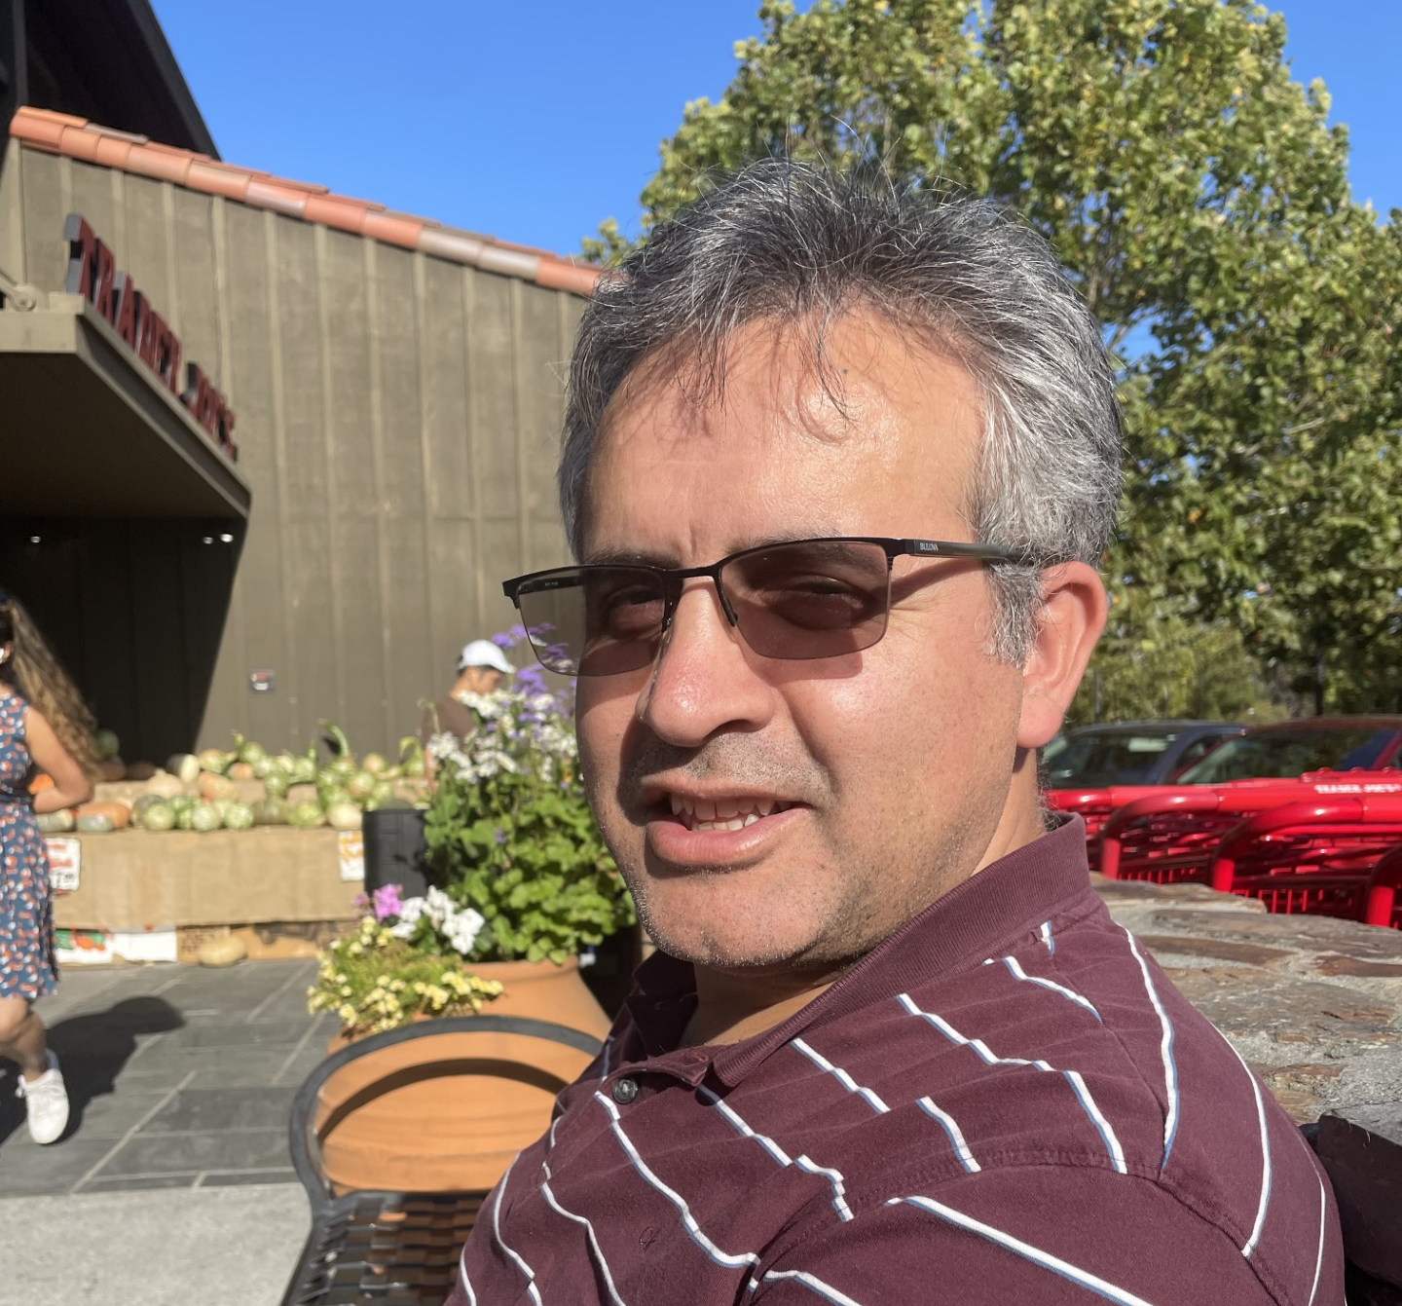
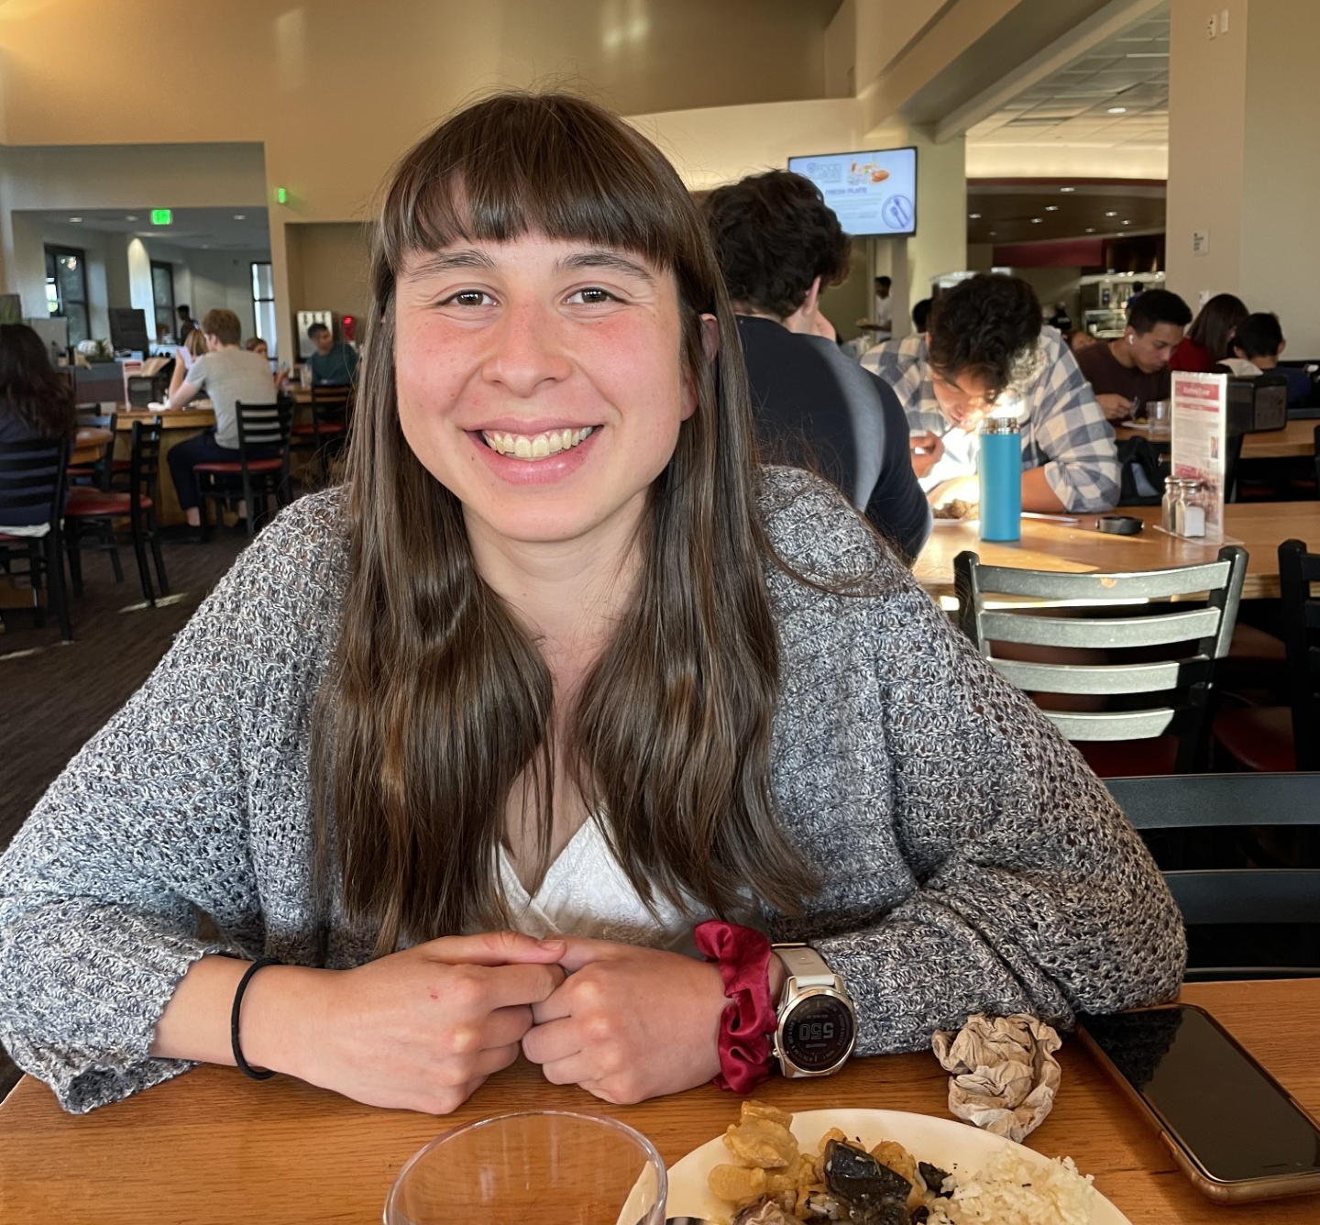
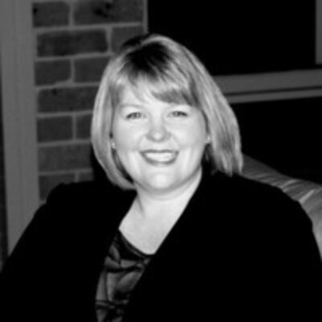
Who We Talked To
Murat (he/him)
Academic and Startup Owner
Nicole T. (she/her)
Stanford Physics Grad Student
Nicole A. (she/her)
Healthcare Management
Notes:
At trader joe’s, we talked to Murat a faculty member at Stanford and the owner of 3 start ups. We talked to Nicole T. a graduate student in physics at Stanford at arillaga, and we also talked to Nicole A., a healthcare manager from Australia who was visiting for a conference here.

Slide 9
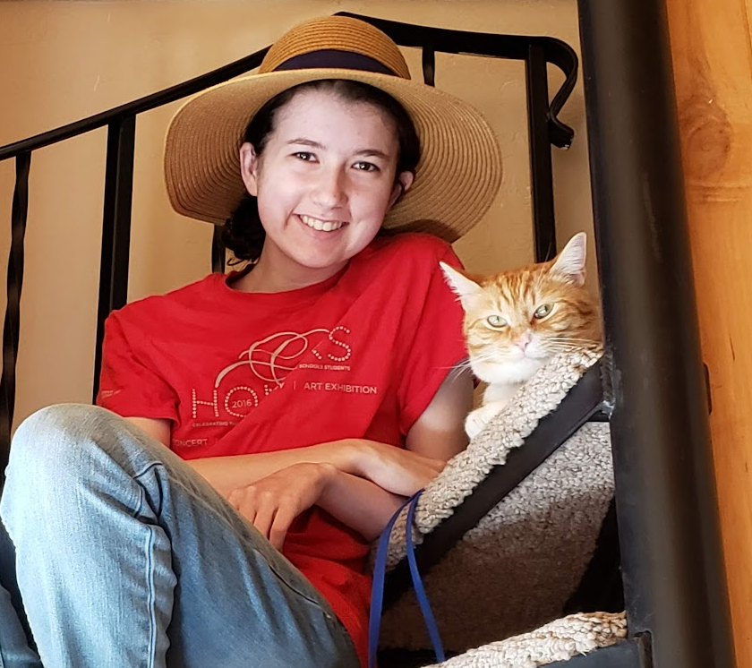
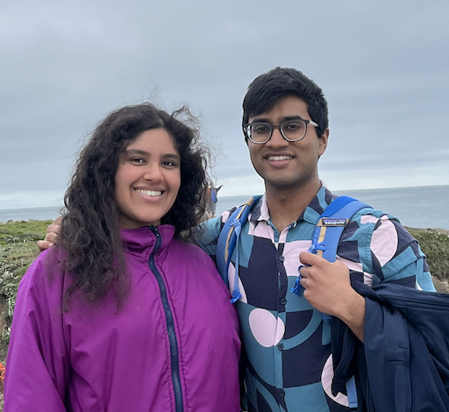
Who We Talked To
Audrey (she/her)
Education Technology
Nikhil (he/him)
Software Engineer
Notes:
We also talked to Audrey and Nikhil over zoom. These two young professionals are in the technology sphere and while Audrey represented more of an average user for our domain, Nikhil, uninterested in forming or reflecting on new friendships didn’t. A lot of the insights from these interviews were also captured by our other interviewees so we won’t go into too much detail about these two interviews.

Slide 10
Empathy Maps and Takeaways
Notes:
But for 3 of our interviews, we will explain some of the insights and needs that we found

Slide 11
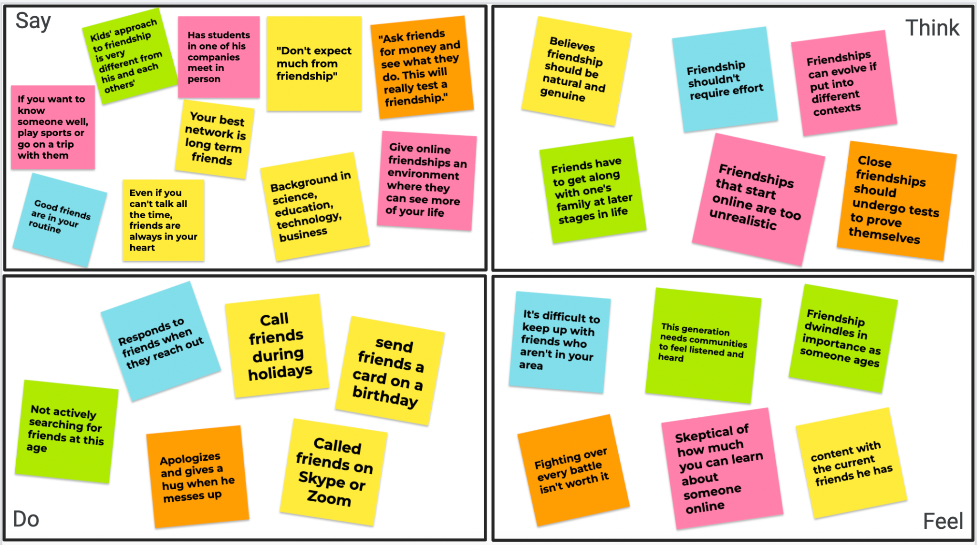
Murat
Notes:
Green: themes of how friendship evolves over time as someone ages
Pink: the value of bringing friendships into different contexts
Blue: the value of connecting with people who are convenient and in your area
Orange: close friendships aren’t always easy and require letting things go and apologizing
Yellow: misc
We’ll start with Murat, whose interview was quite hilarious at times (at one point, he jokingly told us that friends should ask each other for money to really test a relationship). For all of the empathy maps, we color coded our findings based on different themes, and for Murat, his overall attitude was that one should have pretty low expectations for friendship to make it work

Slide 12
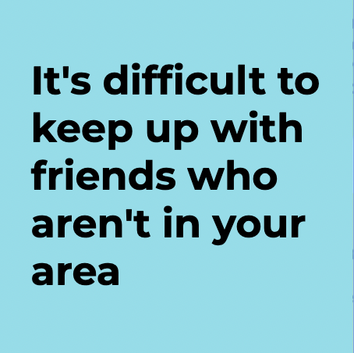
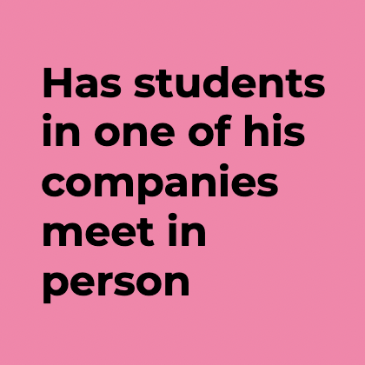
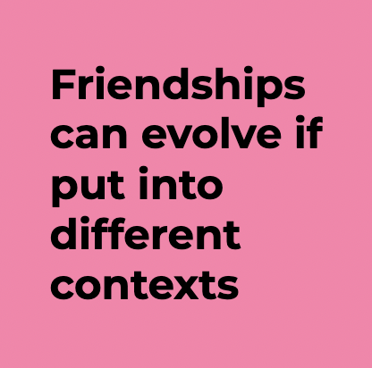
Notes:
One of the things that was surprising for us was that he owned an Education Technology company that was completely virtual whereby kids would learn coding and entrepreneurship online, yet even then, he encouraged all of his students to meet in person because friendships strengthen when placed in different contexts and it’s difficult to keep up with people who aren’t in your area.

Slide 13
Friendship thrives off of in-person interactions
Notes:
From this, we learned that friendship thrives off of in-person interactions

Slide 14
Insight
Need
Friendships thrive off of in-person interactions
People want to see online
friends in different contexts
Notes:
And this insight pointed us to a need: people want to see online friends in different contexts because their view of online people is severely limited.

Slide 15
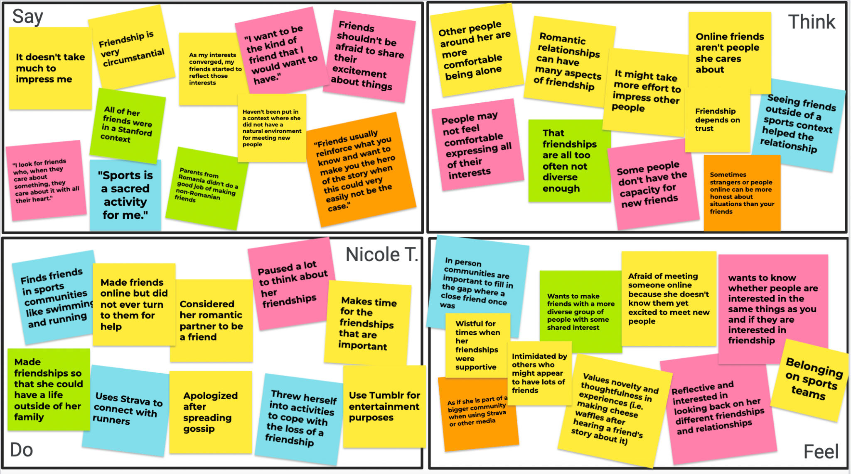
Nicole T.
Notes:
Green: the value of having diversity in friendship
Pink: overall values and what she would like to know about people before becoming friends with them
Blue: the value of sports and communities to fall back on when a friendship or relationship isn’t working
Orange: the value of having people who aren’t as close to you so that they might make you more honest
Yellow: misc
This need was echoed by our interview with Nicole T., a grad student at Stanford. Nicole mentioned that she primarily made friends with people on her sports communities and that seeing those friends in different contexts strengthened her relationships with them.

Slide 16
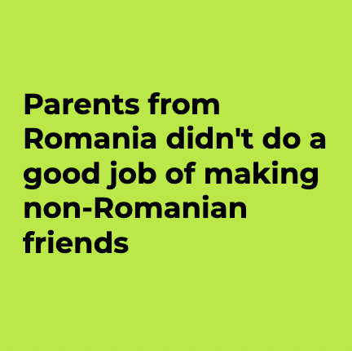
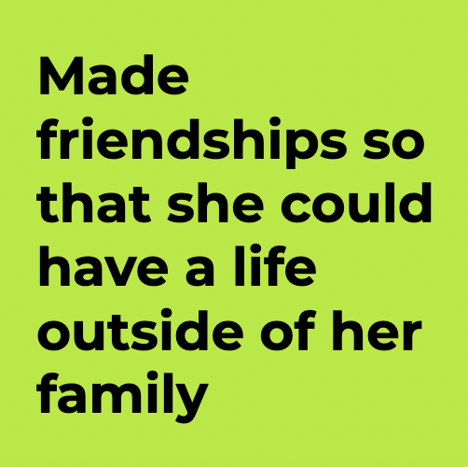
Notes:
Nicole was also very concerned about how friendships affected her life and how her upbringing affected the way she views friendship. She noted specifically that her parents, immigrants from Romania coming to Canada, struggled to meet and befriend non-Romanian people. Nicole believed that her friendships enabled her to have a life outside of her family, and these two findings brought us

Slide 17
People often don’t have diverse social circles
Notes:
To our next insight: people often don’t have diverse social circles

Slide 18
Insight
Need
People often don’t have diverse social circles
People want to be friends with diverse people, but might not be sure how to make this happen
Notes:
This insight has led us to a need: people want to be friends with a more diverse group of people, but they might not know how to make this happen

Slide 19
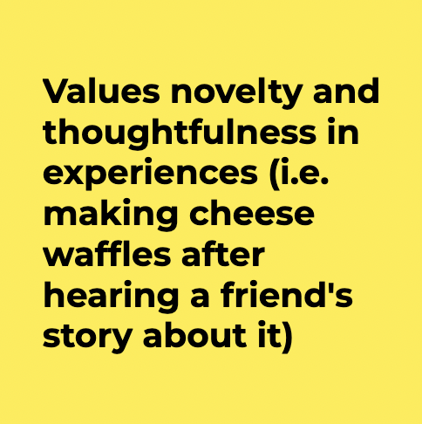
Notes:
Nicole also had a lot of insight into how friendships could be kept young. She told the story about how one of her friends went on a terrible date with someone. The potential suitor for Nicole’s friend offered to make them cheese waffles, and the waffles were not good at all. To transform this slightly embarrassing story into a fun memory, Nicole’s friends all made cheese waffles together.

Slide 20
Close friendship thrives on novelty
Notes:
This story illuminates the fact close friendship thrives on novelty

Slide 21
Insight
Need
Close friendship thrives on novelty
People are looking for creative ways to make their friendships fresh
Notes:
And this insight has led us to a need: people are constantly looking for creative and niche ways to make their friendships fresh

Slide 22
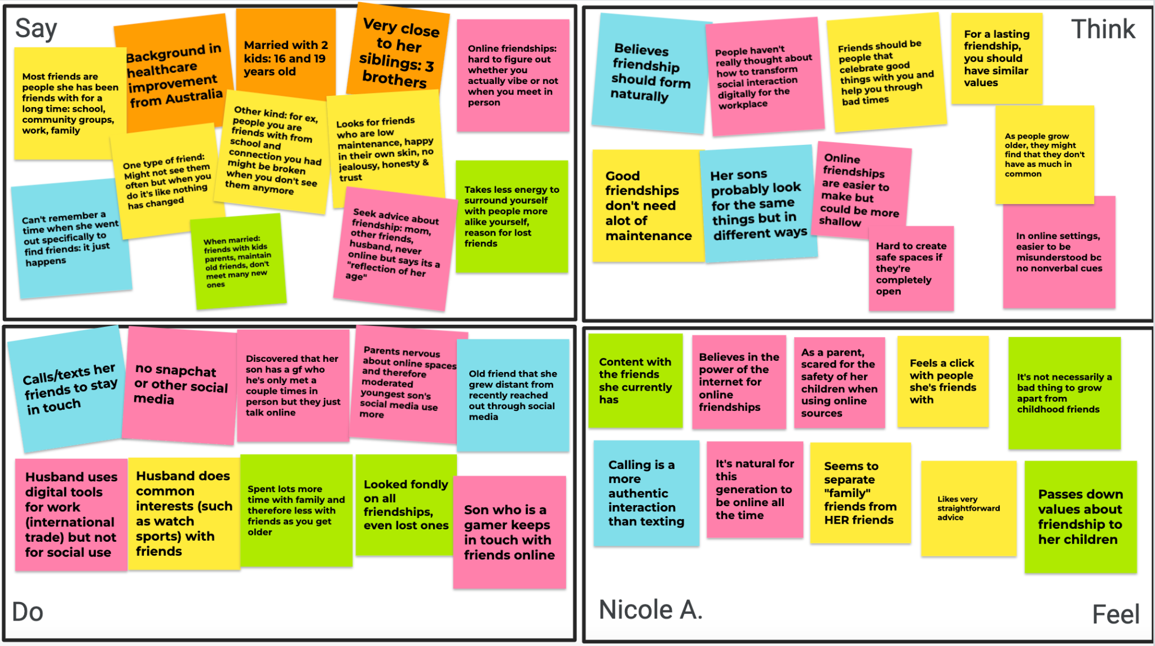
Nicole A.
Notes:
Green: misc, mostly feelings
Pink: thoughts on online tools, social media
Blue: how she forms/maintains friendships
Orange: background info
Yellow: what kind of friends she has/values she wants in a friendship
But we didn’t interview just one Nicole, we had two! We interviewed Nicole A. at Trader Joes. She was coming to Stanford from Australia for a conference, and her interview was quite sweet and nostalgic in nature. When discussing friendship, she frequently brought up how her idea of friendship has changed over time and how it differs from that of her kids.

Slide 23
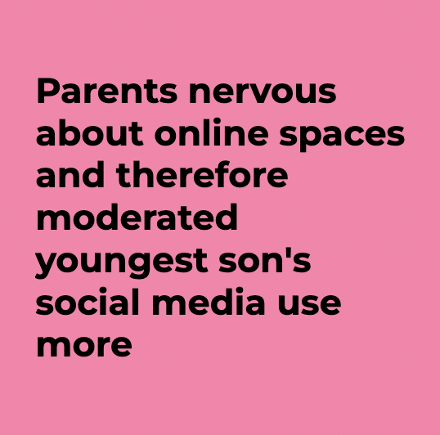
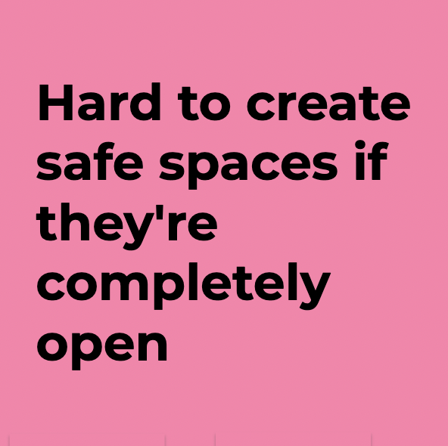
Notes:
Specifically, Nicole was concerned about how her kids’ friendships differed when they were online vs in person. She was really nervous about how social media might affect her youngest son and she expressed concern about the difficulty of creating safe spaces in environments where nearly everything goes

Slide 24
Friendships must be safe spaces
Notes:
The takeaway from this part was that friendships, and the communities that they exist in, must be safe spaces

Slide 25
Insight
Need
Friendships must be safe spaces
Reassurance that you or your kids won’t be in danger in online communities
Notes:
This illustrated a need for reassurance that you or your child won’t be in danger in online communities and that you feel empowered in those spaces

Slide 26
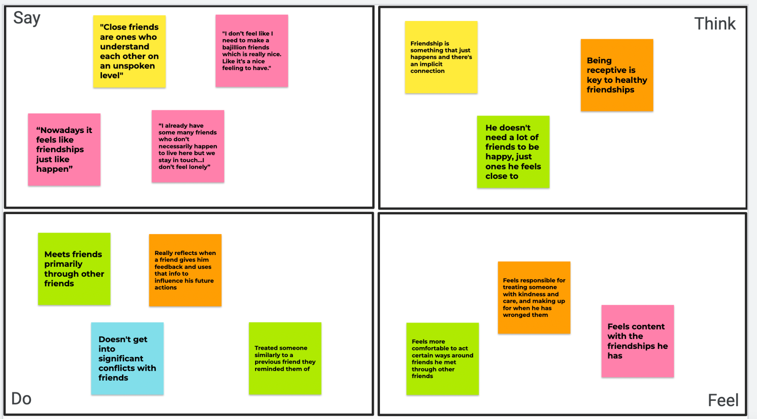
Nikhil
Notes:
Yellow: implicit definitions of friendship
Pink: His lack of a need for friendship
Blue: Conflicts and drama
Green: The value of social connections for meeting new people and strengthening new connections
Orange: how friends influence him and how he approaches friends

Slide 27
Putting it together
Notes:
All of these insights and needs, when synthesized, gave us a clear picture of how we might approach a project about friendship

Slide 28
Safe Space
New Contexts
Shared Aspects
Diversity
Novelty
Notes:
Friendship depends on new contexts to strengthen and generalize it further, it thrives and seeks out diversity, requires a safe space to be nurtured, grows when new, creative memories are made, and comes about through shared experiences and interests. We are interested in combining all of these spheres and domains together to truly make people’s relationships, refreshed.

Slide 29
Thank you!

Slide 30
Appendix

Slide 31
Links to documents
Brainstorming for Domain and Questions we asked
Audrey Interview Notes
Nicole A and Murat Notes
Nicole T Notes
Nikhil Notes
Nicole A recording
Nicole T recording
Murat recording

