Slide 1


Slide 2
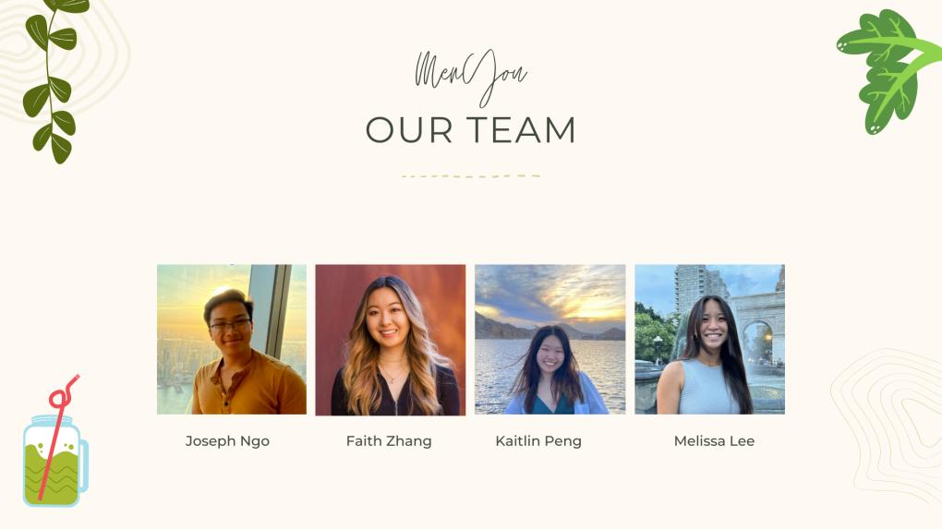

Slide 3
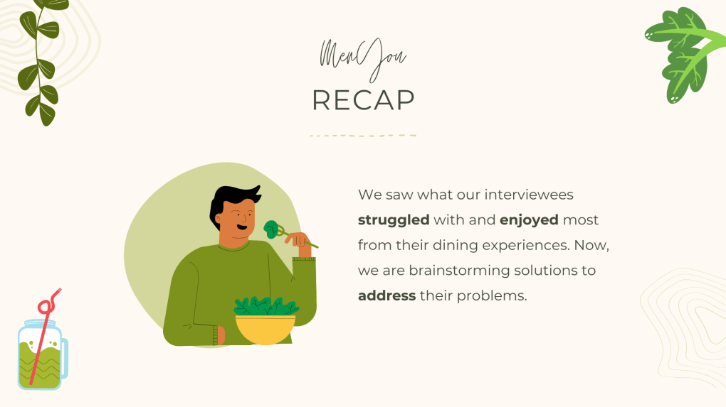

Slide 4
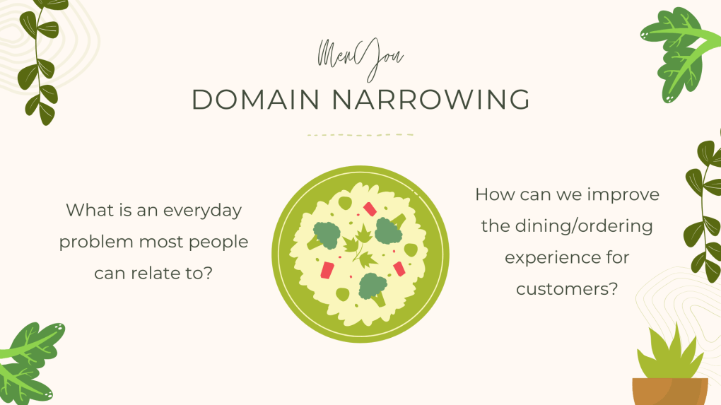

Slide 5
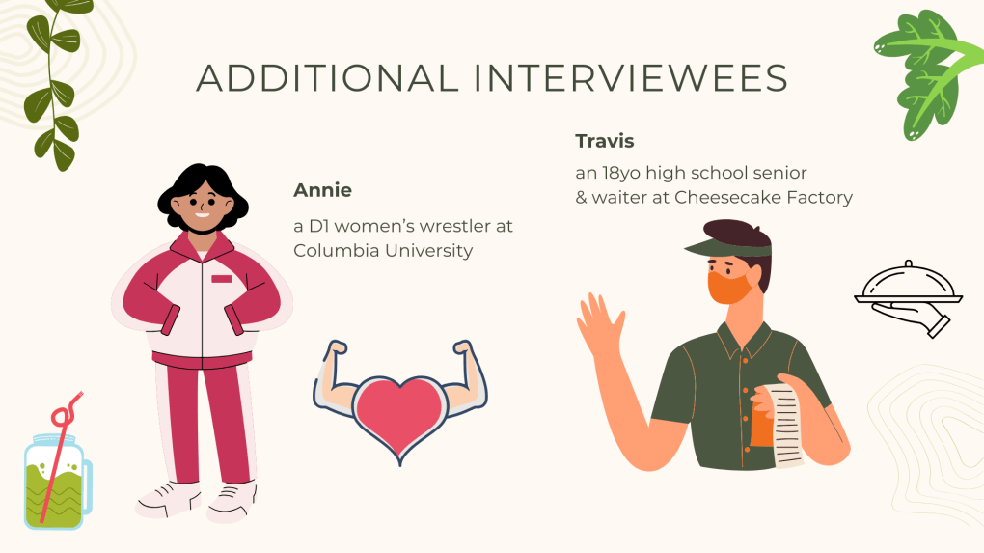

Slide 6
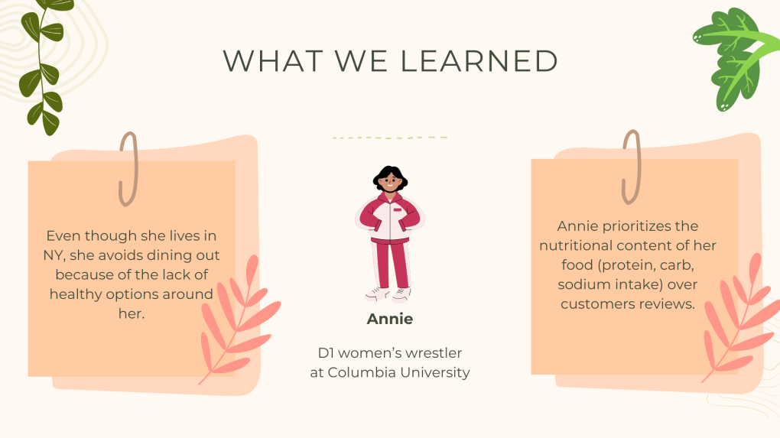

Slide 7
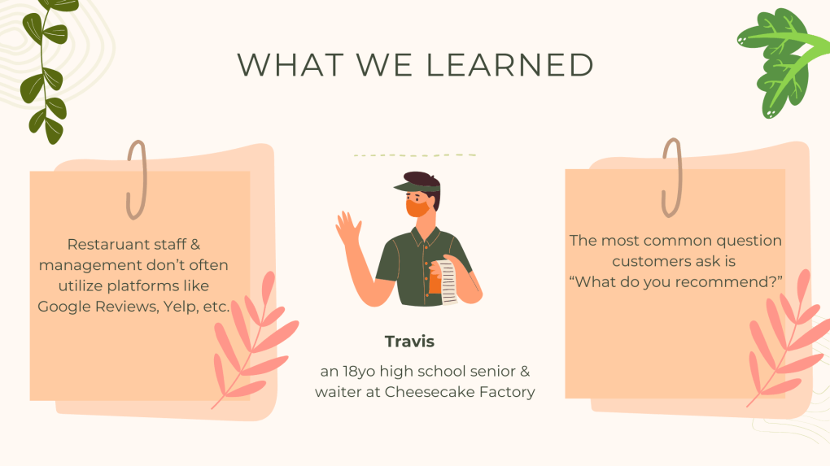

Slide 8
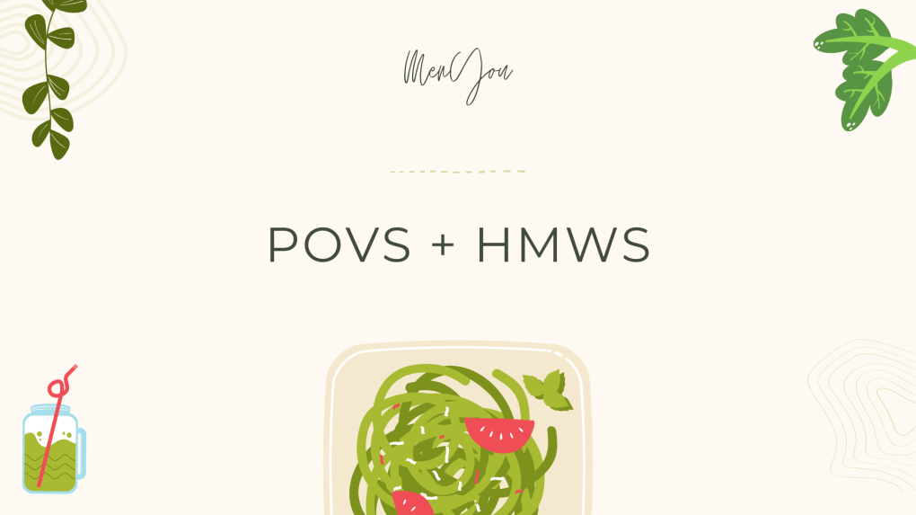

Slide 9
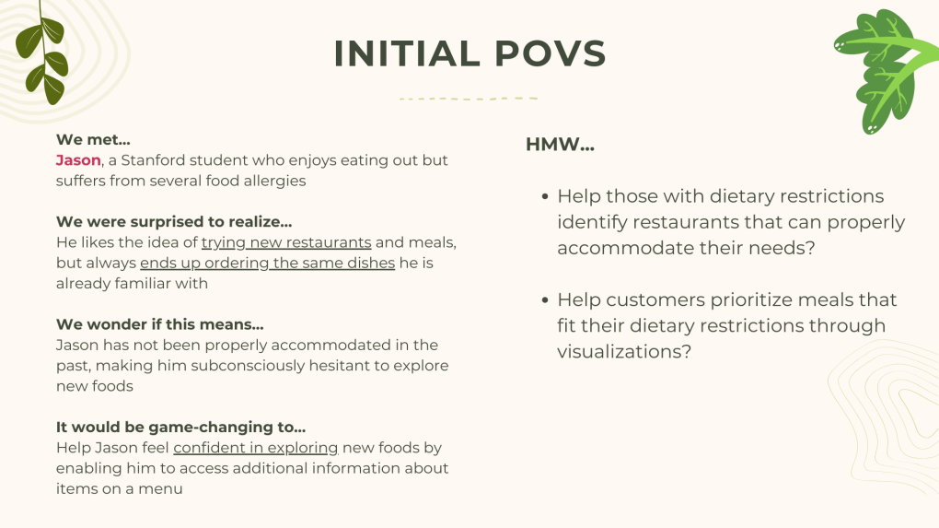

Slide 10
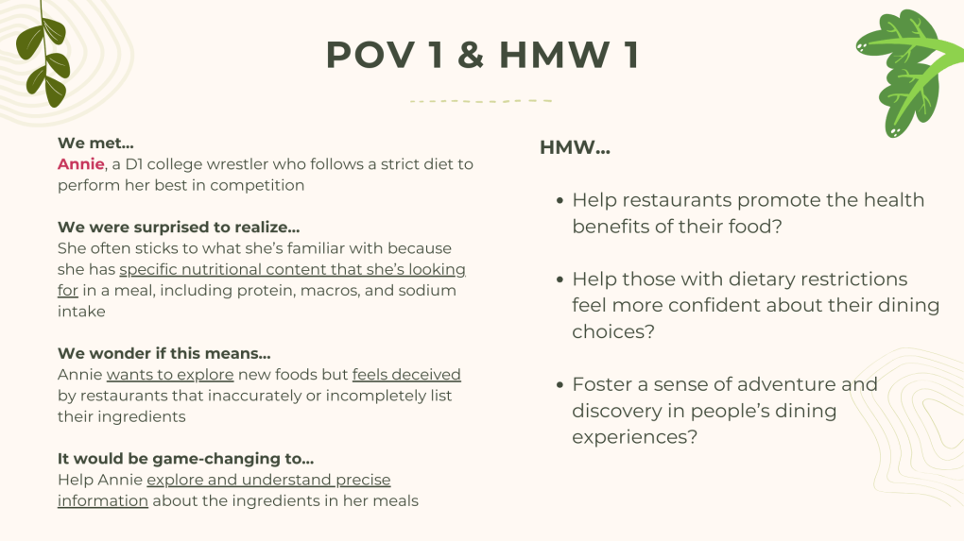
Notes:
HMW help restaurants promote the health benefits of their food?
HMW help those with dietary restrictions feel more confident about their dining choices?
HMW make food exploration more accommodating to those with strict diets?
HMW better inform customers about the positive & negatives about a meal?
HMW make dining out more inclusive and stress-free for individuals with specific dietary needs?
HMW encourage restaurants to prioritize accessible ingredient information for their menu offerings?
HMW foster a sense of adventure and discovery in people’s dining experiences?
HMW help customers prioritize meals that fit their dietary restrictions through visualizations?
HMW increase the visibility of restaurants that accommodate strict dietary needs?
HMW generate recommendations for customers based on their dining and food preferences?

Slide 11
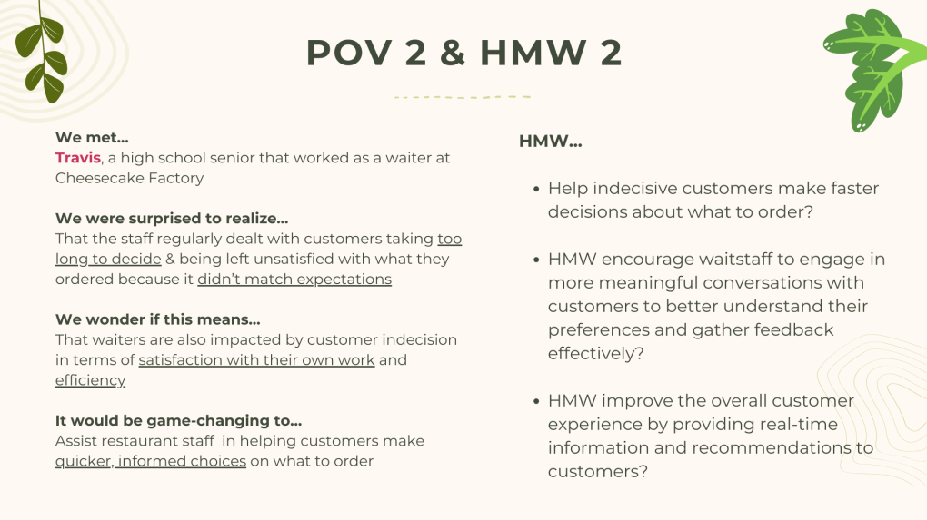
Notes:
HMW help indecisive customers make faster decisions about what to order?
HMW make it easier for the waiter to pass on feedback from the customer to the managing staff?
HMW empower restaurant owners and employees to internalize and reflect on customer feedback?
HMW streamline the process of collecting and analyzing customer feedback for restaurant owners and managers?
HMW enhance the communication between waitstaff and kitchen staff to ensure accurate and timely dish feedback?
HMW improve the overall customer experience by providing real-time information and recommendations to diners?
HMW encourage diners to share their feedback proactively, without relying on waiter prompts?
HMW facilitate the integration of online reviews and crowd-sourced information into the restaurant's decision-making processes?
HMW enable restaurant owners to assess the impact of customer feedback on their menu and overall operations?
HMW encourage waitstaff to engage in more meaningful conversations with customers to better understand their preferences and gather feedback effectively?

Slide 12
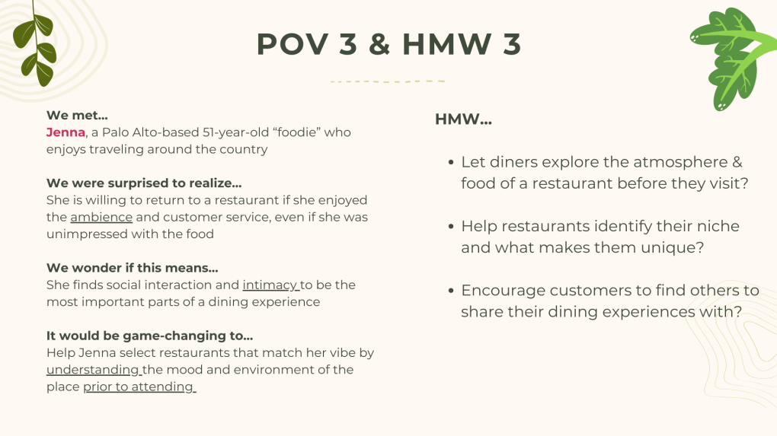
Notes:
HMW help customers find restaurants that match their personalities?
HMW help restaurants identify their niche and what makes them unique?
HMW help restaurants increase their visibility to their ideal customer profiles?
HMW help restaurants track their online presence?
HMW tailor restaurant recommendations to customers’ desires for particular moods or environments?
HMW personalize dining experiences for each customer?
HMW encourage customers to find others to share their dining experiences with?
HMW make customers who don't fit the ambience/vibe of a restaurant feel more confident in their environment?
HMW let diners explore the atmosphere of a restaurant before they visit the restaurant?
HMW help customers digest a large volume of information about a restaurant?

Slide 13


Slide 14
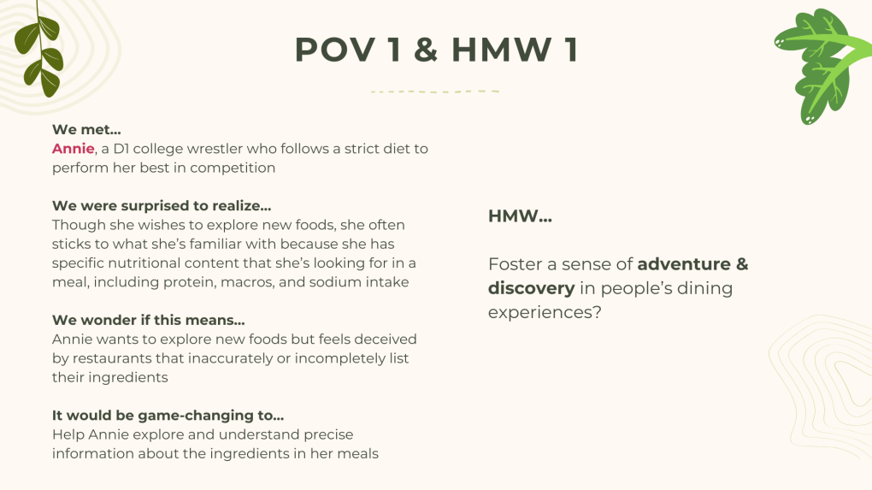

Slide 15
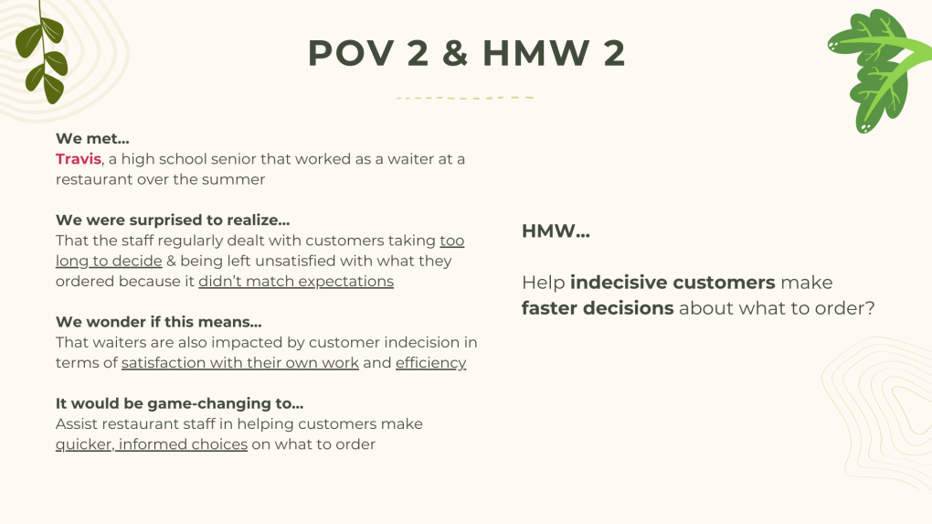

Slide 16
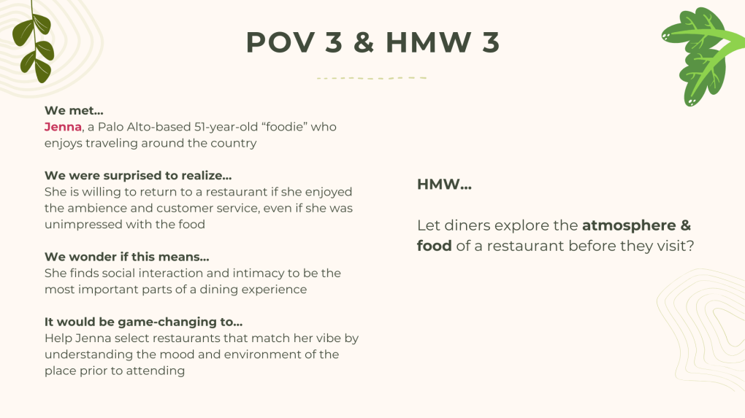

Slide 17


Slide 18
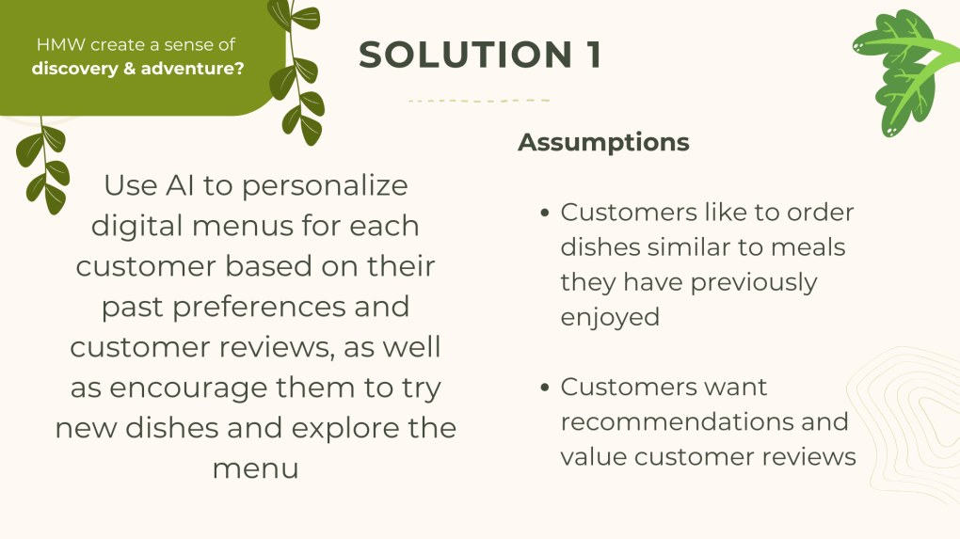

Slide 19
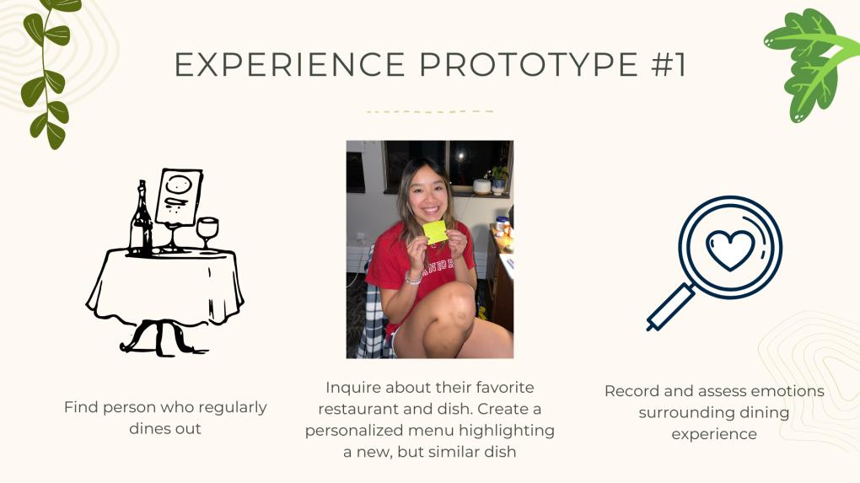

Slide 20
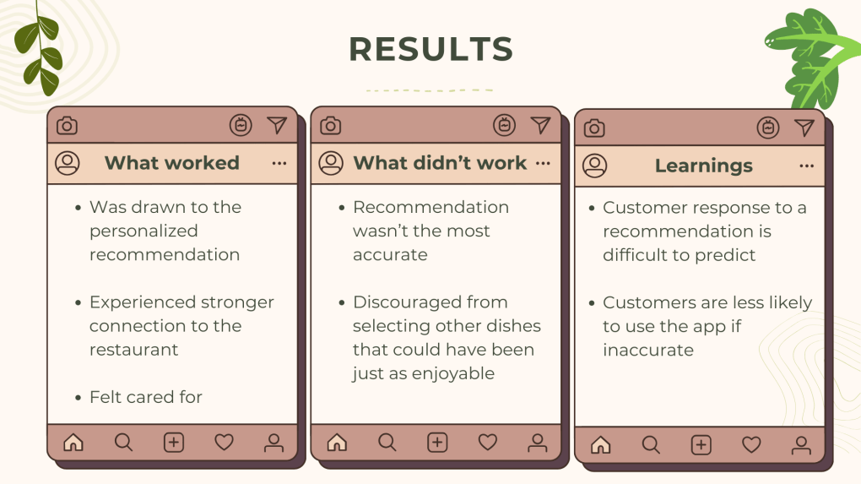

Slide 21
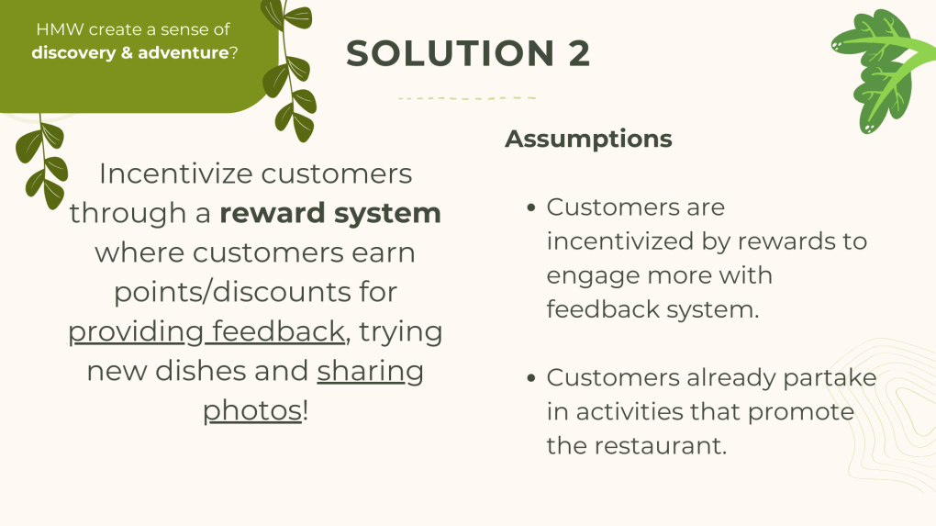

Slide 22
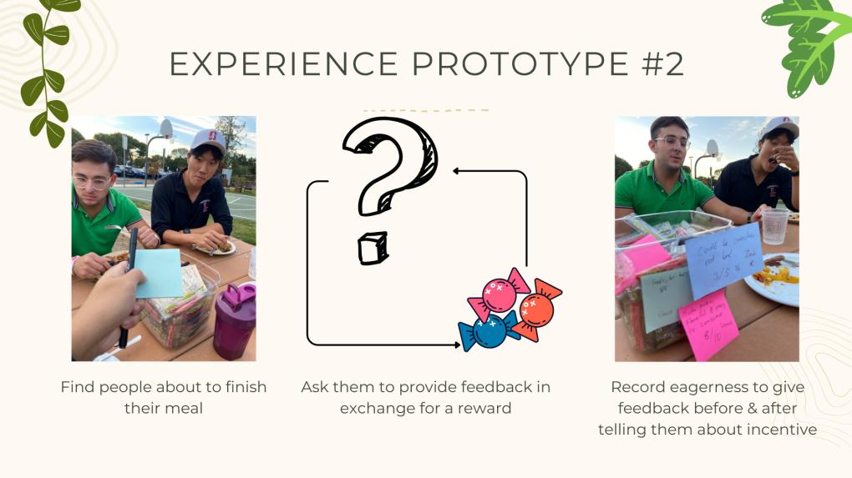

Slide 23
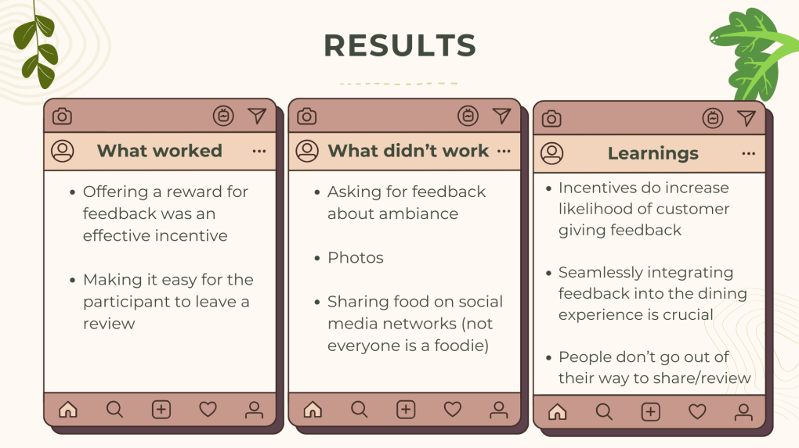

Slide 24
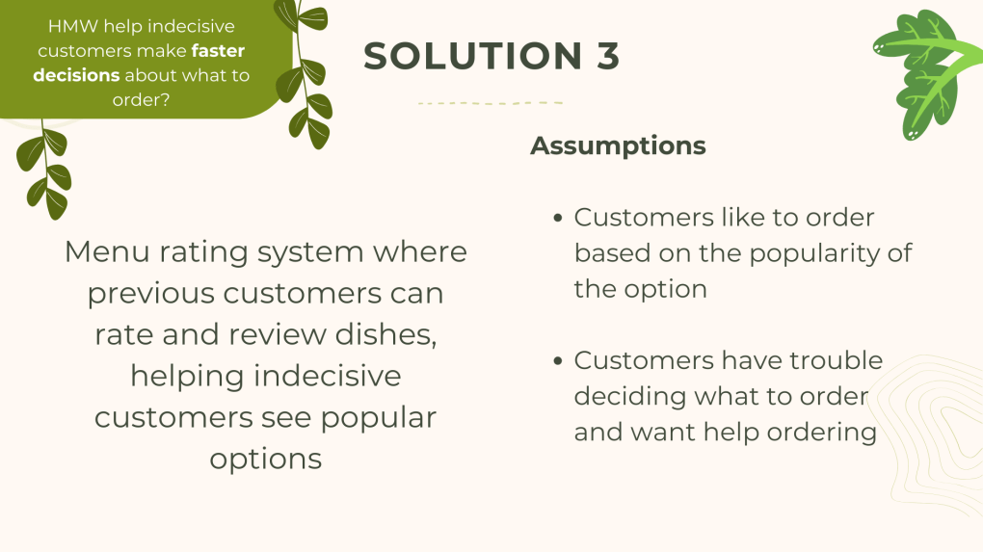

Slide 25
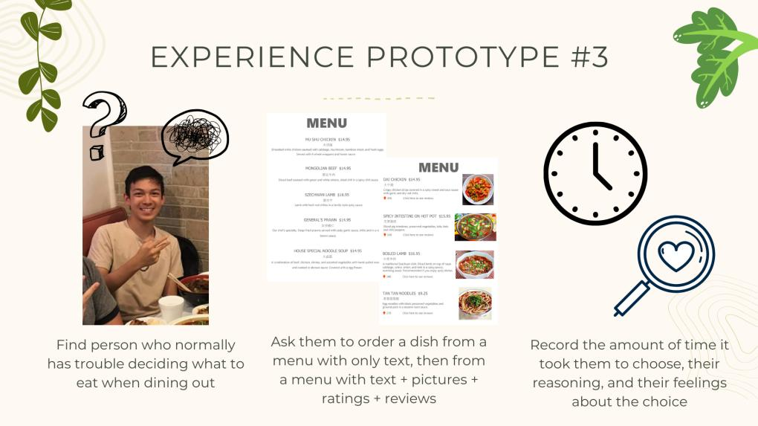

Slide 26
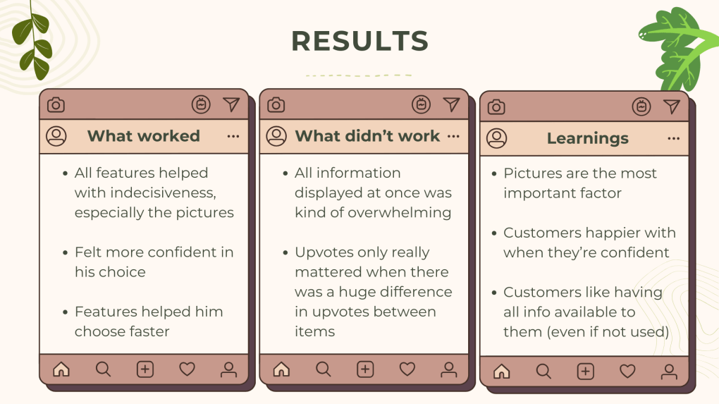

Slide 27


Slide 28
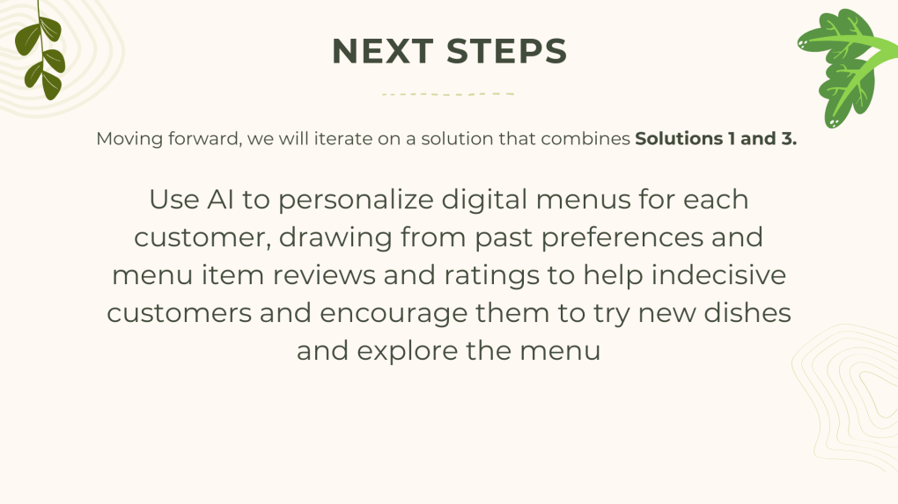

Slide 29
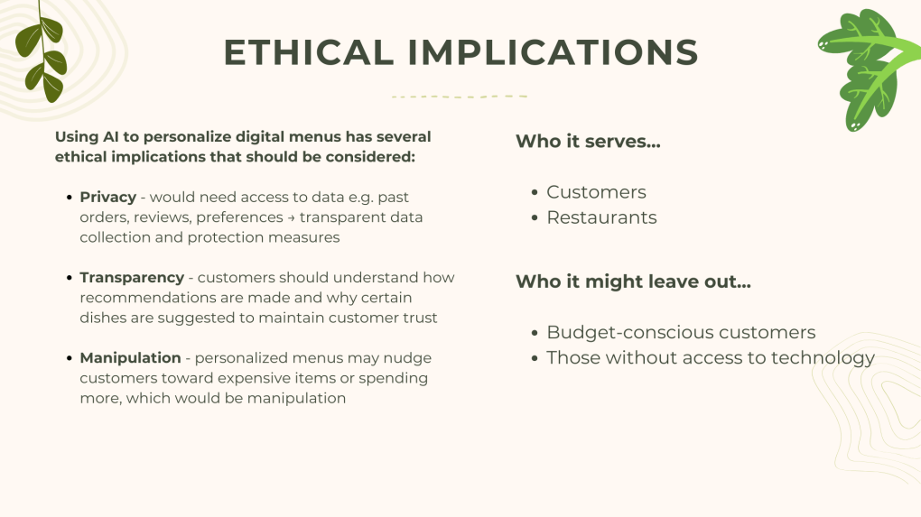

Slide 30


Slide 31


Slide 32
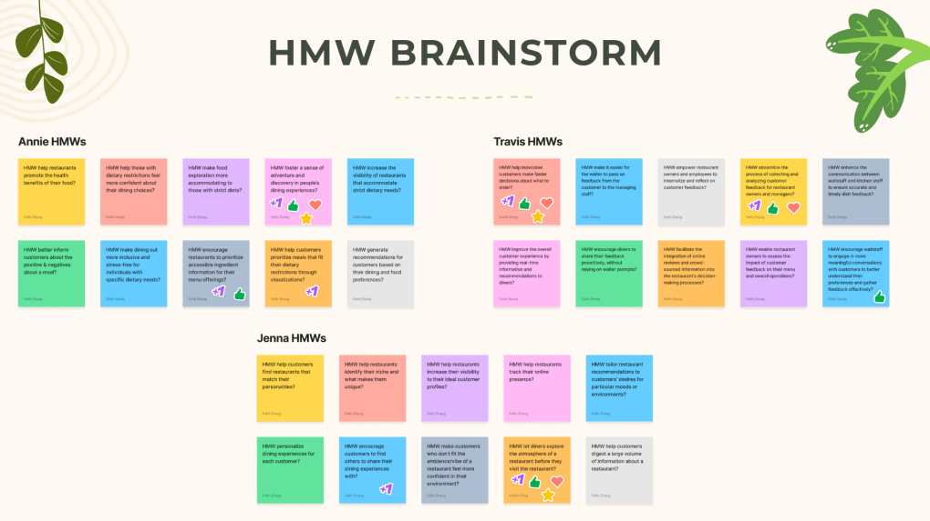

Slide 33
