Slide 1
capsule
Interactive Medium-Fi Prototype
Julia M, Kendal M, Allen N, Tristan S

Slide 2
The problem
capsule
When in newer environments, it can be challenging to establish a sense of belonging and contribute to the collective knowledge of the community.
Value Proposition
The solution
Share knowledge, receive knowledge, one capsule at a time.
Capsule encourages individuals to foster connections and engage with people in their community by presenting daily inquiries or activities, motivating users to provide their responses, leading to them receiving a reciprocal "capsule" from a fellow member within the community.

Slide 3
Values in design

Slide 4
Encoded
values
community-building
inclusivity
How do we help people make connections with one another?
How do we allow as many people as possible to benefit from the app?
Positive online community
Knowledge sharing
How do we encourage people to want to share info with their community?
How do we avoid a toxic online environment?

Slide 5
community-building
Design features
Send capsules to others within a certain proximity to you
Receive capsules from others within a certain proximity to you
Prompts that are community specific
  “What is your favorite place to eat nearby?”
  “Where are good hangout spots?”
A map that displays where received capsules were sent from
  Physically see where community members you relate to are

Slide 6
Inclusivity
Design features
Wide variety of prompts and tasks
Prompts are relatively universal
Multiple prompts received throughout a day
  If you are not able to answer/respond to one of the prompts, you will have multiple opportunities to still contribute that day

Slide 7
knowledge-sharing
Design features
Prompts centered around knowledge sharing
  “What did you learn today?”
  “What is a fun fact you know?”
  “What’s your favorite restaurant around here?”
  “What are good hang out spots in the area?”
Keep your most valuable capsules to revisit at a later time

Slide 8
Positive online atmosphere
Design features
Anonymity
  Encourage people to be their authentic selves
No public comments
  Allow people to form their own reactions
No followers or visible likes
  Deter people from “karma farming” or writing responses with the sole intention of getting as many likes/upvotes/followers as possible

Slide 9
design/value conflicts
Positive Online Community vs
Community Building
We use anonymity to encourage people to be their authentic selves, but if every user is anonymous we see how it could be difficult to form real connections

Slide 10
design/value conflicts
Community Building vs
Inclusivity
In order to build community, we want prompts to be community-specific however we recognize how that can impact inclusivity, in which we encourage more universal prompts.
Potential solution: Have a balance

Slide 11
tasks

Slide 12
Task #1 (Simple):
User receiving and reading a capsule that was created by another user.
Changes:
Previously we provide both “archive” and “like” buttons for the capsule. However, other groups asked clarifications for the difference between the two. We now removed “archive” – all received capsules will be stored for the user forever. We would allow users to “discard” capsules in a different task.

Slide 13
Task #2 (Medium):
User creating and sending a knowledge capsule by responding to a prompt.
Changes:
Previously, we allow users to add “tags” to describe the capsule they posted. It’s not fun nor intuitive to the users. We replaced the “tag” feature with “flair”, that indicate emotions/feelings that the user felt when they create the capsule.

Slide 14
Task #3 (complex):
User organizing the capsules they received.
Changes:
Previously we want users to organize based on the tags of each capsule. Now we rely on the concept of “cabinet” – users can create different cabinets to store capsules. They can discard capsules as well. Since we are an app that focuses on “community”, and people move around, we also want to add a map feature where users can see where they received the capsule.

Slide 15
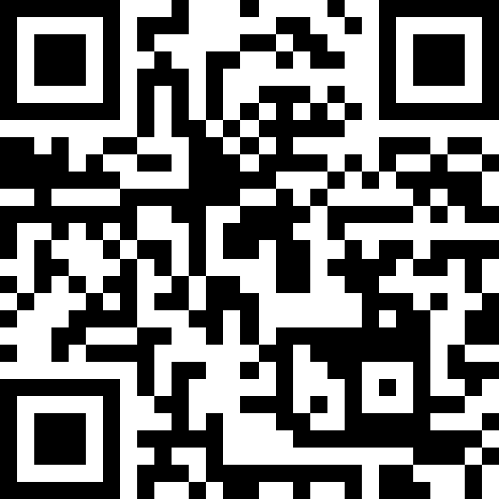
First Task flow
tinyurl.com/capsule-week6

Slide 16
Usability goals & key measurements

Slide 17
Usability goal & Key measurements
Efficiency
Fun
Rationale
Posting / sharing information can be cumbersome, one usability goal of our app is to make sharing as easy and as efficient as possible.
Rationale
We aim to create a sense of joy and incentivize people when they share information with others.
Key Measurement
How much positive feedback can a user receive after sending a capsule? (target: 2+ positive feedback mechanisms)
Key Measurement
How long the user took to respond to a prompt and send a capsule (target: ≤ 120 sec)
Notes:
A feedback mechanism is a design that helps produce dopamine in a user’s neural circuitry.

Slide 18
Progress Towards Usability Goals
Efficiency
Fun
Changes
Removing the retro themed design because it increases cognitive overload. Modern design is more slick and easy to use.
Combined “archive” and “like” to one “like” button.
Instead of free-form tag, we use flairs – which can be selected from a set of flairs – no need for users to enter one themselves.
Changes
Added an animation as a positive feedback mechanism after user sent a capsule.
After sending a capsule, users will immediately receive a capsule from others.
Users can respond to 1 out of 5 prompts each day – adding a choice allows users to feel more positive that they do have something to share.

Slide 19
(Revised) interface sketches

Slide 20
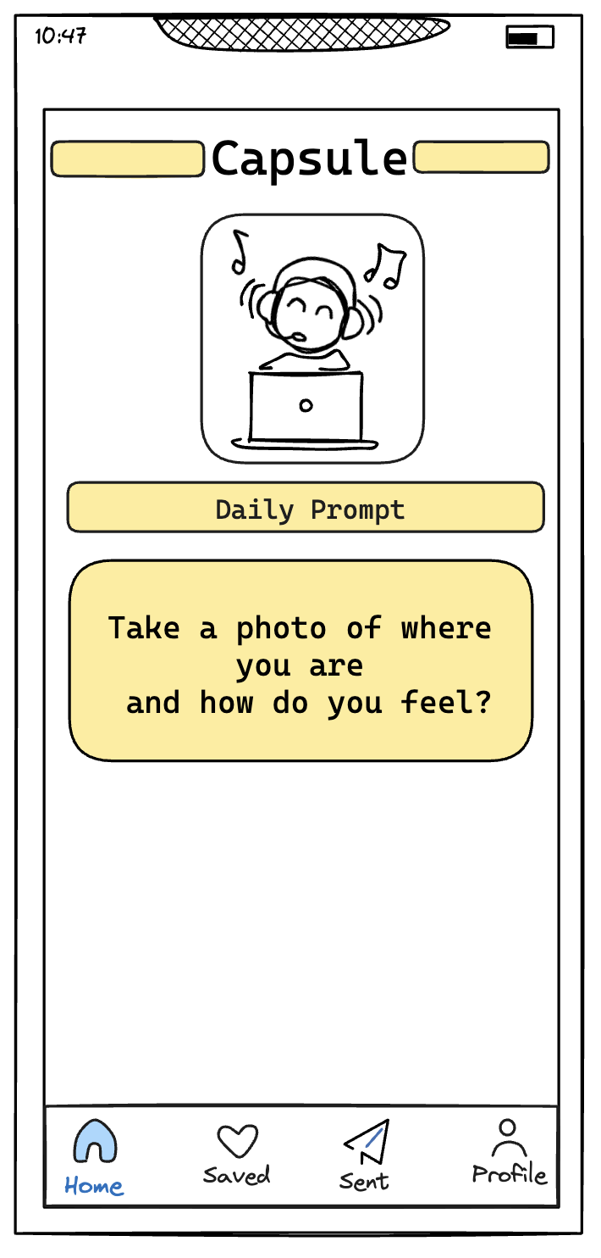
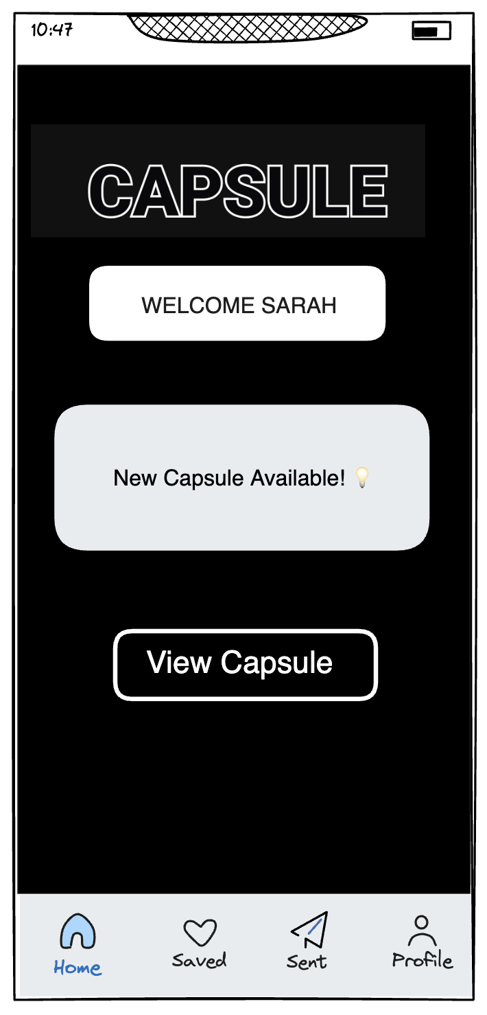
Major Change 1: Theme Change
Change:
Our previous design is retro-themed. Our new design is more black-white modern.
Rationale:
Modern design feels more slick. Cleaner interface leads to less cognitive overload, which leads to higher efficiency.
Old Design
New Design

Slide 21
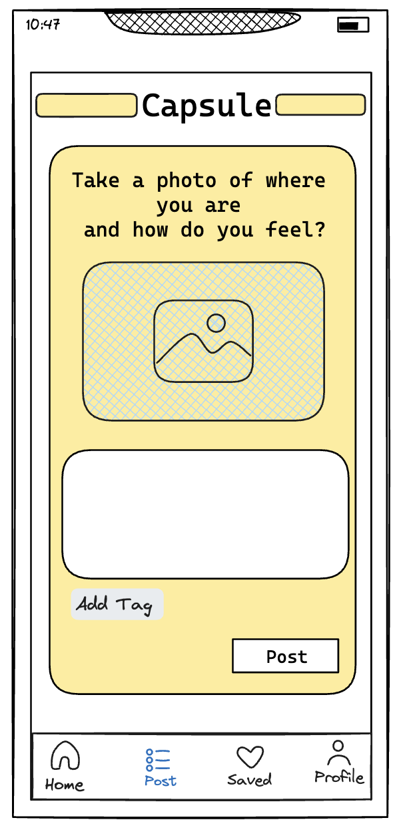
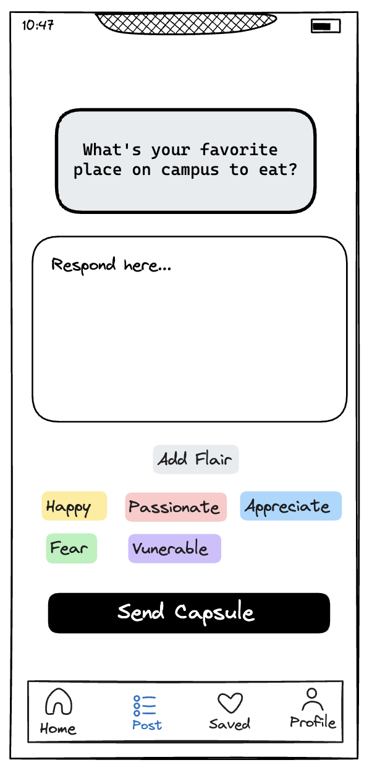
Major Change 2: Flairs not tags
Change:
Instead of “tags” that mark meta-information about the content, we decide to use “flairs” that indicate emotions.
Rationale:
We received feedback that tags are unclear, as in users don’t know what to “tag”. Also, tag is overused in social apps. However, “flair” that indicate how the user feels when they make the knowledge capsule can be refreshing and fun. This is more compatible with our usability goals.
Old Design
New Design

Slide 22
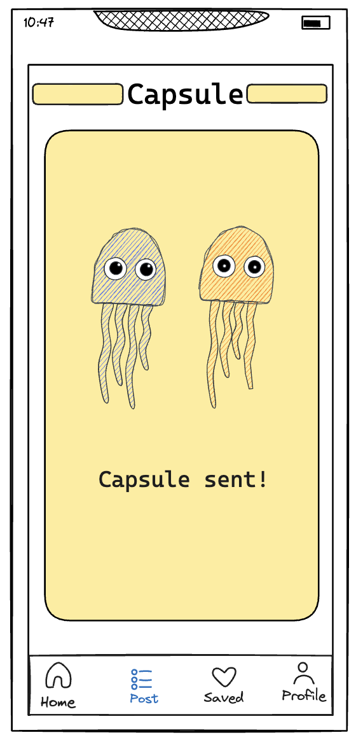
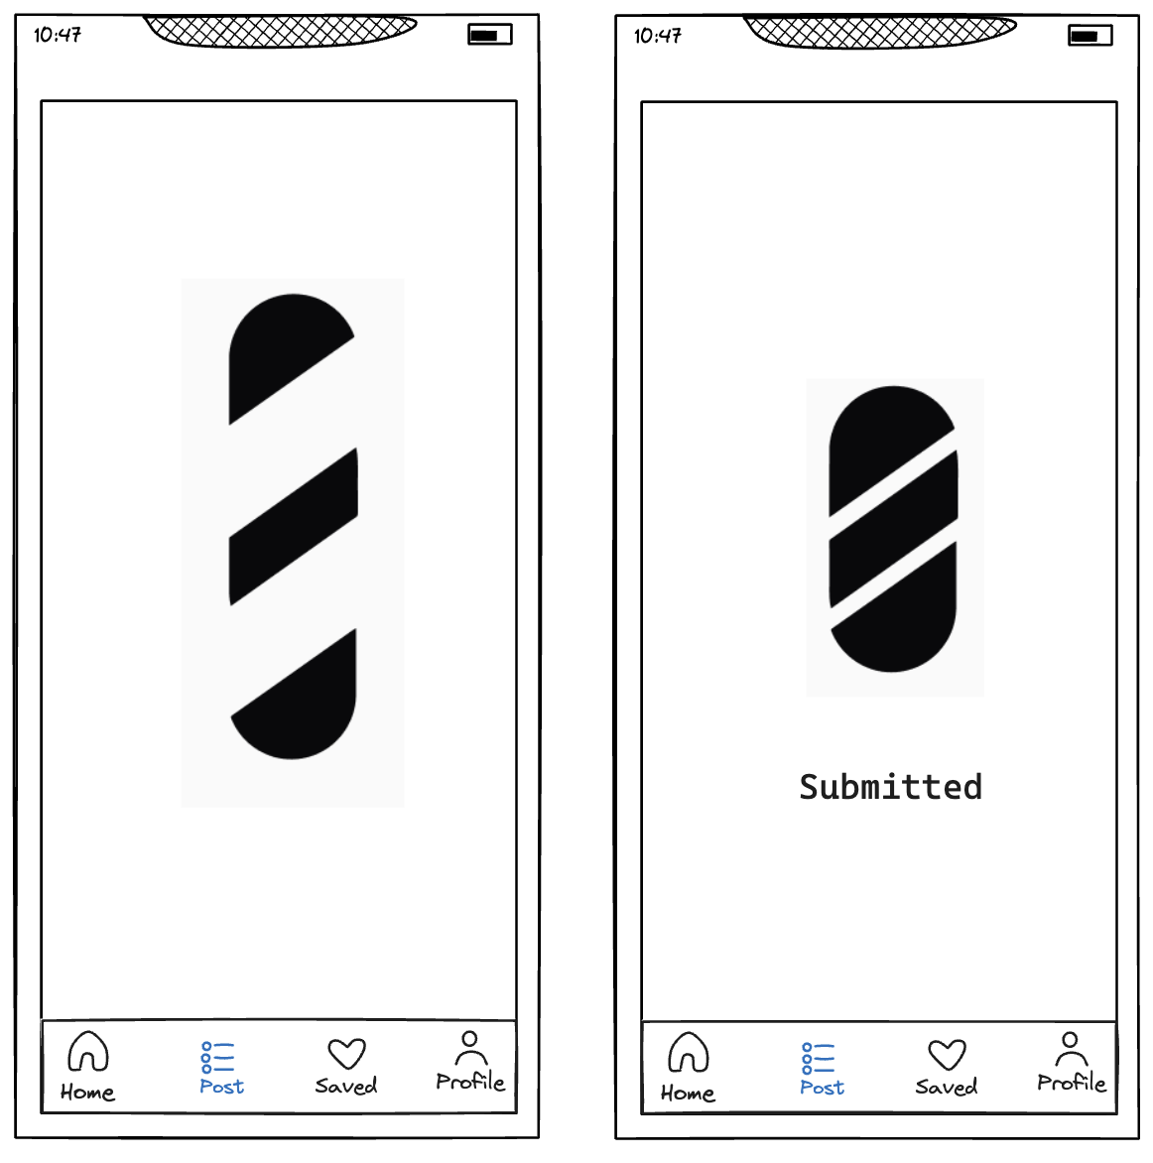
Major Change 3: Animation after sending
Change:
After sending a capsule, our previous design just shows a picture. Our new design has an animation of a capsule being assembled.
Rationale:
Animation makes task completion more rewarding, engaging with the dopamine circuitry in the brain – making knowledge sharing more fun and exciting.We made this change after receiving feedback that jellyfish might be too casual and unrelated to our usability goal.
New Design
Old Design

Slide 23
Medium-fi task flows

Slide 24
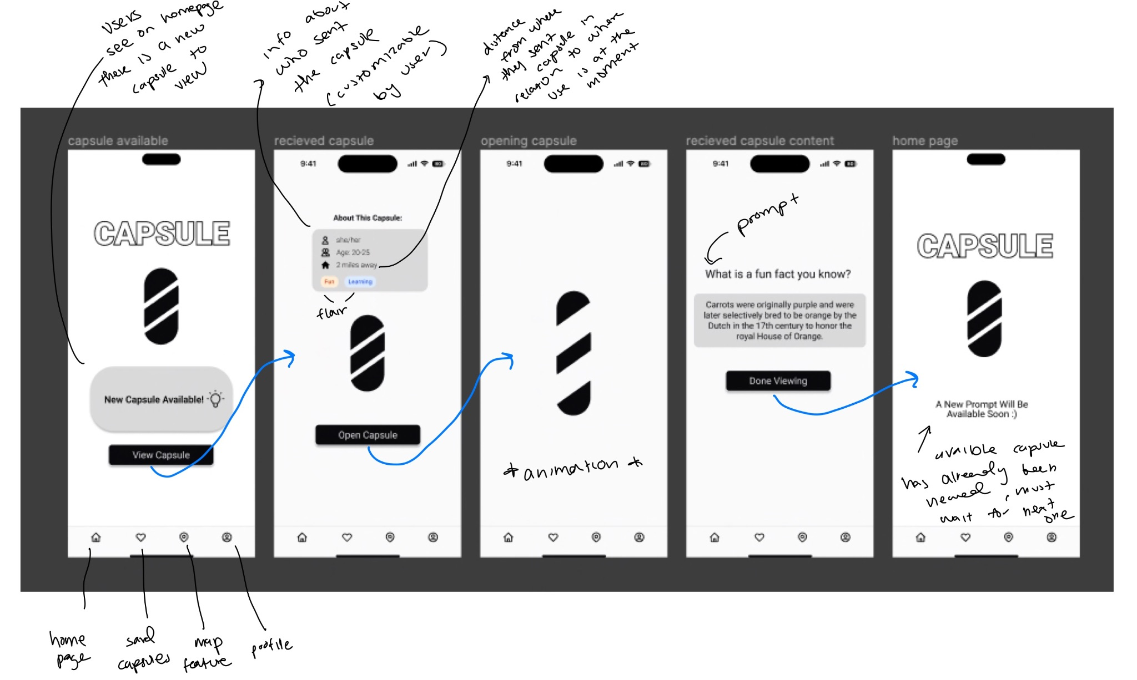
Simple task flow

Slide 25
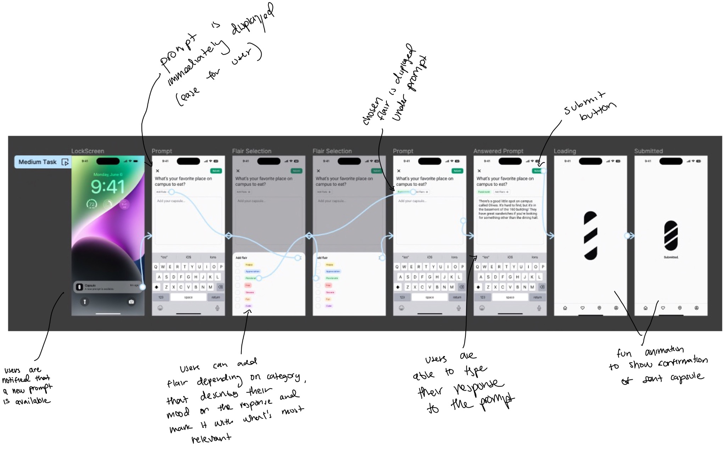
Medium task flow

Slide 26
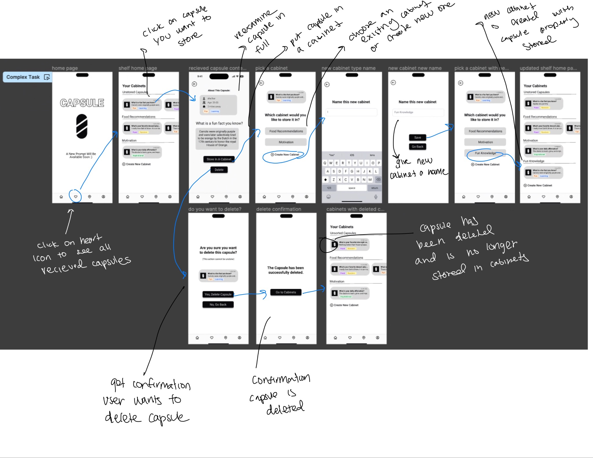
Complex task flow

Slide 27
Prototype implementation

Slide 28

Used tools
We used Excalidraw for our Lo-Fi Prototype/redesigning the UI
Pros:
Pretty easy to navigate
Has the hand-drawn feel but is still electronic with helps keep it neat and organized
Made it easy when creating our Med-Fi prototype since it already resemble a solid UI
Cons:
Not collaborative
  Weren’t able to have multiple people work on it at the same time

Slide 29
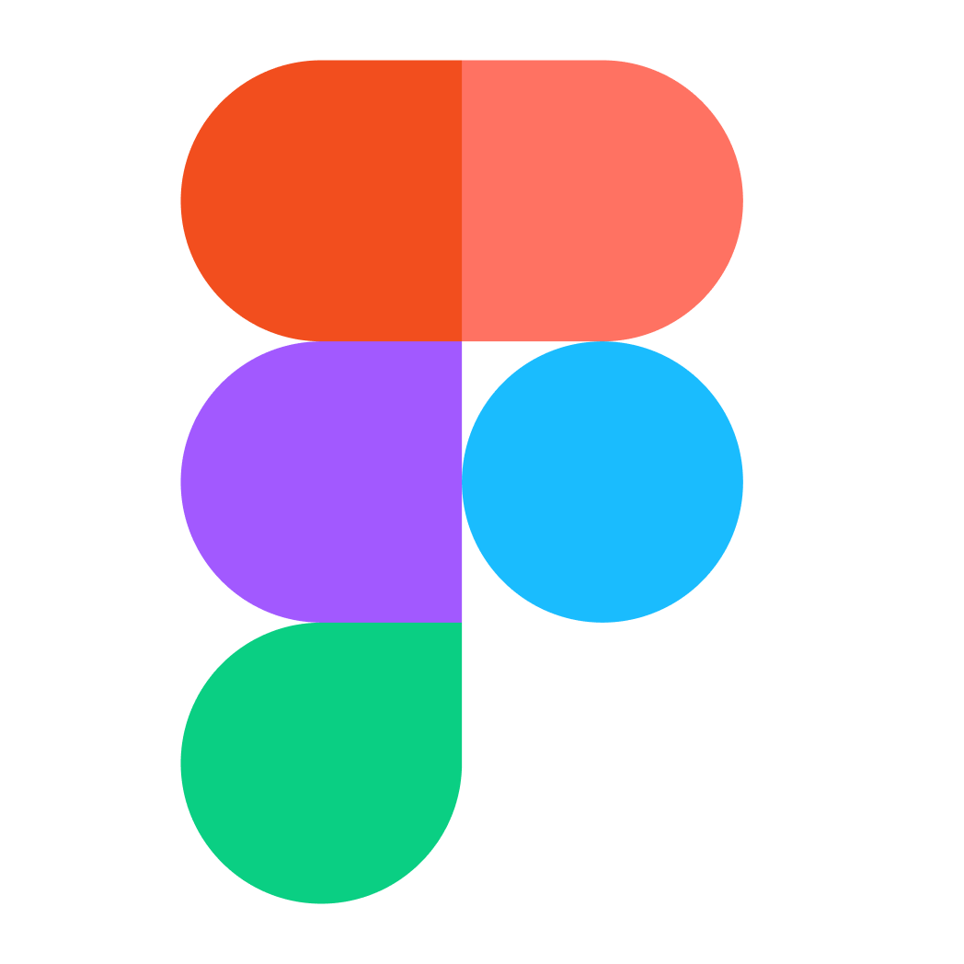
Used tools
We used Figma for our Medium-Fi Prototype
Pros:
Allowed us to really animate in the ay we had envisioned for our app
Great for collaboration as multiple people could work on it
Components feature made it really easy to reuse items we created
Cons:
A little bit of a learning curve
  I.e. learning how to properly make components
  How to make proper prototype transitions

Slide 30
limitations
Wizard-of-oz/hardcoded features
Users are not able to directly interact with their specific profile or interact with the map feature
  Wasn’t related to any major task flow
Users cannot store/delete multiple capsule
  It wasn’t necessary to implement that feature for all capsules as walking through the task for one specific capsule was enough to demonstrate the task flow
Prompt Responses/Cabinet Names
  Through figma, we didn’t have access to features that would allow users to enter their own information when responding to a capsule/creating a new cabinet so we hardcoded it for them
Attached Flair
  It would require to many frames to allow the user to choose their specific flair, and we didn’t feel it was necessary to demonstrate how flair is properly added

Slide 31
appendix

Slide 32
Link to figma
https://tinyurl.com/capsule-task-flows

Slide 33
thank
you

