Slide 1
Capsule
Assignment 4 - Concept Video

Slide 2

01
Project Name and Value Proposition

Slide 3

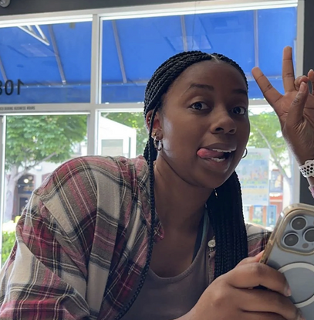
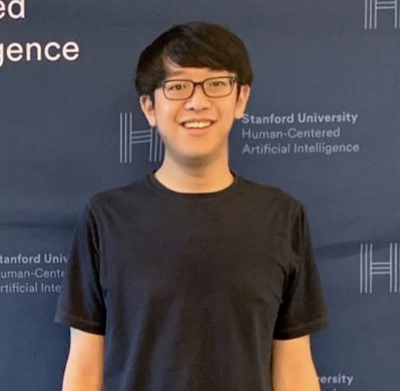
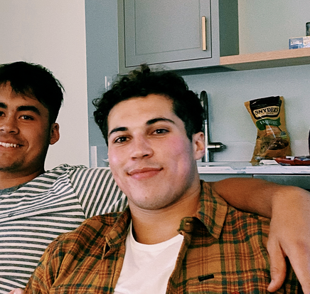
Capsule: The Team
Julia Markel
Kendal Murray
Allen Nie
Tristan Sinclair
3rd Year CS PhD
Pordenone, Italy
Junior in SymSys
Hayward, CA
5th Year CS PhD
Danville, CA
CS Coterm
Alamo, CA

Slide 4
Capsule
Sharing insights, one Capsule at a time.

Slide 5
Origin of “Capsule”
Wanted to explore the idea of sharing daily life knowledge with community members in small doses
Aim was to create a name that was short and memorable while encapsulating the idea behind our app
The name doesn’t immediately give away everything about the platform but invites potential users to delve deeper into what the platform might hold for them, just like a capsule might hold hidden benefits within its small, unassuming form.

Slide 6
02
Problem/Solution Overview

Slide 7
Target Audience: College Students & City Newcomers
Why College Students?
  Seeking quick, reliable info on campus life.
  Desire to connect over shared experiences.
  Eager for insider knowledge to enhance college experience.
Why City Newcomers?
  Need for trustworthy local insights.
  Building connections in a new environment.
  Quick adaptation through community support.
Common Needs:
  Local wisdom: best eats, study spots, etc.
  Social connections: feeling part of a community.
  Quick, fun interaction: fitting for busy lifestyles.

Slide 8
Solution - "Capsule"
Purpose: Community Connection Through Knowledge Sharing
  Local Insights: Swap tips on best local spots and community-specific advice.
  Diverse Discussions: From deep, meaningful conversations to light-hearted chats.
  Interactive Sharing: Users respond to prompts, creating a give-and-take learning environment.
Functionality:
  Send/Receive Capsules: Share and gain knowledge through a fun, interactive process.
  Organize & Save: Keep track of favorite capsules for easy access and reference.
  Rate & Review: Ensure quality content through community feedback.
Benefits:
  Fosters a sense of community and support.
  Encourages discovery and learning.
  Connects users through shared experiences and interests.

Slide 9
03
Market Research

Slide 10
Why These Competitors?
Focused Research: Chose platforms known for community engagement and diverse content sharing.
Competitor Criteria:
Community-centric features.
Variety in content formats.
Different interaction styles.
Goal: Identify market gaps and user preferences to position Capsule uniquely.
Outcome: Insights from competitors' strengths and weaknesses guide Capsule’s innovative approach for effective, authentic community connections.

Slide 11
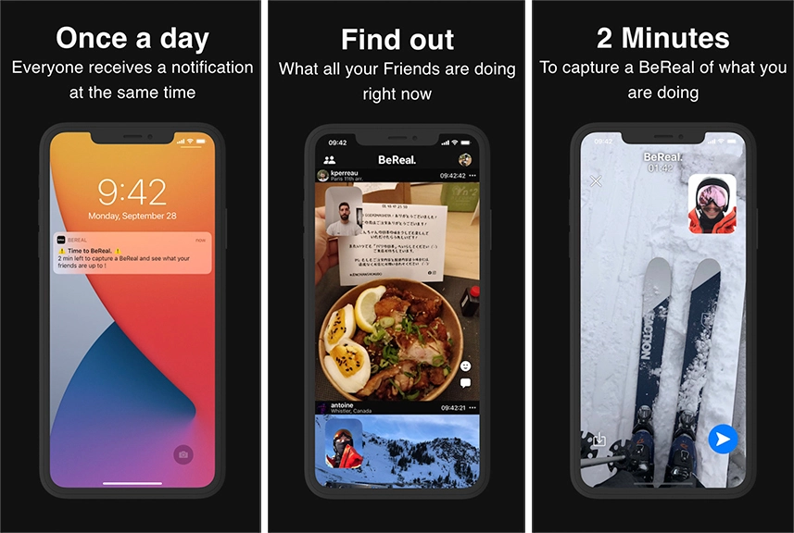
BeReal
Feature: Instant photo sharing.
Pros: Authentic, quick interactions.
Cons: No community aspect, privacy issues.
Difference: "Capsule" prompts community knowledge sharing.
Lesson: Limit response time for authenticity.

Slide 12
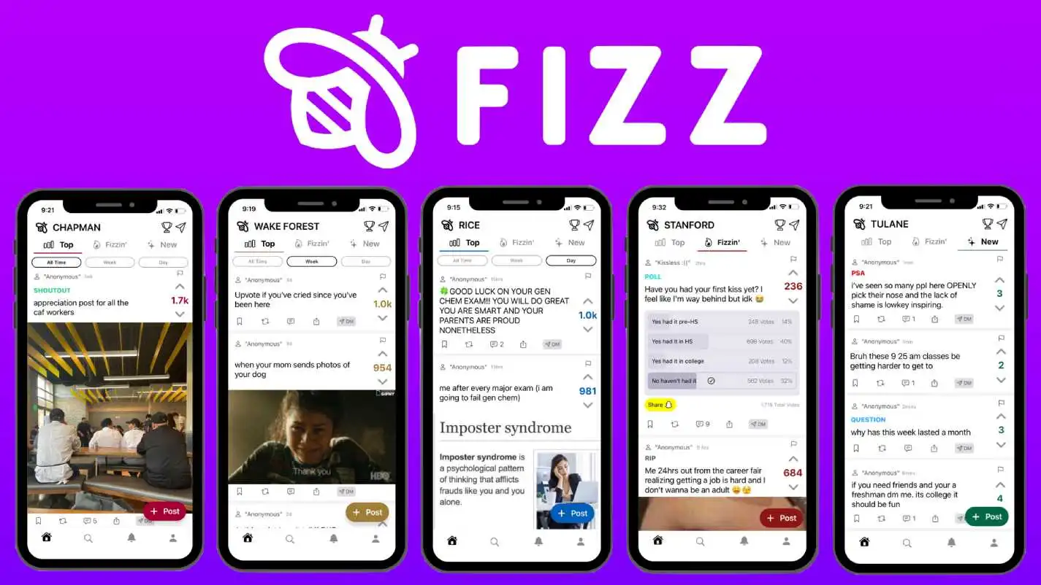
FIZZ
Feature: University-focused community platform.
Pros: Privacy, unites school community.
Cons: Cluttered, unrepresentative.
Difference: "Capsule" uses proximity, not credentials.
Lesson: Capture community vibe succinctly.

Slide 13
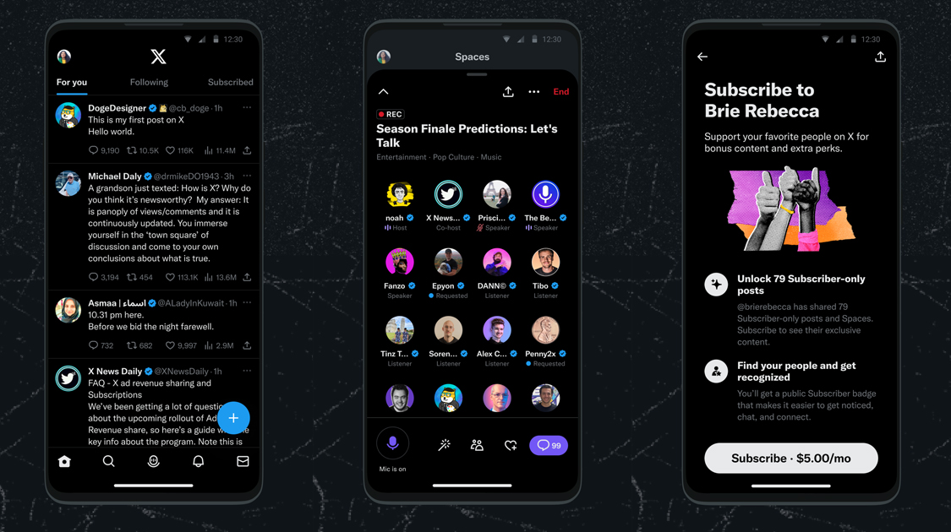
X
Feature: Global content sharing.
Pros: Worldwide reach, dynamic discussions.
Cons: Divisiveness, information overload.
Difference: "Capsule" limits posts, encourages community.
Lesson: Avoid content saturation, ensure safety.

Slide 14
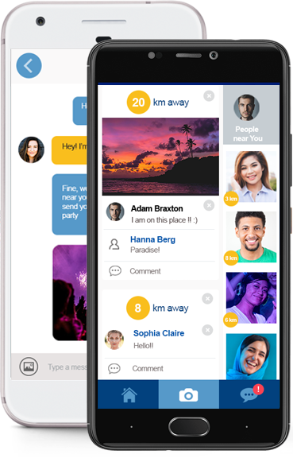
ZINGR
Feature: Location-based networking.
Pros: Local connections, diverse communication.
Cons: Safety concerns, unrefined.
Difference: "Capsule" regulates info flow, emphasizes safety.
Lesson: Focus on safety, consider proximity features.

Slide 15
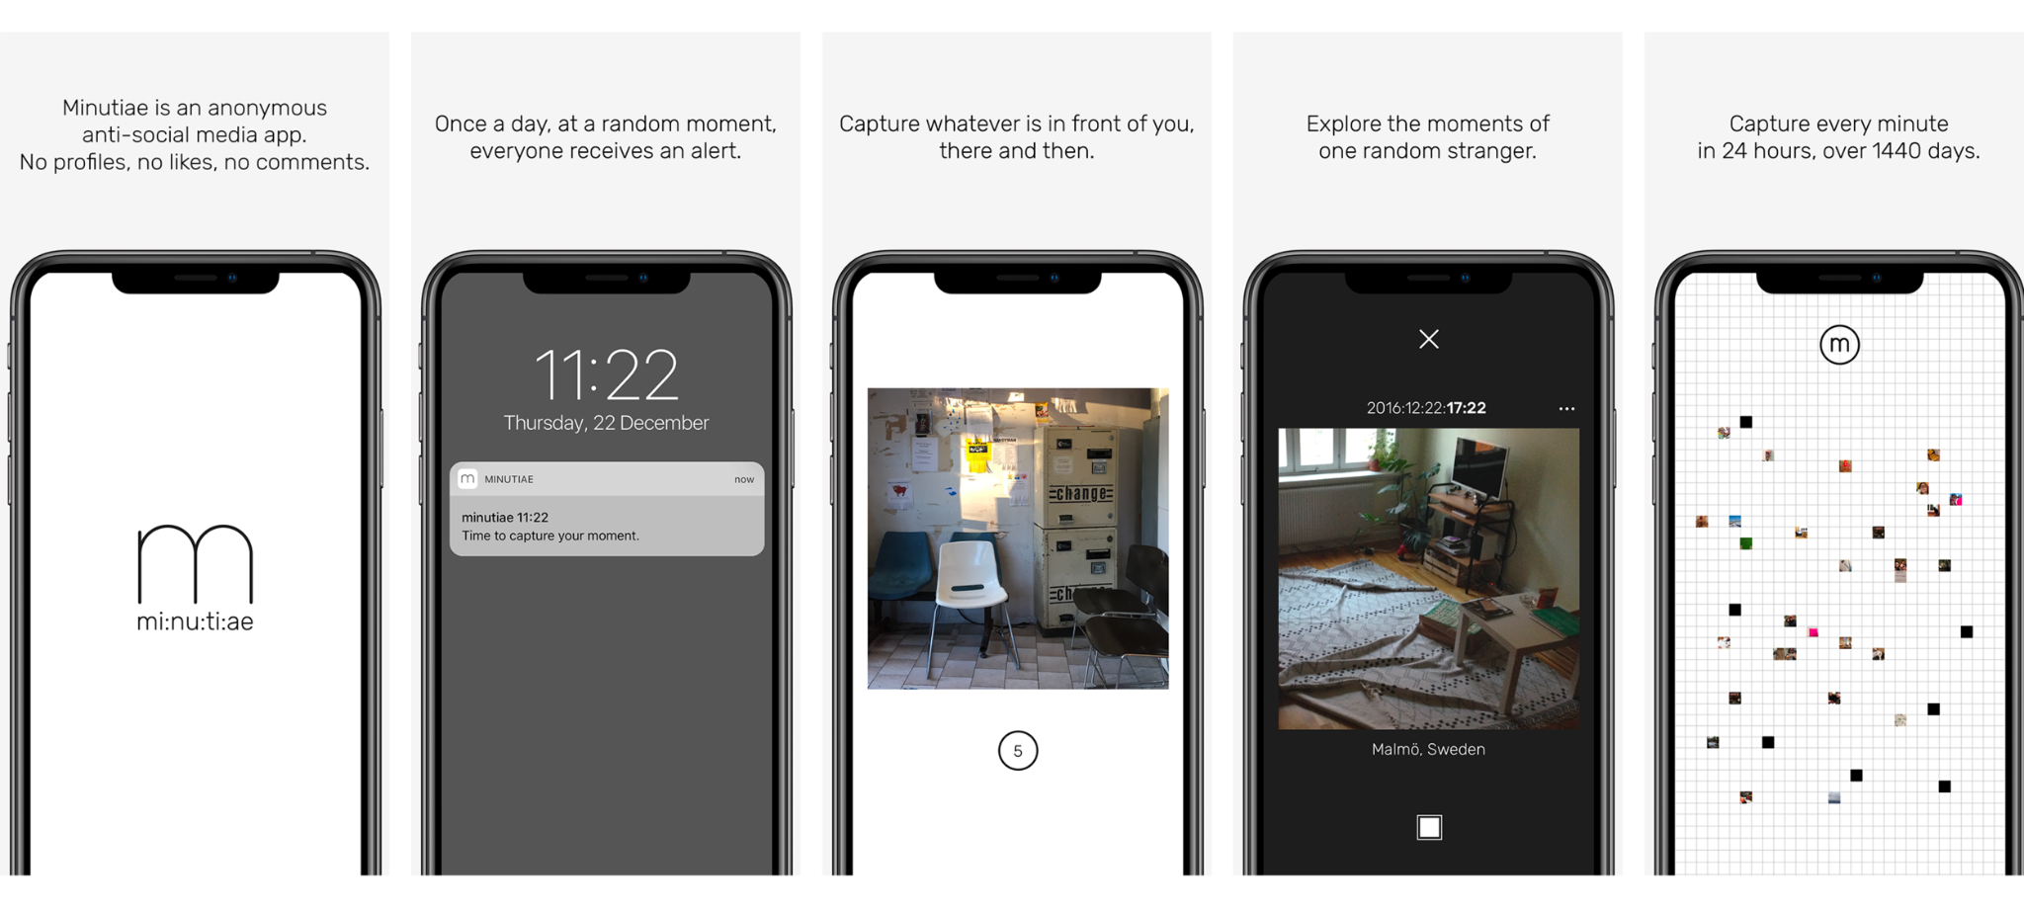
Minutiae
Feature: Daily life photo archive.
Pros: Authenticity, no content fatigue.
Cons: Bad UI, restrictive.
Difference: "Capsule" broader than photos, community-focused.
Lesson: Maintain authenticity, improve UI.

Slide 16
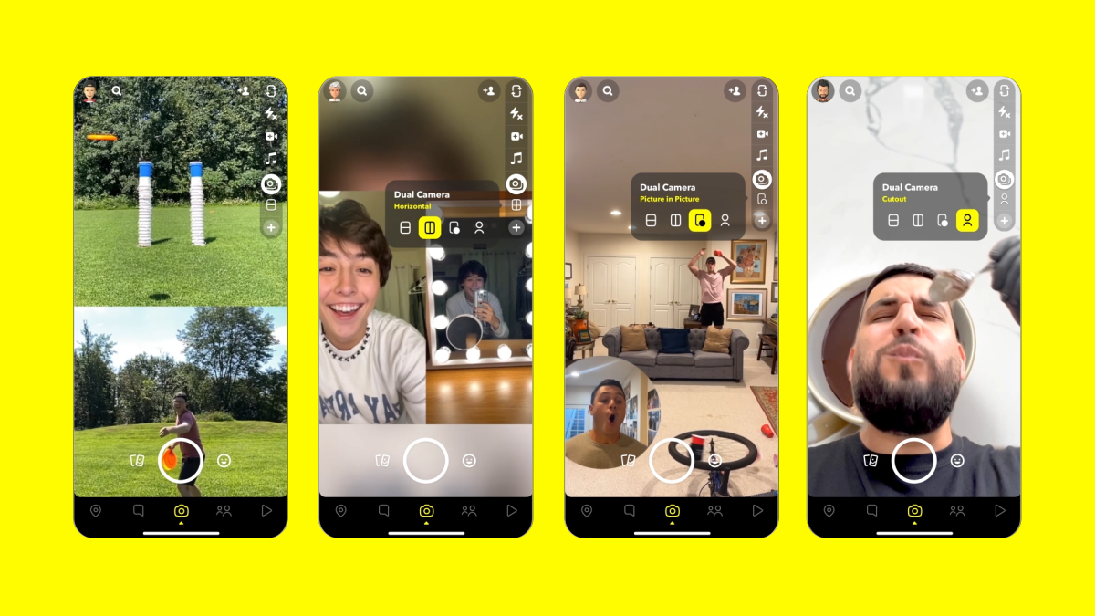
Snapchat
Feature: Ephemeral multimedia messaging.
Pros: Engaging, temporary content.
Cons: User retention, strong competition.
Difference: "Capsule" uses specific, timed prompts.
Lesson: Inject fun, possibly through interactive elements.

Slide 17
04
Values in Design

Slide 18
Direct & Indirect Stakeholders
Direct Stakeholders:
  App Users
  Content Moderators
  Platform Owners (Apple, Google)
Indirect Stakeholders:
  General Public
  Community Authorities
  Family & Friends of Users

Slide 19
Ethical Implication 1: Safety and Privacy
Card: The Scandal
Worst Headlines:
  "App leads to tragic drowning incident."
  "App prompts raise stalking concerns on campuses."
Addressing Concerns: Incorporate safety guidelines, provide user feedback mechanisms, and set up incident-report hotlines.

Slide 20
Ethical Implication 2: Over-Dependency
Card: The Siren
Potential Issue: Prioritizing app prompts over real-life responsibilities.
Addressing Concerns: Limit prompts, avoid over-engagement rewards, and provide well-being tips.

Slide 21
05
Tasks

Slide 22
Simple Tasks
1. Receive a Prompt
2. Respond and Send a Capsule
3. Receive a Capsule
Users gain community insights through brainstorming responses.
Responses shared as short audio or text messages within the app.
Post-response, users get a capsule from others, promoting a knowledge exchange culture.

Slide 23
Medium Tasks
1. Share a Capsule
2. Rate/Rank Capsule
Users can externally share capsules, facilitating long-distance connections and community learning.
Users evaluate received capsules, enhancing the quality of community insights.

Slide 24
Complex Task
Organize Capsule Collection
Users categorize their capsules (authored/received) for efficient access to relevant knowledge or insights.

Slide 25
06
Video
Storyboards

Slide 26
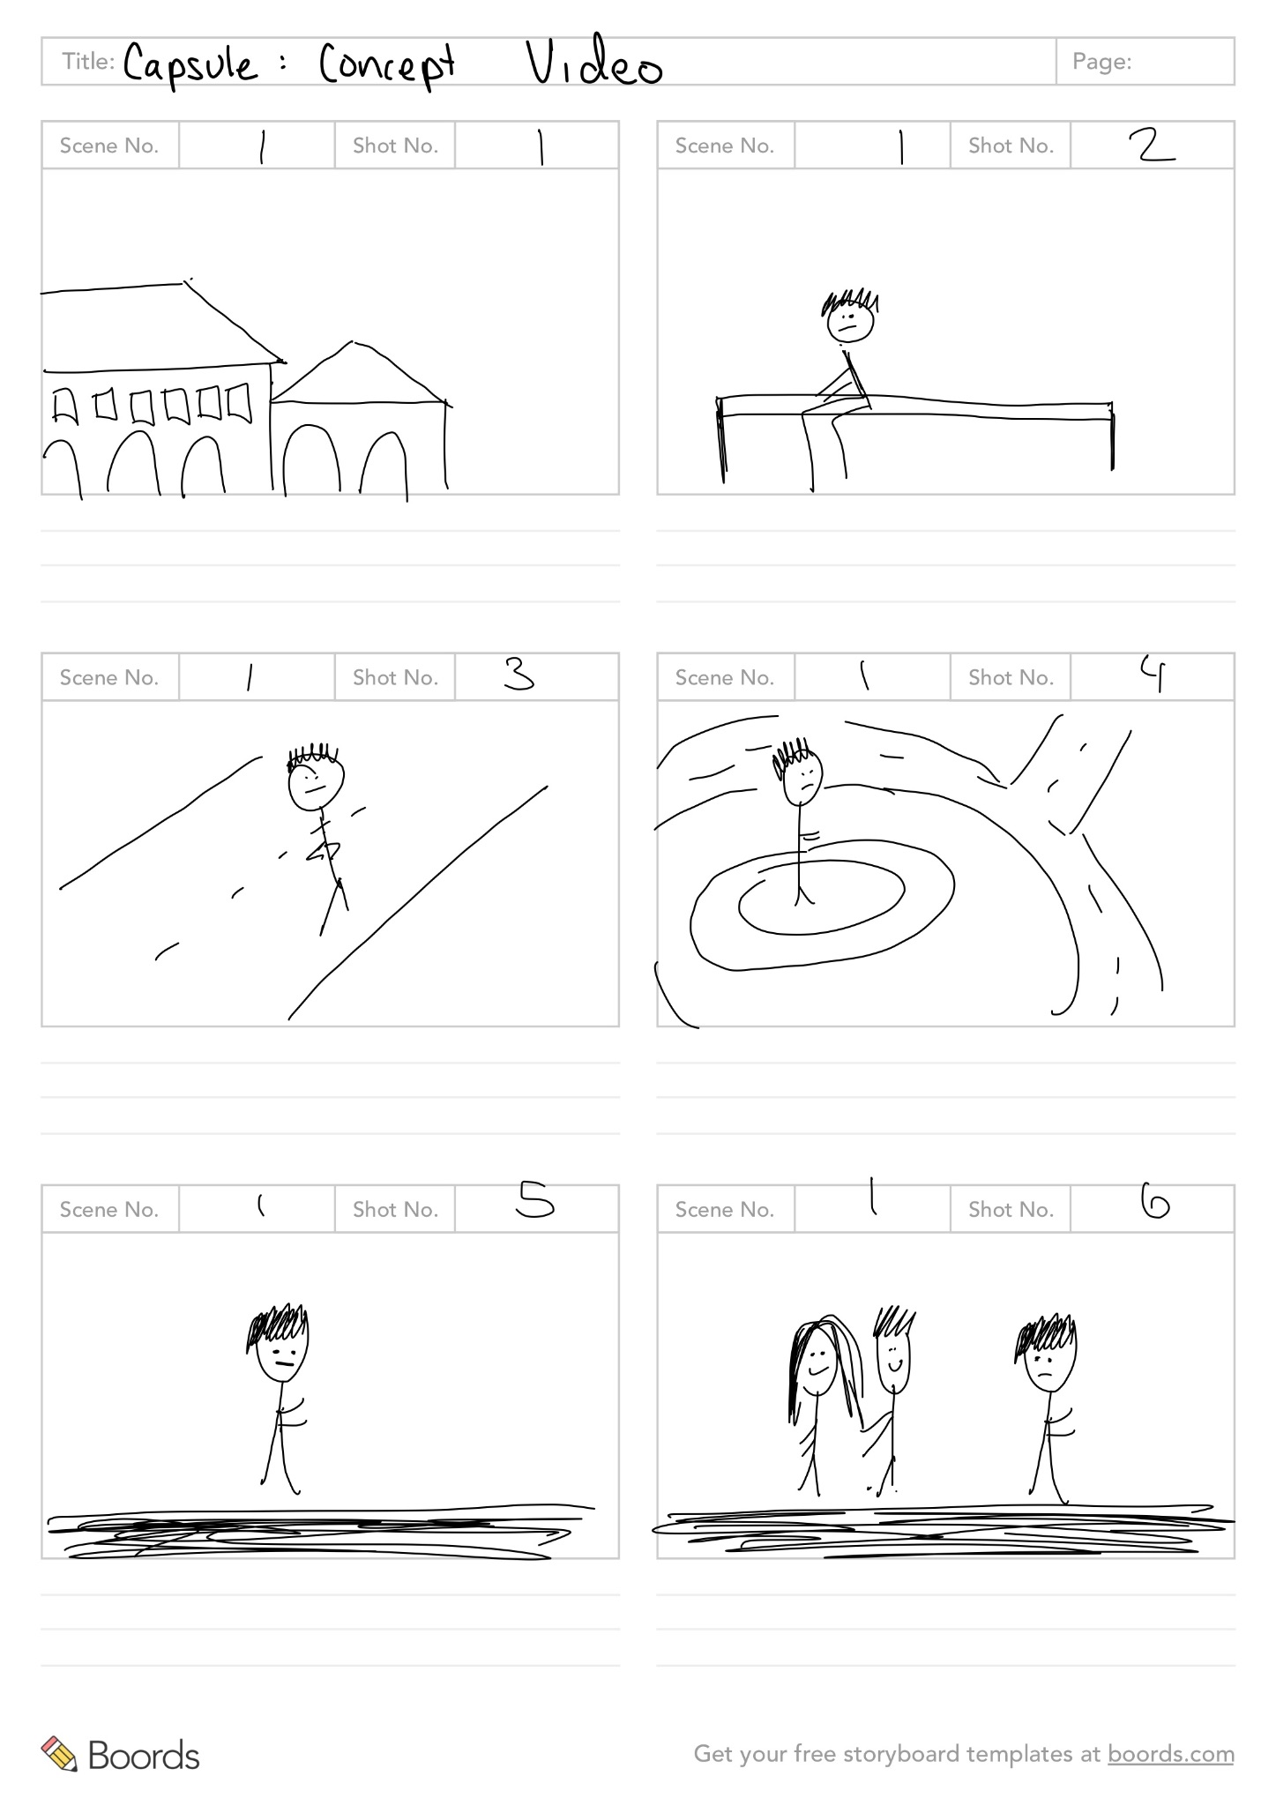
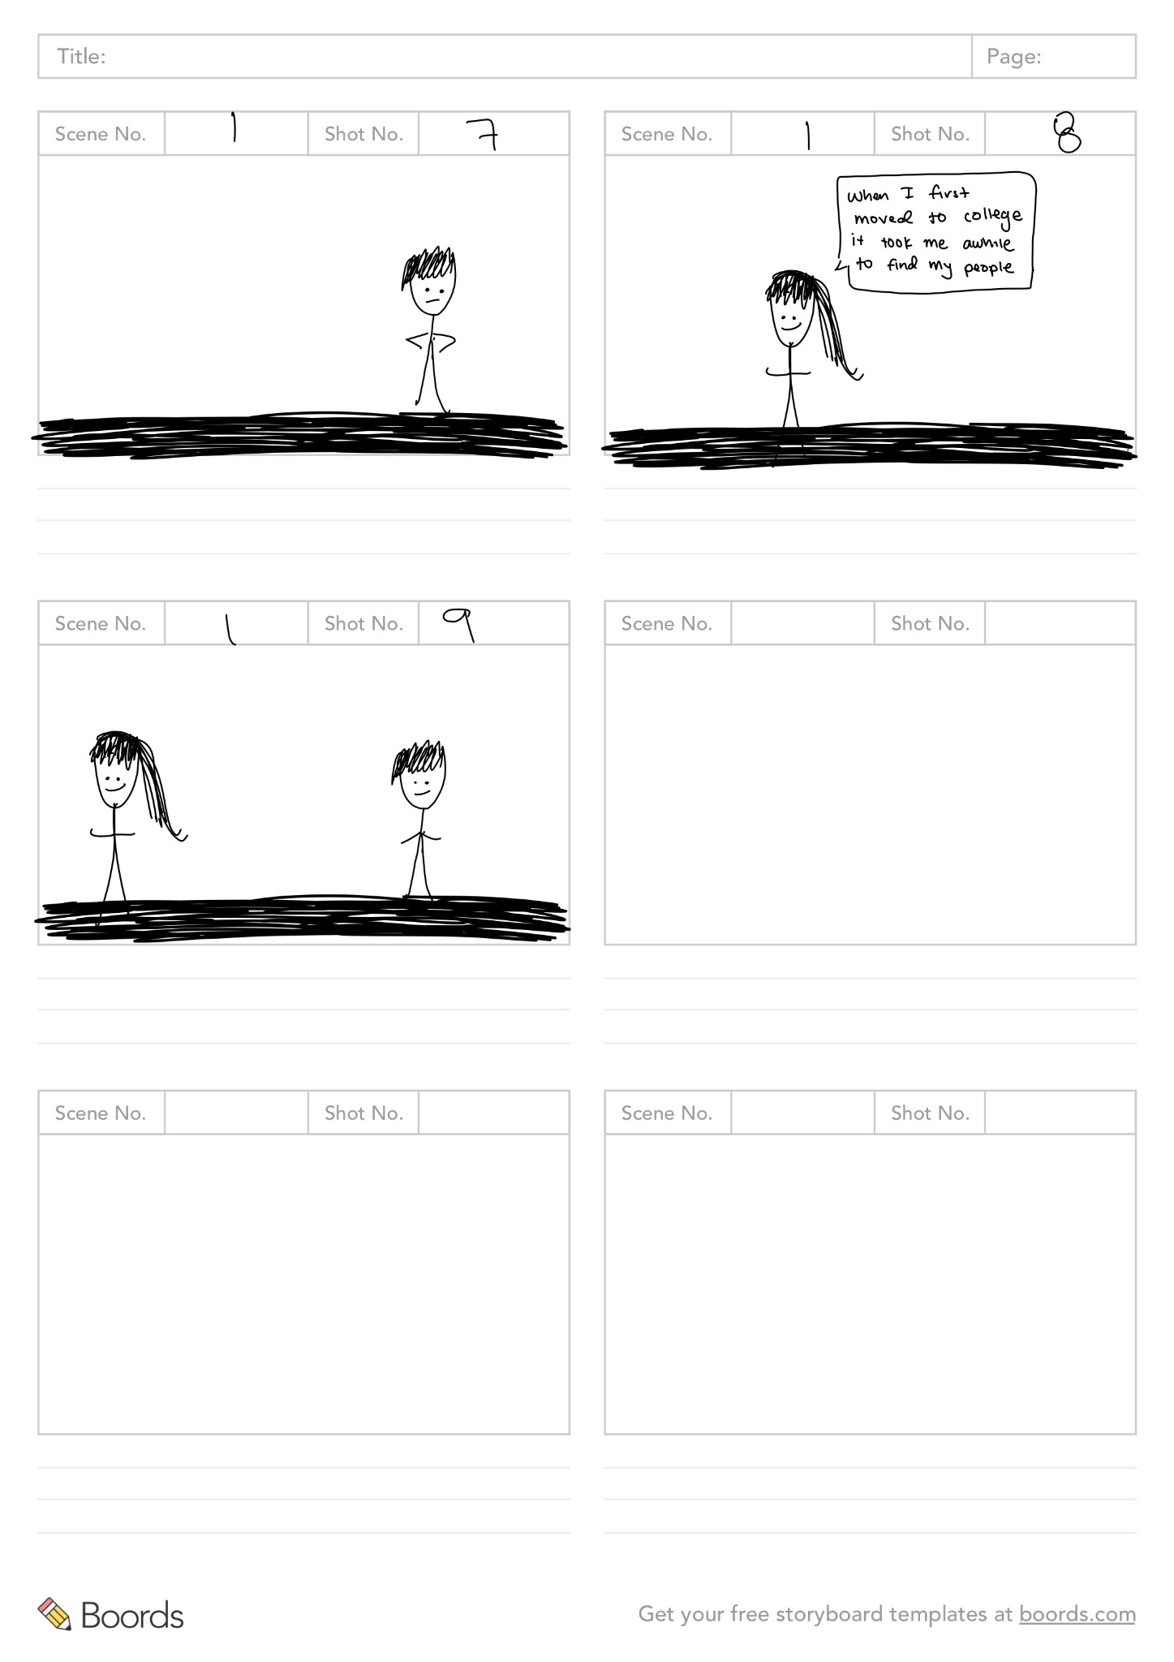
Scene 1

Slide 27
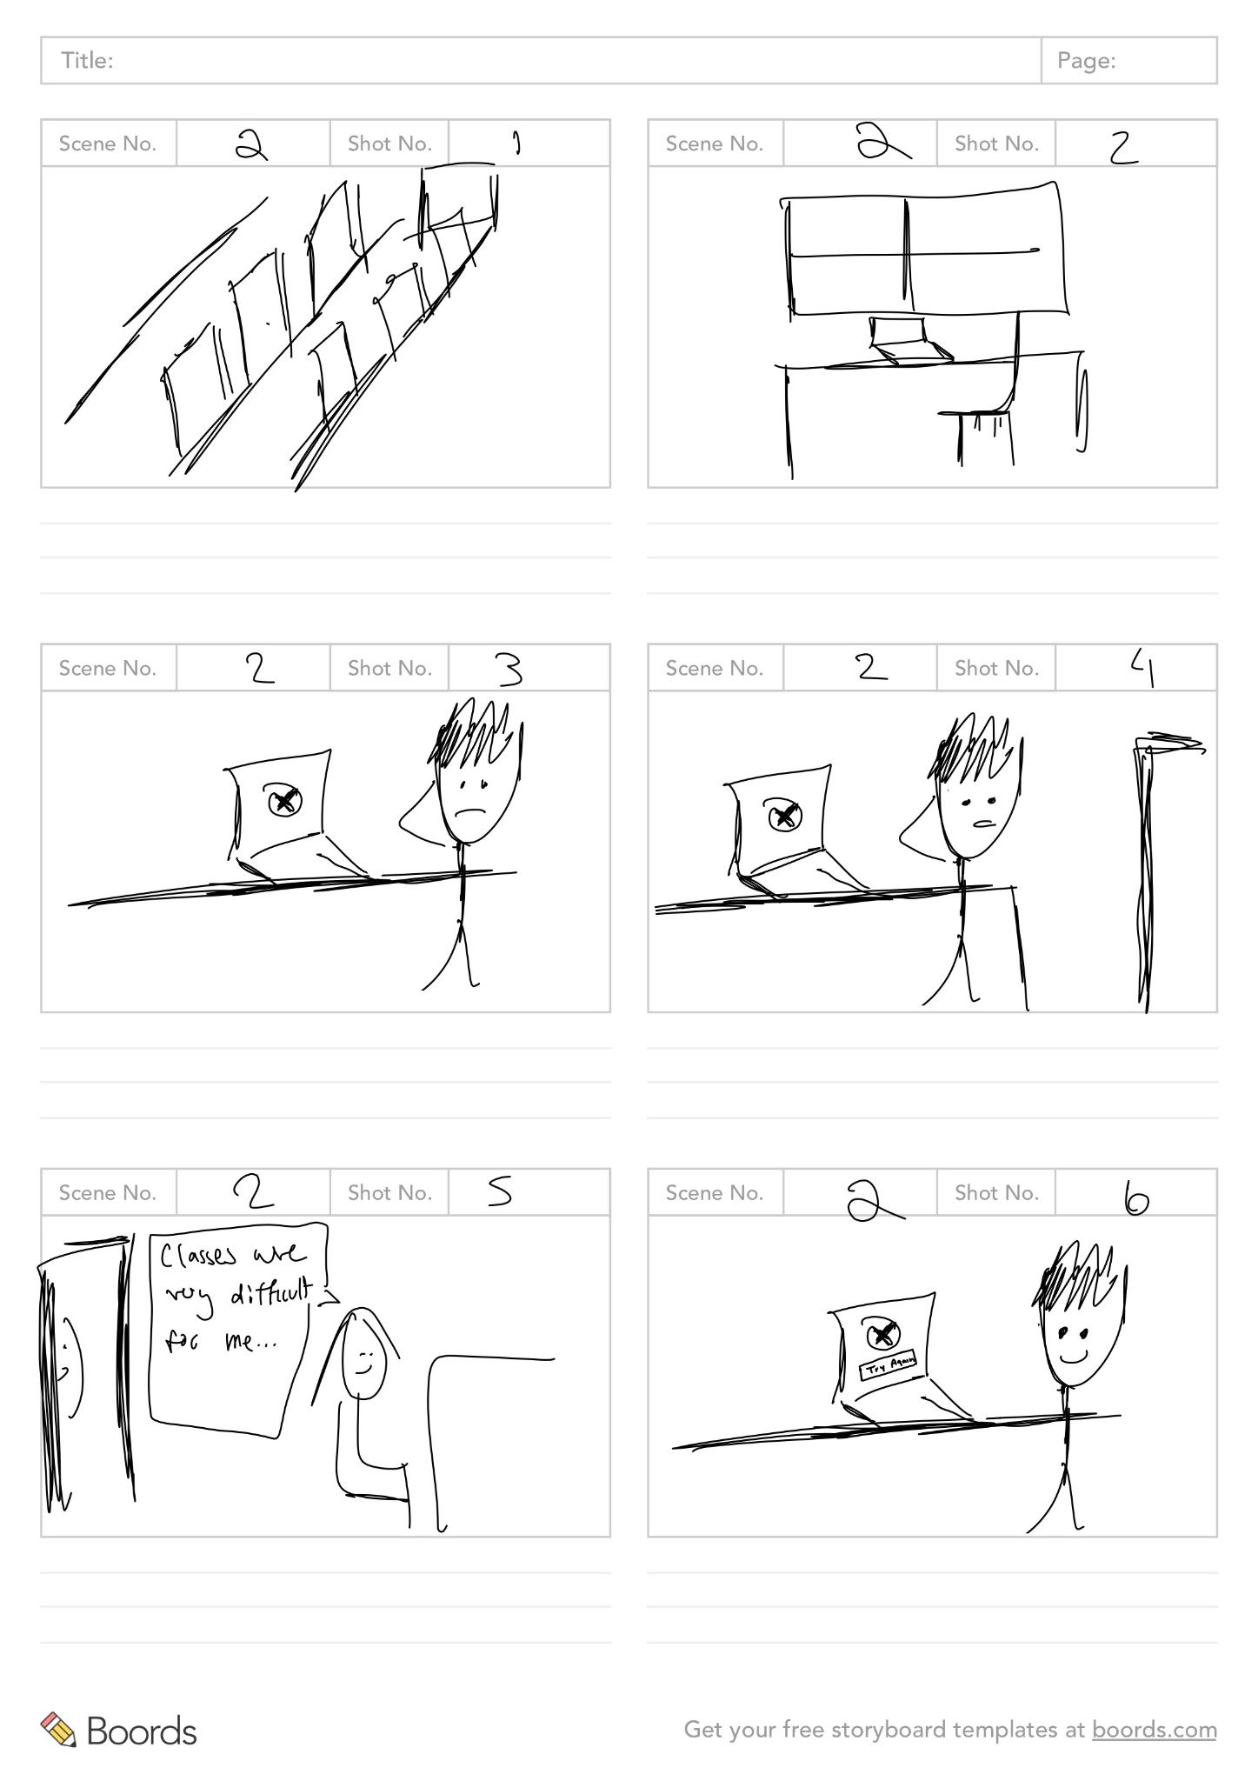
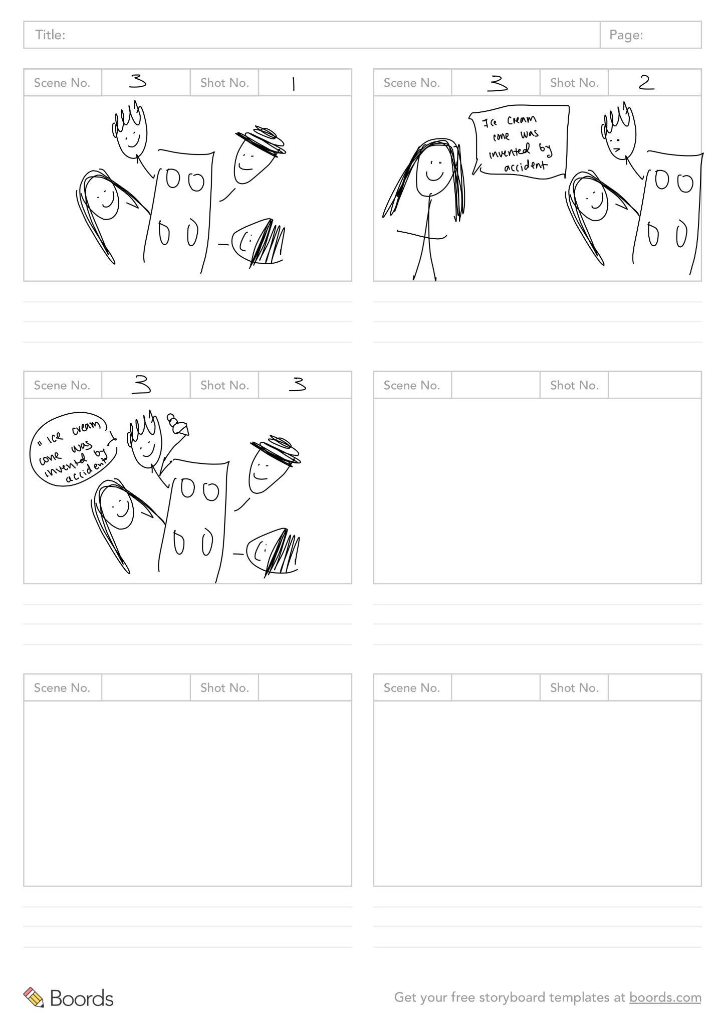
Scene 2-3

Slide 28
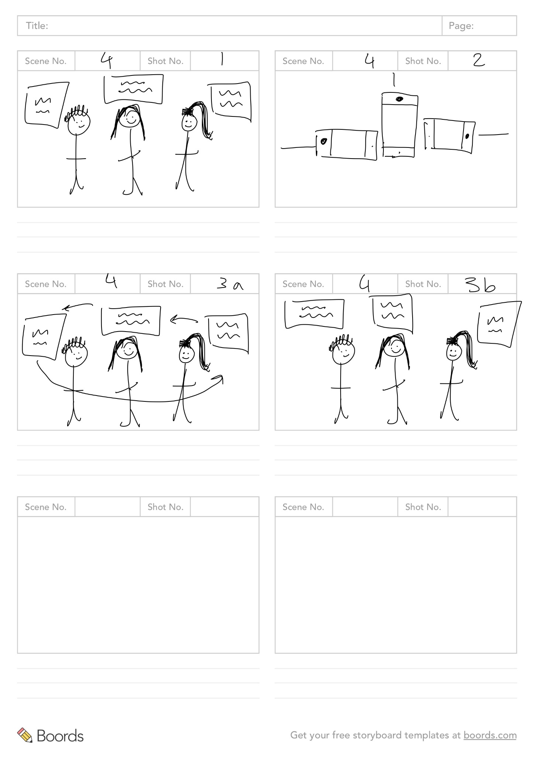
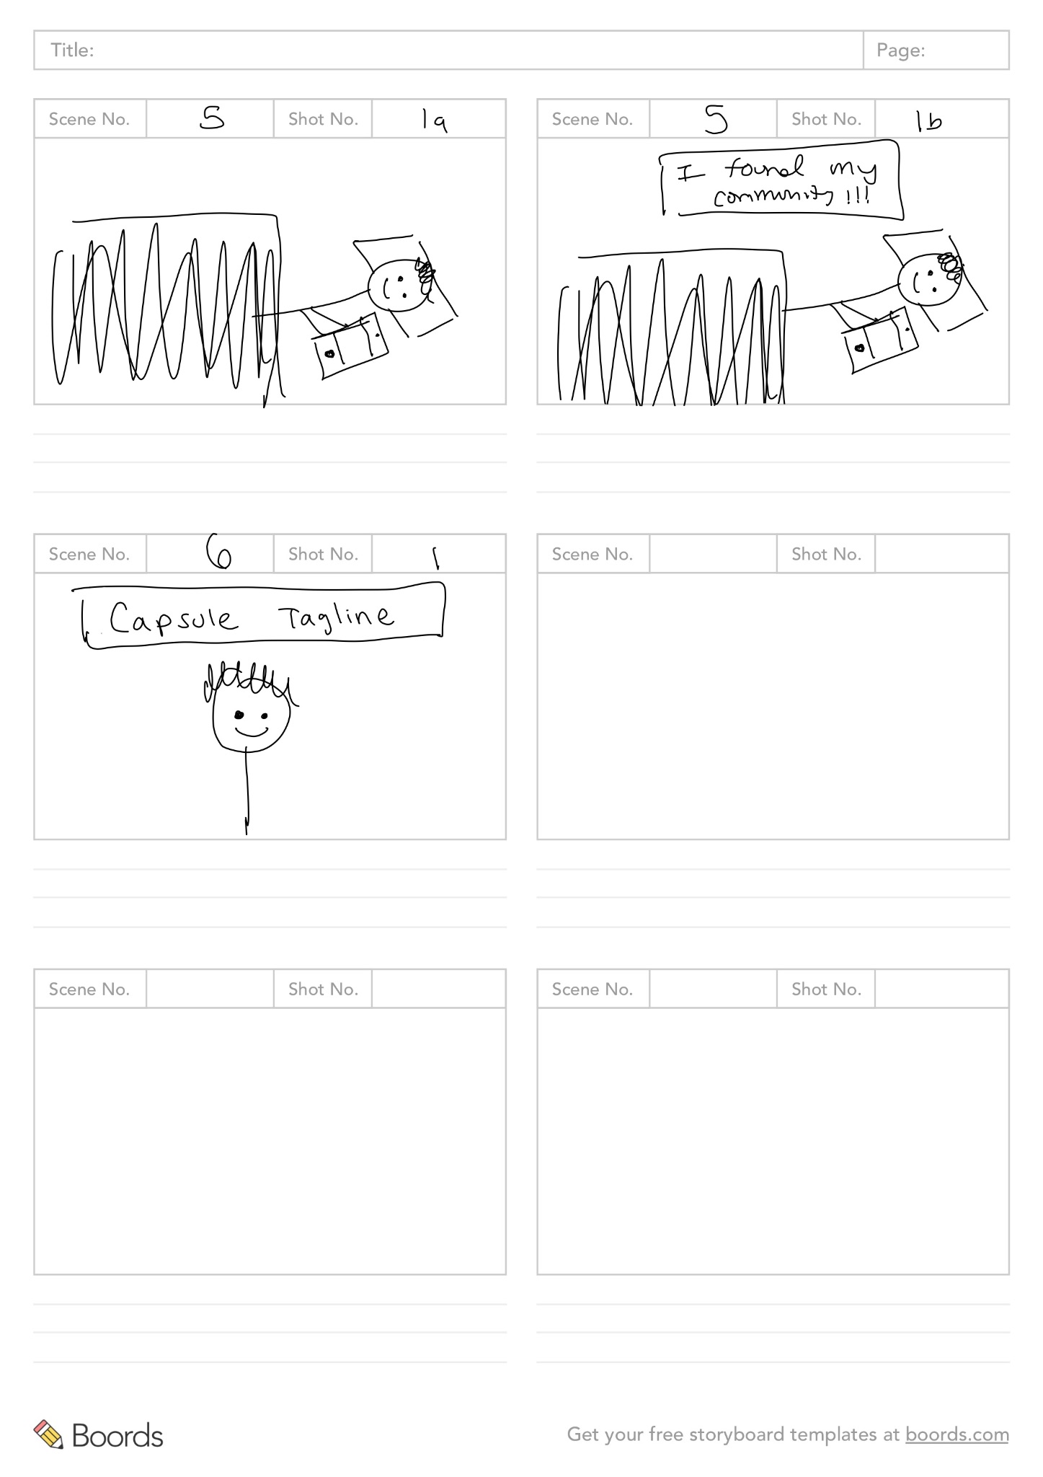
Scene 4-6

Slide 29
07
Concept
Video

Slide 30


Slide 31
Appendix

Slide 32
Market Research for Capsule
BeReal
Description: BeReal is a social media app with a daily feature that prompts users to share a spontaneous photo of themselves and their surroundings within a randomly allocated two-minute timeframe.
Medium: Photo (of user + environment)
Audience: Friends (add / follow paradigm) + optionally friends of friends
What has worked well:
Lightweight interaction (snap quick pic)
Authentic (two minute time frame makes for less “staging”)
Share with your friends
What hasn’t worked well:
Not really community based
Only pictures + short captions
Just a snapshot of where you are at a given moment
Privacy concerns
Why is our solution different from this: Our solution is different from BeReal because we are focusing on community building (based on proximity) and providing prompts to respond to at random times in the day.
Takeaway/implications on our design: Lightweight interaction is great, authenticity is good. A solid takeaway here is maybe to find some way to limit how long a user can take responding to each prompt, to encourage authenticity and lightweight-ness.

Slide 33
Market Research for Capsule
Fizz
Description: This app allows students to connect with their university's private community. Fizz is a platform designed specifically for schools and provides a range of features, including direct messaging, polls, and image sharing, anonymously.
Medium: Discussion forum (similar to Reddit)
Audience: Campus, students (anon.)
What has worked well:
Privacy (requires .edu from the school to join community)
Gathers community members from a primary source of community (one’s school)
Good to get a sense of general vibe of who is using the tool
What hasn’t worked well:
Hard to get info out
Feels like endless scroll
Doesn’t feel necessarily representative
Why is our solution different from this:
Our solution is not like a discussion forum. Like Fizz, it’s meant to connect people of a certain community, like a campus community, but it’s based on physical proximity rather than credentials. Another difference is that Capsule sends prompts rather than allowing users to free-flow thoughts.
Takeaway/implications on our design: It might be nice to have some way of getting a snapshot of the community vibe at one moment in time.

Slide 34
Market Research for Capsule
ZINGR
Description: Zingr is a location-based app that helps users connect with people nearby. Users can share videos, photos, and stories with their neighbors, schoolmates, and college friends, and send short messages to anyone in the vicinity. It's designed for making new friends and having fun.
Medium: Multimodal
Audience: Neighbors, community members (based on proximity)
What has worked well:
Can help people find friends
Multiple modes of communication / info transfer
Community centered
What hasn’t worked well:
Can feel intimidating / dangerous
App itself is not well built
Some people want to filter/search for those in the community and feature not enabled
Feels like a dating app kind of
Why is our solution different from this: ZINGR is one of the closest apps to ours, since it’s also based on proximal community and meant for users to share multiple modes of info and stories. Our solution is different in that our users are specifically prompted at certain times of the day to share, encouraging users to participate and limiting the overflow of info.
Takeaway/implications on our design: We can take away the community-centered approach this app has, and perhaps something to do with showing proximity? We can also take away that our app needs to emphasize safety.

Slide 35
Market Research for Capsule
X/Twitter
Description: The X app/Twitter serves as a self-proclaimed trusted global digital town square, connecting people worldwide. Users can use X to share content openly, engage in public discussions, stay informed with real-time news updates, and follow their passions.
Medium: Multimodal, discussion forum mixed with social media vibes
Audience: Subscription/follow model (follow friends, influencer, accounts, etc)
What has worked well:
Connects people worldwide
Ease of reshare + discussion
What hasn’t worked well:
Divisive
Sometimes unsafe or controversial
Endless stream of information
Why is our solution different from this: Our solution is quite different from X/Twitter. Rather than allowing users to post free-flow, multiple posts at a time, we encourage users to respond via a prompt at random, but specific times of the day. We also offer less kinds of interactions so as to diminish the time drained on the app. Our goal is not to increase time on the app, but to increase community building.
Takeaway/implications on our design: Some implications of this on our own app and design might be more on what not to do. We don’t want an endless stream of information and we want our users to feel safe. Perhaps we could think of a way to easily share capsules.

Slide 36
Market Research for Capsule
Minutiae
Description: Minutiae is a self-proclaimed anti-social media app that encourages users to cherish everyday moments, similar to BeReal. Participants receive a daily alert at a random minute, prompting them to capture and share what's happening around them. Over 1440 days, users’ captured moments contribute to a digital archive, which they even transform into a physical book, fostering a deeper appreciation for life's simple joys.
Medium: Images, then physical book
Audience: One random stranger for 60s
What has worked well:
Encourages users to connect with other humans
Authenticity
Doesn’t encourage endless scroll
Alternative to social media
Great log / collection and slice of life
What hasn’t worked well:
Bad UI
Too similar to BeReal
Quick time frame is too suffocating
Why is our solution different from this:
Our solution is different from this app in that we are not encouraging people to strictly take pictures of their surroundings. It is similar in that we are also looking to plan to match random strangers’ prompt responses (different though, because we’ll base it on community members).
Takeaway/implications on our design: An implication we can carry over to our design here is authenticity and log/collection - we want our app to encourage honesty and archival of life.

Slide 37
Market Research for Capsule
Snapchat
Description: Snapchat is a multimedia messaging app known for its unique feature of sending pictures and messages that self-destruct after a short time, making them inaccessible to recipients once viewed. This ephemeral nature of content sharing adds an element of spontaneity and privacy to the platform, allowing users to communicate and share moments with a sense of impermanence.
Medium: Multimodal
Audience: Friends and potentially strangers, different granularities of audience
What has worked well:
Ephemeral content
Lenses / fun filters
Stories
Geofilters
Engagement
What hasn’t worked well:
User growth (difficult to keep users)
Competition (most people use instagram instead because more people using and more immortalization of content)
Why is our solution different from this: Our solution is profoundly different from Snapchat. We operate on a completely different paradigm (random alerts throughout the day prompting specific responses / types of information to be written and sent). We also don’t use a friend paradigm or look to offer so many features for our user base (discovery, stories, maps, etc).
Takeaway/implications on our design: Though Snapchat is very different from our idea, we like the ephemeral nature of snaps, and that filters can make it fun. Perhaps we can consider adding stickers or “tokens” to capsules that get sent out in order to keep it fun.

Slide 38
Values in Design
Two Tarot cards of Tech:
The Scandal
What’s the worst headline about your product that you can imagine?
Headline 1: “A social media app that caused a young person to drown in a lake.”
Headline 2: “A social media app that encourages stalking on university campuses.”
These headlines imply that the app prompts might not have been carefully curated, leading users into potentially harmful or compromising situations. Some prompts might be perceived as invasive, making others uncomfortable or even unsafe. For example, if a user is asked to say "hi" to a random person, this could be perceived as stalking or unwelcome attention. Additionally, if the app stores or collects data on these interactions without proper consent, it could lead to privacy concerns.
Underlying Value Tension: Fun activities for Community Building vs. Safety and Privacy
Previously overlooked stakeholders: Potential victims of unsolicited actions or organizations advocating for personal privacy and safety.
Addressing the Ethical Implication: The design team should consider incorporating guidelines for safe and respectful interactions. There should be clear disclaimers about the nature of the prompts, the app should offer a feedback mechanism where users can report uncomfortable prompts, and the app can open a hotline for anyone to report incidents caused by inappropriate prompts. Incorporating user-generated content, where users suggest prompts, could help, but these must be reviewed and approved by a team to ensure they are safe and appropriate.
Brainstorm stakeholders and ethical implications
Choose one solution you identified in the last assignment. Identify direct stakeholders and indirect stakeholders for your solution (ideally several, but this may vary depending on the scenario). Choose two Tarot cards of tech to identify and analyze two ethical implications of your solution. Does this ethical implication reflect an underlying value tension? Does it point to any stakeholders you may have previously overlooked? How might you go about addressing these ethical implications in your designs?
Solution we picked: An app that prompts you to do something and share them (e.g. share a fun fact, share what you learned)
Direct Stakeholders:
- User of the app: people who directly use the app to share
- Content moderator of the app
- Platform owners: Apple’s appstore, Google’s store.
Indirect Stakeholders:
- General public: people the users have to interact with to accomplish a prompt (if the prompt requires the user to interact with a third-party, such as – saying hi to a random person, or asking someone how they are doing, or giving a random person a small gift)
- Community authorities: such as school administrators, law enforcement, custodial staff
- Family and Friends of Users: if the app asks user to act according to a prompt at a given time, the user performs the action while in an activity with family or friends.

Slide 39
Values in Design
The Siren
What would using your product “too much” look like?
Users might prioritize the app’s prompts over personal responsibilities or important real-life interactions, continuously seeking the dopamine hits from shares, likes, or acknowledgments from the app community. Because prompts span from taking a few seconds, to minutes, to potentially 30 minutes – and require the user to think about how to accomplish the prompt within the confines of their day. That can cause a highly engaged user to alter their daily life / behavior too much for the app.
Underlying Value Tension: Over-dependency and Disruption of Real-life responsibilities
Overlooked Stakeholders: Employers of the app's users (as productivity might decline), teachers (if the users are students), and therapists or counselors (who might be treating patients for digital addiction).
Addressing the Ethical Implication: The app should limit the number of prompts per day, or possibly per week. The app cannot have mechanisms that punish users for not consistently engaging or rewarding for continuous usage. The app could also incorporate well-being tips, encouraging users to balance their app time with real-world interactions. Another approach could be to provide a weekly summary of time spent on the app, making users aware of their usage patterns.

Slide 40
Value Proposition, Problem/Solution
2. Problem/solution overview a. 1-3 sentences total b. Who the primary user is c. Problem you are tackling d. Brief synopsis of your proposed solution
Primary User: college students, young people moved to in a new city
Problem: How might we empower people to share knowledge with others in their community?
Solution: An app that prompts you to do something and share them (e.g. share a fun fact, share what you learned)
We are recognizing that a lot of people want a sense of community but have difficulty connecting with others. Trading information is an instinctive human behavior when we make connections (for example, telling others about a fun restaurant, a cool hiking spot, etc.). We want to help people feel connected and learn more about the community they are in.
1. Project name and value proposition a. How did your team land on the name? b. One-liner value proposition that conveys what customers get out of your product (e.g., Stripe “Payment infrastructure for the Internet”) c. Sanity check: could your value proposition be applicable to many other apps or is it particular to yours? You want the latter.
Project Name: Capsule
How did we land on the name?
We thought of the word “time capsule”, which is used to store and preserve information. We didn’t want it to sound too archaic, so we removed “time” and just kept “capsule”.
Value Proposition:
Share knowledge, receive knowledge, one capsule at a time.
Sanity check:
Even though there are many apps that focus on sharing/receiving information, we focus on sharing/receiving knowledge about a specific community. We also emphasize on the behavior of “trading” – you give some, you get some. This makes us rather unique compared to other platforms like Twitter/Reddit.

Slide 41
Tasks
Brainstorm 3-5 tasks
These tasks should be core/unique to the value proposition of your application (Note that this is different from values in design). You should have at least 1 simple, 1 moderate, and 1 complex task labeled in your slide deck. Remember, do not say how to carry out the task, but instead say what the user is trying to achieve. Focus on user behavior, not system features.
Solution: An app that prompts you to do something and share them (e.g. share a fun fact, share what you learned)
Tasks:
Capsule
Simple
Receive a prompt to respond to: based on the prompt, the user can brainstorm some knowledge or insight about the community they live in.
Respond to a prompt → sending off a Capsule: the user sends their response in the app – can be a form of audio message (less than 1 minute) or a text message (with character limit).
Receive someone else’s prompt → receiving a Capsule: the user will receive a capsule from another user within the community after they respond to a prompt. This is to encourage send knowledge, receive knowledge behavior.
Medium
Share a Capsule with a friend (text, instagram, etc): To foster long-distance connections, users can share a fun insight/knowledge with their friends – mostly to reminisce about their time together in the same community, OR to learn about each other’s community.
Rate/rank the Capsules received (give feedback): We want to find high quality capsules, insights/knowledge that are most useful to everyone in the community. A user can rate/rank capsules when they receive them.
Complex
Organize my collection of Capsules (both authored and received): After repeated engagements with the app, a user will slowly build up a collection of capsules (imagine your own subreddit or saved TikTok videos). They can organize and review their collection of capsules so that they can find relevant information/knowledge/insight faster.

