Slide 1

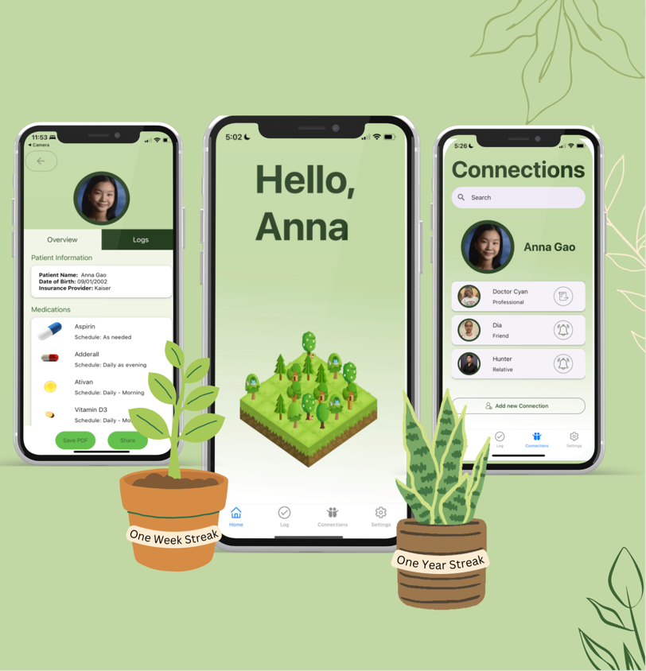
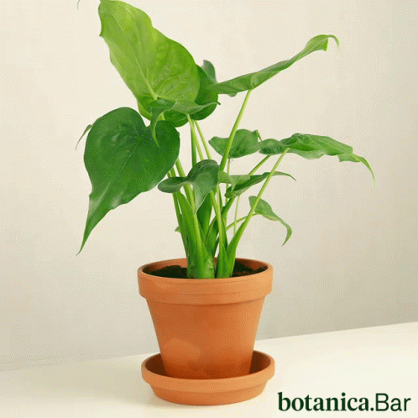
thyme
take thyme and be well
Notes:
PITCH SCRIPT:
Taking care of yourself is like taking care of a plant - as you do it more consistently, it becomes second nature.
That’s why we created Thyme, a medication journal app, where you can track your medications, log symptoms, share with others how you are doing, and remind them to take care of themselves. In our app, our users earn a plant for every milestone they reach across their wellness journey, to help build their very own garden.
Take some thyme to come visit our poster and learn more about how we’ve grown our app.

