Slide 1
POVS,
HMWs,
&
Experience Prototypes
Anna Gao, Becca Osaze Dia Crosse, Cyan DeVeaux, Hunter Zhang

Slide 2


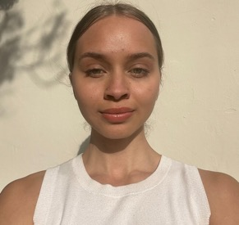
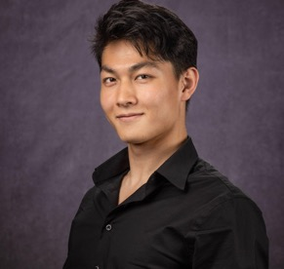
TEAM PILLIONAIRES
Anna
Cyan
Dia
Hunter

Slide 3
Original vs more focused
Improving patients knowledge / agency in their medicinal care
Demystifying medication use
Notes:
Demystifying medications for non professional users and simplifying process, and experience of taking medication for short term and life-long medication users

Slide 4
Our process: start to finish!
Gather more perspectives
Analyze & Brainstorm
Experience prototype
Decide key findings
Interviewed 2 new subjects
re-analyzed all previous interviewees
Analyzed results
Planned next steps under the frameworks of POVS, HMW’s, EP’s
Gathered real-world information our experience prototype on 4 participants
Combed through our info for final insights and next steps

Slide 5
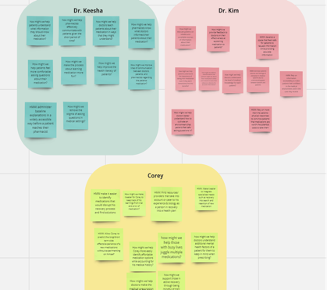
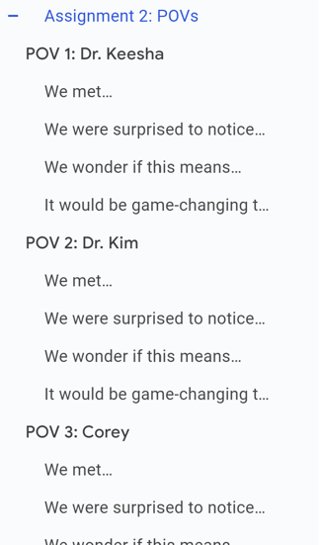
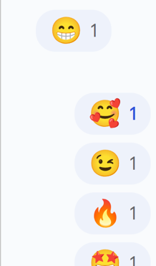
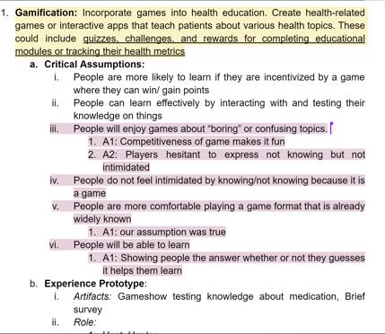
PROCESS: solutions & experience prototypes
How Might We…
Voting &
Discussion
POV’s
Experience Prototype

Slide 6
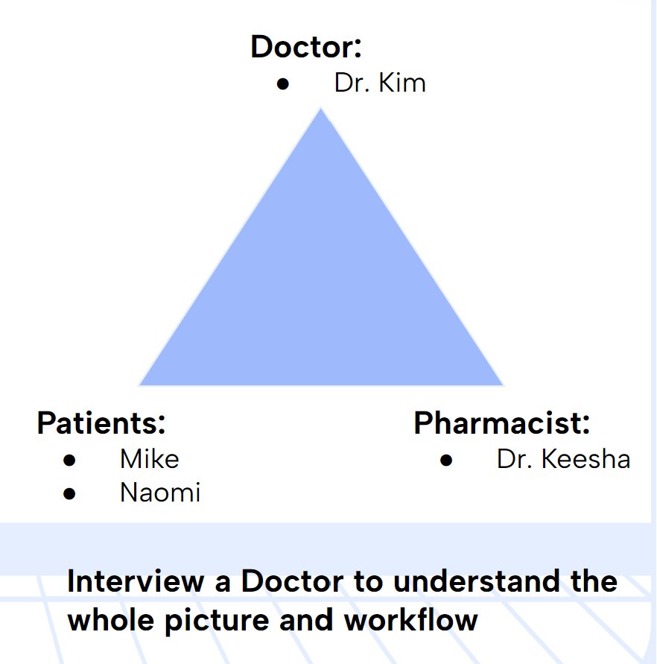
Recall from last time…
Notes:
Hoping to interview a doctor to fill in our understanding of the relationship between patients healthcare providers

Slide 7
Key Takeaways:
Dr. Keesha
Pharmacist are busy, no individualized attention to all the patients
Professionals struggle to explain medication that the patients would understand
Discrimination in the field
There is an uneven playing field when it comes to medicinal education
About Dr. Keesha:
Pharmacy Resident at Penn Presbyterian Medical Center
CVS health, Refuah Health Center, Penn medicine, Thomas Jefferson University Hospital
A lot of experiences with patients
Notes:
“Believes that patients aren’t absorbing all the information they need “ - she thought there were more things they should know than what they asked meaning they may not know q’s to ask

Slide 8
Dr. Keesha
How might we…
We met Dr. Keesha… Pharmacy resident in contact with clients daily
We were surprised to notice… Many patients lack crucial info about the medication they are taking + Hesitant to ask professionals follow-up
We wonder if this means.. Doctors: difficulty to explain professional medical terms. Patients: embarrassed to admit unknowns + hesitant to ask fellow-ups. Together: Patients accumulate questions for pharmacists.
It would be game-changing to… Allow Dr. Keesha to feel more confident that her patients understood key details about their medication -> reduce number of questions patients have
Help improve the health literacy of patients?
Remove the stigma of asking questions in medical settings?
Make the process about learning medication more fun?
Notes:
V We wondered if this may be a communication gap caused on both client& doctor side as client embarrassed & doctors may be inadequate in explaining medical things in ways that patients can understand, which Dr.Keesha had also reported observing
Dr. Keesha felt that many patients do not know too much about the medication they are taking. She described stories of doctors not effectively explaining prescribed medication to the patients and patients not knowing valuable information about their medication (such as their name, side effects, duration of use, and interaction with other substances).

Slide 9

Solution 1:
Critical Assumptions:
People enjoy games about “boring” subjects.
No intimidation to admit unknown.
People enjoy playing games in a format they’re familiar with
Competitiveness enhances learning.
Competitive Game
Notes:
An animated, AI-driven chatbot that explains medical concepts in a friendly, interactive, and visually engaging manner to patients.

Slide 10
Experience Prototype 1: Game testing medical knowledge
5 questions
Right answer + 1
Wrong answer +0
Whoever gets the most points wins.
Player 1
Host
Hit the bell
Player 2

Slide 11
Survey Questions
How much did you enjoy a game about medical knowledge?
People are comfortable playing the games in a format that they are familiar.
Did the competition in a game encourage them to learn about a subject,

Slide 12
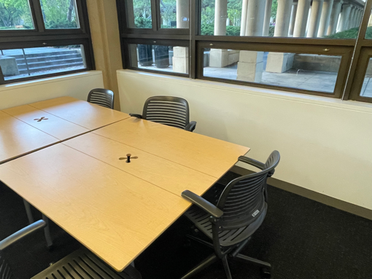
Findings
What did work:
Both participants were engaged:
  They were excited to play the game
  they get happy when they get questions correct.
Both participants were able to retain what they learned during the game.
Both participants were confident about the structure and the format of the game,.
What didn’t work:
Questions lacked variety in its category.
Number of questions were low.
Lathrope, room 149
Notes:
Prior familiarity with chat interfaces and AI-interaction may have helped our sample of young adults feel comfortable asking this chatbot questions
Visuals may help chatbot-interaction feel more exciting
Maintaining a balance between providing accurate information while avoiding information overload and over-repetition is important

Slide 13
Findings
Competitiveness in the game -> more participants’ attention and engagement.
More willingness to learn + retention
Participants were embarrassed to admit the unknowns.
Lathrope, room 149
Notes:
Prior familiarity with chat interfaces and AI-interaction may have helped our sample of young adults feel comfortable asking this chatbot questions
Visuals may help chatbot-interaction feel more exciting
Maintaining a balance between providing accurate information while avoiding information overload and over-repetition is important

Slide 14
Key Takeaways
Dr. Kim
Patients aren’t absorbing important medical information when doctors explain
Educating individual patients is an interactive process
Doctors may not be equipped to explain concepts to patients based on
Patients have very low levels of medication understanding and have barriers in clarifying understanding
About Dr. Kim:
Hospice physician who additionally has previous experience working in outpatient hospitals, in-home care settings, and assisted living facilities
Varying degrees of direct interaction with patients over the course of her career

Slide 15
Dr. Kim
How might we…
We met Dr. Kim… Physician in inhome + outpatient care
We were surprised to notice… Patients may stop taking medication if they couldn’t feel results
We wonder if this means.. Distrust results because they don’t understand treatments conceptually, only tangibly/physically. + Unreliable source of information about the medication
It would be game-changing to… have a reliable source for patients to gain knowledge of their medication in ways they can understand
Provide feedback to doctors on their effectiveness at explaining medication to patients?
Help doctors understand the level of medical knowledge for each patient?
Have a reliable source of information about medication for patients.
Decrease patients distrust and feelings of alienation in medical systems due to understanding gaps between doctors and patients?

Slide 16
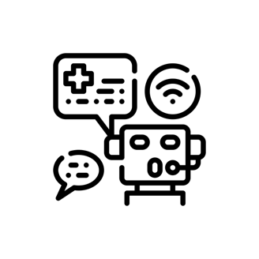
Solution 2:
Critical Assumptions:
People will feel comfortable, not intimidated asking medication-relation questions to an AI chatbot
People will have an idea about what questions to ask a chatbot + how to ask questions
People will ask follow-up questions when they do not understand something
AI Chatbot for Explaining Medical Concepts
Notes:
An animated, AI-driven chatbot that explains medical concepts in a friendly, interactive, and visually engaging manner to patients.
Assumed ppl would ask follow ups which wasnt the case in the real medical workplace

Slide 17
Experience Prototype 2: Participants ask a chatbot questions about cold medicine
Pre-Survey
Brainstorm
Chatbot Interaction
Post-Survey
Pre-survey on prior knowledge of cold medicine
Brainstorm questions to ask chatbot about cold medicine
Ask questions and follow up questions about cold medicine to ChatGPT
Complete post-survey about their experience

Slide 18
Survey Questions
How comfortable did you feel asking this chatbot questions about medication?
How confident do you feel about your knowledge of cold medicine?
Were there any points in which you did not understand a description from the chatbot?
Did you have any remaining questions for the chatbot?
Please describe your overall experience interacting with the chatbot.
Notes:
Questions about how comfortable and confident the process of asking a chatbot

Slide 19
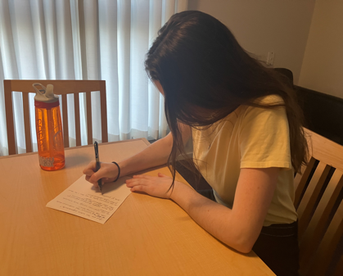
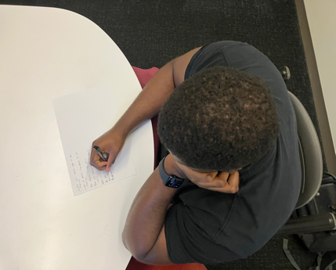
Findings
Things that worked:
Participants rated high levels of comfort asking the chatbot questions
Interacting with a chatbot felt familiar to them
Participants fully understood the chatbot’s answers
Participants did not struggle brainstorming questions
Things that didn’t work:
Repetitive information across questions was annoying
Misinterpretation of participant’s question
  Participant rephrased a question to be more specific
Participants appeared bored
Siobhán, 24, PhD Student
Doug, 30, CAD Technician
Notes:
PArticipants were overall comfortable, knew what to ask, and understood responses
BUT some questions were misinterpreted by the bot or given repetitive info

Slide 20
Key Learnings
Key learnings:
Prior experience with LLM-based chats can help young adults feel comfortable during these interactions
Visuals may help chatbot-interaction feel more exciting
Maintaining a balance between accuracy and conciseness is important
Siobhán, 24, PhD Student
Doug, 30, CAD Technician
Notes:
Prior familiarity with chat interfaces and AI-interaction may have helped our sample of young adults feel comfortable asking this chatbot questions
Visuals may help chatbot-interaction feel more exciting
Maintaining a balance between providing accurate information while avoiding information overload and over-repetition is important

Slide 21
Corey
Key Takeaways
About Corey:
Resident Fellow for The Well House : a substance-free undergraduate dorm
Collegiate Recovery Coordinator for Stanford’s Office of Substance Use, Education & Resources
In active recovery from substance abuse for 9 years
Anxiety, depression, ADHD
Stanford insurance -> Kaiser = Decrease in care and access to his medications
His recovery -> non-abusive/mind altering medications
New medication -> trial-and-error side effects + result of drug interactions
Notes:
Unequal access to meds, trial and error on his body

Slide 22
Corey
How might we…
We met Corey who is currently dealing with various chronic and mental illnesses that he has to take medication for, while being in recovery.
We were surprised to notice how much Corey relies on his own knowledge, obtained through trial and error, to decide if a medication is good for him, and how careful Corey has to be with which medications he takes given his recovery.
We wonder if this means healthcare providers aren’t able to fully take into account Corey’s unique biology and responses to treatment, causing Corey to have to rely on himself much more.
It would be game-changing to help Corey find suitable ways to take care of his chronic illnesses through medication while still continuing his recovery journey.
Find resources/ providers that take into account his experience & biology as a person in recovery into a health plan?
Make it easier to identify medications that would disrupt his recovery process and find solutions?
Make it easier for Corey to keep track of his learnings from trial and error of medication?

Slide 23

Solution 3:
Critical Assumptions:
People will prefer to answer questions that are short/ quick to answer
People prefer less invasive questions
People will find it helpful to check-in with themselves using pre-set questions
Medical Journal

Slide 24
Experience Prototype 3
Medical Journal EP: A Google Form with 12 Questions about the Participant:
4 required, 8 optional
  This was to see which questions participants would want to answer
  Required questions were sprinkled throughout to make sure the participant saw all of the form
Question topics three categories: major/academic interests, food, wellbeing
Varied response types (i.e. short answer, linear scale, multiple-choice/checkbox, long answer/open-ended questions)
Variations of the same question using different response types
  Eg. How are you doing?
    Use three words to describe your week so far (short-answer)
    On a scale of 1-5, how are you feeling today? (linear scale)
Notes:
Looking at behavior more than analyzing their responses. A google form with a mix of optional and required information, and variations of the same questions with different wording to see which people chose to respond to

Slide 25
Findings
What did work:
11/12 questions filled out
  The one question not filled out was: What have you eaten today?
  Through the question, he was reminded that he had not eaten anything that day and needed to grab lunch after
Mix of response types helped to keep the form engaging, less boring
Questions that they saw multiple times but reworded helped them to reimagine how they thought about the answer
Large number of questions but because they were short, easy to answer, it didn’t take too long to complete
What didn’t work:
  Scope of question categories seemed too broad, a little random
Notes:
Mixed response types helped engage participant

Slide 26
Key Learnings
Repetitive filling out of the journal might result in less time spent each time:
  If each question is expected, then it will take less time to gather thoughts on each question
  How does this apply to a medical journal? If someone routinely fills out their medical journal, they might be more regularly reflective on how they feel in anticipation of writing it in their journal
Different questions are more suitable (prompt a quicker response/require more thought) for different response types:
  E.g. he took shorter to answer the “How are you doing” question when it was the linear scale response versus the short answer response
  How does this apply to a medical journal? To ensure that the medication journal is effective, we may need to edit response types to balance how much time is spent on the question with how helpful the participant finds the question.
Notes:
People would fill out the questions quicker over time. Different questions are suitable for different response types

Slide 27
Next Steps
OUR SOLUTION: Tracking + Gamifying + Communication Combo
Our solution involves:
  Easing the process of tracking medication use
  Using gamified components to increase consistent usage
  Creating easy sharing functionality to remove barriers in communication and facilitate comfortable communication from users

Slide 28
Next Steps
Ethical Implications of our solution:
Privacy of medical data
Creating positive/negative correlations around one’s personal health
Who can we serve with our solution?
Patients + their Caretakers
Family of patients
Medical Professionals
Who is left out from our solution?
People without consistent access to a mobile device
People with skepticism of technology
People with disabilities
Notes:
Implications of creating correlations around ones personal health when it comes to gamifying any experience

Slide 29
Thank You!

Slide 30
Appendix

Slide 31
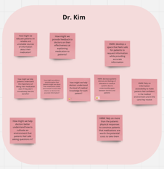
10+ HMWs generated for each POV - Dr. Kim
How might we…
educate patients on reliable and unreliable sources of information about their medication?
provide feedback to doctors on their effectiveness at explaining medication to patients?
develop a space that feels safe for patients to request information while providing accurate information?
decrease patients distrust and feelings of alienation in medical systems due to understanding gaps between doctors and patients?
help patients understand the importance of taking their medication even if they don't immediately feel the benefits?
address misinformation that patients might see about their medications online and instead increase their reliance on doctors for accurate information?
help doctors understand the level of medical knowledge for each patient?
Rely on information accessibility to make patients feel confident in the medical environment and in the care they receive?
Rely on more than the patients physical responses to convince patients that medications are worth the potential costs to take them?
help doctors better understand how to cultivate an environment that patients feel safe asking questions in?

Slide 32
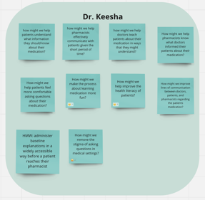
10+ HMWs generated for each POV - Dr. Keesha
How might we…
help patients understand what information they should know about their medication?
help pharmacists effectively communicate with patients given the short period of time?
help doctors teach patients about their medication in ways that they might understand?
help pharmacists know what doctors informed their patients about their medication?
make the process about learning medication more fun?
help improve the health literacy of patients?
help patients feel more comfortable asking questions about their medication?
improve lines of communication between doctors, patients, and pharmacists regarding the patients’ medication?
administer baseline explanations in a widely accessible way before a patient reaches their pharmacist
remove the stigma of asking questions in medical settings?

Slide 33
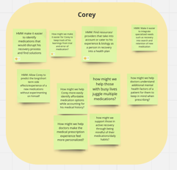
10+ HMWs generated for each POV - Corey
How might we…
make it easier to integrate specialized needs such as recovery into search and retention of new medication
find resources/ providers that take into account or cater to his experience & biology as a person in recovery into a health plan
make it easier to identify medications that would disrupt his recovery process and find solutions
make it easier for Corey to keep track of his learnings from trial and error of medication?
allow Corey to predict the long/short term side effects/experience of a new medications without experimenting on himself
help doctors understand additional mental health factors of a patient for them to keep in mind when prescribing?
help those with busy lives juggle multiple medications?
help Corey more easily identify affordable medication options while accounting for his medical history?
support those in active recovery through being mindful of their medications/daily habits?
help doctors make the medical prescription experience feel more personalized?

Slide 34
Experience Prototype Participants
Siobhán, 24
PhD Student
Recruited by word of mouth
Selected based on status as a young adult, a demographic who might feel comfortable with AI chatbots
Jackson, 18
High School student
Recruited by word of mouth
Selected based on status as a youth who is comfortable with Ai and interested in playing games
Doug, 30
CAD Technician from North Carolina
Recruited by word of mouth
Selected based on status as a young adult, a demographic who might feel comfortable with AI chatbots
…
Nathan, 21
Current student
Recruited by word of mouth
Selected based on status as a young adult, who is usually busy and would need an efficient journal process for his medications

Slide 35
Experience Prototype #3
Post submission questions for the participant:
How did you select which questions you wanted to do?
If you were to do this form again tomorrow, would you change the questions you wanted to answer?
How did you feel about the mix of question types?
Process for Experience Prototype:
Introduce form on participant’s laptop, context: “feel free to answer whichever questions you want”
Participant scans over form to see all the questions
Participant completes the journal form.
Conduct post submission questions
What we wanted to test for:
How did you select which questions you wanted to do?
If you were to do this form again tomorrow, would you change the questions you wanted to answer?
How did you feel about the mix of question types?

Slide 36
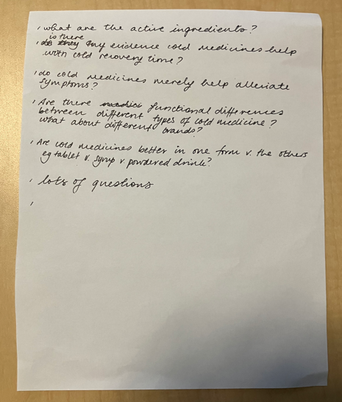
Experience Prototype #2: Additional Details
Questions brainstormed by participant 2:
What are the active ingredients?
Is there any evidence cold medicines help with cold recovery time?
Do cold medicines merely help alleviate symptoms?
Are there functional differences between different types of cold medicine? How about brands?
Are cold medicines better in on form vs the others? e.g. tablet v. syrup v. powdered drink?
Lots of questions

Slide 37
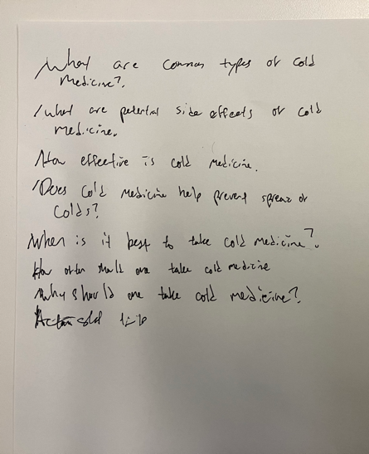
Experience Prototype #2: Additional Details
Questions brainstormed by participant 1:
What are common types of cold medicine?
What are potential side effects of cold medicine?
How effective is cold medicine?
Does cold medicine help prevent spread of colds?
When is it best to take cold medicine?
How often should one take cold medicine?
Why should one take cold medicine?

