Slide 1
“The most common reason participants cited for discontinuing or switching methods of contraception was side effects (48.3%, 70/145)”
Notes:
Feedback:
Why is it recommending a certain medication?
Should we have more algorithms?
Should we use AI?
Accuracy: how will doctors be involved in recommending treatment?
Amelia: doctor might not prescribe a less used contraceptive or one they haven’t worked with… not sure what she was getting at tbh
Show that this is a starting point for doctor-patient interaction
PhD guy: regulatory concerns
Use of colors: good that it’s different
Light blue on light brown might not be color blind friendly
Make sure dots in logo go with logo, use white space to separate
Really heavy letters with light dots isn’t great
Two types of clickable indicators: buttons vs underline, and underlined part isn’t super legible, also uncentered isn’t great
New recommendation page has new blue and pink colors
Pink button with new recommendation page has low contrast which looks disabled
Fix plus icon and make it clear which page we are on
Highlight page you are on
Be consistent with colors in the medication text
Make sure back arrows are big enough
Eric’s note: if we change recommendation our medication should be updated on home page

Slide 2

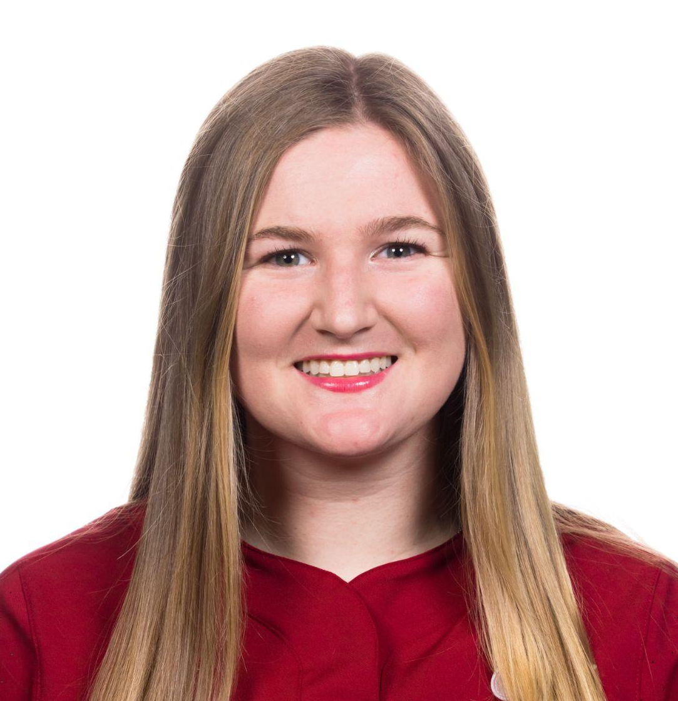


The Team
Shreya
Coterm in CS
Allie
BS in CS
Emily
Coterm in CS
Eric
BS in CS

Slide 3

Problem Overview
Primary User
Menstruators who are seeking to better understand their period symptoms and treatment options.
Problem Tackling
The same treatments are often offered to menstruators with very different symptoms, preferences, and needs → menstruators need to be their own period expert and advocate.

Slide 4

Solution Overview
Preferences & Medical History Questionnaire
Understand a user based on their medical history and hormone preferences.
Select right contraception choice
Find the best contraception for each woman.

Slide 5
Find contraception that is right for you, and minimize the side effects of contraception.
Notes:
Value Proposition.

Slide 6
Values in Design

Slide 7

Values Encoded
Medical Reliability: Provide individuals with effective and safe choices for family planning.
Accessibility: Access to contraception should be available to all regardless of background, location or socioeconomic status.
Privacy: Individuals should have the freedom to make their family planning decisions without judgement.
Personalization: Contraceptive solutions should be tailored to meet each person’s needs, preferences, and medical preferences.

Slide 8
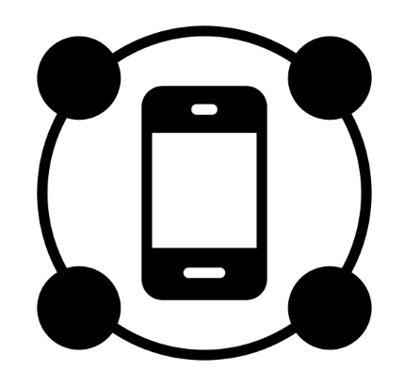
Value Expression Through Design
Medical Reliability: The check-in process ensures iterative approach to contraception to minimize side-effects.
Accessibility through Location: Location-based services help users find nearby pharmacies to get contraceptives.
Data Encryption: To ensure privacy protection, data minimization and encryption should be utilized.
Personalized Contraception: After filling in your profile, every individual produces a contraceptive choice.

Slide 9

Value Tensions
Privacy vs. Personalization
Minimize data collection, but also have enough data for perfect contraceptive fit.
Accessibility vs Personalization
Want to find the best contraceptive fit, but a less common contraceptive might not be accessible in all geographies.

Slide 10
Tasks

Slide 11
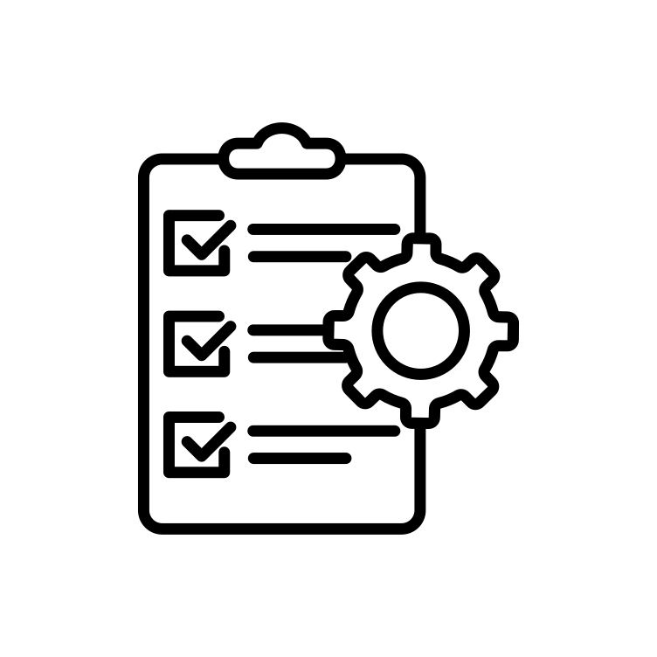
Task 1
Please log your symptoms.
Simple

Slide 12
Task 2
Find a pharmacy that carries your current prescription.
Moderate

Slide 13
Task 3
Change your current contraceptive recommendation.
Complex

Slide 14

Changes From the Lo-Fi Prototype
The button to log symptoms is no longer called ‘check-in’ and is now ‘log symptoms’
Words on the ‘prescriptions’ page are less wordy and more direct
We specified that the location pins need to be clicked on the ‘find your pharmacy/treatment’ map
Added back and submit buttons on all the pages
Changed the size of buttons to emphasize importance

Slide 15
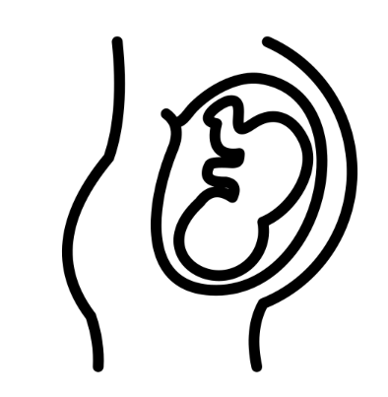
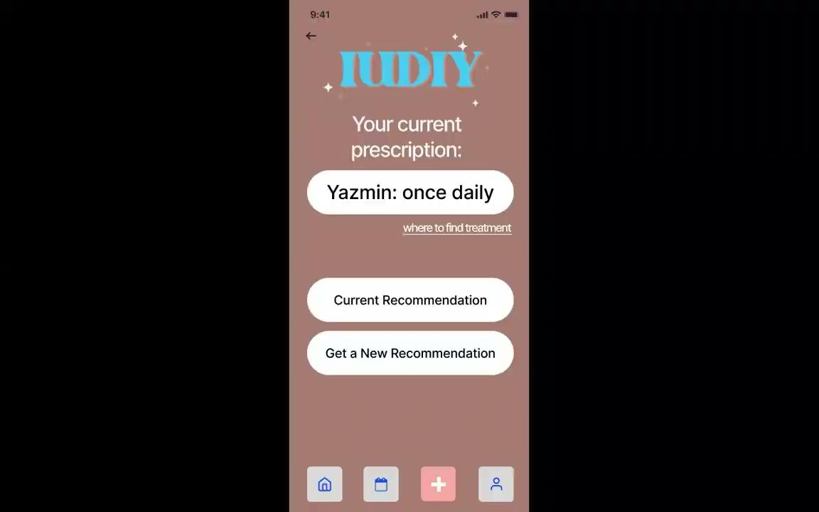

Slide 16
Usability Goals & Key Measurements

Slide 17

Usability Goals & Key Measurements
Key Measurements
# of Clicks: Measure of intuitiveness and ease.
# of Errors: Measure of user-friendliness.
Usability Goals
Complex - clicks =< 4
Moderate - clicks =< 3
Simple - clicks =< 2

Slide 18
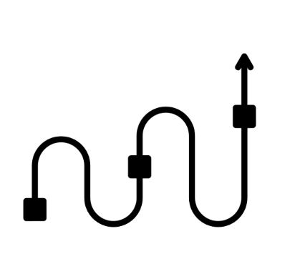
Progress towards Goals
Hitting Usability Goals
All task flows meet usability goals.
Task Flow | # Clicks
Simple | 2
Moderate | 3
Complex | 3

Slide 19
Revised
Interface
Sketches

Slide 20
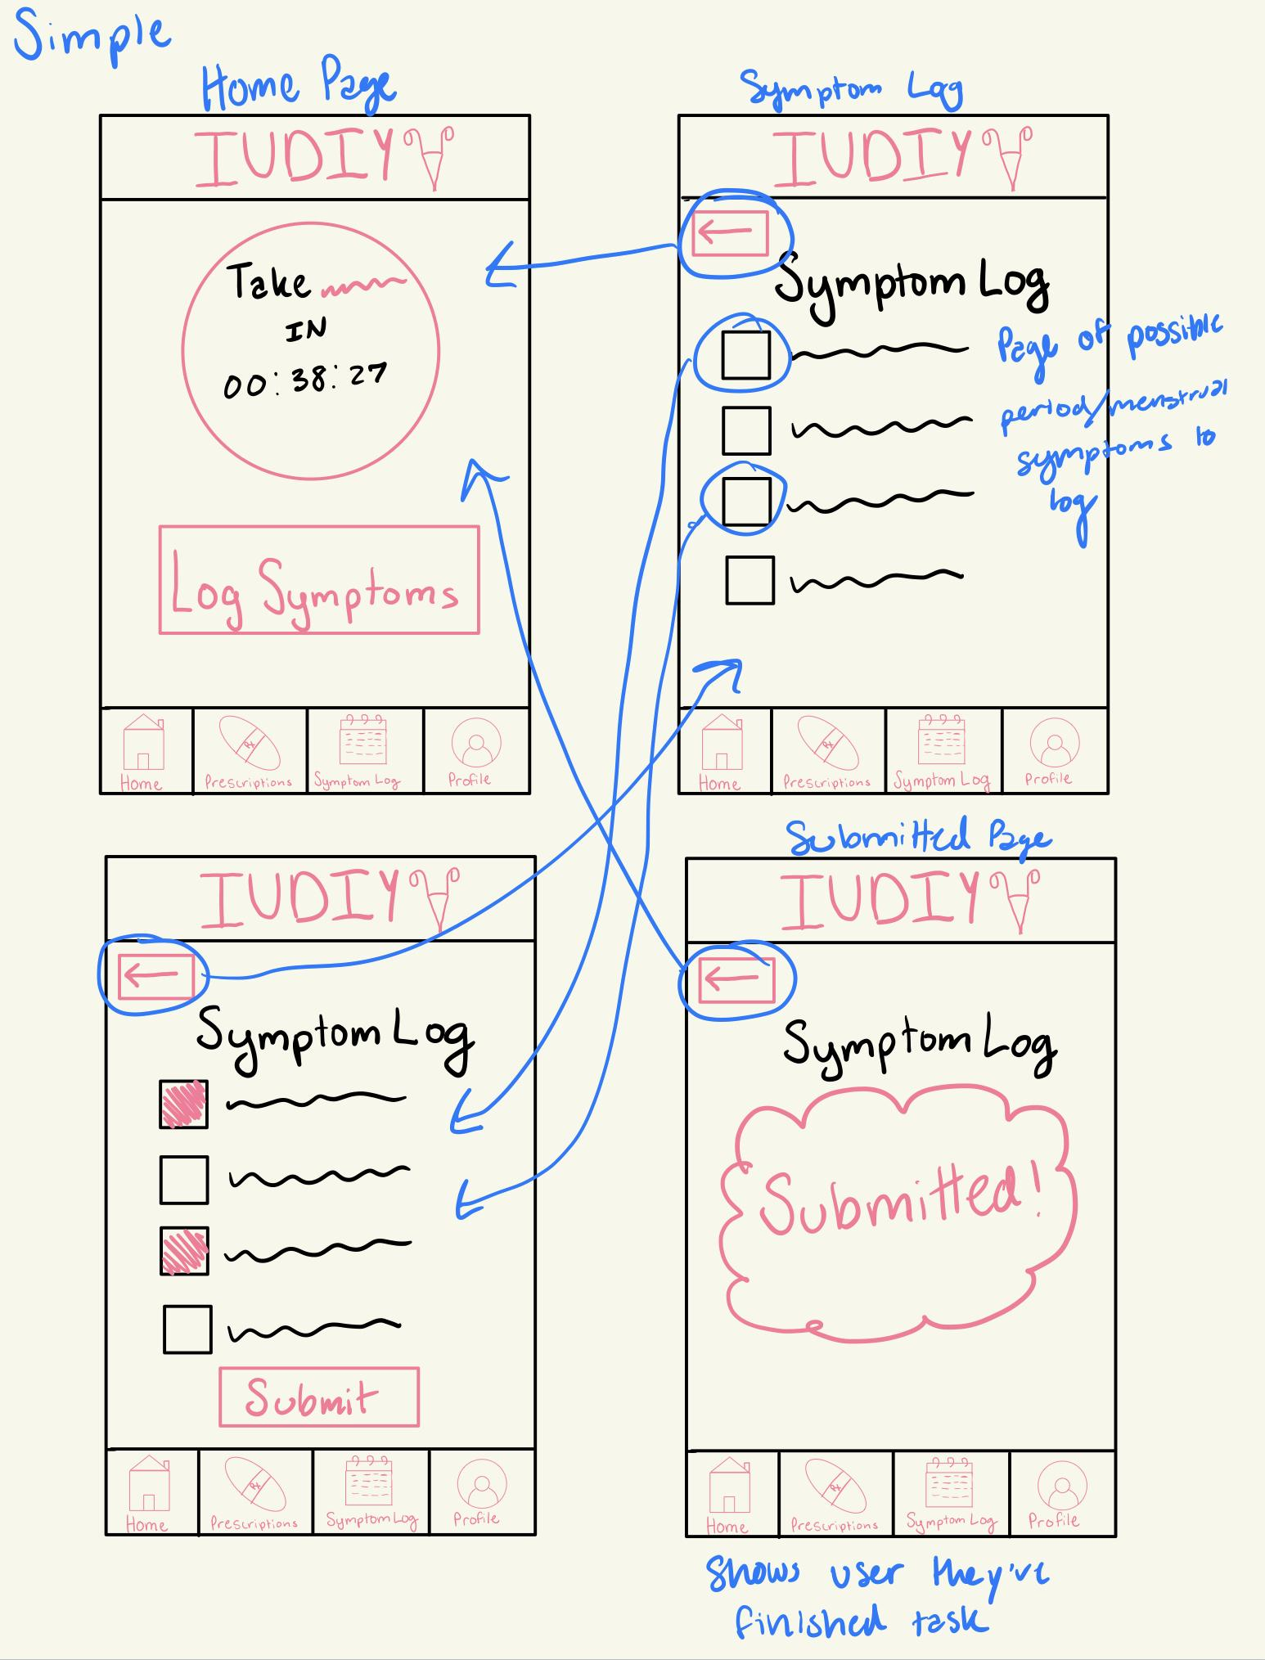
Updated Simple Task Sketch

Slide 21
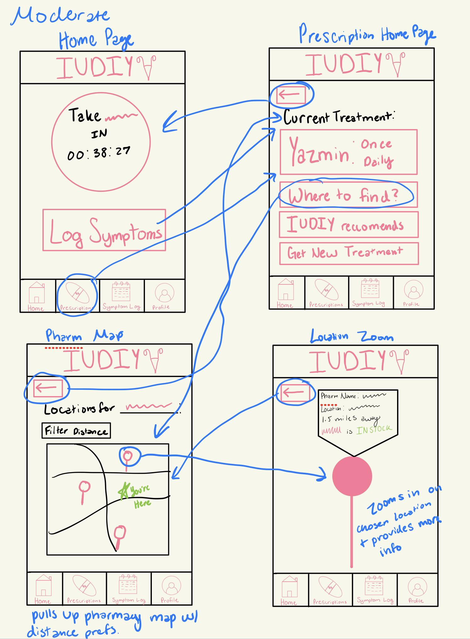
Updated Moderate Task Sketch

Slide 22
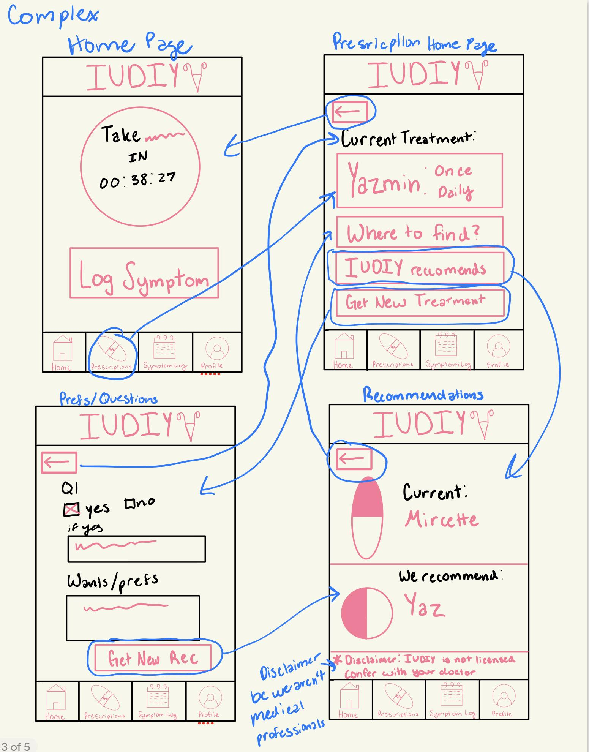
Updated Complex Task Sketch

Slide 23

Major Interface Changes
Addition of Back Buttons: It is now possible to navigate from home to every page and back.
Movement of Complex Task to Within Prescriptions: The complex task of changing prescription used to be housed in the profile section, but now it makes more sense for the prescription tab.
Switch “Check-In” to “Log Symptoms”: The check-in terminology was hard to understand so we have switched to “log symptoms”.

Slide 24

Changes v. Usability Goals
Back buttons will reduce the number of clicks as a mistaken click will no longer significantly increase the number of clicks.
Complex task moved into prescriptions which will increase intuitiveness.
Switch up of Check-In to Log will make it easier to understand what to do at that step, reducing mistaken clicks and increasing intuitiveness.

Slide 25

Feedback
Be color blind accessible: Light blue coloring on light brown is not color blind friendly.
Create consistent clickable indicators: There are two types of clickable indicators (buttons vs underline), which is confusing.
Generate consistent colors: The new recommendation page has new blue and pink colors, not consistent with rest of app.
Optimize for easy navigation: Make sure back arrows are big enough. Ensure that it is clear which page you are on, using highlighting.

Slide 26
Medium-fi
Task
Flows

Slide 27
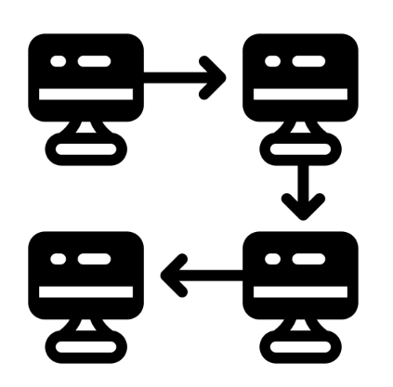
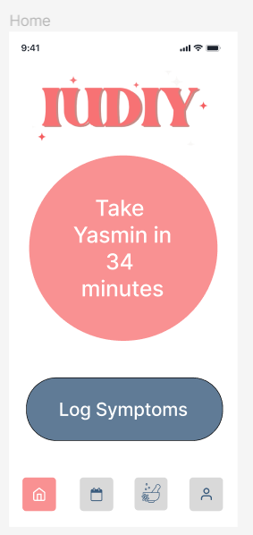
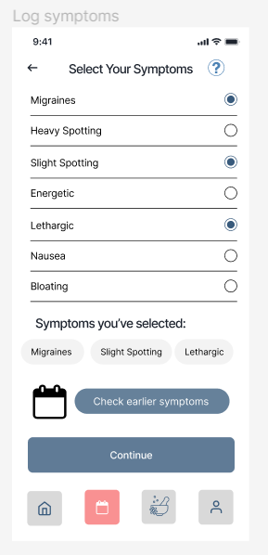
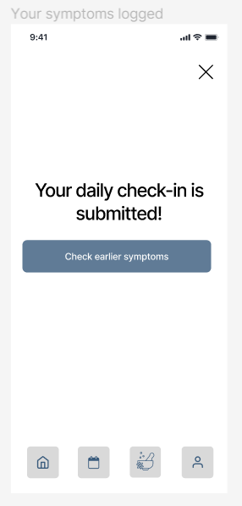
Simple: Log Your Symptoms
Click check-in icon.
Add symptoms, and click continue.
Symptoms experienced are then submitted.

Slide 28
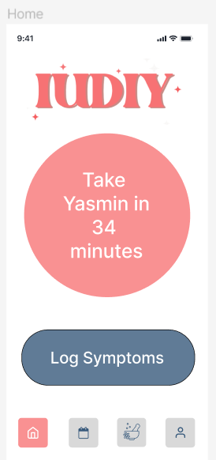
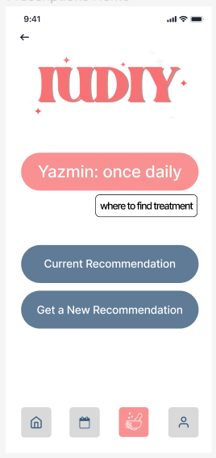
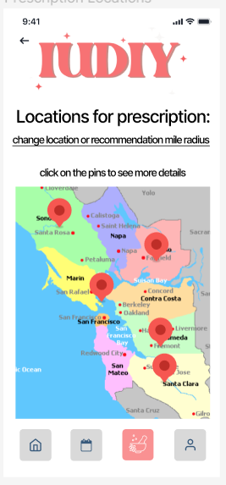
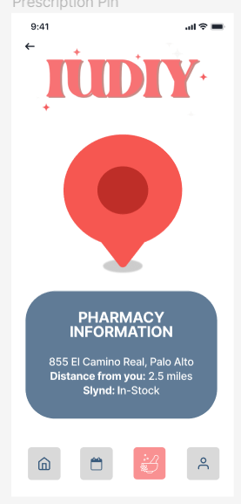
Moderate: Find pharmacy that carries your prescription
Click prescriptions button.
Click to see where to find treatment.
Click a specific pin.
Review details of pharmacy.

Slide 29
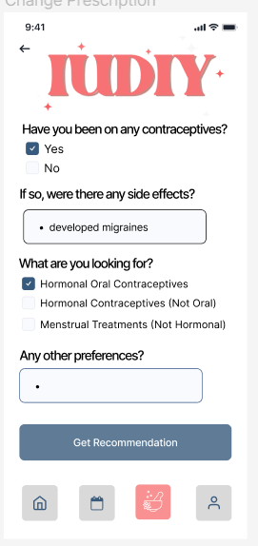
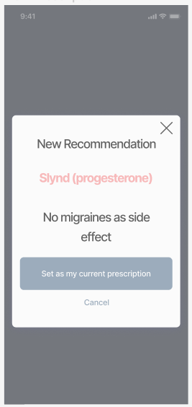
Complex Task Flow
Click prescriptions button.
Click Get a New Recommendation.
Add updates and click get Recommendation.
Review new recommendation.

Slide 30
Prototype Implementation

Slide 31

Figma Tool Review
Pros
Figma supports a large and robust component library, which allowed for design consistency.
Version control was also key to enable fast prototyping.
Cons
Large design files degrade Figmas performance leading to slower response times.

Slide 32

Limitations
Figma can only show specific task flows.
Missing task flows:
How to fill out the initial profile.
How to sign up for the service.
How to change symptoms once daily symptoms have been logged.

Slide 33

Hard-coded & Wizard-of-Oz Features
Certain Symptoms Logging:
We had to hard-code one version of the symptoms that could be selected but a much larger range should be allowed.
Non-Personalized Recommendation:
Only one recommendation is outputted but based on symptoms and preferences one should generate a personalized medication.

Slide 34
Appendix
Notes:
https://www.figma.com/file/iNHuMxJYa3eGNotBrUavR2/IUDIY-medium-fi-prototype?type=design&node-id=0-1&mode=design&t=Isnpr0go8guL0HVl-0

